Slide 1

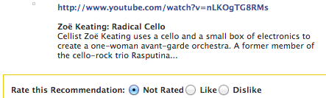



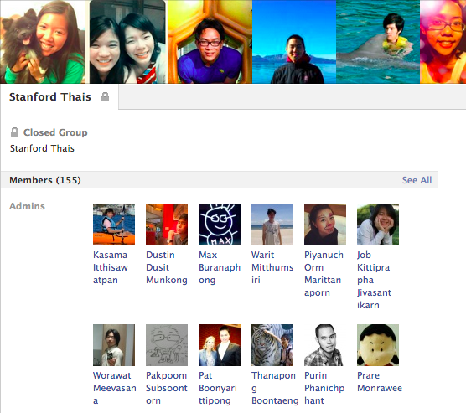

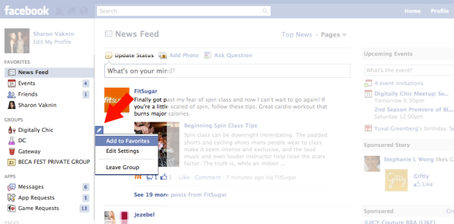
User u
Link i
Like?
Interactions and
Activities
Social Affinity Group
Like/Dislike
Interactions
{link, post, photo, video} × {like, tag, comment} × {incoming, outgoing}
Activities
Groups
Pages
Favorites

Slide 2










Slide 3
