Slide 1
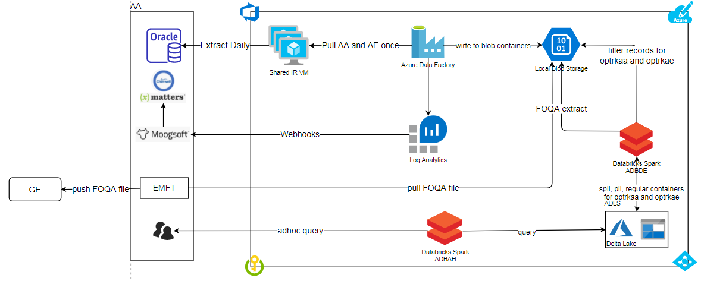
OPTRK migration architecture

Slide 2
LANDING ZONE
RAW ZONE
STRUCT ZONE
PREP ZONE
SPECIFICS :
Storage : Blob
Partition : Daily
Retention : A day
Source : Oracle (via ADF)
SPECIFICS :
Storage : ADLS GEN2
Partition : Daily
Retention : A Week
Source : LANDING ZONE
SPECIFICS :
Storage : ADLS GEN2
Partition : Monthly
Retention : 10 years
Source : RAW ZONE
SPECIFICS :
Storage : adls gen2
Partition : MONTHY
Retention : 10 years
Source : RAW ZONE
CREW EVENT
FLIGHT EVENT
FLIGHT ADMIN EVENT
CREW MAIL MESSAGES
CREW LOCKS
FLIGHT LOCKS
CREW EVENT
FLIGHT EVENT
FLIGHT ADMIN EVENT
CREW MAIL MESSAGES
CREW LOCKS
FLIGHT LOCKS
CREW EVENT
FLIGHT EVENT
FLIGHT ADMIN EVENT
CREW MAIL MESSAGES
CREW LOCKS
FLIGHT LOCKS
optrkaa_spii
+ views
CREW EVENT
FLIGHT EVENT
FLIGHT ADMIN EVENT
CREW MAIL MESSAGES
CREW LOCKS
FLIGHT LOCKS
AA/AE
CREW EVENT
FLIGHT EVENT
FLIGHT ADMIN EVENT
CREW MAIL MESSAGES
CREW LOCKS
FLIGHT LOCKS
CREW EVENT
FLIGHT EVENT
FLIGHT ADMIN EVENT
CREW MAIL MESSAGES
CREW LOCKS
FLIGHT LOCKS
CREW EVENT
FLIGHT EVENT
FLIGHT ADMIN EVENT
CREW MAIL MESSAGES
CREW LOCKS
FLIGHT LOCKS
optrkaa_pii
+ views
spii
pii
(regular)
CREW EVENT
FLIGHT EVENT
FLIGHT ADMIN EVENT
CREW MAIL MESSAGES
CREW LOCKS
FLIGHT LOCKS
CREW EVENT
FLIGHT EVENT
FLIGHT ADMIN EVENT
CREW MAIL MESSAGES
CREW LOCKS
FLIGHT LOCKS
CREW EVENT
FLIGHT EVENT
FLIGHT ADMIN EVENT
CREW MAIL MESSAGES
CREW LOCKS
FLIGHT LOCKS
optrkaa
+ views
optrkae_spii
CREW EVENT
FLIGHT EVENT
FLIGHT ADMIN EVENT
CREW MAIL MESSAGES
CREW LOCKS
FLIGHT LOCKS
CREW EVENT
FLIGHT EVENT
FLIGHT ADMIN EVENT
CREW MAIL MESSAGES
CREW LOCKS
FLIGHT LOCKS
CREW EVENT
FLIGHT EVENT
FLIGHT ADMIN EVENT
CREW MAIL MESSAGES
CREW LOCKS
FLIGHT LOCKS
+ views
CREW EVENT
FLIGHT EVENT
FLIGHT ADMIN EVENT
CREW MAIL MESSAGES
CREW LOCKS
FLIGHT LOCKS
CREW EVENT
FLIGHT EVENT
FLIGHT ADMIN EVENT
CREW MAIL MESSAGES
CREW LOCKS
FLIGHT LOCKS
CREW EVENT
FLIGHT EVENT
FLIGHT ADMIN EVENT
CREW MAIL MESSAGES
CREW LOCKS
FLIGHT LOCKS
optrkae_pii
+ views
optrkae
CREW EVENT
FLIGHT EVENT
FLIGHT ADMIN EVENT
CREW MAIL MESSAGES
CREW LOCKS
FLIGHT LOCKS
CREW EVENT
FLIGHT EVENT
FLIGHT ADMIN EVENT
CREW MAIL MESSAGES
CREW LOCKS
FLIGHT LOCKS
CREW EVENT
FLIGHT EVENT
FLIGHT ADMIN EVENT
CREW MAIL MESSAGES
CREW LOCKS
FLIGHT LOCKS
+ views

Slide 3
Table List
Views List
CREW EVENT
FLIGHT EVENT
FLIGHT ADMIN EVENT
CREW MAIL MESSAGES
CREW LOCKS
FLIGHT LOCKS
aa_crew_event
aa_crew_mail_messages
aa_crew_locks
aa_crew_event_full
aa_flight_event
aa_flight_admin_event
aa_flight_locks
aa_flight_event_full
ae_crew_event
ae_crew_mail_messages
ae_crew_locks
ae_crew_event_full
ae_flight_event
ae_flight_admin_event
ae_flight_locks
ae_flight_event_full

Slide 4
NOTEBOOKS LIST
DATA LOAD SCRIPTS
landing_to_raw
Raw_To_DeltaStruct
Raw_To_DeltaPrep
ViewAsTableCreation_spii_Prep
ViewAsTableCreation_pii_Prep
ViewAsTableCreation_reg_Prep
PURGE SCRIPTS
purge_raw_data
purge_struct_data (once a year run)
TABLE CREATION SCRIPTS
TableCreation_struct (one-time run)
TableCreation_prep (one-time run)
REPORT GENERATION
FOQA_report

Slide 5
NOTEBOOKS LIST DESCRIPTION
DATA LOAD SCRIPTS
landing_to_raw : script is responsible for loading data from landing zone(blob) to raw zone(adls gen2). Runs daily.
Raw_To_DeltaStruct : script is responsible for loading data from raw zone to struct zone. Runs daily.
Raw_To_DeltaPrep : script is responsible for loading data from raw zone to struct zone. Runs daily.
ViewAsTableCreation_spii_Prep : script is responsible for refreshing data for Viewastables ( these are views, but currently they exists as table ) for spii category.
ViewAsTableCreation_pii_Prep : script is responsible for refreshing data for Viewastables ( these are views, but currently they exists as table ) for pii category.
ViewAsTableCreation_reg_Prep : script is responsible for refreshing data for Viewastables ( these are views, but currently they exists as table ) for regular category.

Slide 6
NOTEBOOKS LIST DESCRIPTION
PURGE SCRIPTS
purge_raw_data : script is responsible for purging data in RAW zone which is older than 7 days.
purge_struct_data : script is responsible for purging data in STRUCT zone which is an year old.
TABLE CREATION SCRIPTS
TableCreation_struct : script is responsible for creating all databases and base tables in STRUCT zone
TableCreation_prep : script is responsible for creating all databases and base tables in PREP zone
PURGE SCRIPTS
FOQA_report : script generate FOQA report and upload it to desired location (blob storage)

Slide 7
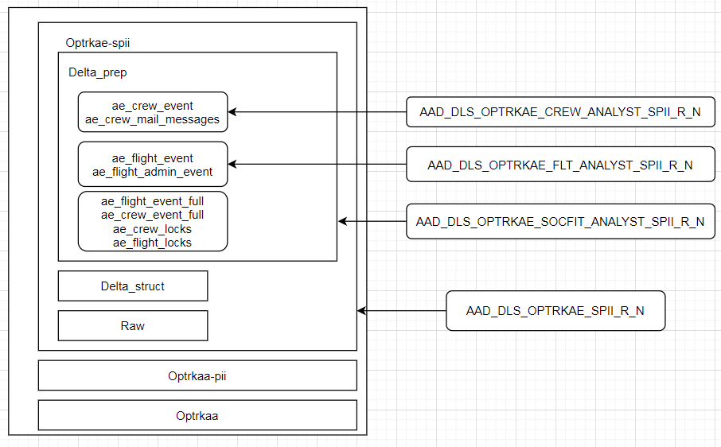
Access control using AD groups at table level

