Slide 1
Discrimination of olive oils origin based on FTIR Spectroscopy data
Evgeniia Martynova (s1038931)
Lili Mészáros (s1015790)

Slide 2
Data. Spectrum is obtained by Fourier transform infrared spectroscopy
FTIR spectroscopy is fast and no complex samples pre-processing is needed
2 measurements of each sample made within 1-24 days interval
60 samples of olive oils from 4 countries obtained for the original study [1]
Group designation | Country of origin | No. of samples
1 | Greece | 10
2 | Italy | 17
3 | Portugal | 8
4 | Spain | 25
 | total: | 60
[1] Henri S. Tapp, Marianne Defernez, E. Katherine Kemsley, FTIR Spectroscopy and Multivariate Analysis Can Distinguish
the Geographic Origin of Extra Virgin Olive Oils
J. Agric. Food Chem. 2003

Slide 3
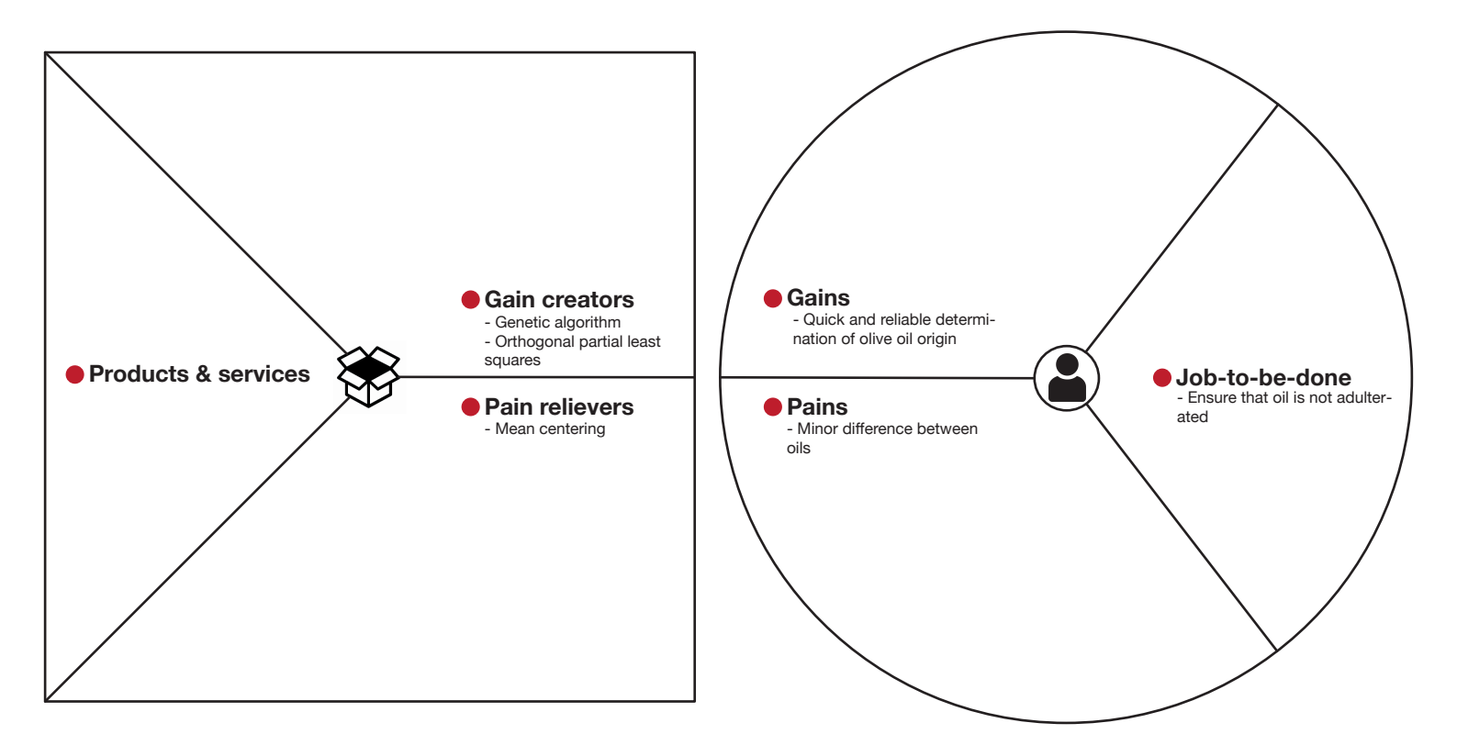

Slide 4
Experiment design and motivation
Original study:
Used internal cross-validation
PLS
Variable selection with genetic algorithm
Our study:
Used Double cross-validation (LOO as for internal cross-validation)
OPLS
Further exploration of solutions with GA

Slide 5
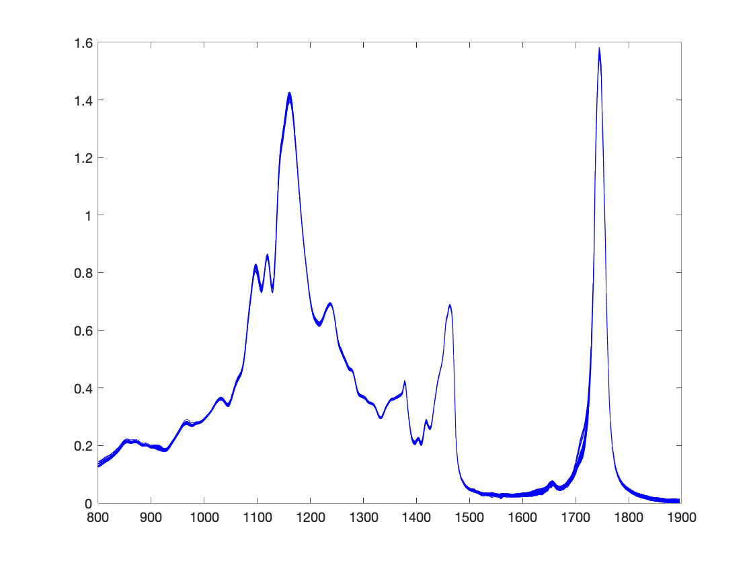
Preprocessing. Raw data
Mean-centering – is used to make wavelength values more comparable and spectrum of samples from different countries more distinctive
Autoscaling – should not be used for the FTIR data, because we would loose important information about peaks in spectrum

Slide 6
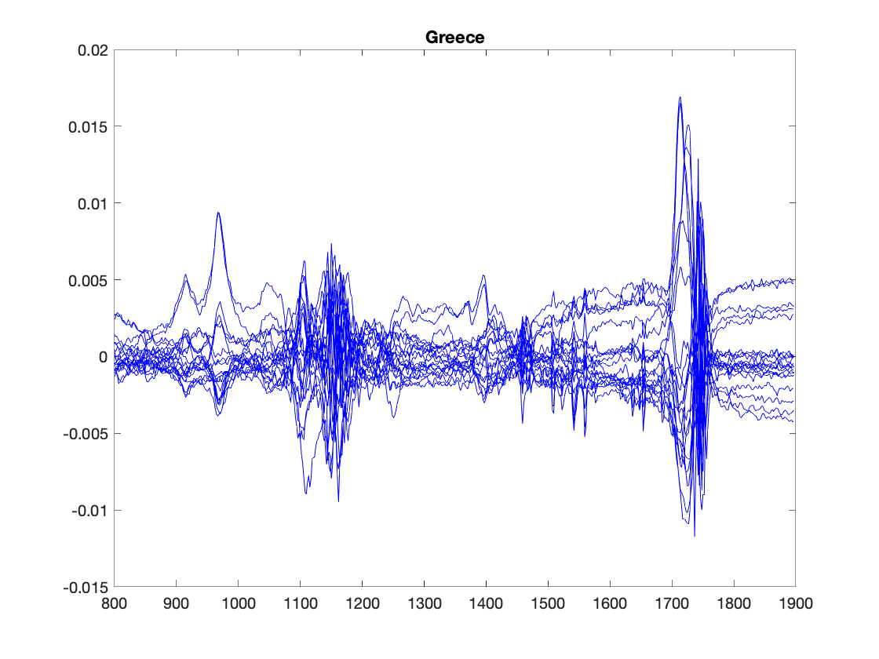
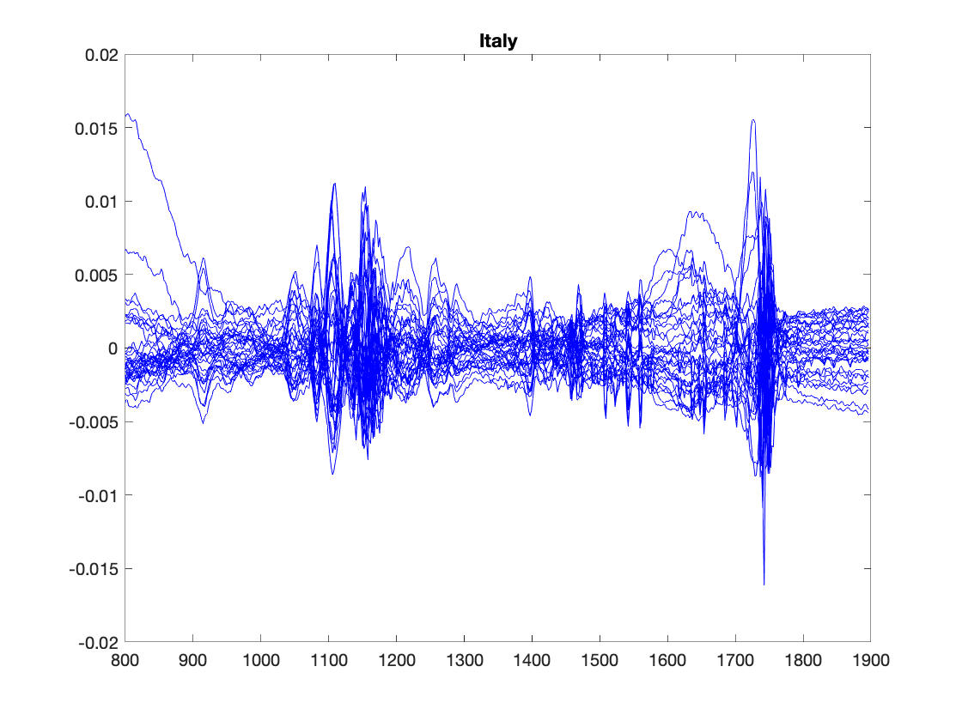
Images of raw and mean centered spectrum. Greece and Italy

Slide 7
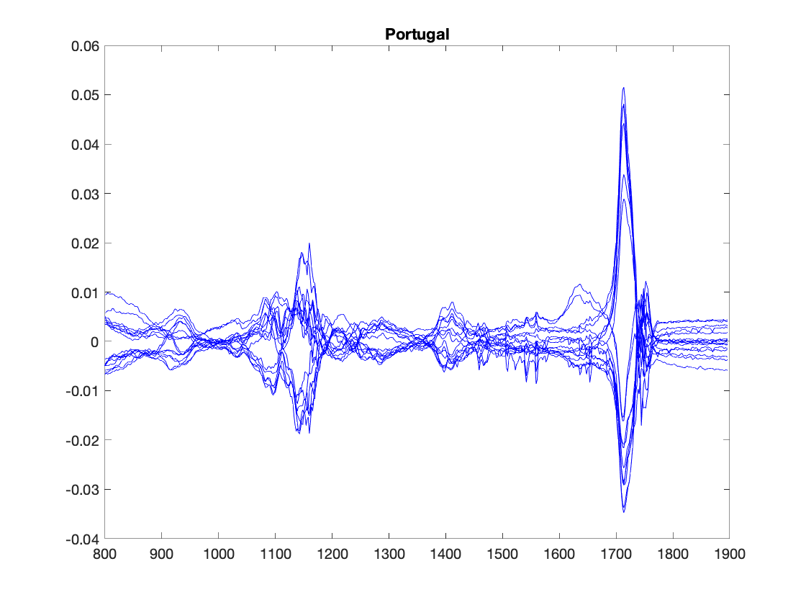
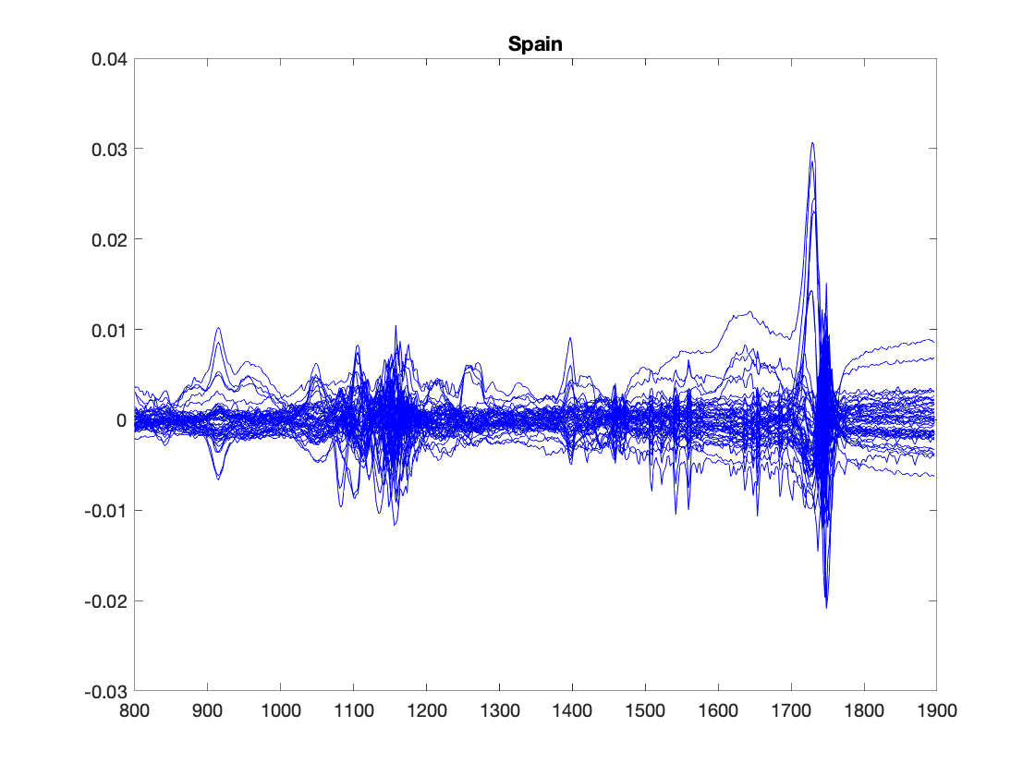
Images of raw and mean centered spectrum. Portugal and Spain

Slide 8
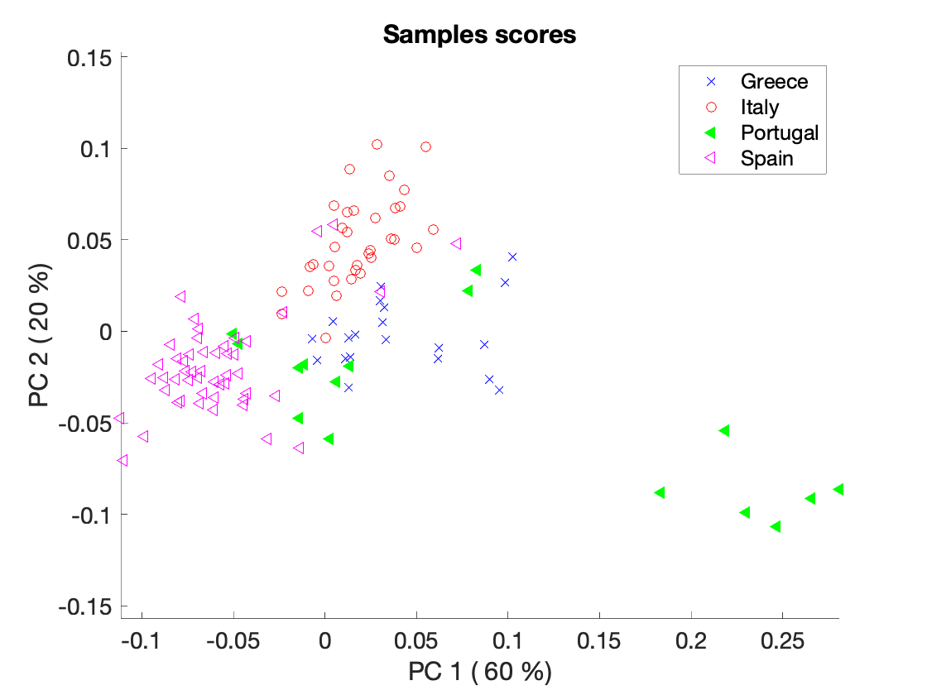
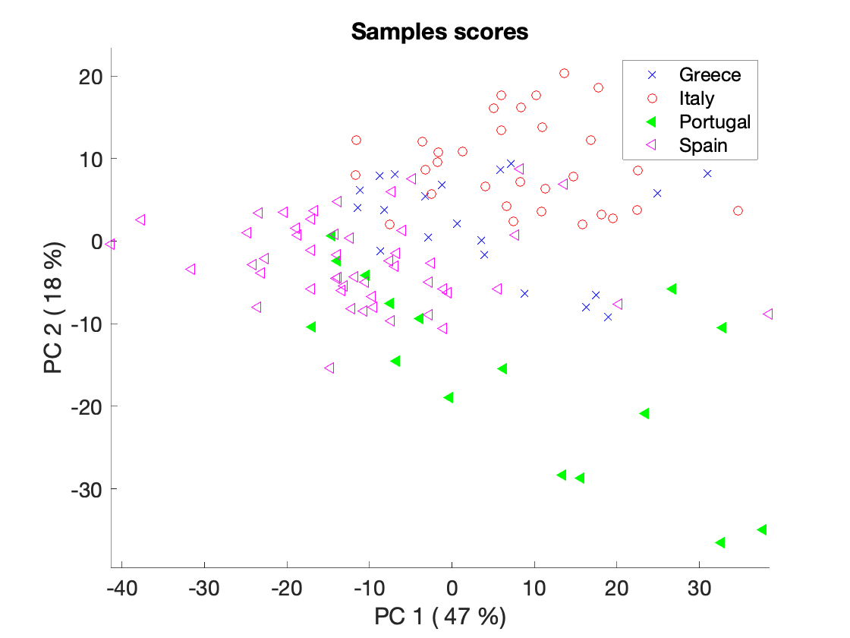
PCA analysis
Mean-centered
Autoscaled

Slide 9
Double cross validation
25 % of the data set will be used as independent test set
The data is splitted into validation and test set randomly, but
Since we have 2 measurements for each sample we ensure that both go to the same set to avoid sharing information between validation and test set
We ensure that samples from different countries are evenly distributed in validation and test set
We use the analogue of LOO cross-validation (with the correction of duplicates) for model tuning

Slide 10
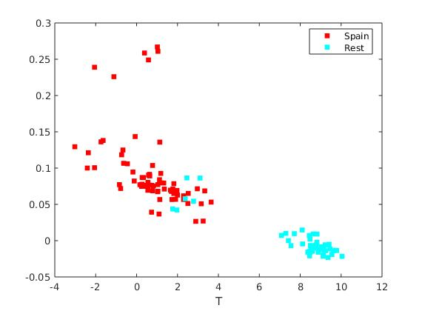
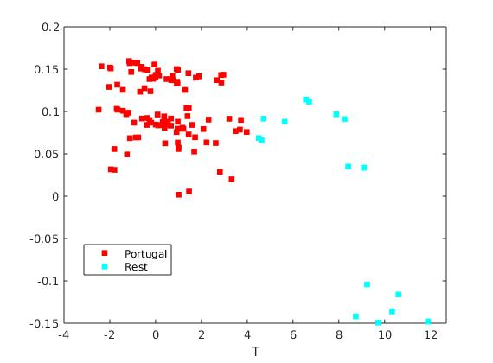
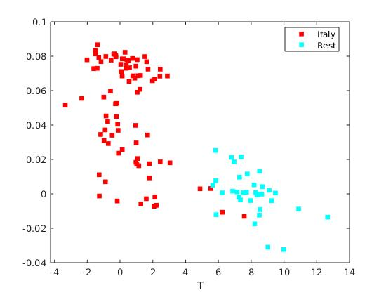
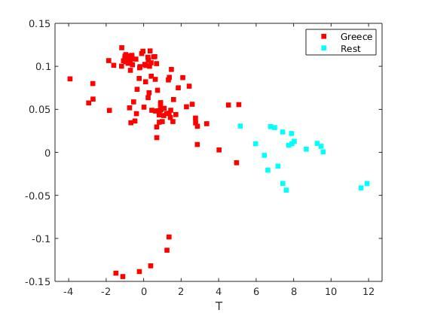
OPLS

Slide 11
OPLS Cross Validation
5 random testsets were used, the number of latent variables was 4
Number of missclassified samples varies, but is generally low, no higher than 4%
Q2 value qualifies as significant, generally around 0.55-0.7

Slide 12
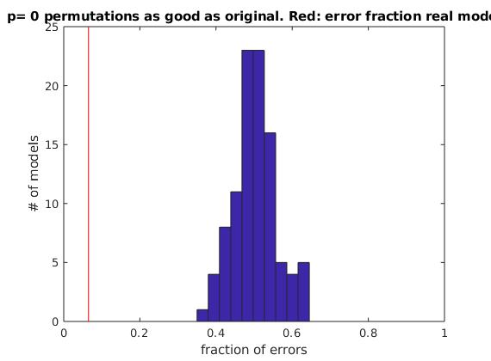
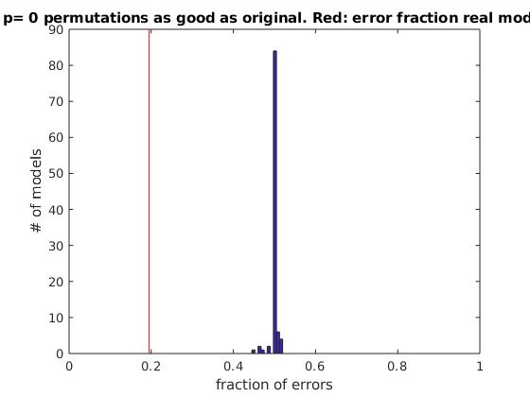
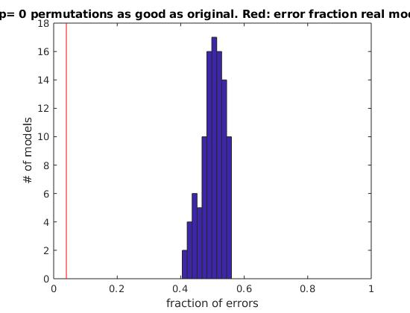
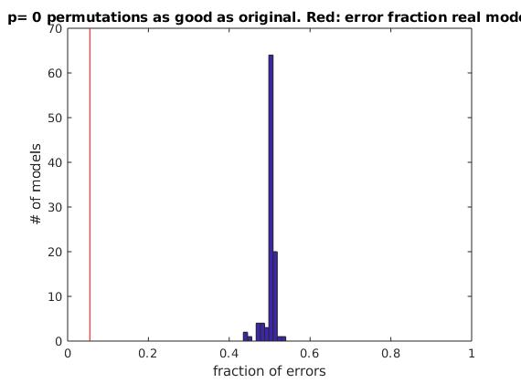
Significance test

Slide 13
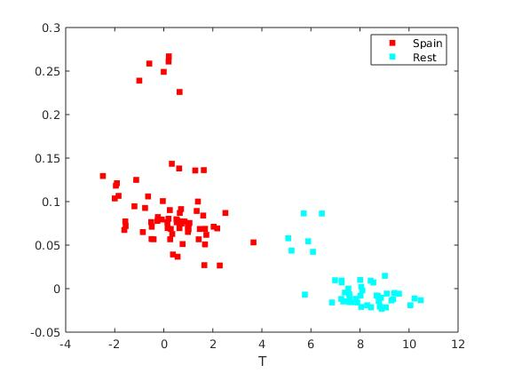
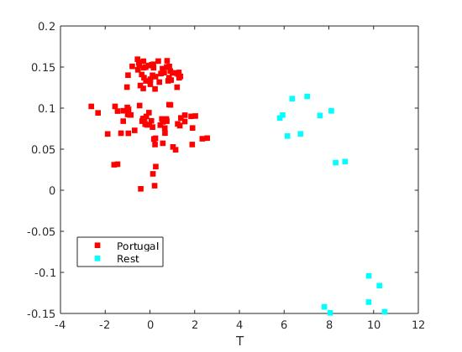
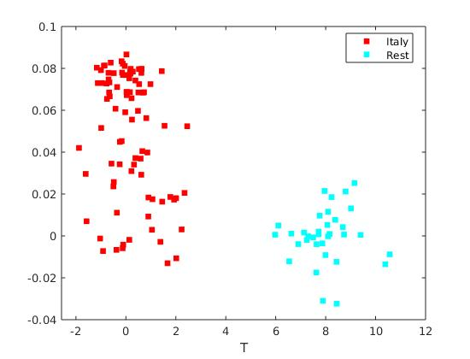
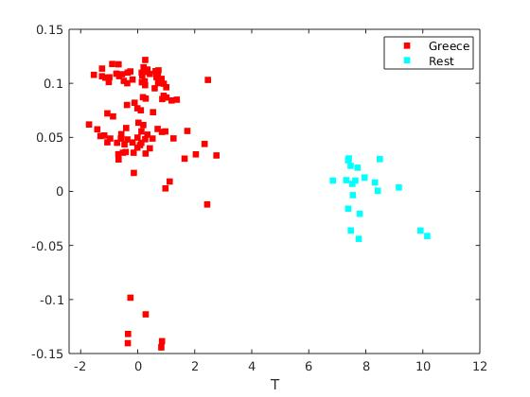
OPLS with 8 latent variables

Slide 14
OPLS Cross Validation
5 random testsets were used, the number of latent variables increased to 8
Number of missclassified samples decreases, usually 0%, occasionally 1%
Q2 value increases, generally around 0.7-0.8

Slide 15
GA implementation
Based on the results of OPLS we aim to find a subset of 8 wavelengths to classify oils with LDA
Initial population is generated randomly
Encoding: real values (more precisely integers)
For new generations: 2-points crossover with 0.8 rate and mutation by shifting a wavelength number in (-10, 10) interval with 0.05 rate
Generational reproduction with ranked-based selection strategy is used
Fitness function: LOO internal validation
Final evaluation with independent test set (25%)
Stop criterion: 0 error rate or max number of generations is reached

Slide 16
GA – tried parameters settings
Population size: 200, max number of iterations: 30. 100 runs
Population size: 50, max number of iterations: 50. 100 runs
Baseline – average error rate of 1000 classifications based on randomly selected wavelengths subset
Method | Average error rate | Convergence | Zero error rate runs
Random baseline 1 | 22.11 | - | -
GA version 1 | 18 | 100 of 100 (min 1, max 12) | 0
Random baseline 2 | 10.44 | - | -
GA version 2 | 4.85 | 77 of 100 (min 4) | 24

Slide 17
GA – tried parameters settings
GA1 - population size: 200, max number of iterations: 30. 100 runs
GA2 - population size: 50, max number of iterations: 50. 100 runs
Baseline – average error rate of 1000 classifications based on randomly selected wavelengths subset
Method | Average error rate | Convergence | Zero error rate runs
Random baseline 1 | 22.11 | - | -
GA1 | 18 | 100 of 100 (min 1, max 12) | 0
Random baseline 2 | 10.44 | - | -
GA2 | 4.85 | 77 of 100 (min 4) | 24

Slide 18
GA2 zero error rate solutions evaluation
We evaluate zero error rate the solutions obtained by GA2 with 4-fold cross-validation (to have 25% test set).
CV is performed 10 times with different training and test sets splits and the results are averaged for each solution
Min – 0.33
Max – 3.42
Top ten solutions error rates
0.33
1.24
1.25
1.25
1.48
1.73
1.83
1.83
1.83
1.88

Slide 19
Top-10 selected wavelengths statistics
Wavelengths range: 799 -1897
Wawelength | Occurences
1007.3 | 24
1134.6 | 19
1132.7 | 18
1202.2 | 17
1617.0 | 15
1128.8 | 13
1130.8 | 13
1005.3 | 11
1013.1 | 11
1620.9 | 11

Slide 20
GA issues and possible improvements
Main issues:
100 runs of both GA versions took about 3 hours
The results tend to be affected by a separation into training and tests set
LOO validation tend to overfit
Possible improvements:
Generate initial population based on obtained knowledge
More GA runs
More detailed analysis of top selected wavelenghts
GA implementation

