Slide 1
Discrimination of olive oils origin based on FTIR Spectroscopy data by OPLS and GA
Evgeniia Martynova (s1038931)
Lili Mészáros (s1015790)

Slide 2
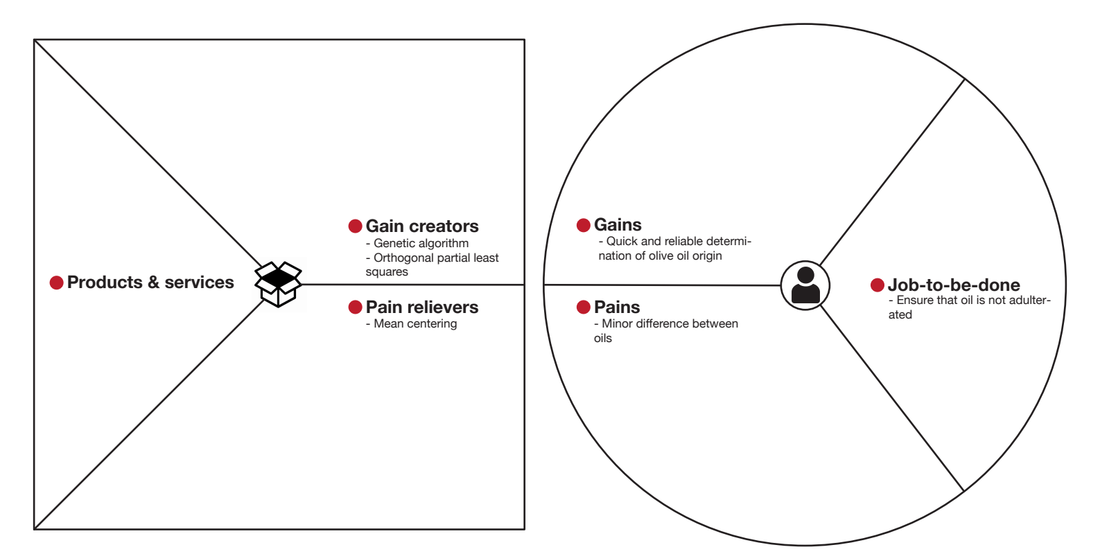

Slide 3
Data. Spectrum is obtained by Fourier transform infrared spectroscopy
FTIR spectroscopy is fast and no complex samples pre-processing is needed
2 measurements of each sample made within 1-24 days interval
60 samples of olive oils from 4 countries obtained for the original study [1]
Group designation | Country of origin | No. of samples
1 | Greece | 10
2 | Italy | 17
3 | Portugal | 8
4 | Spain | 25
 | total: | 60
[1] Henri S. Tapp, Marianne Defernez, E. Katherine Kemsley, FTIR Spectroscopy and Multivariate Analysis Can Distinguish
the Geographic Origin of Extra Virgin Olive Oils
J. Agric. Food Chem. 2003

Slide 4
Experiment design and motivation
Original study:
Used internal cross-validation
PLS
Variable selection with genetic algorithm
Our study:
Used LOO cross-validation
OPLS
New version of genetic algorithm

Slide 5
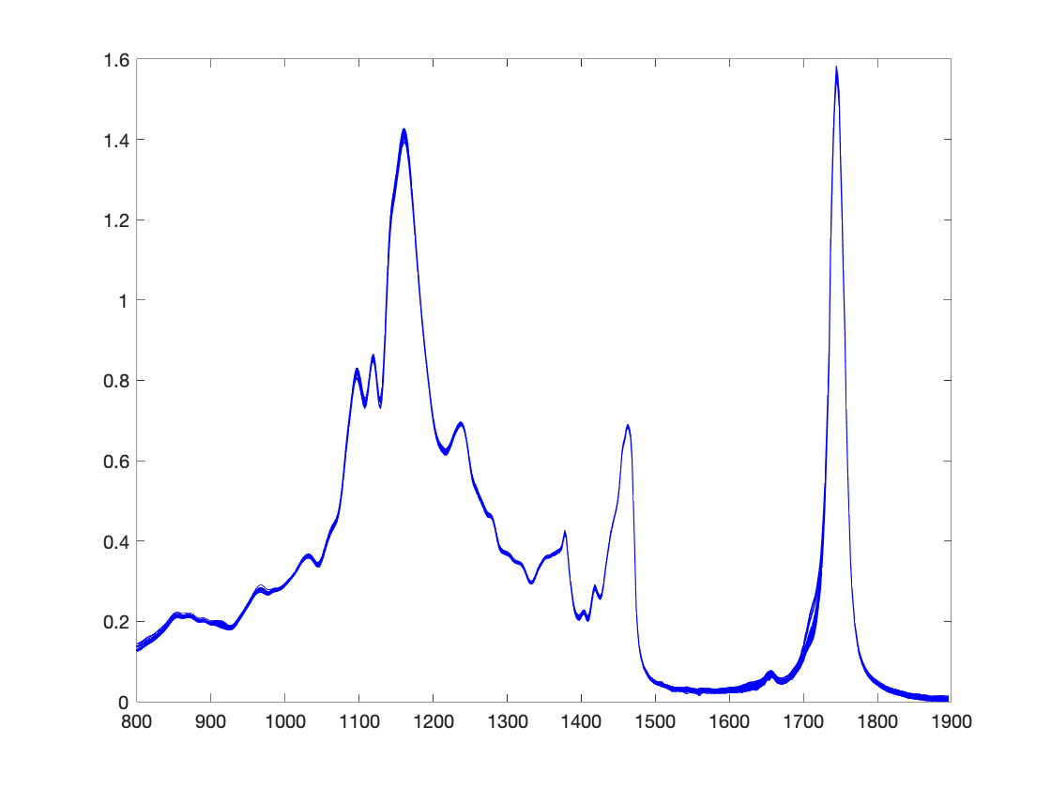
Preprocessing. Raw data
Mean-centering – will be used to make wavelength values more comparable
Autoscaling – should not be used for the FTIR data, because we would loose important information about peaks in spectrum
Normalization/SNV-scaling – we are not sure if it is useful for these data

Slide 6
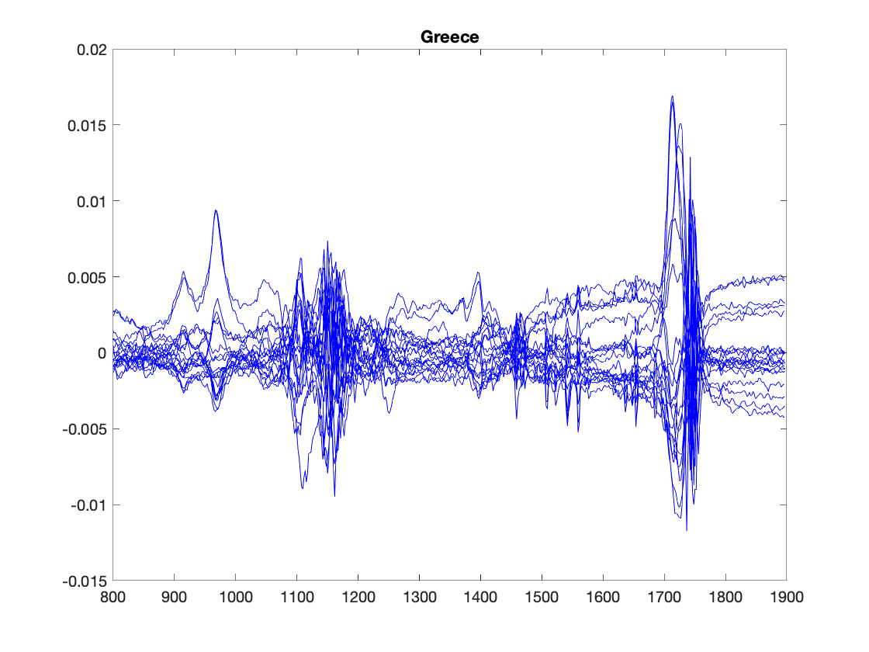
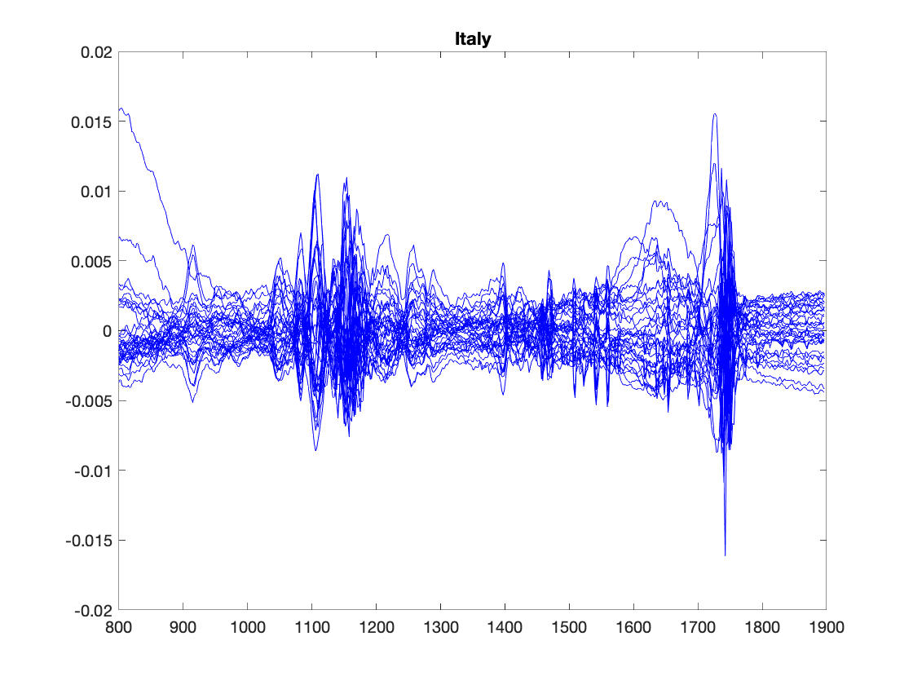
Images of raw and mean centered spectrum. Greece and Italy

Slide 7
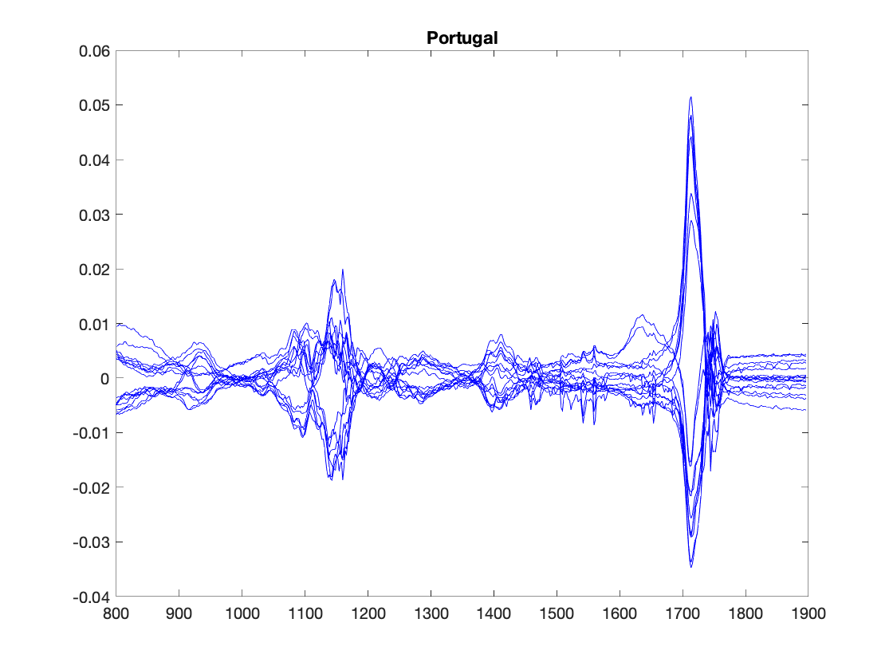
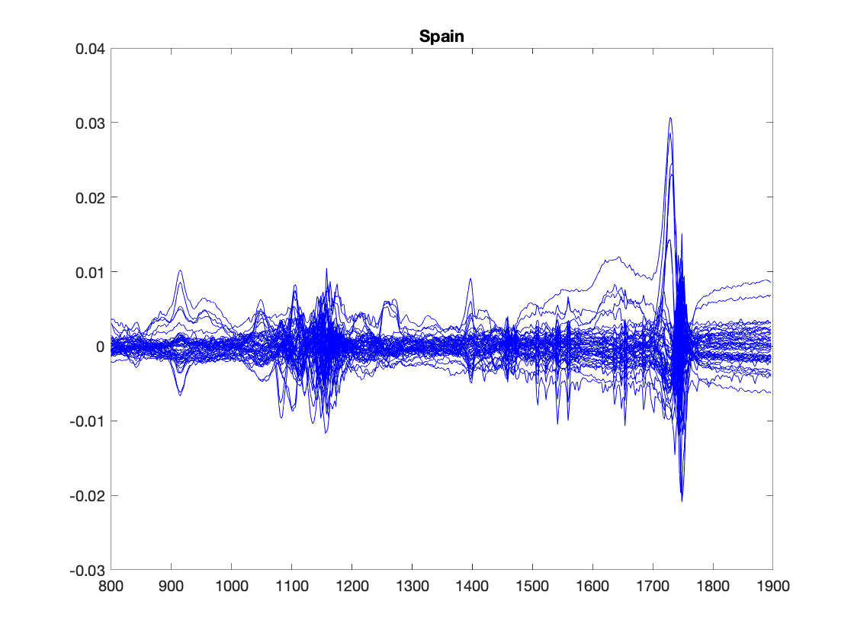
Images of raw and mean centered spectrum. Portugal and Spain

Slide 8
Double cross validation
25 % of the data set will be used as independent test set
The data is splitted into validation and test set randomly, but
Since we have 2 measurements for each sample we ensure that both go to the same set to avoid sharing information between validation and test set
We ensure that samples from different countries are evenly distributed in validation and test set
We use the analogue of LOO cross-validation (with the correction of duplicates) for model tuning

Slide 9
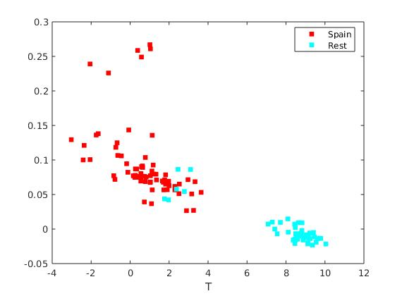
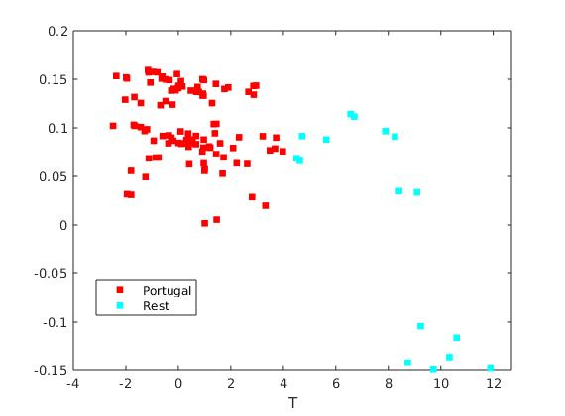
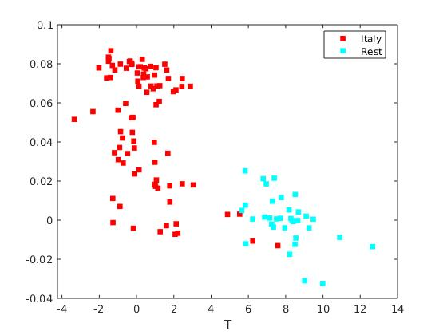
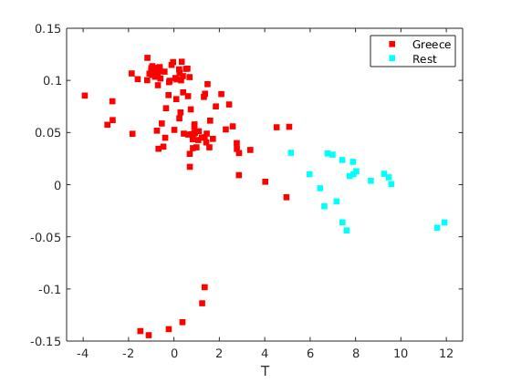
OPLS

Slide 10
OPLS Cross Validation
5 random testsets were used, the number of latent variables was 4
Number of missclassified samples varies, but is generally low, no higher than 4%
Q2 value qualifies as significant, generally around 0.55-0.7

Slide 11
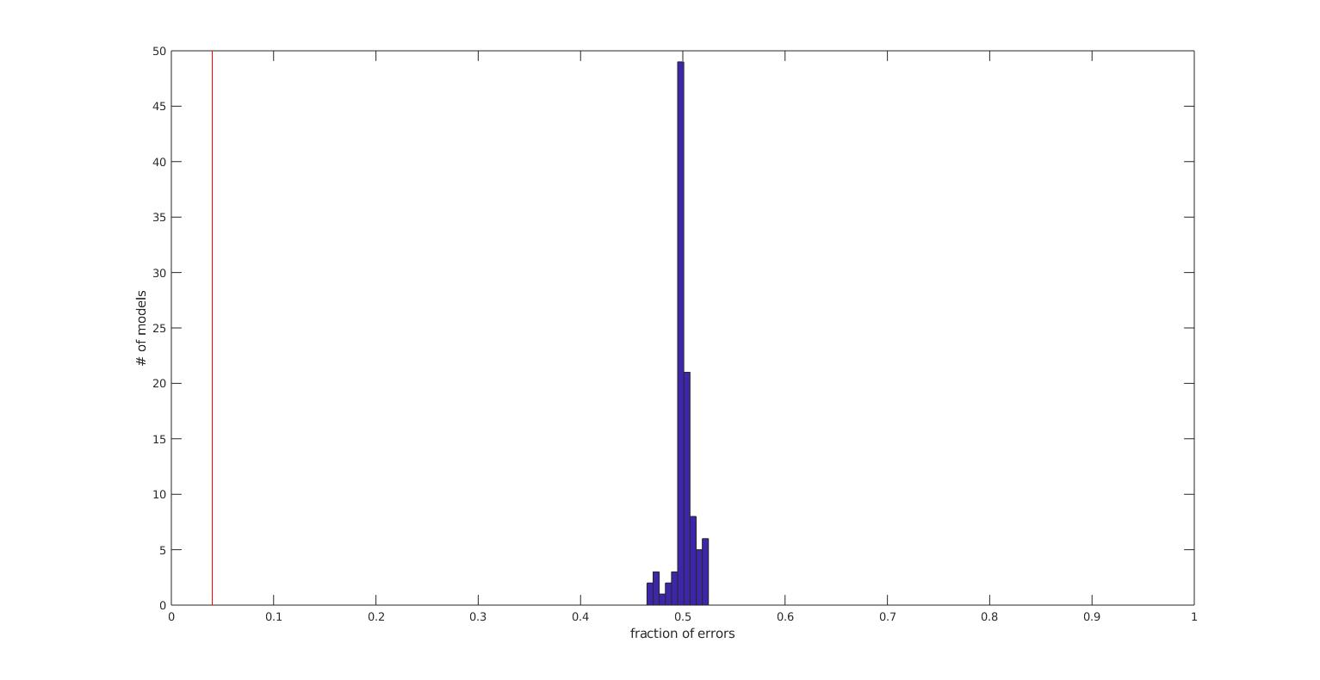
Permutation test

