Slide 1

Sensing the World
Presentation
Meghan Tennant, Cal Stewart, and Kindah Qaissi
Notes:
C

Slide 2
Introduction and Project Overview
M
Objective: create a mechanism to automatically store and collect rainwater when rain is detected
When rain is detected, the hatch is opened to collect rainwater and the LED is turned on. When rain is not detected, the hatch remains closed, and the LED is turned off. We also added an override switch to manually open and close the hatch.
Notes:
M

Slide 3
Implementation Overview
K
Input 1: Rain sensor (A0/GPIO 1)
  Activates on dropping below voltage threshold (1.5V) via wetness
Input 2: Custom IED sensor mask (A1/GPIO 2 and 3V3)
  Activates on certain ohm range that theoretically shifts on ohm range*
Input 3: Manual switch (D2/GPIO 5)
  Activates on button hold, deactivates on release
Notes:
*This ohm range is extremely volatile as it depends on humidity and temperature. Often times, on first run, the ohm range will be lower than the ohm range after the program has been running for a while.

Slide 4
Implementation Overview
K
Output 1: Stepper motor (D3,4,5,6/GPIO 6,7,8,9)
  Takes one of any three inputs and rotates 90 degrees, stays until release
Output 2: LED (D7/GPIO 10)
  Activates when any one of three inputs is detected
  Deactivates on release
Hold element
Notes:
These outputs will only be active for as long as any of the three inputs are active. As such, the lid will stay open for as long as it is active and should not return unless these inputs are released.

Slide 5
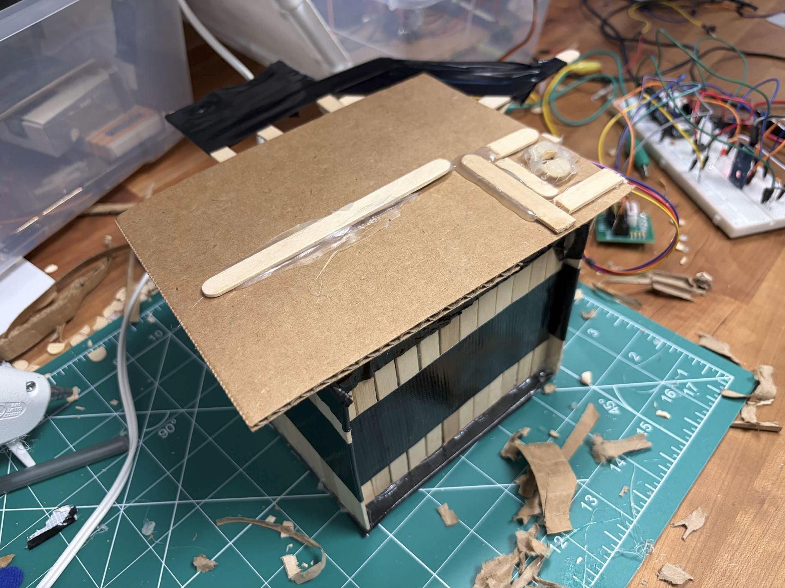
Implemented Prototype
C
Reinforcement of the lid was necessary
Theoretically Waterproof
Notes:
C

Slide 6
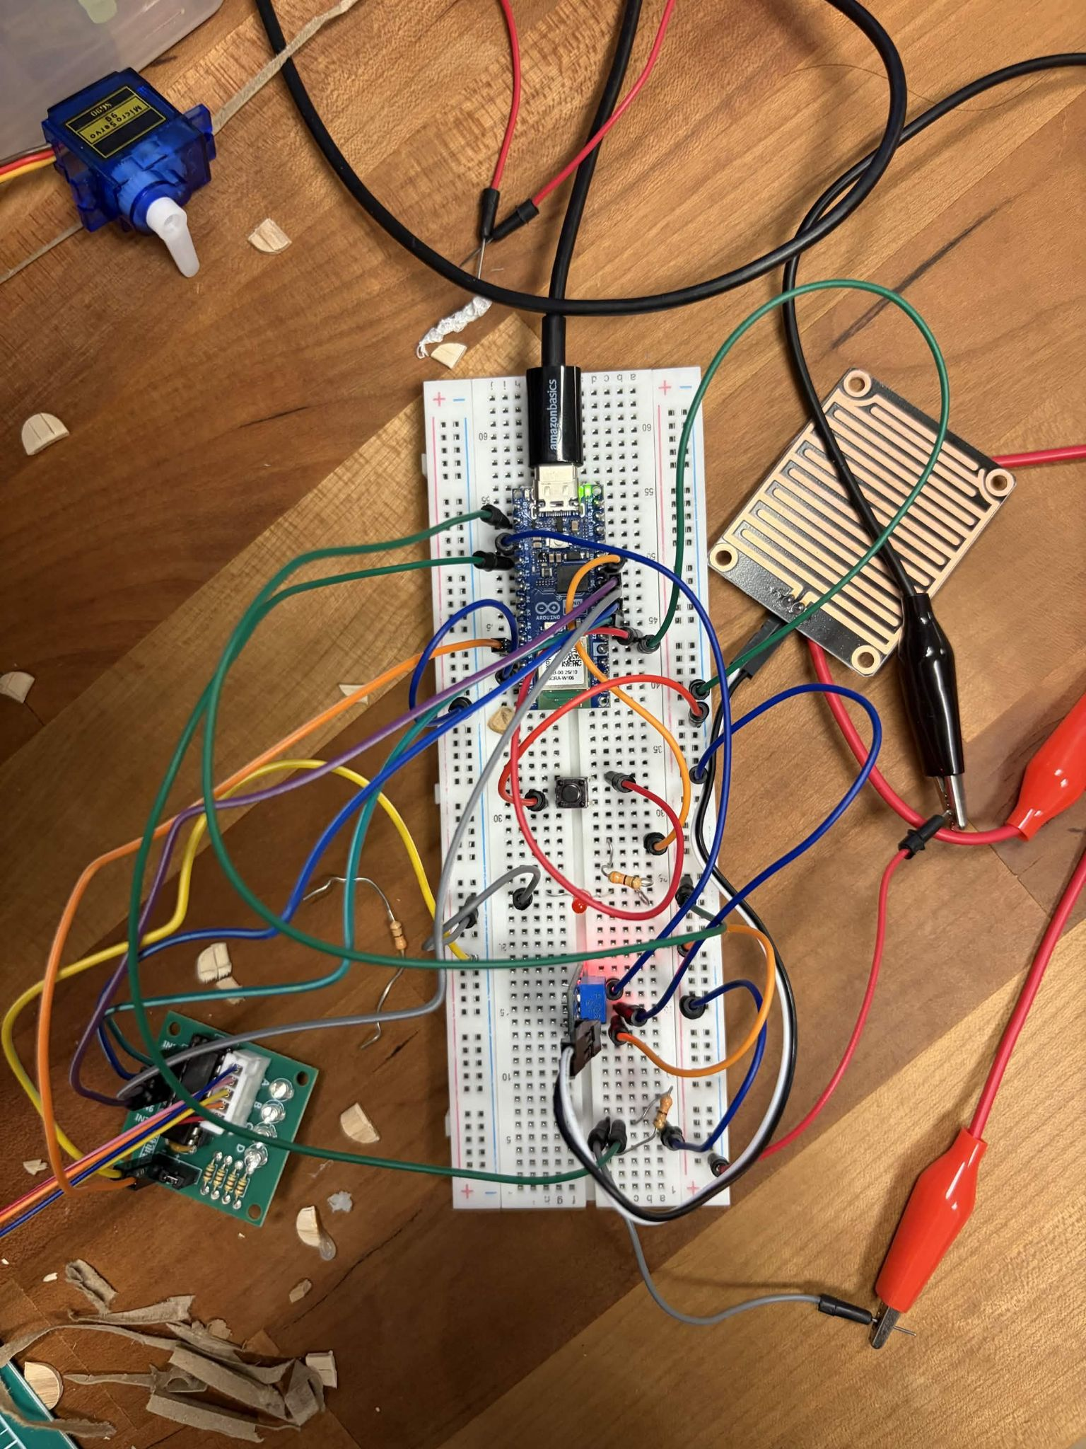
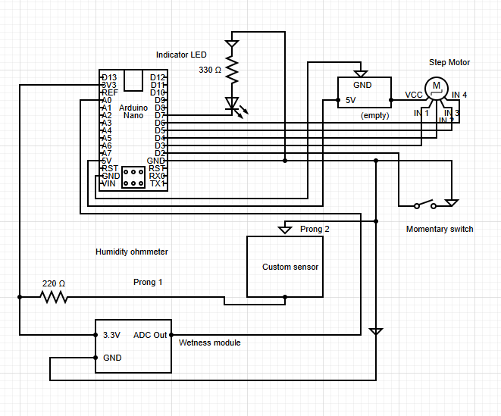
K
Breadboard and Circuit Diagram

Slide 7
M
Use of AI
code
Software & Coding
Aided in coding our program by asking AI specific questions when our code wasn't working.
memory
Hardware & Wiring
Consulted AI for direct guidance and technical advice on how to properly wire the system.
Notes:
M

Slide 8

Results
M
A prototype for a water collection system that turns on the LED and opens the lid to the water collection container when water is sensed.
sensors
Water Sensor Input
Turns on LED and opens lid when 1.5 voltage or more is detected.
water_drop
Custom Water Sensing Mask
Uses our custom IED sensor mask, turning on LED and opening lid when water is detected.
touch_app
Manual Switch
Uses a manual override switch, turning on LED and opening lid when pressed.
Notes:
M

Slide 9
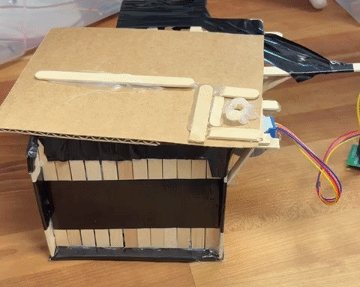
Conclusion/ Reflection
C
We ultimately provided a robust, focus-driven product while overcoming key setbacks.
In real life, we would likely utilize a better waterproofing system, a better motor, and better/more robust sensors for our system, avoiding volatile elements.
Ultimately, this project was a success.
Notes:
C

