Slide 1
Reification by Parametricity
Fast Setup for Proof by Reflection, in Two Lines of Ltac
ITP 2018
Jason Gross, Andres Erbsen, and Adam Chlipala

Slide 2
Reification
part of proof by reflection:
a technique for making proofs check faster, or
a technique for making proofs more robust

Slide 3
Time Spent in my PhD

Slide 4
Reification by Parametricity
or
“A solution to
‘my technique for making my proofs check faster is too slow’.”
or
“A solution to
‘my technique for making my proofs more robust is too fragile or complex’.”

Slide 5
What is proof?
Inductive is_even : nat → Prop :=
|even_O :is_even O
|even_SS:∀x,is_even x → is_even (S (S x)).
Theorem is_even_two : is_even 2.
Proof. repeat constructor. Qed.
Print is_even_two.
(* is_even_two = even_SS 0 even_O *)

Slide 6
When is proof slow?
Goal is_even 9002.
Time repeat constructor.
(* 55.966 secs *)
Qed.
Goal is_even
(let x := 100 * 100 * 100 * 100 in
let y := x * x * x * x in
y * y * y * y).
cbv. (* stack overflow *)
Abort.

Slide 7
Why is proof slow?
Goal is_even 9002.
Time repeat constructor.
(* 55.966 secs *)
Show Proof.
(*even_SS 9000 (even_SS 8998 … )*)
Set Printing All. Check 9002.
(*S (S (S (S (S (S (S … )))))):nat*)

Slide 8
What is proof by reflection?
Inductive is_even : nat → Prop :=
|even_O :is_even O
|even_SS:∀x,is_even x → is_even (S (S x)).
Fixpoint check_is_even (n : nat) : bool
:= match n with
| O ⇒ true
| S n’ ⇒ ¬ check_is_even n’
end.
Notes:
“Reflection” refers to denotation, so this is just ingredient

Slide 9
What is proof by reflection?
Theorem soundness
: ∀n, check_is_even n = true → is_even n.
Goal is_even 9002.
Time repeat constructor.(*55.966 s *)
Undo.
Time apply soundness; vm_compute;
reflexivity. (* 0.035 s *)

Slide 10
What is proof by reflection?
Theorem soundness
: ∀n, check_is_even n = true → is_even n.
Goal is_even 9002.
Time apply soundness; vm_compute;
reflexivity. (* 0.035 secs *)
Show Proof.
(* soundness 9002 eq_refl *)

Slide 11
What is proof by reflection?
Theorem soundness
: ∀n, check_is_even n = true → is_even n.
Goal is_even
(10*10*10*10*10*10*10*10*10).
Time apply soundness; vm_compute;
reflexivity.
(* 174.322 secs *)
Notes:
10^9

Slide 12
What is reification?
Fixpoint check_is_even (n : nat) : bool
:= match n with
| O ⇒ true
| S n’ ⇒ ¬ check_is_even n’
end.
Fixpoint check_is_even (n : expr)
: bool
:= match n with
| NatO ⇒ true
| NatS n’ ⇒ ¬ check_is_even n’
| NatMul x y ⇒
check_is_even x || check_is_even y
end.

Slide 13
What is reification?
Inductive expr :=
| NatO : expr
| NatS : expr → expr
| NatMul : expr → expr → expr.
Reify : nat → expr
Reify O := NatO
Reify (S n) := NatS (Reify n)
Reify (x*y) := NatMul (Reify x) (Reify y)
Requires metaprogramming!
Notes:
Emphasize that this is fake code / pseudo-code

Slide 14
What is reification?
Example in Ltac:
Ltac reify term :=
lazymatch term with
| O => NatO
| S ?x => let rx := reify x in
constr:(NatS rx)
| ?x * ?y => let rx := reify x in
let ry := reify y in
constr:(NatMul rx ry)
end.

Slide 15
When is reification complicated?
When binders show up
Inductive expr {var : Set} :=
| NatO : expr
| NatS : expr → expr
| NatMul : expr → expr → expr
| Var : var → expr
| LetIn : expr → (var → expr) → expr
.
Notes:
Call out var → expr in PHOAS

Slide 16
When is reification complicated?
Reify : nat → expr
Reify O := NatO
Reify (S n) := NatS (Reify n)
Reify (x*y) := NatMul (Reify x) (Reify y)
Reify (let x := v in f)
:= LetIn (Reify v)
(𝜆 x : var, Reify f)
Ltac alone admits seven(!) variants of recursing under binders.

Slide 17
When is reification slow?

Slide 18
When is reification slow?
On big terms
Notes:
Note 20,000

Slide 19
When is reification slow?
On big terms with many binders
Notes:
Note 300;
Ltac cutoff: ~1 minute at ~2,000 binders

Slide 20
Outline
Introduction and Motivation
What is proof?
When is proof slow?
What is proof by reflection?
What is reification?
When is reification slow or complicated?
Outline
Reification by parametricity
What is it?
What’s special about it?
What’s left?

Slide 21
Reification by Parametricity

Slide 22
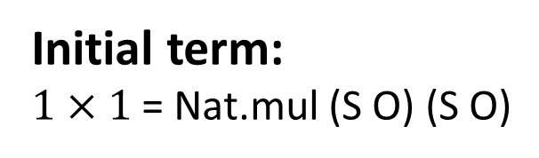
What is reification by parametricity?
Key idea:
The initial and reified terms have the same shape.
S
O
Initial term:
$1×1$ = Nat.mul (S O) (S O)
×
S
O
Reified term:
NatMul (NatS NatO)
(NatS NatO)
NatS
NatO
NatMul
NatS
NatO

Slide 23
What is reification by parametricity?
Key idea:
The initial and reified terms have the same shape.
We can abstract or generalize to get this shape, and specialize or substitute to reify.
initial term
reification
reified term
generalize
specialize
abstracted term

Slide 24

What is reification by parametricity?
initial term
reification
reified term
generalize
specialize
abstracted term
$$1×1$$
NatMul (NatS NatO) (NatS NatO)
Λ N. λ (Mul : N → N → N) (O : N) (S : N → N). Mul (S O) (S O)

Slide 25
Reification by Parametricity: What’s special about it?
Fast
Concise
Powerful

Slide 26
Reification by Parametricity: It’s Fast

Slide 27
Reification by Parametricity: It’s Fast

Slide 28
Reification by Parametricity: It’s hard to do better
Notes:
TODO: Make 8.8 graph, or mention it

Slide 29
Reification by Parametricity: It’s hard to do better (Coq v8.8)

Slide 30
Reification by Parametricity: It’s Concise
OCaml Reification:
(*i camlp4deps: "parsing/grammar.cma" i*)
(*i camlp4use: "pa_extend.cmp" i*)
open Names
let rec unsafe_reify_helper
(mkVar : Constr.t -> 'a)
(mkO : 'a)
(mkS : 'a -> 'a)
(mkOp : 'a -> 'a -> 'a)
(mkLetIn : 'a -> Name.t -> Constr.t -> 'a -> 'a)
(gO : Constr.t)
(gS : Constr.t)
(gOp : Constr.t)
(gLetIn : Constr.t)
(unrecognized : Constr.t -> 'a)
(term : Constr.t)
=
let reify_rec term =
unsafe_reify_helper
mkVar mkO mkS mkOp mkLetIn gO gS gOp gLetIn unrecognized term in
let kterm = Constr.kind term in
if Constr.equal term gO
then mkO
else begin match kterm with
| Term.Rel _ -> mkVar term
| Term.Var _ -> mkVar term
| Term.Cast (term, _, _) -> reify_rec term
| Term.App (f, args)
->
if Constr.equal f gS
then let x = Array.get args 0 in
let rx = reify_rec x in
mkS rx
else if Constr.equal f gOp
then let x = Array.get args 0 in
let y = Array.get args 1 in
let rx = reify_rec x in
let ry = reify_rec y in
mkOp rx ry
else if Constr.equal f gLetIn
then let x = Array.get args 2 (* assume the first two args are type params *) in
let f = Array.get args 3 in
begin match Constr.kind f with
| Term.Lambda (idx, ty, body)
-> let rx = reify_rec x in
let rf = reify_rec body in
mkLetIn rx idx ty rf
| _ -> unrecognized term
end
else unrecognized term
| _
-> unrecognized term
end
let unsafe_reify
(cVar : Constr.t)
(cO : Constr.t)
(cS : Constr.t)
(cOp : Constr.t)
(cLetIn : Constr.t)
(gO : Constr.t)
(gS : Constr.t)
(gOp : Constr.t)
(gLetIn : Constr.t)
(var : Constr.t)
(term : Constr.t) : Constr.t =
let mkApp0 (f : Constr.t) =
Constr.mkApp (f, [| var |]) in
let mkApp1 (f : Constr.t) (x : Constr.t) =
Constr.mkApp (f, [| var ; x |]) in
let mkApp2 (f : Constr.t) (x : Constr.t) (y : Constr.t) =
Constr.mkApp (f, [| var ; x ; y |]) in
let mkVar (v : Constr.t) = mkApp1 cVar v in
let mkO = mkApp0 cO in
let mkS (v : Constr.t) = mkApp1 cS v in
let mkOp (x : Constr.t) (y : Constr.t) = mkApp2 cOp x y in
let mkcLetIn (x : Constr.t) (y : Constr.t) = mkApp2 cLetIn x y in
let mkLetIn (x : Constr.t) (idx : Name.t) (ty : Constr.t) (fbody : Constr.t)
= mkcLetIn x (Constr.mkLambda (idx, var, fbody)) in
let ret = unsafe_reify_helper
mkVar mkO mkS mkOp mkLetIn gO gS gOp gLetIn
(fun term -> term)
term in
ret
let unsafe_Reify
(cVar : Constr.t)
(cO : Constr.t)
(cS : Constr.t)
(cOp : Constr.t)
(cLetIn : Constr.t)
(gO : Constr.t)
(gS : Constr.t)
(gOp : Constr.t)
(gLetIn : Constr.t)
(idvar : Id.t)
(varty : Constr.t)
(term : Constr.t) : Constr.t =
let fresh_set = let rec fold accu c = match Constr.kind c with
| Constr.Var id -> Id.Set.add id accu
| _ -> Constr.fold fold accu c
in
fold Id.Set.empty term in
let idvar = Namegen.next_ident_away_from
idvar
(fun id -> Id.Set.mem id fresh_set) in
let var = Constr.mkVar idvar in
let rterm = unsafe_reify cVar cO cS cOp cLetIn gO gS gOp gLetIn var term in
let rterm = Vars.substn_vars 1 [idvar] rterm in
Constr.mkLambda (Name.Name idvar, varty, rterm)
DECLARE PLUGIN "reify"
open Ltac_plugin
open Stdarg
open Tacarg
open Names
(** Stolen from plugins/setoid_ring/newring.ml *)
open Tacexpr
open Misctypes
open Tacinterp
(* Calling a locally bound tactic *)
let ltac_lcall tac args =
TacArg(Loc.tag @@ TacCall (Loc.tag (ArgVar(Loc.tag @@ Id.of_string tac),args)))
let ltac_apply (f : Value.t) (args: Tacinterp.Value.t list) =
let fold arg (i, vars, lfun) =
let id = Id.of_string ("x" ^ string_of_int i) in
let x = Reference (ArgVar (Loc.tag id)) in
(succ i, x :: vars, Id.Map.add id arg lfun)
in
let (_, args, lfun) = List.fold_right fold args (0, [], Id.Map.empty) in
let lfun = Id.Map.add (Id.of_string "F") f lfun in
let ist = { (Tacinterp.default_ist ()) with Tacinterp.lfun = lfun; } in
Tacinterp.eval_tactic_ist ist (ltac_lcall "F" args)
let to_ltac_val c = Tacinterp.Value.of_constr c
open Pp
TACTIC EXTEND quote_term_cps
| [ "quote_term_cps" "[" ident(idvar) "," constr(varty) "]"
constr(cVar) constr(cO) constr(cS) constr(cOp) constr(cLetIn)
constr(gO) constr(gS) constr(gOp) constr(gLetIn)
constr(term) tactic(tac) ] ->
[ (** quote the given term, pass the result to t **)
Proofview.Goal.enter begin fun gl ->
let _ (*env*) = Proofview.Goal.env gl in
let c = unsafe_Reify
(EConstr.Unsafe.to_constr cVar)
(EConstr.Unsafe.to_constr cO)
(EConstr.Unsafe.to_constr cS)
(EConstr.Unsafe.to_constr cOp)
(EConstr.Unsafe.to_constr cLetIn)
(EConstr.Unsafe.to_constr gO)
(EConstr.Unsafe.to_constr gS)
(EConstr.Unsafe.to_constr gOp)
(EConstr.Unsafe.to_constr gLetIn)
idvar
(EConstr.Unsafe.to_constr varty)
(EConstr.Unsafe.to_constr term) in
ltac_apply tac (List.map to_ltac_val [EConstr.of_constr c])
end ]
END;;

Slide 31
Reification by Parametricity: It’s Concise
Ltac Reification:
Definition var_for {var : Type} (n : nat) (v : var) := False.
Ltac reify var term :=
let reify_rec term := reify var term in
lazymatch goal with
| [ H : var_for term ?v |- _ ] => constr:(@Var var v)
| _ =>
lazymatch term with
| O => constr:(@NatO var)
| S ?x => let rx := reify_rec x in constr:(@NatS var rx)
| ?x * ?y => let rx := reify_rec x in let ry := reify_rec y in constr:(@NatMul var rx ry)
| (dlet x := ?v in ?f)
=> let rv := reify_rec v in
let not_x := fresh in
let not_x2 := fresh in
let rf := lazymatch constr:(
fun (x : nat) (not_x : var) (_ : @var_for var x not_x)
=> match f return @expr var with
| not_x2
=> ltac:(let fx := (eval cbv delta [not_x2] in not_x2) in
clear not_x2;
let rf := reify_rec fx in
exact rf)
end) with
| fun _ v' _ => @?f v' => f
| ?f => error_cant_elim_deps f
end in
constr:(@LetIn var rv rf)
| ?v => error_bad_term v
end
end.

Slide 32
Reification by Parametricity: It’s Concise
Typeclass-based Reification:
Local Generalizable Variables x y rx ry f rf.
Section with_var.
Context {var : Type}.
Class reify_of (term : nat) (rterm : @expr var) := {}.
Global Instance reify_NatMul `{reify_of x rx, reify_of y ry}
: reify_of (x * y) (rx * ry).
Global Instance reify_LetIn `{reify_of x rx}
`{forall y ry, reify_of y (Var ry) -> reify_of (f y) (rf ry)}
: reify_of (dlet y := x in f y) (elet ry := rx in rf ry).
Global Instance reify_S `{reify_of x rx}
: reify_of (S x) (NatS rx).
Global Instance reify_O
: reify_of O NatO.
End with_var.
Ltac Reify x :=
let c := constr:(fun var => (_ : @reify_of var x _)) in
lazymatch type of c with
| forall var, reify_of _ (@?rx var) => rx
end.

Slide 33
Reification by Parametricity: It’s Concise
Reification by Parametricity:
Ltac reify var x :=
match(eval pattern nat, O, S, Nat.mul, (@Let_In nat nat) in x)with ?rx _ _ _ _ _ ⇒
constr:(rx (@expr var) NatO NatS NatMul (λ x' f', LetIn x' (λ v, f' (Var v)))) end.
Notes:
Don’t mention universes

Slide 34
Reification by Parametricity: It’s Concise
Reification by Parametricity:
1. let x := constr:(1 * 1) in
2. let x := (eval pattern nat, O, S, Nat.mul in x) in
3. let x := match x with ?rx _ _ _ _ ⇒ rx end in
4. let x := constr:(x (@expr var) NatO NatS NatMul) in
5. let x := (eval cbv beta in x) in
x
1. x = 1 * 1 (= Nat.Mul (S 0) (S 0))
2. x = ((λ N o s m, m (s o) (s o)) nat 0 S Nat.mul)
3. x = (λ N o s m, m (s o) (s o))
4. x = ((λ N o s m, m (s o) (s o)) expr NatO NatS NatMul)
5. x = NatMul (NatS NatO) (NatS NatO)

Slide 35
Reification by Parametricity: It’s Powerful
We can commute reduction and reification.
This allows us to:
Reify once, apply to many examples
Reify once, reduce in the vm, cbv, extraction, etc

Slide 36

Reification by Parametricity: It’s Powerful
$$dlet x_{1}≔1×1 in$$
$$dlet x_{2}≔x_{1}×x_{1} in$$
$$dlet x_{3}≔x_{2}×x_{2} in$$
…
$$dlet x_{100}≔x_{99}×x_{99} in$$
$$x_{100}$$

Slide 37
Reification by Parametricity: It’s Powerful
Inductive count :=
| none | one_more (how_many : count).
Fixpoint big (n:count) (x:nat) : nat
:= match n with
| none => x
| one_more n'
=> dlet x' := x * x in
big n' x'
end.
big 100 1

Slide 38
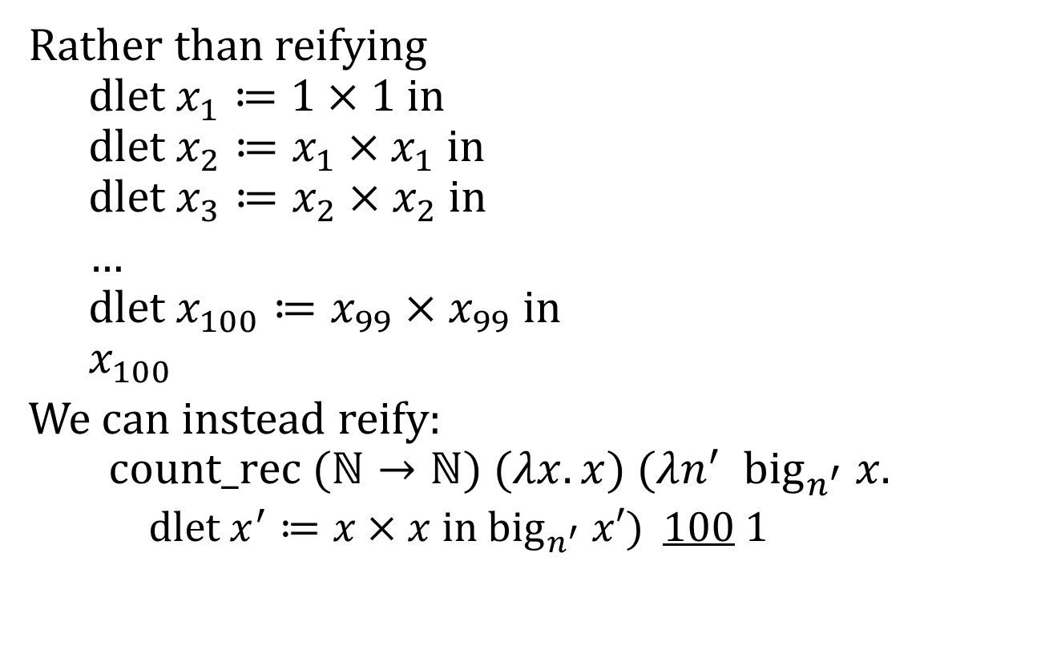
Reification by Parametricity: It’s Powerful
Rather than reifying
$$dlet x_{1}≔1×1 in$$
$$dlet x_{2}≔x_{1}×x_{1} in$$
$$dlet x_{3}≔x_{2}×x_{2} in$$
…
$$dlet x_{100}≔x_{99}×x_{99} in$$
$$x_{100}$$
We can instead reify:
$$count_rec (ℕ→ℕ) (λx. x) (λn^{′} {big}_{n^{′}} x.$$
$dlet x^{′}≔x×x in {big}_{n^{′}} x′)$ 100 1

Slide 39
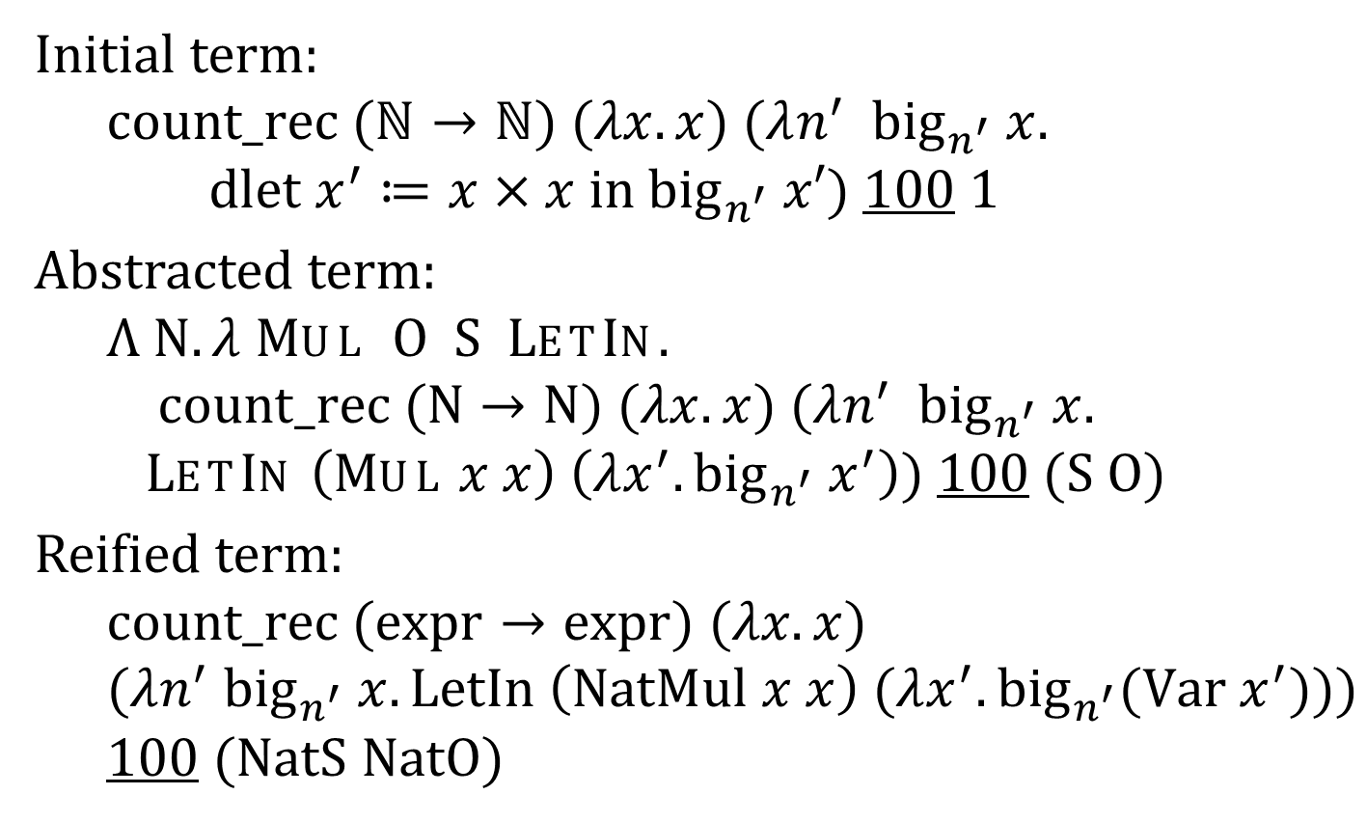
Reification by Parametricity: It’s Powerful
Initial term:
$$count_rec (ℕ→ℕ) (λx. x) (λn^{′} {big}_{n^{′}} x.$$
$dlet x^{′}≔x×x in {big}_{n^{′}} x′)$ 100 1
Abstracted term:
$$Λ N. λ Mul O S LetIn.$$
$count_rec (N→N) (λx. x) (λn^{′} {big}_{n^{′}} x.$
$LetIn \left(Mul x x\right) \left(λx^{′}. {big}_{n^{′}} x^{′}\right))$ 100 $(S O)$
Reified term:
$$count_rec (expr→expr) (λx. x)$$
$(λn^{′} {big}_{n^{′}} x.LetIn \left(NatMul x x\right) (λx^{′}. {big}_{n^{′}}(Var x^{′})))$100 $(NatS NatO)$

Slide 40
Reification by Parametricity: It’s Powerful
reification
initial term
reified term
abstracted term

Slide 41

Reification by Parametricity: It’s Powerful
reification
unreduced term
reduced term
reduced
reified term
$$δβι$$
abstracted term

Slide 42


Reification by Parametricity: It’s Powerful
reification
unreduced term
$$δ$$
small partially reduced term
reduced term
reduced
reified term
$$βι$$
abstracted term

Slide 43



Reification by Parametricity: It’s Powerful
reification
unreduced term
$$δ$$
small partially reduced term
reduced term
reduced
reified term
$$βι$$
abstracted term
reification
unreduced term
$$δ$$
small partially reduced term
unreduced reified term
reduced
reified term
$$βι$$
abstracted term

Slide 44
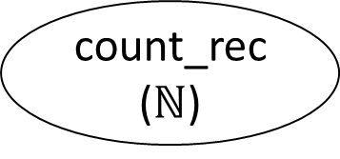
Reification by Parametricity: It’s Powerful
big 100 1
count_rec
($ℕ$)
dlet … in
(100 lines)
reification
LetIn … …
(100 lines)
$$δ$$
$$βι$$

Slide 45
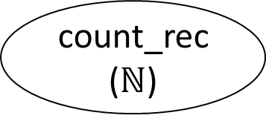
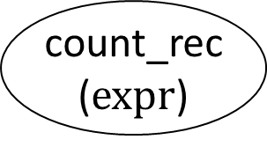
Reification by Parametricity: It’s Powerful
big 100 1
count_rec
($ℕ$)
dlet … in
(100 lines)
reification
LetIn … …
(100 lines)
$$δ$$
$$βι$$
big 100 1
count_rec
($ℕ$)
reification
count_rec
($expr$)
LetIn … …
(100 lines)
$$δ$$
$$βι$$

Slide 46
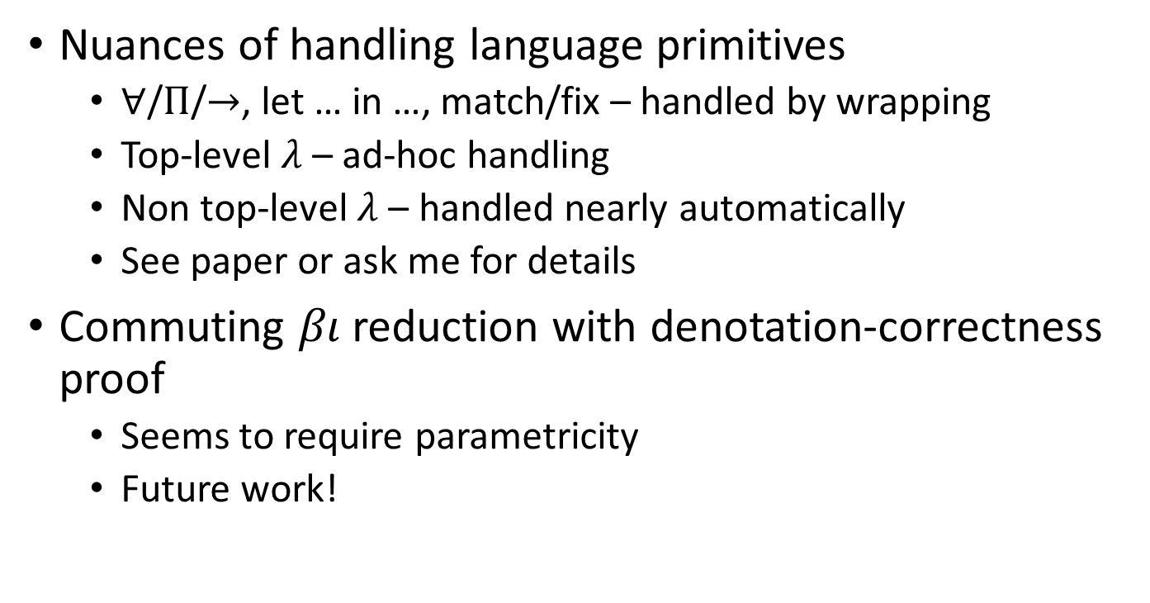
What’s left?
Nuances of handling language primitives
$∀$/$Π$/$→$, let … in …, match/fix – handled by wrapping
Top-level $λ$ – ad-hoc handling
Non top-level $λ$ – handled nearly automatically
See paper or ask me for details
Commuting $βι$ reduction with denotation-correctness proof
Seems to require parametricity
Future work!

Slide 47
Takeaways (if things went well)
Reification is useful for making proofs check faster
Reification by parametricity is
based on the insight that reification preserves shape
concise
powerful (can commute reduction and reification)
fast

Slide 48
Thank you
Any questions?
Reification and benchmarking code and data available at https://github.com/mit-plv/reification-by-parametricity
Paper available at http://adam.chlipala.net/papers/ReificationITP18/

Slide 49
Reification by Parametricity: It’s Concise
Reification by Parametricity:
Ltac reify var x :=
match(eval pattern nat, O, S, Nat.mul in x)with ?rx _ _ _ _ ⇒
constr:(rx (@expr var) NatO NatS NatMul) end.
Notes:
Don’t mention universes

Slide 50



Reification by Parametricity: It’s Powerful
big 100 1
reification
$$δ$$
$$βι$$
$$dlet x_{1}≔1×1 in$$
…
$$x_{100}$$
$$LetIn \left(NatMul … \right) (λ x_{1}.$$
…
$$Var x_{100}$$
$$count_rec (ℕ→ℕ) (λx. x) (λn^{′} {big}_{n^{′}} x.$$
$dlet x^{′}≔x×x in {big}_{n^{′}} x′)$ 100 1

Slide 51


Reification by Parametricity: It’s Powerful
big 100 1
reification
$$δ$$
$$βι$$
$$dlet x_{1}≔1×1 in$$
…
$$x_{100}$$
$$LetIn \left(NatMul … \right) (λ x_{1}.$$
…
$$Var x_{100}$$
$$count_rec (ℕ→ℕ) (λx. x) (λn^{′} {big}_{n^{′}} x.$$
$dlet x^{′}≔x×x in {big}_{n^{′}} x′)$ 100 1
big 100 1
reification
$$δ$$
$$count_rec (expr →expr) (λx. x)$$
$$(λn^{′} {big}_{n^{′}} x.LetIn \left(NatMul x x\right)$$
$$(λx^{′}. {big}_{n^{′}}(Var x^{′})))$$
100 $(NatS NatO)$
$$βι$$
$$LetIn \left(NatMul … \right) (λ x_{1}.$$
…
$$Var x_{100}$$
$$count_rec (ℕ→ℕ) (λx. x) (λn^{′} {big}_{n^{′}} x.$$
$dlet x^{′}≔x×x in {big}_{n^{′}} x′)$ 100 1

Slide 52
Reification by Parametricity: It’s Concise
Reification by Parametricity
Ltac reify var x :=
match (eval pattern
nat, O, S, Nat.mul, (@Let_In nat nat)
in x) with ?rx _ _ _ _ _ ⇒
constr:(rx (@expr var) NatO NatS NatMul
(λ x' f', LetIn x' (λ v, f' (Var v)))) end.

Slide 53
Reification by Parametricity: It’s Concise
Reification by Parametricity:
Ltac Reify x :=
match (eval pattern
nat, O, S, Nat.mul, (@Let_In nat nat)
in x) with
| (fun N : Set => ?rx) _ _ _ _ _ =>
let rx := constr:(fun N : Type => rx) in
let __ := type of rx in (* propagate universes *)
constr:(fun var : Type =>
rx (@expr var) NatO NatS NatMul
(fun x' f' => LetIn x' (fun v => f' (Var v))))
end.

Slide 54



Reification by Parametricity: It’s Powerful
unreduced term
$$δ$$
small partially reduced term
reduced term
reduced reified term
$$βι$$
abstracted term
$$βι$$
generalization
unreduced reified term
application
unreduced abstracted term

Slide 55
Notes
why called "parametricity"
maybe not describe outline
(align "is" in outline)
"what are the sorts of things that make things slow"
note quadratic in time
don't introduce binders in is_even stack overflow
why vm_compute?
why variability
slide 24 was fast, hard to understand, need more guidance (but good diagram)
skip slide 29 (without binders)
mention wrapping at slide 30
describe dlet
describe commuting reduction and reification more (and slower transformations)
replace 100 as count_100 or underline
Mention motivation with C code more and earlier

