Slide 1
INNOTHON 2.0
TEAM - AVIATORS
TARUN KUMAR KUSHWAHA
AMIT KUMAR DHARA
VISHNU KUMAR
KRITI KUMARI
VIKRANT INSTITUTE OF TECHNOLOGY & MANAGEMENT INDORE

Slide 2

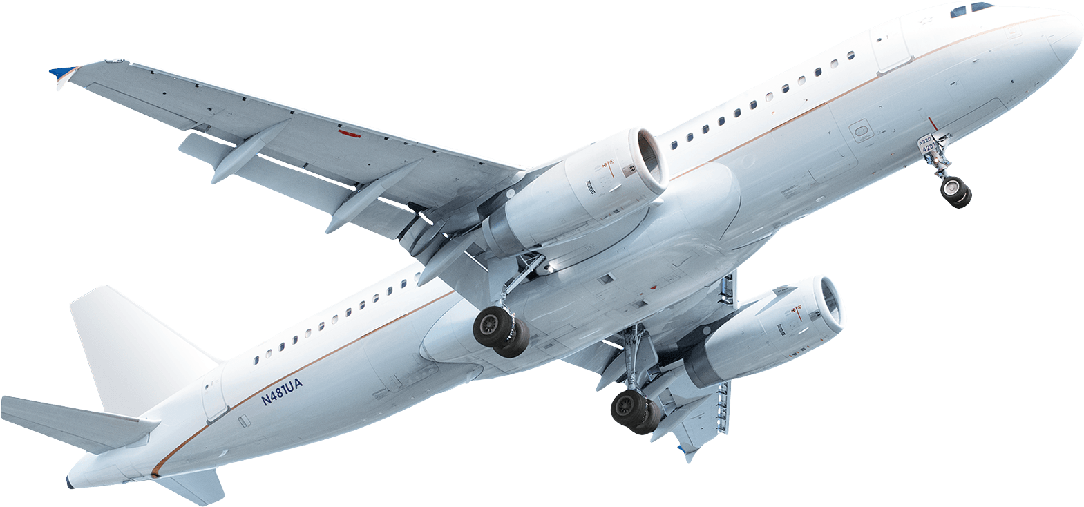

Space-Tech & Aerospace
Weather Prediction for Aviation: Predict extreme weather using deep learning.

Slide 3



Approach
Weather API
Potential Warning
Json Data
Summary
GPT API
Aviation Data

Slide 4

Tech Stack
Backend: Python
Frontend : Flutter
APIs : Aviation-Stack (Aviation Data), Openweathermap 5 Days/3 Hours(Weather Forecast), OpenAI, Open-Cage (Reverse Geocoding).

Slide 5
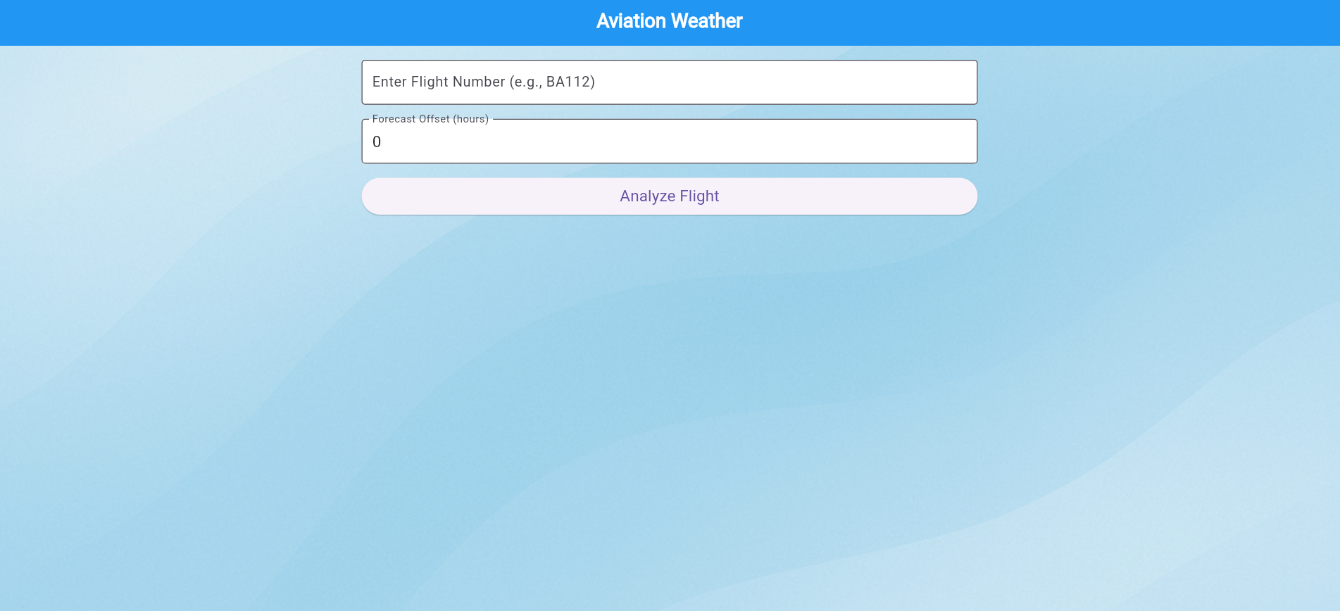
Weather prediction platform for ATC to help and
recognize patterns through weather
forcast data to a particular
flight route with the
Help of AI Model.

Slide 6
GitHub : meta0tarun/Aviators_AviationWeather_INNOTHON2.0

