Slide 1
클래스 다이어그램

Slide 2

AboutUs

Slide 3
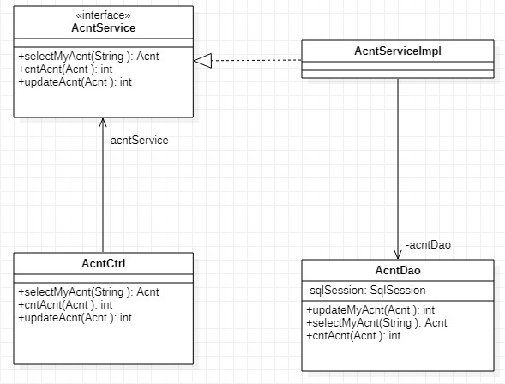
Acnt

Slide 4
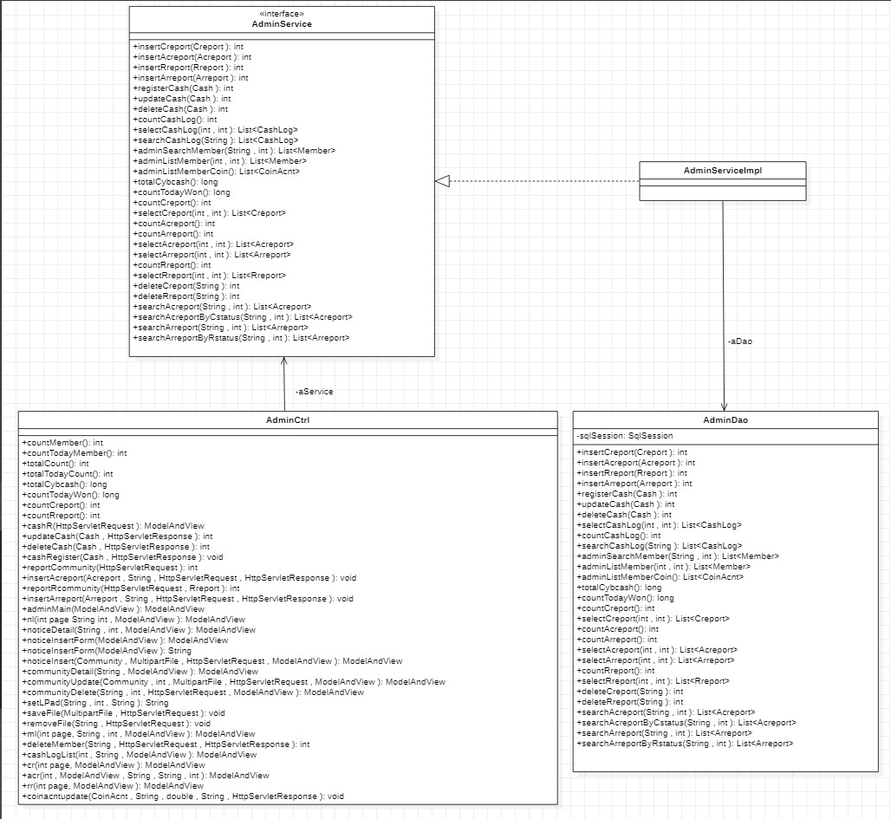
Admin

Slide 5

AfterThrowingLog

Slide 6

AroundLog

Slide 7
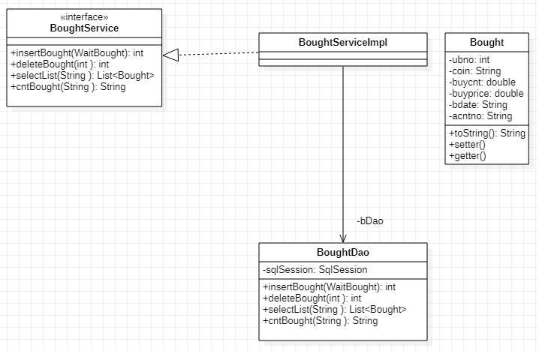
Bought

Slide 8
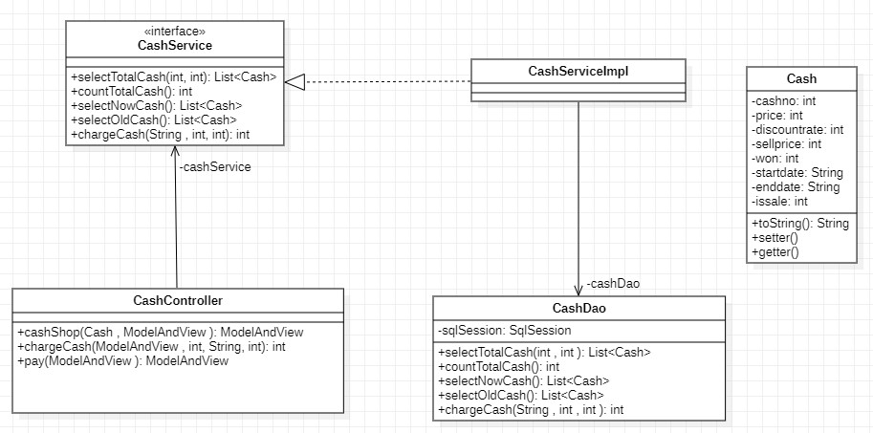
Cash

Slide 9
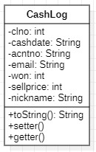
CashLog

Slide 10
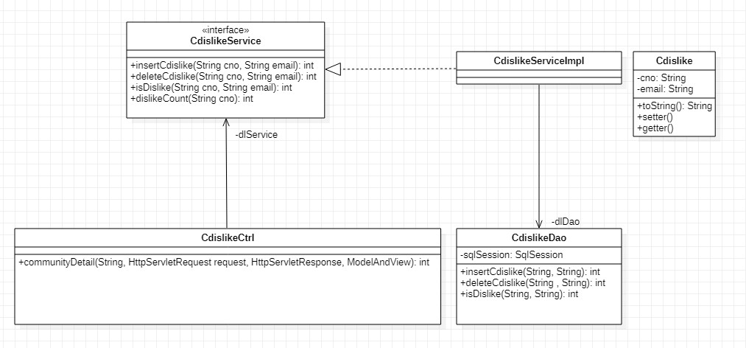
Cdislike

Slide 11
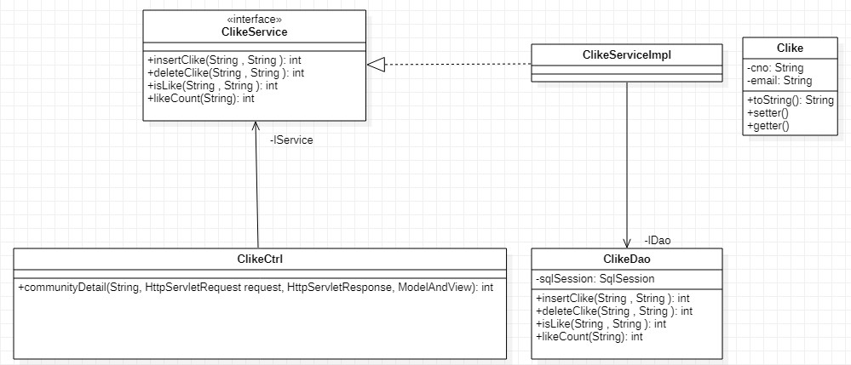
Clike

Slide 12
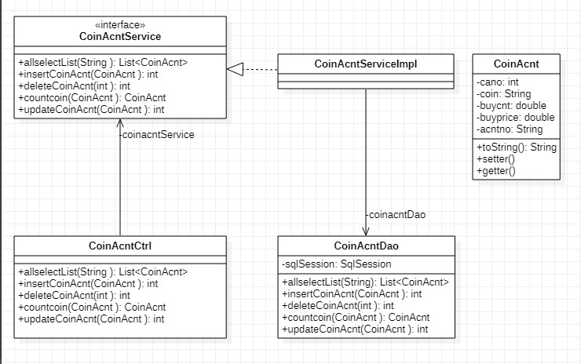
CoinAcnt
Class

Slide 13
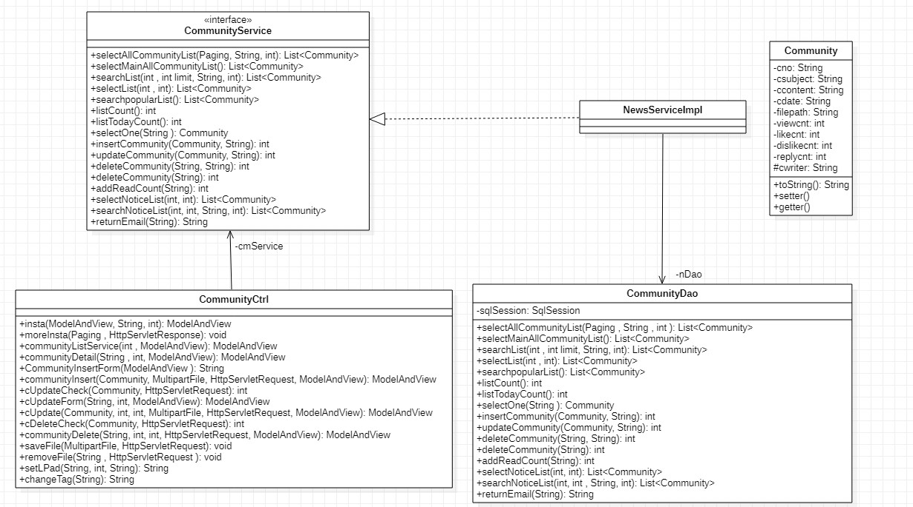
Community

Slide 14
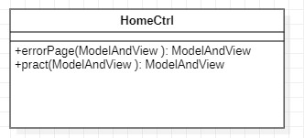
HomeController

Slide 15
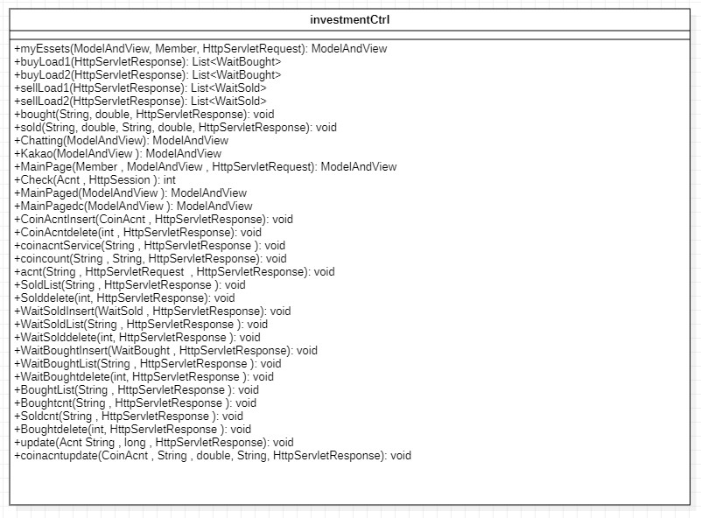
InvestmentCtrl

Slide 16

LogPointcut

Slide 17
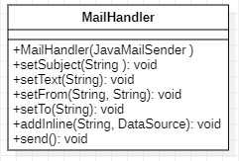
MailHandler

Slide 18
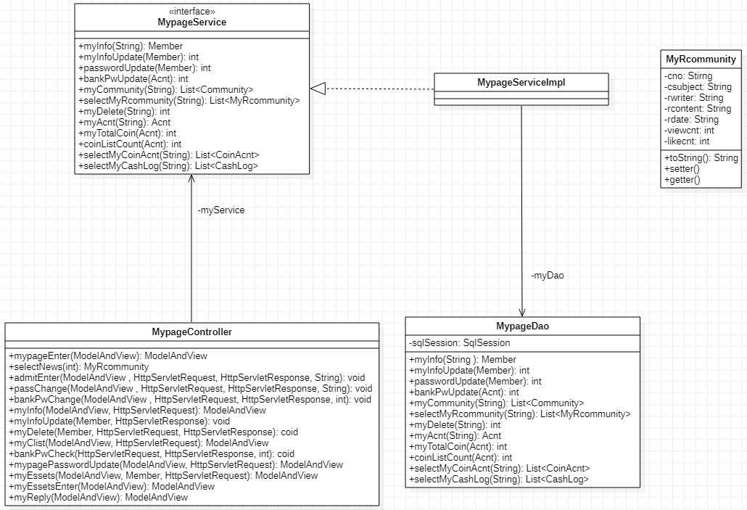
Mypage

Slide 19

ProchartController

Slide 20
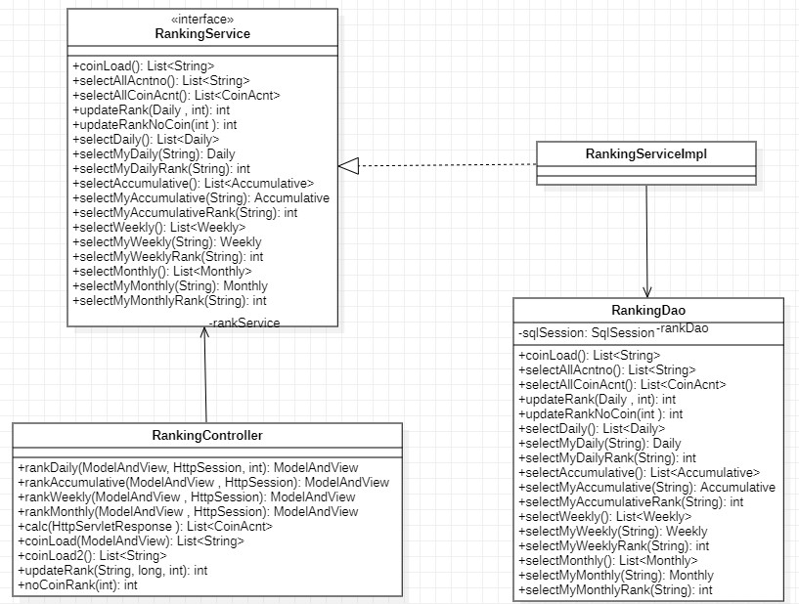
Ranking

Slide 21
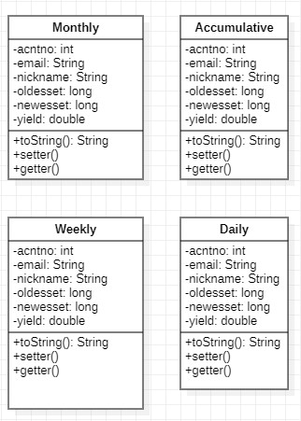
Rankingvo

Slide 22
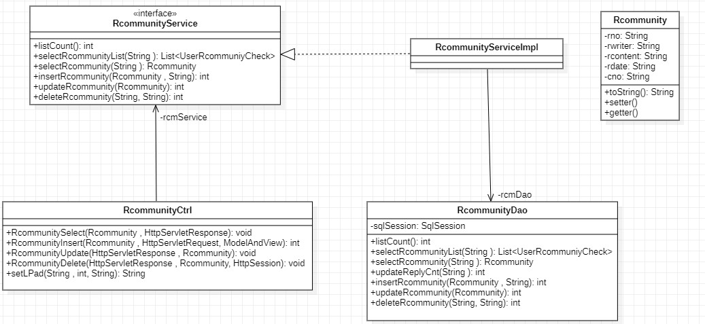
Rcommunity

Slide 23
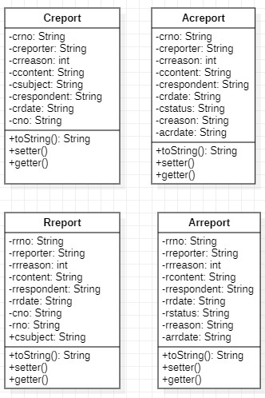
Reportvo

Slide 24
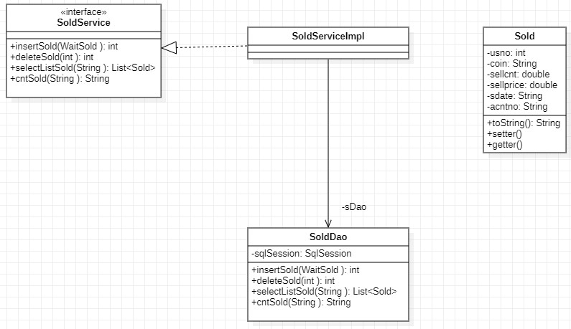
Sold

Slide 25

TempKey

Slide 26
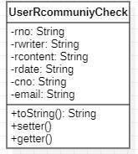
UserRcommuniyCheck

Slide 27
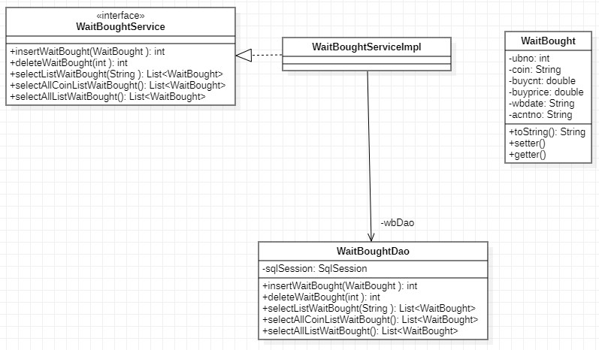
WaitBought

Slide 28
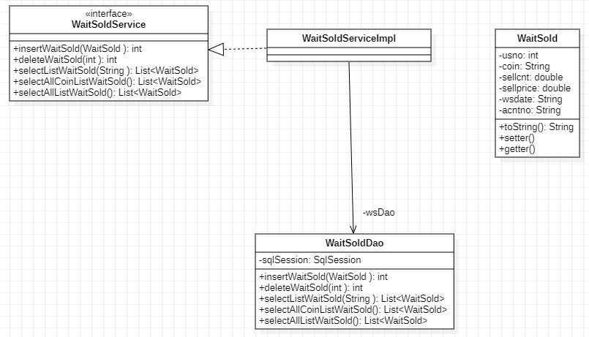
WaitSold

