Slide 1
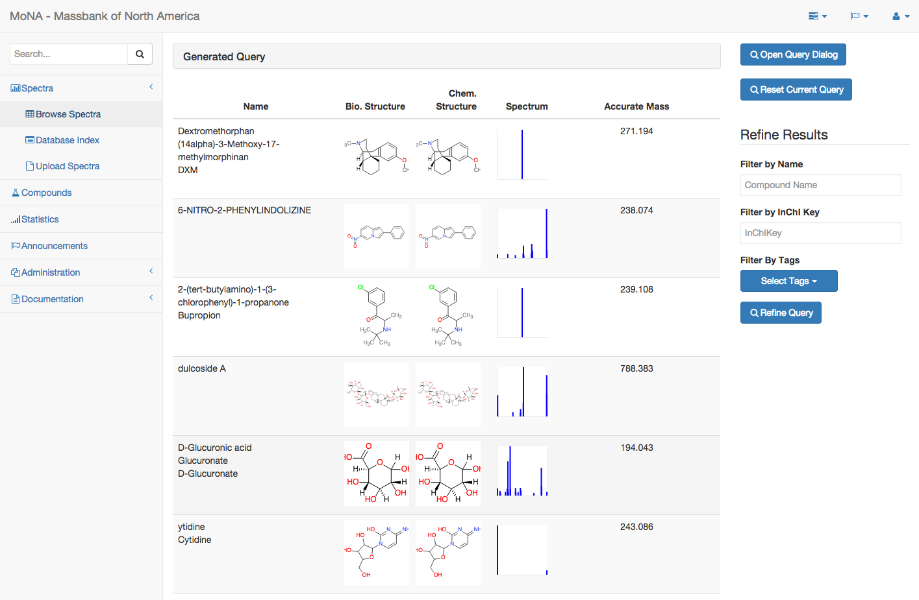
Spectrum Browser

Slide 2
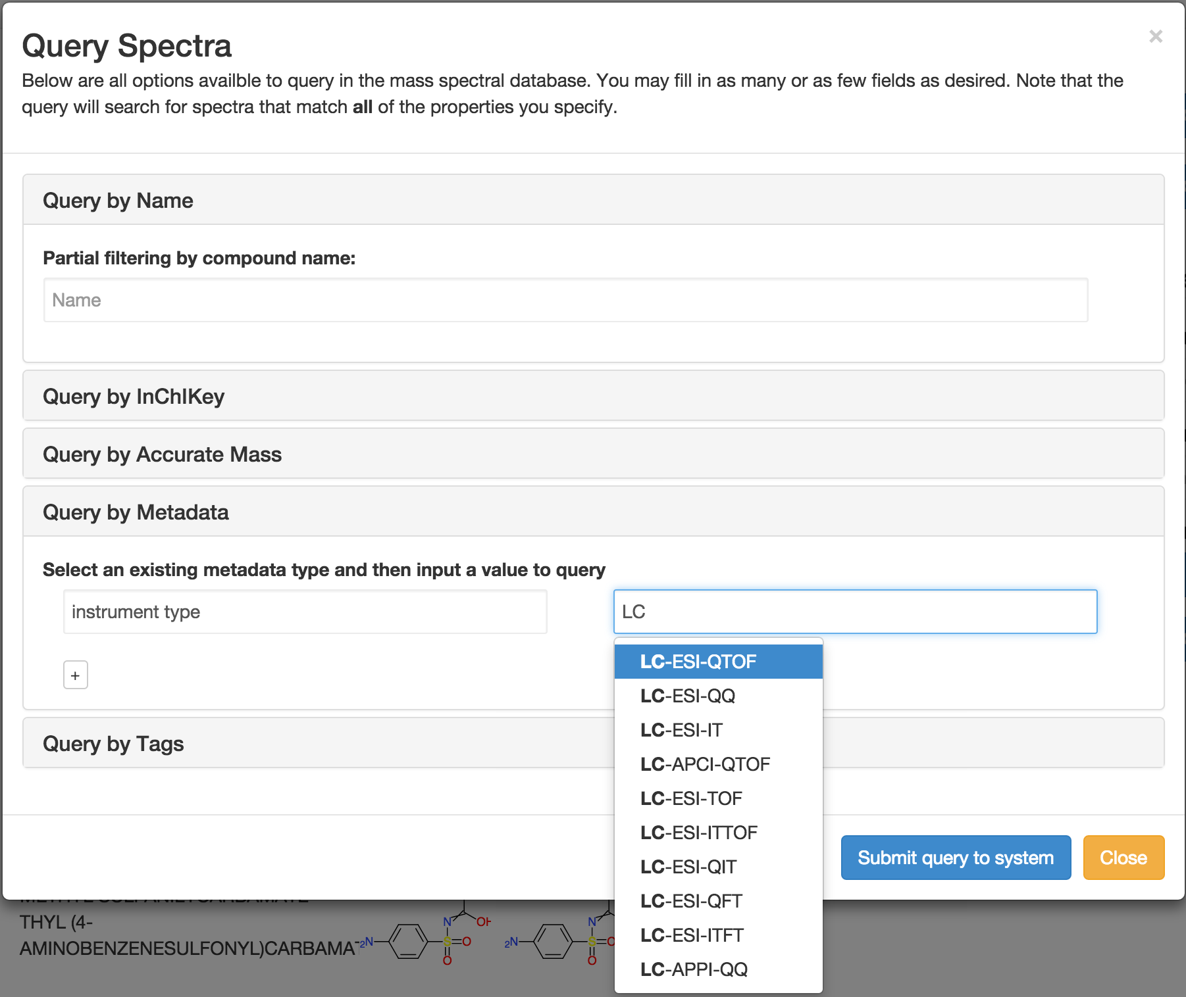

Slide 3
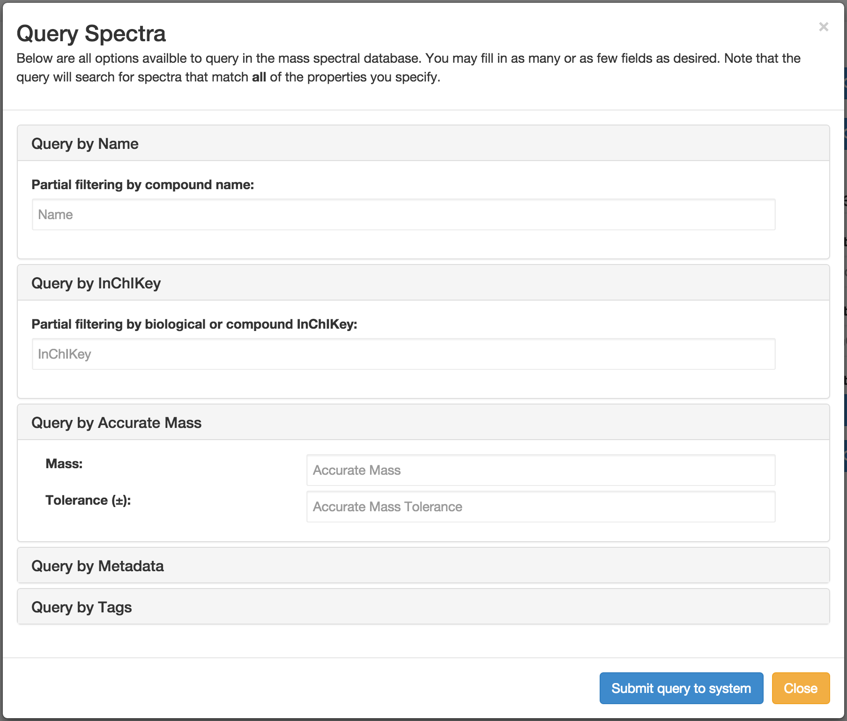
Query Dialog

Slide 4
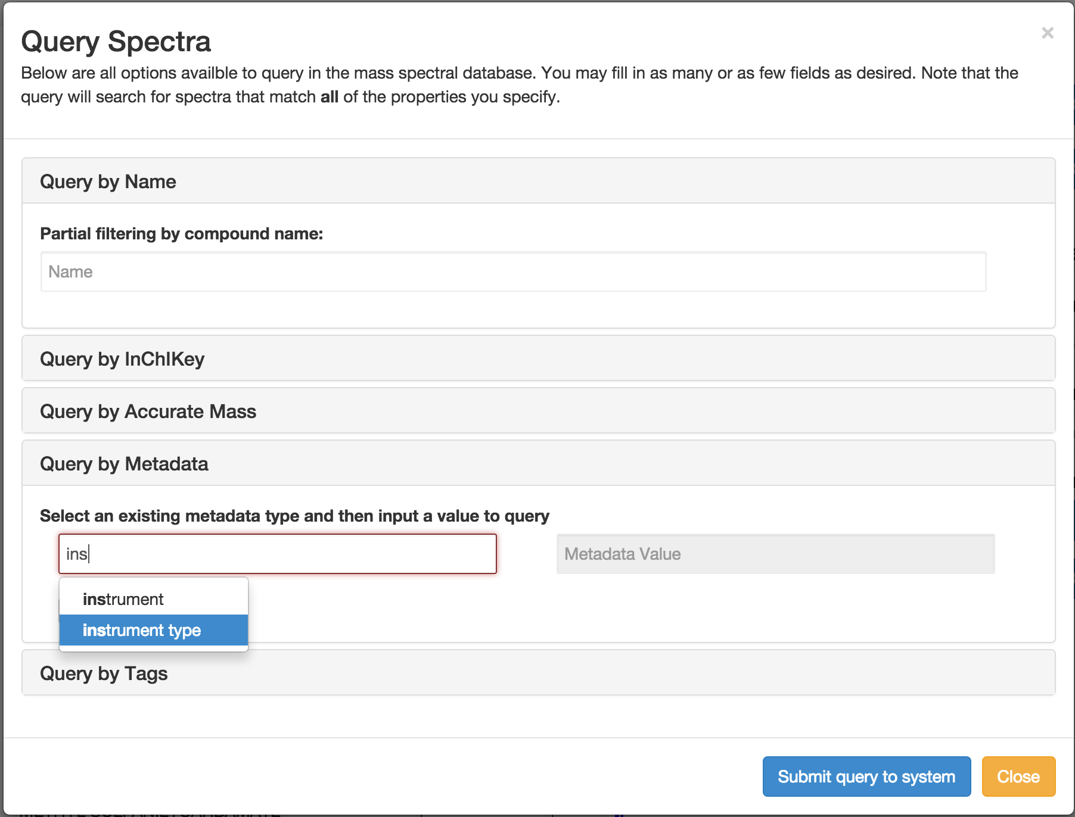
Query Dialog

Slide 5
Query Dialog

Slide 6
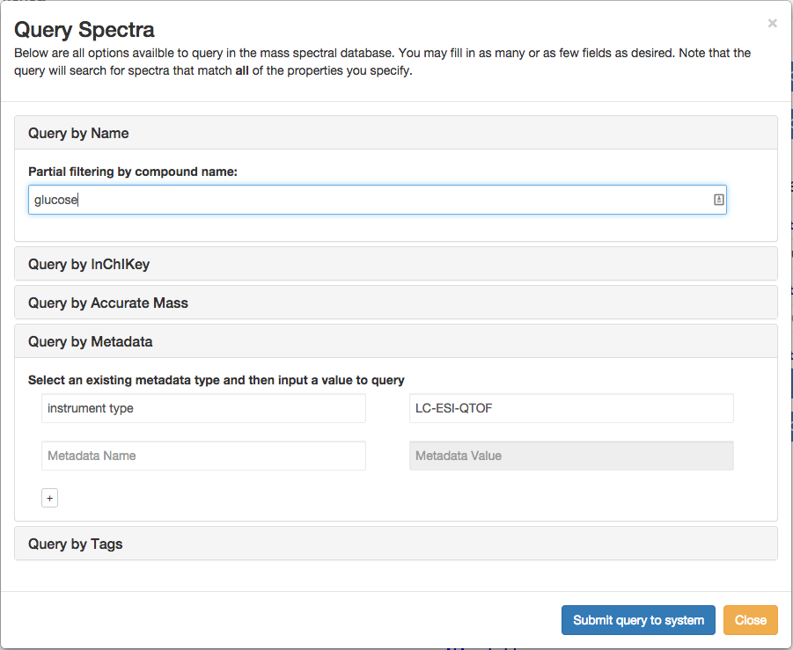
Query Dialog

Slide 7
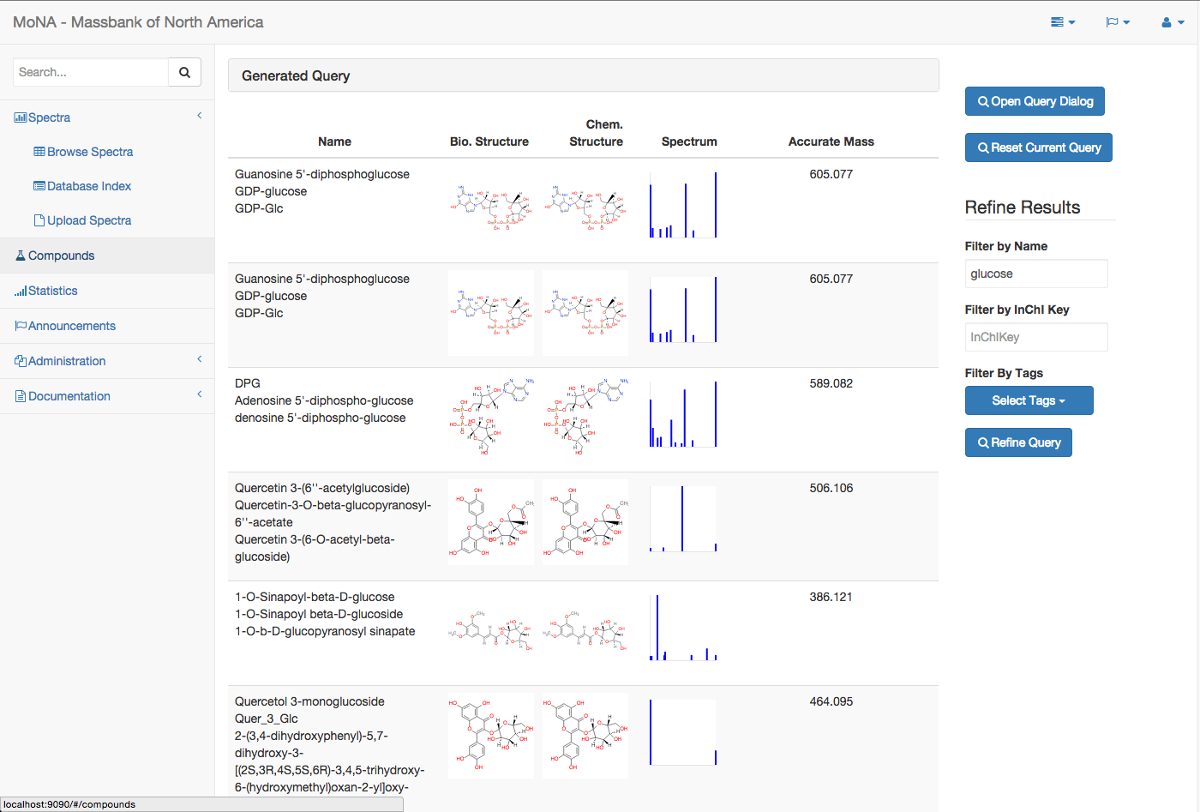
Query Results

Slide 8
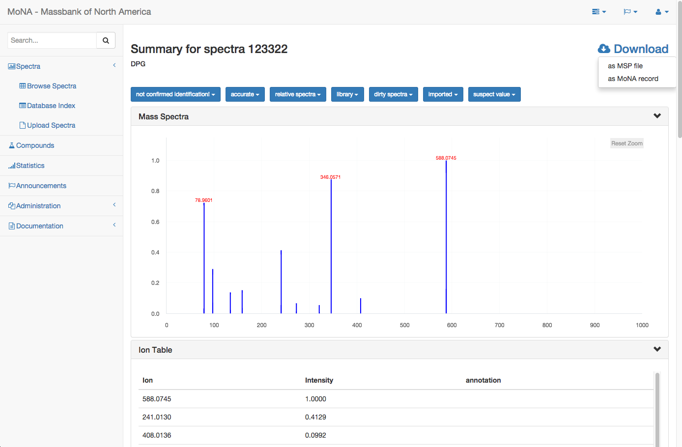
Spectrum Viewer (with download option)

Slide 9
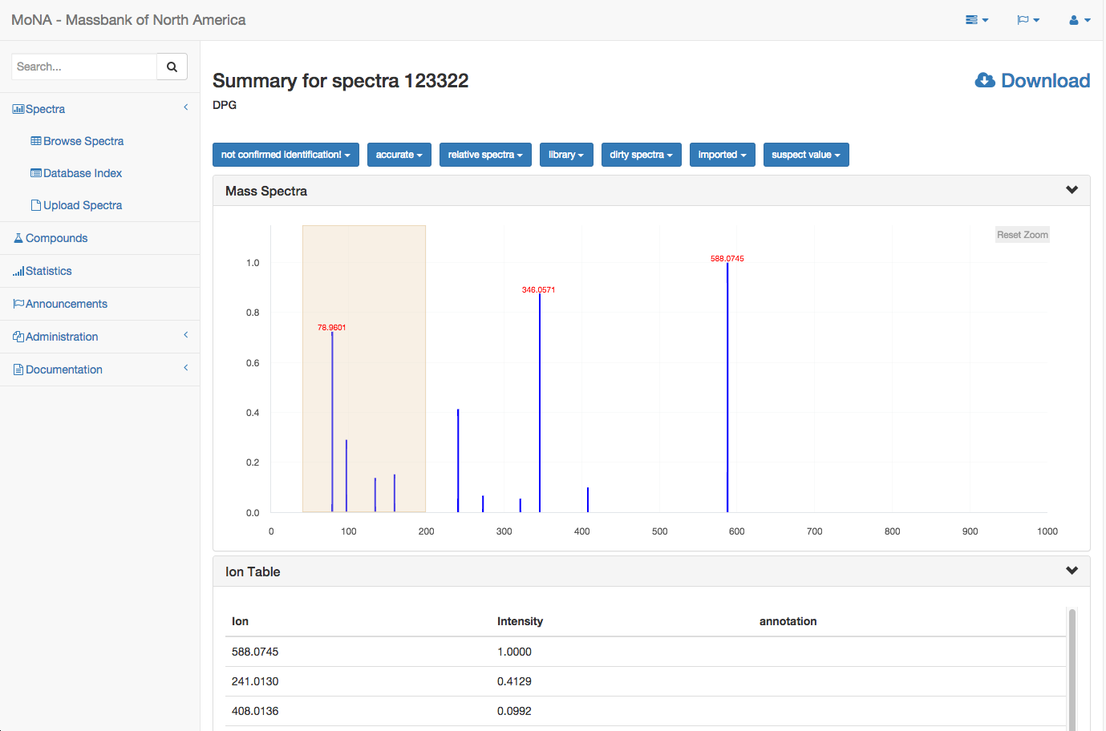
Mass Spectrum Zooming

Slide 10
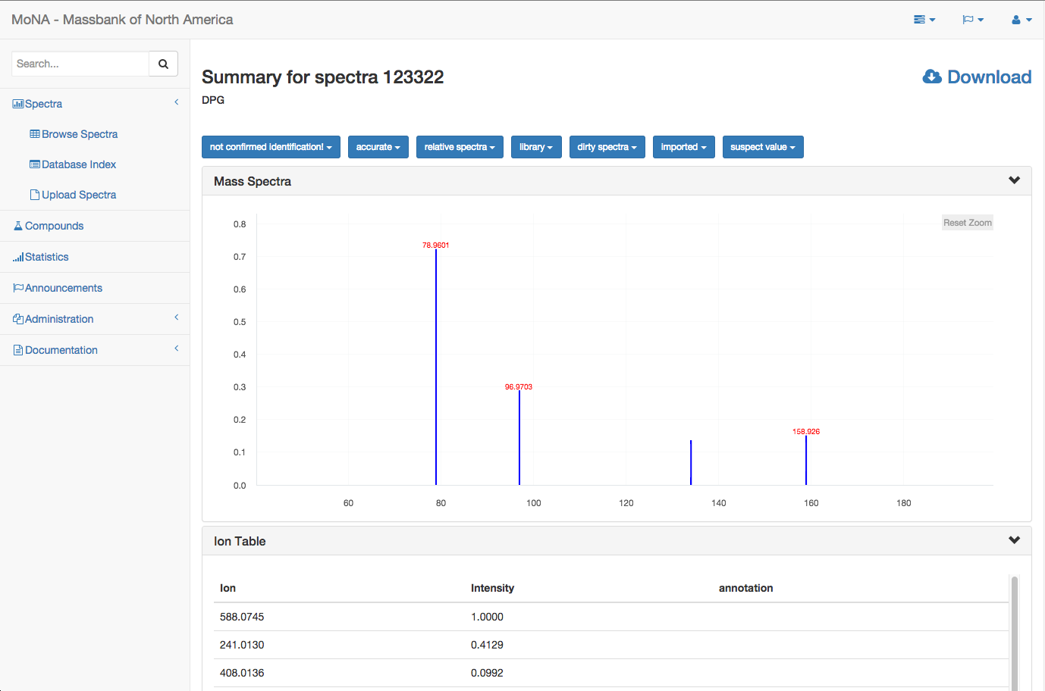
Mass Spectrum Zooming

Slide 11
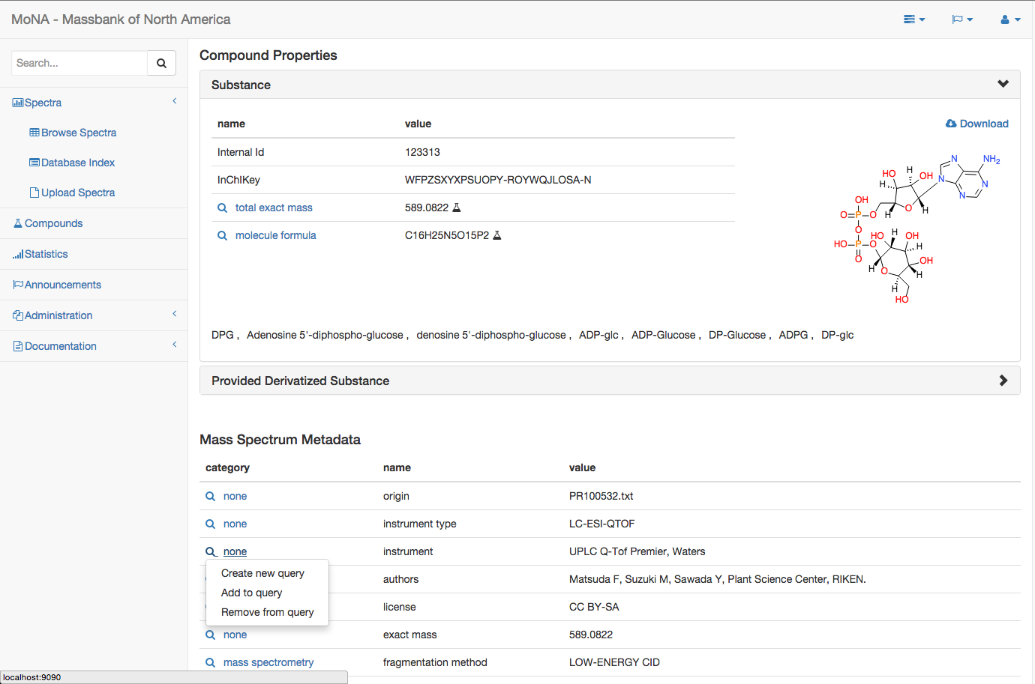
Compound Details & Spectrum Metadata

Slide 12
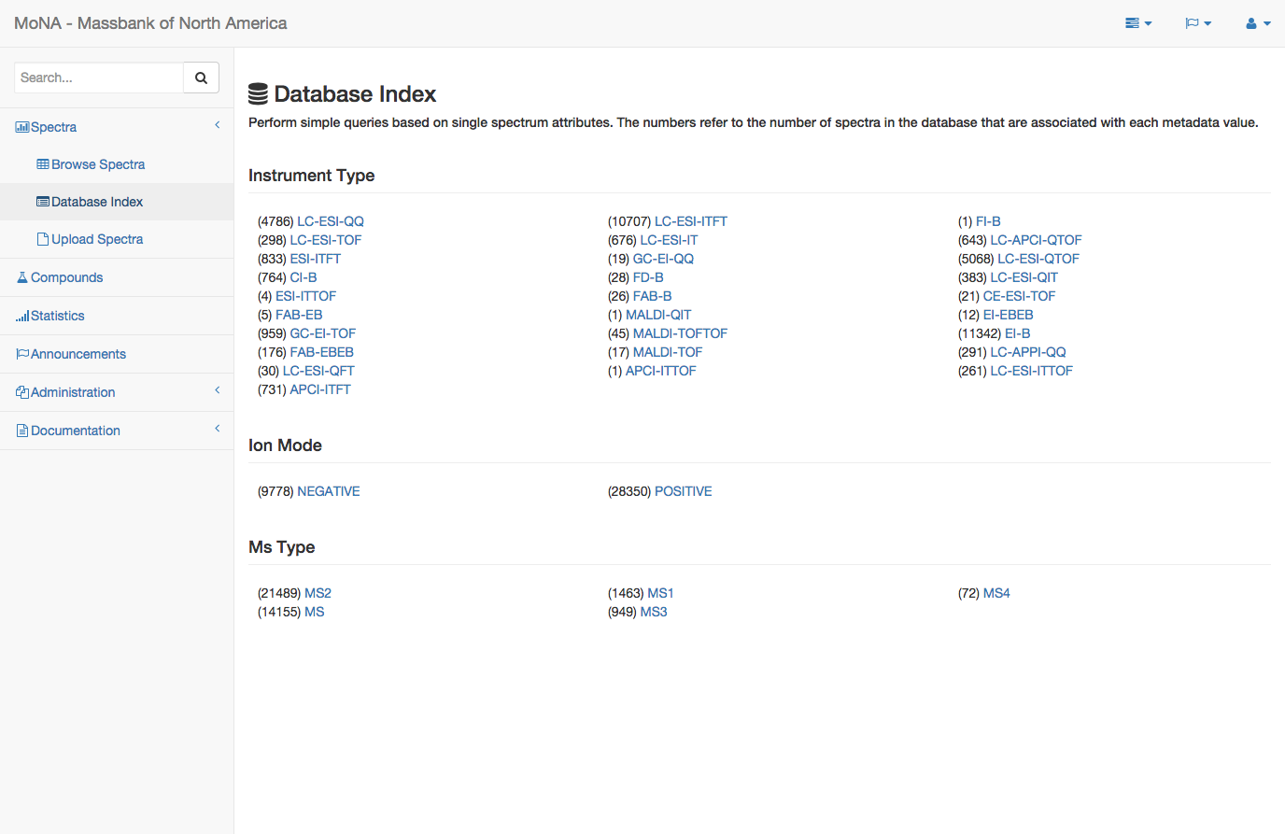
Database Index

Slide 13
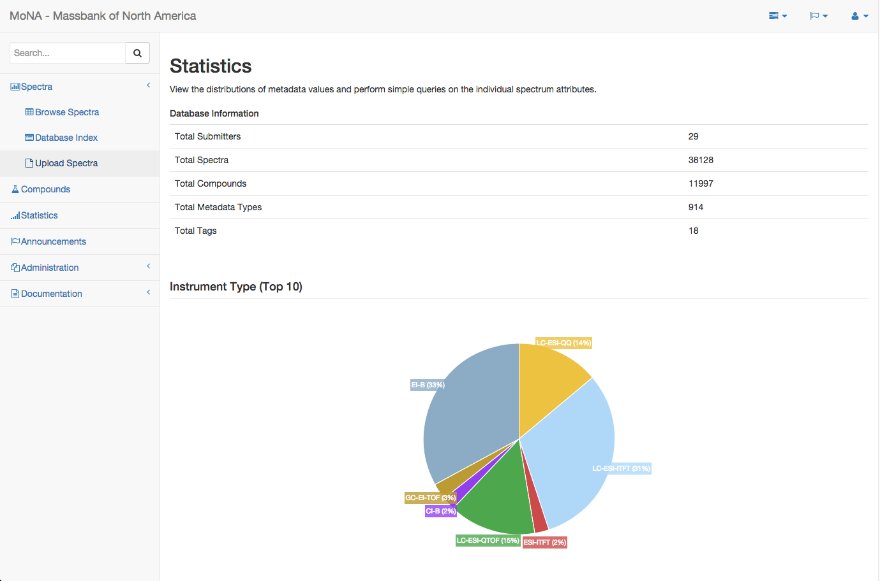
Graphical (Interactive) Statistics

Slide 14
Performance
Can import over 500k spectra a day (median is 6 spectra second)
Importing the complete MassBank repository took less than 2 hours
Performance stays constant, independent of database volume (confirmed up to 200k spectra)
Fast similarity search in under 1 second (tested on 40k spectra)
Memory efficient

Slide 15
Architecture
Uses Postgres 9.4 for datastorage and queries
Grails 2.3.8 for all server side functions and the REST api
Very simple data exchange format, based on JSON
REST api provides full access to a custom, query by example based query approach
Angular for the web client, utilizes the REST api to access all Mona functionality
Msp, MassBank, MGF, Mona file format support for upload
Support for batch data upload
Possible to access it from MSDial, Mzmine or other tools using the mentioned REST based services
Rule based autocurration service to correct and verify MetaData and Massspectral properties

