Slide 1
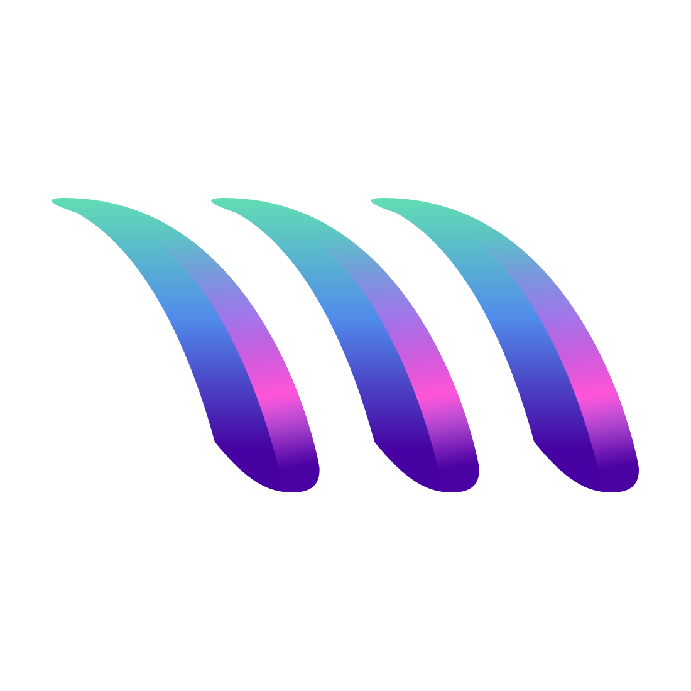
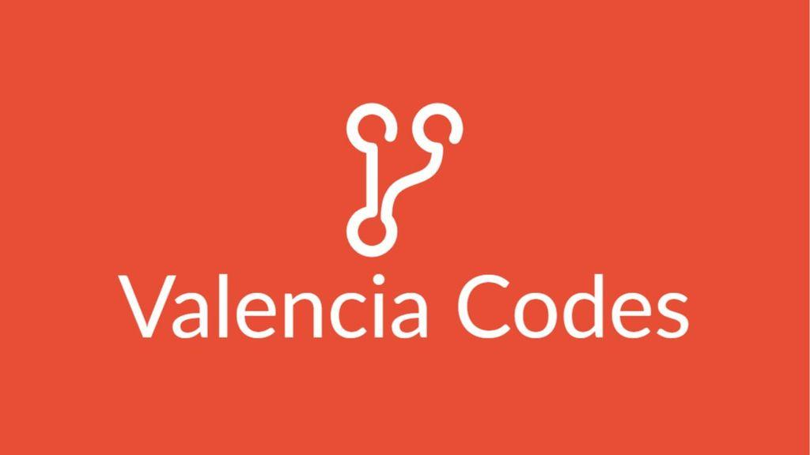

Slide 2


Slide 3
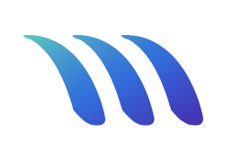


The Problem

Slide 4
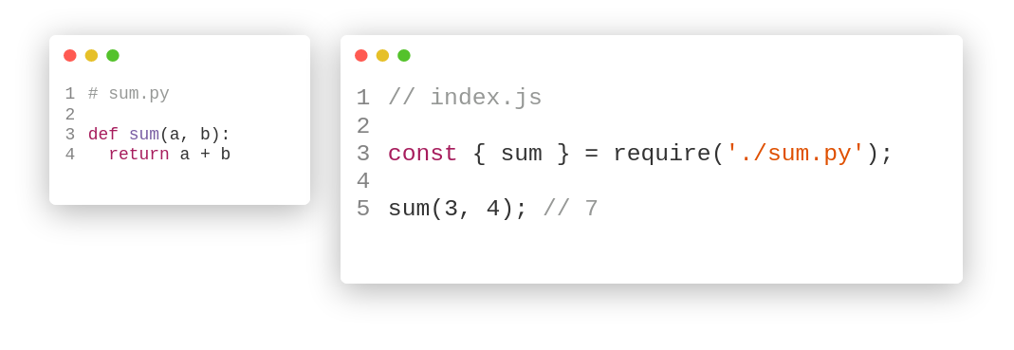
Solution (Polyglot)
MetaCall is an open source Polyglot Runtime

Slide 5
MetaCall in Production (FaaS)
Automatic generation of APIs from code.
Simplified DevOps (or almost NoOps).
Ability to interconnect multiple technologies (languages) in the same project.
Automatic scalability and parallelization.
No vendor lock-in.

Slide 6
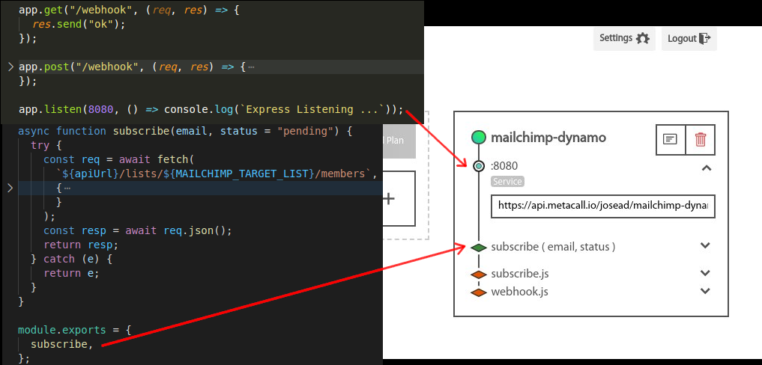
MetaCall in Production (FaaS)

Slide 7
