Slide 1
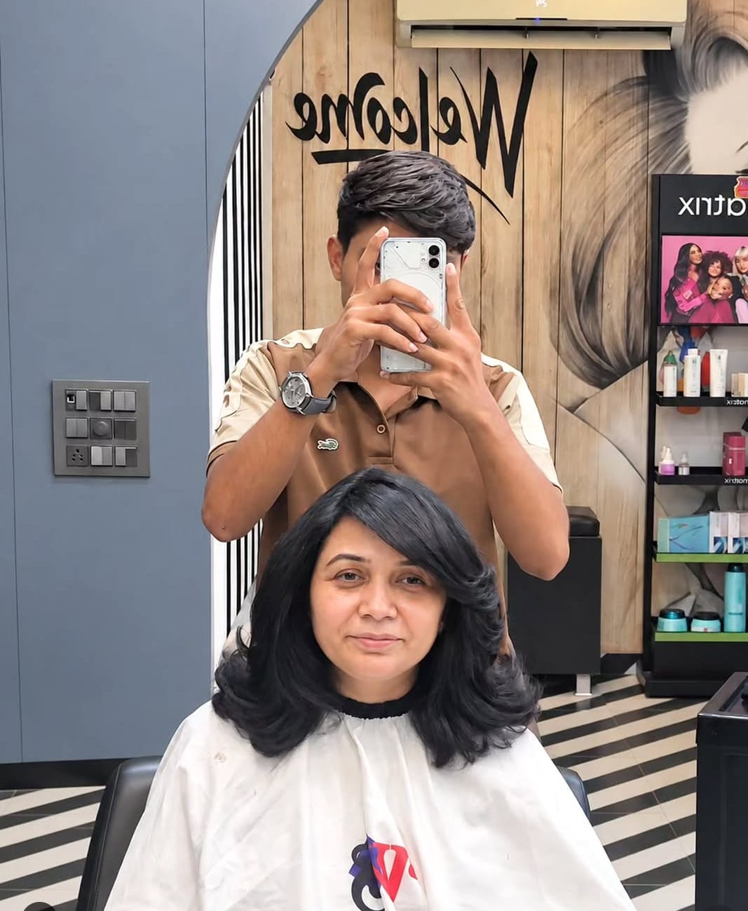

Galora
GALORA
Salon Management & Customer Booking Platform
College Project Presentation
Presented by: [Student Name]
College: [College Name] | Guide: [Guide Name]
Academic year: [Academic Year]
Notes:
SLIDE 1 - Title
Kya bolna hai: "Good morning sir/ma'am. Mera project hai Galora, jo ek Salon Management aur Customer Booking Platform hai. Isme salon owner apna poora salon manage karta hai aur customer online booking karta hai."
Tip: Apna naam, college, guide ka naam aur academic year placeholders ki jagah likh lena (slide 1 aur slide 17).
Ek line me project: "Galora = salon ka digital manager + customers ke liye booking app."

Slide 2



Introduction: what is Galora?
One platform that connects salons and their customers.
Salon owners & staff
Manage the whole salon from one dashboard.
Salon teams run appointments, customers, billing and offers from one dashboard.
Customers find a salon, pick services and book a time slot online.
A Super Admin oversees every salon on the platform.
Customers
Discover salons, compare prices, book a slot.
Platform admin
Website (React) + Mobile app (Expo)
One REST API | MongoDB database
Approve owners and monitor all salons.
Notes:
SLIDE 2 - Introduction
Kya bolna hai: Galora ek platform hai jo salon aur customer ko jodta hai. Teen type ke log isse use karte hain: (1) salon owner aur unka staff, (2) customers, (3) platform admin (Super Admin).
Technology ek line me: website React me bani hai, mobile app Expo/React Native me, dono ek hi REST API aur MongoDB database use karte hain.
Viva point: "Ek backend, do frontends (web + mobile)" - ye architecture ki strength hai.

Slide 3





Problem statement
Appointment clashes
Scattered customer data
Manual billing
Phone calls and paper diaries lead to double-booking and missed slots.
Names, visit history and spending sit in notebooks or chat apps.
Hand-written bills cause discount and tax mistakes; payments are hard to track.
The result
Time lost on paperwork, unhappy customers and missed repeat visits.
Packages on paper
Customers cannot compare
Session balances and membership discounts are easy to forget or dispute.
No easy way to see nearby salons, prices and free time slots online.
Notes:
SLIDE 3 - Problem Statement
Kya bolna hai: Chhote salons me aaj bhi kaam diary, phone call aur WhatsApp se hota hai. Isse 5 problems aati hain: appointment clash, customer data bikhra hua, manual billing me galtiyan, package/membership ka hisaab kaagaz par, aur customer ko online salon compare karne ka rasta nahi.
Dhyan rakho: Ye general problems hain, maine koi survey statistic nahi diya. Agar poochhe "data kahan hai?" to bolo: ye commonly dikhne wali problems hain jinhe project solve karta hai.

Slide 4
Project objectives
For salon owners
For customers
For the platform
Run bookings, customers and billing in one place
Control who can see and change what (roles)
Sell packages and memberships, track balances
Publish the salon so customers can find it
Find salons by city, area, service and price
See services, prices and free time slots
Book in a few taps, from web or mobile
Know the booking status (pending, confirmed)
Approve new salon owners before access
Suspend or activate salons when needed
Keep a history of important actions (audit)
Notes:
SLIDE 4 - Objectives
Kya bolna hai: Teen goals hain.
Owner ke liye: ek jagah booking, customers, billing; roles se access control; packages/memberships; salon ko public karna.
Customer ke liye: salon dhoondhna, services aur price dekhna, free slot dekh kar book karna, status jaanna.
Platform ke liye: naye owner ko approve karna, salon ko suspend/activate karna, audit history rakhna.

Slide 5
Existing system vs proposed system
Area | Existing (manual) system | Galora (proposed system)
Appointments | Phone calls, paper diary | Online booking with live free slots
Customer records | Notebooks, memory, chat apps | Customer list with visits and total spend
Billing | Hand-written bills | Digital invoices, cash / UPI / card payments
Packages & memberships | Paper cards, no balance check | Plans with session balance and discount tracking
Staff access | Everyone sees everything | Owner, manager, receptionist, staff roles
Finding a salon | Word of mouth | Search by city, area, service, price, map
Notes:
SLIDE 5 - Existing vs Proposed
Kya bolna hai: Table left se right padho. Pehle appointment phone/diary se hota tha, ab live free slots ke saath online. Customer records pehle notebook me, ab list me visits aur total spend ke saath. Billing pehle haath se, ab digital invoice aur cash/UPI/card payment record. Packages, staff roles aur salon discovery bhi digital hue.
Viva point: Hum "payment gateway" nahi bolte - payment salon me hota hai aur system me record hota hai.

Slide 6





Main features and their status
Salon discovery
Appointment booking
Customers
Services
Staff
Search by city, area, service, price; map view
Live free slots; pending to confirmed flow
Visits, spend; new, regular, inactive
Price list, duration, at salon or at home
Skills, working hours, active status
Implemented
Implemented
Implemented
Implemented
Implemented
Packages
Memberships
Billing
Offers
Ratings & reviews
Session bundles with a balance ledger
Plans with discounts and a ledger
Invoices, cash / UPI / card, refunds
Discounts on chosen services and dates
Rating filter and display are ready; customers cannot submit reviews yet
Implemented
Implemented
Implemented
Implemented
Planned
Also built: in-app notifications, audit history, team invitations and roles, contact inquiries, home-service option.
Notes:
SLIDE 6 - Main Features (status ke saath)
Kya bolna hai: Ye slide honest status dikhati hai. Green "Implemented" ka matlab code me bana hua hai aur chalta hai: discovery, booking, customers, services, staff, packages, memberships, billing, offers.
Ratings & Reviews "Planned" hai: database me salon ka rating field aur search me rating filter/sort hai, lekin customer abhi review likh nahi sakta. Review module future scope hai.
Extra built features: notifications, audit history, team invitations, contact inquiries, home-service option.
Viva tip: Agar koi poochhe "reviews kyun nahi?", seedha bolo - planned hai, aur rating ka structure pehle se ready hai.

Slide 7
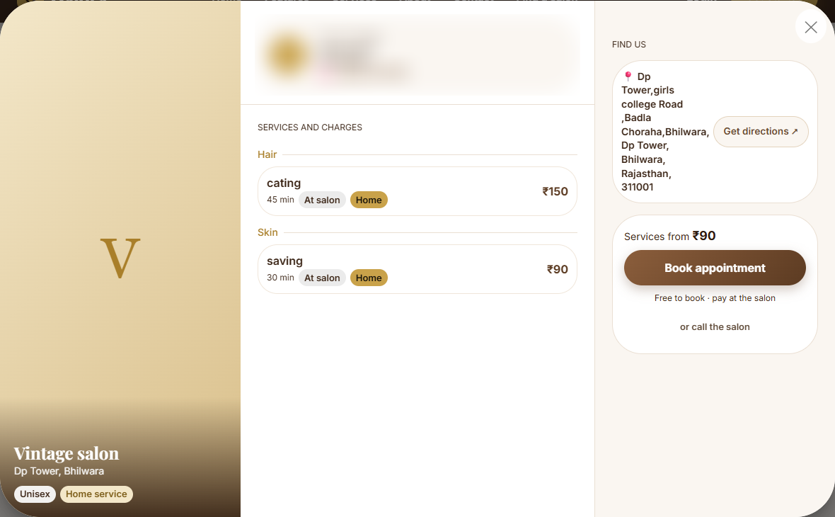
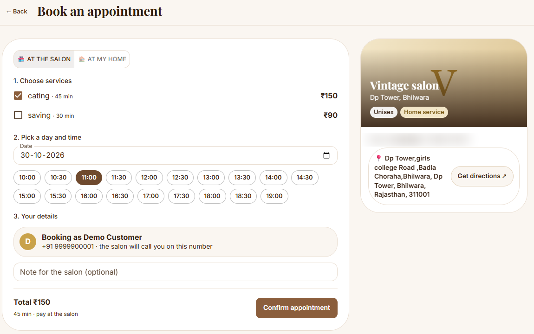
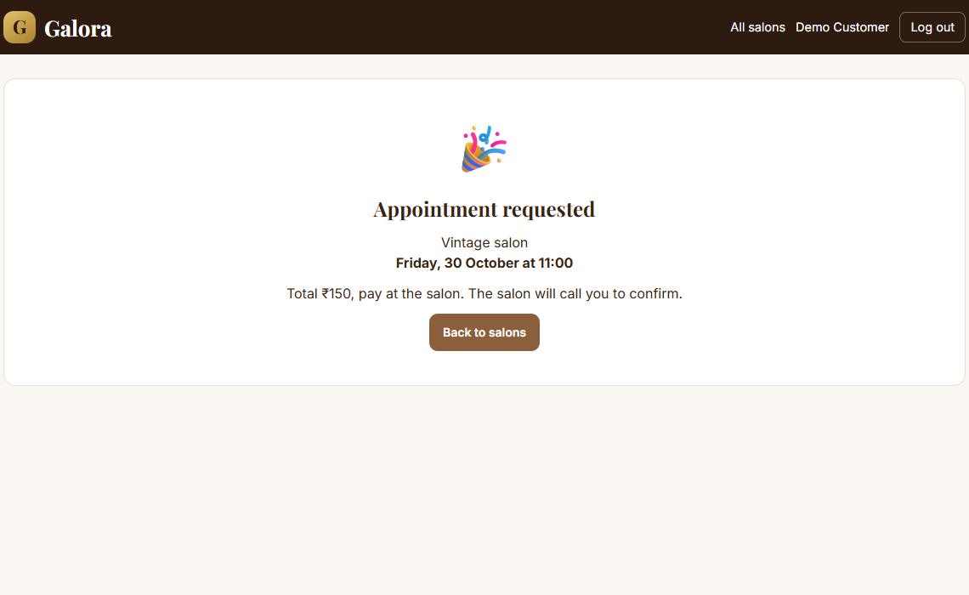
Customer workflow
Search salon
Salon details
Select services
Book appointment
Booking status
City, area, filters
Prices, map, offers
Pick services and a time slot
Login with a one-time code
Pending, then confirmed
2. Salon details and prices
3-4. Choose services and a slot
5. Request sent; owner confirms
Booking status:
Pending
Confirmed
Completed
Cancelled
Owner confirms or declines from the dashboard.
Notes:
SLIDE 7 - Customer Workflow
Kya bolna hai: Customer ka safar 5 steps me: salon search -> salon details (services, price, map) -> services choose -> appointment book -> status.
Booking ke time customer ko login karna padta hai (one-time code se). Dev mode me code screen par dikh jata hai, production me email/SMS se jayega.
Booking pehle "Pending" hoti hai. Owner dashboard se Confirm ya Decline karta hai. Baad me Completed ya Cancelled.
Screenshots asli project ke hain (demo test data ke saath).

Slide 8
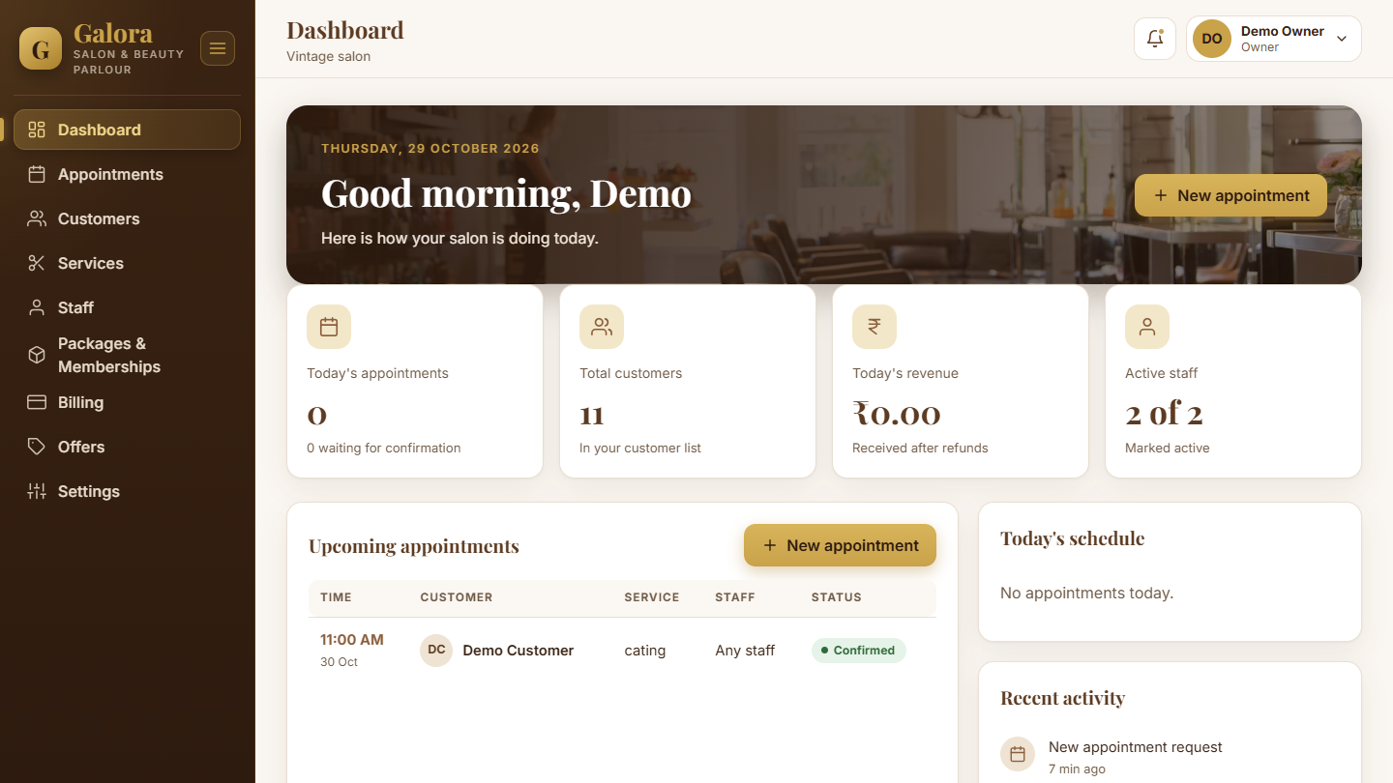

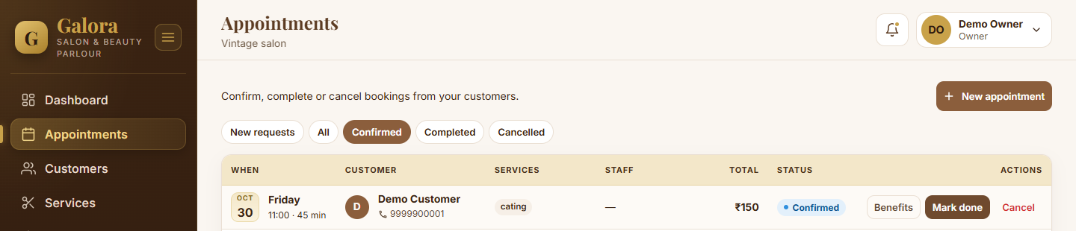

Salon owner dashboard
Sidebar modules
Dashboard
Appointments
Customers
Services
Staff
Packages & Memberships
Billing
Offers
Settings
Roles: Owner, Manager, Receptionist, Staff
Each role sees only the pages it is allowed to use.
Notes:
SLIDE 8 - Salon Owner Dashboard
Kya bolna hai: Ye owner ka main screen hai: aaj ki appointments, total customers, aaj ka revenue, active staff, upcoming appointments.
Left menu ke 9 modules: Dashboard, Appointments, Customers, Services, Staff, Packages & Memberships, Billing, Offers, Settings.
Roles: Owner, Manager, Receptionist, Staff. Har role ko sirf wahi pages dikhte hain jinki permission hai (jaise memberships plan sirf owner bana sakta hai).
Neeche wala screenshot Confirmed booking ka hai - "Mark done" se booking complete hoti hai.

Slide 9
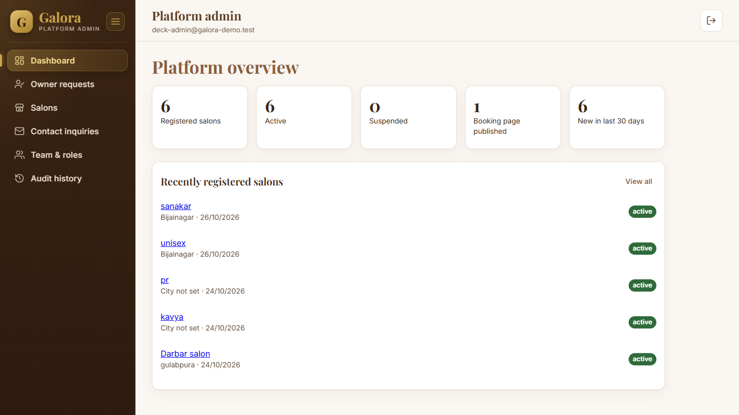
Platform admin (Super Admin)
Salon owner
Works inside ONE salon: bookings, customers, billing, staff, offers.
Super Admin
Sees ALL salons and platform numbers
Approves or rejects new owner requests
Creates salons; sets them active or suspended
Reads contact inquiries and platform audit history
Owner sign-up flow
Owner registers
Super Admin approves
Email verified
Owner sets up salon
Notes:
SLIDE 9 - Platform Admin / Super Admin
Kya bolna hai: Salon owner sirf apne ek salon ke andar kaam karta hai. Super Admin poore platform ko dekhta hai: kitne salons, kitne active/suspended, naye owner requests, users, inquiries, audit.
Sign-up flow: owner register karta hai -> Super Admin approve karta hai -> email verify hota hai -> owner salon set up karta hai. Isse fake salons rukte hain.
Super Admin ka role database me user ke platformRole = admin se banta hai, aur ye command se hi set hota hai, API se nahi (security ke liye).

Slide 10





Technology stack
Frontend (website)
Backend (API)
Database
React 19 + Vite 8
Material UI (MUI 9)
React Router, TanStack Query
React Hook Form + Zod
Node.js + Express 5
Mongoose 9 (ODM)
JWT, bcrypt, Helmet
Zod, rate limiting, Nodemailer
MongoDB
Replica set for transactions
24 collections (Mongoose models)
Mobile app
Testing
React Native 0.88 + Expo 58
React Navigation
TanStack Query, shared REST API
Node test runner + Supertest
137 backend tests, all passing
Notes:
SLIDE 10 - Technology Stack
Kya bolna hai: Frontend: React 19 + Vite + Material UI, forms ke liye React Hook Form + Zod, server data ke liye TanStack Query.
Backend: Node.js + Express 5, database ke liye Mongoose, security ke liye JWT, bcrypt, Helmet, rate limiting, Zod validation, emails ke liye Nodemailer.
Database: MongoDB (replica set, taaki transactions chal sakein - jaise billing aur booking).
Mobile: React Native + Expo.
Testing: Node ka built-in test runner + Supertest; 137 backend tests pass hote hain.

Slide 11
System architecture
Clients
REST API (Node.js + Express)
Database
Website
React + Vite + MUI
Security headers, CORS, rate limit
MongoDB
24 collections
Replica set (transactions)
HTTPS + JSON
Authentication (JWT, sessions)
Mongoose
Role and salon check (RBAC)
Mobile app
React Native + Expo
Input validation (Zod)
Modules: bookings, billing, customers, packages, memberships, offers, platform
The website and the mobile app share the same API.
Email (SMTP via Nodemailer) and SMS / OTP (Twilio adapter)
In development, codes are written to a local log instead of being sent.
Notes:
SLIDE 11 - System Architecture
Kya bolna hai: Left se right padho. Client (website ya mobile app) HTTPS par JSON request bhejta hai REST API ko. API ke andar layers hain: security headers/CORS/rate limit -> authentication -> role aur salon check -> input validation -> phir module ka kaam (bookings, billing...). API Mongoose ke through MongoDB se baat karti hai.
Email aur SMS/OTP ke liye alag adapters hain; development me code log file me likha jata hai.
Viva point: "Frontend directly database se baat nahi karta - sirf API ke through." Isse security aur control milta hai.

Slide 12
Database design
User (via Membership role)
Branch (hours)
Service
24 collections in 7 groups
Core (6)
User, Salon, Branch, Membership, Session, VerificationToken
Catalogue (3)
Service, Staff, Offer
Customers & booking (3)
Customer, CustomerOtp, Booking
Packages (3)
Package, CustomerPackage, PackageLedger
Memberships (3)
MembershipPlan, CustomerMembership, MembershipLedger
Billing (3)
Invoice, Payment, InvoiceCounter
Operations (3)
Notification, AuditEvent, ContactInquiry
Staff
Salon
Offer
Customer
Package > CustomerPackage
Booking
Invoice > Payment
Every record that belongs to a salon stores its salonId, so one salon never sees another salon's data.
Notes:
SLIDE 12 - Database Design
Kya bolna hai: MongoDB me 24 collections hain (Mongoose models). Center me Salon hai - ye "tenant" hai. Salon se jude records: Branch (working hours), Service, Staff, Offer, Booking, Customer, Invoice/Payment, Package, Membership plan.
User aur Salon ka rishta Membership collection se banta hai, jisme role (owner/manager/receptionist/staff) store hota hai. Is wajah se ek user alag-alag salon me alag role rakh sakta hai.
Har salon-related record me salonId hota hai, isliye ek salon dusre salon ka data nahi dekh sakta (multi-tenant).
Packages aur memberships me "Ledger" collections hain, jisme har use/adjustment ka record hota hai.

Slide 13
Security & authentication
1
Login
Verified in the code
Email + password (customers use a one-time code)
Passwords hashed with bcrypt
Login lock: 5 wrong tries lock the account for 15 minutes
Role permission table (deny by default)
Salon data separated per salon (tenant tests pass)
Rate limiting, Helmet headers, single-origin CORS
Secrets in .env; server refuses to start if config is invalid
New owners need Super Admin approval
2
Tokens
Access token (15 min) + refresh token (7 days, httpOnly cookie)
3
Every API call
Check token, salon membership and role permission
4
Validate
Zod checks all input before any database work
Record
Before going live: turn on HTTPS (secure cookies) and connect real email / SMS providers.
5
Important actions are saved in the audit history
Notes:
SLIDE 13 - Security & Authentication
Kya bolna hai: Flow: login -> server access token (15 min) aur refresh token (7 din, httpOnly cookie) deta hai -> har API call par token, salon membership aur role permission check hoti hai -> input Zod se validate hota hai -> important actions audit history me save hote hain.
Verified items: bcrypt password hashing; 5 galat attempts par 15 minute lock; role permission table (jo likha nahi wo allowed nahi); tenant isolation tests; rate limiting + Helmet + CORS; .env secrets.
Honest note: Go-live se pehle HTTPS (secure cookies) aur real email/SMS providers lagane honge - abhi development setup hai.

Slide 14
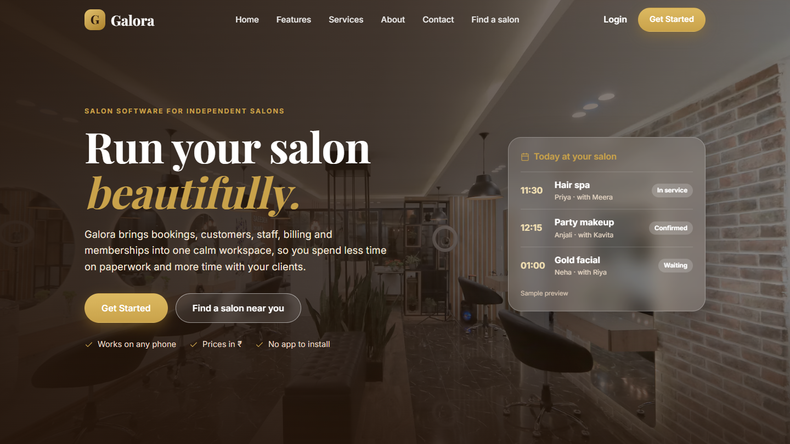
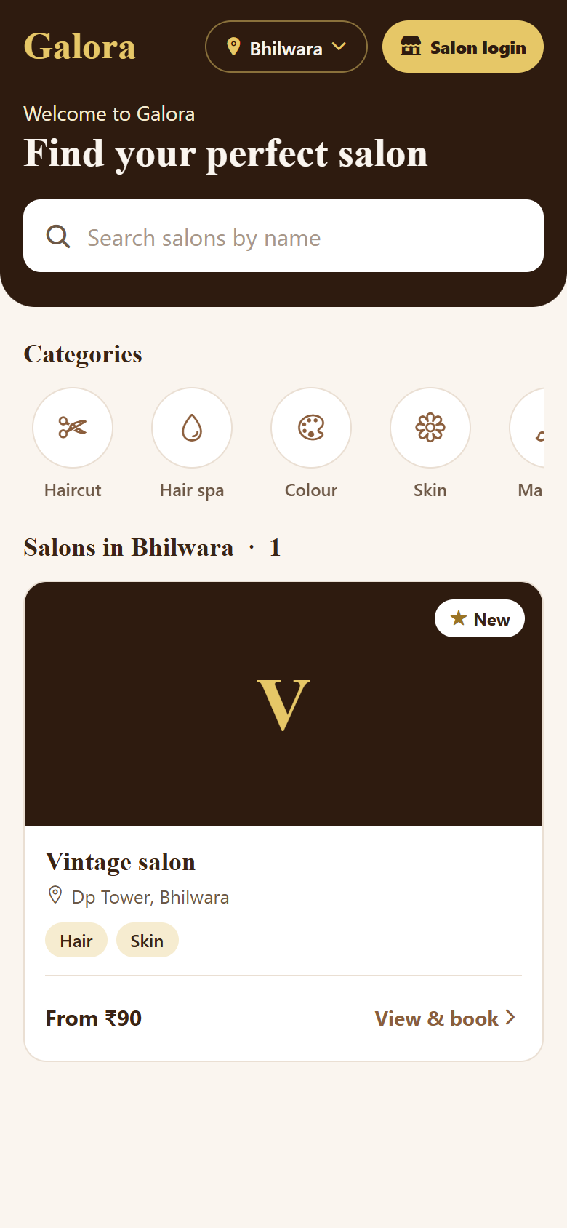
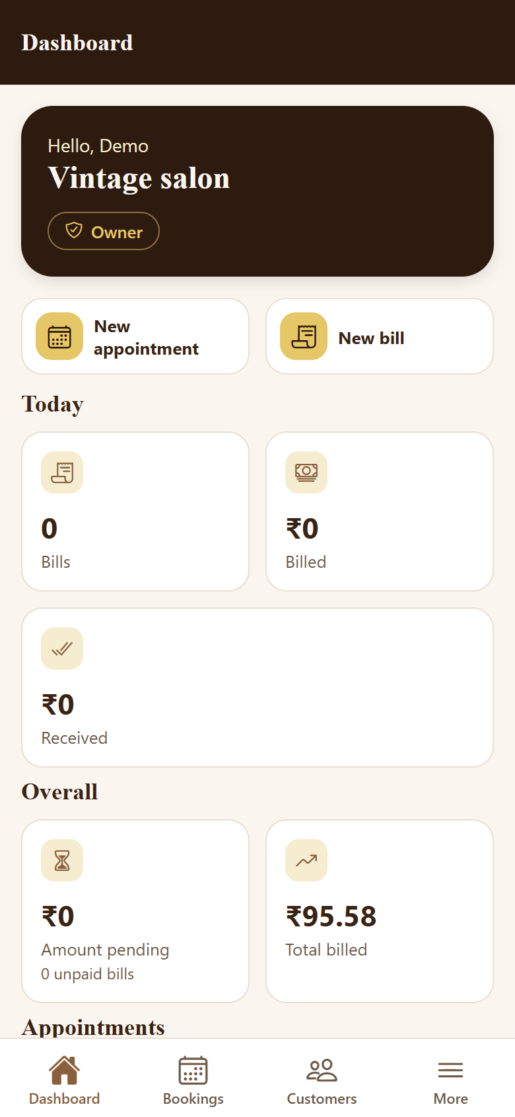
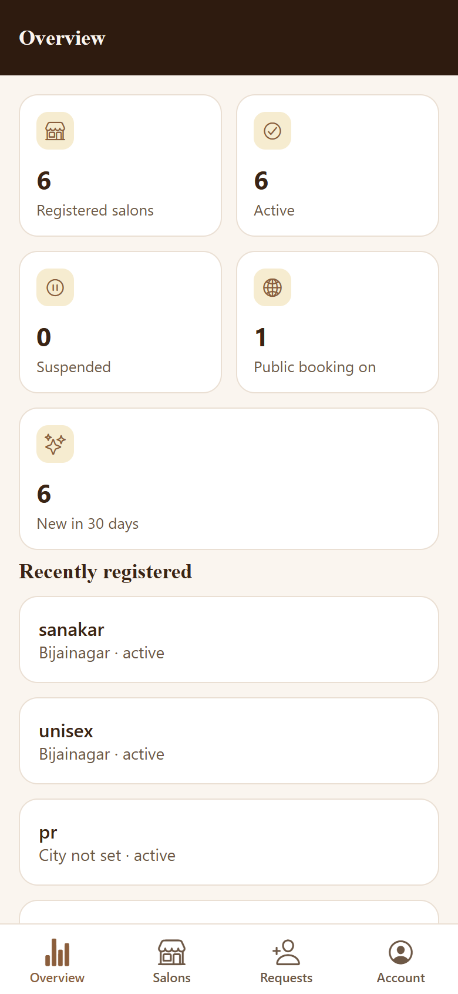
Website and mobile application
Customer home
Owner dashboard
Admin overview
Website: working
Landing page, salon search, customer booking, owner and admin dashboards.
Mobile app: in development
Customer, salon-team and admin screens run in Expo. Store release is pending.
Notes:
SLIDE 14 - Website and Mobile App
Kya bolna hai: Website poori chalti hai: landing page, salon search, customer booking, owner aur admin dashboards.
Mobile app Expo/React Native me bani hai aur uski screens customer, salon team aur admin ke liye chalti hain (maine browser preview me verify ki). Isliye label "in development" hai - app store/play store par release abhi nahi hui.
Teen phone screenshots: customer home (salon search), owner dashboard, admin overview.
Viva tip: Mobile ke baare me confidently bolo "working screens hain, release pending hai."

Slide 15


Benefits and future scope
Benefits (available today)
Future scope (planned, not built)
Online discovery helps customers find the salon
Fewer clashes: customers see only free slots
Packages, memberships and offers bring customers back
Digital bills and customer history save time
Roles keep staff access safe
One platform for web and mobile
Ratings & reviews: let customers rate after a visit
Online payments: pay through a gateway (today: pay at salon)
Reminders: SMS / email / push before appointments
Reports: revenue and customer analytics
Mobile release: publish the app to the stores
Customer bookings page on the website (today on mobile only)
Notes:
SLIDE 15 - Benefits and Future Scope
Kya bolna hai: Benefits jo aaj milte hain: online discovery, free-slot booking se kam clash, packages/memberships/offers se repeat customers, digital billing, role-based safety, ek platform web aur mobile ke liye.
Future scope (planned, abhi bana nahi): ratings & reviews, online payment gateway, reminders (SMS/email/push), reports aur analytics, mobile app ka store release, website par customer ka "My bookings" page (abhi mobile me hai).
Viva tip: Future scope ko "planned" hi bolna, "done" nahi.

Slide 16

Conclusion
One connected platform
Complete salon workflow
Built with quality
Customers, salon teams and the platform admin work on the same system.
Discover, book, serve, bill and bring customers back with packages and offers.
Role-based security and 137 passing backend tests.
Galora helps salons spend less time on paperwork and more time with customers.
Notes:
SLIDE 16 - Conclusion
Kya bolna hai: Galora teen cheezein deta hai: ek connected platform; poora salon workflow (discover, book, serve, bill, retain); aur quality (role-based security, 137 passing backend tests).
Closing line: "Galora salon ko paperwork se azaadi aur customers ko aasaan booking deta hai."

Slide 17
Thank You
GALORA
Questions?
[Student Name] | [College Name]
Guide: [Guide Name] | [Academic Year]
Notes:
SLIDE 17 - Thank You / Questions
Kya bolna hai: "Thank you. Ab main aapke sawalon ke liye taiyaar hoon."
Tip: Viva ke liye separate document "Galora_Viva_Guide" me 15 sawal-jawab diye hain. Demo ke liye pehle se backend aur frontend chalu rakhna.

