Slide 1










Meta-Analytic
Databases
Transform
Upload
Release
Update
MetaCIH
Data Format
Github
Repository
Versioning
Digital Object Identifier
Documentation
docs.metacih.org
Analyze in R
Analyze Online
metapsyTools
tools.metapsy.org
Meta-Analysis Tool
metapsy.org

Slide 2
Meta-Analytic
Databases
Transform
Upload
Release
Update
MetaCIH
Data Format
Github
Repository
Versioning
Digital Object Identifier
Documentation
docs.metacih.org
Aanalyze in R
Analyze Online
metapsyTools
tools.metapsy.org
Meta-Analysis Tool
metapsy.org

Slide 3




Meta-Research
Network Meta-analyses
Meta-Analyses (IPD, Living Systematic Reviews)
Umbrella Reviews
Meta-Analytic Research Domains (MARD)
Open Science
Evidence Maps
Meta-Science
Umbrella Reviews
Transparency &
Consistency
Comprehensive
Evidence
MARD
Re-Usability &
Accessibility
Up-to-date
Information
Statistical Software
Rapid Reviews
Research Synthesis
Methods
Living Systematic Reviews
Science Communication
Leif Michelsen, Gordo Ibáñez, Kemesh Maharjan, Popular from Noun Project

Slide 4
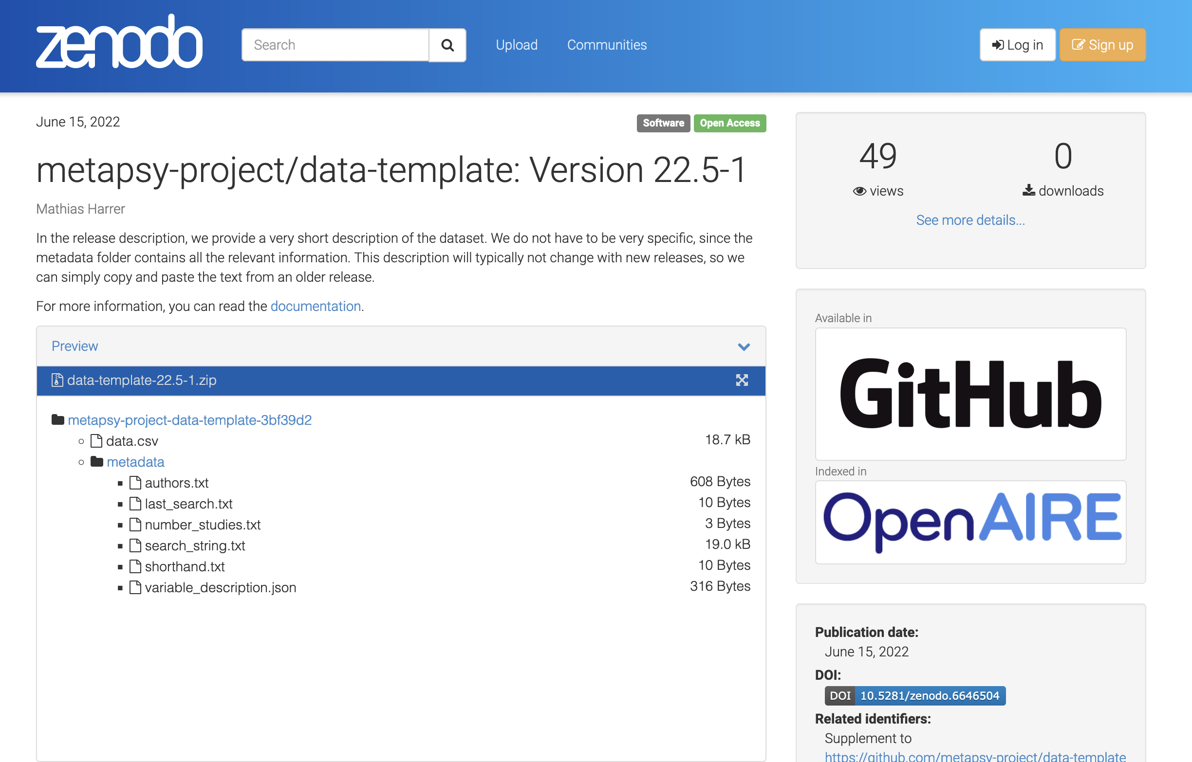
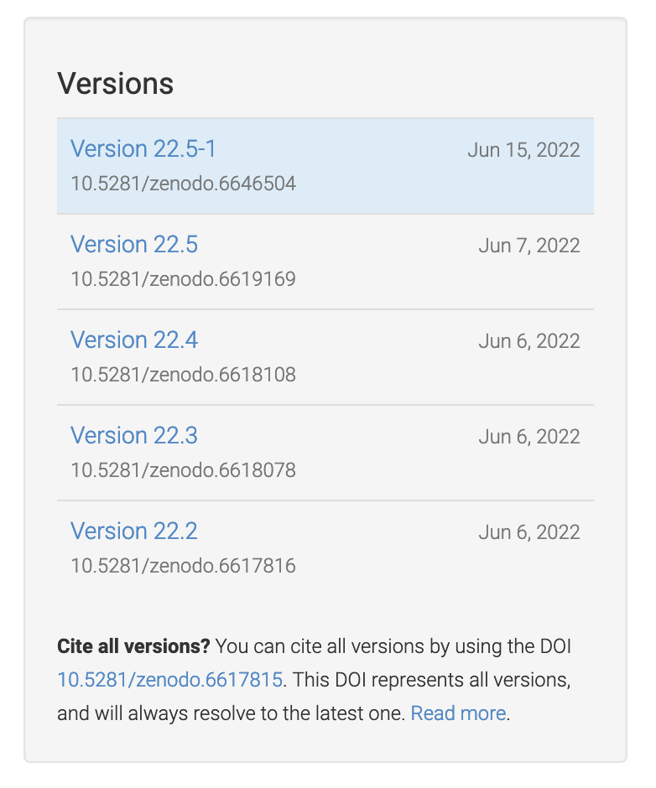
Link to the state of the GitHub repository at the latest release
Latest Database Version DOI
”Frozen” Database Repository Contents
Overall Database DOI
(Concept DOI)

