Slide 1
Vision
Database Workshop
Migration Hub Berlin
2016-01-09
Notes:
I will outline our vision of the stakeholders and their interactions with a database
If you have immediate questions feel free to interrupt
If you think something is missing or that we should focus on an aspect not mentioned in the plan, write on card

Slide 2
Goals
Provide a centralized overview of initiatives that aid newcomers for multiple stakeholders
Foster networking
Reduce duplication and offer ideas for redeployment
Facilitate data exchange
Enable liberal consumption of data
Open source and open data

Slide 3
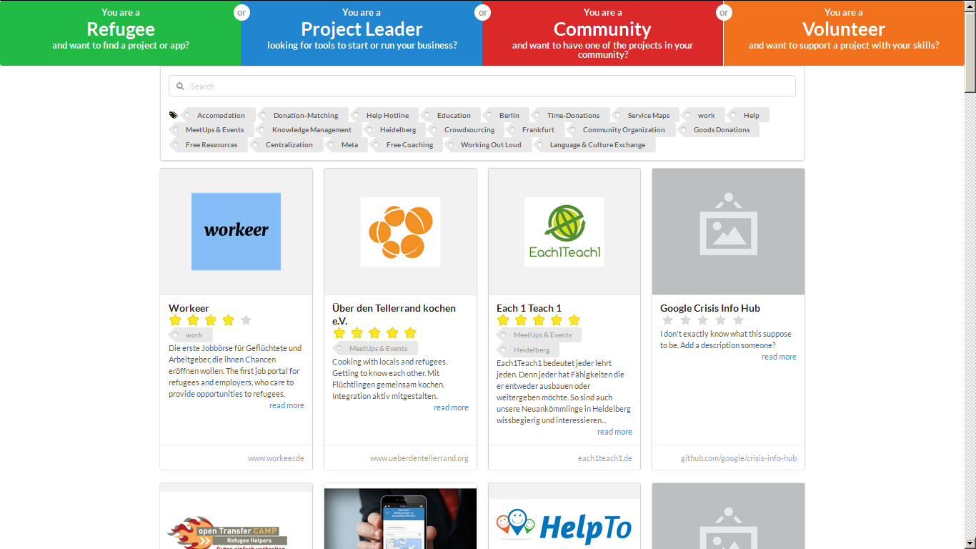
socialprohub.org

Slide 4
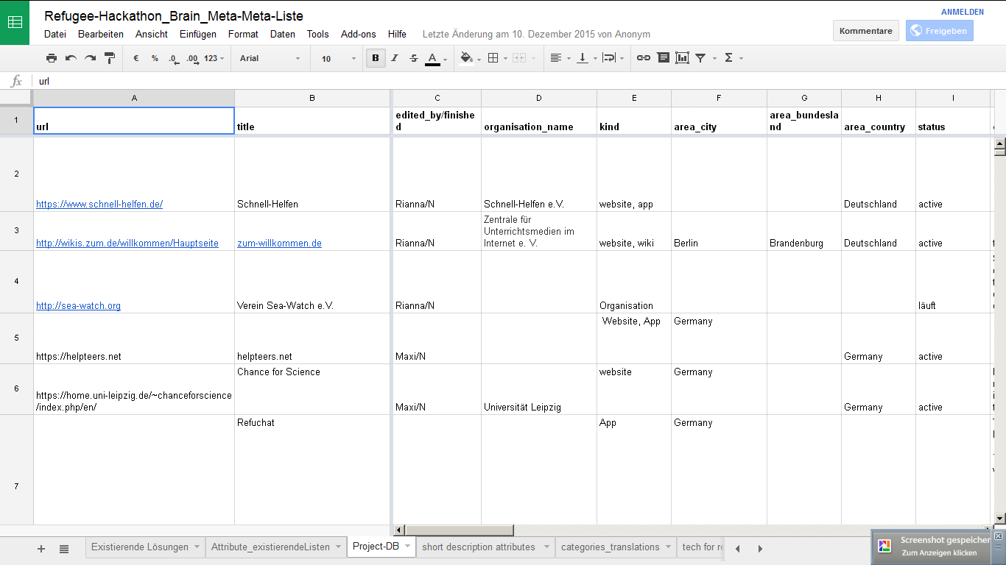
metabrain google spreadsheets

Slide 5
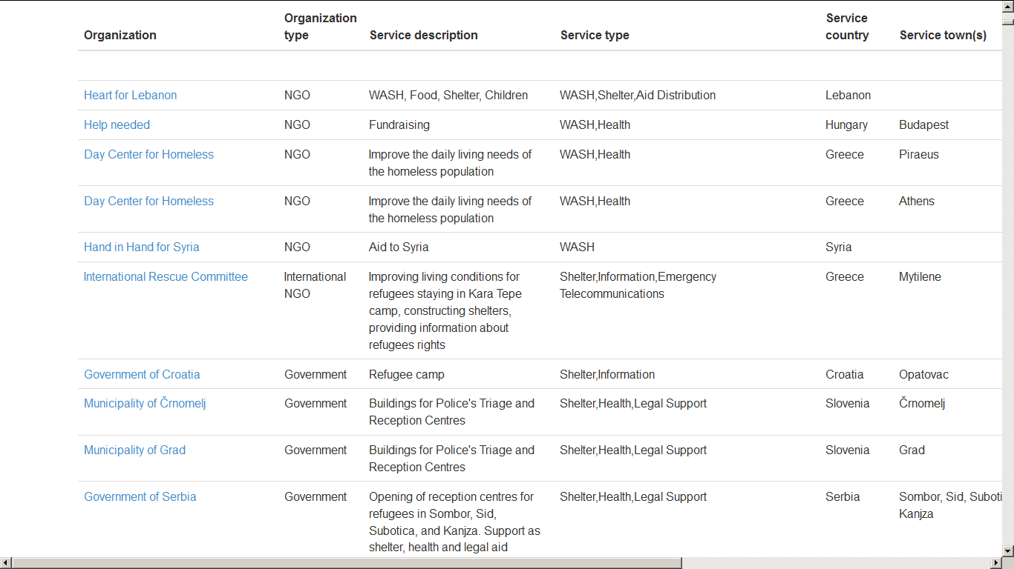
simonbjohnson.github.io

Slide 6
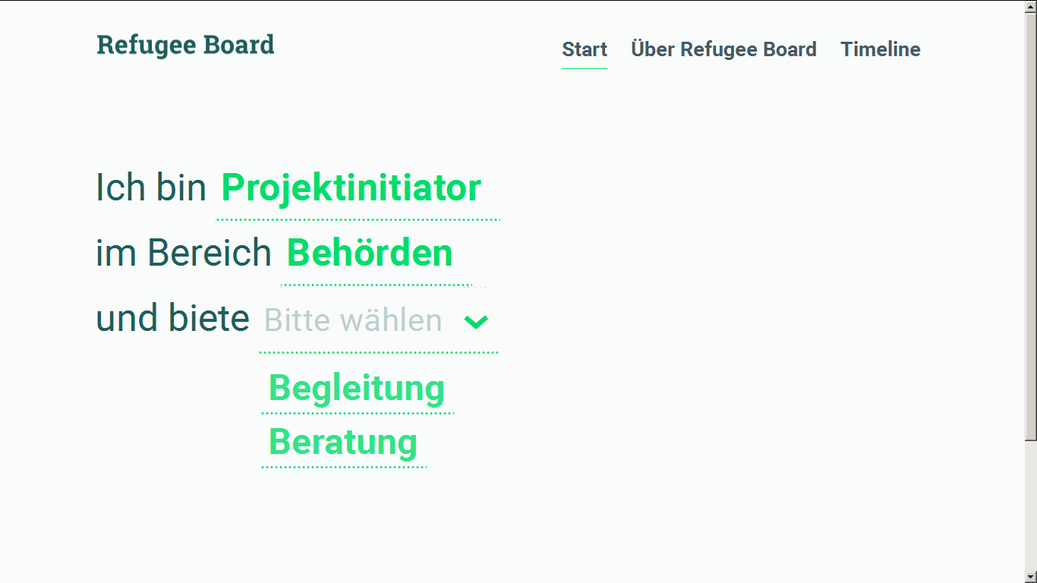
refugeeboard.de

Slide 7
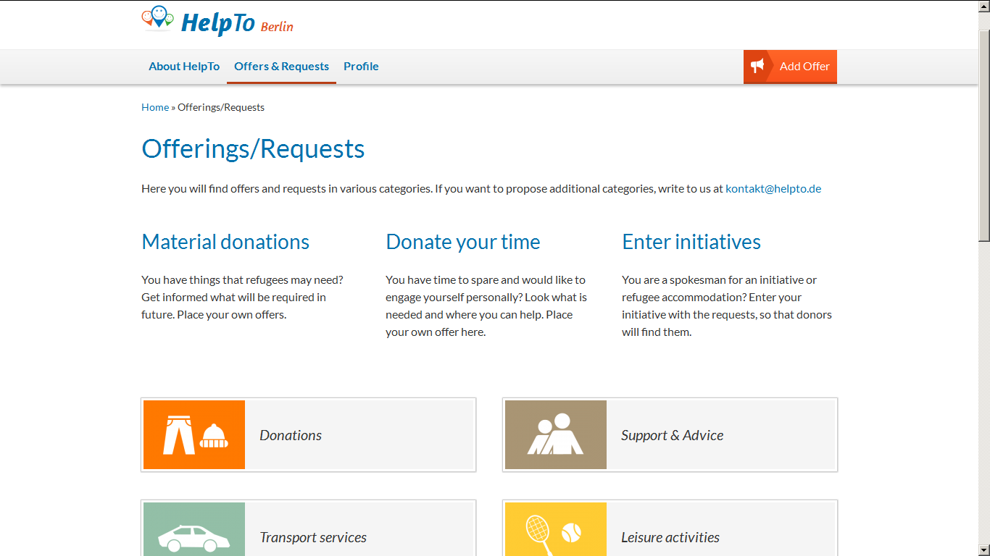
Berlin.helpto.de

Slide 8
Problems
Finding information about “all” the initiatives out there
Keeping that information up to date
Having many “central” repositories is a burden on projects in the field
Getting people to use the database

Slide 9
Interactions with Stakeholders
Looking for help:
Newcomer
(Citizen)
Looking to contribute:
Newcomer
Volunteer
Developer
Donor
Looking for data:
Initiative
NGO
Government
Administration
Private Sector
Press
Looking to connect:
Initiative
NGO
Government
Administration
Private Sector
Central Repository
Notes:
Interactions and user roles will be a separate topic at the USEEDS UX/UI workshop January 20-21
Implications for schema, API and categories

Slide 10
Repository Components
Frontend
API
Backend
Dynamic Information
Categories
Static Information
User Mgmt.
Notes:
Mostly static information and categories
User management will lead to single sign-on (OpenID, OAuth, oz)
Dynamic information is a bulletin board

Slide 11
Looking for Help
Frontend
Anonymous
Registered
API
Backend
Categories
Static Information
User Mngmt.

Slide 12
Looking to Contribute
Frontend
Anonymous
Registered
API
Backend
Dynamic Information
Categories
Static Information
User Mgmt.

Slide 13
Looking for Data
Frontend
Anonymous
Registered
API
Backend
Dynamic Information
Categories
Static Information
User Mgmt.

Slide 14
Looking to Connect
Frontend
Anonymous
Registered
API
Backend
Dynamic Information
Categories
Static Information
User Mgmt.

Slide 15
Complete Information
Complete is probably impossible but exchange between databases is
Should this exchange happen via HXL?
Create incentives for projects to register with the repository
Build a specific crawler to extend database content
Notes:
Crawler results differentiate between information from verified projects and other results
Could provide “certificates” from other entities (government, administration)

Slide 16
Keeping Information Up To Date
Service for projects to update their information
Publish a list of meta-tags that fill database fields and can be crawled periodically
Volunteers search and curate information

Slide 17
Multiple Data Repositories
Coordination to minimize number
Exchange data automatically between services that do need to co-exist
Redeploy database per country

Slide 18
General Outlook
Single sign-on and data access management
Provide a general search:
  Index content of known URLs in different languages
  Index public Facebook group content

Slide 19
Conclusion for the Workshop
Decide on form of collaboration
Focus on a shared or at least core schema
Create a joint first version of a category system to classify projects
Draft an API that serves multiple needs
Define work packages for each focus area
Publish and publicize workshop results
Notes:
Current issues
define backend
define well defined working package
move away from pure project mgmt to getting things done
Group decision on collobaration
Group decision on which platform to collaborate
maybe not one single platform, but finding an interface (API)
For Germany: SocialProHub or something completely new?

