Slide 1
Device-specific research and data stream events*
Adrian Mackenzie
Sociology, Lancaster University, UK
12 June 2014
* “SELECT count(type) as event_count FROM [githubarchive:github.timeline]”
207 million events

Slide 2
In any practical going-on with numbers, what matters is that they can be made to work, and making them work is a politics. Yet is a politics that completely evades conventional foundationist analysis (Verran, 2001: 88)
'momentary apprehensions of depth' (Anne-Lise Riles, 2001)

Slide 3
The datastream

Slide 4
Simple event?
http://api.github.com/events
{
"id": "2111998059",
"type": "WatchEvent",
"actor": {
"id": 1459103,
"login": "mmemetea",
"gravatar_id": "4532d1e4885f579ca7d9aa8748418817",
"url": "https://api.github.com/users/mmemetea",
"avatar_url": "https://avatars.githubusercontent.com/u/1459103?"
},
"repo": {
"id": 14802742,
"name": "OpenSensorsIO/azondi",
"url": "https://api.github.com/repos/OpenSensorsIO/azondi"
},
"payload": {
"action": "started"
},
"public": true,
"created_at": "2014-05-23T08:40:56Z",
"org": {
"id": 5497318,
"login": "OpenSensorsIO",
"gravatar_id": "1e0218942846ec8ef59f5d679dbca782",
"url": "https://api.github.com/orgs/OpenSensorsIO",
"avatar_url": "https://avatars.githubusercontent.com/u/5497318?"
}
},

Slide 5
Event depth?
1. {
2. "id": "2111998057",
3. "type": "IssueCommentEvent",
4. "actor": {
5. "id": 179265,
6. "login": "FroMage",
7. "gravatar_id": "b8932676ae05ecdd084d3839d1f49da8",
8. "url": "https://api.github.com/users/FroMage",
9. "avatar_url": "https://avatars.githubusercontent.com/u/179265?"
10. },
11. "repo": {
12. "id": 1287859,
13. "name": "ceylon/ceylon-compiler",
14. "url": "https://api.github.com/repos/ceylon/ceylon-compiler"
15. },
16. "payload": {
17. "action": "created",
18. "issue": {
19. "url": "https://api.github.com/repos/ceylon/ceylon-compiler/issues/1490",
20. "labels_url": "https://api.github.com/repos/ceylon/ceylon-compiler/issues/1490/labels{/name}",
21. "comments_url": "https://api.github.com/repos/ceylon/ceylon-compiler/issues/1490/comments",
22. "events_url": "https://api.github.com/repos/ceylon/ceylon-compiler/issues/1490/events",
23. "html_url": "https://github.com/ceylon/ceylon-compiler/issues/1490",
24. "id": 23820110,
25. "number": 1490,
26. "title": "CLI plugins: support distribution",

Slide 6
26.
27. "user": {
28. "login": "FroMage",
29. "id": 179265,
30. "avatar_url": "https://avatars.githubusercontent.com/u/179265?",
31. "gravatar_id": "b8932676ae05ecdd084d3839d1f49da8",
32. "url": "https://api.github.com/users/FroMage",
33. "html_url": "https://github.com/FroMage",
34. "followers_url": "https://api.github.com/users/FroMage/followers",
35. "following_url": "https://api.github.com/users/FroMage/following{/other_user}",
36. "gists_url": "https://api.github.com/users/FroMage/gists{/gist_id}",
37. "starred_url": "https://api.github.com/users/FroMage/starred{/owner}{/repo}",
38. "subscriptions_url": "https://api.github.com/users/FroMage/subscriptions",
39. "organizations_url": "https://api.github.com/users/FroMage/orgs",
40. "repos_url": "https://api.github.com/users/FroMage/repos",
41. "events_url": "https://api.github.com/users/FroMage/events{/privacy}",
42. "received_events_url": "https://api.github.com/users/FroMage/received_events",
43. "type": "User",
44. "site_admin": false
45. },
46. "labels": [
47. {
48. "url": "https://api.github.com/repos/ceylon/ceylon-compiler/labels/FEATURE",
49. "name": "FEATURE",
50. "color": "02e10c"
51. },

Slide 7
52. {
53. "url": "https://api.github.com/repos/ceylon/ceylon-compiler/labels/IN+PROGRESS",
54. "name": "IN PROGRESS",
55. "color": "02d7e1"
56. },
57. {
58. "url": "https://api.github.com/repos/ceylon/ceylon-compiler/labels/tools",
59. "name": "tools",
60. "color": "e102d8"
61. }
62. ],
63. "state": "open",
64. "assignee": null,
65. "milestone": {
66. "url": "https://api.github.com/repos/ceylon/ceylon-compiler/milestones/7",
67. "labels_url": "https://api.github.com/repos/ceylon/ceylon-compiler/milestones/7/labels",
68. "id": 217273,
69. "number": 7,
70. "title": "1.1",
71. "description": "",
72. "creator": {
73. "login": "tombentley",
74. "id": 879487,
75. "avatar_url": "https://avatars.githubusercontent.com/u/879487?",
76. "gravatar_id": "19f6b3877a3b4d15467481f7eeb0f635",
77. "url": "https://api.github.com/users/tombentley",
78. "html_url": "https://github.com/tombentley",
79. "followers_url": "https://api.github.com/users/tombentley/followers",
80. "following_url": "https://api.github.com/users/tombentley/following{/other_user}",
81. "gists_url": "https://api.github.com/users/tombentley/gists{/gist_id}",
82. "starred_url": "https://api.github.com/users/tombentley/starred{/owner}{/repo}",
83. "subscriptions_url": "https://api.github.com/users/tombentley/subscriptions",
84. "organizations_url": "https://api.github.com/users/tombentley/orgs",
85. "repos_url": "https://api.github.com/users/tombentley/repos",
86. "events_url": "https://api.github.com/users/tombentley/events{/privacy}",
87. "received_events_url": "https://api.github.com/users/tombentley/received_events",
88. "type": "User",
89. "site_admin": false
90. },
91. "open_issues": 21,
92. "closed_issues": 175,
93. "state": "open",
94. "created_at": "2012-11-22T11:43:26Z",
95. "updated_at": "2014-05-22T16:34:51Z",
96. "due_on": null
97. },
98. "comments": 4,
99. "created_at": "2013-12-05T21:43:00Z",
100. "updated_at": "2014-05-23T08:40:56Z",
101. "closed_at": null,
102. "body": "We need to find a way to support distribution/installation of script plugins. One possible strategy would be to package whatever scripts are located in
103. },
104. "comment": {
105. "url": "https://api.github.com/repos/ceylon/ceylon-compiler/issues/comments/43984368",
106. "html_url": "https://github.com/ceylon/ceylon-compiler/issues/1490#issuecomment-43984368",
107. "issue_url": "https://api.github.com/repos/ceylon/ceylon-compiler/issues/1490",
108. "id": 43984368,
109. "user": {
110. "login": "FroMage",
111. "id": 179265,
112. "avatar_url": "https://avatars.githubusercontent.com/u/179265?",
113. "gravatar_id": "b8932676ae05ecdd084d3839d1f49da8",
114. "url": "https://api.github.com/users/FroMage",
115. "html_url": "https://github.com/FroMage",
116. "followers_url": "https://api.github.com/users/FroMage/followers",
117. "following_url": "https://api.github.com/users/FroMage/following{/other_user}",
118. "gists_url": "https://api.github.com/users/FroMage/gists{/gist_id}",
119. "starred_url": "https://api.github.com/users/FroMage/starred{/owner}{/repo}",
120. "subscriptions_url": "https://api.github.com/users/FroMage/subscriptions",
121. "organizations_url": "https://api.github.com/users/FroMage/orgs",
122. "repos_url": "https://api.github.com/users/FroMage/repos",
123. "events_url": "https://api.github.com/users/FroMage/events{/privacy}",
124. "received_events_url": "https://api.github.com/users/FroMage/received_events",
125. "type": "User",
126. "site_admin": false
127. },
128. "created_at": "2014-05-23T08:40:56Z",
129. "updated_at": "2014-05-23T08:40:56Z",
130. "body": "We could put the scripts in the `.car`, but then where would the JS compiler put it?"
131. }
132. },
133. "public": true,
134. "created_at": "2014-05-23T08:40:56Z",
135. "org": {
136. "id": 579261,
137. "login": "ceylon",
138. "gravatar_id": "a38479e9dc888f68fb6911d4ce05d7cc",
139. "url": "https://api.github.com/orgs/ceylon",
140. "avatar_url": "https://avatars.githubusercontent.com/u/579261?"
141. }
142. }

Slide 8
Work to:
render analytically productive the formatted, dynamic character of digital networked data; (Marres & Weltevrede, 2013, 327)
render traffic between the object and process of social research analytically productive. … the formats and life cycles of online data may lend structure to the analytic objects and findings of social research. (Marres and Weltevrede, 2013, p. 233)
In order to:
develop ethnographic sensibility in data;
momentarily apprehend depth.

Slide 9
The device/platform and its events

Slide 10
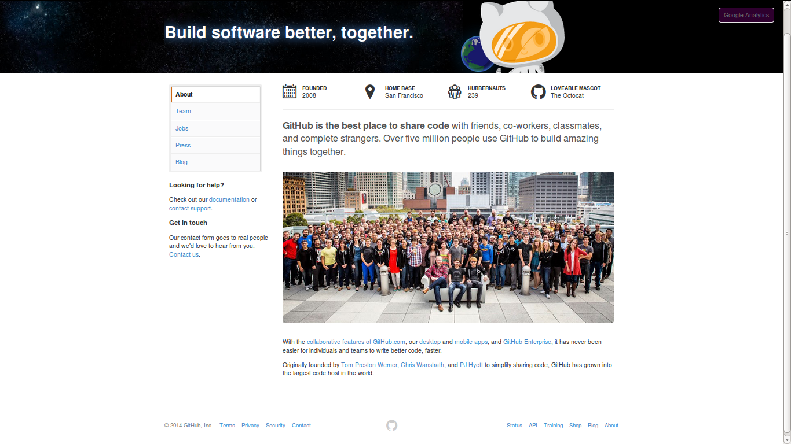

Slide 11
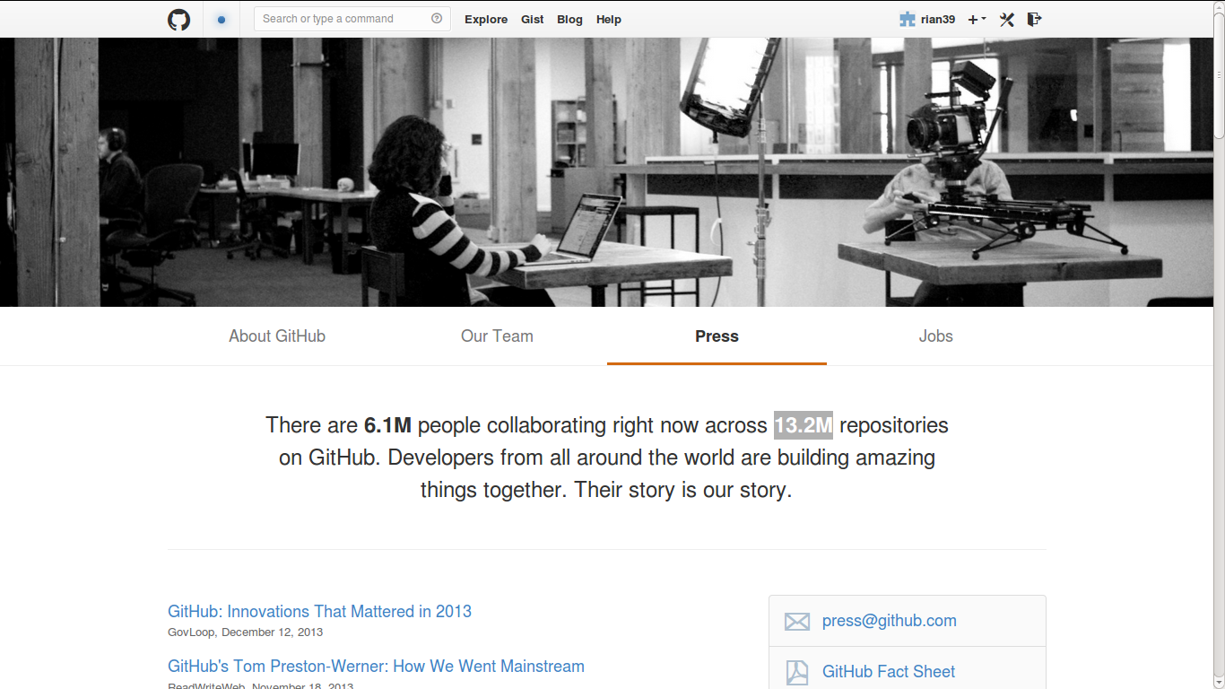
'Their story is our story'

Slide 12
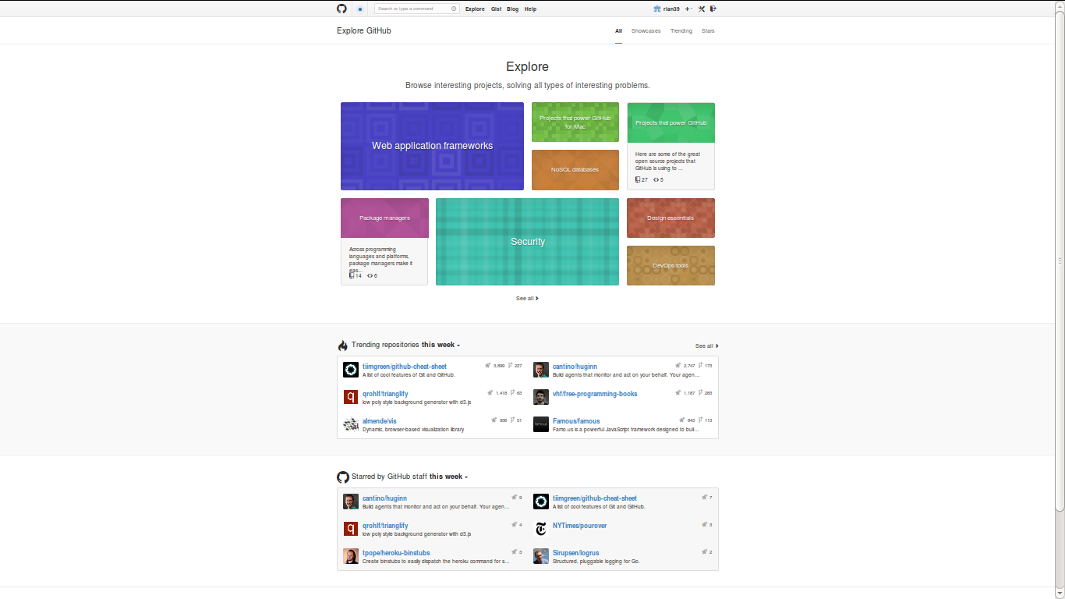
13.2 million repositories: 'their story' as showcase

Slide 13
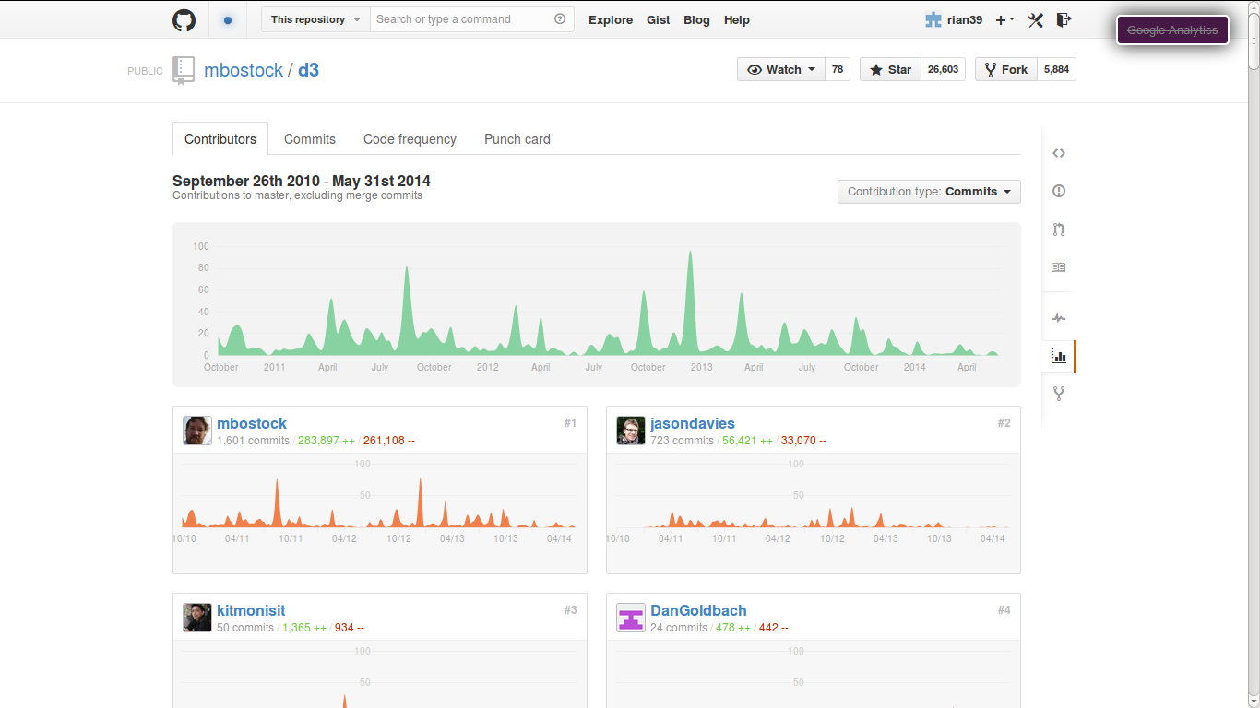
'Their story': 1 repository at a time

Slide 14
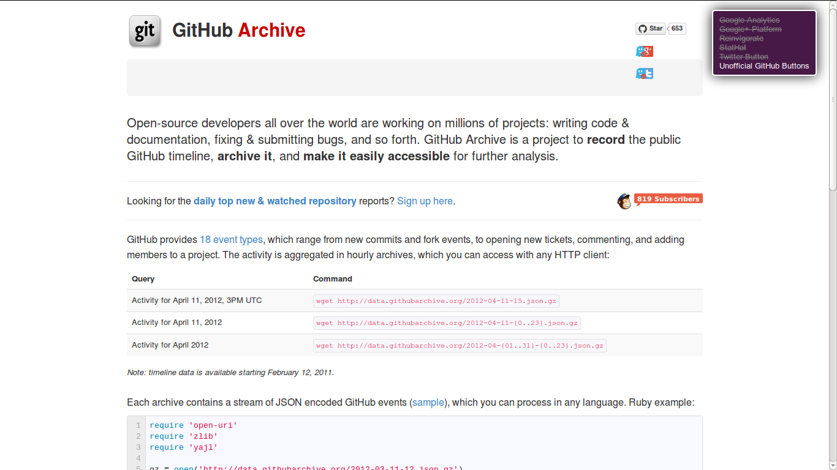
Publishing events: 210 million (1 March 2011 – today) : www.githubarchive.org

Slide 15
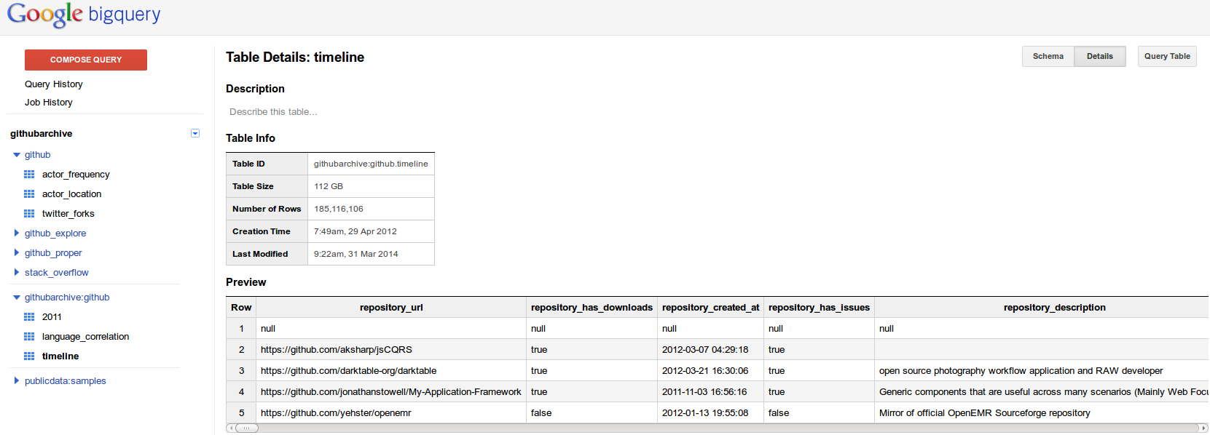
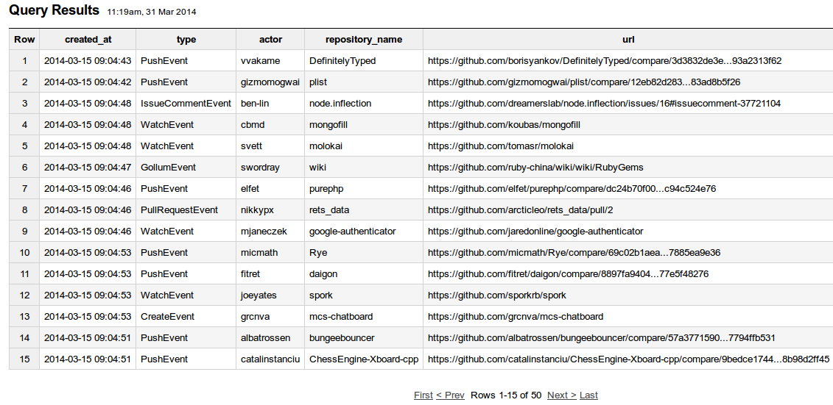
Devices re-format published events

Slide 16
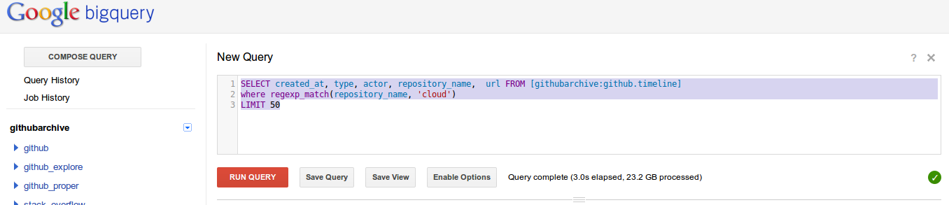
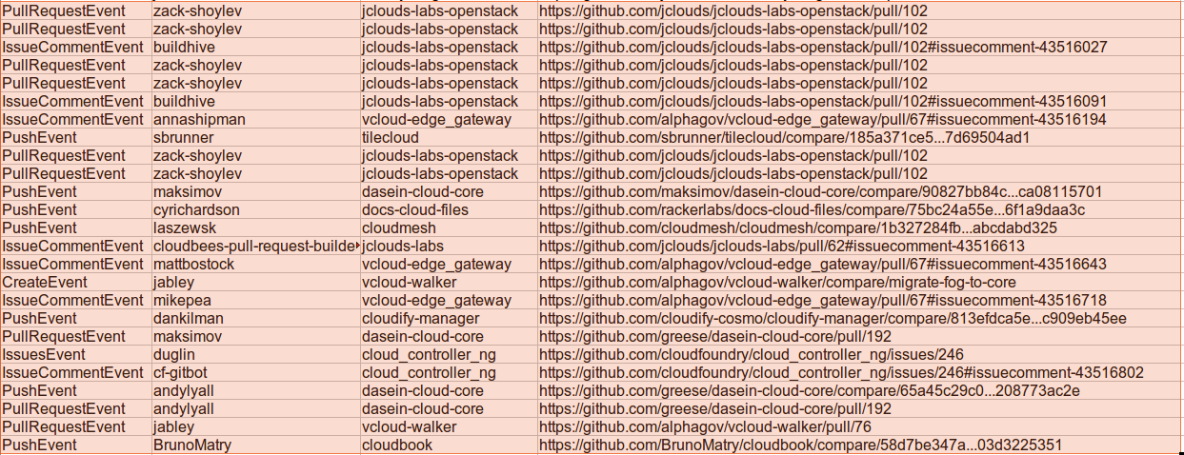

Slide 17
The datastream and its platform stories

Slide 18
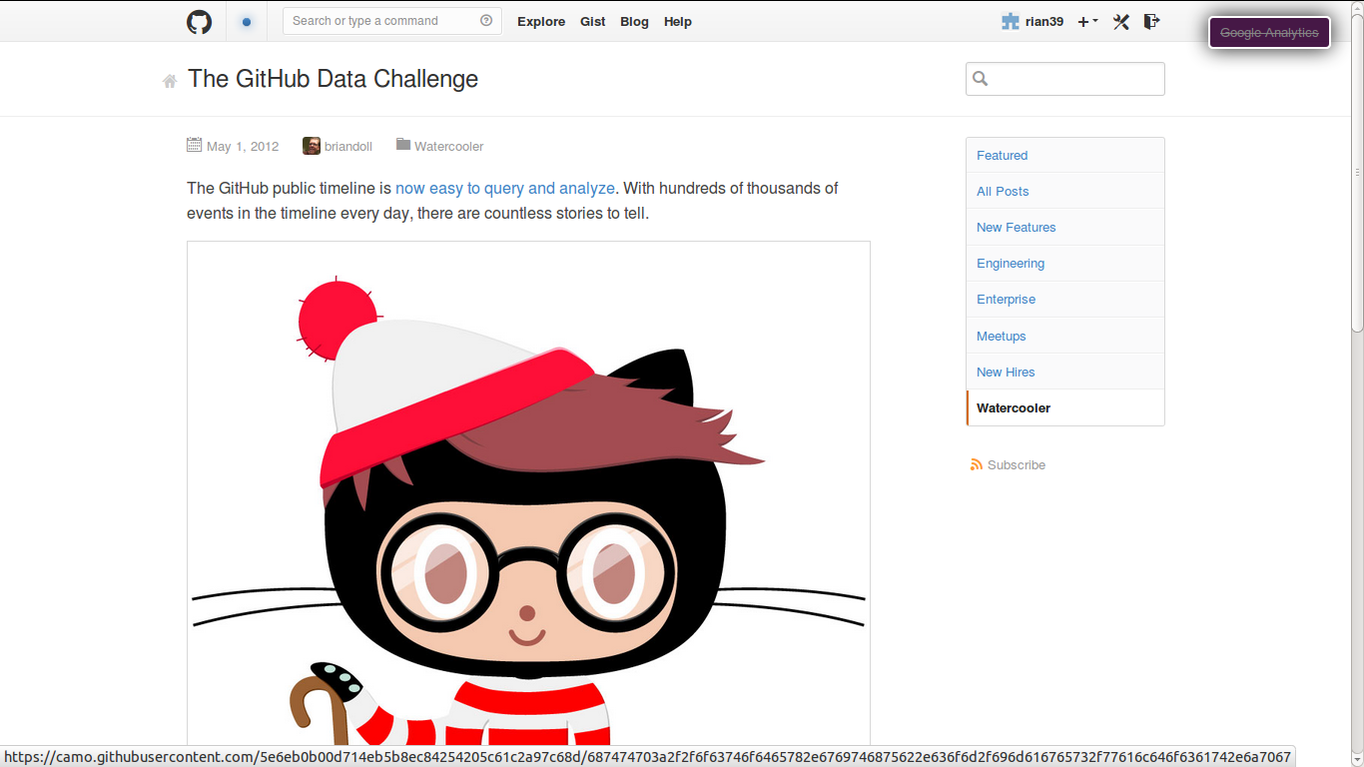
'Countless stories to tell'

Slide 19
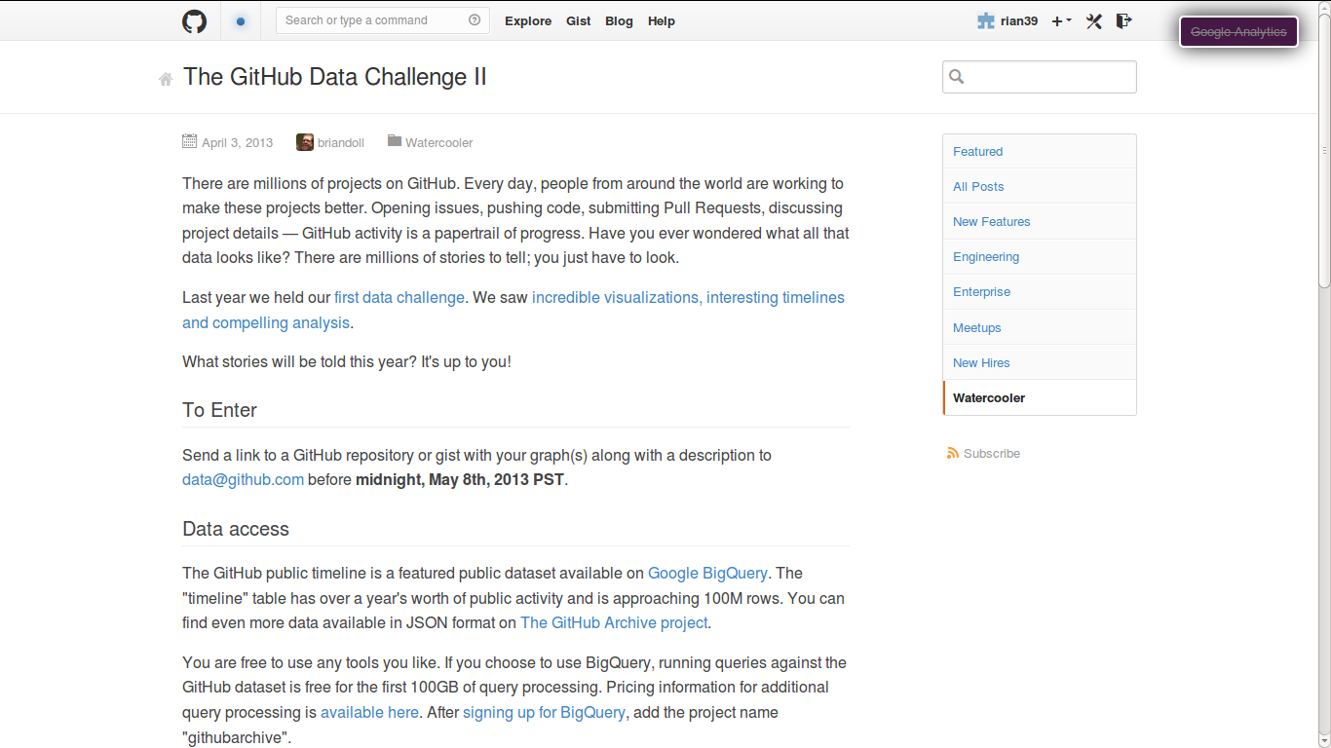
'What stories will be told this year? Its up to you'

Slide 20
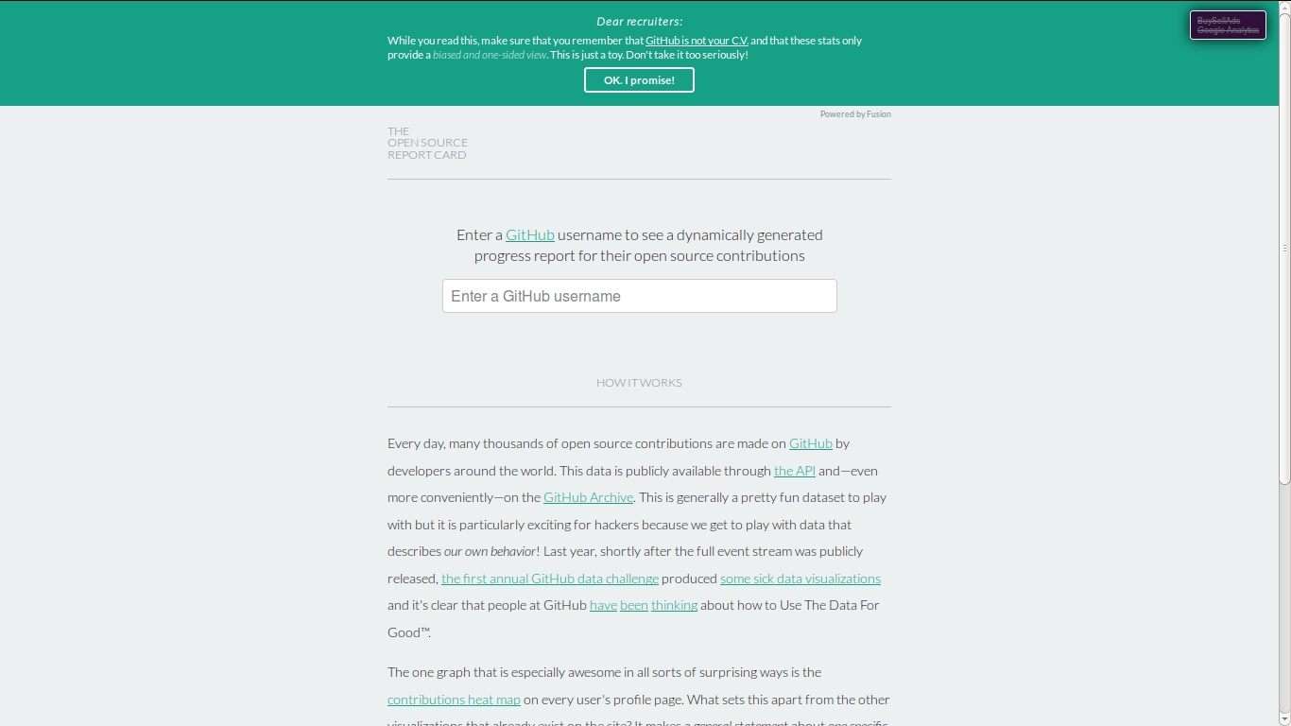
Stories: individuals and their similiarities

Slide 21
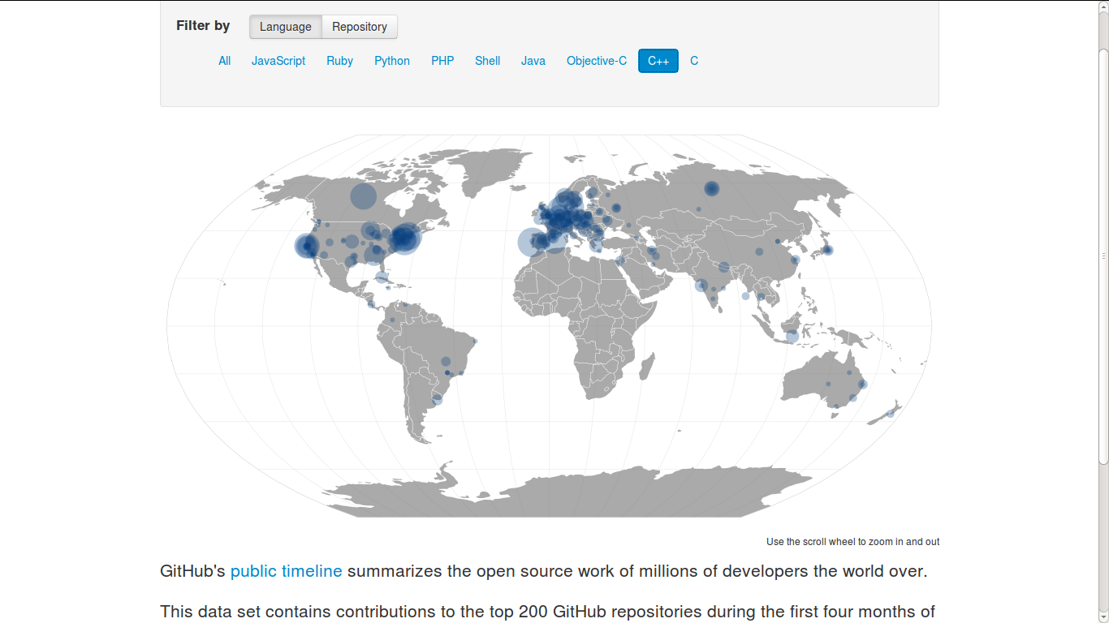
Repositories and their places

Slide 22
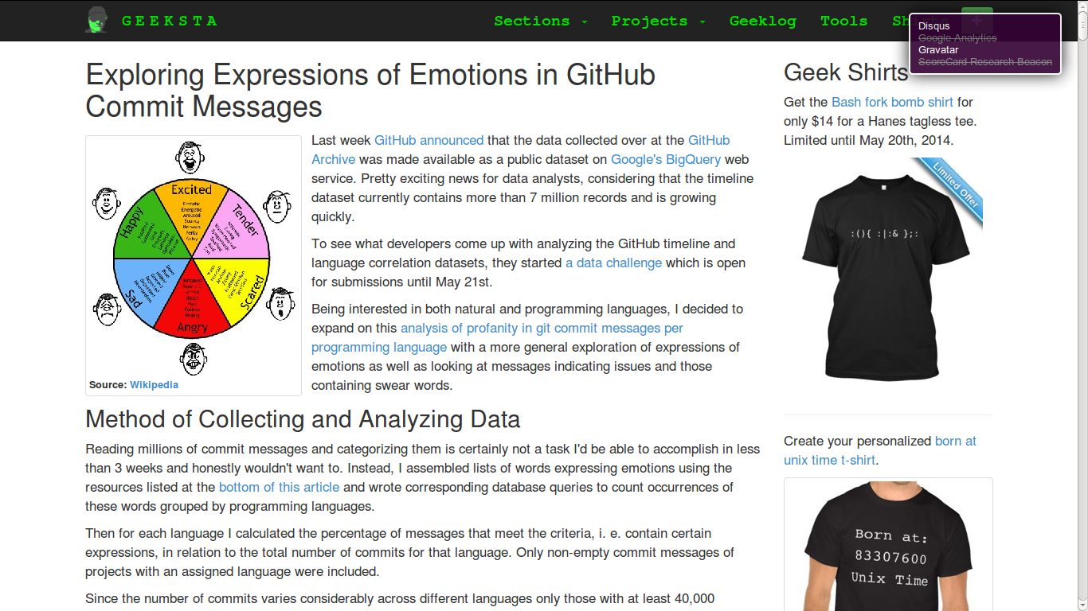

Slide 23
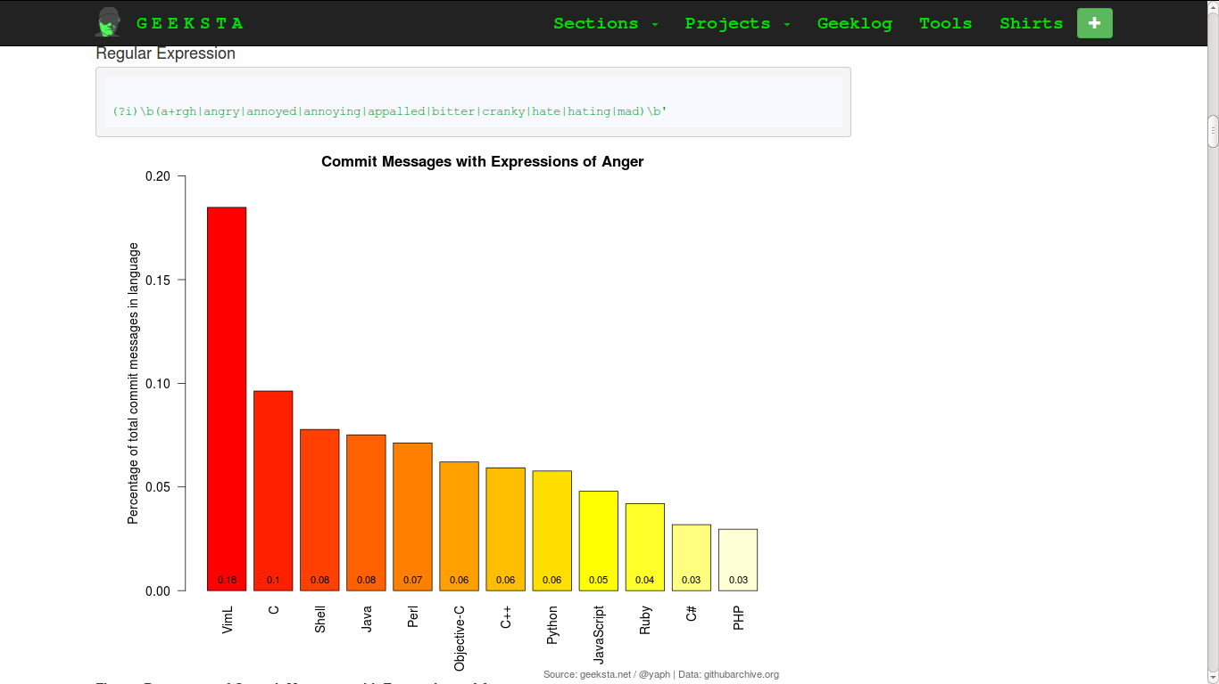
Affects into repositories

Slide 24
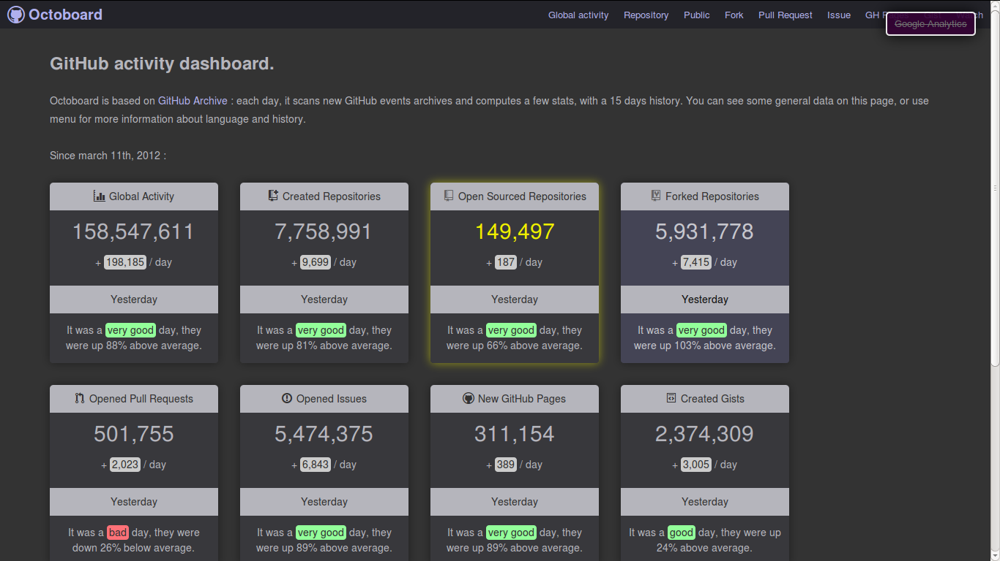
Live reports of event counts

Slide 25
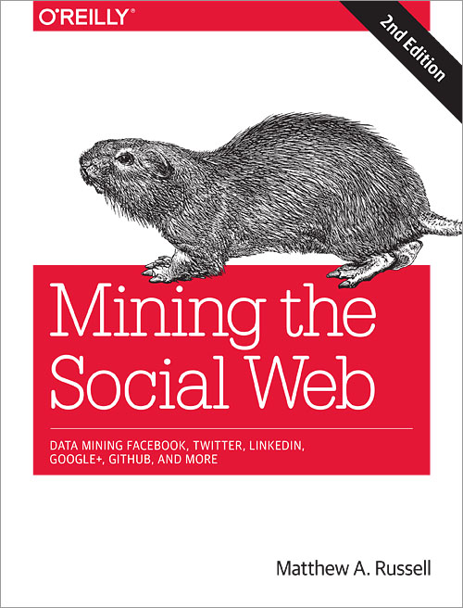
Github data as examplar for coding work

Slide 26
Unformatted imitation in the data stream

Slide 27
names in datastreams
Names in STS
'Consider for a moment the more general conditions of naming. First, a name is offered, given, imposed by someone or by some set of someones, and it is attributed to someone else. It requires an intersubjective context, but also a mode of address, for the name emerges as the addressing of a coinage to another, and in that address, a rendering of that coinage proper' (Butler, 1997: 29)
'it is important to explore the variety in current naming traditions in terms of what they do, the impact of the speech acts involved, integrating analyses of such technologies into studies of the constitution of subjects, the politics of belonging, exclusion, and control' (Palsson, 2014: 628).

Slide 28
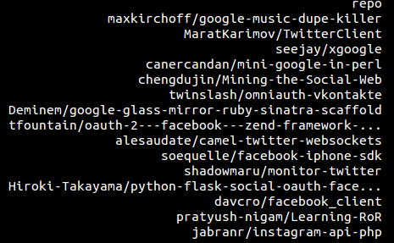

Slide 29
dpackcartonmachine/3layer-5layer-7layer-corrug...
dpackcartonmachine/corrugated-box-machine--817258
dpackcartonmachine/corrugated-box-machine--854402
dpackcartonmachine/corrugated-box-machine--709152
dpackcartonmachine/5-layers-corrugated-box-mac...
dpackcartonmachine/7-layers-corrugated-box-mac...
dpackcartonmachine/7-layers-corrugated-box-mac...
dpackcartonmachine/3-layers-corrugated-box-mac...
dpackcartonmachine/3-layers-corrugated-box-mac...
dpackcartonmachine/5-layers-corrugated-box-mac...
dpackcartonmachine/corrugated-box-machine--529003
dpackcartonmachine/corrugated-box-machine--058569
dpackcartonmachine/corrugated-box-machine--564559
dpackcartonmachine/semi-automatic-four-color-p...
dpackcartonmachine/3layer-5layer-7layer-Corrug...
dpackcartonmachine/3layer-corrugated-box-machi...
dpackcartonmachine/3layer5layer7layer-corrugat...
dpackcartonmachine/corrugated-box-machine--408286
dpackcartonmachine/3layer-5layer-7layer-Corrug...
dpackcartonmachine/corrugated-box-machine--952283
dpackcartonmachine/7-layers-corrugated-box-mac...
dpackcartonmachine/7-layers-corrugated-box-mac... 4

Slide 30
Copied names as affective imitation: forks, mirrors
FORKCOUNT: 4,468128 (approximately 4.5 million repos are forks
SELECT count(*) as fork_count FROM [metacommunities:github_proper.repo_list] where fork=1
UNIQUE NAMES: 5,323,230 (approximately 5.3 million repos have unique names, so 7 million names are imitations)
SELECT count(distinct(repository_name)) as name_count FROM [githubarchive:github.timeline] LIMIT 1000;
'incorporation into collectivities involves affective imitation' (Gatens & Lloyd, 1999)

Slide 31
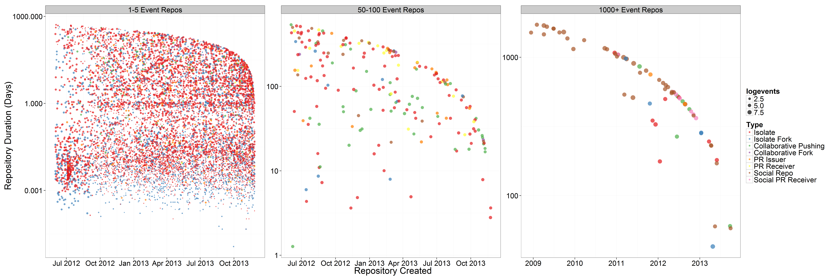
13.2 million repositories, but mostly imitative incorporations

Slide 32
Names as bundles
'passionate imitation'
Most common repository names
the importance of suggestion and imitation in social life, and the limits of forms of analysis which confine themselves to the study of representation or inscription. (Barry and Thrift, 2007: 511)

Slide 33
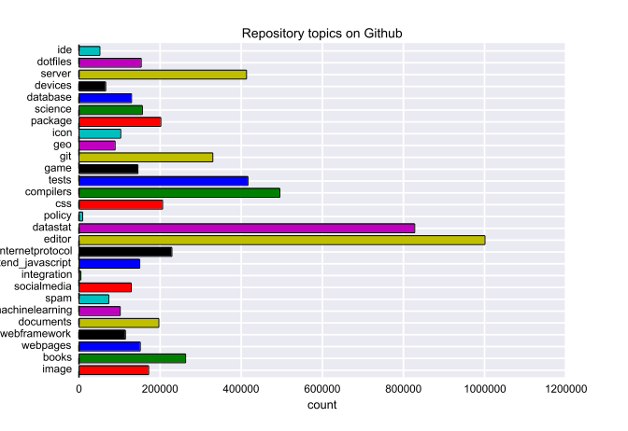
Namespace as device-specific imitation

Slide 34
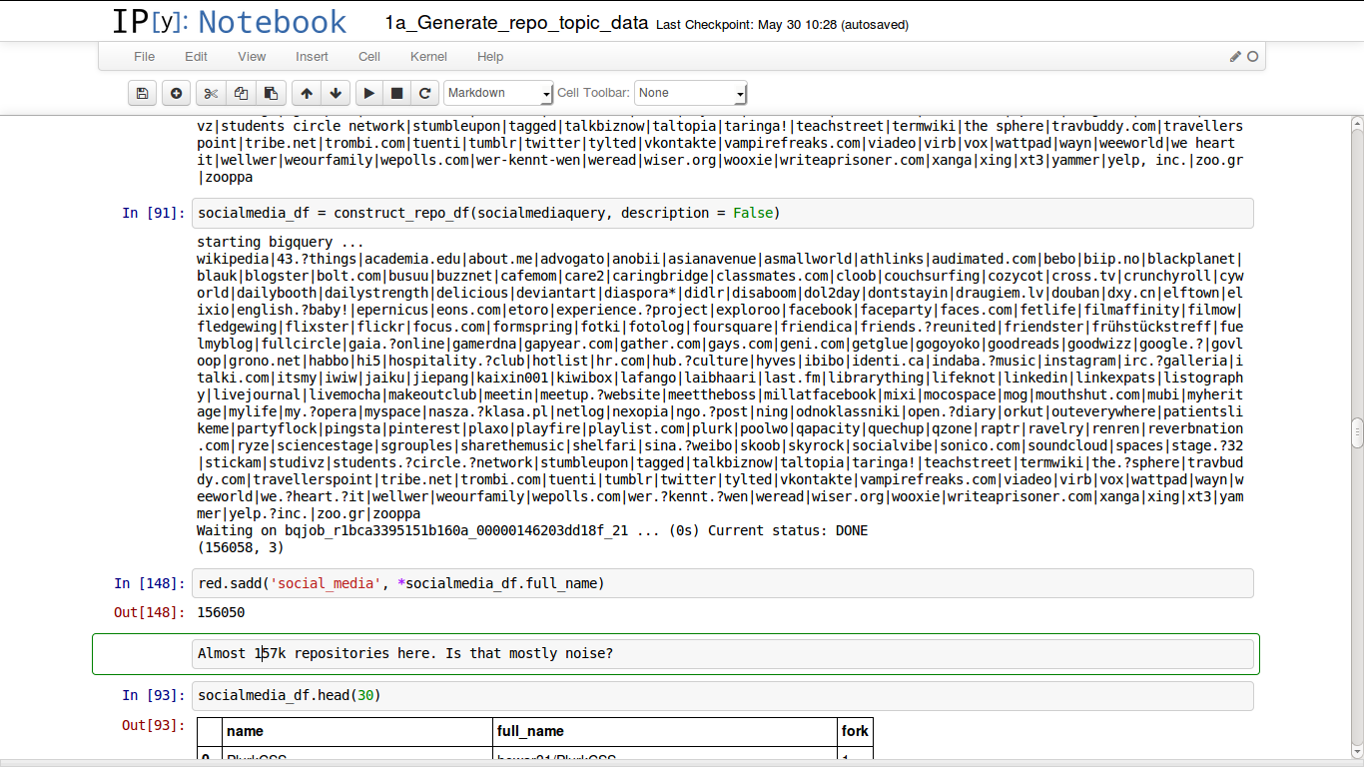
Querying device-specfic affective imitation

Slide 35
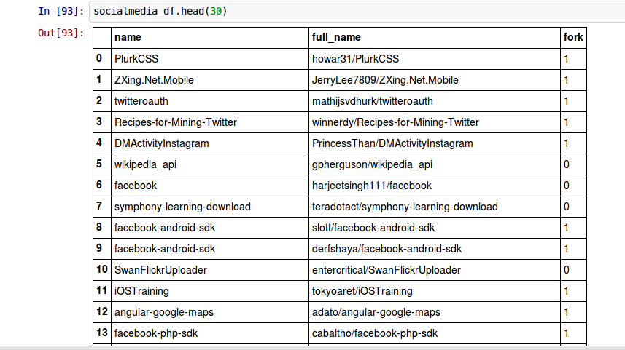

Slide 36
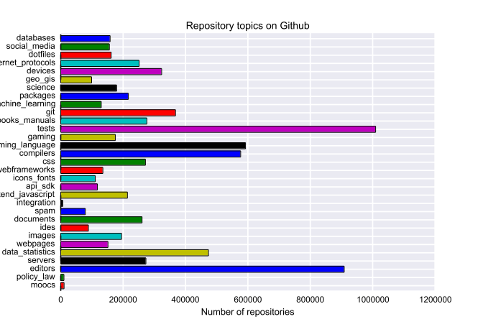
Unstable trajectories in the namespace

Slide 37
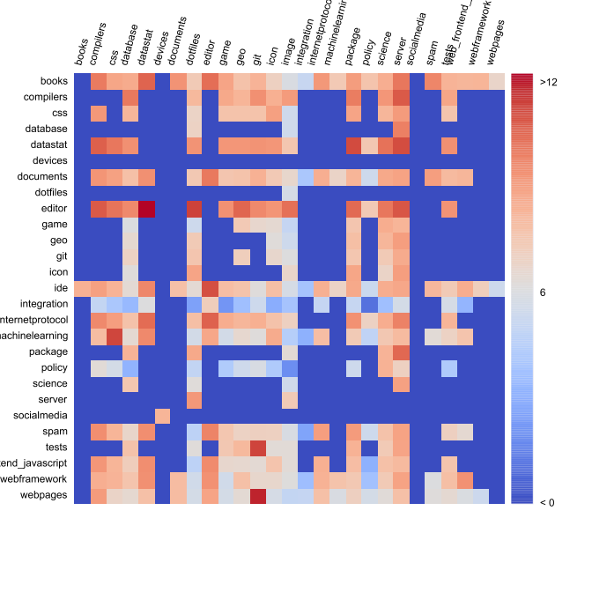
Variations and inventions through imitation

Slide 38
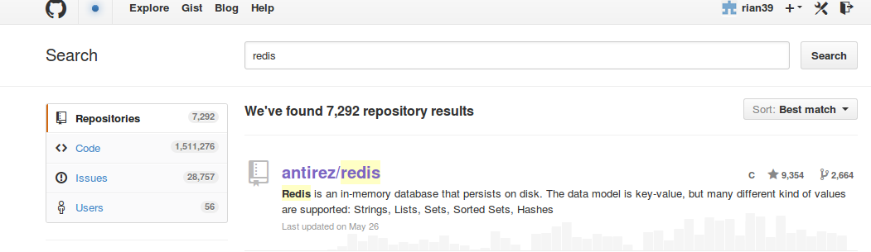
Recursively device-specific social research and its affective imitations

Slide 39
Conclusion: datastream stories
'their story is our story': repeating the platform's formatting
'countless stories to tell': mirroring the platform
'what stories will be told this year?': datastream as platform

Slide 40
Conclusions
Latour: 'Let the agents produce a dynamics and collect the traces that their actions leave as they unfold so as to produce a rich data set’ (Latour et al., 2012):
Verran: work on numbers (especially one-many/part-whole tensions)
Marres/Weltevrede: work on data formats to heighten ambivalent tensions between device-specific and social process
Gatens/Barry/Thrift/Tarde: Affective/passionate imitation and incorporation in collectives generates invention
Riles: momentary apprehensions of depth

Slide 41
Acknowledgements
Research funded by ESRC (UK Economic and Social Research Council) under 'Google Data Analytics' programme, 2013-2014
Richard Mills and Stuart Sharples – research associates
Matthew Fuller and Andrew Goffey – co-researchers

Slide 42
'Is it possible to do justice to … common experience by shifting from prediction and simulation to description and data mining? … Let the agents produce a dynamics and collect the traces that their actions leave as they unfold so as to produce a rich data set’ (Latour et al., 2012)
Live social research ... is social research that seeks to render analytically productive the formatted, dynamic character of digital networked data. As such, this research practice endorses the dynamism or ‘shape-shifting’ of online data, turning these into a resource and an object of digital social research. (Marres & Weltevrede, 2013, 327)

Slide 43
What happens on Github, 'the largest code repository on the planet'?
1. sharing: not automatic, but problematic;
2. recursive publics: modify conditions of their own existence; but where do they stop?
3. device-specific social research: reckon on platform-data dynamics, but how many platforms do we reckon with?

Slide 44
1. Sharing and other forms of participation
'there is nothing automatic about cultural sharing' (Hannerz, 1992, p. 44)

Slide 45
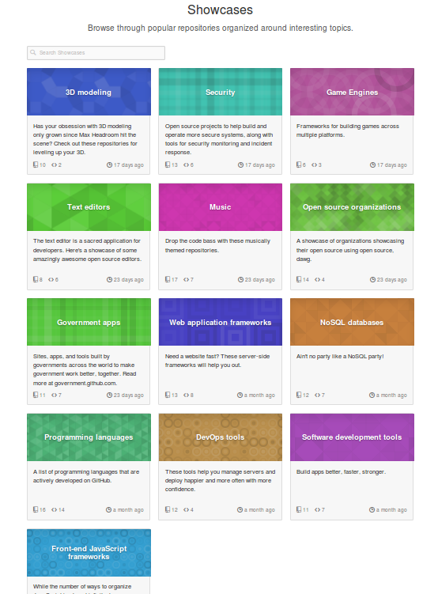
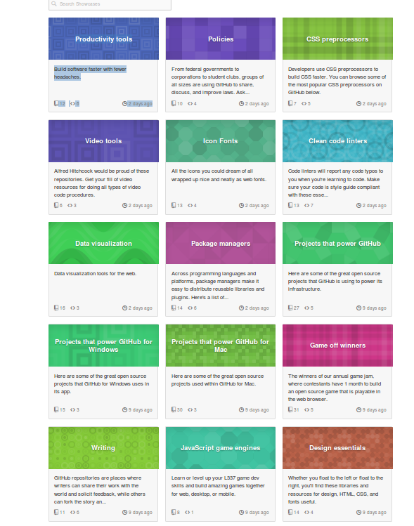
t

Slide 46
Linux: https://github.com/torvalds/linux
Android: https://github.com/CyanogenMod
Web-Data platform at The Washington Post https://github.com/django/django
Mozilla Foundation's Firefox web browser code https://github.com/mozilla/gecko-projects
'Big data infrastructures': noSQL database MongoDb https://github.com/mongodb/mongo; or the Apache Foundation's CouchDb https://github.com/apache/couchdb).
Minecrafts mods (https://github.com/Bukkit/Bukkit).
Platforms on Github
Software

Slide 47
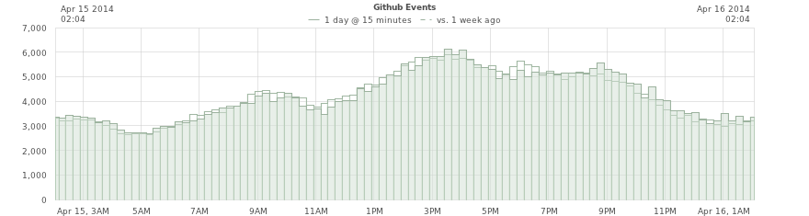
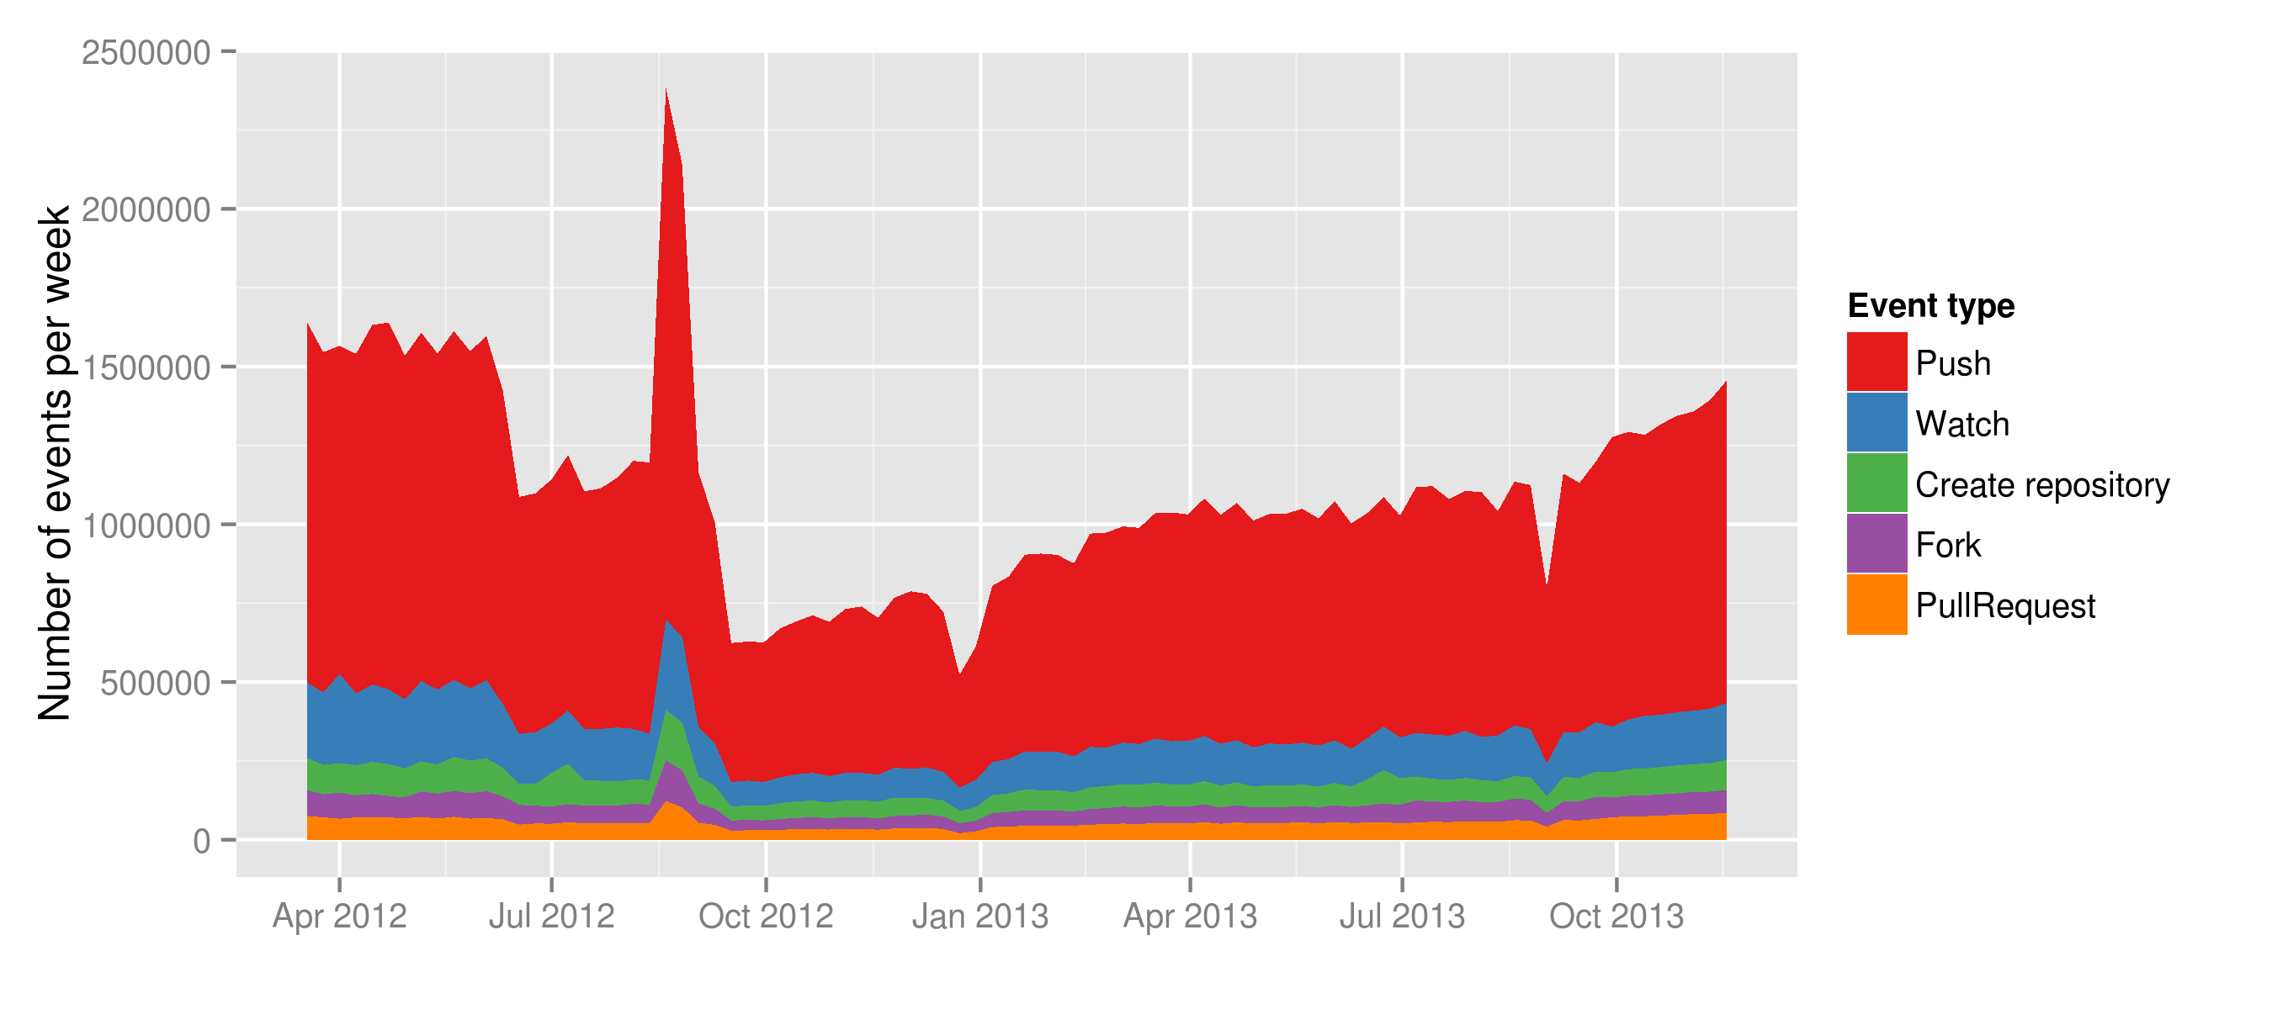
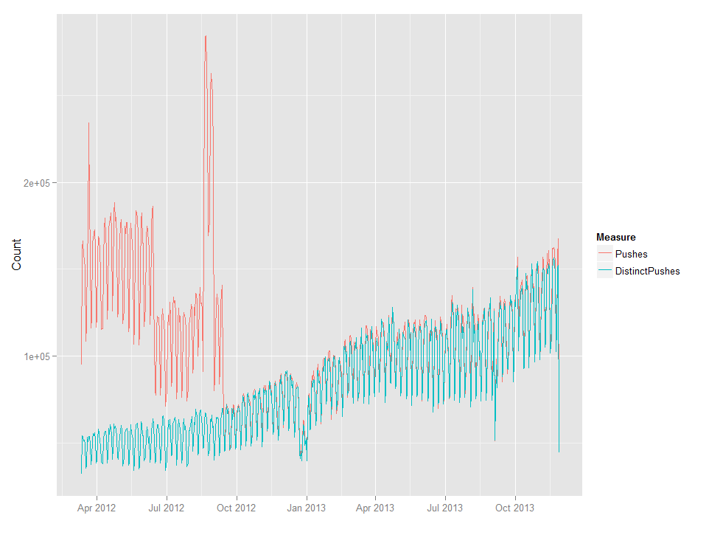

Slide 48
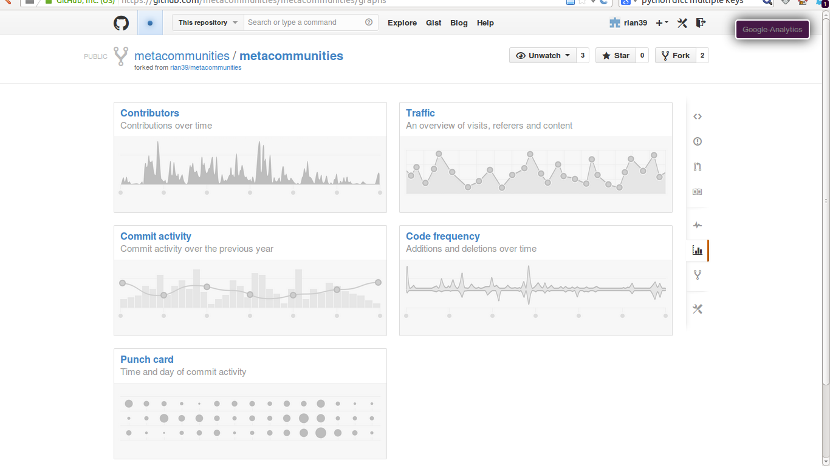
'Their story': 1 repository at a time

Slide 49
Acknowledgements
Research funded by ESRC (UK Economic and Social Research Council) under 'Google Data Analytics' programme, 2013-2014.
Thanks to Google Cloud Services for $USD1600 refund

Slide 50
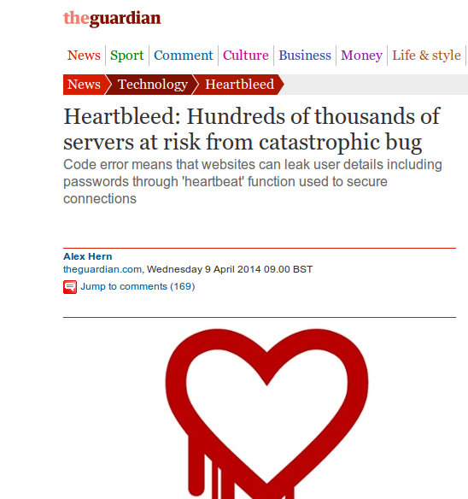

Slide 51
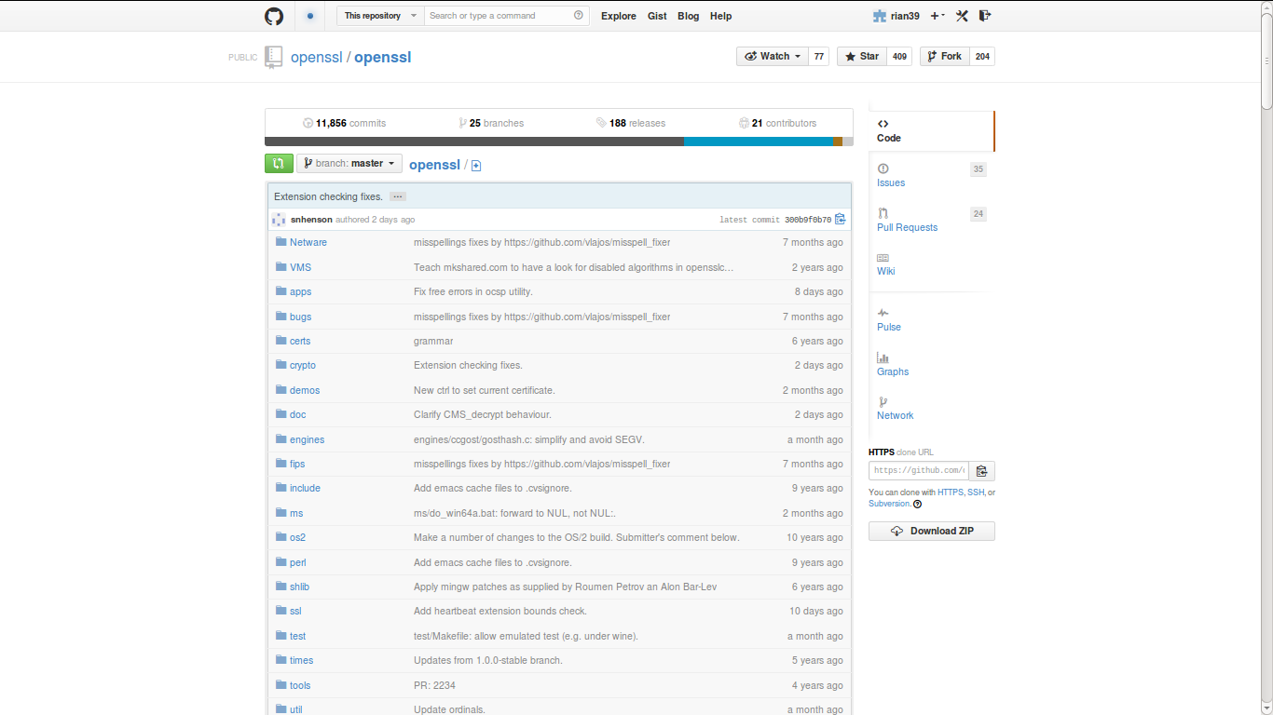
https://github.com/openssl/openssl

Slide 52
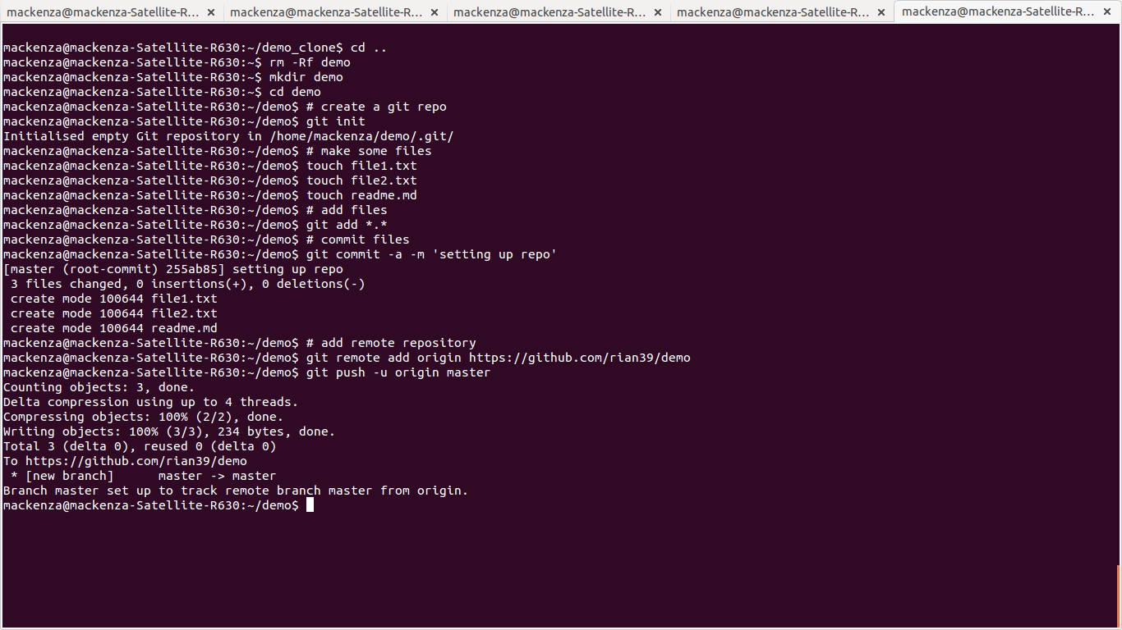

Slide 53
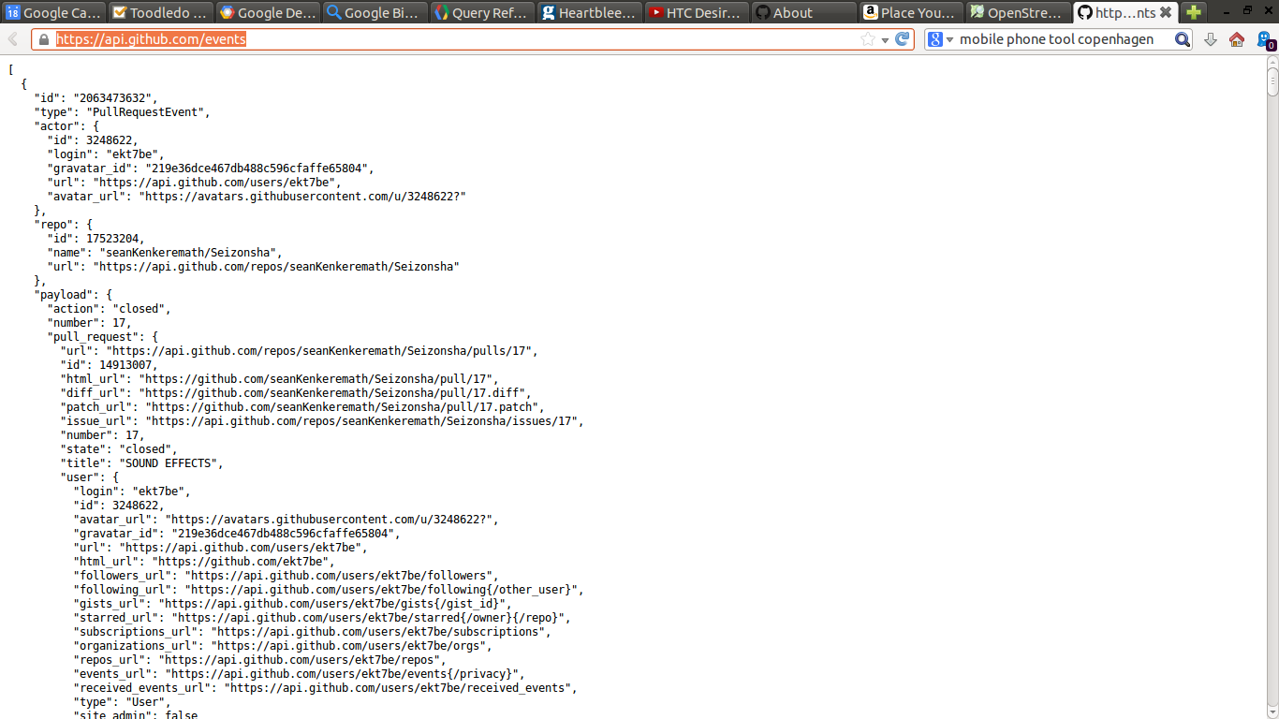

Slide 54
1 October 2012 – Events on Github
SELECT type, count(type) as events from githubarchive:github.timeline where PARSE_UTC_USEC(created_at) < PARSE_UTC_USEC('2012-10-02 00:00:00')
and PARSE_UTC_USEC(created_at) > PARSE_UTC_USEC('2012-10-01 00:00:00') group by type order by events desc;

Slide 55
SELECT type, count(type) as event_count FROM [githubarchive:github.timeline]
group by type order by event_count desc

Slide 56
2. Recursive publics modify platforms/devices/assemblages
A recursive public is a public that is vitally concerned with the material and practical maintenance and modi- fication of the technical, legal, practical, and conceptual means of its own existence as a public; it is a collective independent of other forms of constituted power and is capable of speaking to existing forms of power through the production of actually existing alternatives. (Kelty, Two Bits, 2010, 3)

Slide 57
Early repositories on Github (2007/8) are recursive?

Slide 58
Config or test repositories
Users: 3.4 million
SELECT count(distinct actor) as actor_count FROM [githubarchive:github.timeline]
TOTAL: 393999 (395k repositories are configuration files or test)
select sum(repo_count) from (SELECT name, count(*) as repo_count FROM [metacommunities:github_proper.repo_list]
where REGEXP_MATCH(name, 'dot|test|config|try') group by name order by repo_count desc)

Slide 59
Code repository-inspired projects
'We the People' petitioning system is at https://github.com/WhiteHouse
Tate Gallery collection metadata: https://github.com/tategallery/collection
the White House's open data policy (http://project-open-data.github.io/policy-memo
the US Pirate Party's archive (http://uspirates.github.io/),
the complete genome of Kenneth Reitz (https://github.com/kennethreitz/genome)
collections of maps (https://github.com/djaiss/mapsicon)

Slide 60
Data-based recursions
Denis Roussel, Octoboard http://octoboard.com/ https://github.com/KuiKui/Octoboard
David Fischer, Open Source Contributions by Location
http://davidfischer.github.io/gdc2/#repositories/twitter/bootstrap
Dan Foreman Mackay, Open Source Report card http://osrc.dfm.io/
https://github.com/dfm/osrc
JeongHoon Byun, Coding Conventions http://sideeffect.kr/popularconvention#python
https://github.com/outsideris/popularconvention/

Slide 61
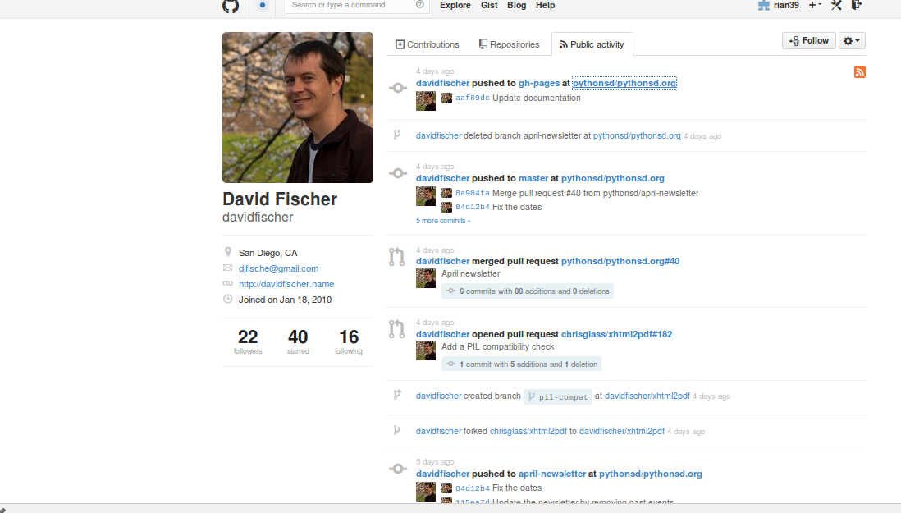
Public activity

Slide 62
Organizations on github
80,000 organizations
e.g. BBC
https://github.com/BBC Has 6 repositories and they are not updated very often.
But 32 BBC organisations on the Github: BBCNews, BBCFrameworks (https://github.com/bbc-frameworks), BBC R&D (https://github.com/bbcrd), BBC Data (https://github.com/BBC-Data)

Slide 63
Organisations: 80,000
BBC & social media platform repositories

Slide 64
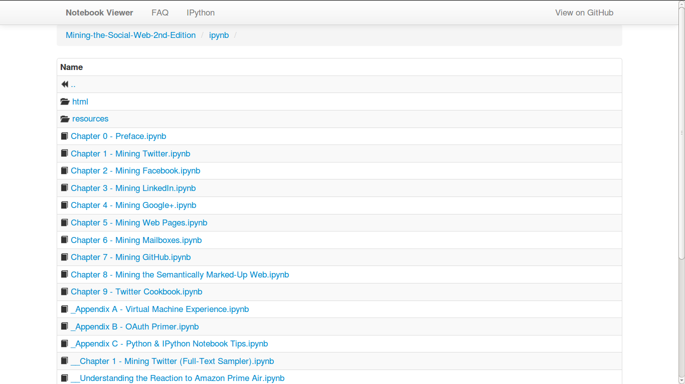
Matthew Russell, Mining the Social Web, 2nd edition

Slide 65
3. Device-specific social research and events?
Scraping, we propose, makes it possible to render traffic between the object and process of social research analytically productive. It enables a form of ‘real-time’ social research, in which the formats and life cycles of online data may lend structure to the analytic objects and findings of social research. (Marres and Weltevrede, 2013, p. 233)

Slide 66
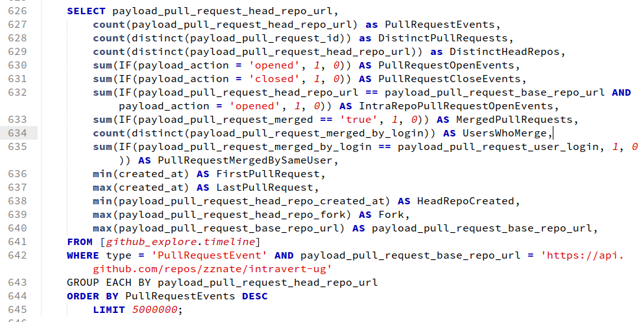
Mapping between Github and git events

Slide 67
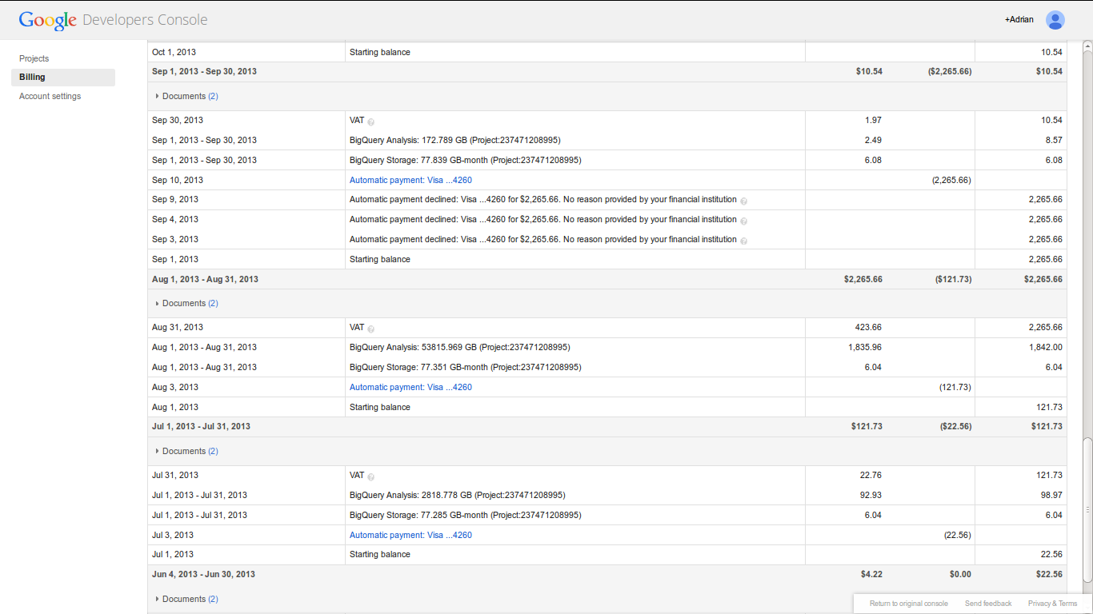
Big bill for big query

Slide 68
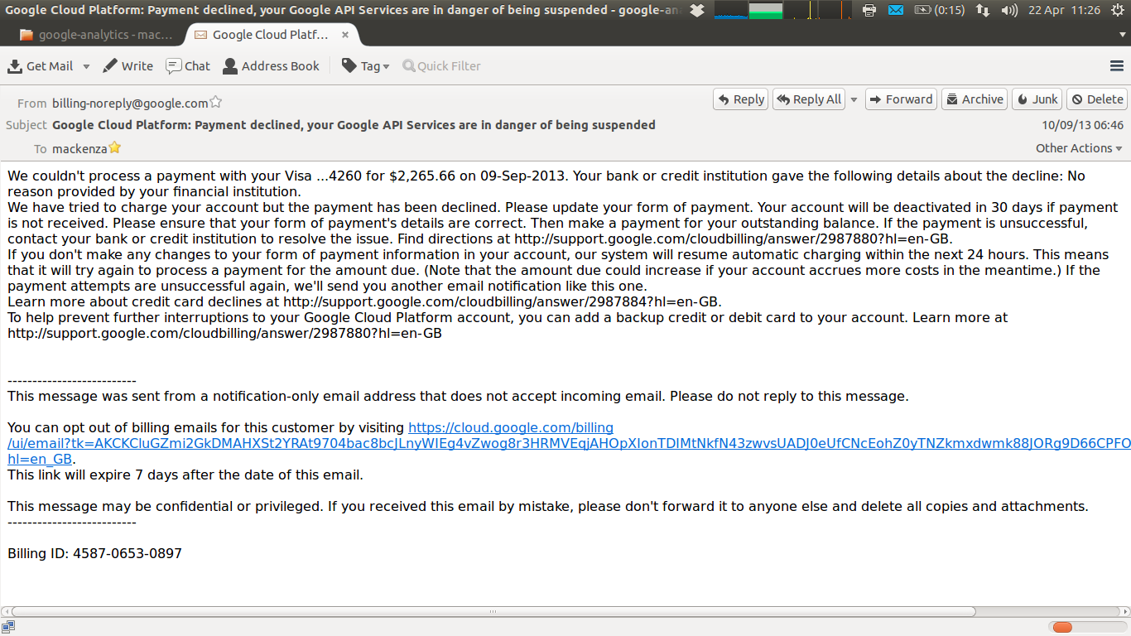
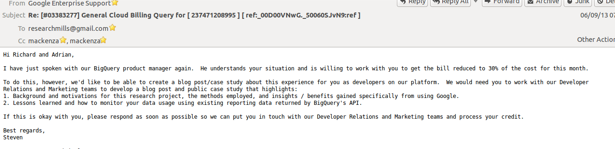

Slide 69
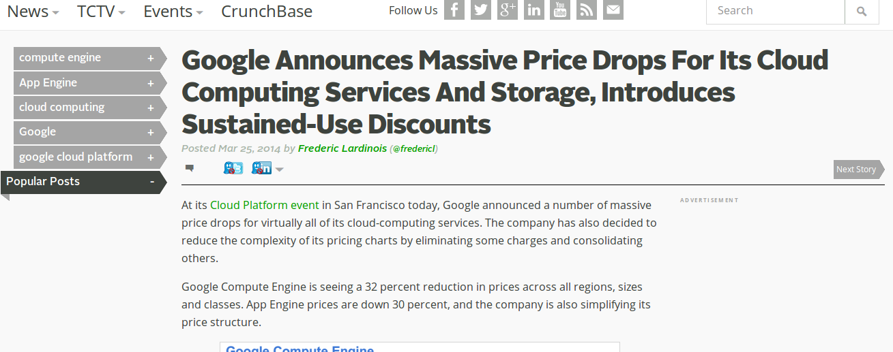

Slide 70
Conclusion
1. sharing: not automatic, but problematic due to different event-forms;
2. recursive quasi-publics: modify conditions of their own existence, but the conditions of their own existence are also modified;
3. device-specific social research: encounter with platform-data events is multiple

