Slide 1
Capital numbers and the obscure numericality of code configuration
Adrian Mackenzie

Slide 2
The problem(s) of big numbers in STS
In any practical going-on with numbers, what matters is that they can be made to work, and making them work is a politics. Yet is a politics that completely evades conventional foundationist analysis (Verran, 2001: 88)

Slide 3
Numbers as configurations?
the device of configuration has two broad uses. First, as an aid to delineating the composition and bounds of an object of analysis, in part through the acknowledgment that doing so so is integral not only to the study of technologies, but to their very existence as objects. And second, in drawing our analytic attention to the ways in which technologies materialize cultural imaginaries, just as imaginaries narrate the significance of technological artefacts. Configuration in this sense is a device for studying technologies with particular attention to the imaginaries and materialities that they join together, an orientation that resonates as well with the term's common usages to refer to the conjoining of diverse elements in practices of systems design and engineering [@Suchman_2012, 48]

Slide 4
Overview
1. The case study:
a social media platform that hosts ~20 million code repositories;
the contemporary political economies of counting and graphing
2. The broader 'mixtures' issue: obstacles to and potentials for count-based ethnographic sensibilities

Slide 5
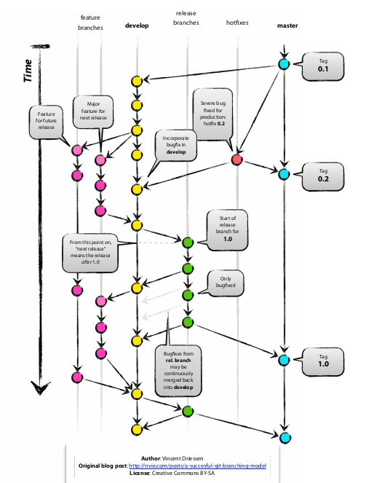
Workflows in collective coding

Slide 6
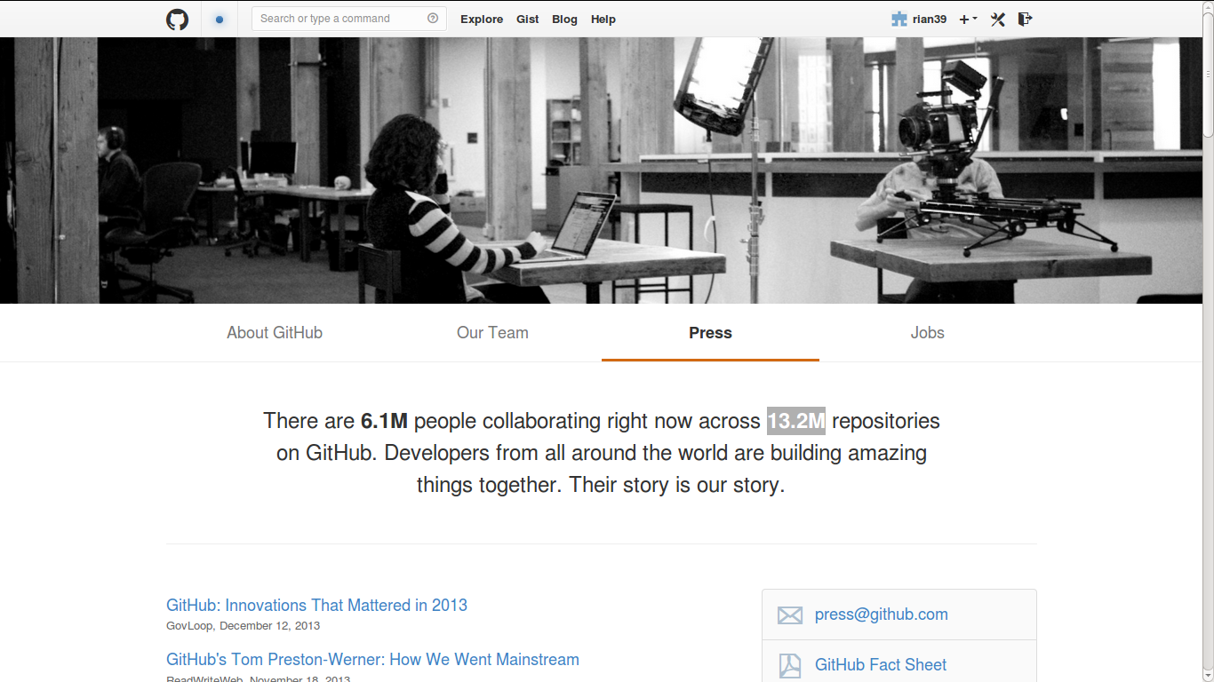
'Their story is our story'

Slide 7
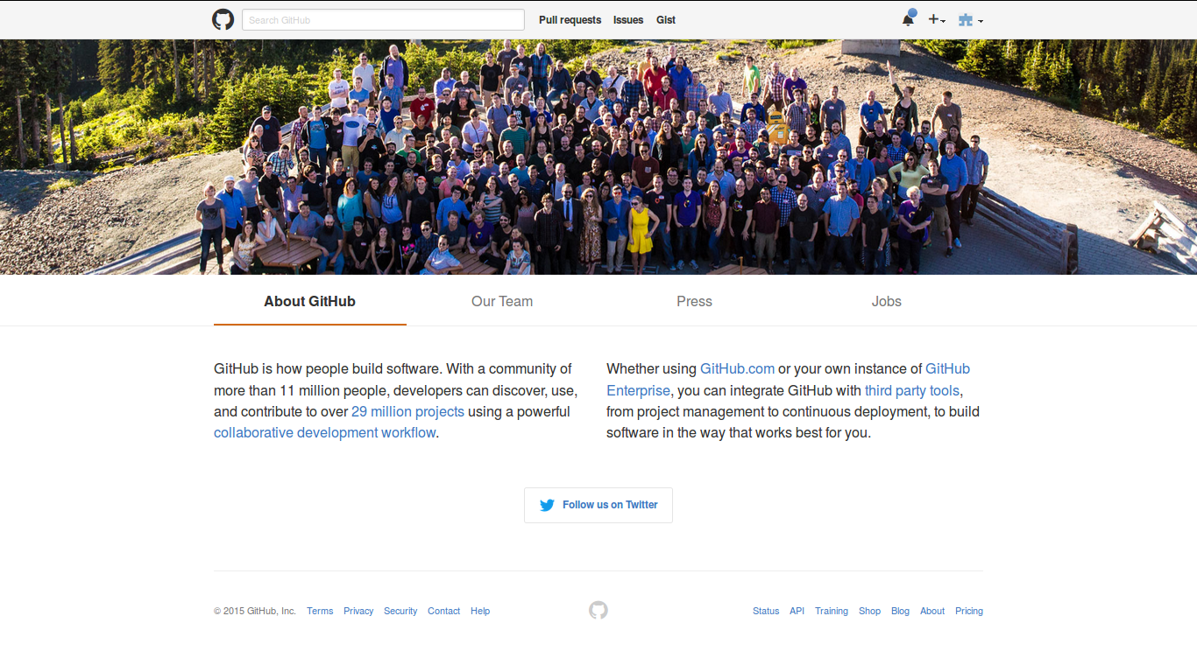
November 2015

Slide 8
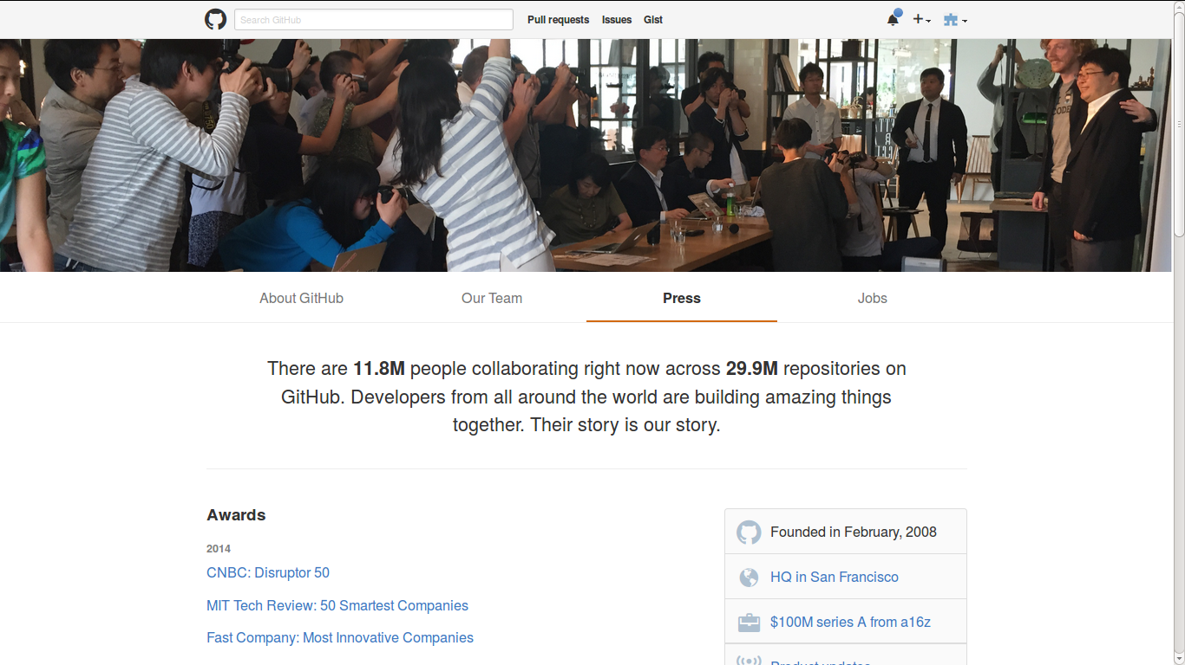
November 2015

Slide 9
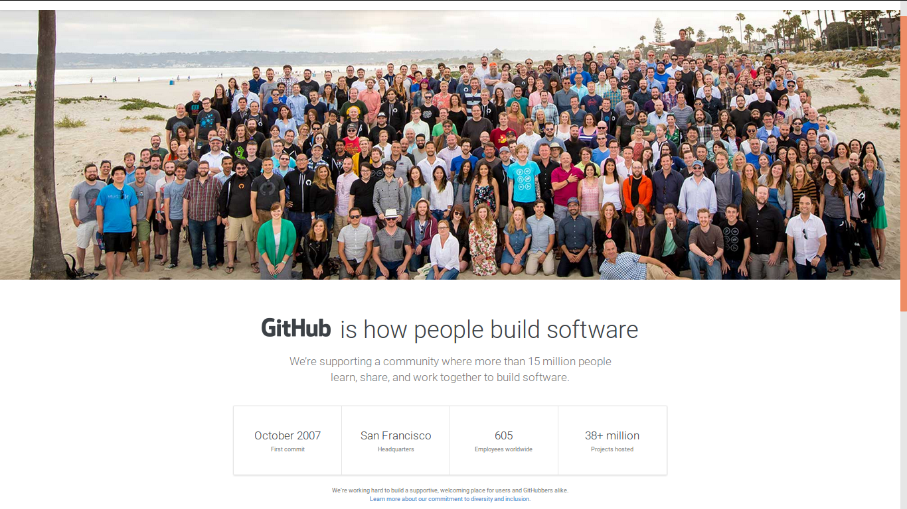
August 2016

Slide 10

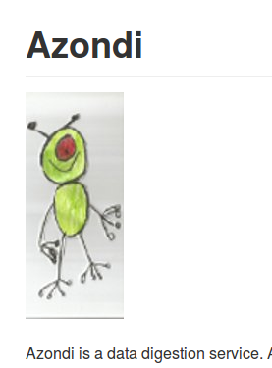
Data as raw material?
http://api.github.com/events
{
"id": "2111998059",
"type": "WatchEvent",
"actor": {
"id": 1459103,
"login": "mmemetea",
"gravatar_id": "4532d1e4885f579ca7d9aa8748418817",
"url": "https://api.github.com/users/mmemetea",
"avatar_url": "https://avatars.githubusercontent.com/u/1459103?"
},
"repo": {
"id": 14802742,
"name": "OpenSensorsIO/azondi",
"url": "https://api.github.com/repos/OpenSensorsIO/azondi"
},
"payload": {
"action": "started"
},
"public": true,
"created_at": "2014-05-23T08:40:56Z",
"org": {
"id": 5497318,
"login": "OpenSensorsIO",
"gravatar_id": "1e0218942846ec8ef59f5d679dbca782",
"url": "https://api.github.com/orgs/OpenSensorsIO",
"avatar_url": "https://avatars.githubusercontent.com/u/5497318?"
}
},

Slide 11
3 Perspectives on data formats
Latour & Venturini, 2012 'The Whole is Smaller than the Part: How Digital Navigation May Modify Social Theory.'
– traceability changes social theory
Marres, Noortje, 2013, 'The redistribution of methods: on intervention in digital social research, broadly conceived'
- device-specific research must look at format
Gill, Ros, and Andy Pratt. 2008. ‘In the Social Factory?: Immaterial Labour, Precariousness and Cultural Work’.
- symbolic-analytical work is changing

Slide 12
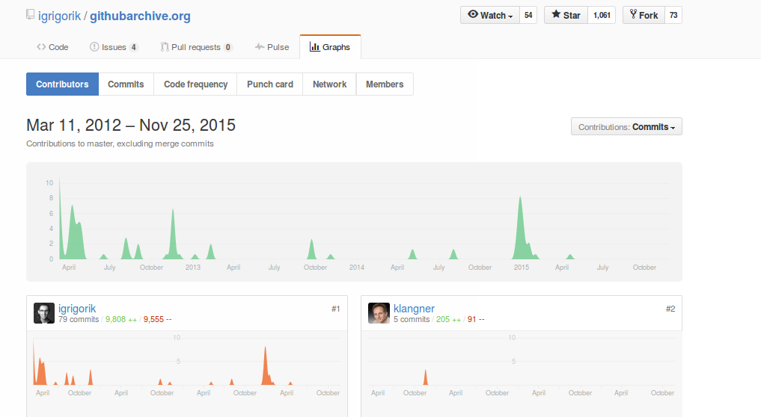
The data has always/already been collected by someone

Slide 13
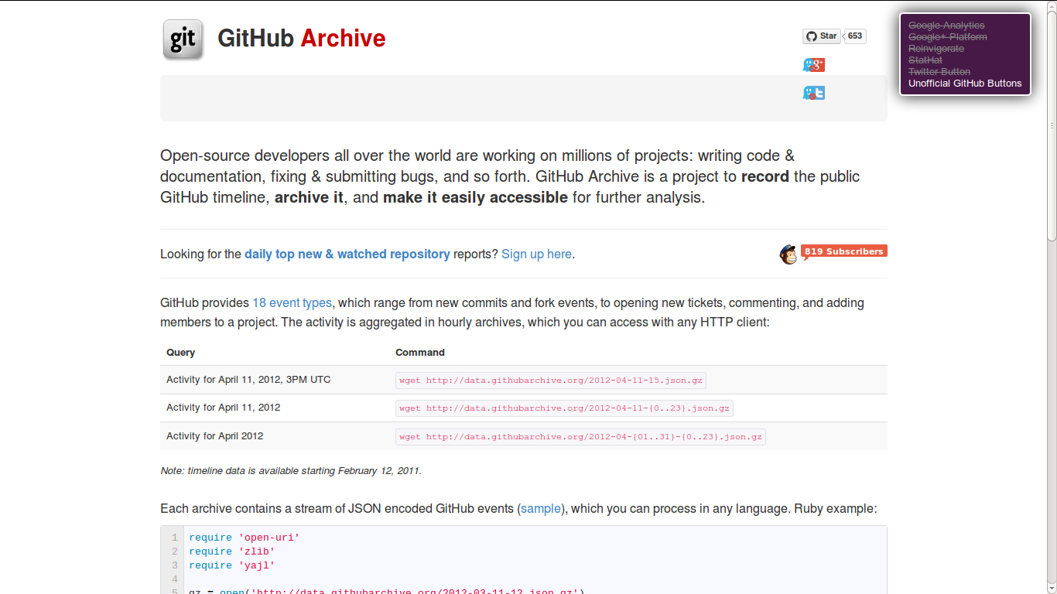
Public 'events: ~400 million (1 March 2011 – today)

Slide 14
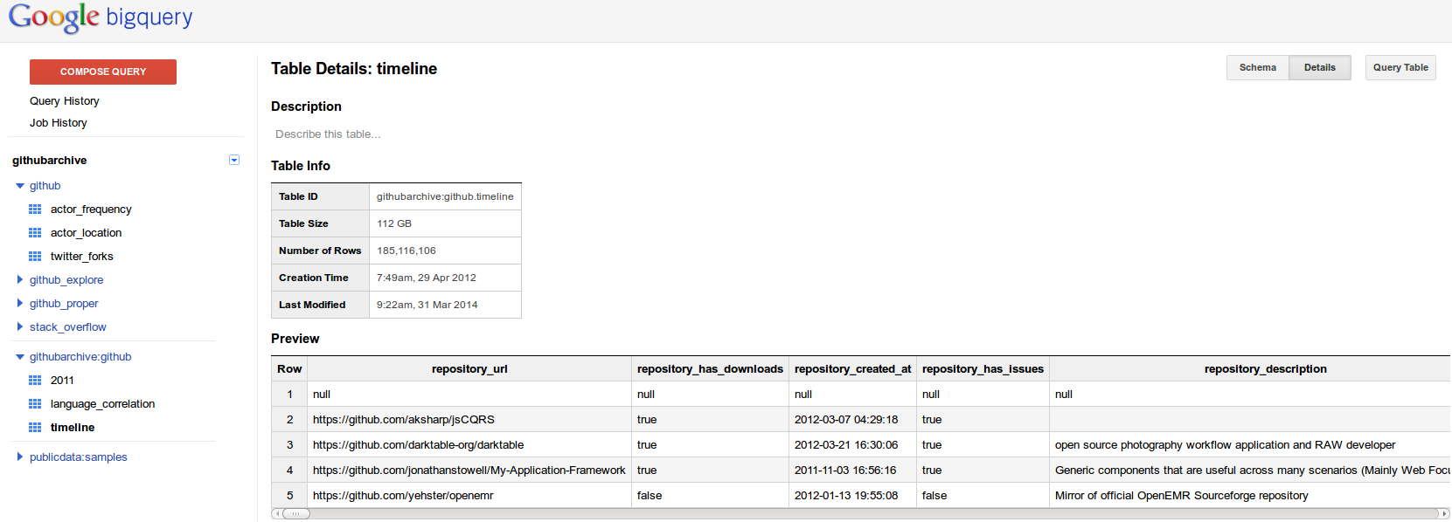
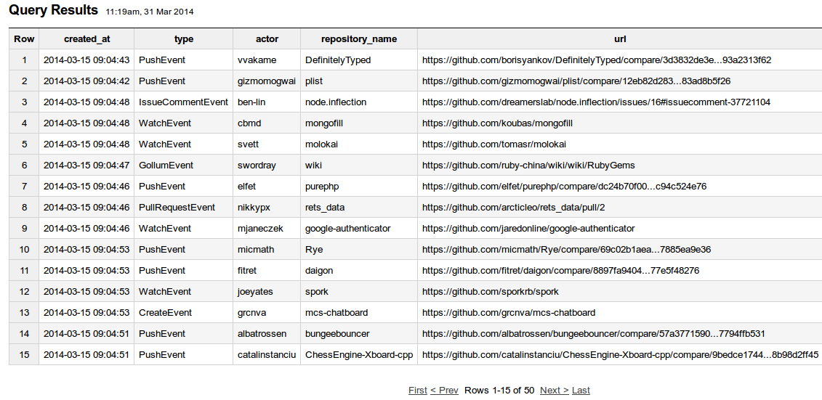
GoogleBigQuery: 'capturing and connecting of the huge data flows.' (ESRC Call)

Slide 15

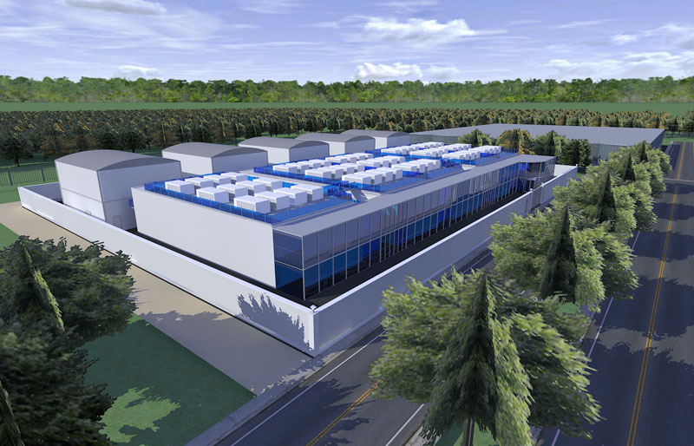
Steam billows from one query …

Slide 16
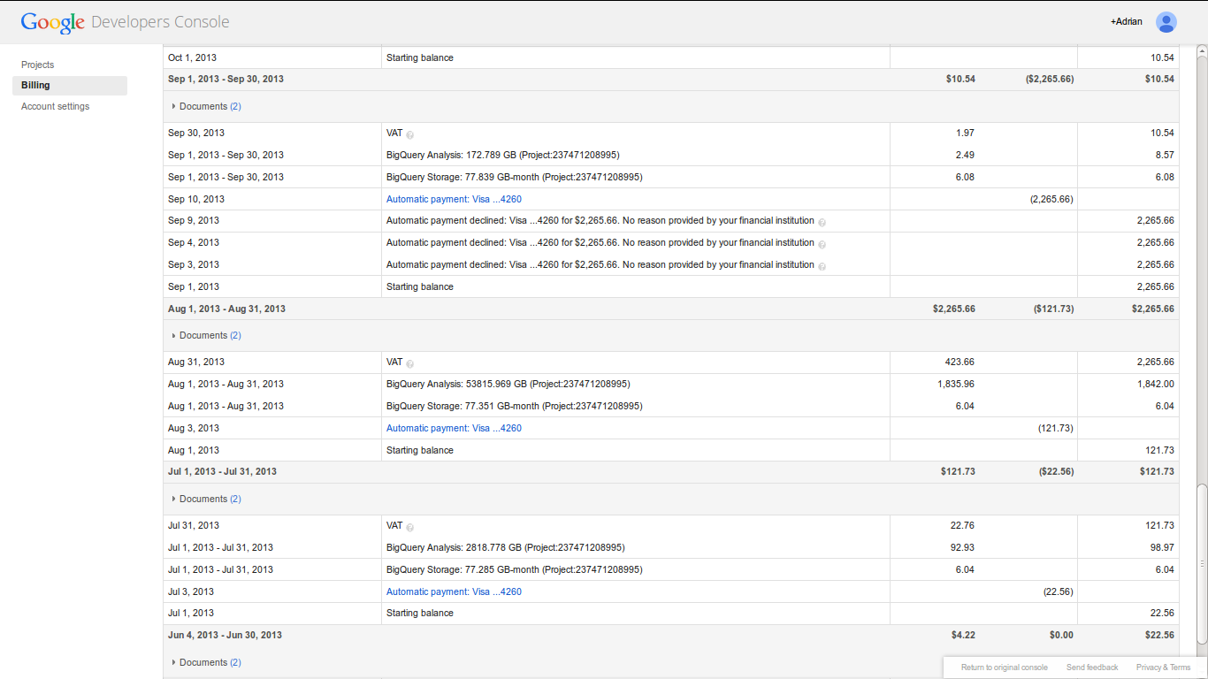
Big bill for big query: $USD1835 + $USD 420 VAT = $2200

Slide 17
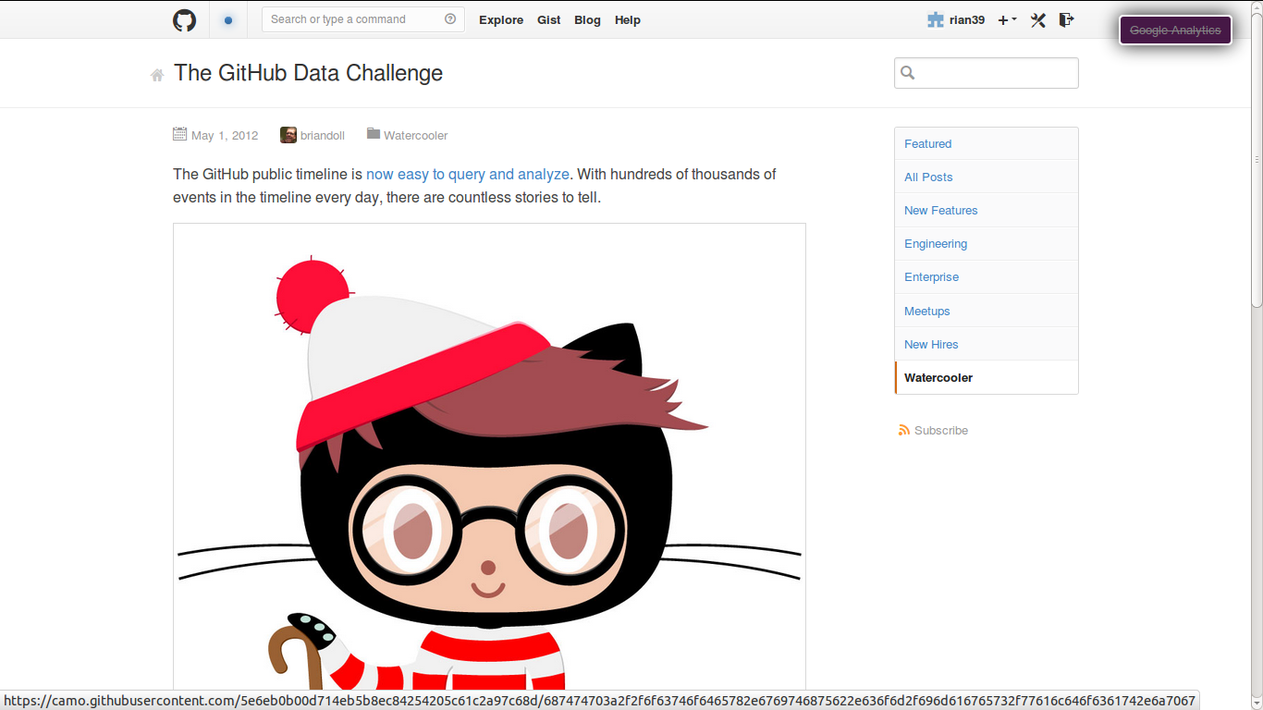
'Countless stories to tell': other people are working with the data

Slide 18
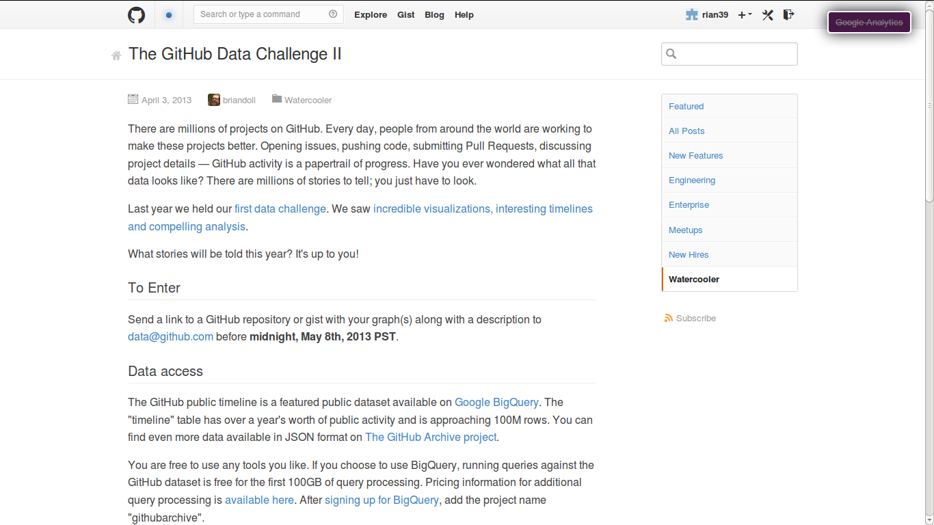
'What stories will be told this year? Its up to you'

Slide 19
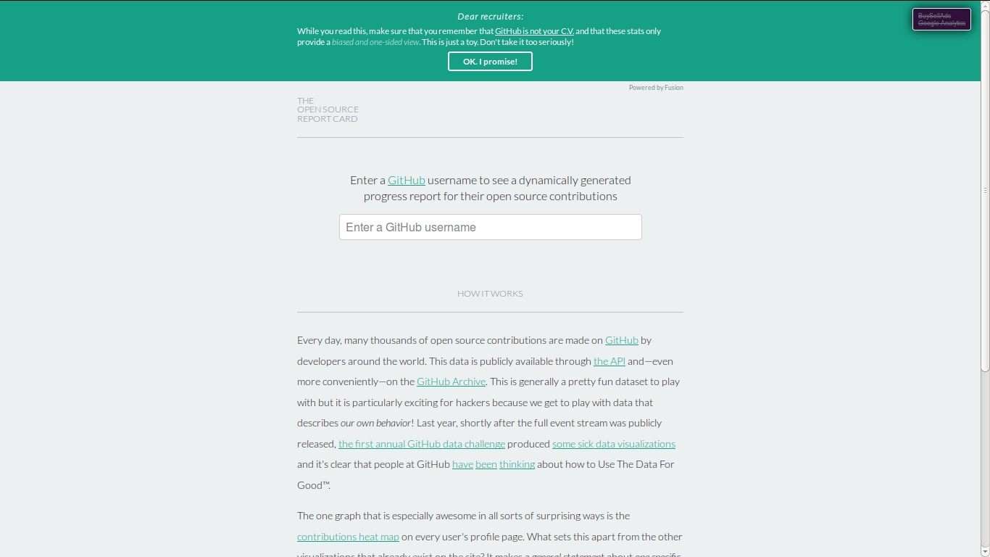
Typical stories: “all individuals are similar”

Slide 20
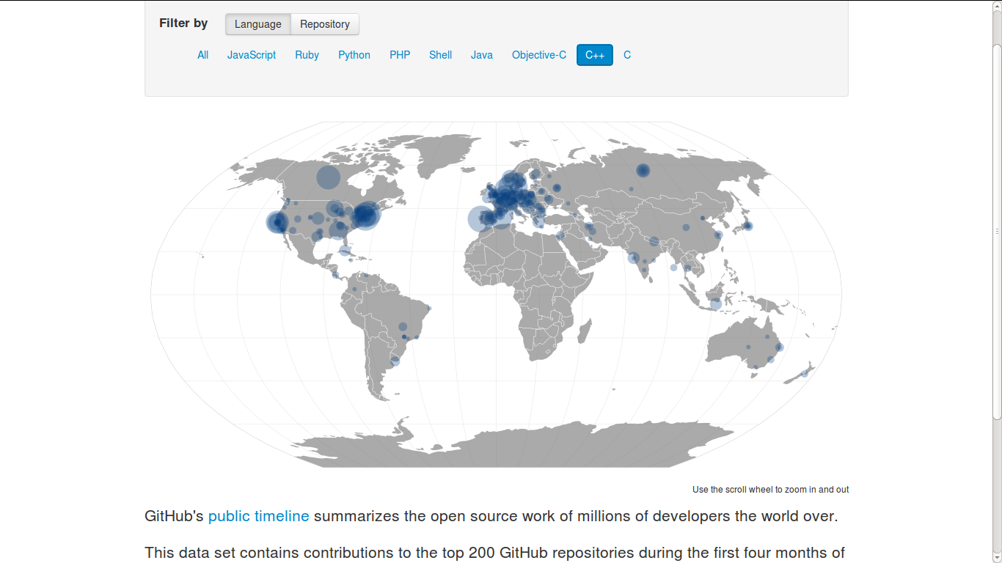
Stories: “Repositories live in familiar places: SF, NY, LON, etc.'

Slide 21
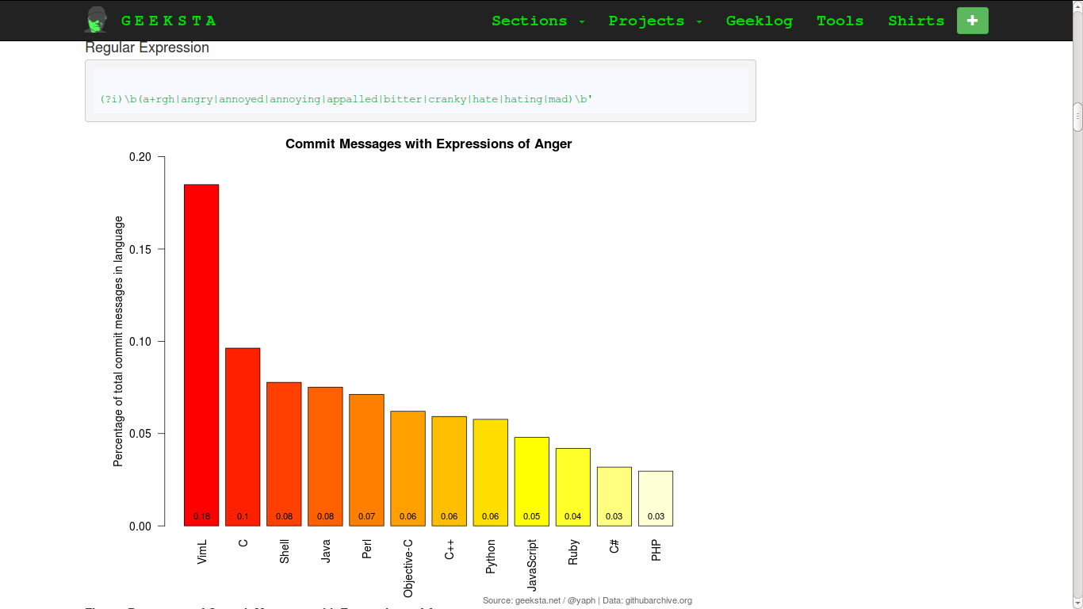
Story: 'coding is hard work'

Slide 22
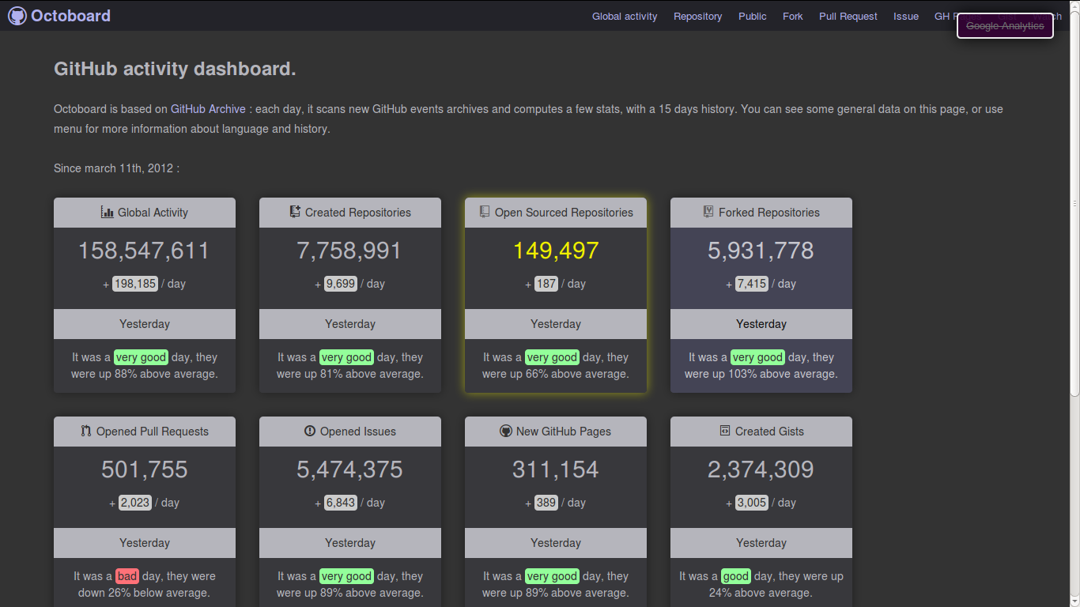
Story: 'we need live numbers'

Slide 23
Story: 'Code is a social network'

Slide 24

Story: 'Github data is an examplar for data-as-raw-material mining imaginary'

Slide 25
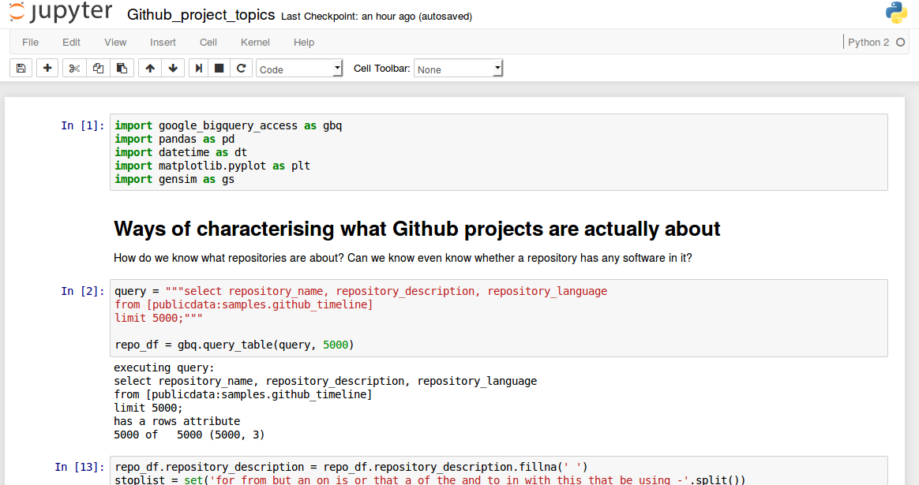
All questions are too difficult

Slide 26
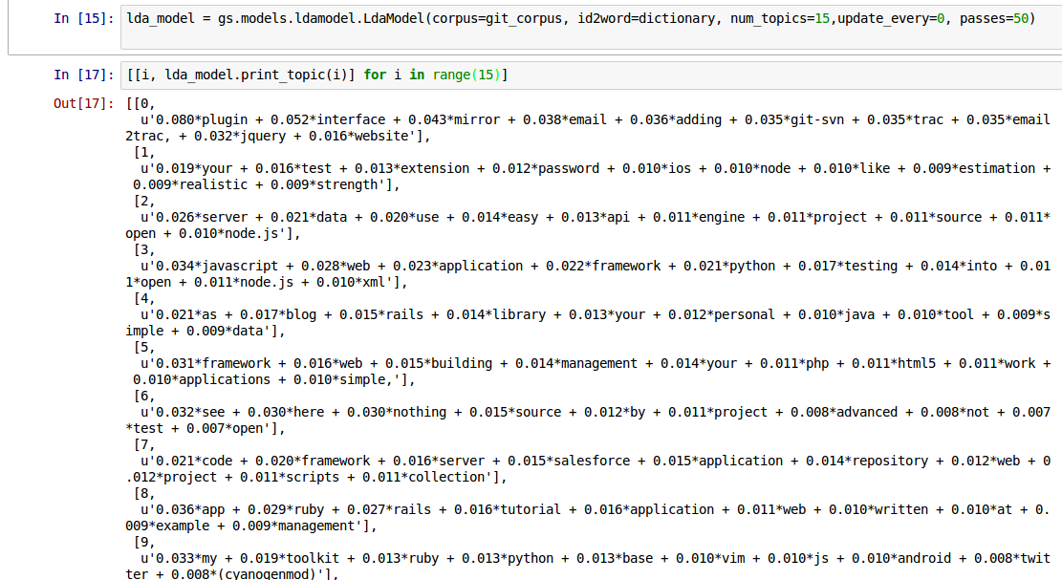
All questions are too difficult

Slide 27
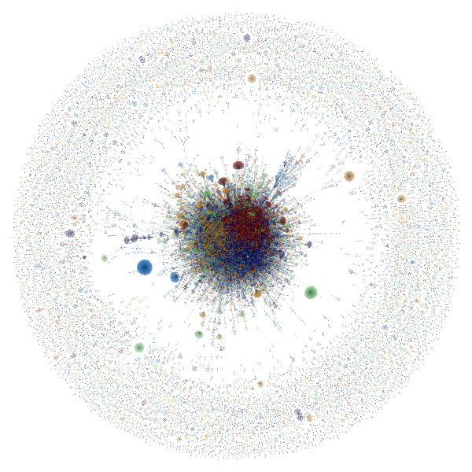
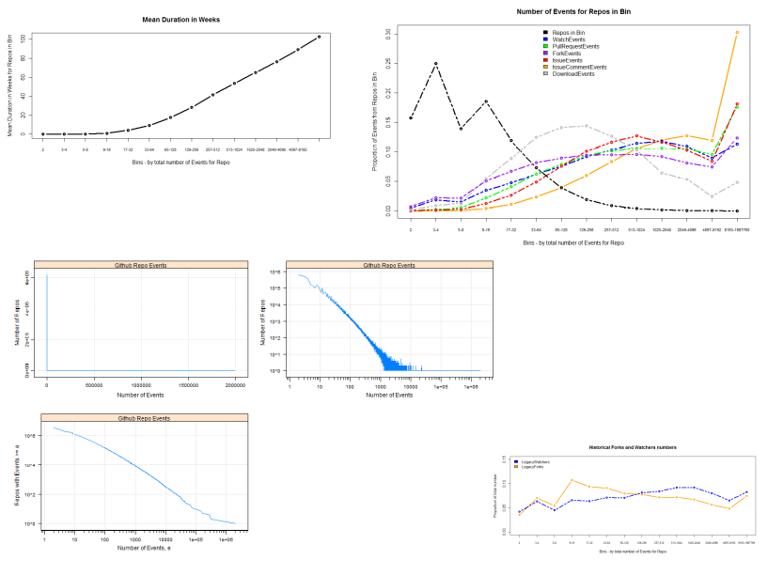
Statistician says 'no'
'Digital sociologist' says 'yes'
statistics
digital sociology?

Slide 28
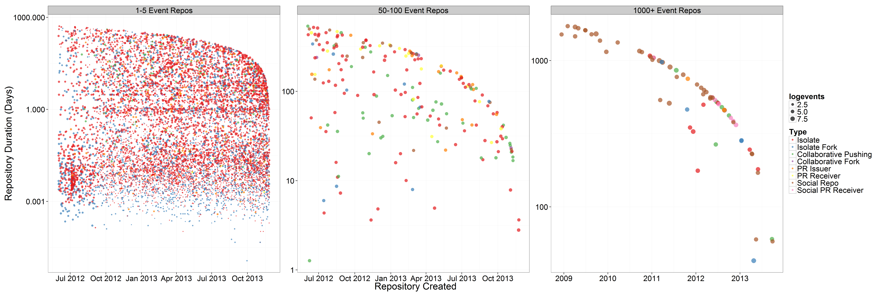
After failing to extract wealth from the raw material, something shiny appears
The millions repositories on Github are most ephemeral imitations

Slide 29
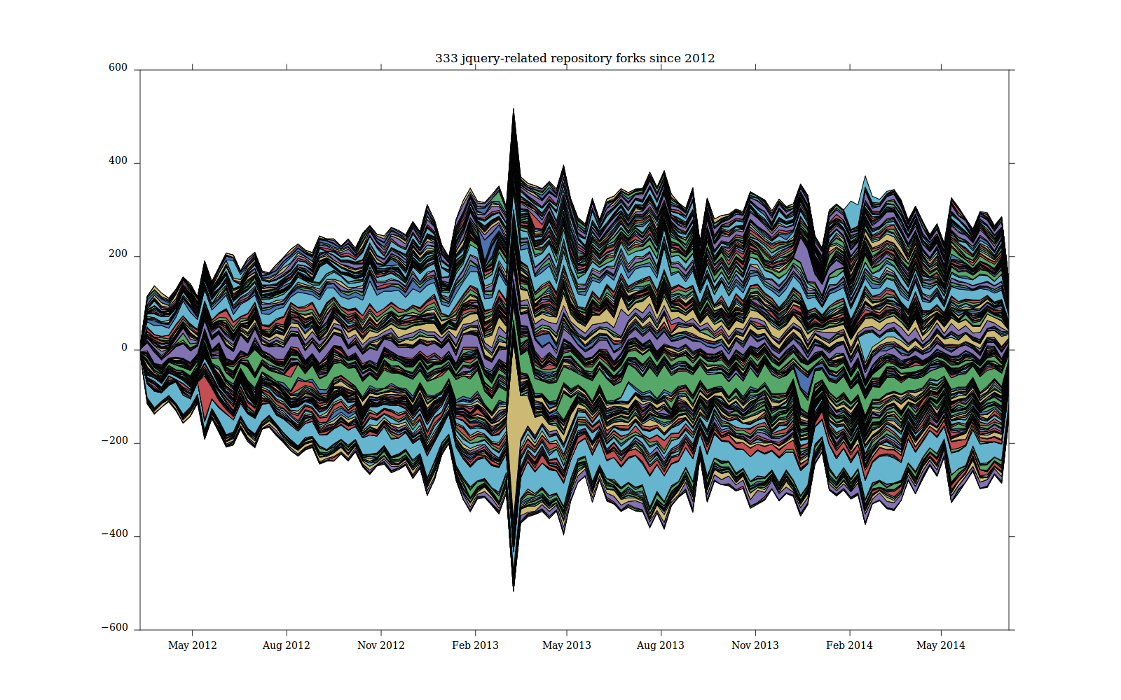
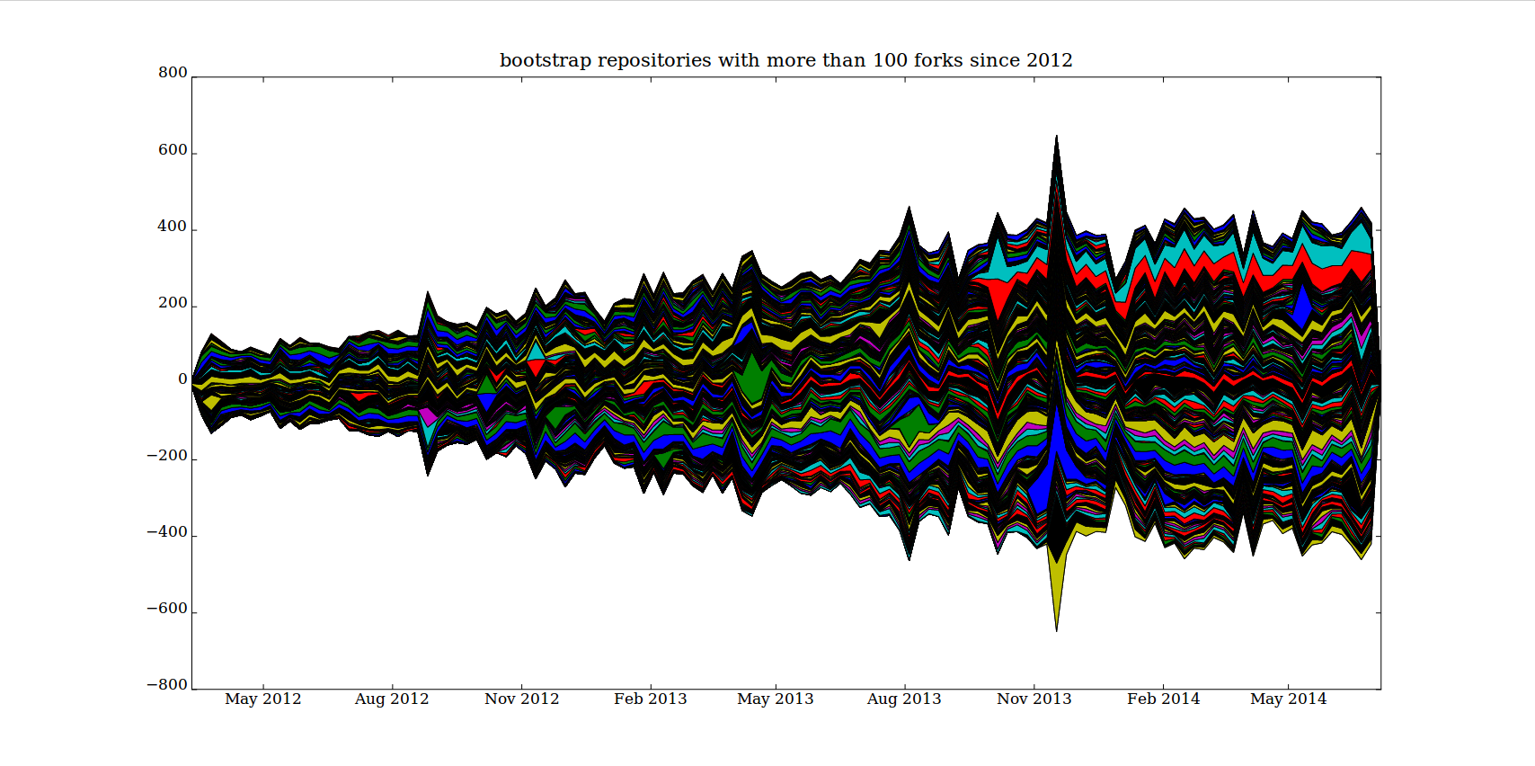
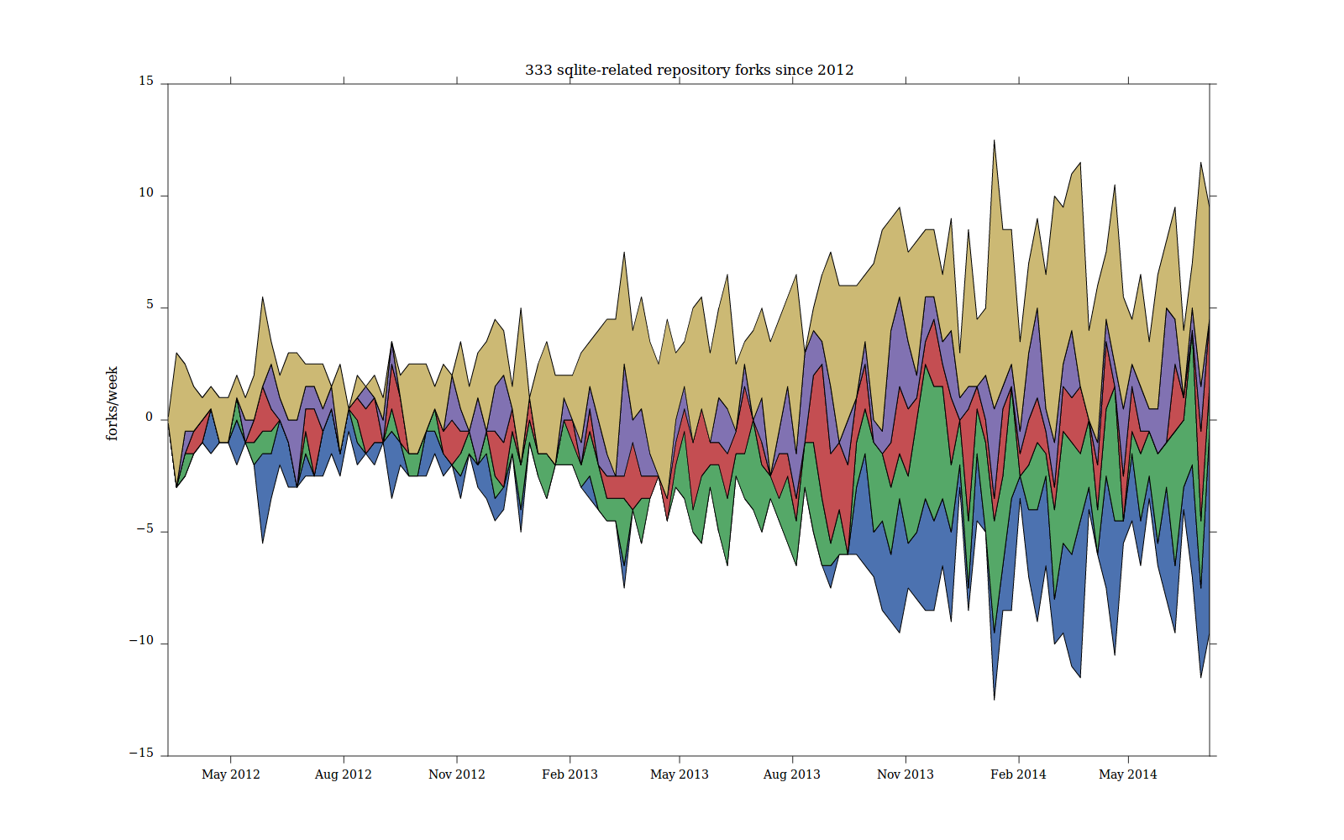
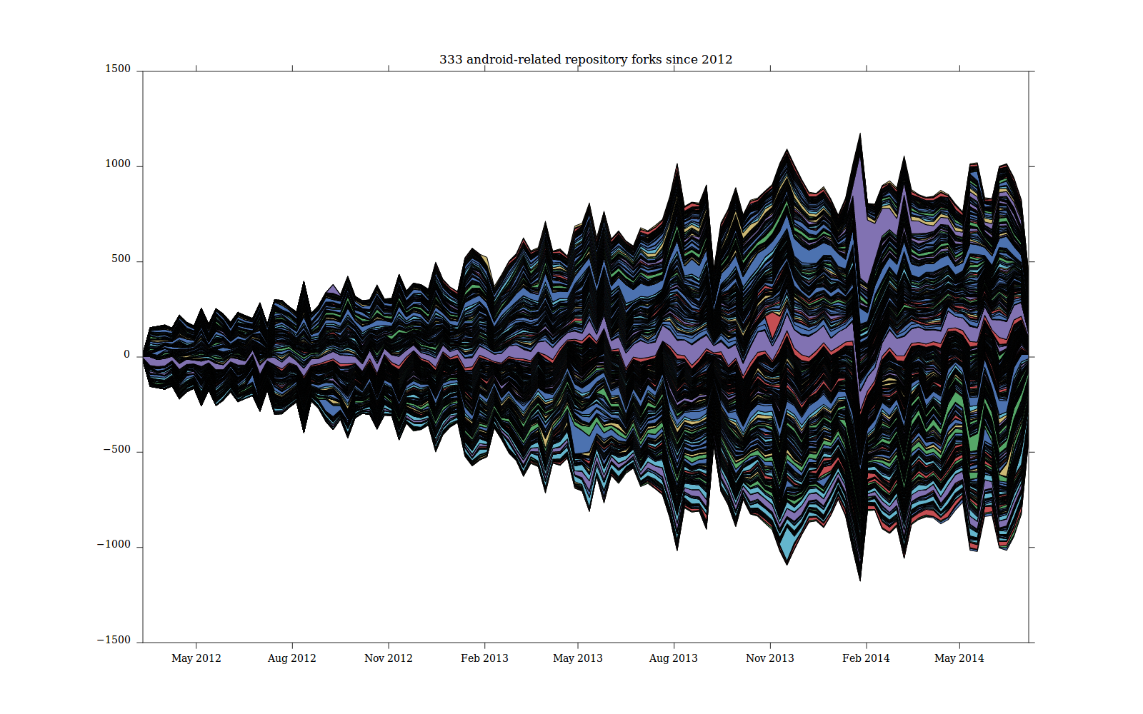
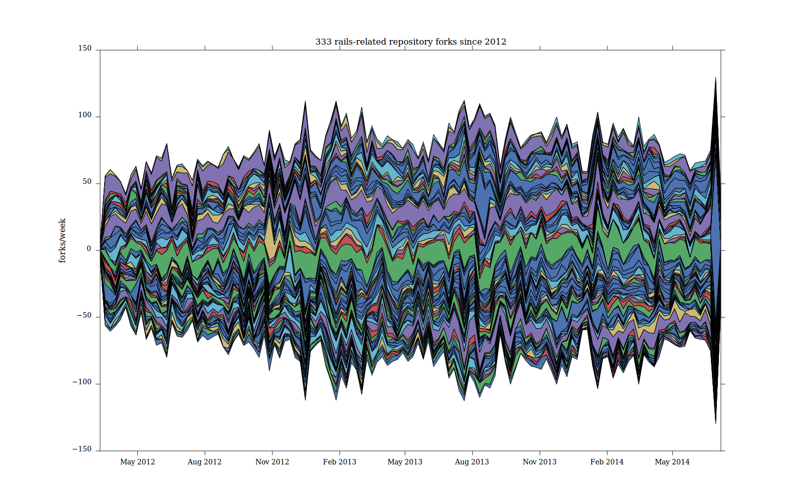
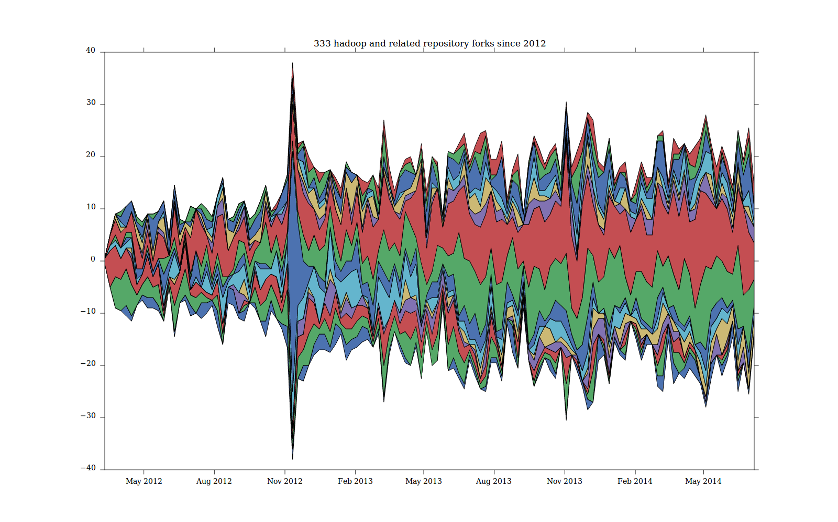
Mapping imitative fluxes: follow the copying of names across repositories

Slide 30
Conclusions? Work in the data-as-raw-material imaginary
Data-as-raw-material imaginary is very disconnected from the liveliness of the data
STSish responses:
  Traceability (Latour) assumes data is a trace left behind.
  Device-specific research suggests all traces are 'mixtures' that continue to format, attract, and overflow
  Large numbers can be re-scaled by attending to imitative fluxes
Re-scaling large numbers might be politically useful

Slide 31
Acknowledgements
Research funded by ESRC (UK Economic and Social Research Council) under 'Google Data Analytics' programme, 2013-2014
Richard Mills and Stuart Sharples – research associates
Matthew Fuller (Goldsmiths) and Andrew Goffey (Nottingham) – co-researchers

