Slide 1
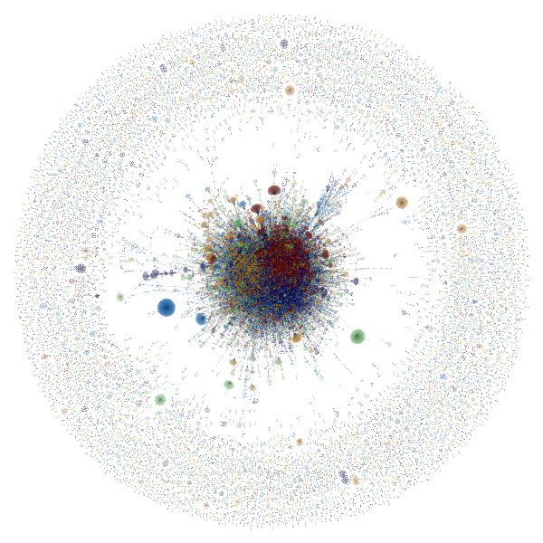
Many names and large numbers: methods for imitative fluxes in the data-as-raw-material imaginary?
Adrian Mackenzie
Sociology, Lancaster University

Slide 2
Overview: Github case
Github as social media platform that hosts ~20 million code repositories;
  Compare earlier accounts of coding (Kelty – recursive publics; Coleman – coding freedom)
  Github code as symptom of and infrastructure for burgeoning post-social attachments;
Github as example of large number (N=ALL)
  the contemporary political economies of counting and graphing the many or the N = ALL
  obstacles to and potentials for number-based ethnographic sensibilities;
  how to re-count and make large numbers
  What work numbers makes us do;

Slide 3
Part A: Post-social attachments in code

Slide 4
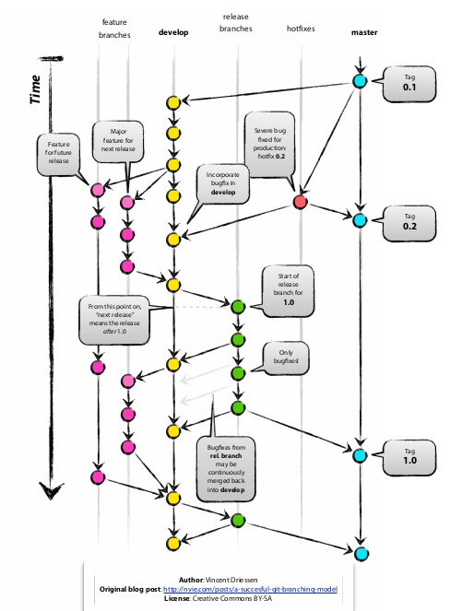
Github: post-social attachments in collective coding
“Since these markets are exteriorized and concentrated on screen, traders not only participate in these markets, they relate to them as a complex ‘other’ with which they are strongly, even obsessively, engaged. The term ‘postsocial relationships’ refers to new kinds of bonds such as those constructed between humans and objects.”
Knorr-Cetina, “Traders' Engagement with Markets. A Postsocial Relationship, ” 2002, 162
“Since these repositories are exteriorized and concentrated on screen, coders not only participate in these repositories, they relate to them as a complex ‘other’ with which they are strongly, even obsessively, engaged. The term ‘postsocial relationships’ refers to new kinds of bonds such as those constructed between humans and objects.”
Mackenzie, “Coder's Engagement with Code Repositories', ~ ~

Slide 5
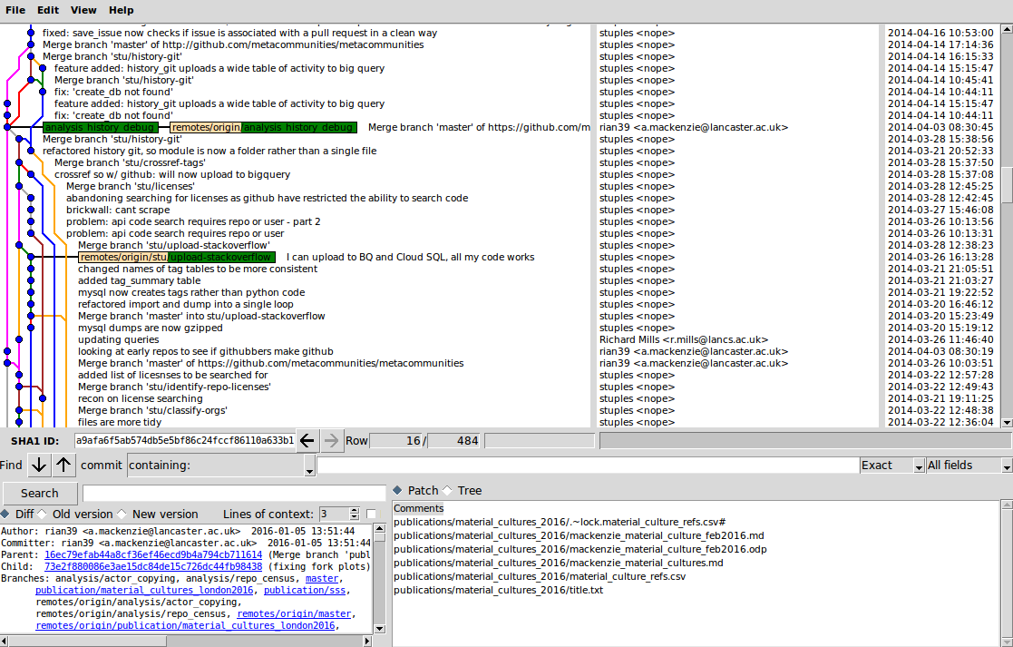
Ethnography also becoming post-social?

Slide 6
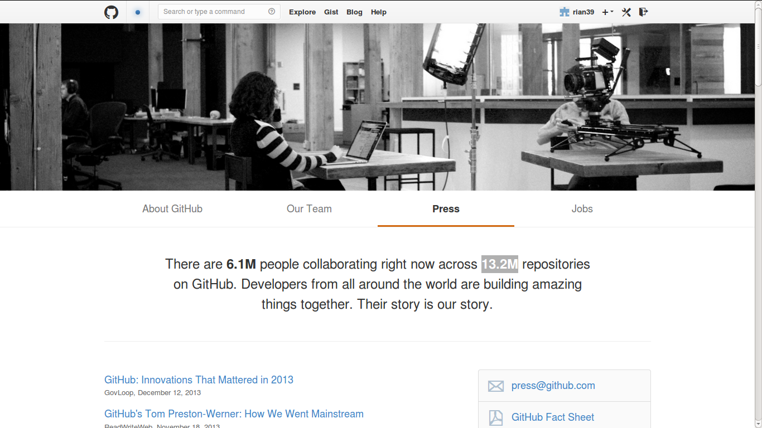
November 2013: Github founder resigns after sexual harrassment claims
'Their story is our story'

Slide 7
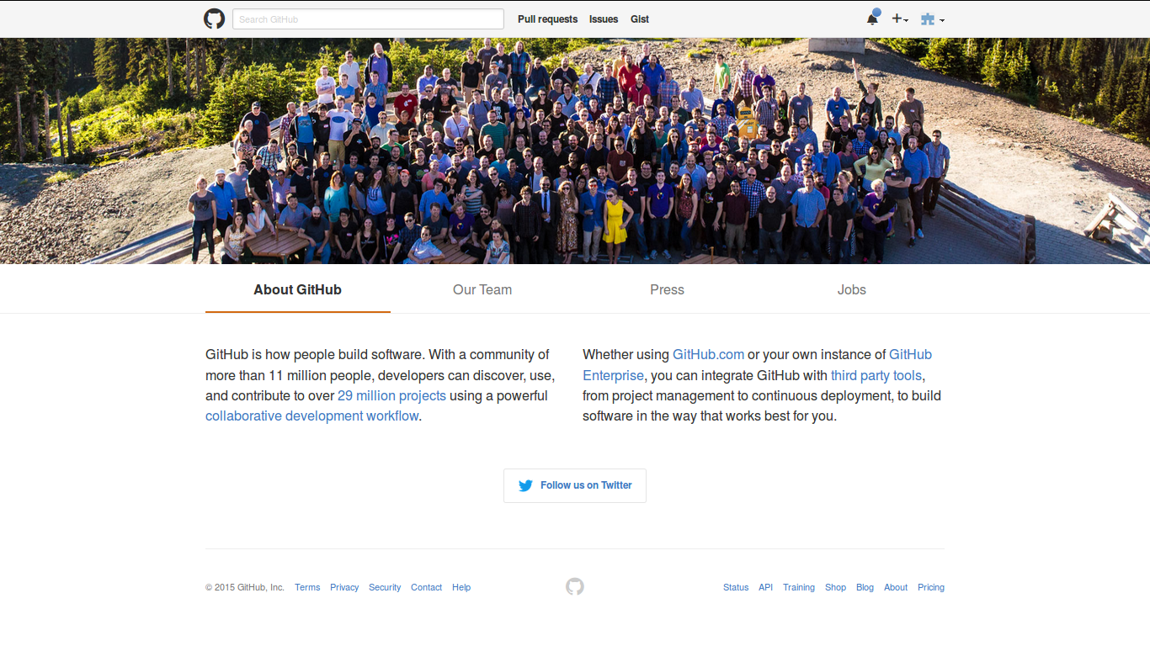
November 2013

Slide 8
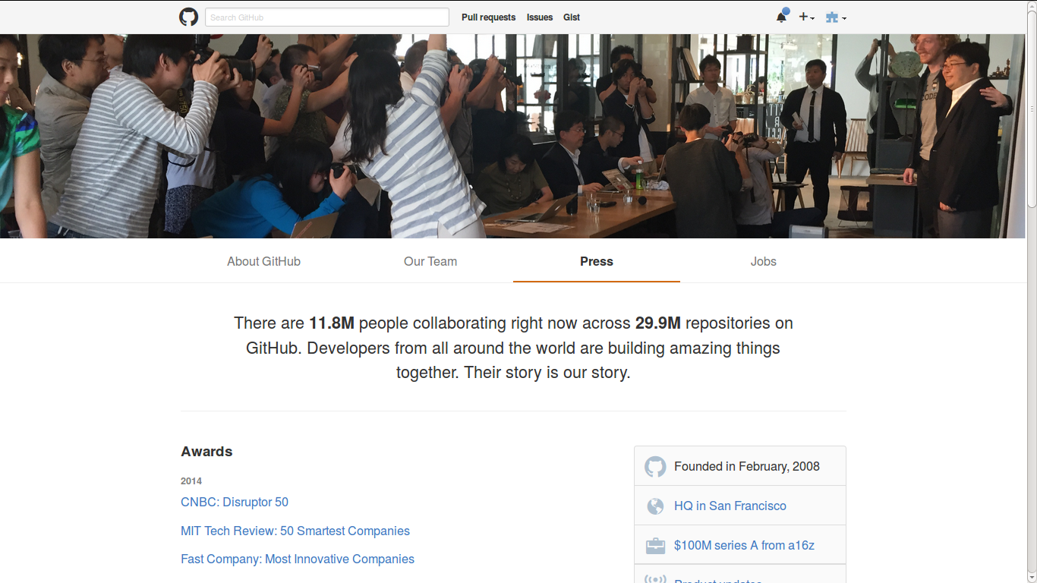
November 2015: China denial of service attack

Slide 9
Part B: Data-as-raw-material imaginary*
* imaginary: unstable cluster of statements/articulations whose relations concern sense of whole + sensible forms projected as densities, boundaries, or diagrammatic connection

Slide 10
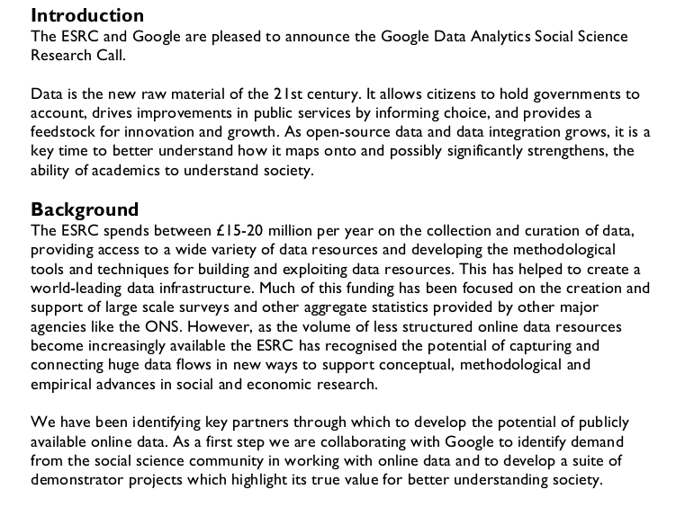
Data-as-raw-material imaginary?

Slide 11
The problem(s) of numbers
In any practical going-on with numbers, what matters is that they can be made to work, and making them work is a politics. Yet this is a politics that completely evades conventional foundationist analysis (Verran, 2001: 88)

Slide 12

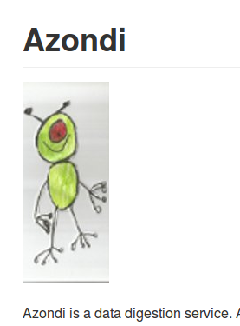
Data as raw material?
http://api.github.com/events
Event
information
{
"id": "2111998059",
"type": "WatchEvent",
"actor": {
"id": 1459103,
"login": "mmemetea",
"gravatar_id": "4532d1e4885f579ca7d9aa8748418817",
"url": "https://api.github.com/users/mmemetea",
"avatar_url": "https://avatars.githubusercontent.com/u/1459103?"
},
"repo": {
"id": 14802742,
"name": "OpenSensorsIO/azondi",
"url": "https://api.github.com/repos/OpenSensorsIO/azondi"
},
"payload": {
"action": "started"
},
"public": true,
"created_at": "2014-05-23T08:40:56Z",
"org": {
"id": 5497318,
"login": "OpenSensorsIO",
"gravatar_id": "1e0218942846ec8ef59f5d679dbca782",
"url": "https://api.github.com/orgs/OpenSensorsIO",
"avatar_url": "https://avatars.githubusercontent.com/u/5497318?"
}
},
Actor information
Repository
Information

Slide 13
3 Perspectives on data and its analysis
Latour & Venturini, 2012 'The Whole is Smaller than the Part: How Digital Navigation May Modify Social Theory.'
– traceability frees social theory from macro-micro split
Marres, Noortje, 2013, 'The redistribution of methods: on intervention in digital social research, broadly conceived'
- device-specific research must look at platform-data format and what overflows it
Gill, Ros, and Andy Pratt. 2008. ‘In the Social Factory?: Immaterial Labour, Precariousness and Cultural Work’.
- symbolic-analytical work is changing (including ours?)

Slide 14
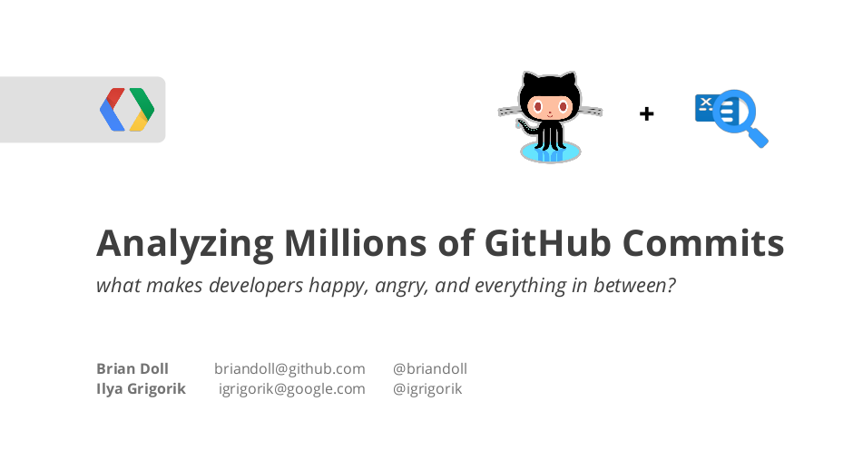
GithubArchive.org collects it all

Slide 15
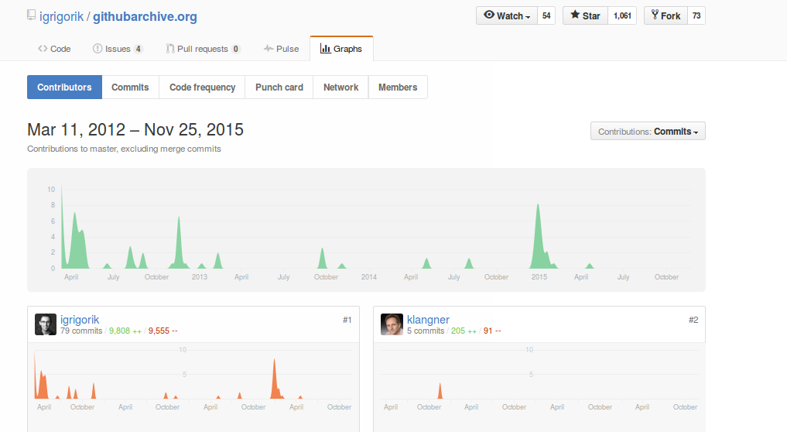
The data has always/already been collected by someone

Slide 16
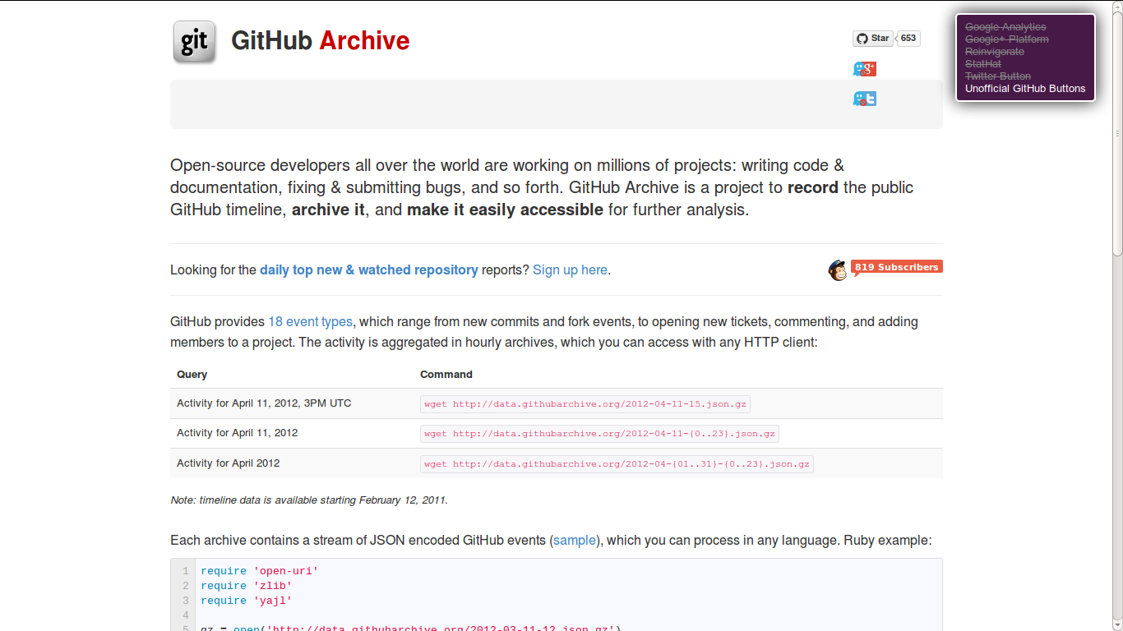
Public 'events: ~400 million (1 March 2011 – today)

Slide 17
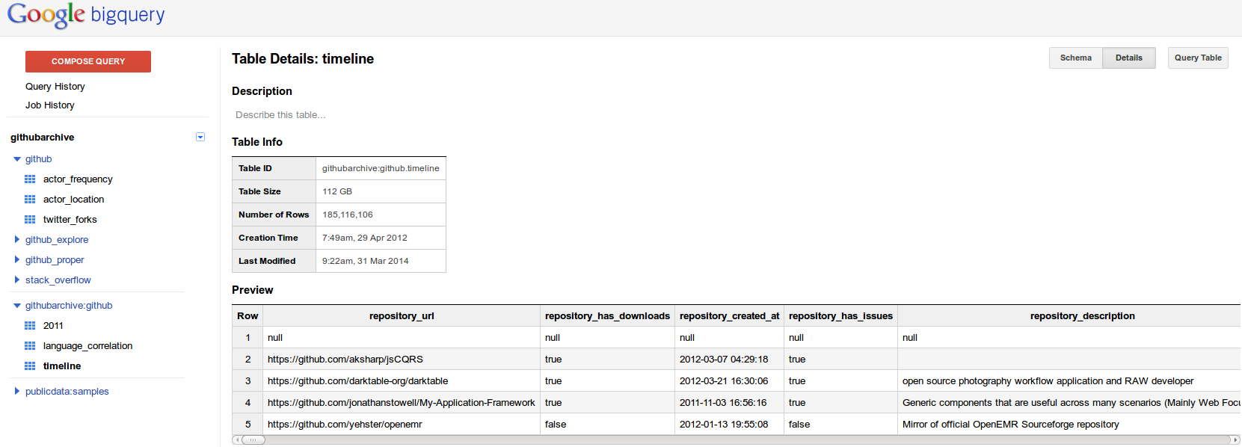
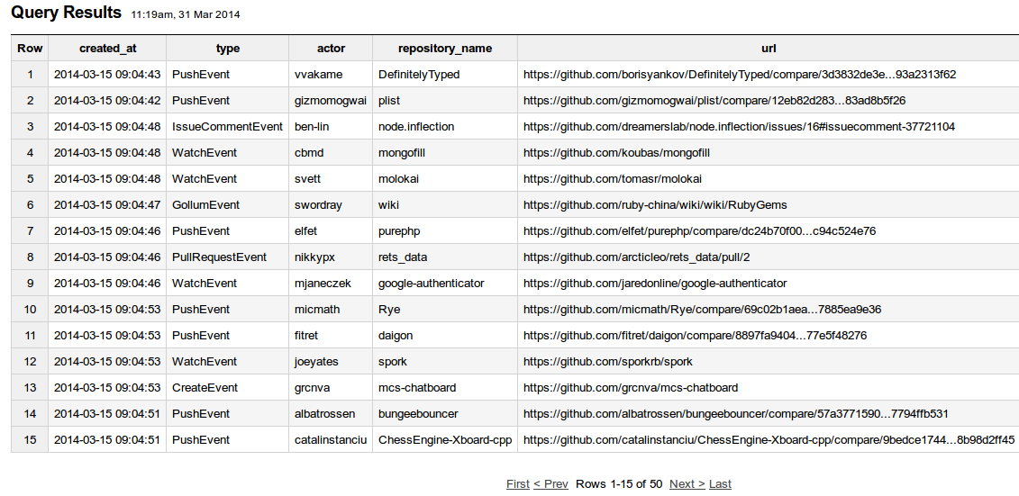
GoogleBigQuery: 'capturing and connecting of the huge data flows.' (ESRC Call)

Slide 18
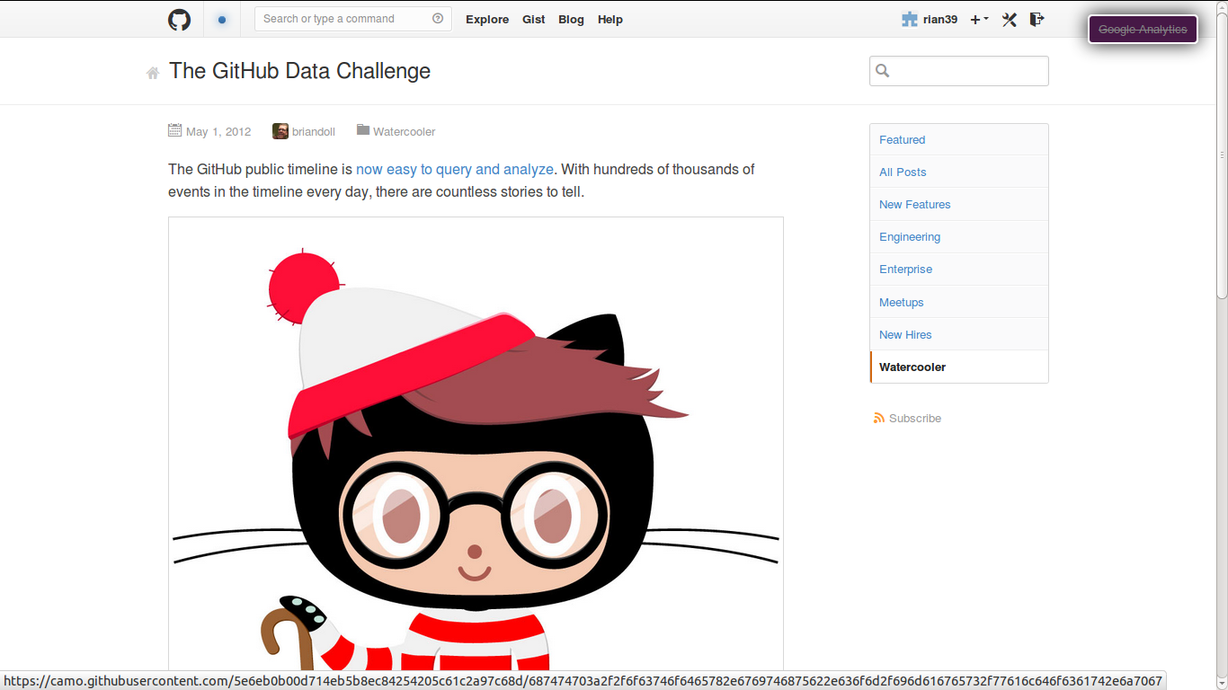
'Countless stories to tell': other people are working with the data

Slide 19
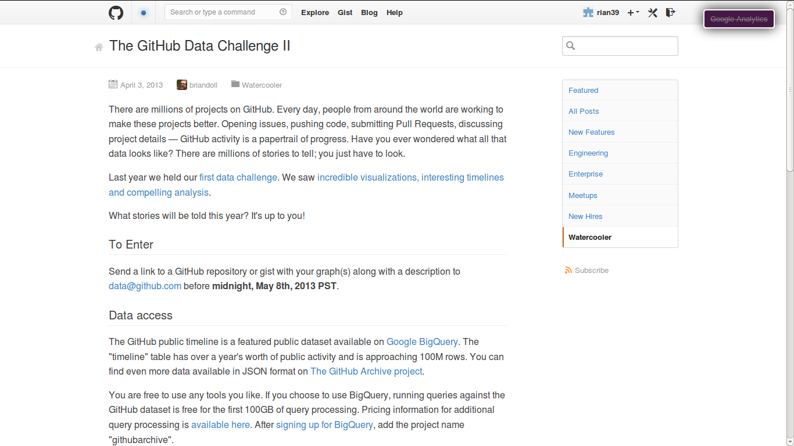
'What stories will be told this year? Its up to you'

Slide 20
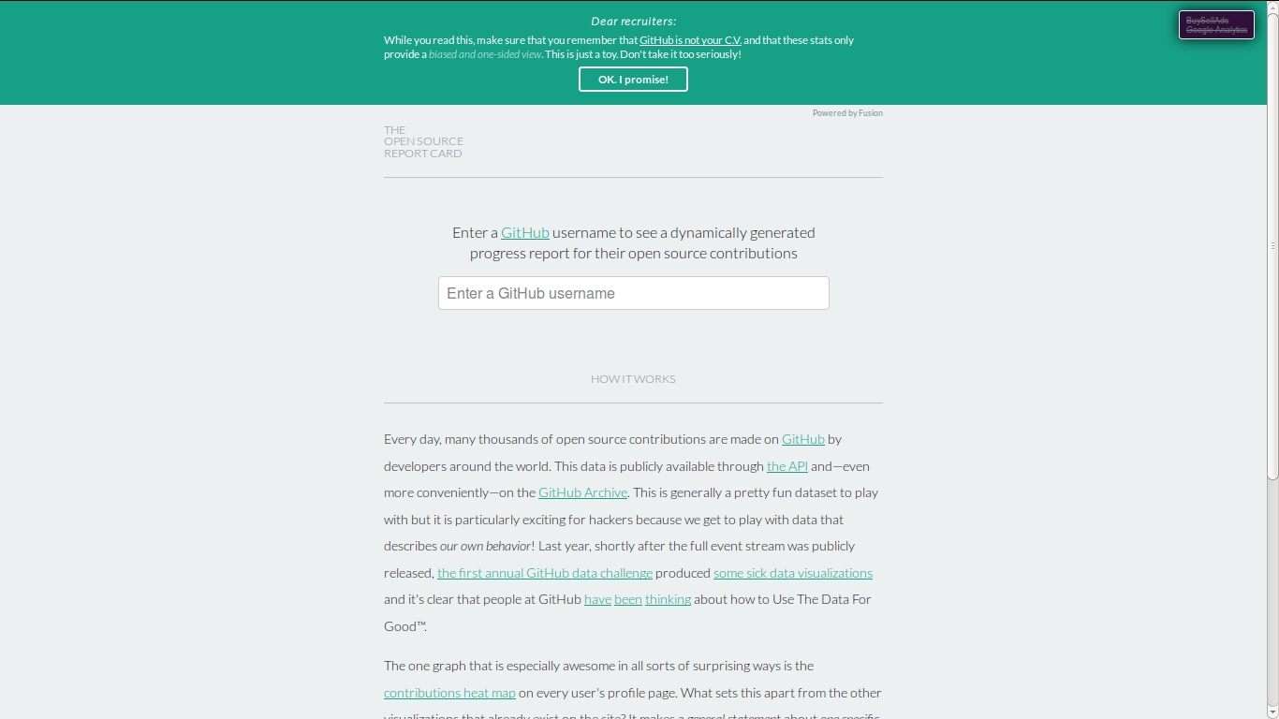
Typical stories: “all individuals are similar”

Slide 21
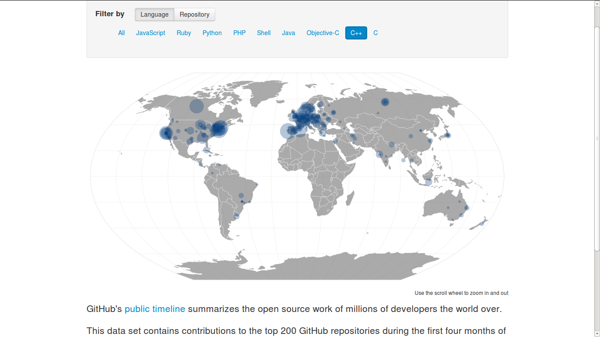
Stories: “Repositories live in familiar places: SF, NY, LON, etc.'

Slide 22
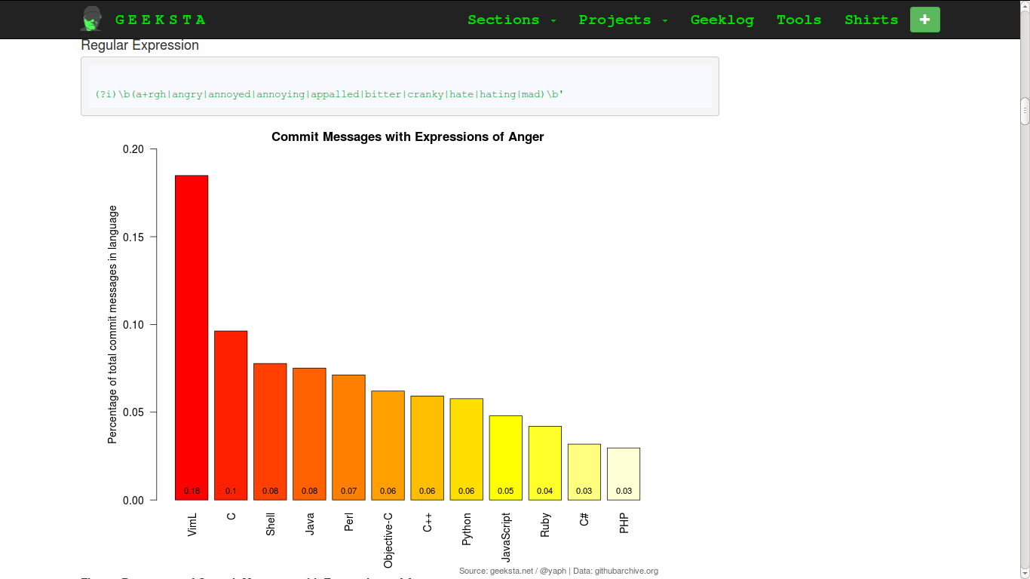
Story: 'coding is hard work'

Slide 23
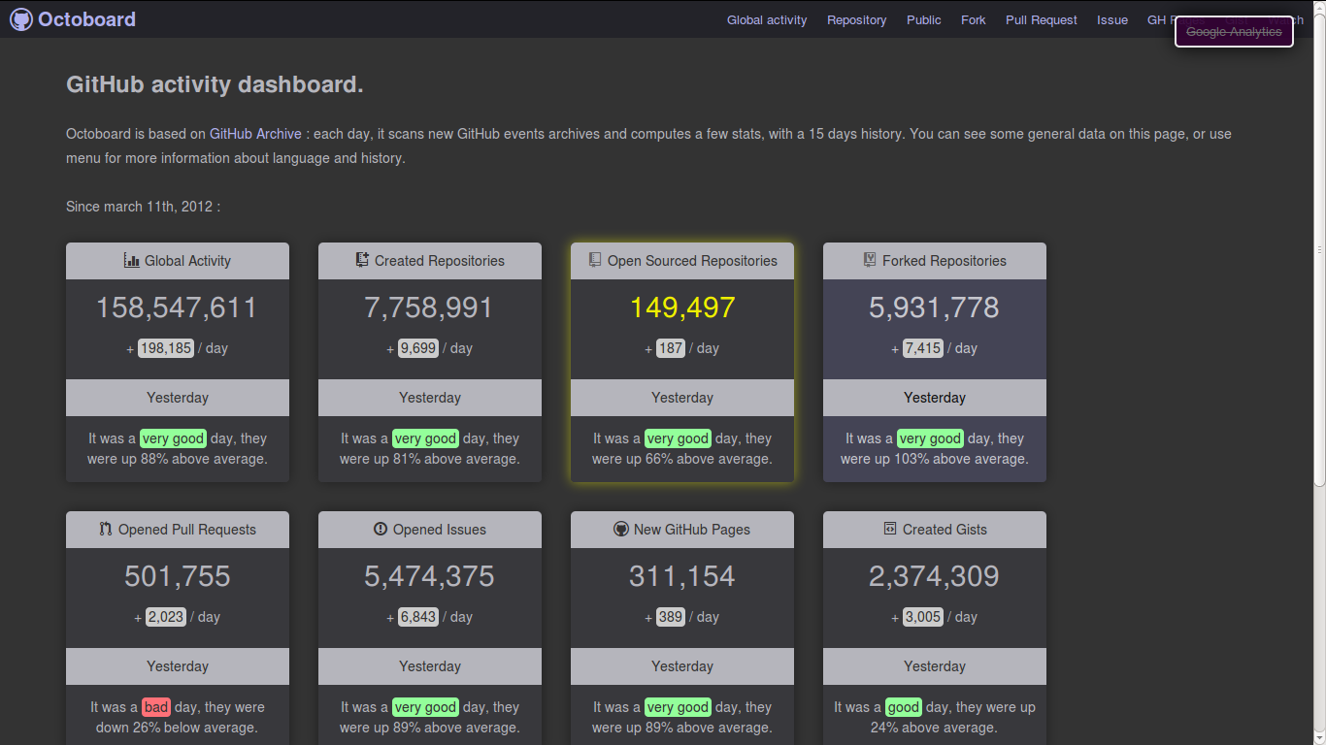
Story: 'we need live numbers'

Slide 24
Story: 'Code is a social network'

Slide 25

Story: 'Github data is an examplar for data-as-raw-material mining imaginary'

Slide 26
Part C: re-counting 'capital numbers'

Slide 27
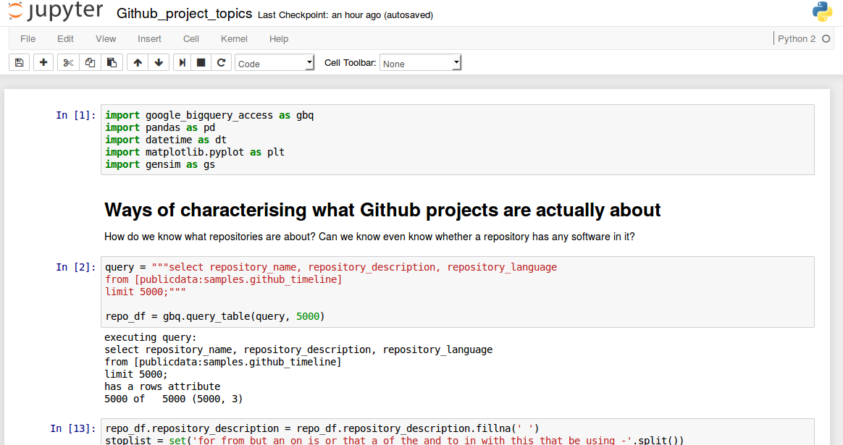
Statistician to digital sociologist: “All your questions are too difficult”

Slide 28
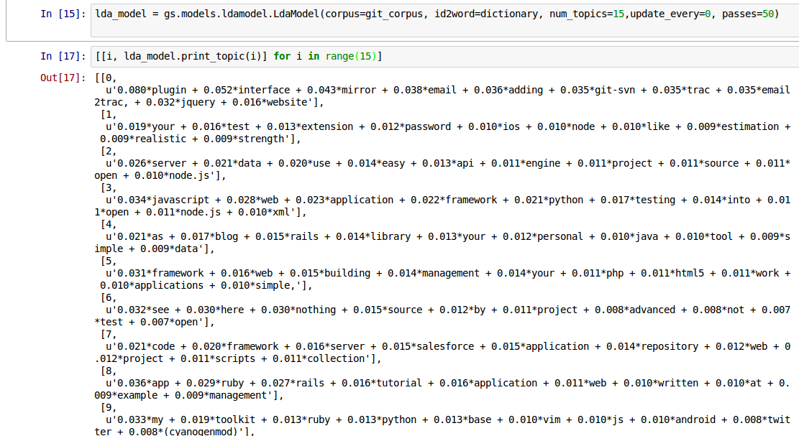
“All questions are too difficult” Use big analytics?

Slide 29
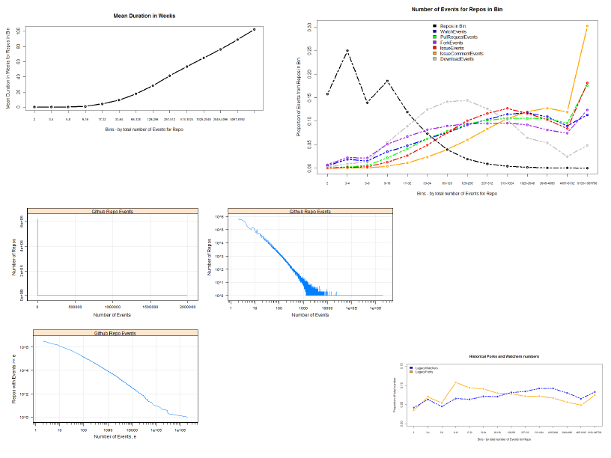
Statistician says 'no'
'Digital sociologist' says 'yes'
statistics
digital sociology?

Slide 30

Statistician says 'yes'

Slide 31

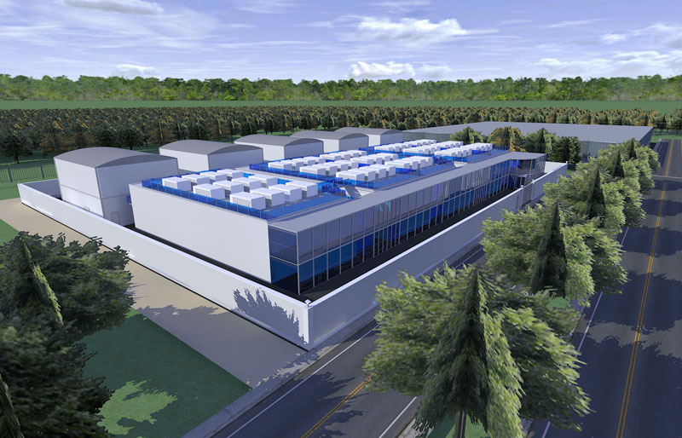
Steam billows from one query …

Slide 32
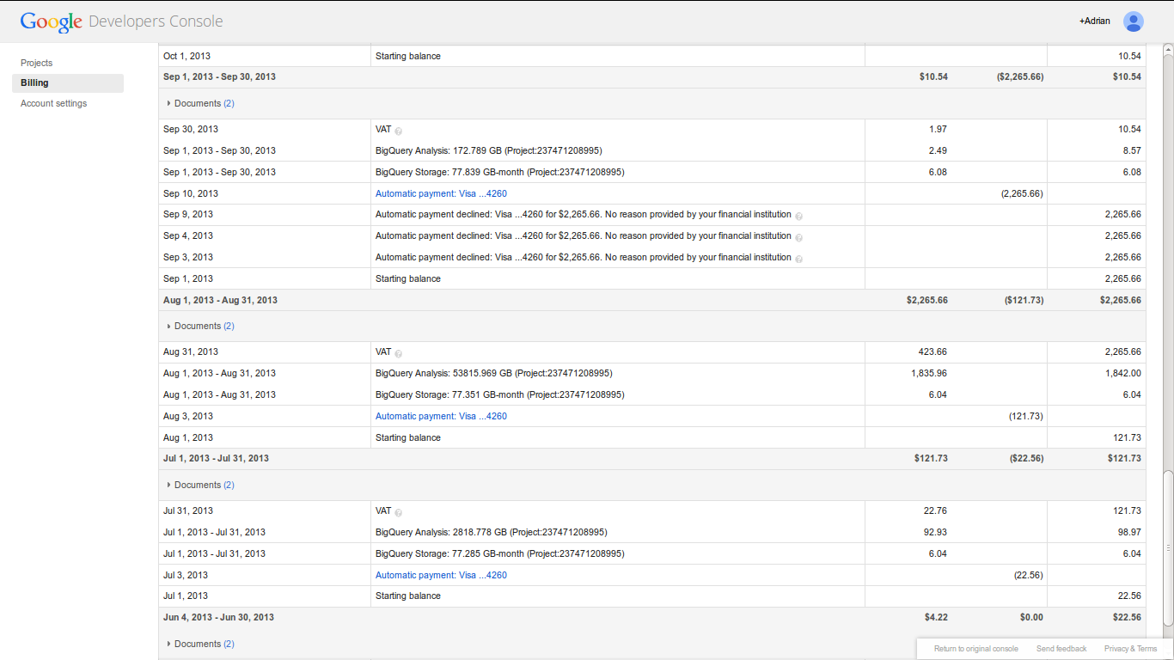
Big bill for big query: $USD1835 + $USD 420 VAT = $2200

Slide 33
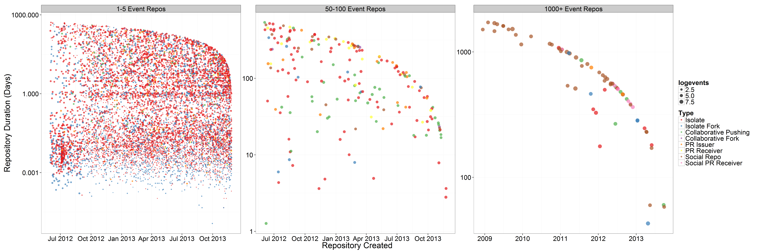
“Give me something chunky”
The millions repositories on Github are mostly ephemeral imitations

Slide 34
Early repositories ( c. 2008)
Recent repositories (c. 2014)
1 mojombo/grit
2 wycats/merb-core
3 rubinius/rubinius
4 mojombo/god
5 vanpelt/jsawesome
6 wycats/jspec
7 defunkt/exception_logger
8 defunkt/ambition
9 labria/restful-authentication
10 technoweenie/restful-authentication
11 technoweenie/attachment_fu
12 topfunky/bong
13 anotherjesse/s3
14 anotherjesse/taboo
15 mojombo/glowstick
16 wycats/merb-more
17 macournoyer/thin
18 jamesgolick/resource_controller
19 defunkt/cache_fu
20 bmizerany/sinatra
21 rtomayko/sinatra
22 jnewland/gsa-prototype
23 defunkt/mofo
24 schacon/ruby-git
25 mmower/simply_versioned
26 abhay/calais
27 mojombo/chronic
28 al3x/git-wiki
29 schacon/git-wiki
30 sr/git-wiki
31 queso/signal-wiki
32 drnic/ruby-on-rails-tmbundle
33 danwrong/low-pro-for-jquery
34 mojombo/yaws
35 grempe/amazon-ec2
36 peterc/switchpipe
37 up_the_irons/ebay4r
38 wycats/merb-plugins
39 atmos/fitter_happier
40 brosner/oebfare
41 cristibalan/braid
42 evilchelu/braid
43 jnicklas/uploadcolumn
44 engineyard/eycap
45 chneukirchen/gitsum
46 brosner/django-mptt
47 technomancy/bus-scheme
48 Caged/groomlake
49 sevenwire/forgery
50 lazyatom/soup
1 2m1tsu3/practice
2 tylerdmace/ledomme
3 yehiaelghaly/xssya
4 istvan-antal/commandjs
5 JohnKrigbjorn/ObjectOne
6 chenx/Ci35_1
7 mohsenbezanj/AI_Project
8 Dineshkarthik/blogengine
9 sapanbhuta/Sapari
10 gwoodroof/chat-gwoodroof
11 tryuichi/Hello-World
12 prateek0020/NepTravelMate
13 discoverfly/discoverfly.github.io
14 evan-007/ng-wikiful
15 sanemat/zipcode-jp
16 donreamey/PJKiller
17 discoverfly/discover
18 jkkorean/MIUI-KK
19 Artofacks1/ionic-app
20 jkkorean/MIUI-JB
21 tycho01/rails-i18n
22 Oksisane/Websockets
23 chenxiruanhai/XScrollView
24 jhonM17/footer-fixed-boostrap
25 McPringle/workshops
26 JosemyD/testing-laravel
27 wngravette/FlogResources
28 Ethico/temp
29 Tripod2K/cse223p
30 Parbhat/tango_with_django_1.6
31 ManuelAlanis/ios
32 kowito/pnxstudio
33 raimana/activiti_merger
34 dylanling/connect_four
35 vipseo2014/game-cho-android
36 dylanling/connect
37 analoq/temvoc
38 a554b554/algorithm-competition
39 a7657z/12306_2
40 scwuhao/jumpybloc
41 jjfine/post_mail
42 h4di/PROYEK-TKPPL
43 EXOgreen/TwitchBot
44 ericcarpenterle/creepcreep
45 pt1490/ubuntu-example
46 tstrimple/cookie-parser
47 AngAven/Pulse
48 lyc4n/lyc4n.github.io
49 drjwhut/elebldc
50 mivim/fosiness

Slide 35
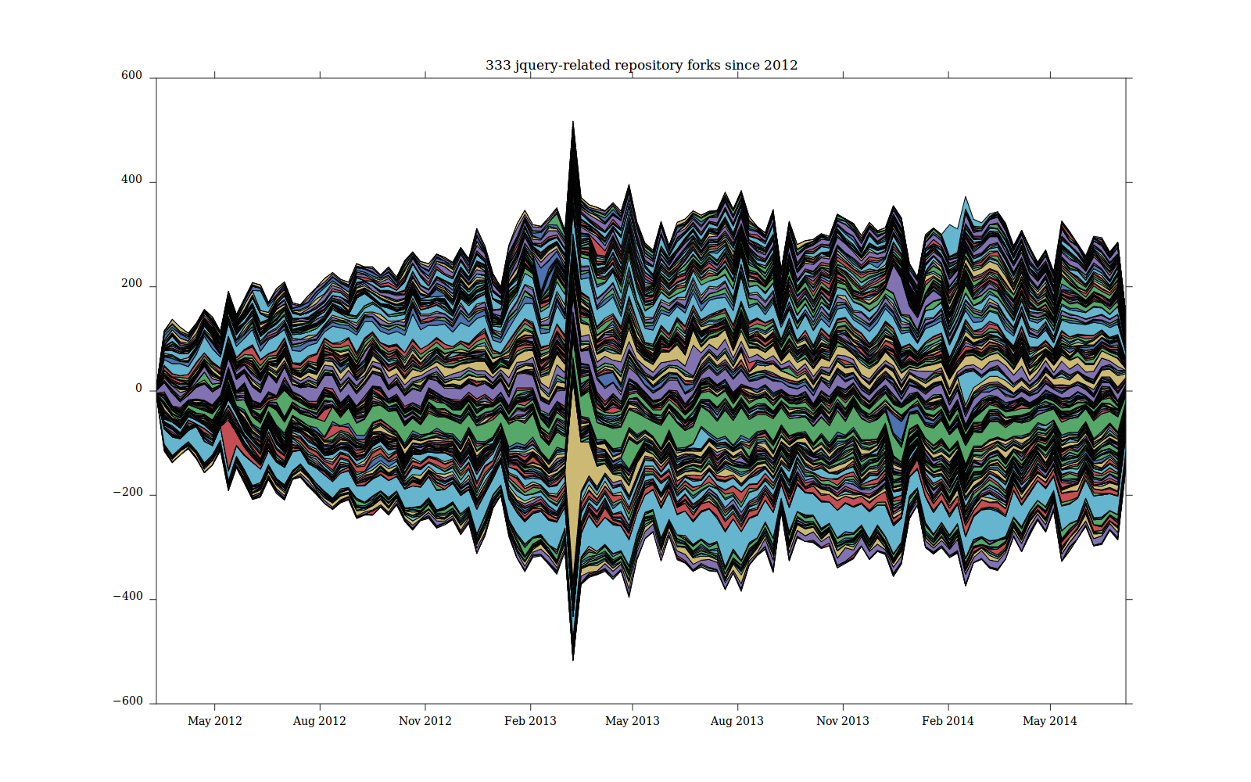
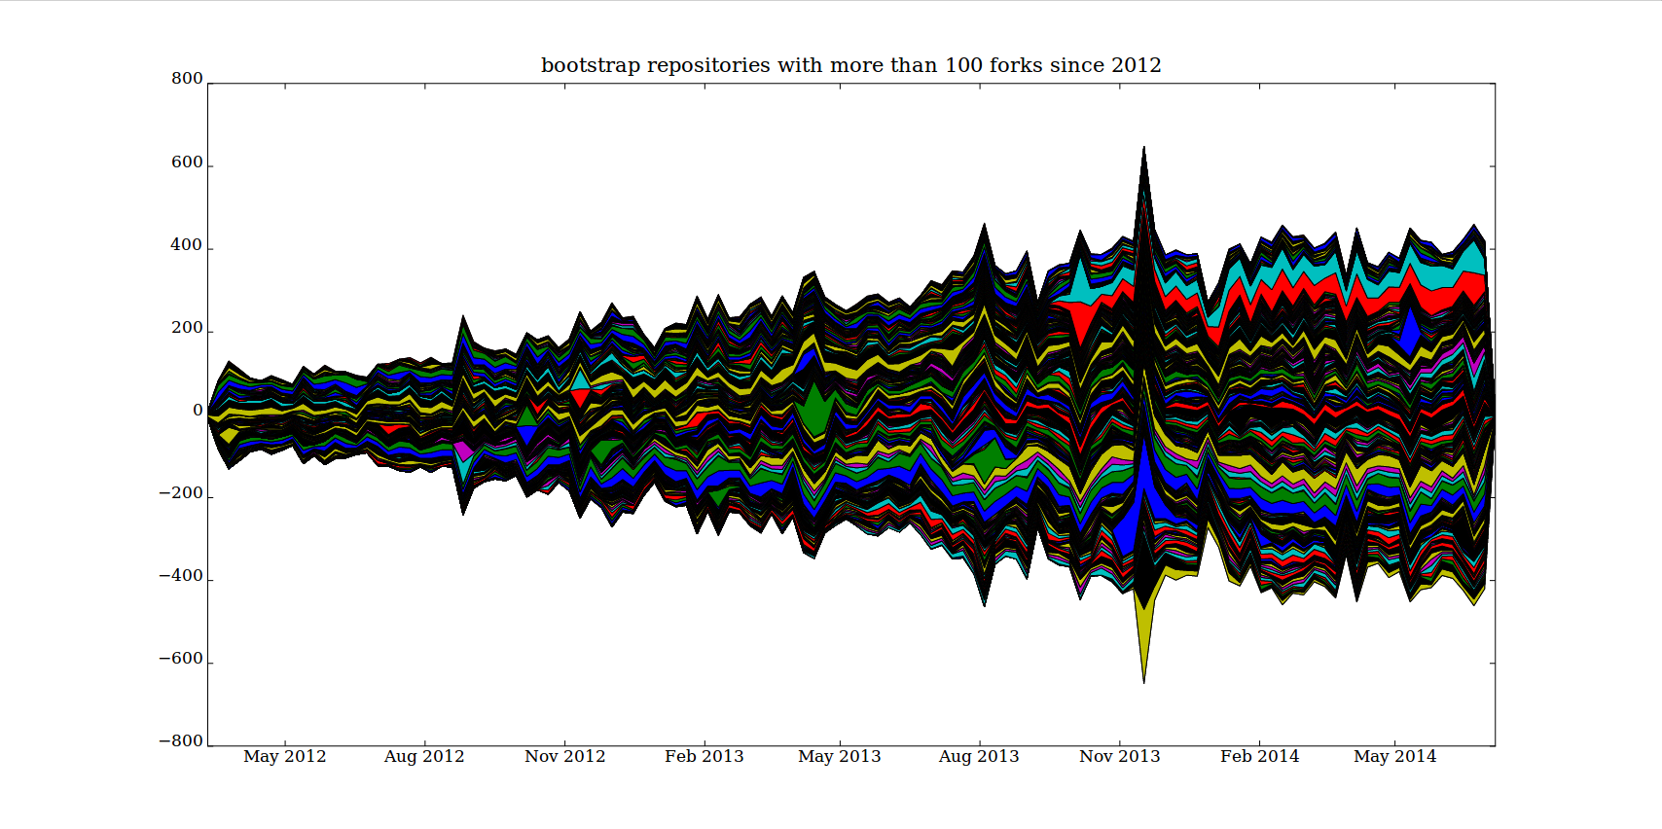
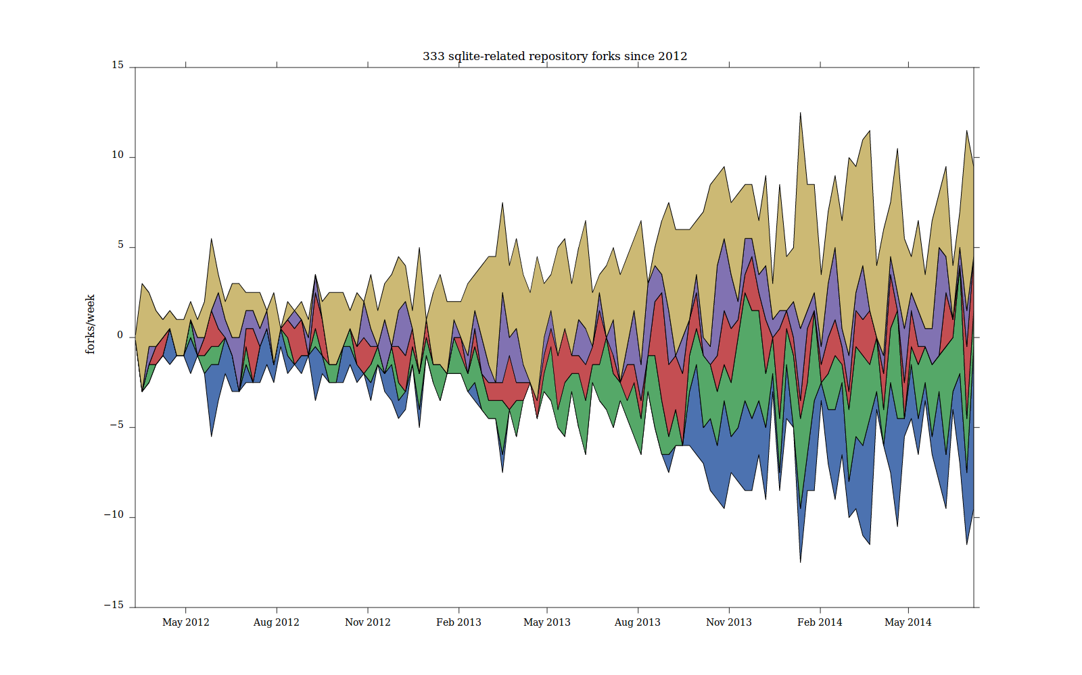
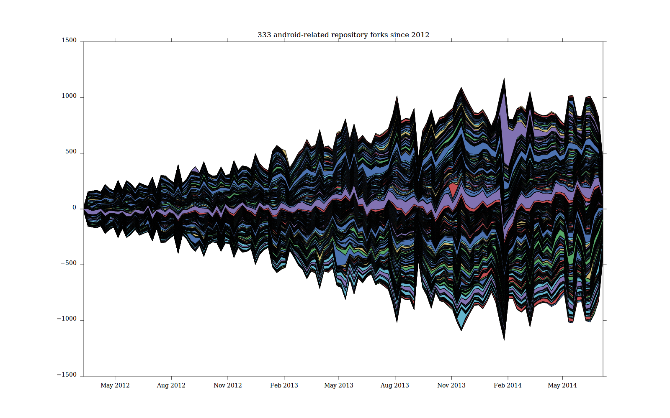
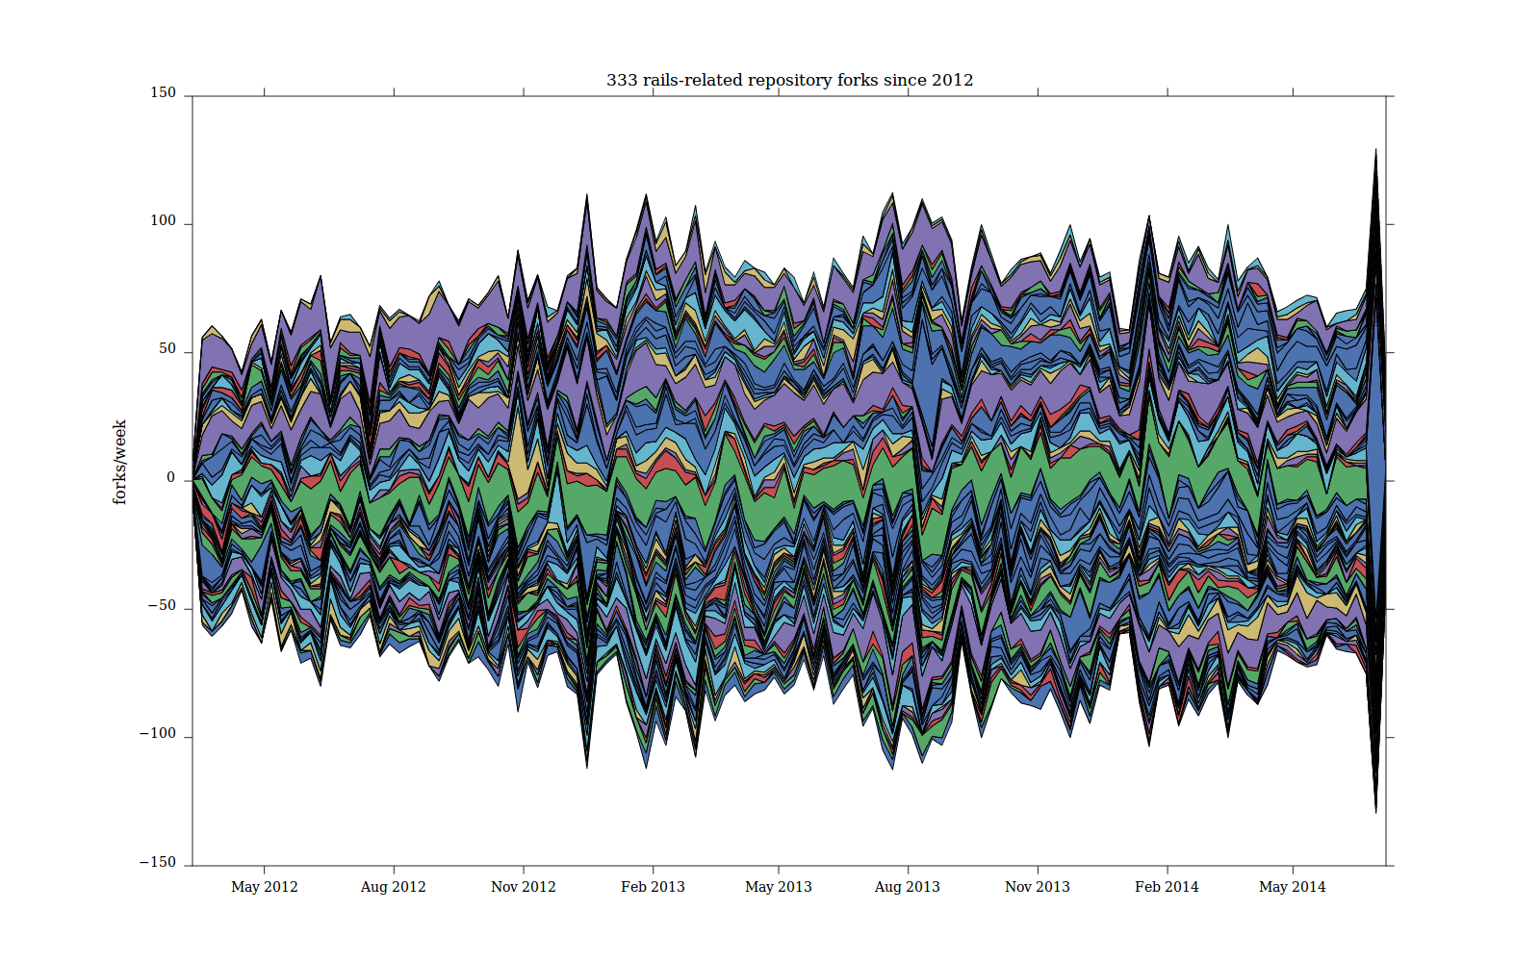
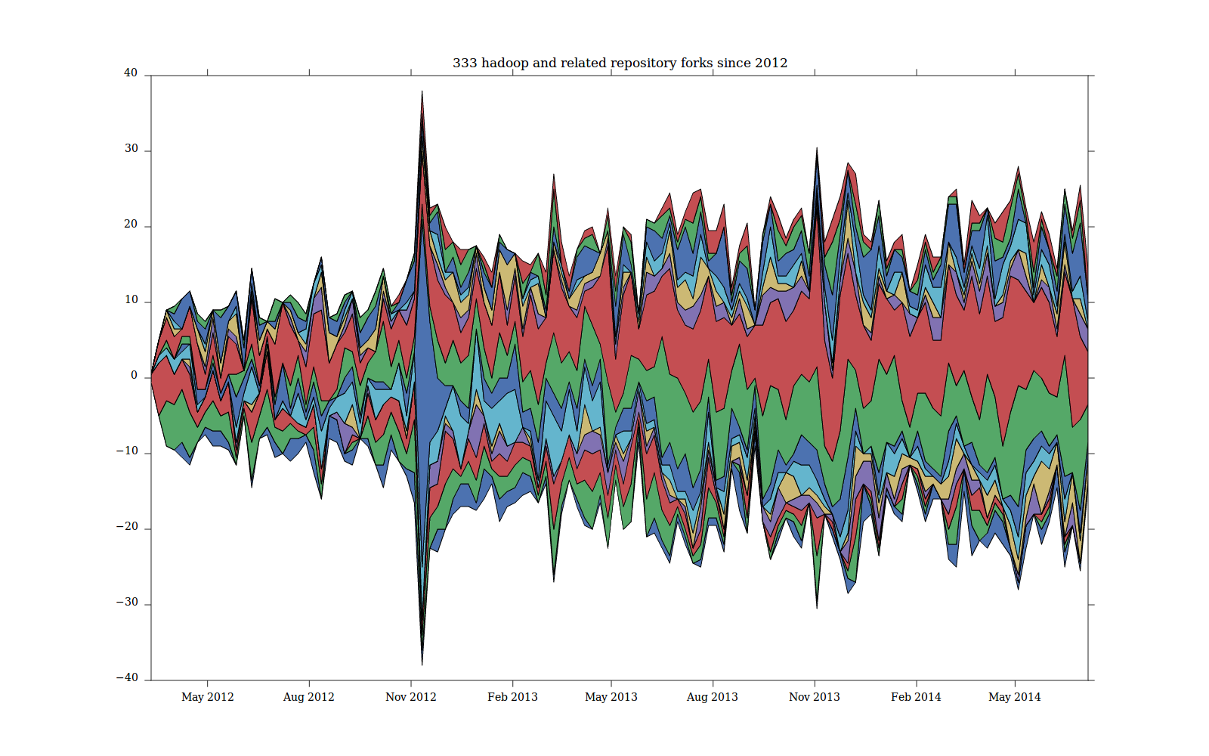
Mapping imitative fluxes: follow the copying of names across repositories

Slide 36
Conclusions? Work in the data-as-raw-material imaginary
Data-as-raw-material imaginary: very disconnected from the liveliness of the data as imitative fluxes and its congealing in large or 'capital' numbers
What happens to perspectives on data format?
  Traceability and digital navigation (Latour) assumes data is a trace left behind not something being intensively worked (e.g. in data challenges and the data-as-raw-material imaginary)
  Device-specific research and re-distribution of methods (Marres) suggests all traces are 'mixtures' that format, attract, and overflow;
    Definitely resists naïve claims about data power and transparency, but
  Transformation in symbolic-analytic work (Gill & Pratt) associated with data:
    Expand to include academic research feeding into large numbers and data visuality, not just the work that of creatives

Slide 37
Conclusions? Work in the data-as-raw-material imaginary
“What I am suggesting is that there are multiple ways to do the relation unity/plurality; hence there are multiple sorts of numbers.”
Verran, 2001, 107
Re-counting large numbers might:
  Begins to differentiate another kind of contemporary numerality (alongside ordinals, parameters, percentages, constants, real numbers, differentials, one-many): capital numbers
  Re-scale them in relation to networks of imitation replete with differences and similarities
  Be done from within the data not standing outside it
  Might be politically useful in resisting the capitalisation of large number

Slide 38
Acknowledgements
Research funded by ESRC (UK Economic and Social Research Council) under 'Google Data Analytics' programme, 2013-2014
Richard Mills and Stuart Sharples – research associates
Matthew Fuller (Goldsmiths) and Andrew Goffey (Nottingham) – co-researchers

