Slide 1
What is an important event? 175* million events and counting
Adrian Mackenzie
Sociology, Lancaster University
With Matthew Fuller (Goldsmiths), Andrew Goffey (Nottingham), Richard Mills and Stu Sharples (Lancaster)
29 April 2014
* “SELECT count(type) as event_count FROM [githubarchive:github.timeline]”
192,001,809: 192 million events

Slide 2
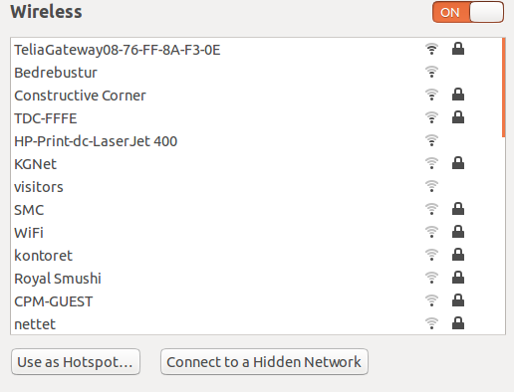
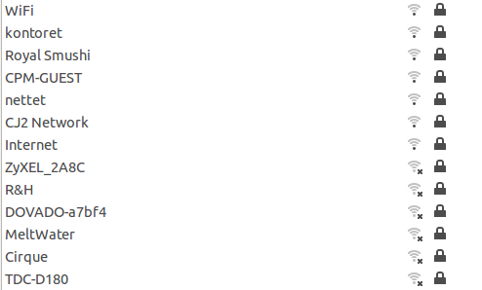

Slide 3
What happens on Github, 'the largest code repository on the planet'?
1. sharing: not automatic, but problematic;
2. recursive publics: modify conditions of their own existence; but where do they stop?
3. device-specific social research: reckon on platform-data dynamics, but how many platforms do we reckon with?

Slide 4
'Is it possible to do justice to … common experience by shifting from prediction and simulation to description and data mining? … Let the agents produce a dynamics and collect the traces that their actions leave as they unfold so as to produce a rich data set’ (Latour et al., 2012)
Live social research ... is social research that seeks to render analytically productive the formatted, dynamic character of digital networked data. As such, this research practice endorses the dynamism or ‘shape-shifting’ of online data, turning these into a resource and an object of digital social research. (Marres & Weltevrede, 2013, 327)

Slide 5
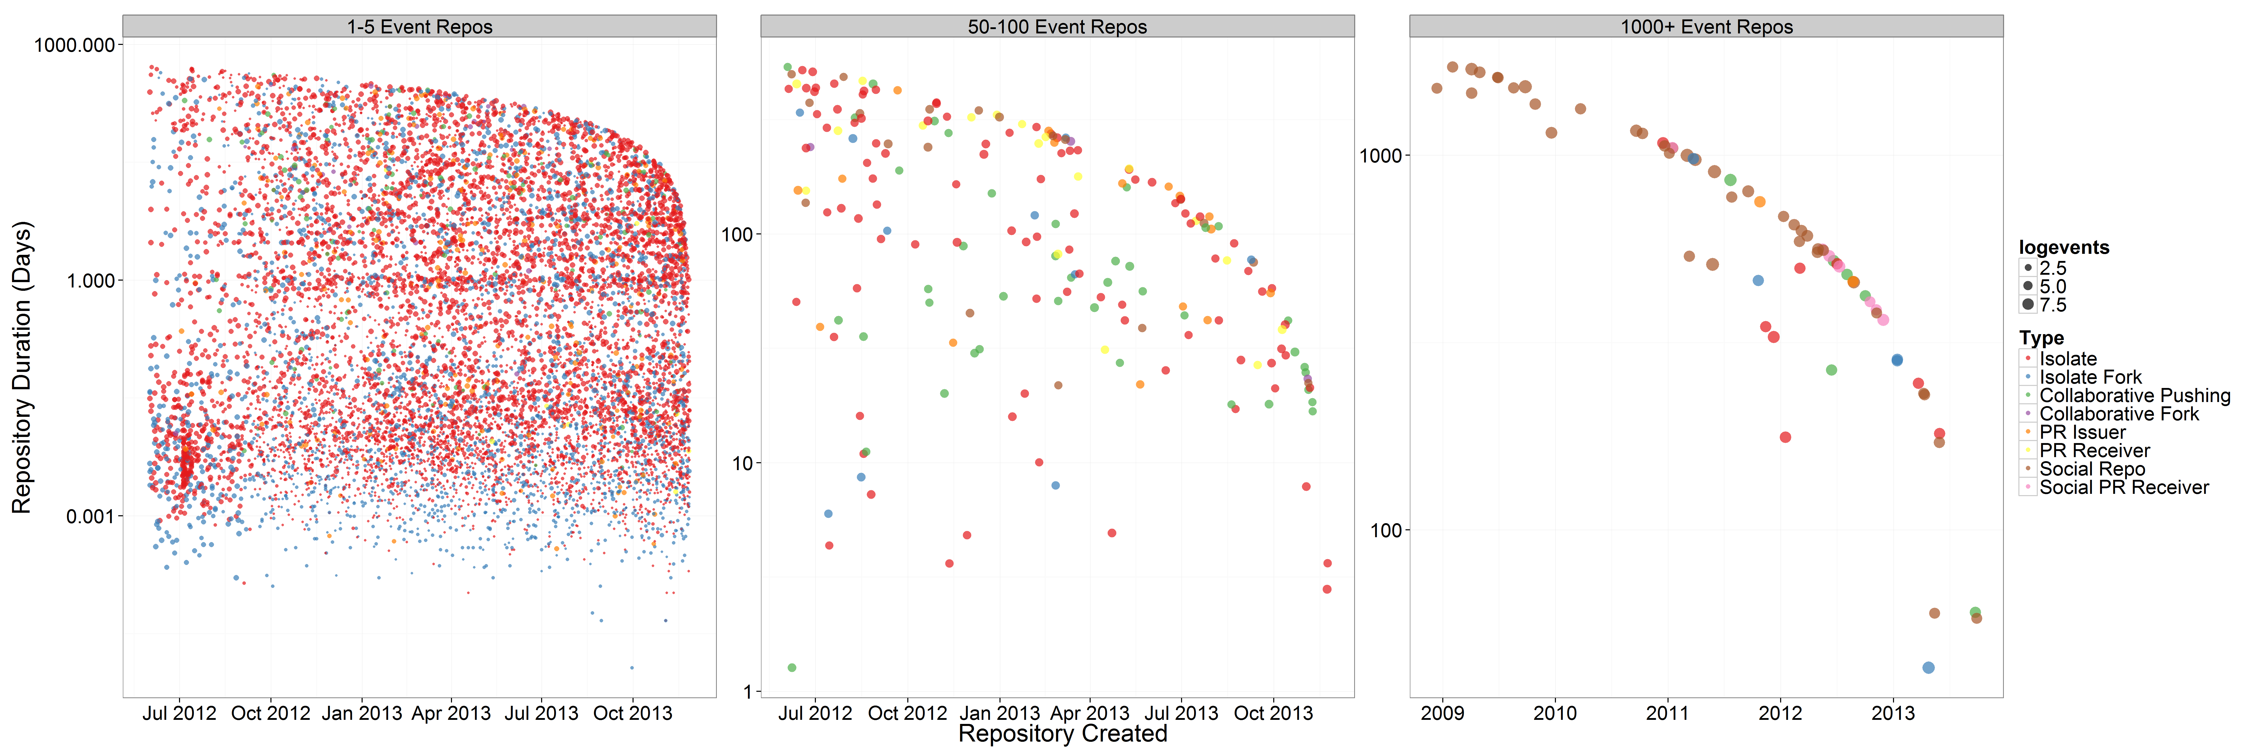
12.4* million repositories, but most ephemeral or 'a-social'

Slide 6
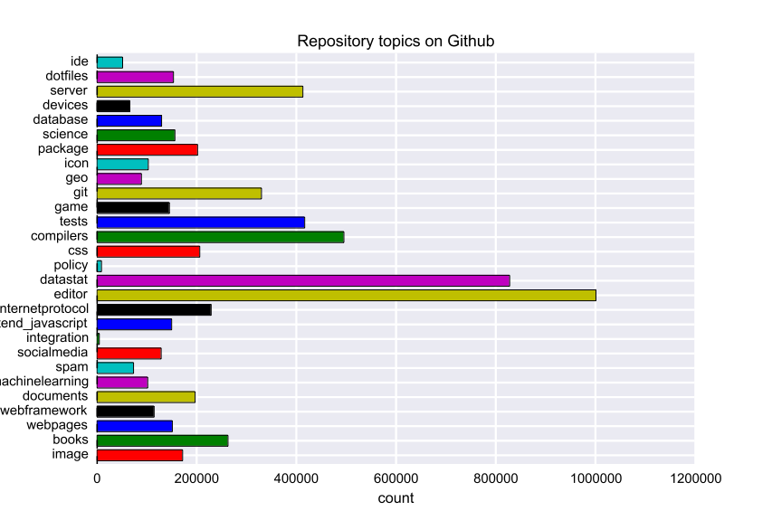

Slide 7
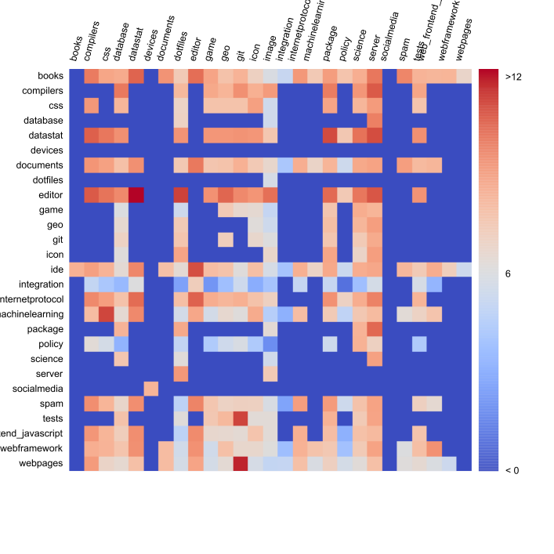

Slide 8
1. Sharing and other forms of participation
'there is nothing automatic about cultural sharing' (Hannerz, 1992, p. 44)

Slide 9
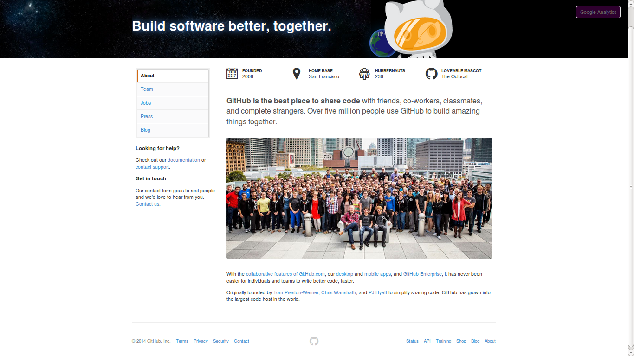

Slide 10
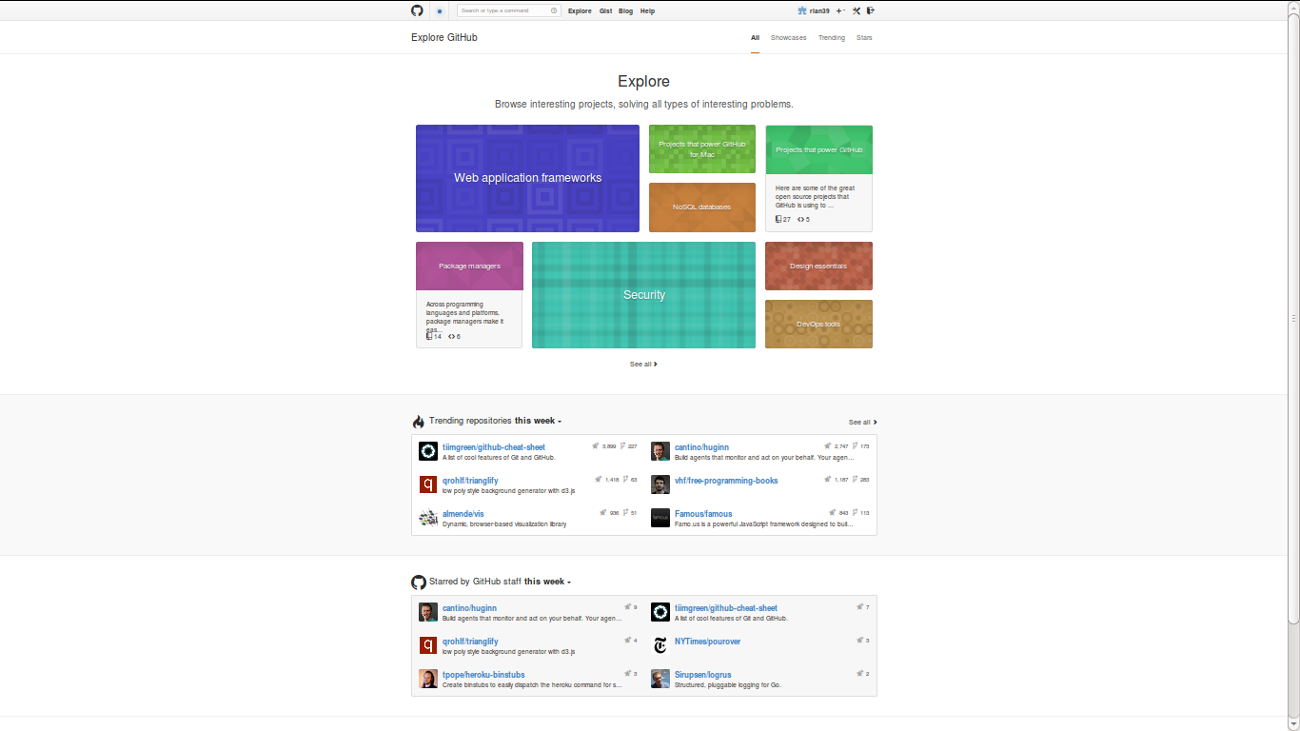

Slide 11
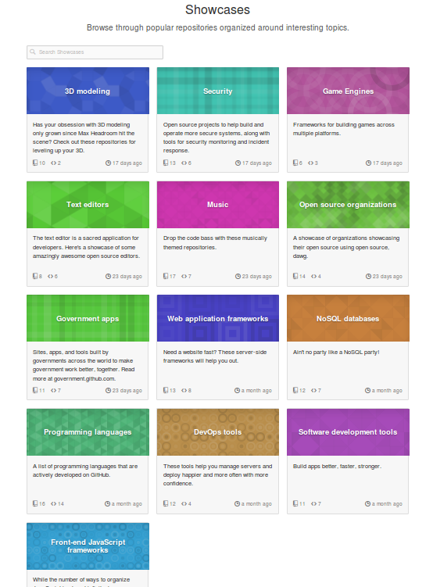
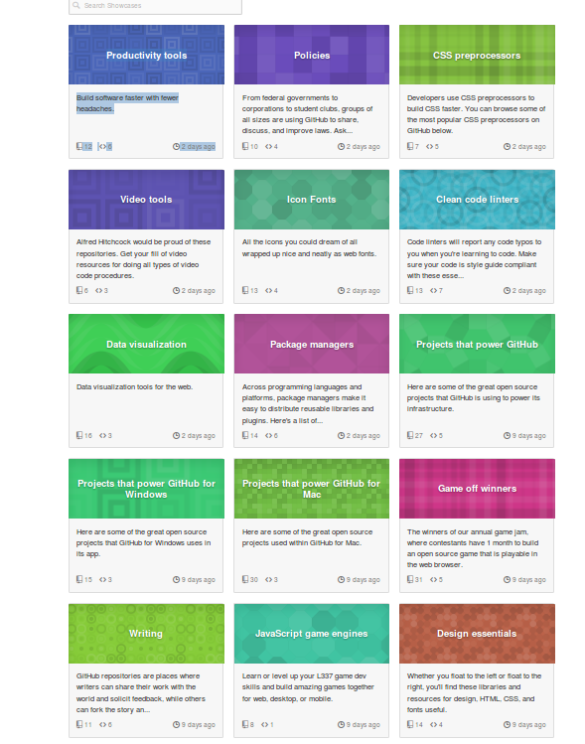
t

Slide 12
Linux: https://github.com/torvalds/linux
Android: https://github.com/CyanogenMod
Web-Data platform at The Washington Post https://github.com/django/django
Mozilla Foundation's Firefox web browser code https://github.com/mozilla/gecko-projects
'Big data infrastructures': noSQL database MongoDb https://github.com/mongodb/mongo; or the Apache Foundation's CouchDb https://github.com/apache/couchdb).
Minecrafts mods (https://github.com/Bukkit/Bukkit).
Platforms on Github
Software

Slide 13
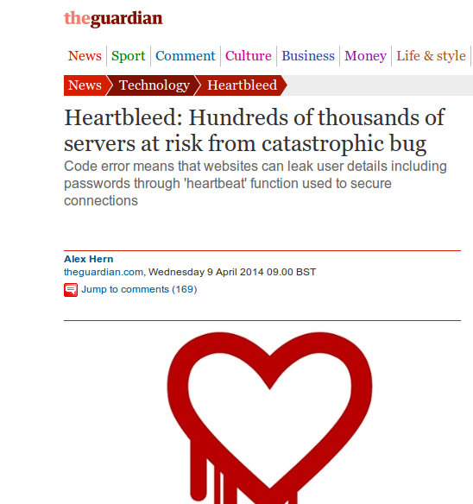

Slide 14
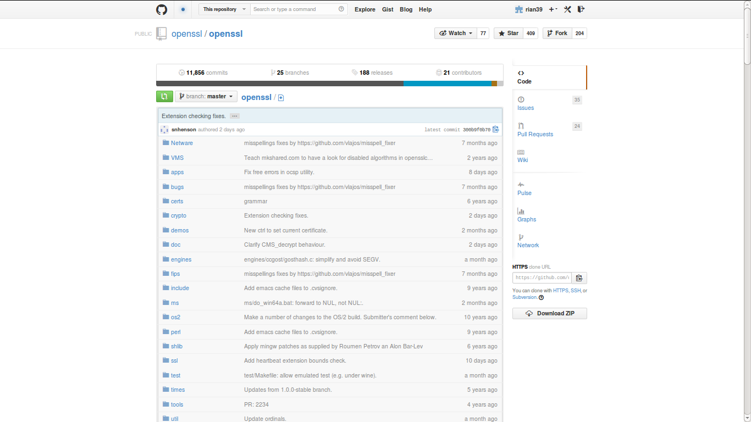
https://github.com/openssl/openssl

Slide 15
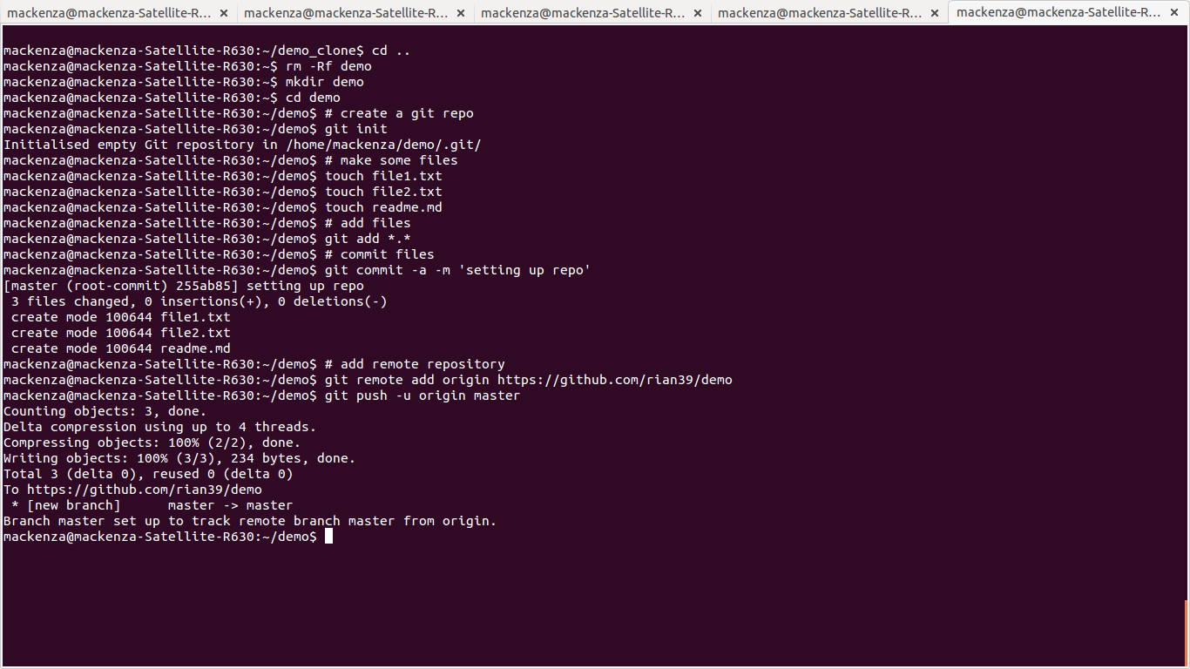

Slide 16
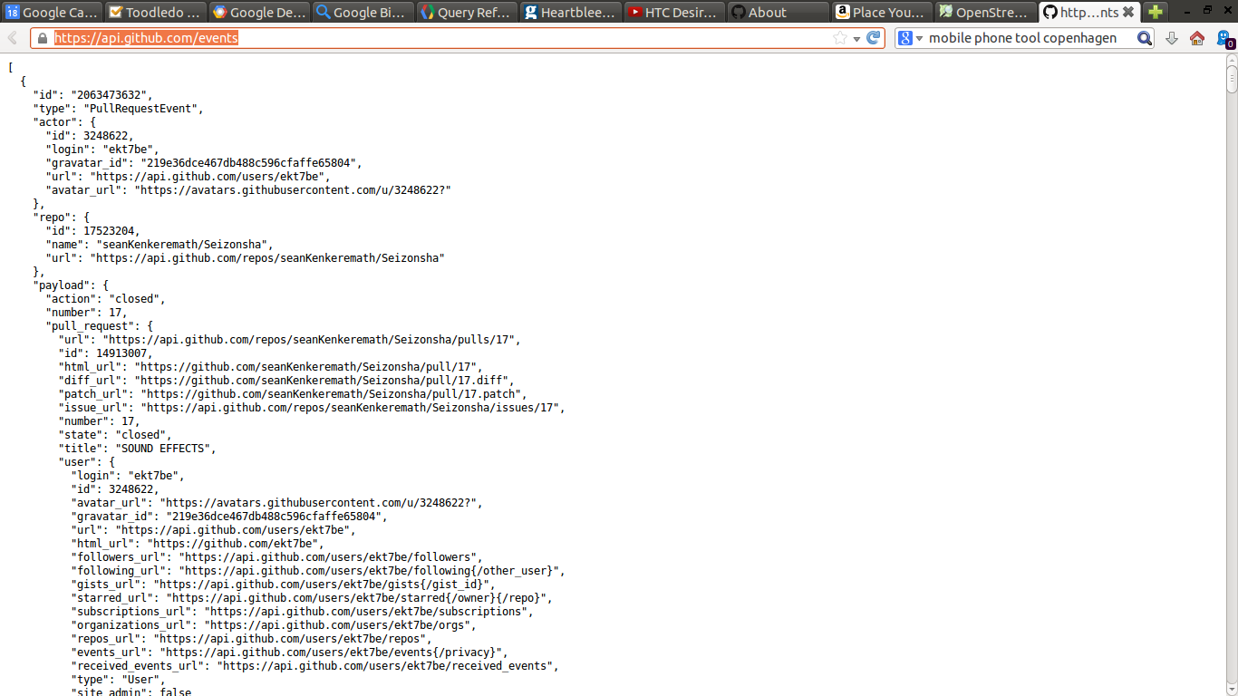

Slide 17
1 October 2012 – Events on Github
SELECT type, count(type) as events from githubarchive:github.timeline where PARSE_UTC_USEC(created_at) < PARSE_UTC_USEC('2012-10-02 00:00:00')
and PARSE_UTC_USEC(created_at) > PARSE_UTC_USEC('2012-10-01 00:00:00') group by type order by events desc;

Slide 18
SELECT type, count(type) as event_count FROM [githubarchive:github.timeline]
group by type order by event_count desc

Slide 19
2. Recursive publics modify platforms/devices/assemblages
A recursive public is a public that is vitally concerned with the material and practical maintenance and modi- fication of the technical, legal, practical, and conceptual means of its own existence as a public; it is a collective independent of other forms of constituted power and is capable of speaking to existing forms of power through the production of actually existing alternatives. (Kelty, Two Bits, 2010, 3)

Slide 20
Early repositories on Github (2007/8) are recursive?

Slide 21
Forks and mirrors
FORKCOUNT: 4,468128 (approximately 4.5 million repos are forks
SELECT count(*) as fork_count FROM [metacommunities:github_proper.repo_list] where fork=1

Slide 22
Config or test repositories
Users: 3.4 million
SELECT count(distinct actor) as actor_count FROM [githubarchive:github.timeline]
TOTAL: 393999 (395k repositories are configuration files or test)
select sum(repo_count) from (SELECT name, count(*) as repo_count FROM [metacommunities:github_proper.repo_list]
where REGEXP_MATCH(name, 'dot|test|config|try') group by name order by repo_count desc)

Slide 23
Code repository-inspired projects
'We the People' petitioning system is at https://github.com/WhiteHouse
Tate Gallery collection metadata: https://github.com/tategallery/collection
the White House's open data policy (http://project-open-data.github.io/policy-memo
the US Pirate Party's archive (http://uspirates.github.io/),
the complete genome of Kenneth Reitz (https://github.com/kennethreitz/genome)
collections of maps (https://github.com/djaiss/mapsicon)

Slide 24
Data-based recursions
Denis Roussel, Octoboard http://octoboard.com/ https://github.com/KuiKui/Octoboard
David Fischer, Open Source Contributions by Location
http://davidfischer.github.io/gdc2/#repositories/twitter/bootstrap
Dan Foreman Mackay, Open Source Report card http://osrc.dfm.io/
https://github.com/dfm/osrc
JeongHoon Byun, Coding Conventions http://sideeffect.kr/popularconvention#python
https://github.com/outsideris/popularconvention/

Slide 25
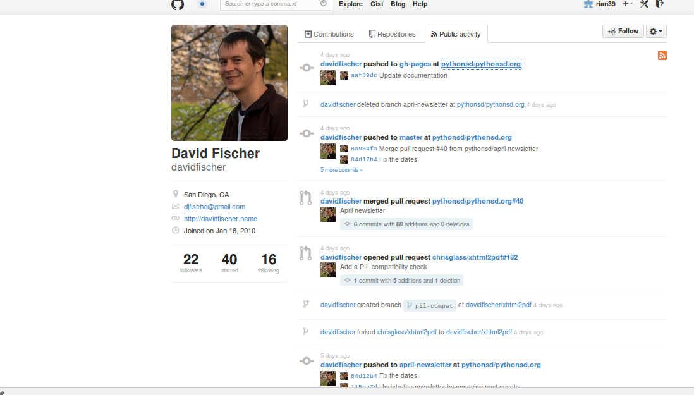
Public activity

Slide 26
Organizations on github
80,000 organizations
e.g. BBC
https://github.com/BBC Has 6 repositories and they are not updated very often.
But 32 BBC organisations on the Github: BBCNews, BBCFrameworks (https://github.com/bbc-frameworks), BBC R&D (https://github.com/bbcrd), BBC Data (https://github.com/BBC-Data)

Slide 27
Organisations: 80,000
BBC & social media platform repositories

Slide 28
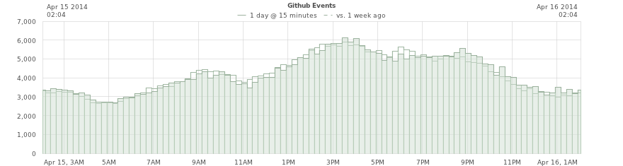
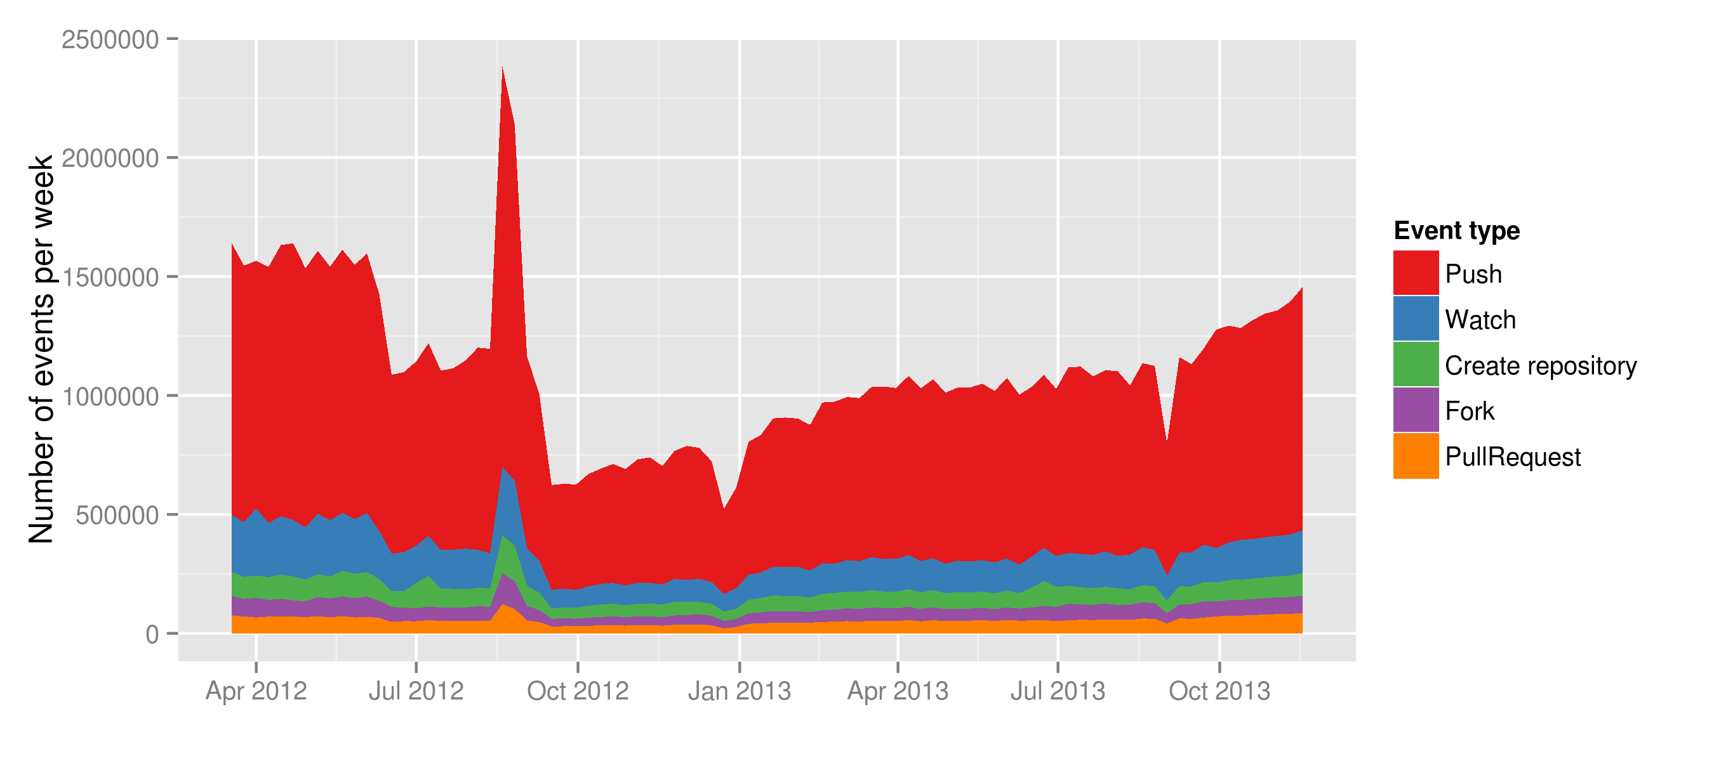
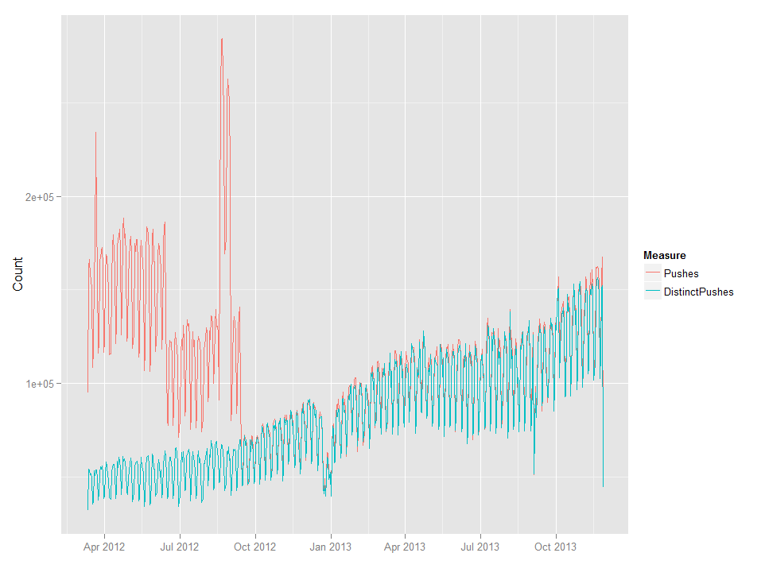

Slide 29
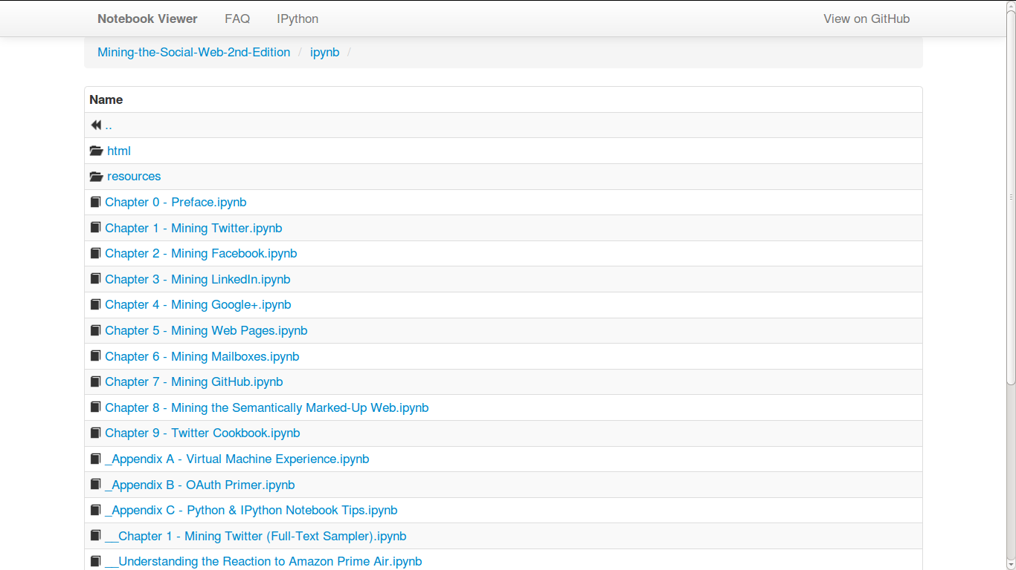
Matthew Russell, Mining the Social Web, 2nd edition

Slide 30
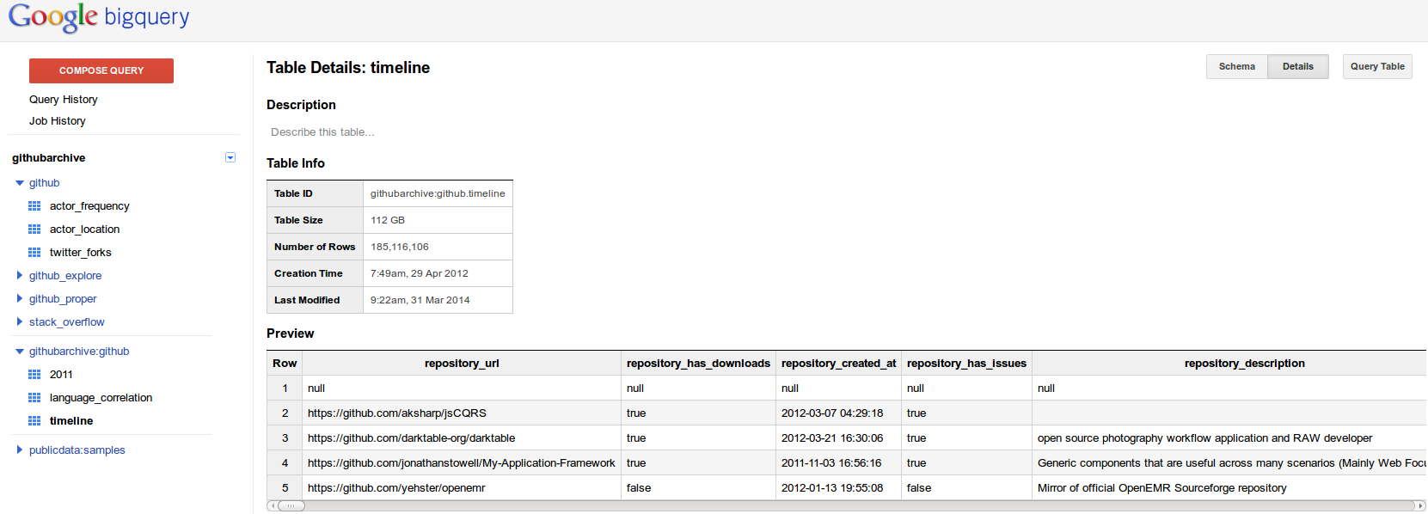
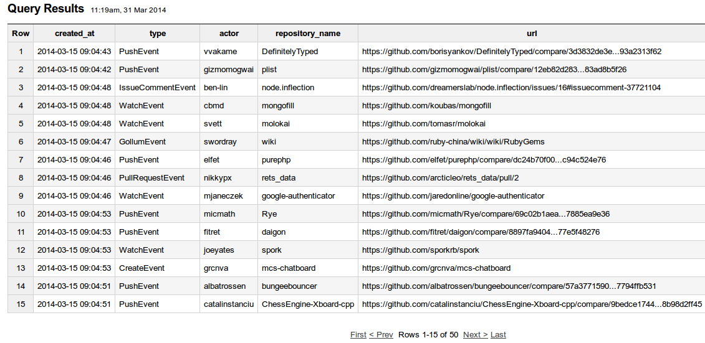
Open-source developers all over the world are working on millions of projects: writing code & documentation, fixing & submitting bugs, and so forth. GitHub Archive is a project to record the public GitHub timeline, archive it, and make it easily accessible for further analysis (Grigorik, 2012)

Slide 31
3. Device-specific social research and events?
Scraping, we propose, makes it possible to render traffic between the object and process of social research analytically productive. It enables a form of ‘real-time’ social research, in which the formats and life cycles of online data may lend structure to the analytic objects and findings of social research. (Marres and Weltevrede, 2013, p. 233)

Slide 32
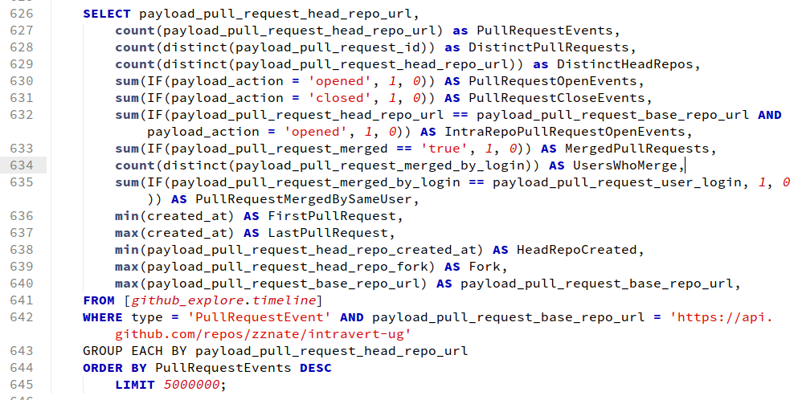
Mapping between Github and git events

Slide 33
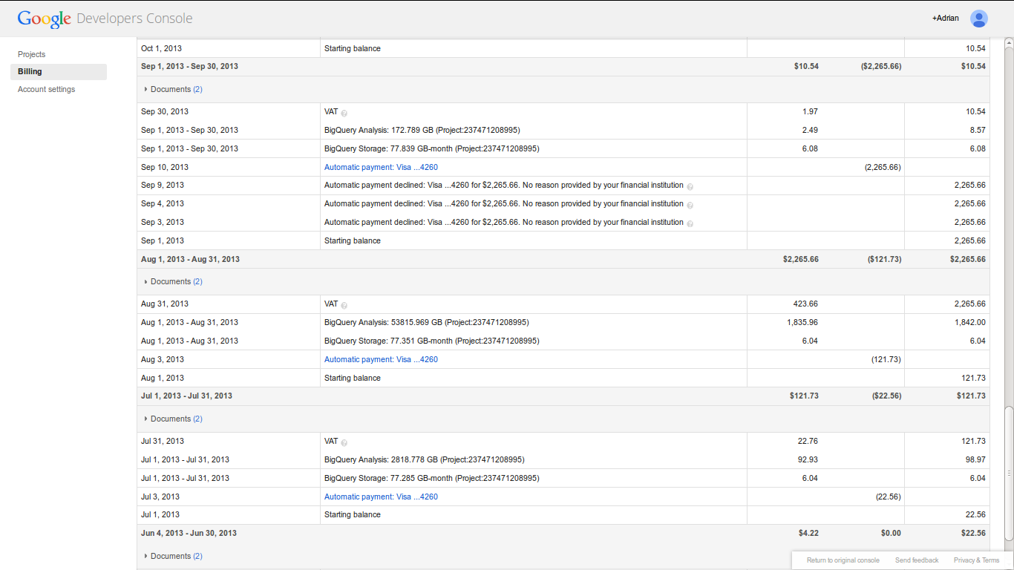
Big bill for big query

Slide 34
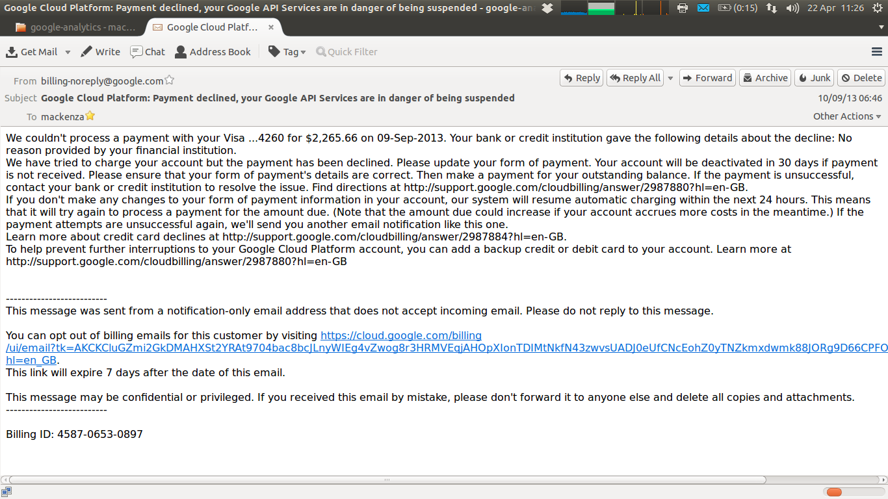
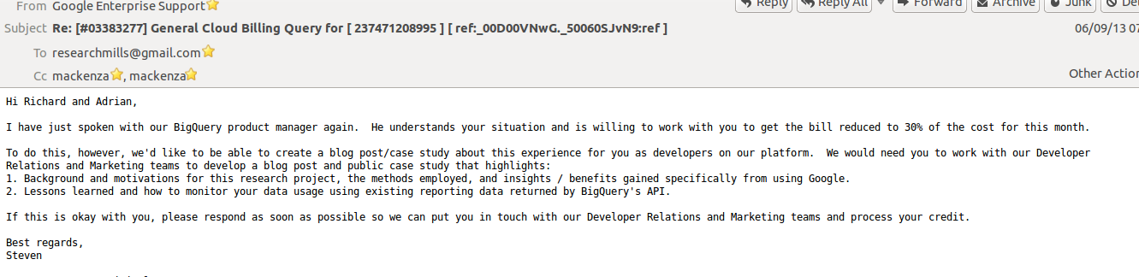

Slide 35
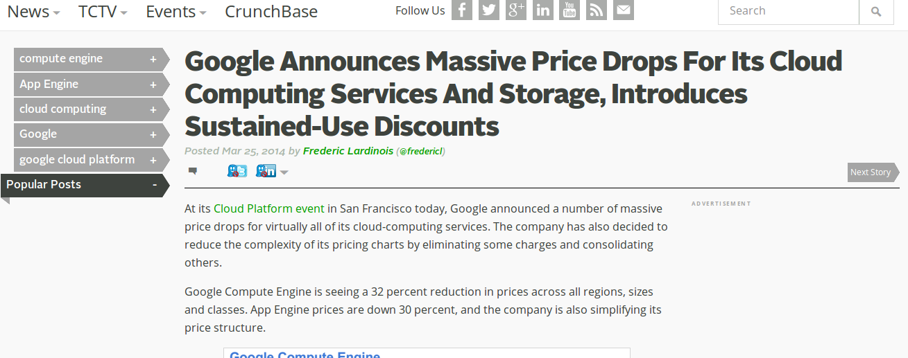

Slide 36
Conclusion
1. sharing: not automatic, but problematic due to different event-forms;
2. recursive quasi-publics: modify conditions of their own existence, but the conditions of their own existence are also modified;
3. device-specific social research: encounter with platform-data events is multiple

Slide 37
Acknowledgements
Research funded by ESRC (UK Economic and Social Research Council) under 'Google Data Analytics' programme, 2013-2014.
Thanks to Google Cloud Services for $USD1600 refund

