Slide 1
What is an important event? 175* million events and counting
Adrian Mackenzie
Sociology, Lancaster University
With Matthew Fuller (Goldsmiths), Andrew Goffey (Nottingham), Richard Mills and Stu Sharples (Lancaster)
22 April 2014
* “SELECT count(type) as event_count FROM [githubarchive:github.timeline]”
192,001,809: 192 million events

Slide 2
What happens on Github, 'the largest code repository on the planet'?
1. sharing: not automatic, but problematic;
2. recursive publics: modify conditions of their own existence;
3. device-specific social research: encounter with platform-data dynamics.

Slide 3
'Is it possible to do justice to … common experience by shifting from prediction and simulation to description and data mining? … Let the agents produce a dynamics and collect the traces that their actions leave as they unfold so as to produce a rich data set’ (Latour et al., 2012)
Live social research ... is social research that seeks to render analytically productive the formatted, dynamic character of digital networked data. As such, this research practice endorses the dynamism or ‘shape-shifting’ of online data, turning these into a resource and an object of digital social research. (Marres & Weltevrede, 2013, 327)

Slide 4
1. Sharing and other forms of participation
'there is nothing automatic about cultural sharing' (Hannerz, 1992, p. 44)

Slide 5
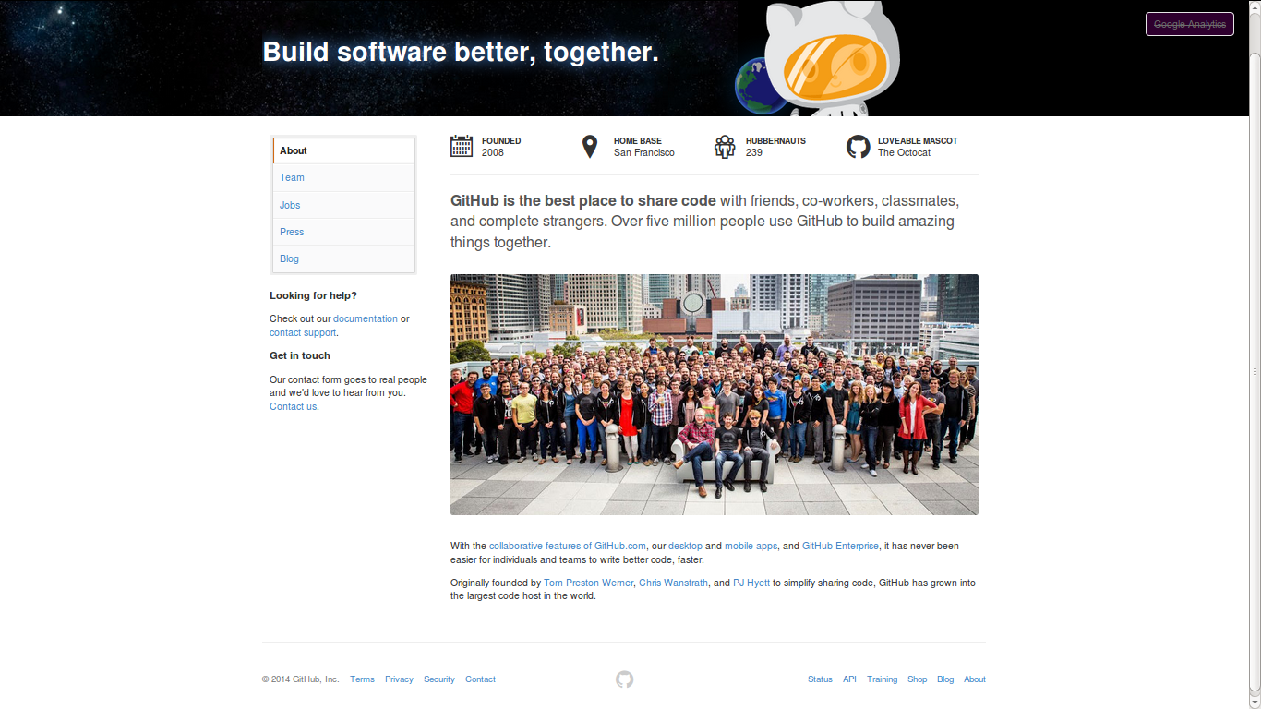

Slide 6
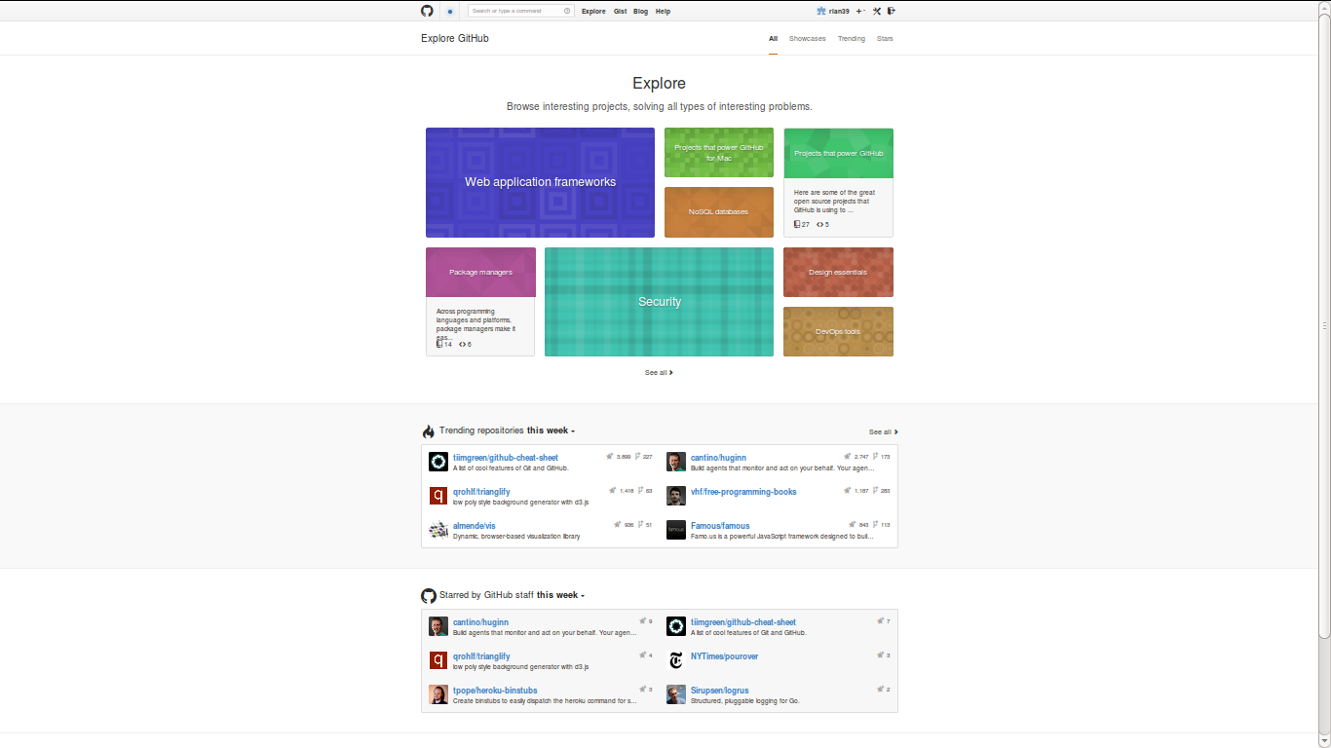

Slide 7
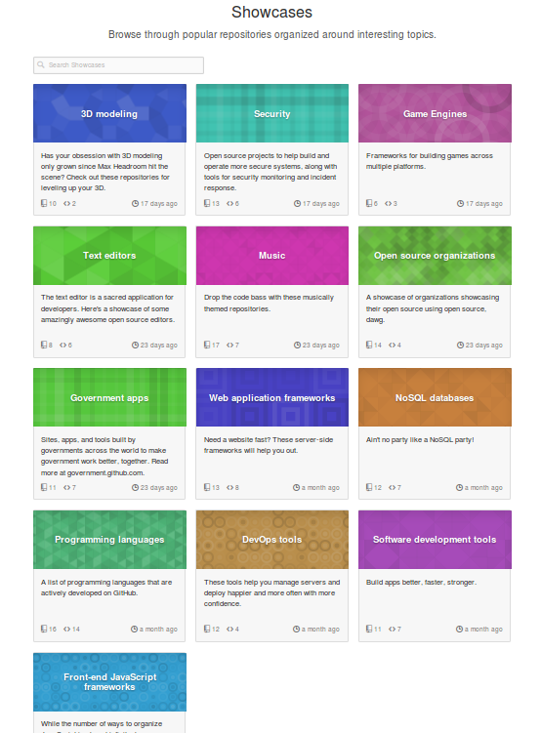
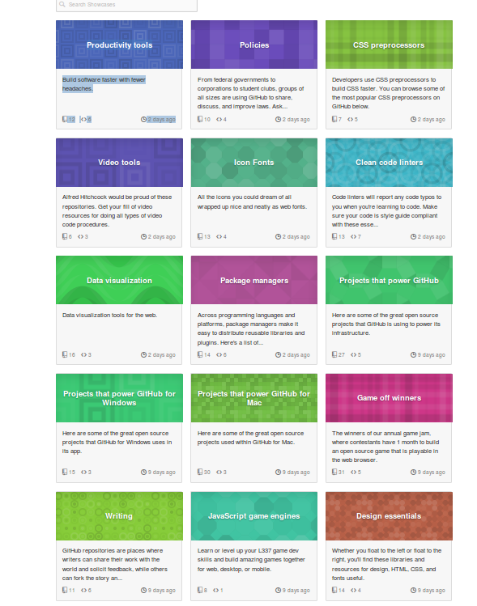
t

Slide 8
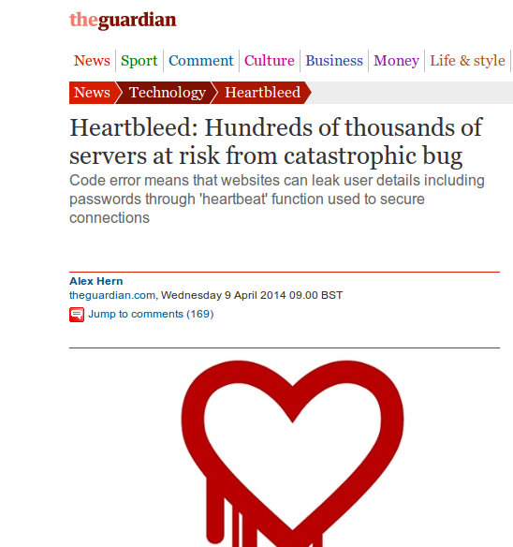

Slide 9
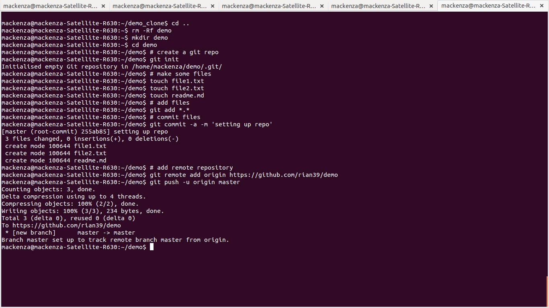

Slide 10
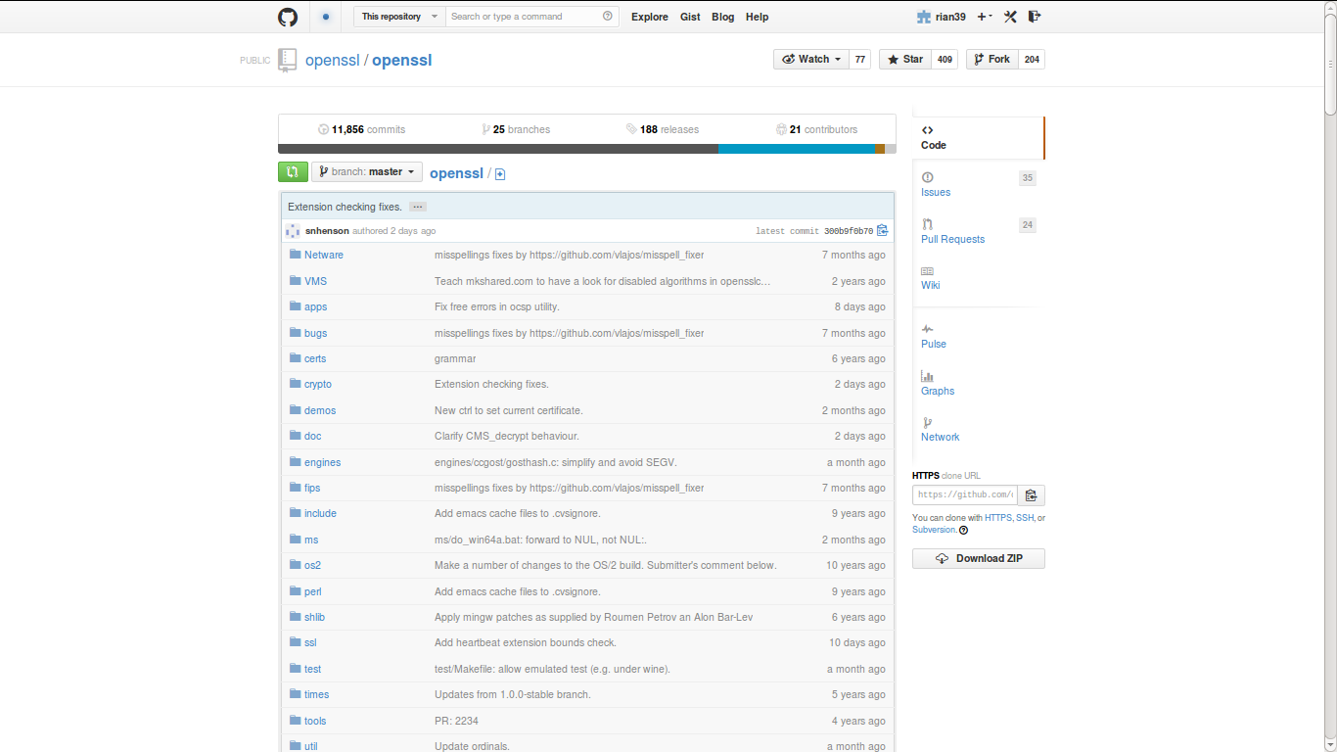
https://github.com/openssl/openssl

Slide 11
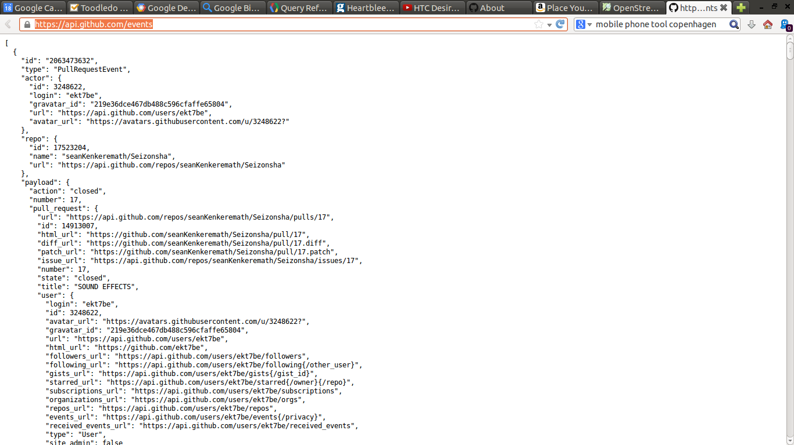

Slide 12
1 October 2012 – Events on Github
SELECT type, count(type) as events from githubarchive:github.timeline where PARSE_UTC_USEC(created_at) < PARSE_UTC_USEC('2012-10-02 00:00:00')
and PARSE_UTC_USEC(created_at) > PARSE_UTC_USEC('2012-10-01 00:00:00') group by type order by events desc;

Slide 13
SELECT type, count(type) as event_count FROM [githubarchive:github.timeline]
group by type order by event_count desc

Slide 14
2. Recursive publics modify platforms
A recursive public is a public that is vitally concerned with the material and practical maintenance and modi- fication of the technical, legal, practical, and conceptual means of its own existence as a public; it is a collective independent of other forms of constituted power and is capable of speaking to existing forms of power through the production of actually existing alternatives. (Kelty, Two Bits, 2010, 3)

Slide 15
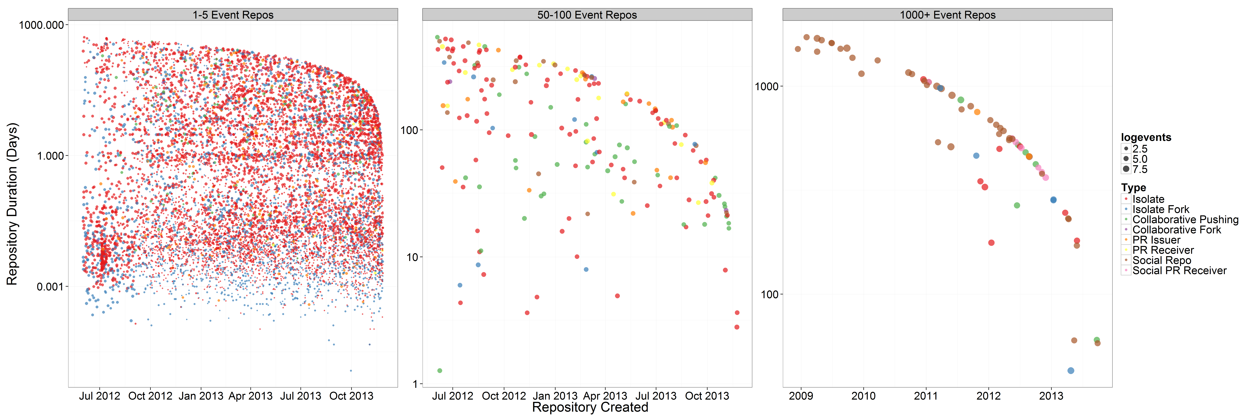
12.4* million repositories, but most ephemeral or 'a-social'

Slide 16
Early repositories on Github (2007/8) are recursive?

Slide 17
Config repositories
TOTAL: 310,646 (300k repositories are configuration files or test)
select sum(repo_count) from (SELECT name, count(*) as repo_count FROM [metacommunities:github_proper.repo_list]
where REGEXP_MATCH(name, 'dot|test|config') group by name order by repo_count desc)

Slide 18
Forks and mirrors
FORKCOUNT: 4,468128 (approximately 4.5 million repos are forks
SELECT count(*) as fork_count FROM [metacommunities:github_proper.repo_list] where fork=1

Slide 19
Linux: https://github.com/torvalds/linux
Android: https://github.com/CyanogenMod
Data platform at The Washington Post https://github.com/django/django
Mozilla Foundation's Firefox web browser code https://github.com/mozilla/gecko-projects
'Big data infrastructures': noSQL database MongoDb https://github.com/mongodb/mongo; or the Apache Foundation's CouchDb https://github.com/apache/couchdb).
Minecrafts mods (https://github.com/Bukkit/Bukkit).
Platforms on Github
Software
Software-inspired platforms
'We the People' petitioning system is at https://github.com/WhiteHouse
Tate Gallery collection metadata: https://github.com/tategallery/collection
the White House's open data policy (http://project-open-data.github.io/policy-memo
the US Pirate Party's archive (http://uspirates.github.io/),
the complete genome of Kenneth Reitz (https://github.com/kennethreitz/genome)
collections of maps (https://github.com/djaiss/mapsicon)

Slide 20
Organizations on github
80,000 organizations
e.g. BBC
https://github.com/BBC Has 6 repositories and they are not updated very often.
But 32 BBC organisations on the Github: BBCNews, BBCFrameworks (https://github.com/bbc-frameworks), BBC R&D (https://github.com/bbcrd), BBC Data (https://github.com/BBC-Data)

Slide 21
Organisations: 80,000
BBC & social media platform repositories

Slide 22
3. Device-specific social research and events?
Scraping, we propose, makes it possible to render traffic between the object and process of social research analytically productive. It enables a form of ‘real-time’ social research, in which the formats and life cycles of online data may lend structure to the analytic objects and findings of social research. (Marres and Weltevrede, 2013, p. 233)

Slide 23
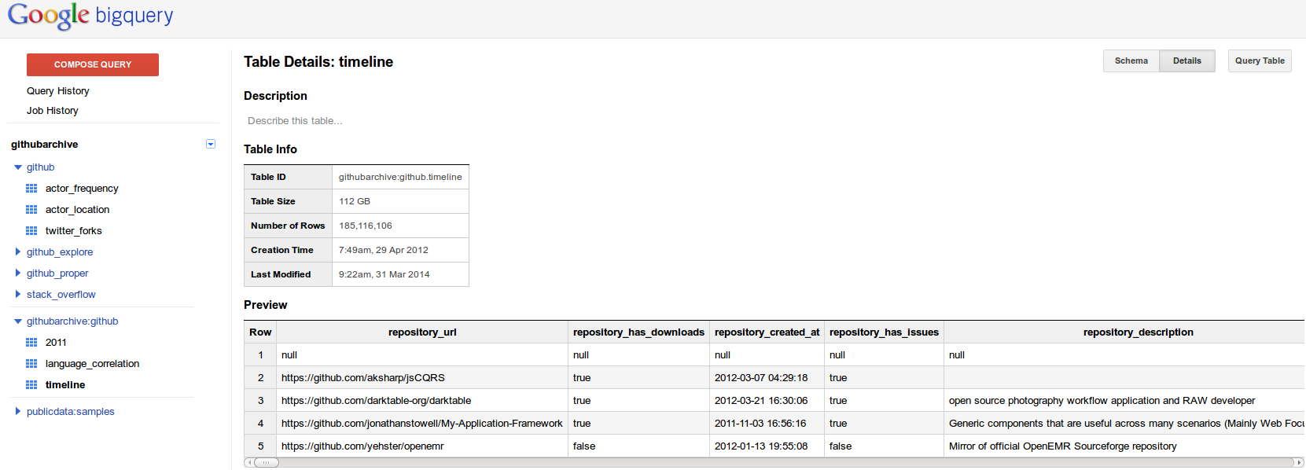
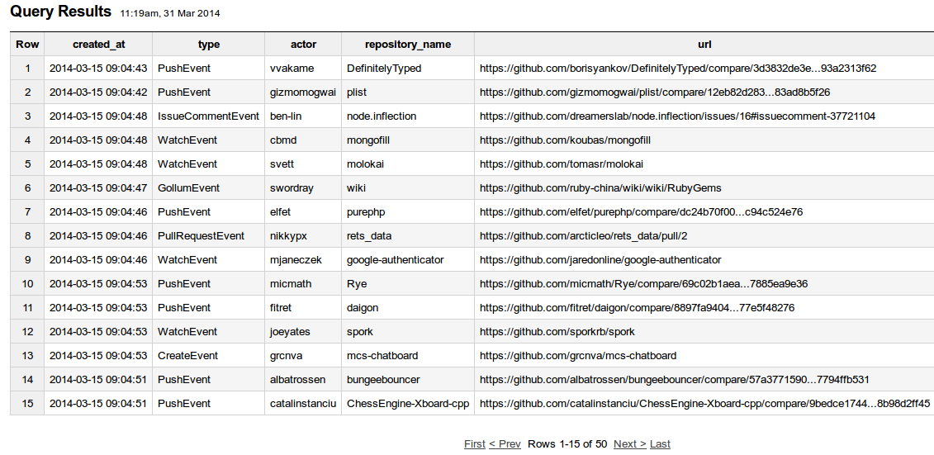
Open-source developers all over the world are working on millions of projects: writing code & documentation, fixing & submitting bugs, and so forth. GitHub Archive is a project to record the public GitHub timeline, archive it, and make it easily accessible for further analysis (Grigorik, 2012)

Slide 24
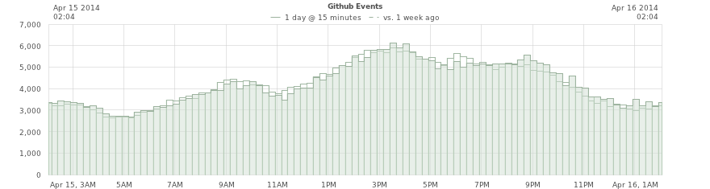
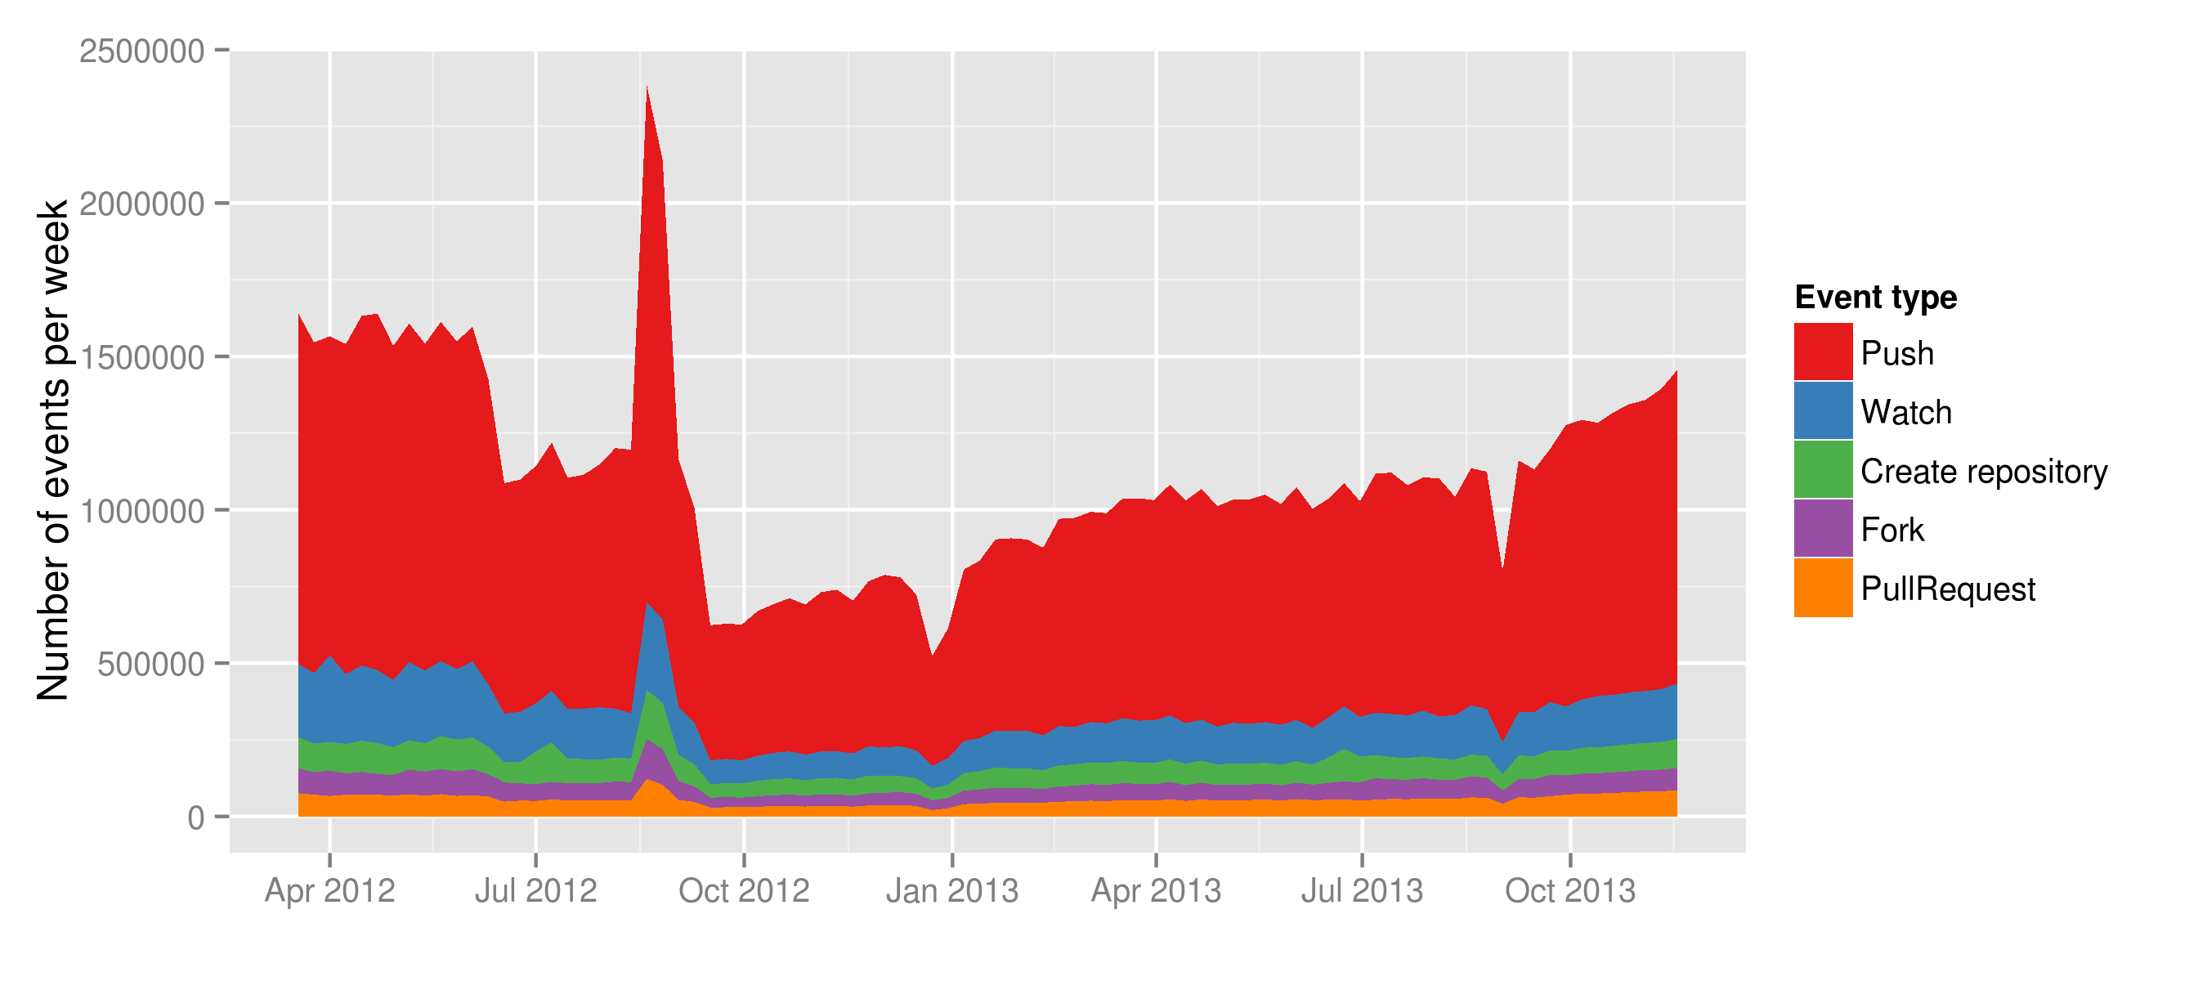
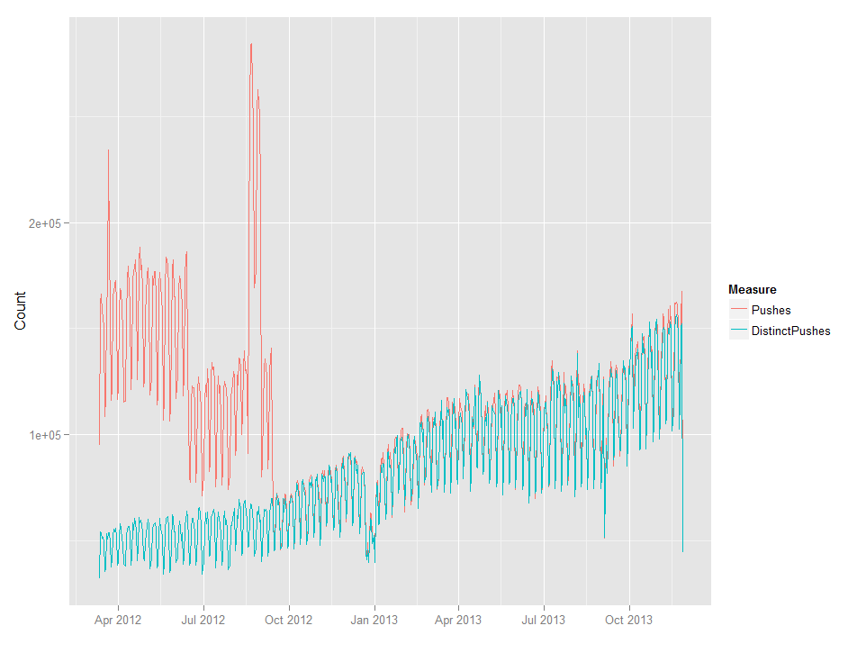

Slide 25
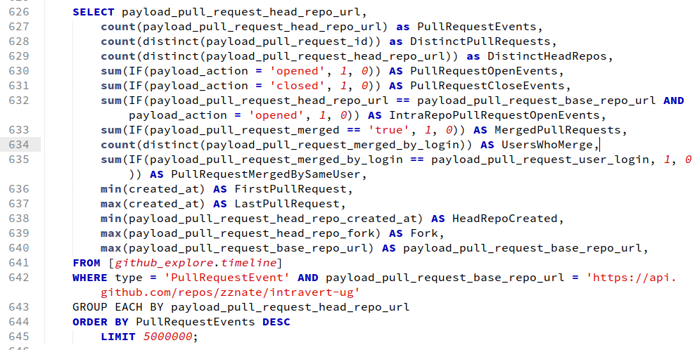
Mapping between Github and git events

Slide 26
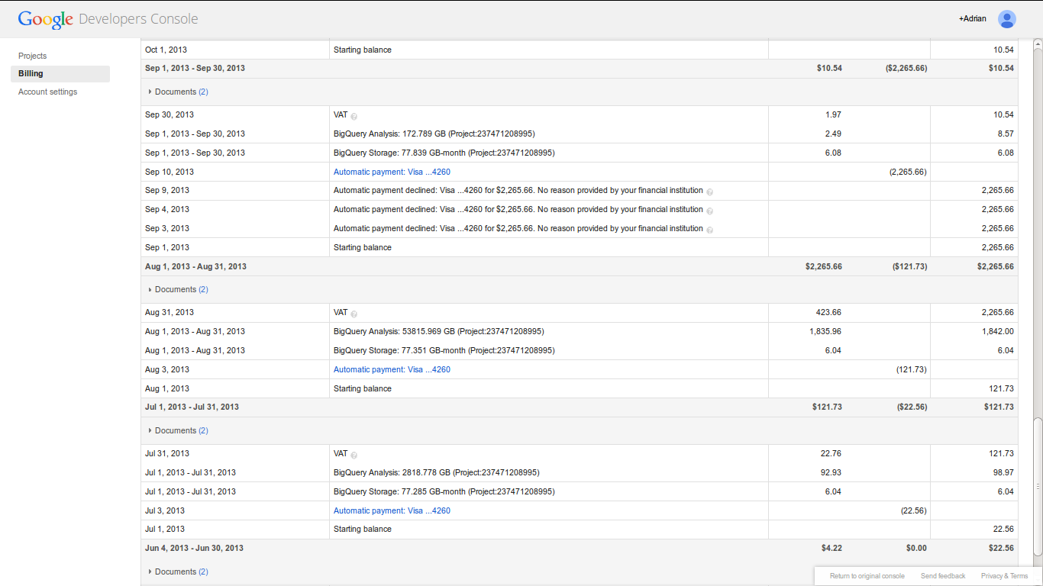
Big bill for big query

Slide 27
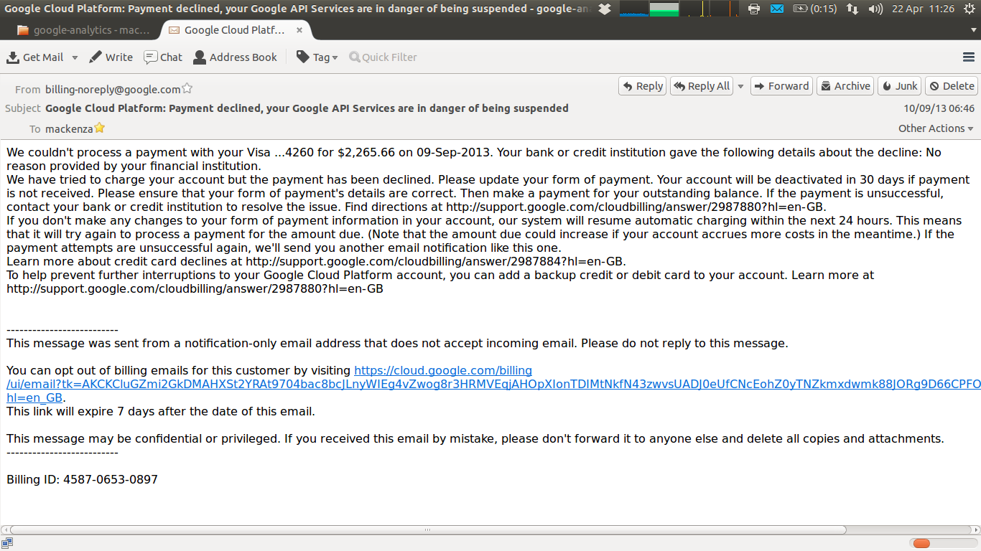
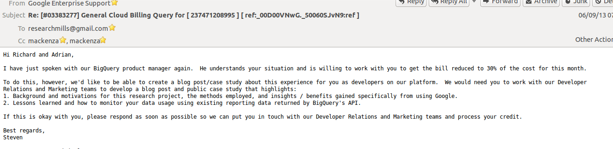

Slide 28
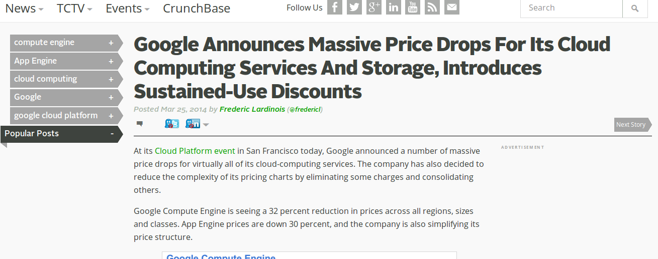

Slide 29
Conclusion
1. sharing: not automatic, but problematic;
2. recursive publics: modify conditions of their own existence, but the conditions of their own existence are also modified;
3. device-specific social research: encounter with platform-data dynamics is multiple

Slide 30
Acknowledgements
Research funded by ESRC (UK Economic and Social Research Council) under 'Google Data Analytics' programme, 2013-2014.
Thanks to Google Cloud Services for $USD1600 refund

