Slide 1
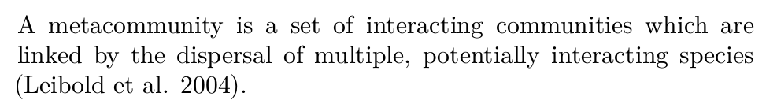
Metacommunities in the code-sharing commons
Adrian Mackenzie, Lancaster
Matthew Fuller, Goldsmiths
Andrew Goffey, Nottingham
Richard Mills, Cambridge
Stu Sharples, Lancaster

Slide 2
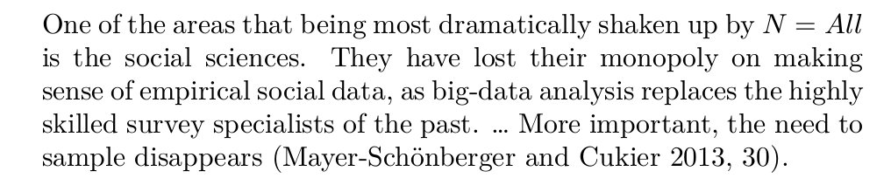
N = All and public datasets

Slide 3
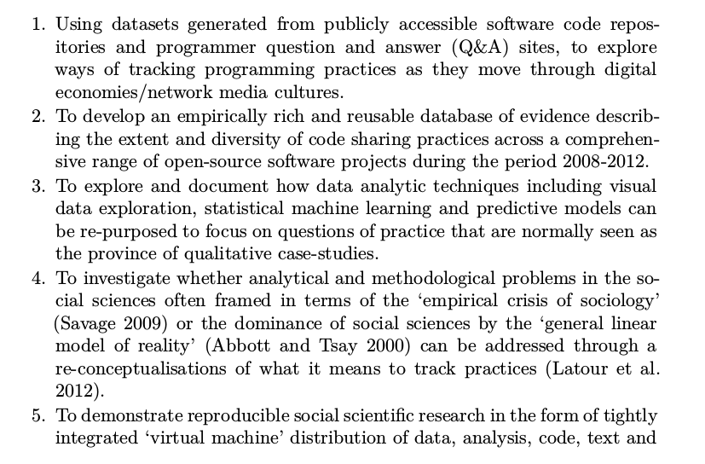
Objectives

Slide 4
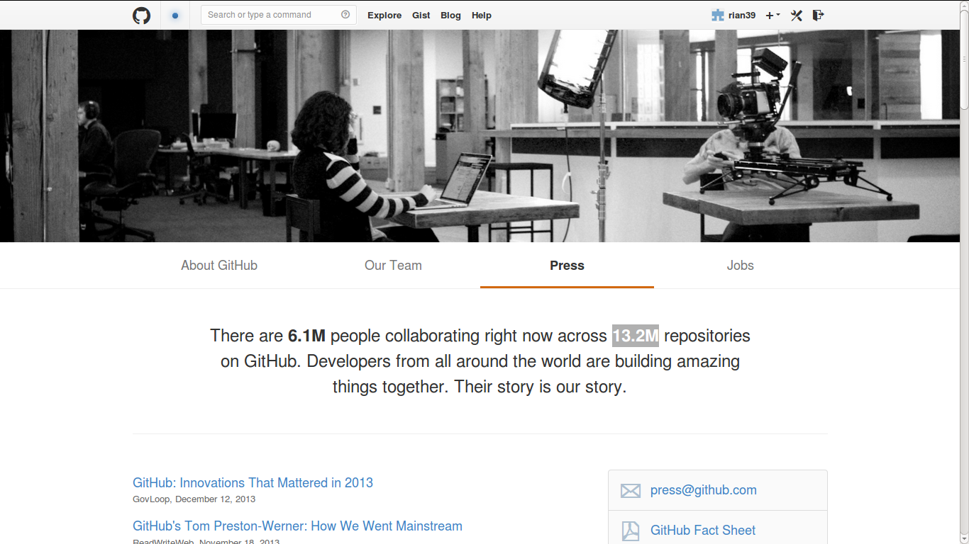
Github as code commons & metacommunity

Slide 5
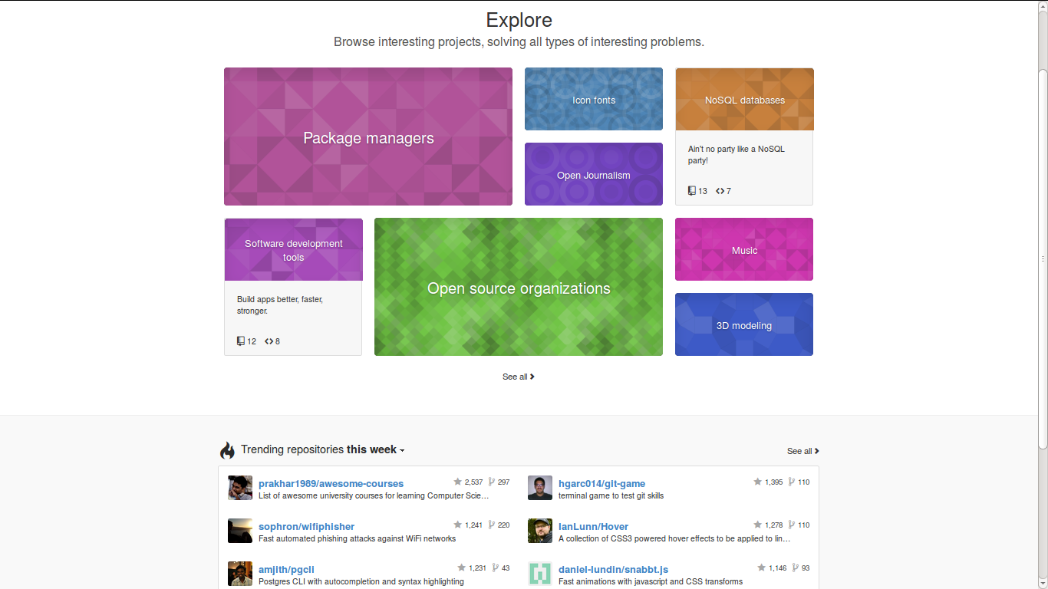
Github's 'mosaic plot' of repositories: N = ?

Slide 6
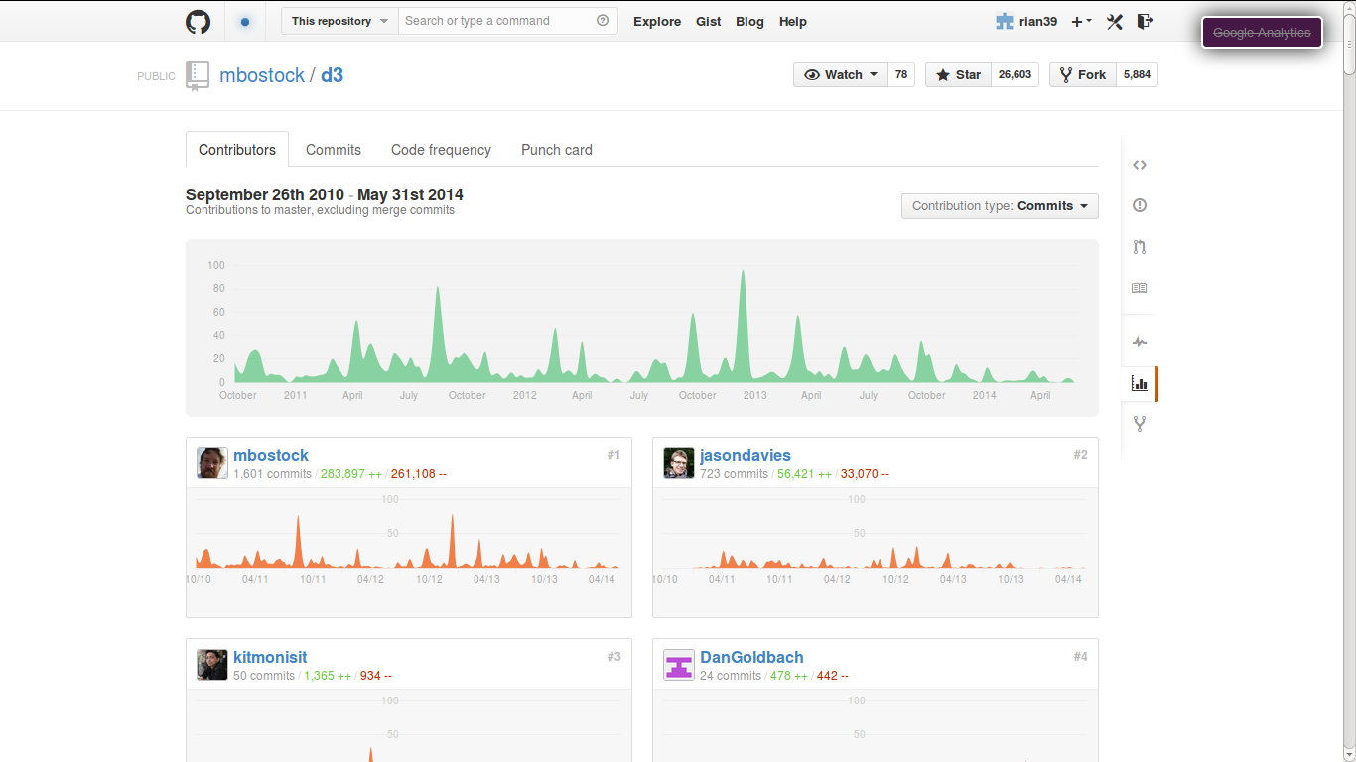
What Github data analytics shows: N = 1

Slide 7
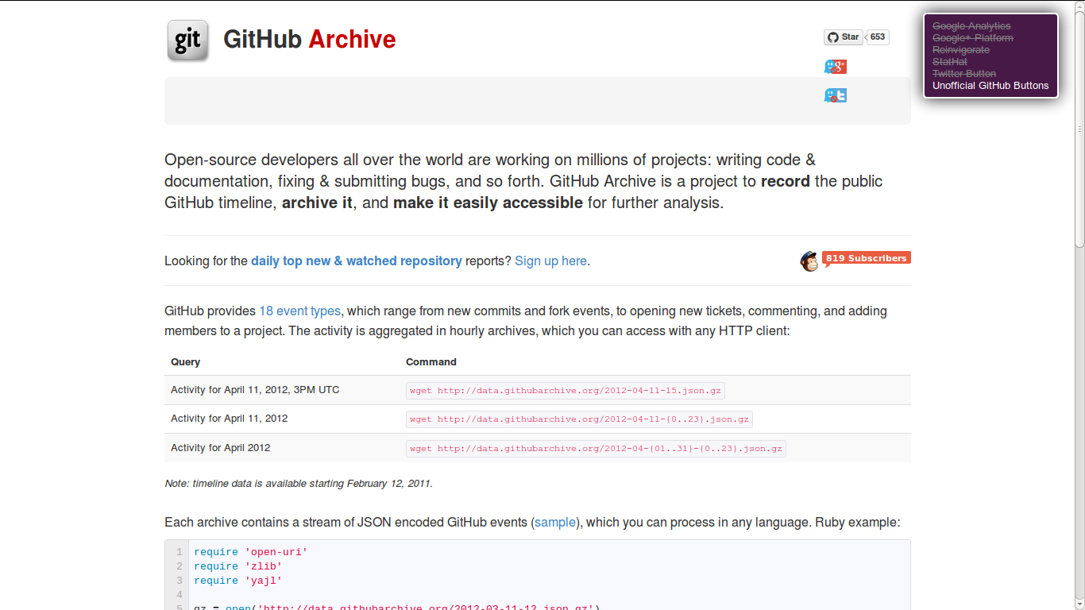
Publically accessible Github data: N= 295 million events: www.githubarchive.org

Slide 8
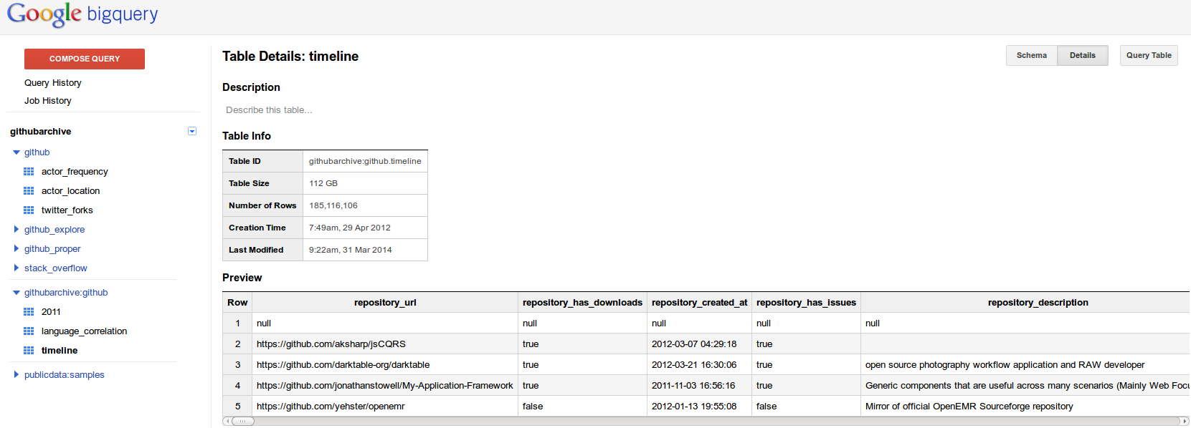
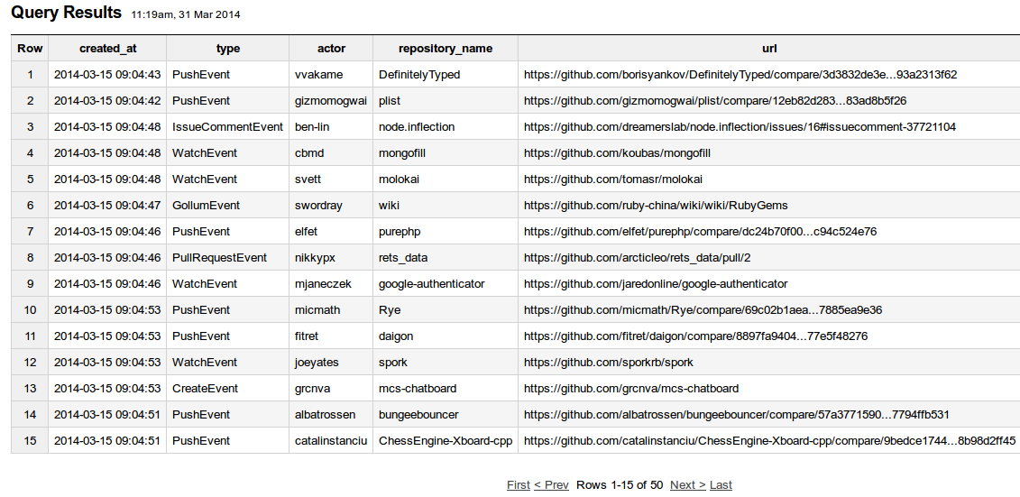
Online analytic tools and devices

Slide 9
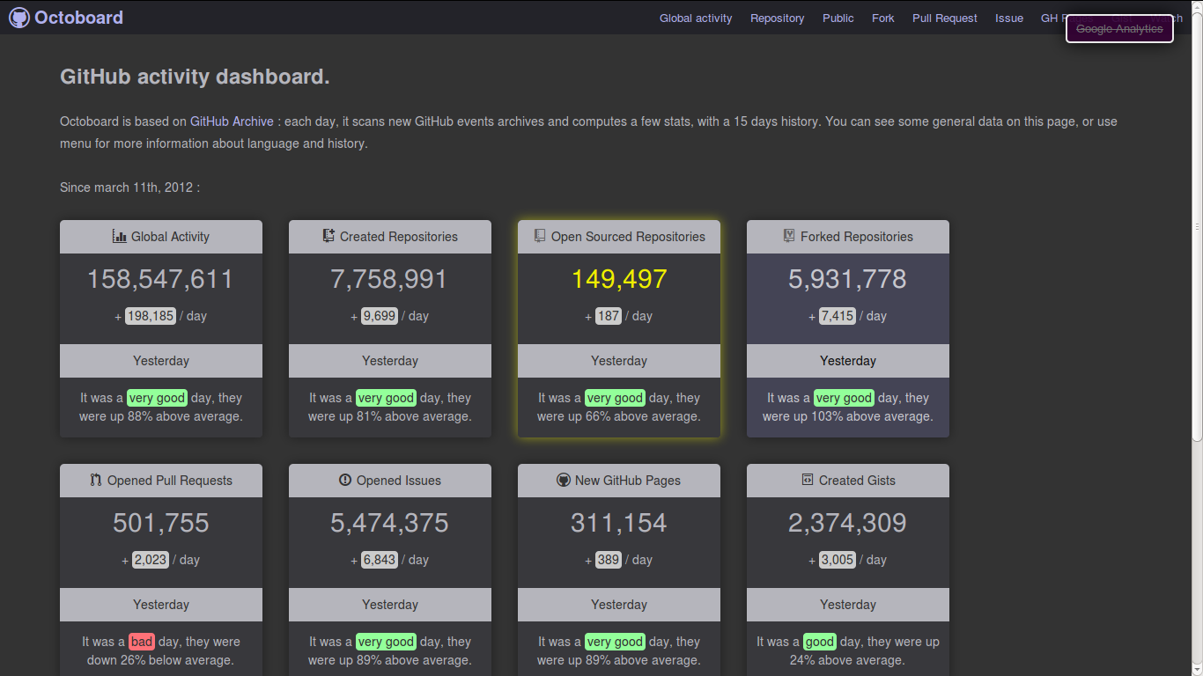
Uses of Github event data: counting N

Slide 10
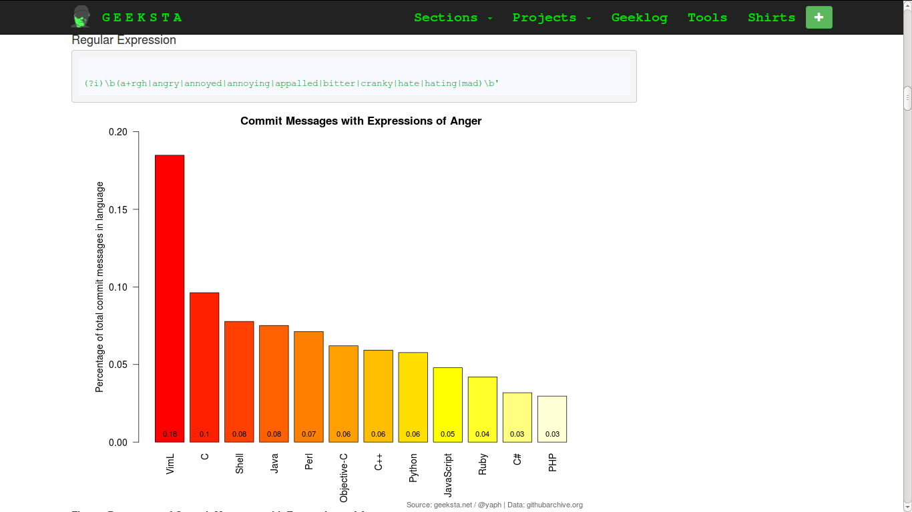
Counting angry words in code

Slide 11
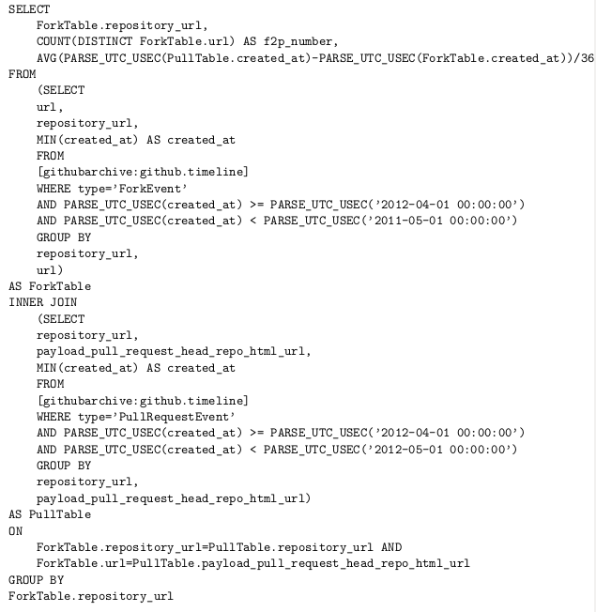
Crafting queries

Slide 12
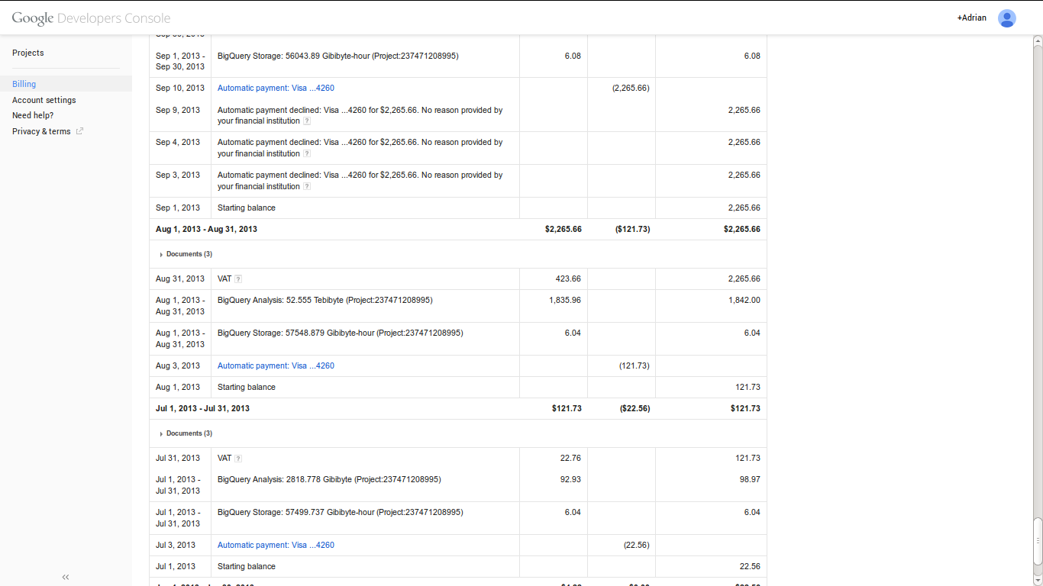
Tradeoffs between interactive and programmatic tools

Slide 13
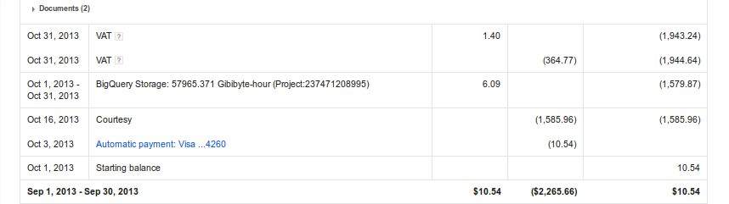

Slide 14
Modelling and visualizing N=all

Slide 15
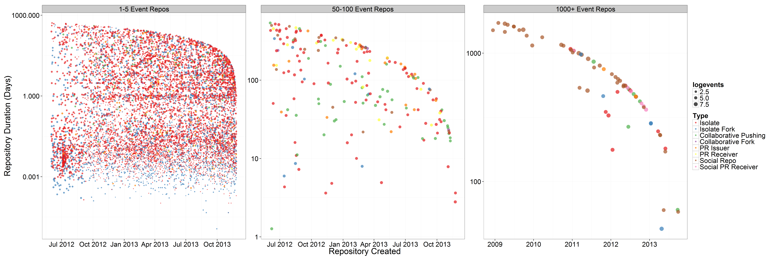
Dreaded power law distributions
13.2 million repositories on Github, but mostly imitative

Slide 16
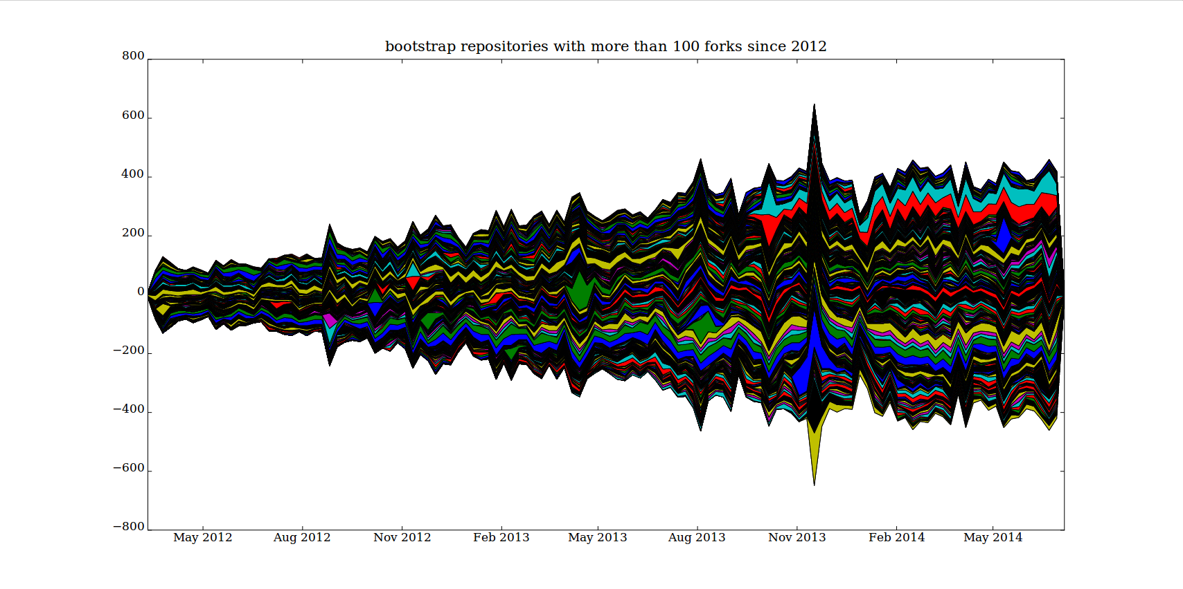
Mapping high-powered imitation: N = ?

Slide 17
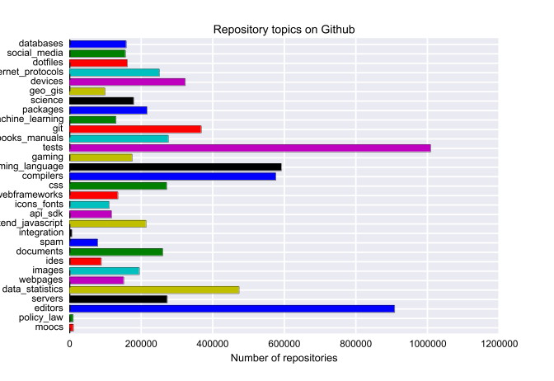
Machine learning imitative flows: Github repository name classifiers; N ~ 80%

Slide 18
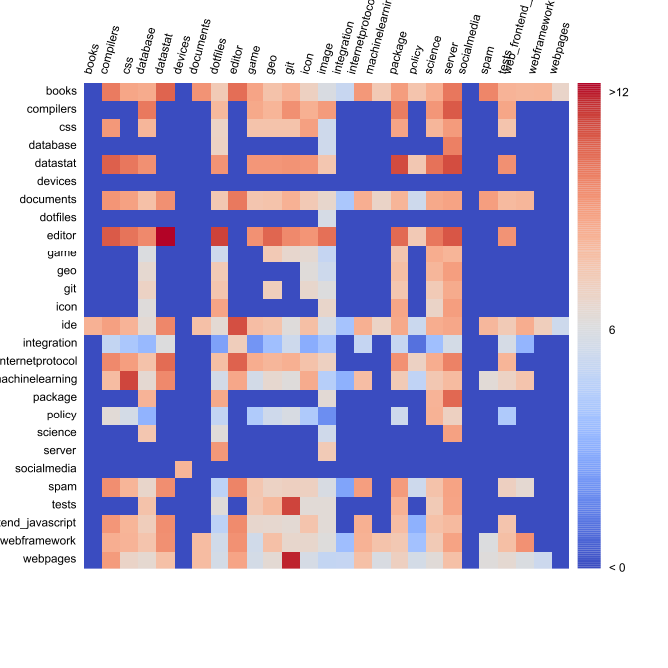
Variations and inventions through imitation

Slide 19
Reproducibility = git?
git clone https:/github.com/metacommunities/metacommunities

Slide 20
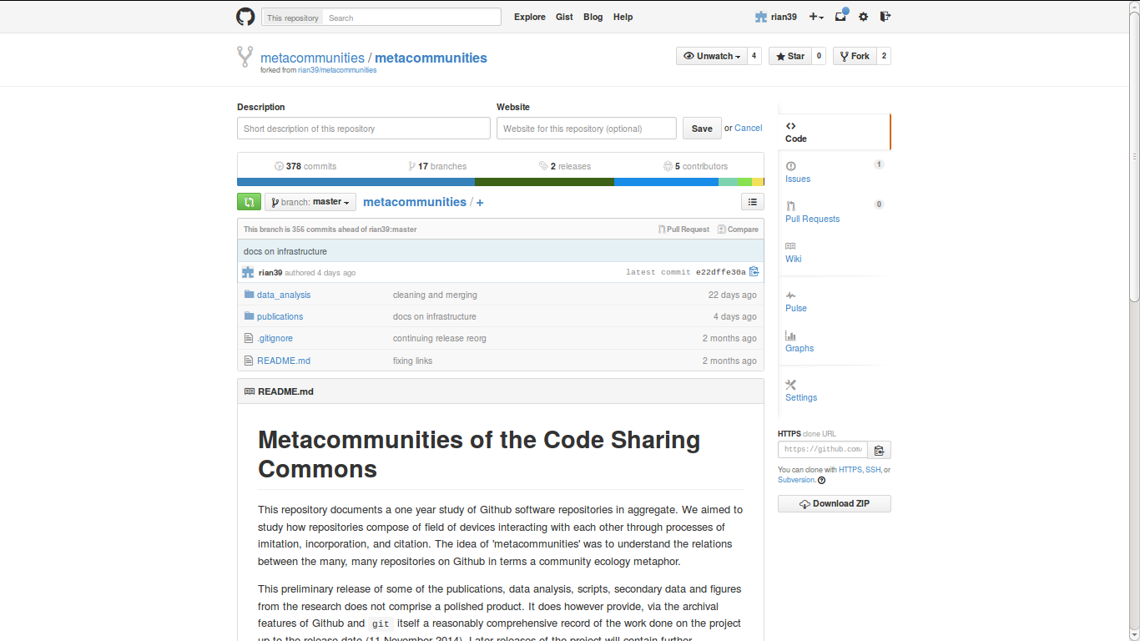
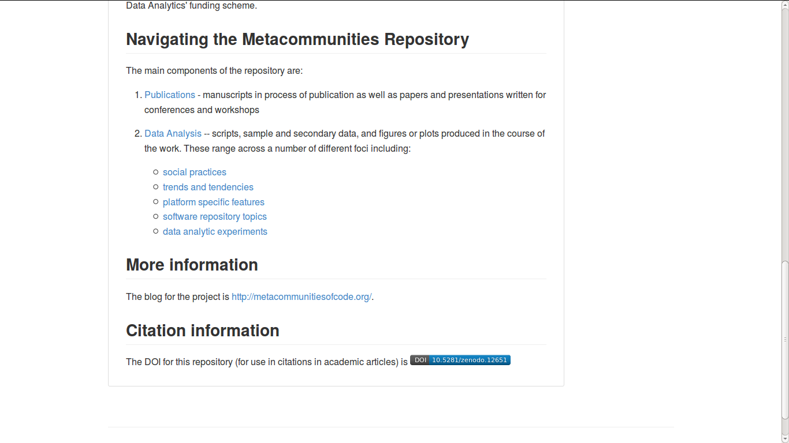

Slide 21
Overall lessons
1. N=All is hard in metacommunities – practice is dispersed and heterogeneous
2. Completely online data analytics is hard (at least in research settings) because only some tools are there;
3. Machine learning and modelling approaches add a lot of sorting power, but rarely work out of the box; need training data; and coding skills
4. Reproducibility of data analysis getting easier (e.g. interactive notebooks and github repositories), but coding skills (R, Python in particular) still vital.

