Slide 1
Many names and large numbers: methods for imitative fluxes?
Adrian Mackenzie

Slide 2
N = All and public datasets

Slide 3
Objectives

Slide 4
Github as code commons & metacommunity

Slide 8
Online analytic tools and devices

Slide 12
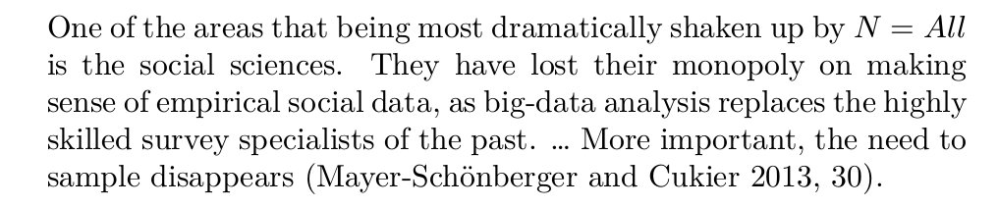
Tradeoffs between interactive and programmatic tools

Slide 13
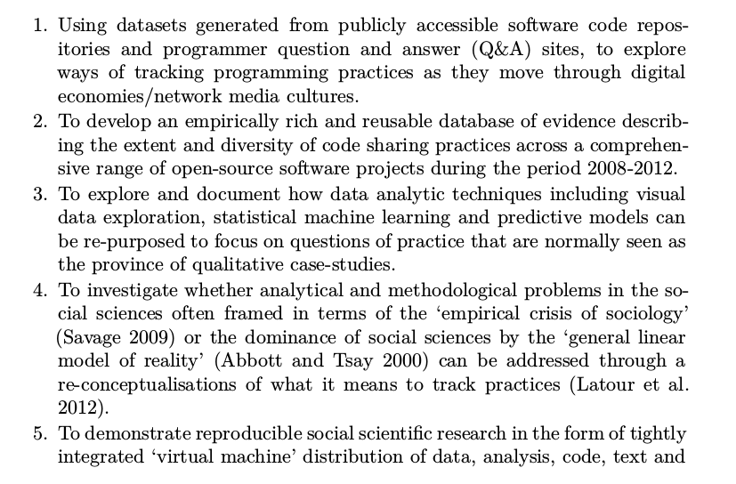

Slide 14
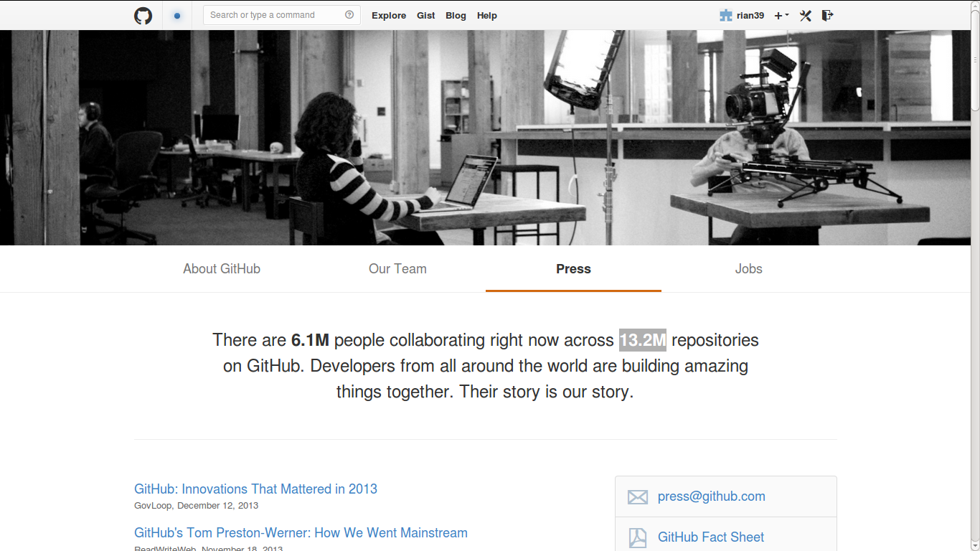
Modelling and visualizing N=all

Slide 15
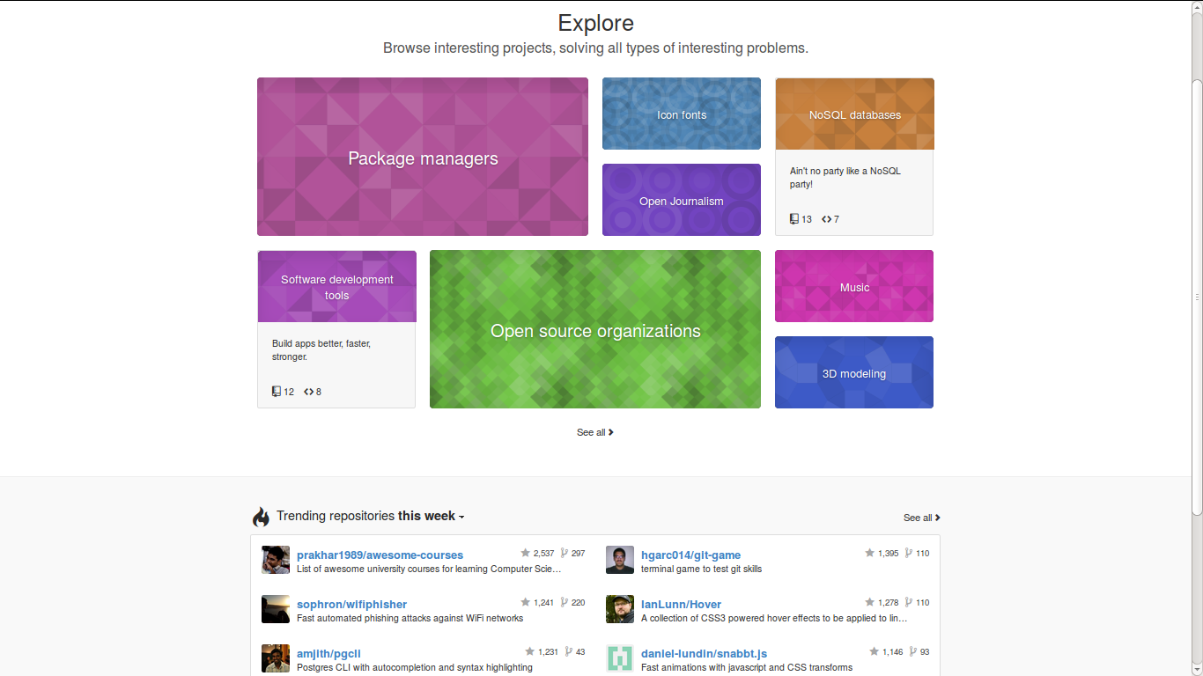
Dreaded power law distributions
Github's 'mosaic plot' of repositories: N = ?

Slide 16
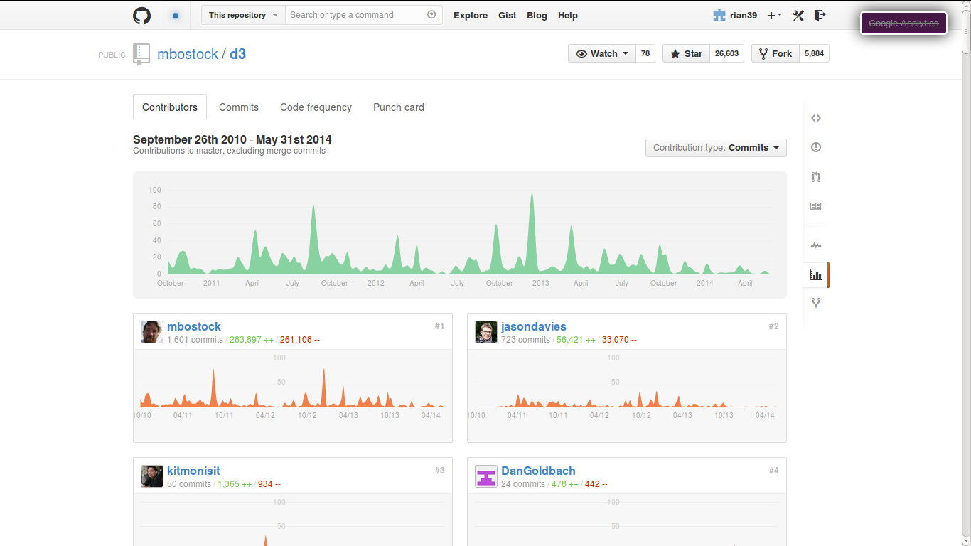
Mapping high-powered imitation: N = ?
What Github data analytics shows: N = 1

Slide 17
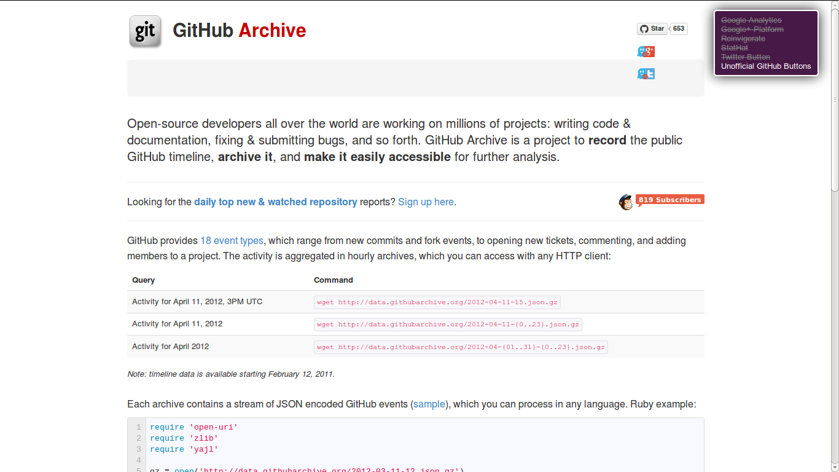
Machine learning imitative flows: Github repository name classifiers; N ~ 80%
Publically accessible Github data: N= 295 million events: www.githubarchive.org

Slide 18
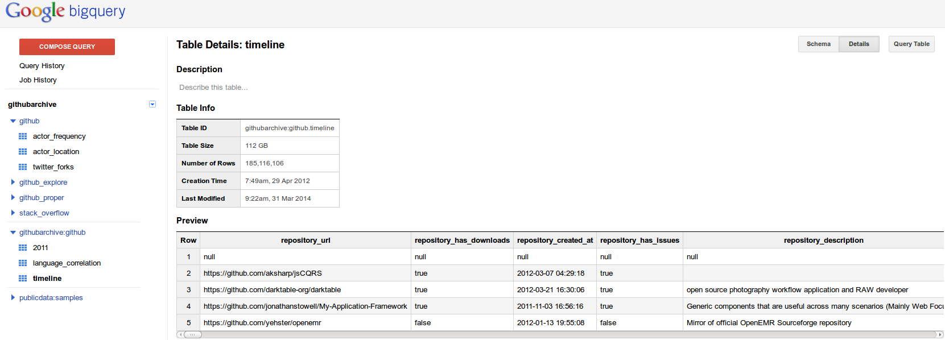
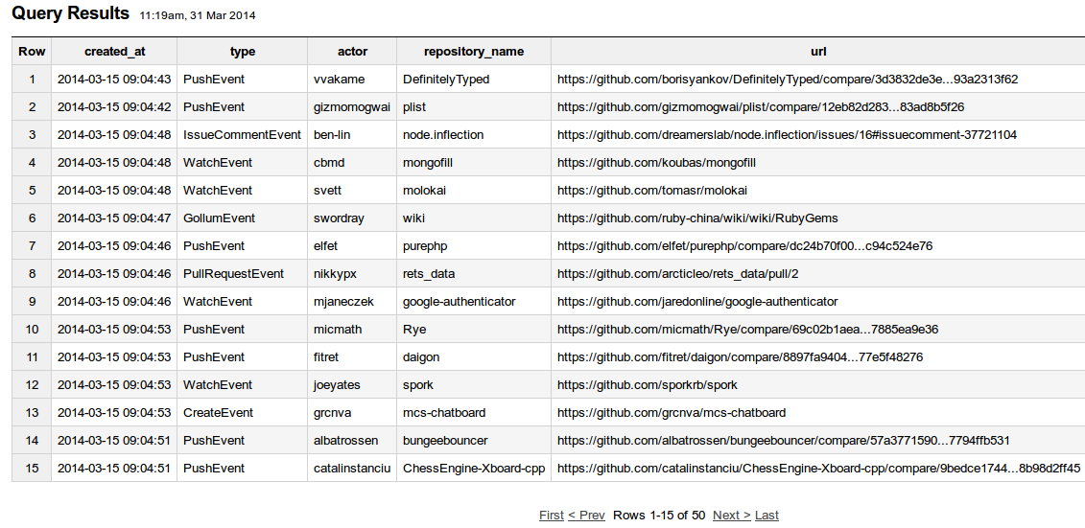

Slide 19
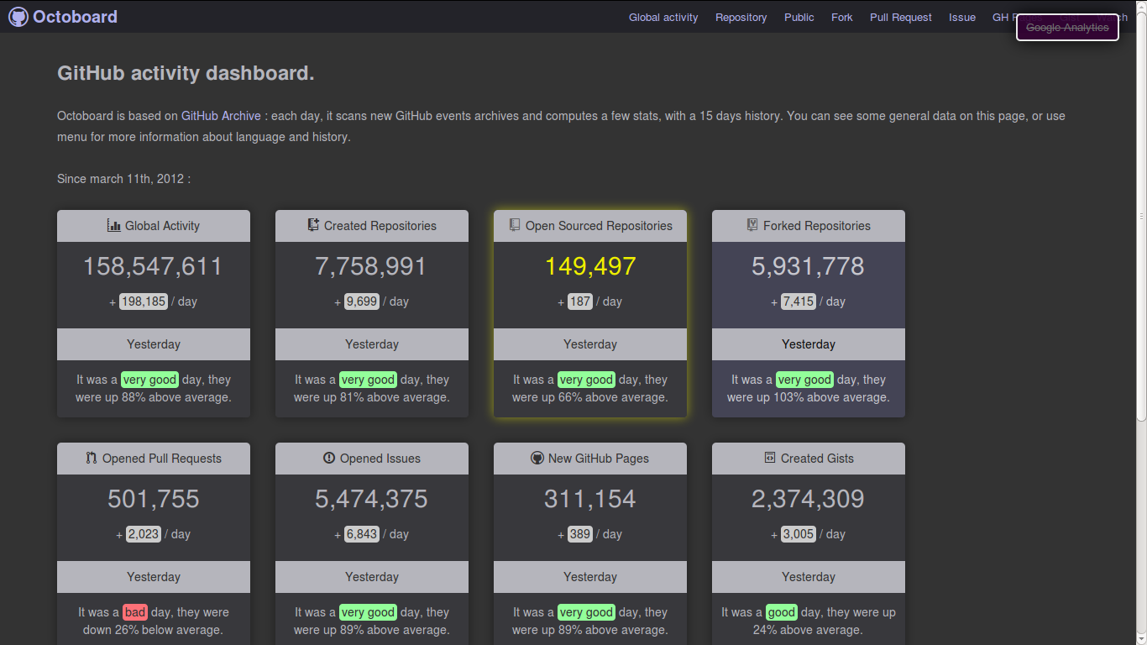
Reproducibility = git?
Uses of Github event data: counting N

Slide 20
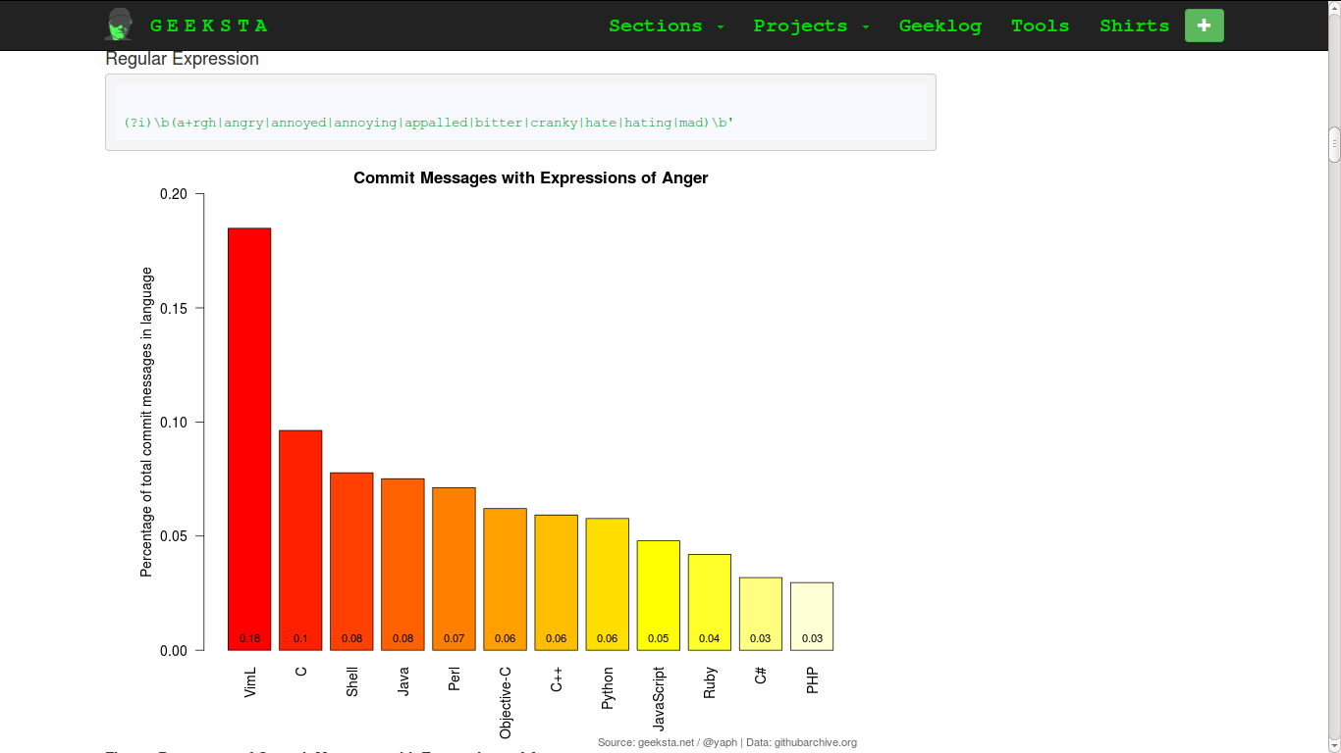
Counting angry words in code

Slide 21
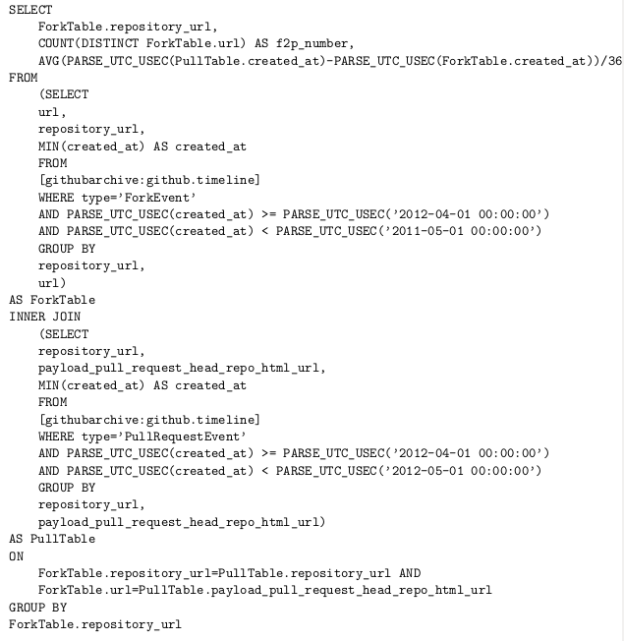
Overall lessons
Crafting queries

Slide 22
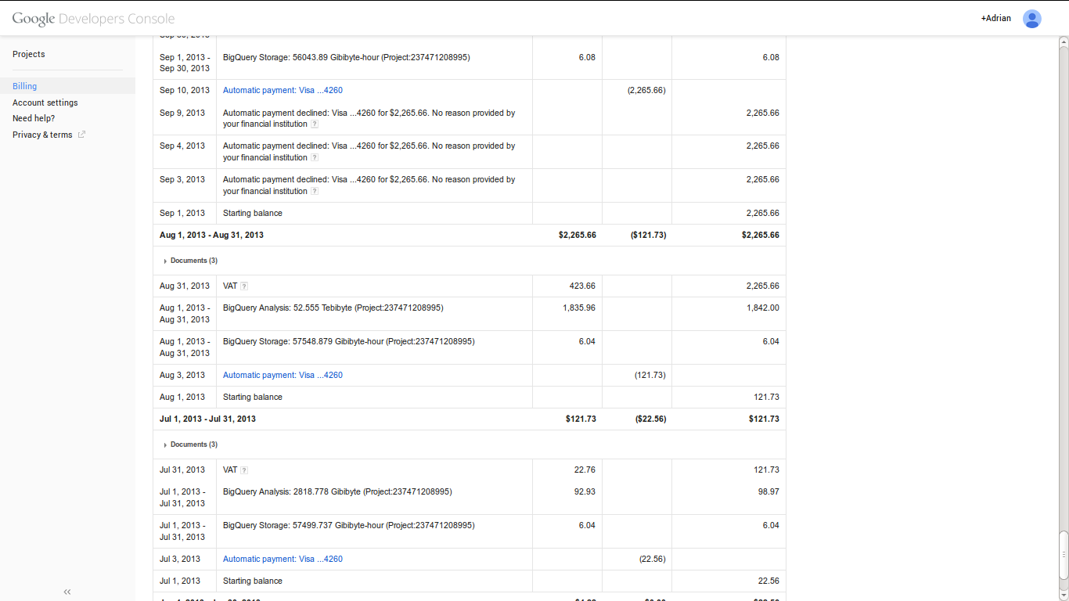
Tradeoffs between interactive and programmatic tools

Slide 23
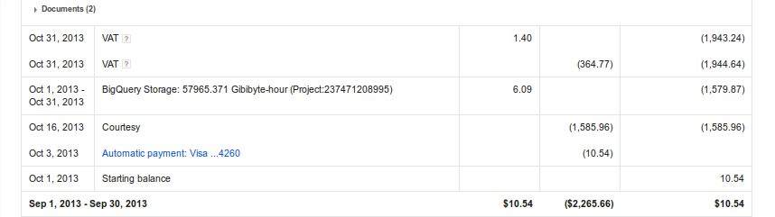

Slide 24
Modelling and visualizing N=all

Slide 25
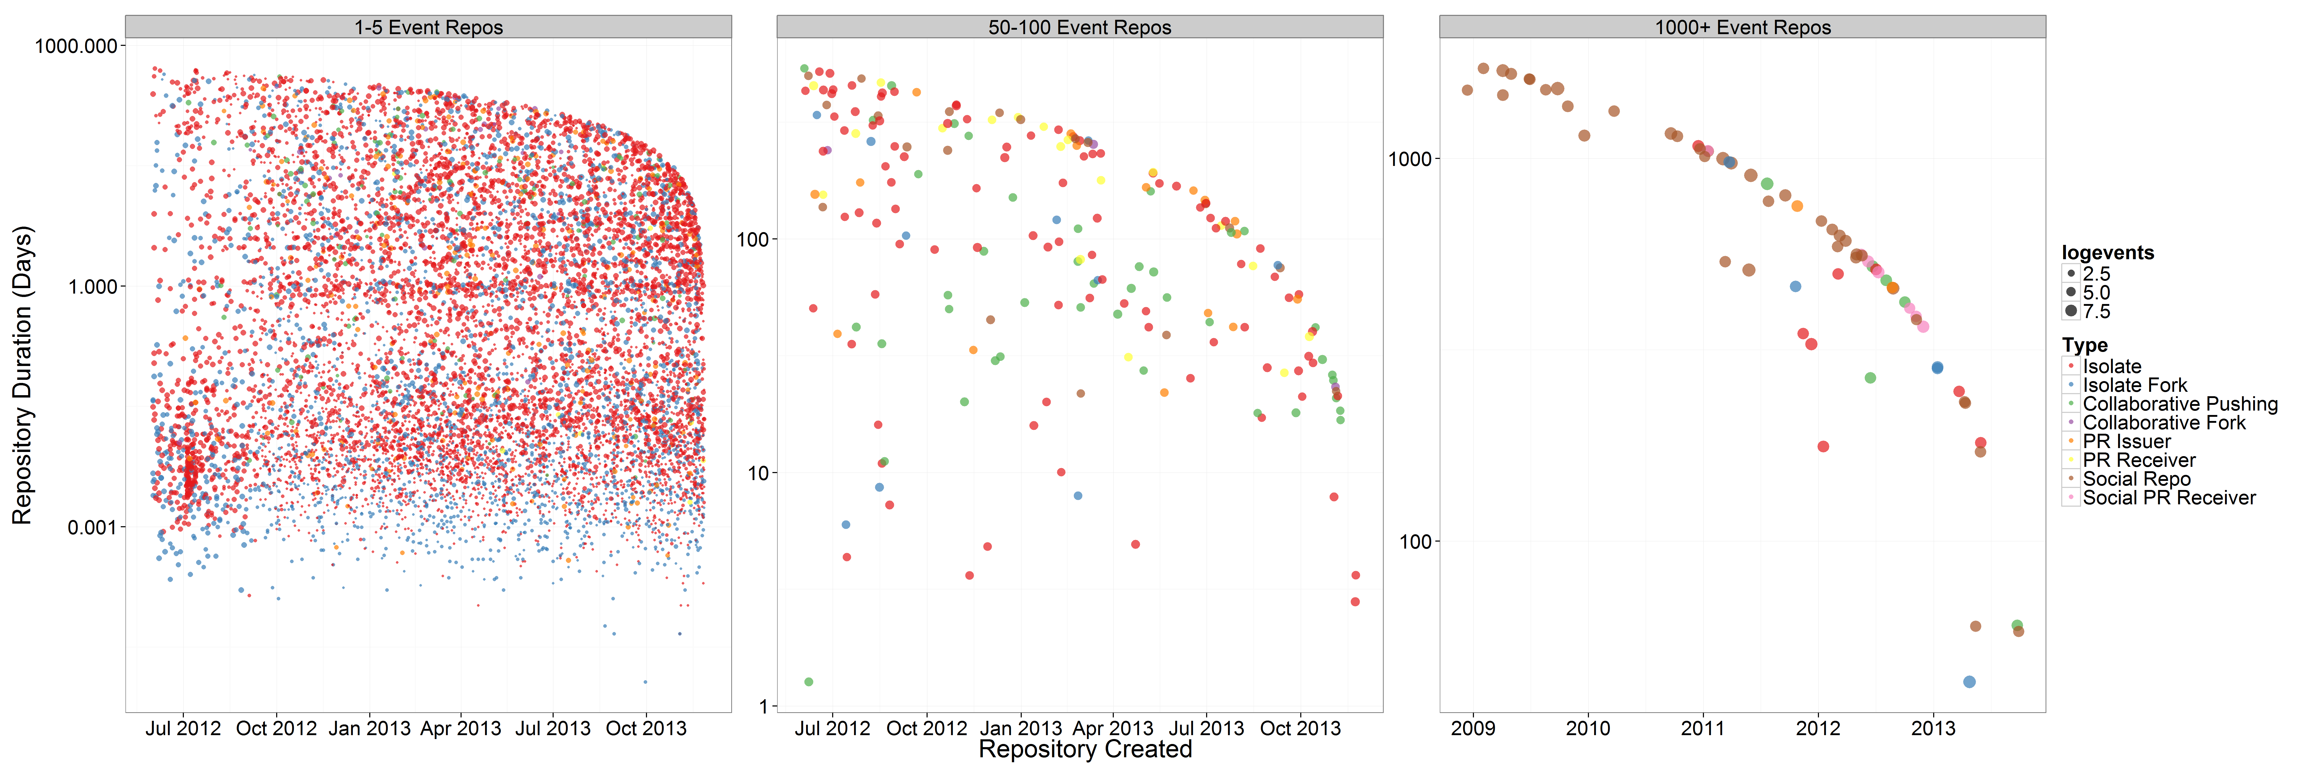
Dreaded power law distributions
13.2 million repositories on Github, but mostly imitative

Slide 26
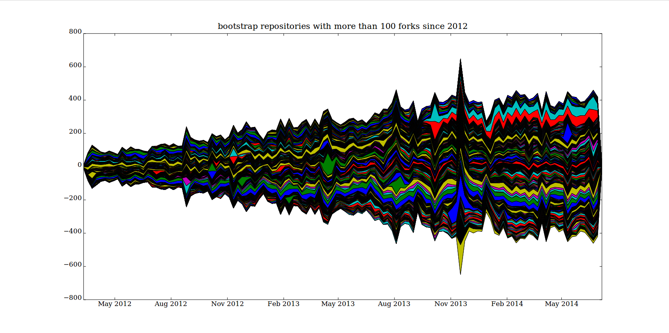
Mapping high-powered imitation: N = ?

Slide 27
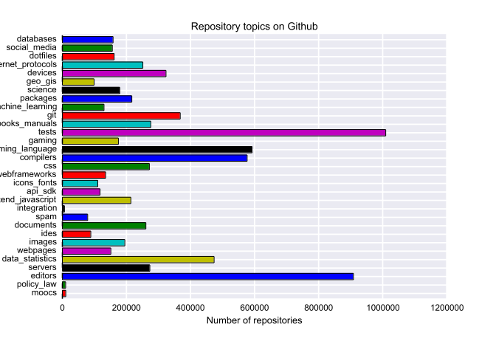
Machine learning imitative flows: Github repository name classifiers; N ~ 80%

Slide 28
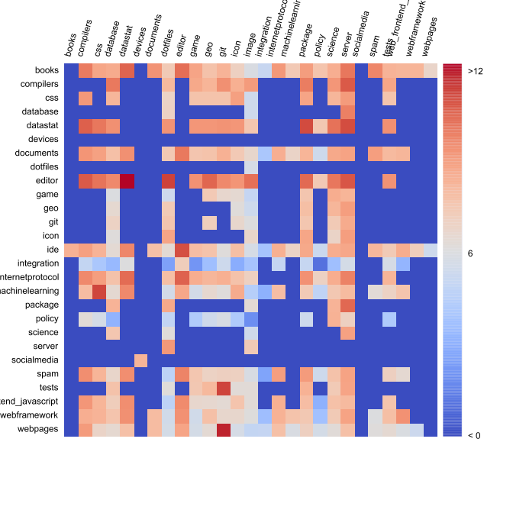
Variations and inventions through imitation

Slide 29
Reproducibility = git?
git clone https:/github.com/metacommunities/metacommunities

Slide 30
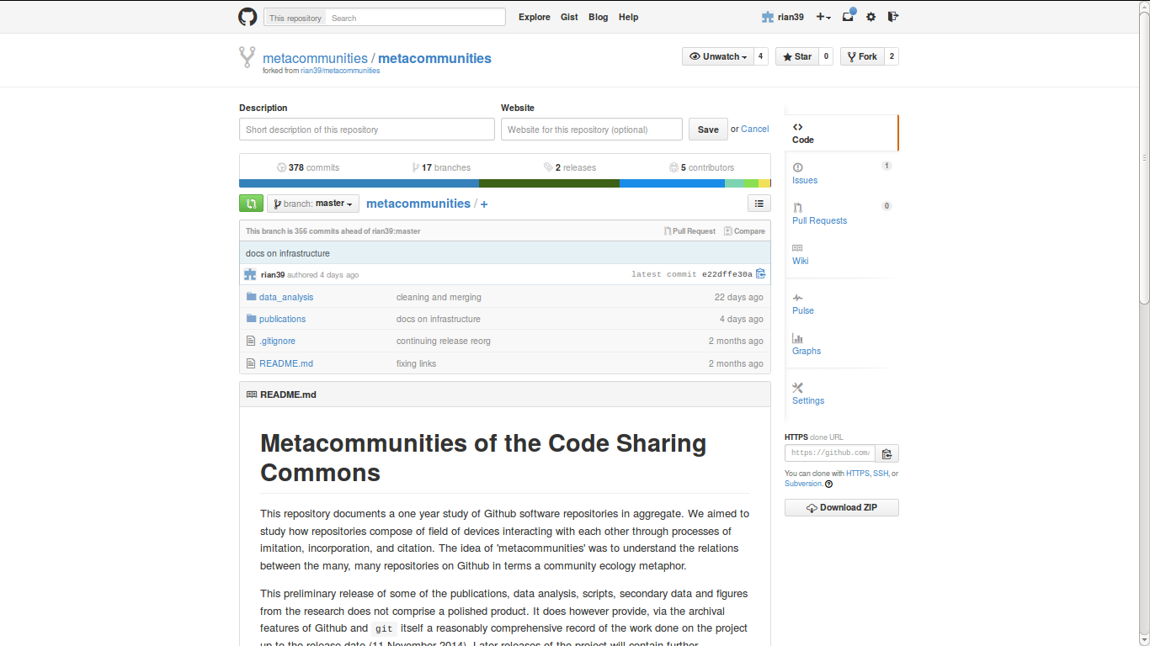
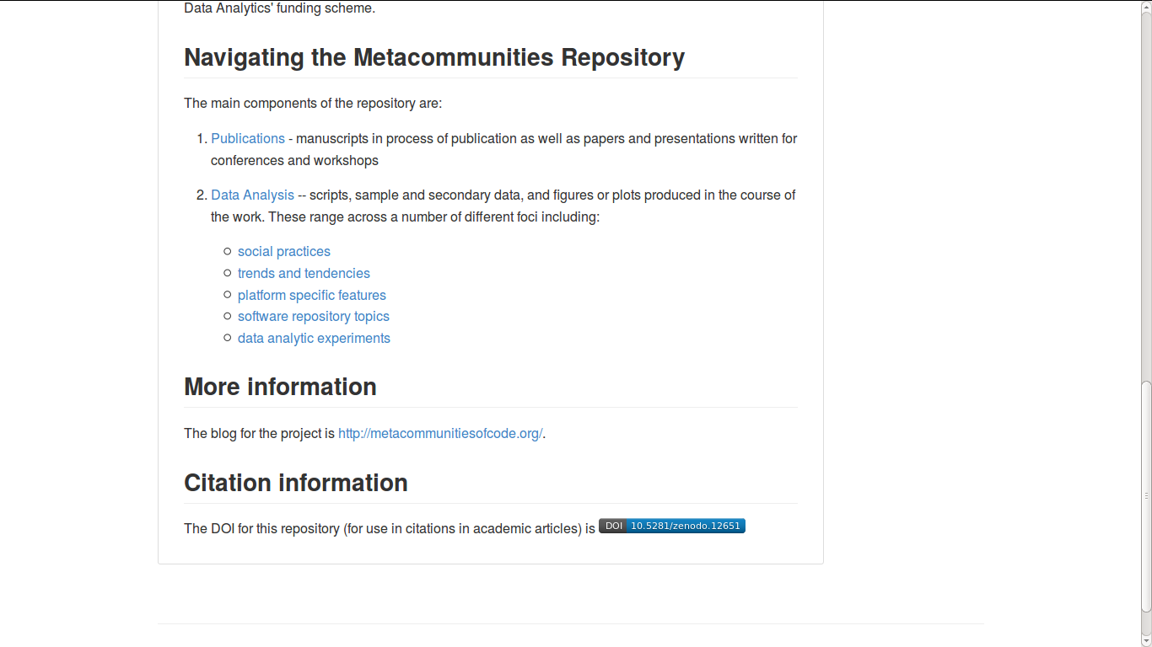

Slide 31
Overall lessons
1. N=All is hard in metacommunities – practice is dispersed and heterogeneous
2. Completely online data analytics is hard (at least in research settings) because only some tools are there;
3. Machine learning and modelling approaches add a lot of sorting power, but rarely work out of the box; need training data; and coding skills
4. Reproducibility of data analysis getting easier (e.g. interactive notebooks and github repositories), but coding skills (R, Python in particular) still vital.

