Slide 1
Many names and large numbers: methods for imitative fluxes?
Adrian Mackenzie

Slide 2
The problem(s) of counting in STS
In any practical going-on with numbers, what matters is that they can be made to work, and making them work is a politics. Yet is a politics that completely evades conventional foundationist analysis (Verran, 2001: 88)
'momentary apprehensions of depth' (Anne-Lise Riles, 2001)

Slide 3
Overview
- the case study – a social media platform that hosts ~20 million code repositories;
- code and field of devices: 'co-device analysis'
- diagrammatic cultures and data: the political economies of counting and graphing
- obstacles to and potentials for count-based ethnographic sensibility

Slide 4
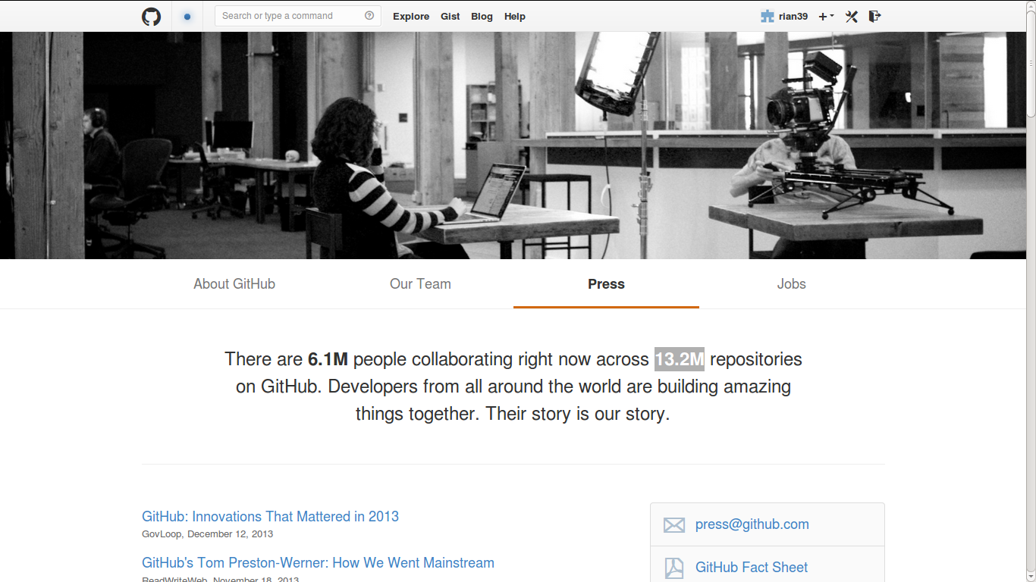
'Their story is our story'

Slide 5
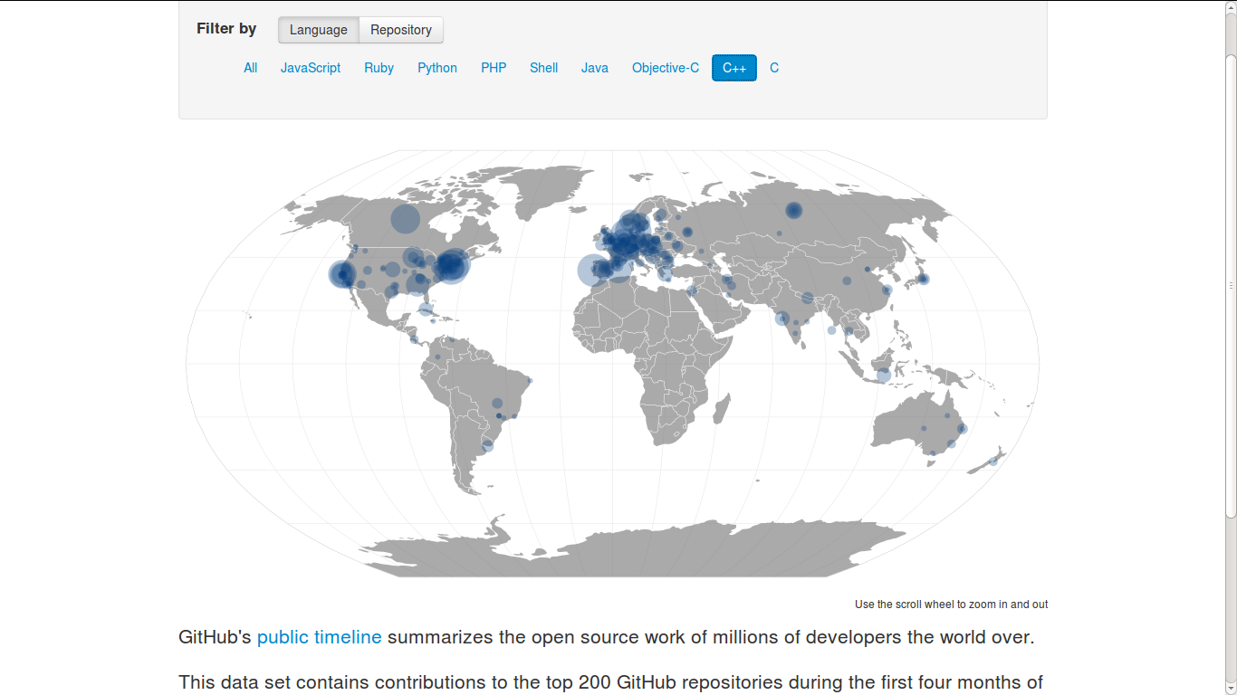
Repositories and their places

Slide 6
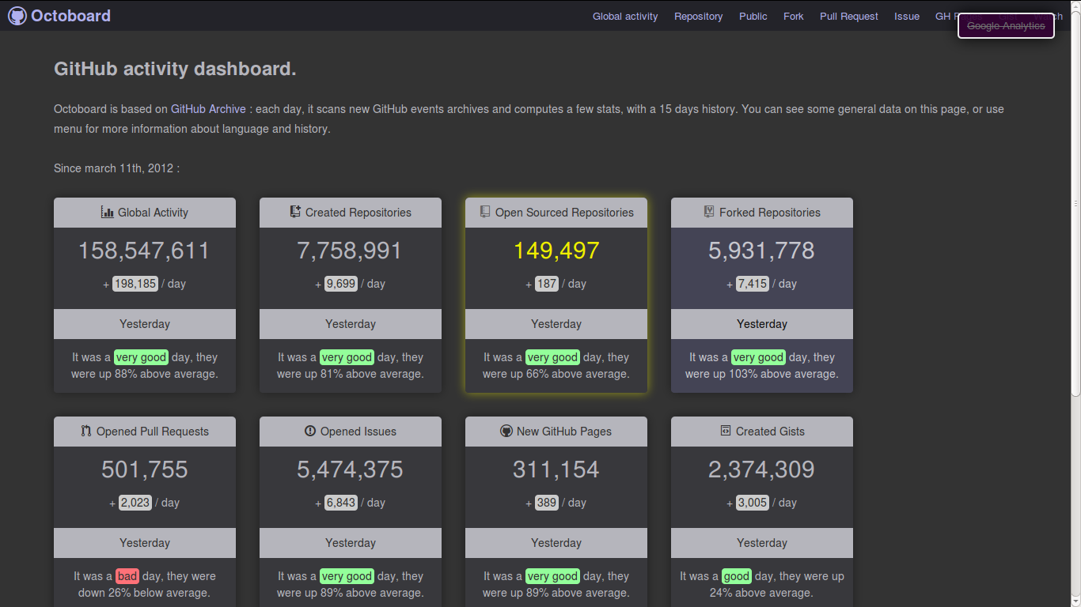
Live reports of event counts

Slide 7
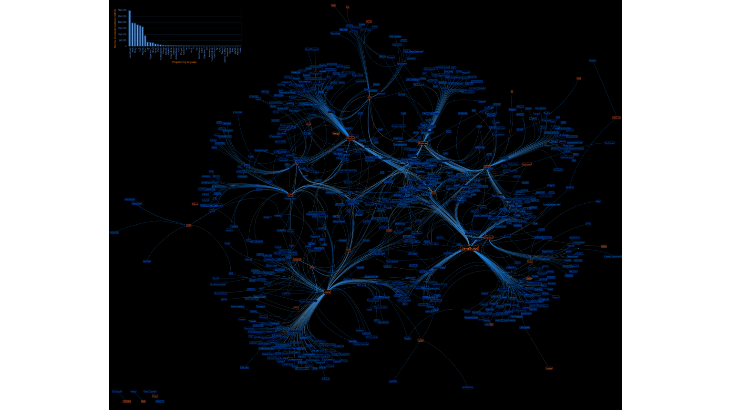

Slide 8
Acknowledgements
Research funded by ESRC (UK Economic and Social Research Council) under 'Google Data Analytics' programme, 2013-2014
Richard Mills and Stuart Sharples – research associates
Matthew Fuller and Andrew Goffey – co-researchers

