Slide 1
Code-crowd: how software repositories express urban life
Adrian Mackenzie
Sociology
Lancaster
With Matthew Fuller (Goldsmiths), Andrew Goffey (Nottingham), Richard Mills (Cambridge) and Stuart Sharples (Lancaster)

Slide 2
is there any way of making a more general assessment of software in the city?
[Thrift & French, 2002, 311-312]
1. the most obvious, the large and complex geography of the writing of software – of the production of lines of code – a geography that takes in many different locations and many different languages and which has been built up progressively since the invention of programming in the 1940s [Thrift & French, 2002, 323].
2. in essence, we can say that it [software] consists of rules of conduct able to be applied to determinate situations [325]
3. the general profusion of software, its increasing complexity and consequent emergent properties, all count as means of producing playful idioms that have not been captured by dominant orders. Software's very indeterminacy and lack of closure provide a means of creating new kinds of order (328)

Slide 3
'Take just the case of coded cities understood as a whole.
Should we think of them simply as projections of an autistic capitalist power in which all consequences are externalized? … as entities gathered around matters of prescribed concern and uninterested in much that lies outside them? … as tied into a kind of ethic of care by the need to roll over systems which demand resilience? … as having an increasingly involved dream life, based on projection and retrojection of all the searches, blogs and tweets that are continually being generated? … as geometric beings, born out of constant requests for navigation? … as the result of newly found abilities to represent arising out of advances in visualization?
There is no set format or single cause but what is clear is that it is increasingly possible for these entities to learn – in however a limited way – to transform themselves, to author themselves either through emergent tendencies arising out of complexity or through simple happenstance which places them in unexpected situations which require adaptation'
[Thrift, 2014, 13]

Slide 4
> Software is more like a kind of traffic between beings, wherein one sees, so to speak, the effects of the relationship. What transpires becomes reified in actions, body stances, general anticipations. We would argue, then, that software is best thought of as a kind of absorption, an expectation of what will turn up in the everyday world. [Thrift & French, 2002, 312]

Slide 5
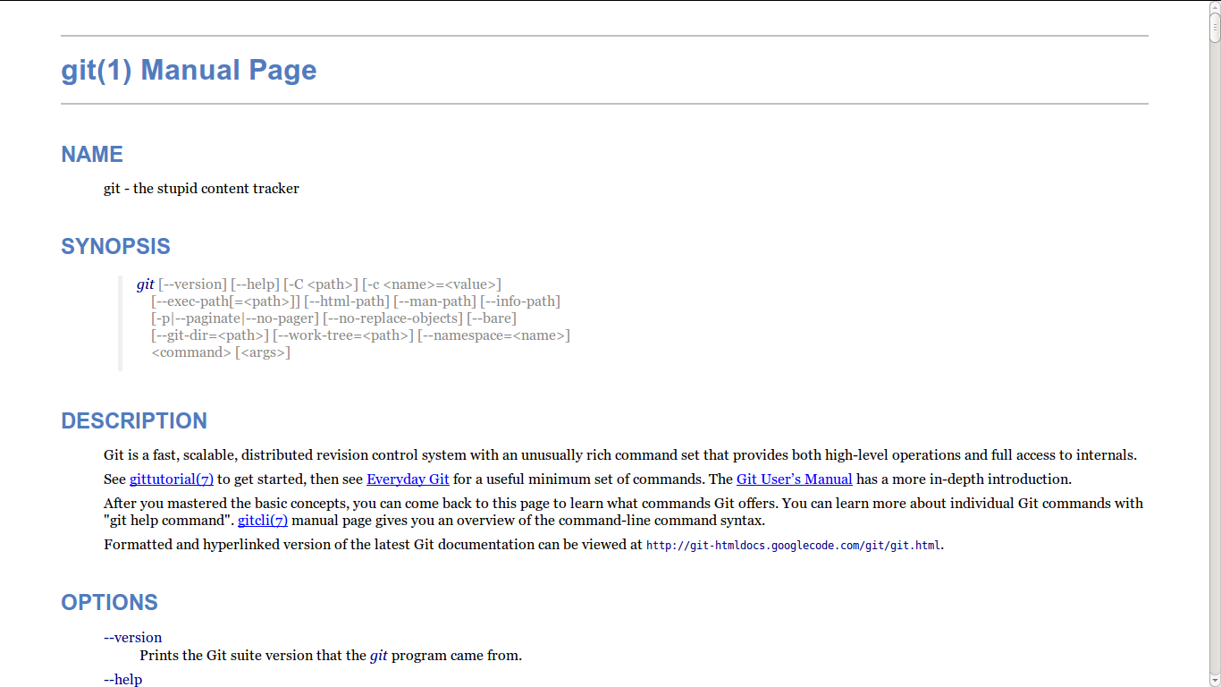
Git

Slide 6
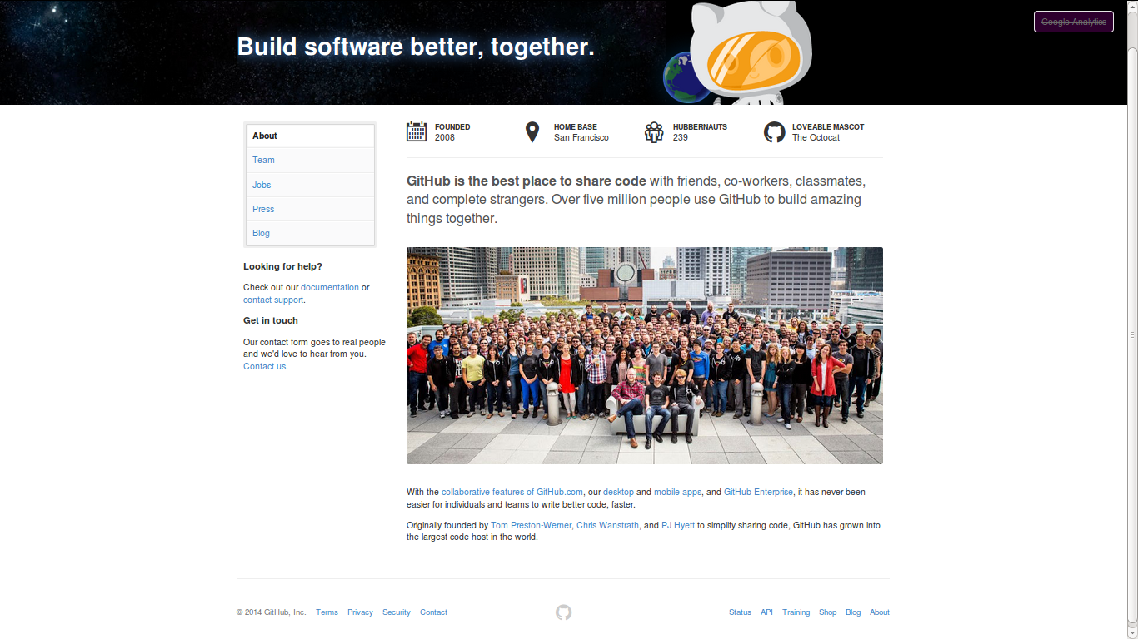
From git to Github: code in traffic

Slide 7
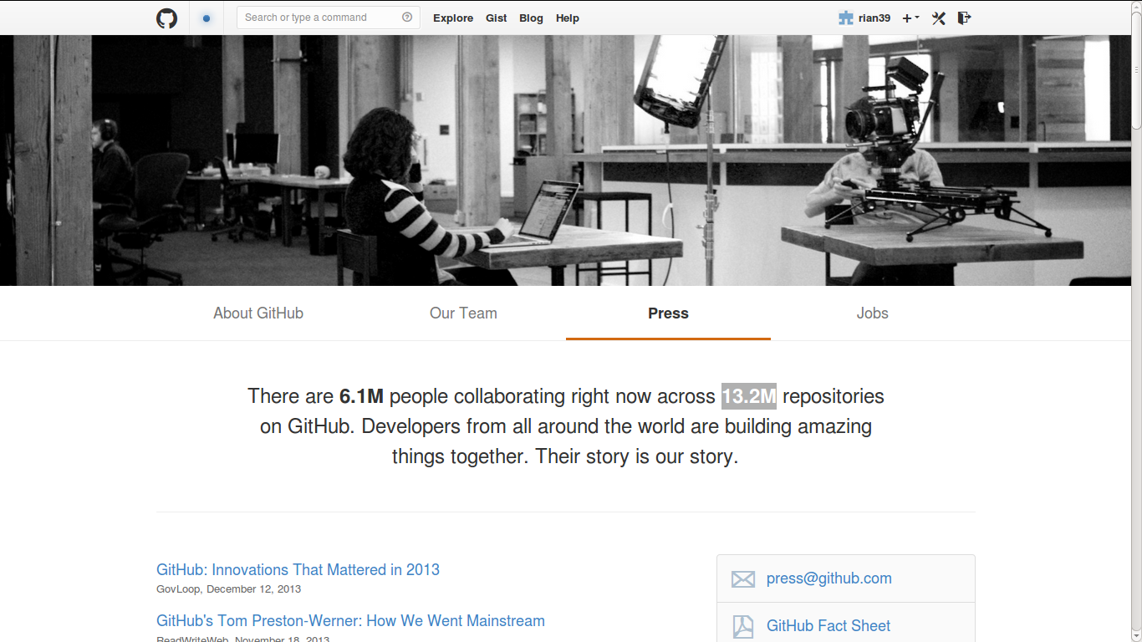

Slide 8
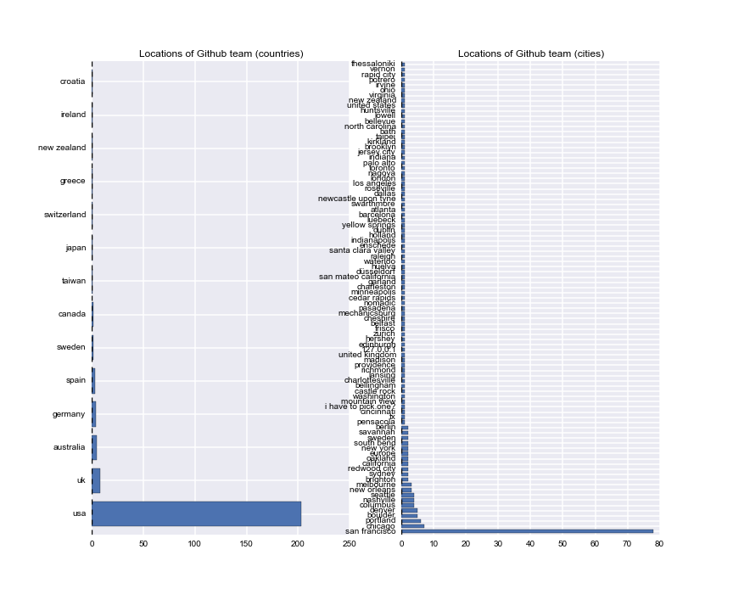
Geographies of 'Hubbernauts'

Slide 9
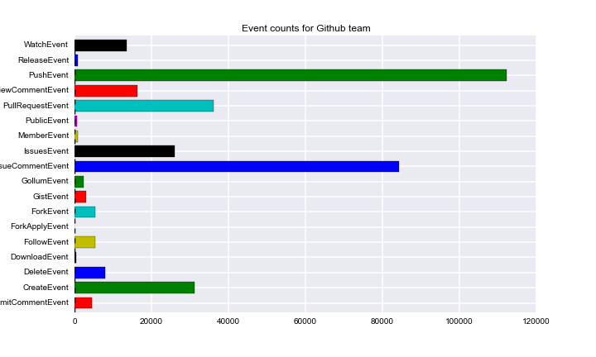

Slide 10
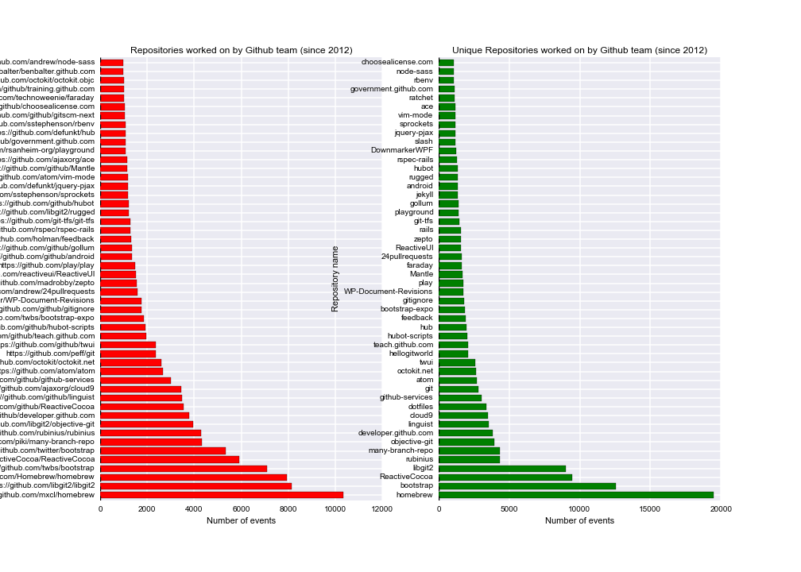

Slide 11
Early repositories ( c. 2008)
Recent repositories (c. 2014)
1 mojombo/grit
2 wycats/merb-core
3 rubinius/rubinius
4 mojombo/god
5 vanpelt/jsawesome
6 wycats/jspec
7 defunkt/exception_logger
8 defunkt/ambition
9 labria/restful-authentication
10 technoweenie/restful-authentication
11 technoweenie/attachment_fu
12 topfunky/bong
13 anotherjesse/s3
14 anotherjesse/taboo
15 mojombo/glowstick
16 wycats/merb-more
17 macournoyer/thin
18 jamesgolick/resource_controller
19 defunkt/cache_fu
20 bmizerany/sinatra
21 rtomayko/sinatra
22 jnewland/gsa-prototype
23 defunkt/mofo
24 schacon/ruby-git
25 mmower/simply_versioned
26 abhay/calais
27 mojombo/chronic
28 al3x/git-wiki
29 schacon/git-wiki
30 sr/git-wiki
31 queso/signal-wiki
32 drnic/ruby-on-rails-tmbundle
33 danwrong/low-pro-for-jquery
34 mojombo/yaws
35 grempe/amazon-ec2
36 peterc/switchpipe
37 up_the_irons/ebay4r
38 wycats/merb-plugins
39 atmos/fitter_happier
40 brosner/oebfare
41 cristibalan/braid
42 evilchelu/braid
43 jnicklas/uploadcolumn
44 engineyard/eycap
45 chneukirchen/gitsum
46 brosner/django-mptt
47 technomancy/bus-scheme
48 Caged/groomlake
49 sevenwire/forgery
50 lazyatom/soup
1 2m1tsu3/practice
2 tylerdmace/ledomme
3 yehiaelghaly/xssya
4 istvan-antal/commandjs
5 JohnKrigbjorn/ObjectOne
6 chenx/Ci35_1
7 mohsenbezanj/AI_Project
8 Dineshkarthik/blogengine
9 sapanbhuta/Sapari
10 gwoodroof/chat-gwoodroof
11 tryuichi/Hello-World
12 prateek0020/NepTravelMate
13 discoverfly/discoverfly.github.io
14 evan-007/ng-wikiful
15 sanemat/zipcode-jp
16 donreamey/PJKiller
17 discoverfly/discover
18 jkkorean/MIUI-KK
19 Artofacks1/ionic-app
20 jkkorean/MIUI-JB
21 tycho01/rails-i18n
22 Oksisane/Websockets
23 chenxiruanhai/XScrollView
24 jhonM17/footer-fixed-boostrap
25 McPringle/workshops
26 JosemyD/testing-laravel
27 wngravette/FlogResources
28 Ethico/temp
29 Tripod2K/cse223p
30 Parbhat/tango_with_django_1.6
31 ManuelAlanis/ios
32 kowito/pnxstudio
33 raimana/activiti_merger
34 dylanling/connect_four
35 vipseo2014/game-cho-android
36 dylanling/connect
37 analoq/temvoc
38 a554b554/algorithm-competition
39 a7657z/12306_2
40 scwuhao/jumpybloc
41 jjfine/post_mail
42 h4di/PROYEK-TKPPL
43 EXOgreen/TwitchBot
44 ericcarpenterle/creepcreep
45 pt1490/ubuntu-example
46 tstrimple/cookie-parser
47 AngAven/Pulse
48 lyc4n/lyc4n.github.io
49 drjwhut/elebldc
50 mivim/fosiness

Slide 12
Most forked repositories on Github (January 2013)
forks repository
1478 bootstrap
1276 Spoon-Knife
763 dotfiles
504 rails
426 html5-boilerplate
410 jquery
375 homebrew
345 linux
343 android
291 phonegap-plugins
280 node

Slide 13
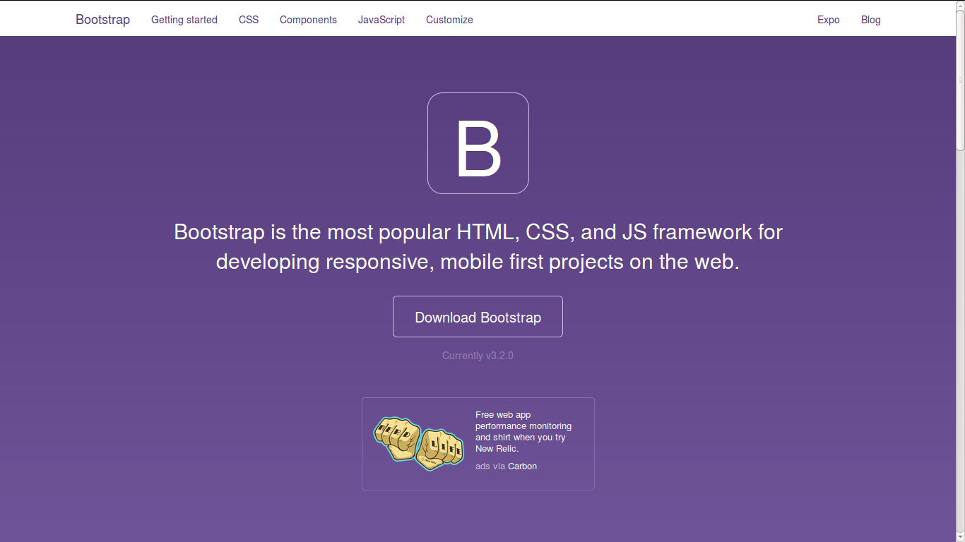

Slide 14
Bootstrap-related forks (January 2013)
forks repo
1478 bootstrap
109 bootstrap-datepicker
84 jekyll-bootstrap
60 bootstrap-wysihtml5
54 bootstrap-tour
48 twitter-bootstrap-rails
48 bootstrap-sass
46 bootstrap-datetimepicker
43 jquery-ui-bootstrap
42 bootstrap-modal
40 wordpress-bootstrap
36 bootstrap-daterangepicker
31 sass-twitter-bootstrap
31 Bootstrap-Image-Gallery
26 rails3-bootstrap-devise-cancan
26 bootstrapwp-Twitter-Bootstrap-for-WordPress
24 metro-bootstrap
24 bootstrap-timepicker
23 bootstrap-toggle-buttons
23 MopaBootstrapBundle
19 twitter.bootstrap.mvc
19 bootstrap-switch
18 google-bootstrap
18 Bootstrap-IE6
17 gwt-bootstrap
17 django-bootstrap-toolkit
17 bootstrap-magic
17 android-bootstrap
16 sinatra-bootstrap
16 CodeIgniter-Bootstrap

Slide 15
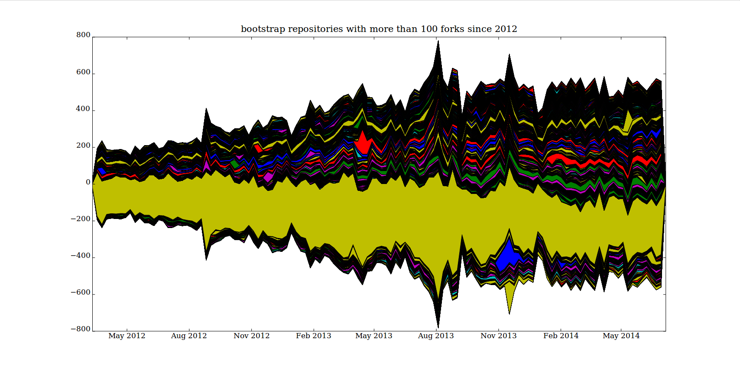

Slide 16
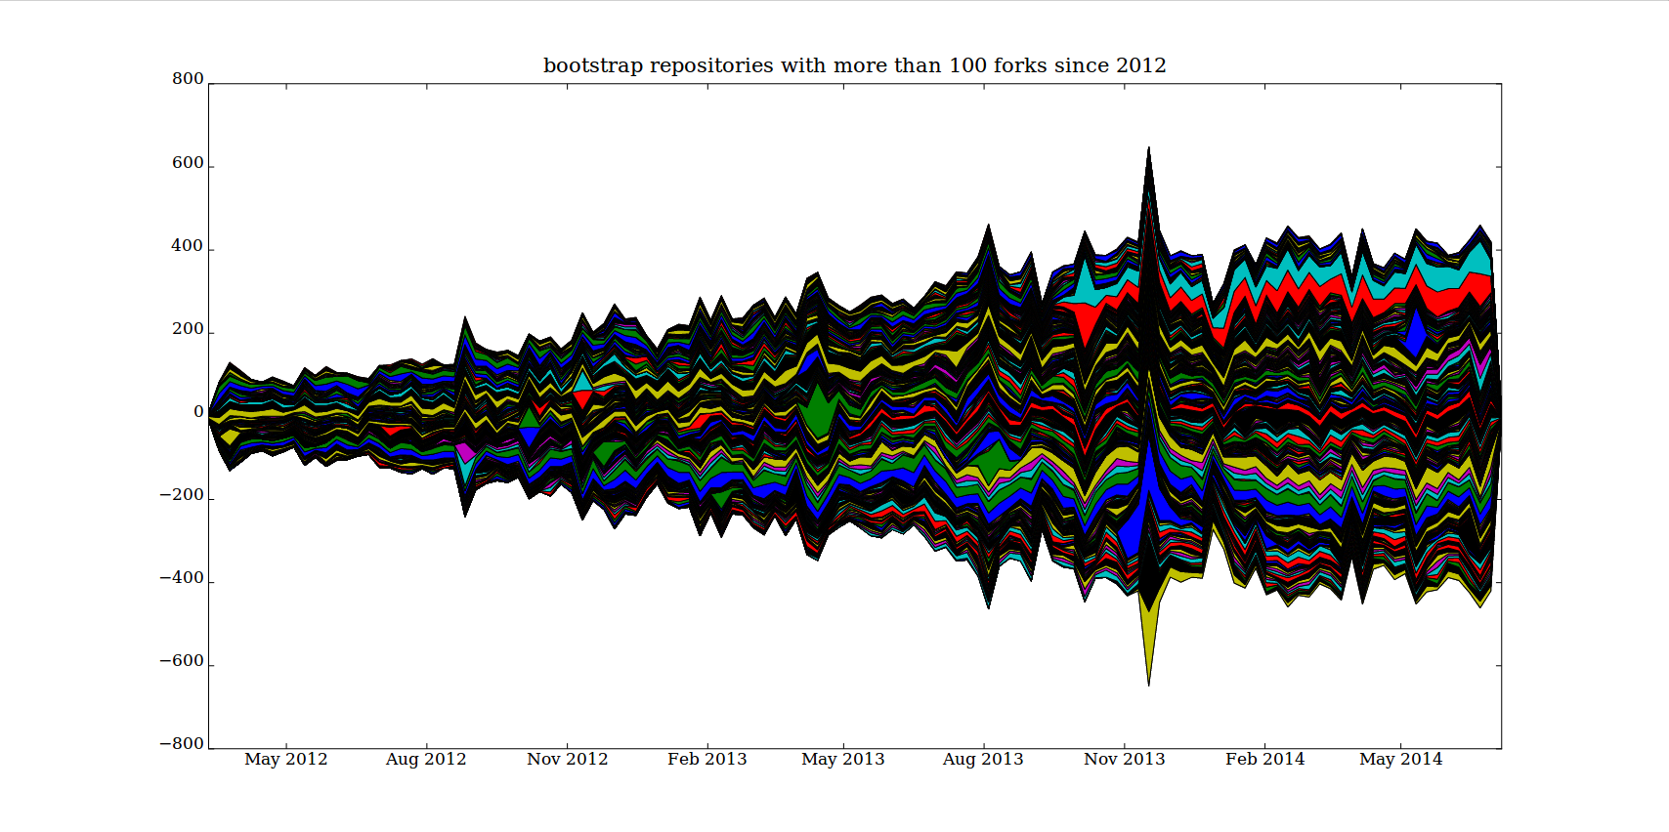

Slide 17
Conclusion: code-crowd?
Github platform as passional assemblage that seeks to recursively urbanise code
vs.
Coding as convolutional imitation with crowd dynamics

Slide 18
Acknowledgments
UK Economic and Social Research Council Funding under 'Google Data Analytics' call, 2013-2014

