Slide 1
Metacommunities of the Code Sharing Commons
Machines of the Code-Sharing Commons, a mid-way report on a slightly large-scale analysis of software repositories
Adrian Mackenzie, Richard Mills, Stu Sharples, (Lancaster)Matthew Fuller, (Goldsmiths), Andrew Goffey (Nottingham)

Slide 2
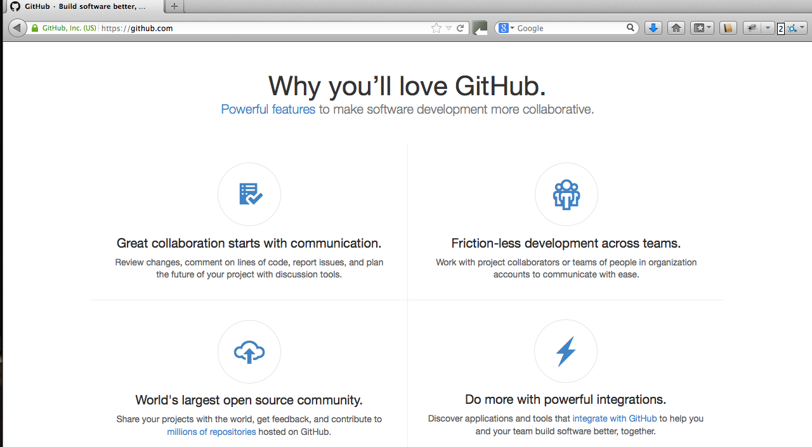

Slide 3
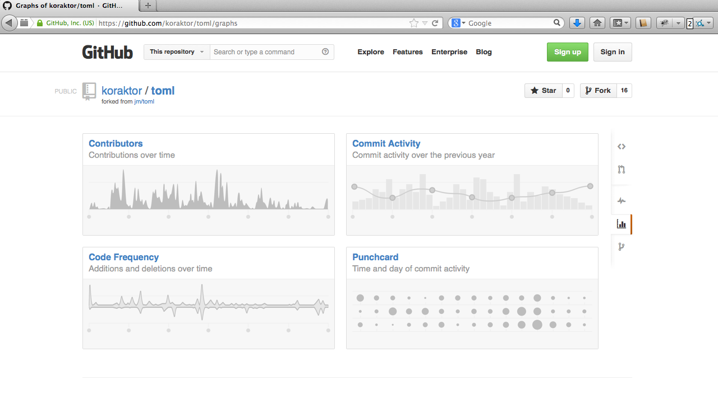

Slide 4
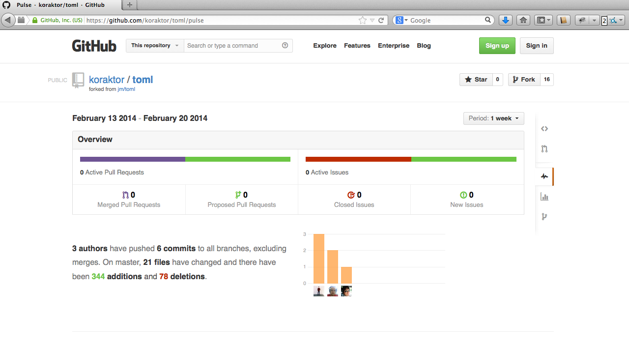

Slide 5
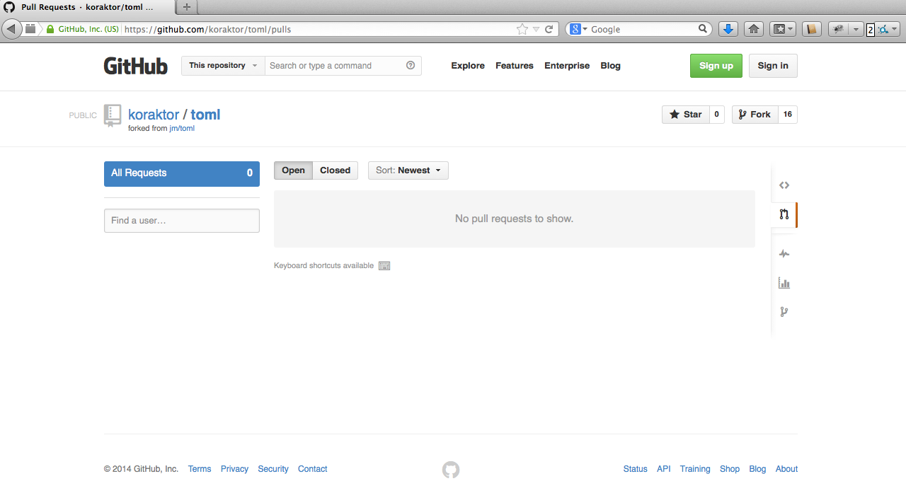

Slide 6
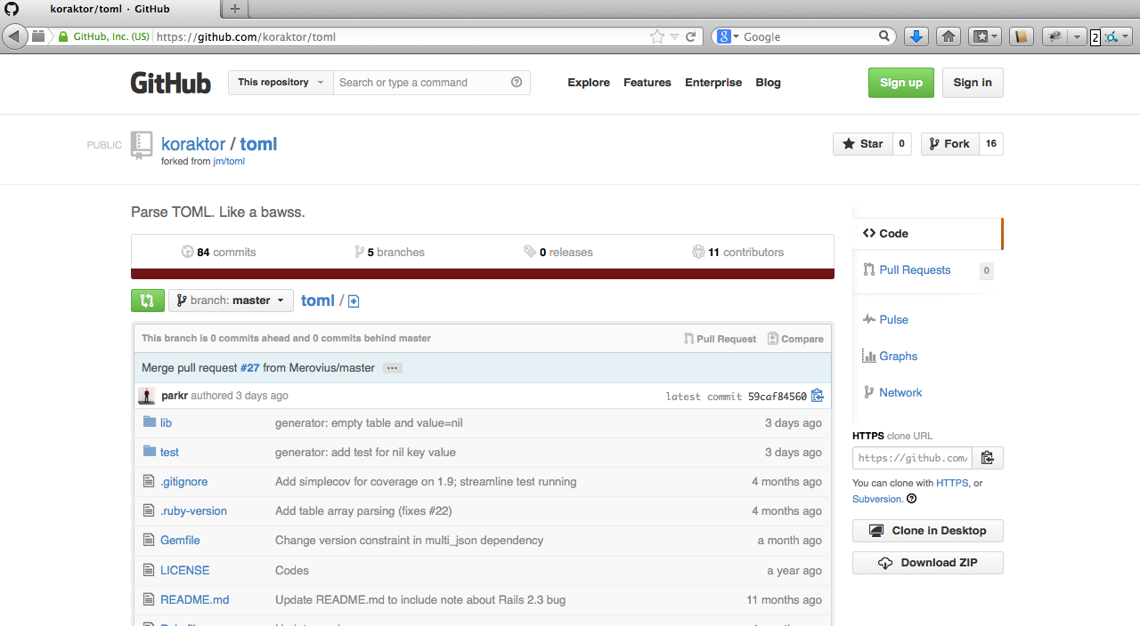

Slide 7
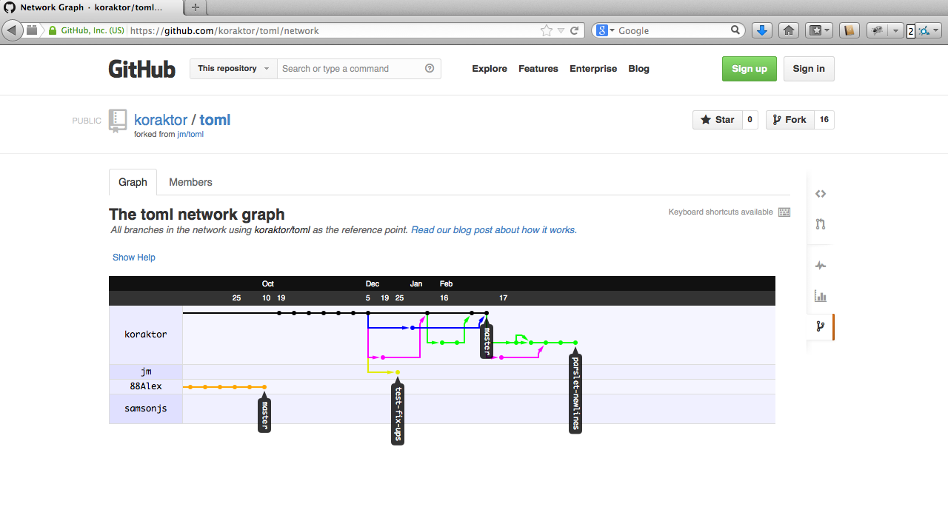

Slide 8
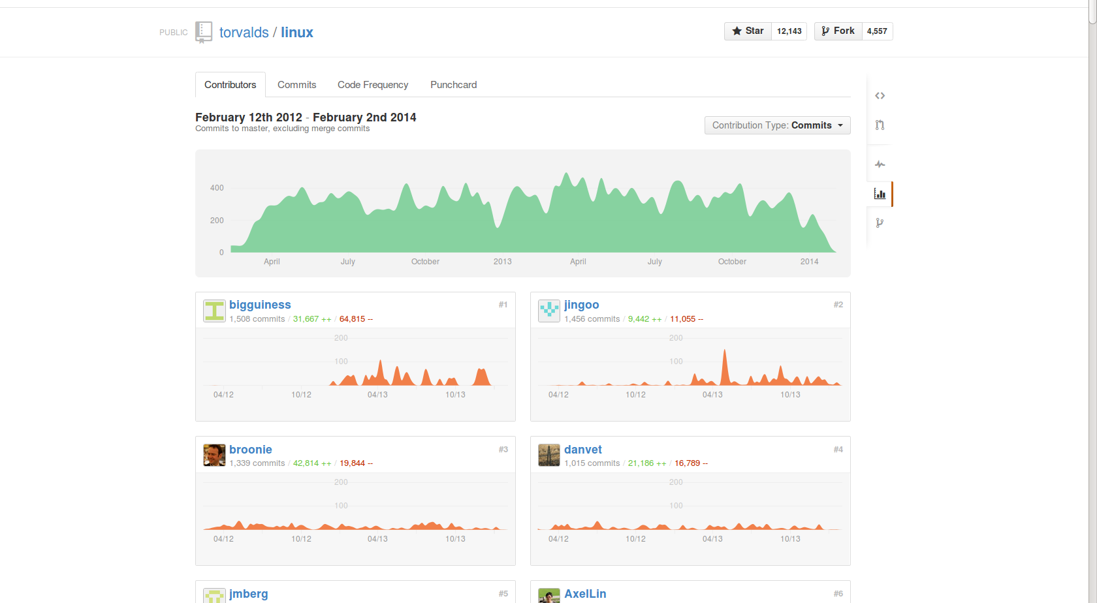

Slide 9
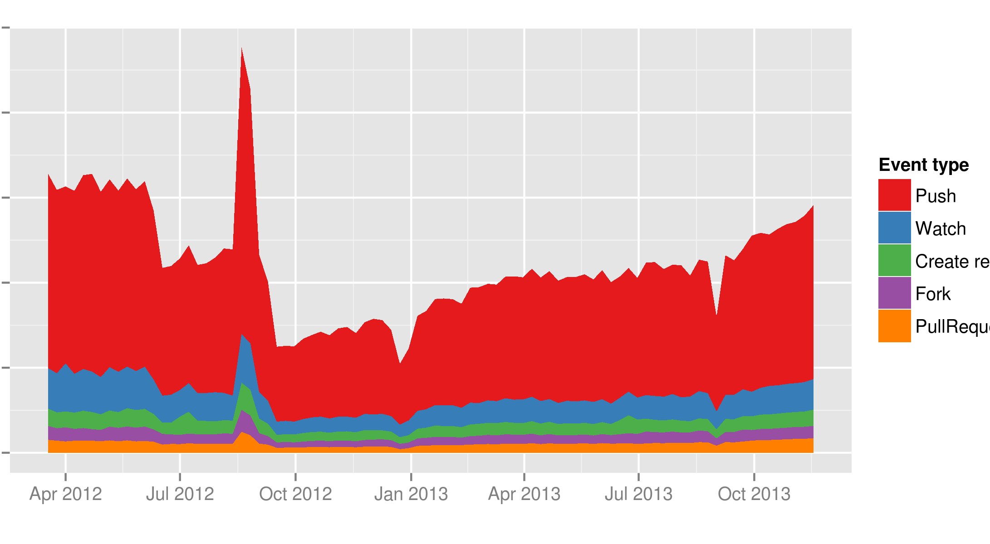

Slide 10
Github Data
The ‘Timeline’ and the API

Slide 11
Github Timeline
174 million events (and counting) starting from March 2012
One row for each event, each row has 199 columns
Wide table format – for a given type of event, many rows are redundant (or “NULL”)
Working on Google’s “BigQuery”, a cloud computing service

Slide 12
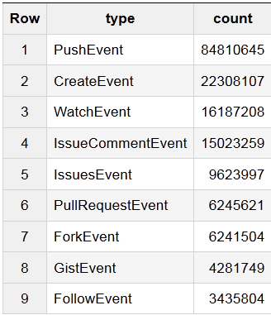
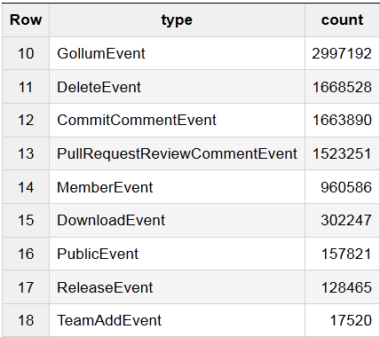
Github Timeline Event Types

Slide 13

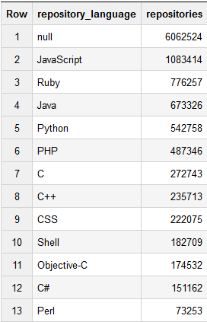
Working with the Gitub timeline
“GROUP BY” queries to aggregate data
“JOIN” queries to build more
interesting tables

Slide 14
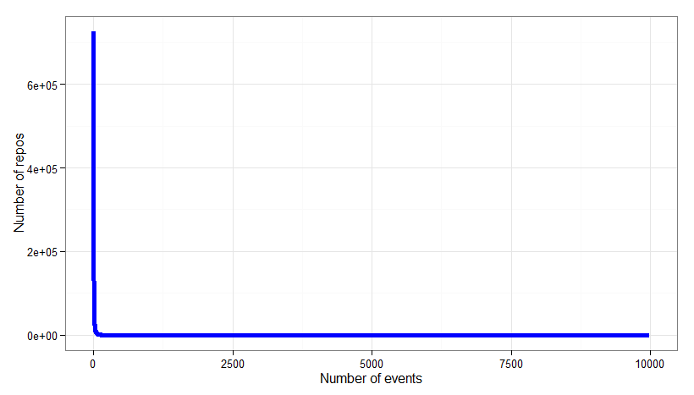
“Power Law” distributions
The “background radiation” of big data

Slide 15
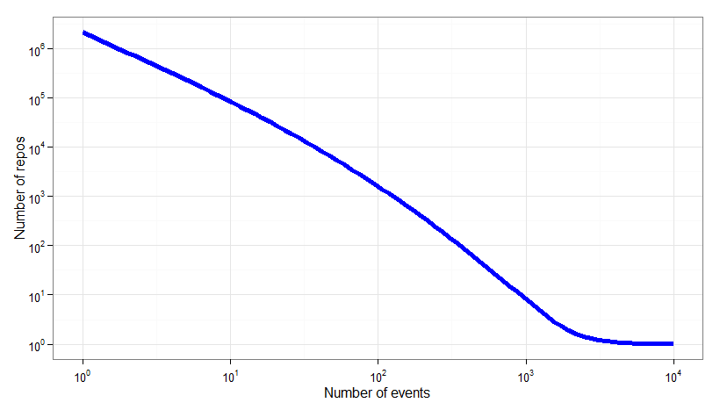
“Power Law” distributions
Logarithmic scaling of axes

Slide 16
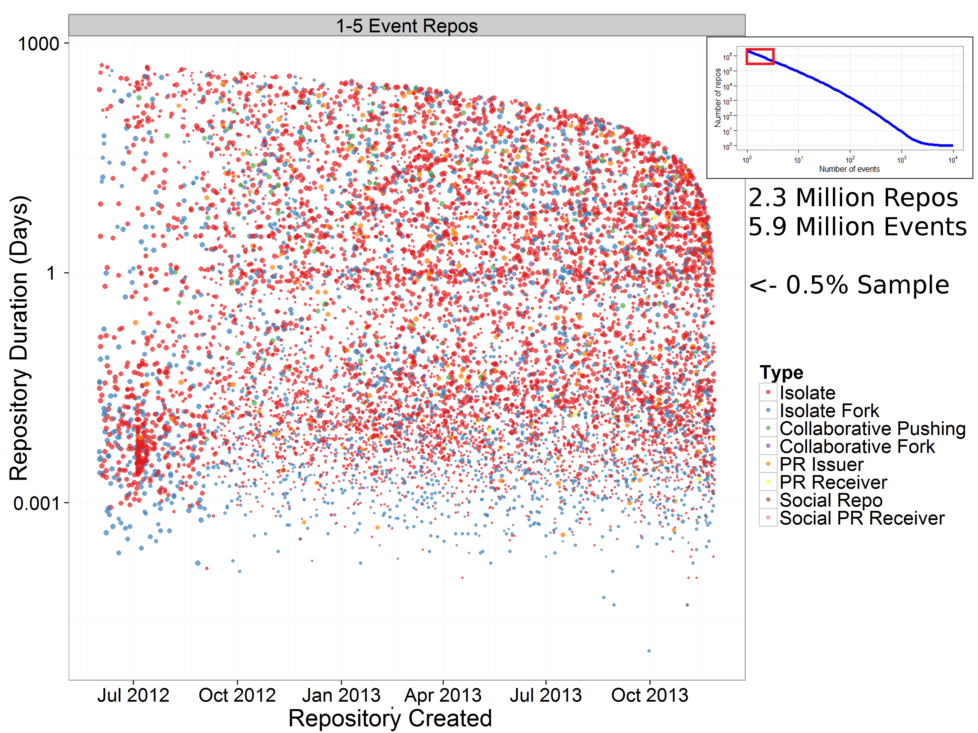

Slide 17
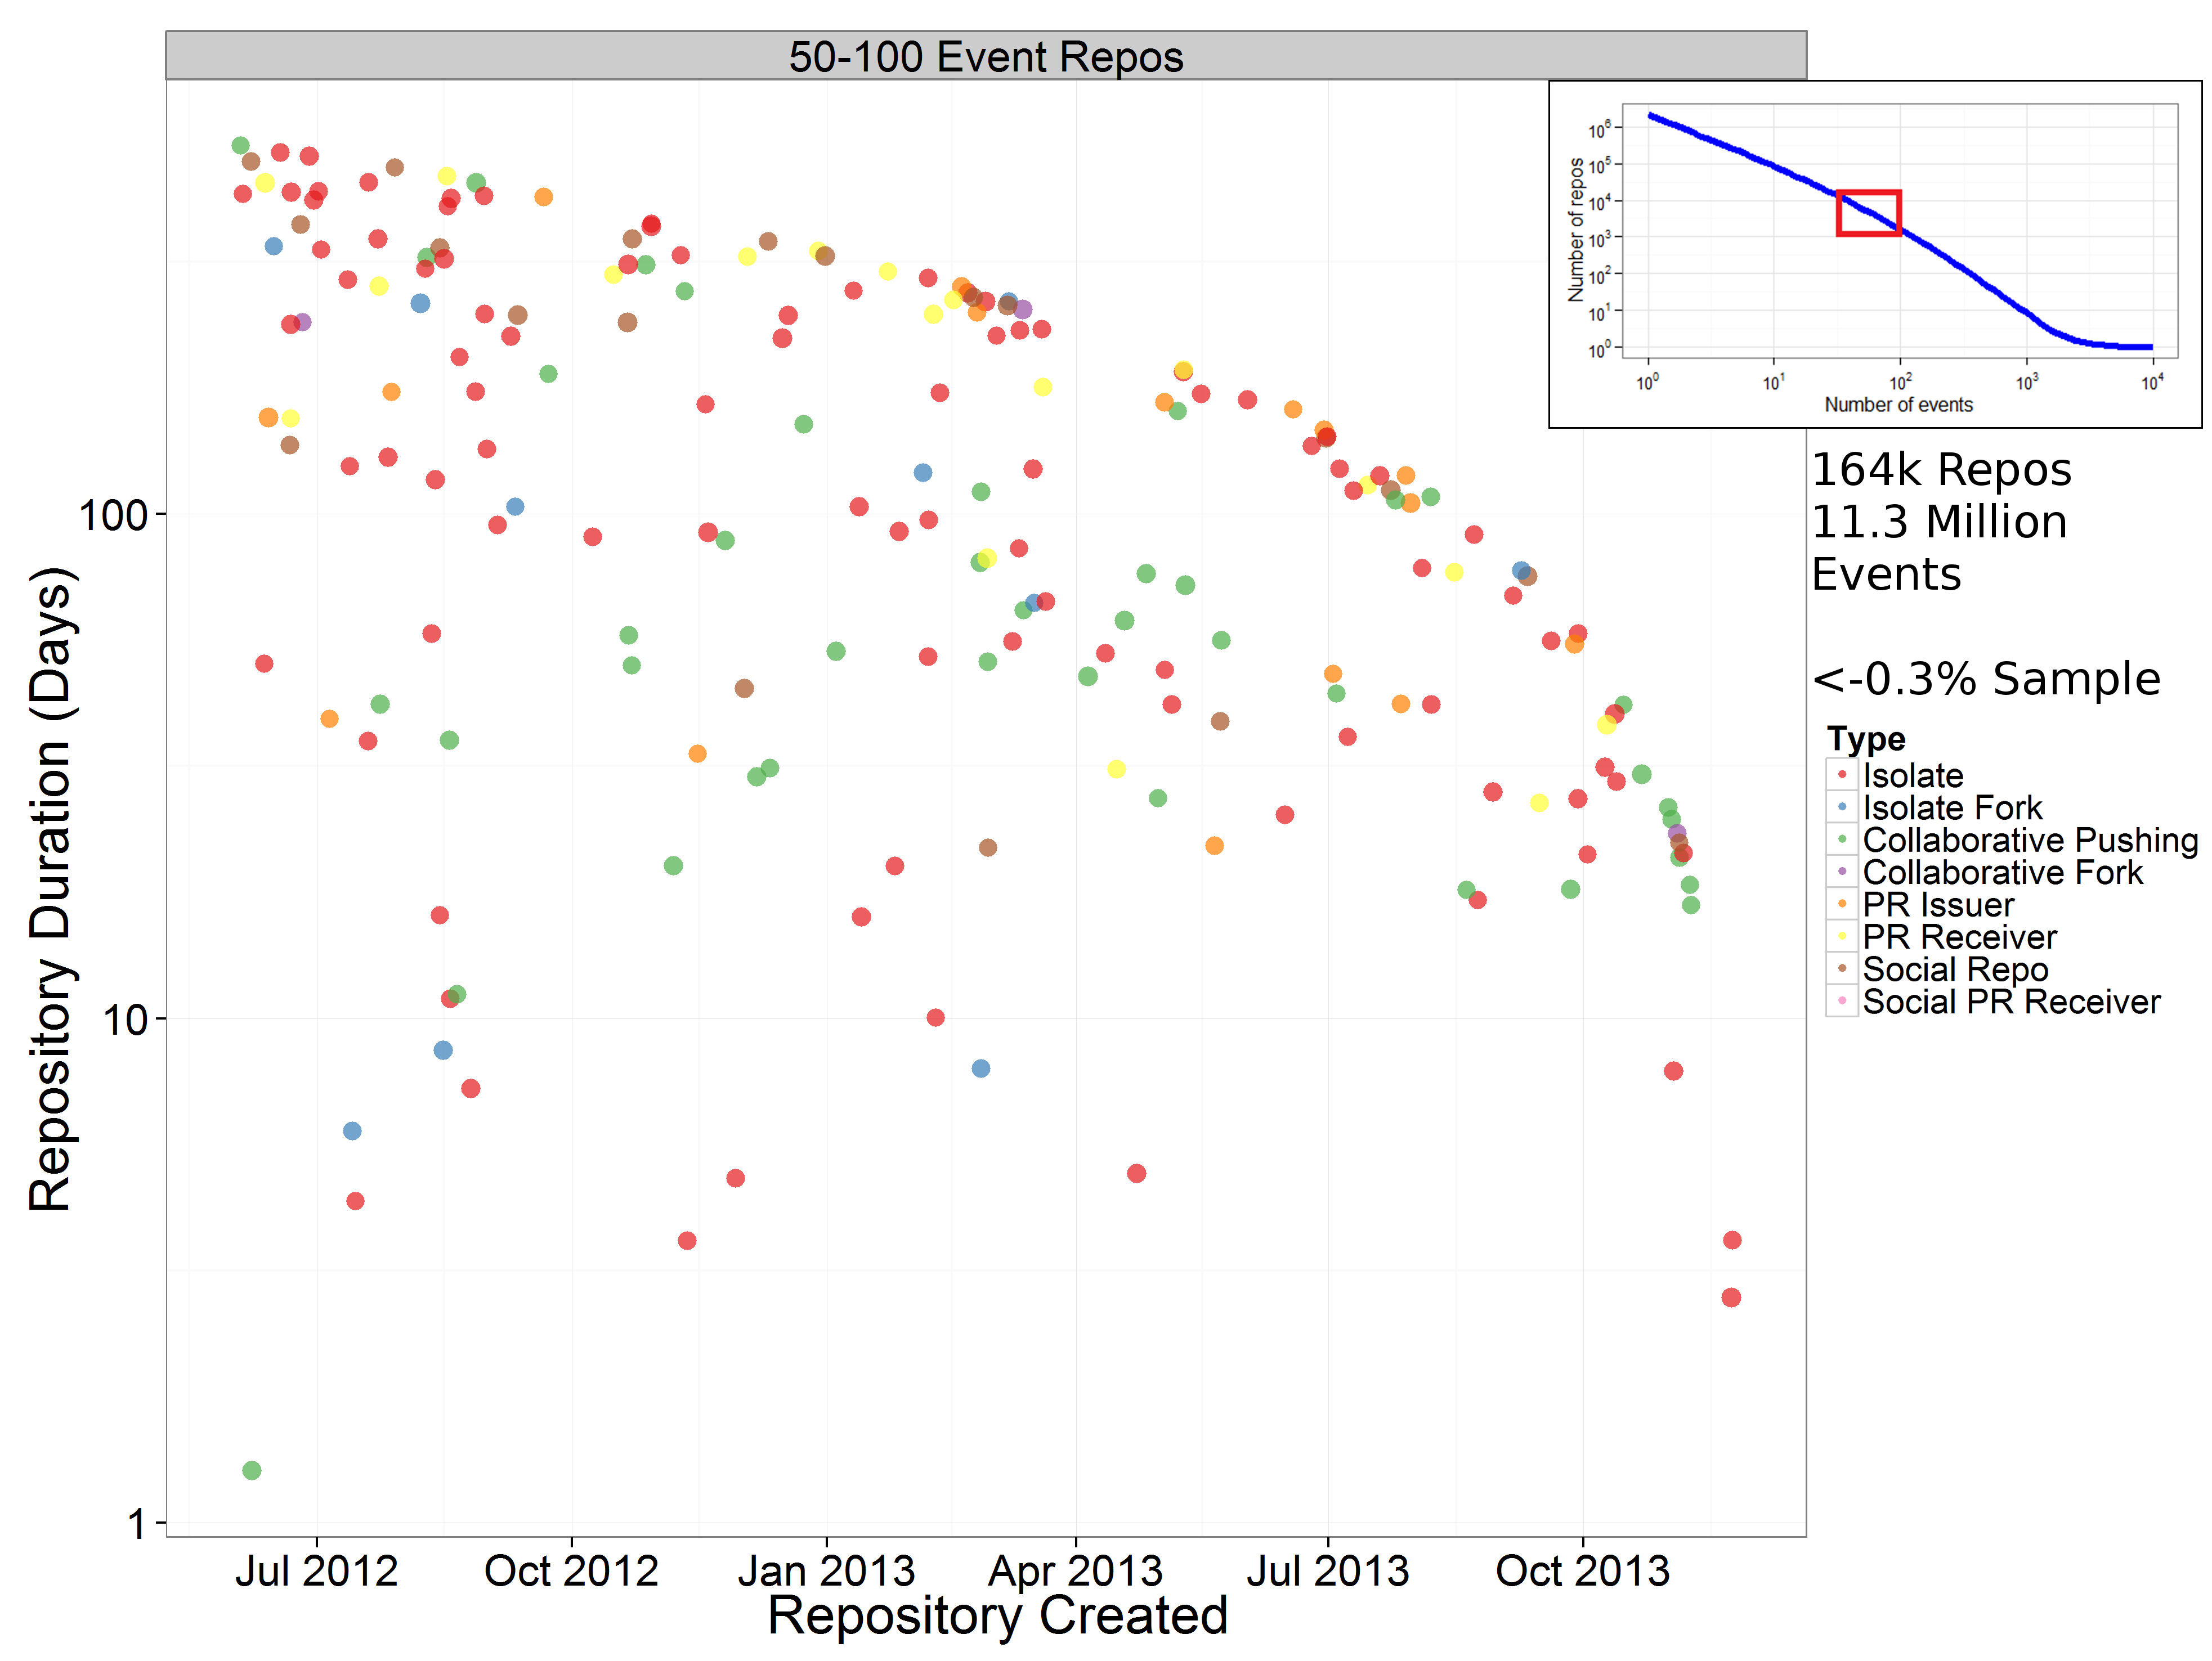

Slide 18
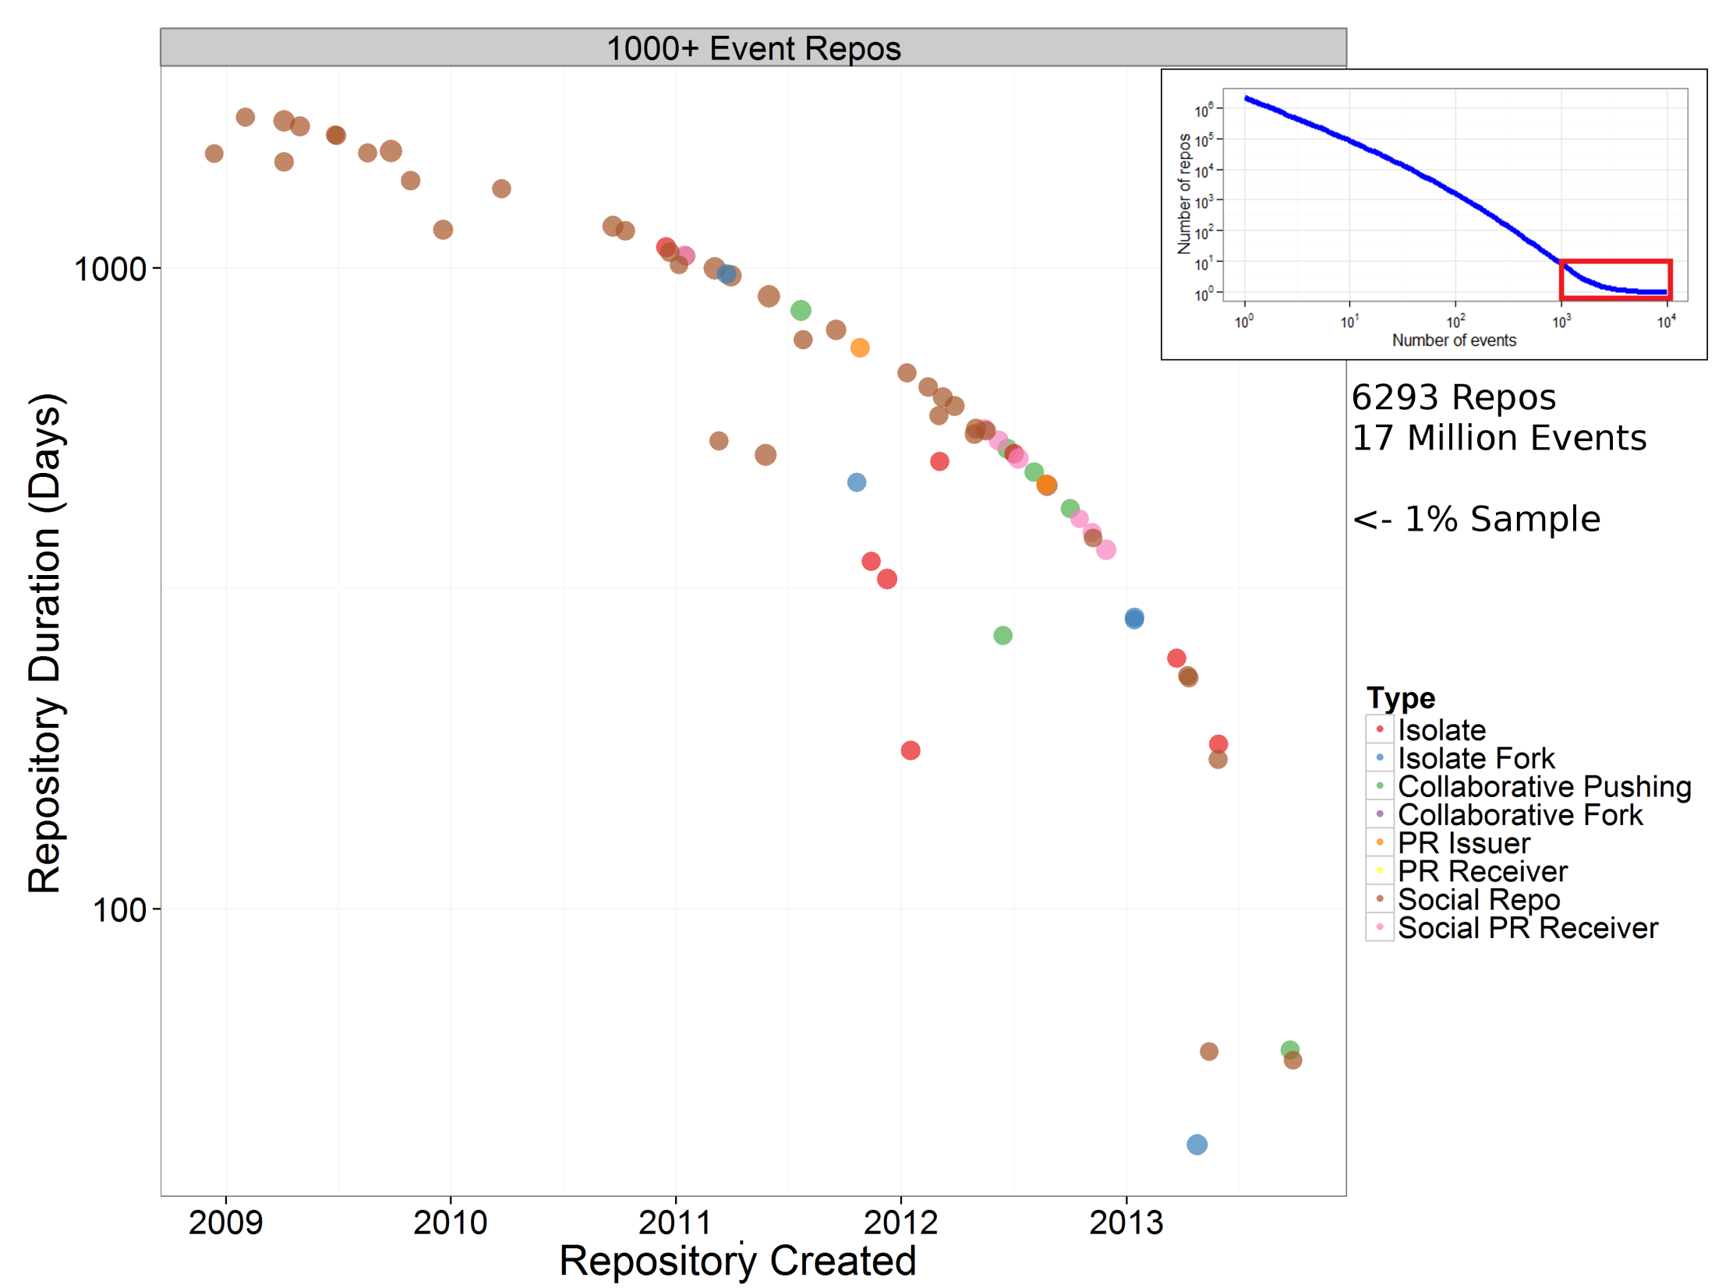

Slide 19
Pull Requests
User A creates Repository A and pushes code
User B forks Repository A and makes changes or additions to code
User B makes a Pull Request from Repo B (the “Head” repo) to Repo A (the “Base” repo) – an invitation for Repo A to merge the changes made in Repo B into the original repository
User A (or any Repo A contributor) can choose to accept or reject this invitation

Slide 20
Pull Requests
2,137,449 distinct pull requests on Timeline
863,462 Base/Head Pull Request Pairs
605,677 “drive-by commits” – single Pull Request between Base/Head Pair
So around 258k Pull Request “relationships” which consist of more than a single pull request
“Intra-Repo” Pull Requests – used by 105k repositories, 550k Intra-Repo Pull Requests

Slide 21
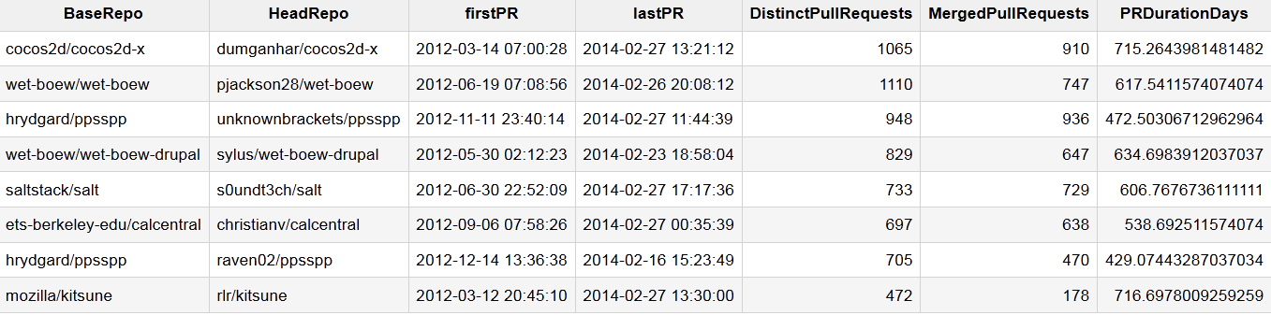
Pull Request Relationships

Slide 22
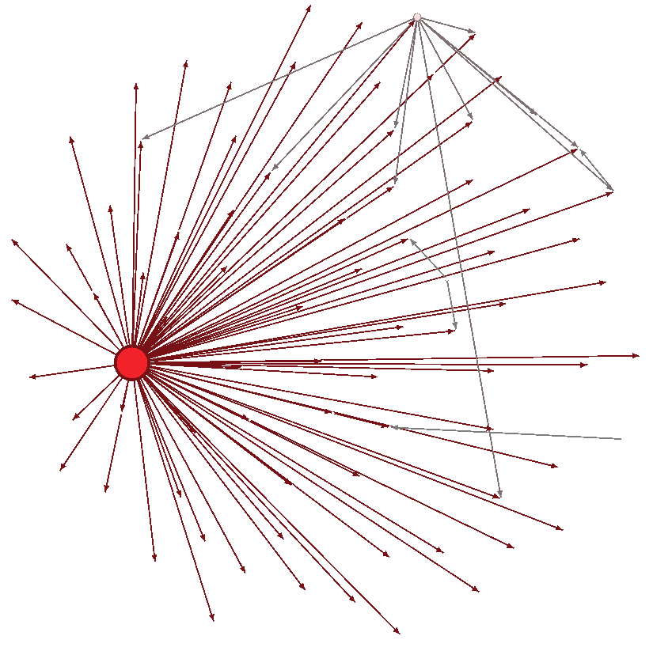
Pull Requests
Typical Scenario – Many people fork a central repository and feed changes back to central repository through pull requests
This example also has a secondary “hub” of pull request activity

Slide 23
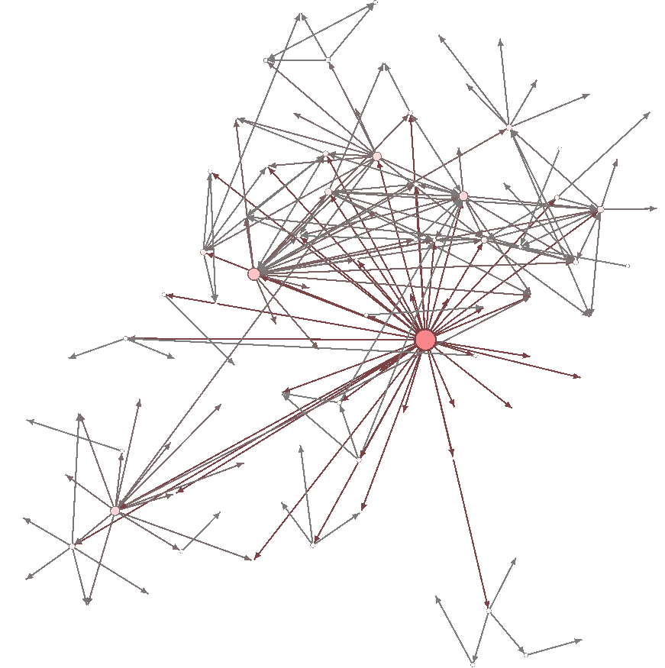
Pull Requests
Atypical Scenario – a much more distributed network of pull request activity

Slide 24
Pull Requests and recruitment?
HeadRepo | BaseRepo | User
vinnymac/B2W2eng | Kyohack/B2W2eng | vinnymac
Head Pushes | First Head Push | Last Head Push
202 | 2012-06-23 04:15:20 | 2012-06-27 18:20:44
Pull Requests | First PullRequest | Last PullRequest
86 | 2012-06-23 18:39:5 | 2012-06-28 20:38:40
Base Pushes | First Base Push | Last Base Push
982 | 2012-06-28 18:20:52 | 2012-08-11 07:13:55
14,348 Users who follow this sequence of events:
Fork a repository -> Work on code in forked repo (Pushes) ->
Make Pull Request(s) -> Added as contributor on Base Repo, Push code directly rather than use Pull Requests

Slide 25
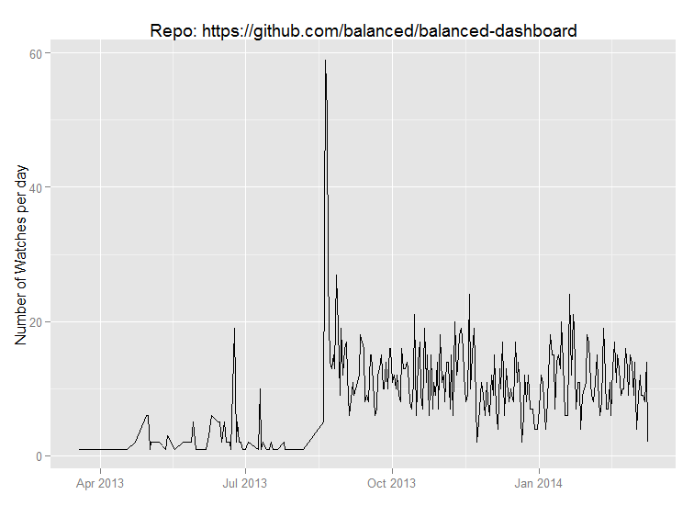
Important Events

Slide 26
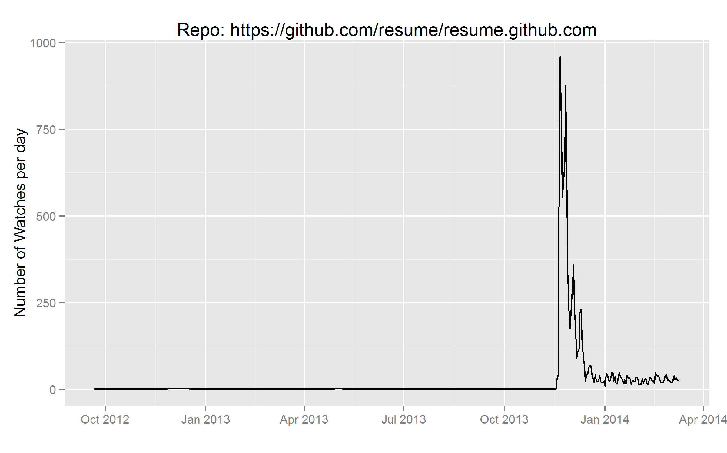
Important Events

Slide 27
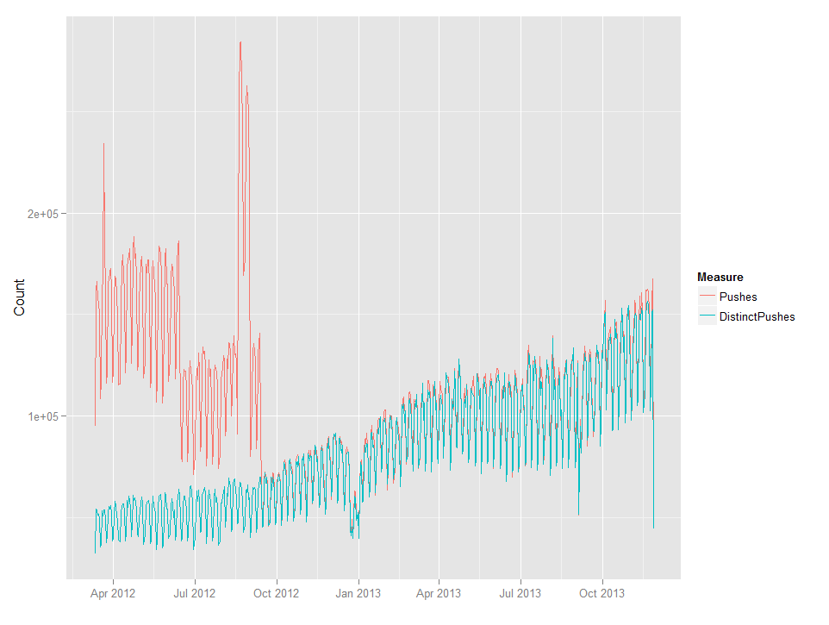
Data Quality

Slide 28
Github API
Complete history of activity for repositories
Additional information available
Free to use
But
More difficult and time-consuming to collect data
Requests made for events of a particular type
300 records per request
More difficult to assemble and work with data

Slide 29
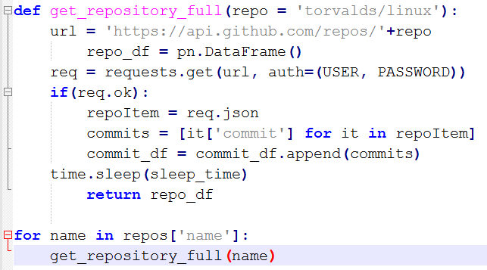
Example API code
Time: 24 hours for 30,000 repos
Cost: £Free

Slide 30
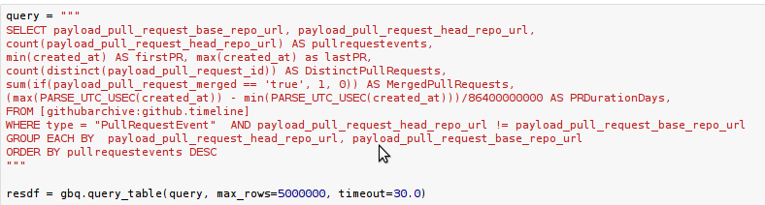
Accessing BigQuery through API
Time: 30 seconds
Cost: £0.05

Slide 31
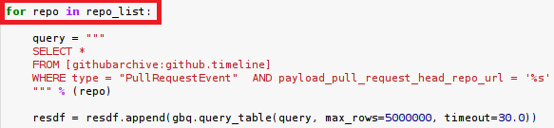
Don’t loop BigQuery requests through the API…
Time: 24 hours for 30,000 iterations
Cost: £1500

