Slide 1
[[PBib]]

Slide 2
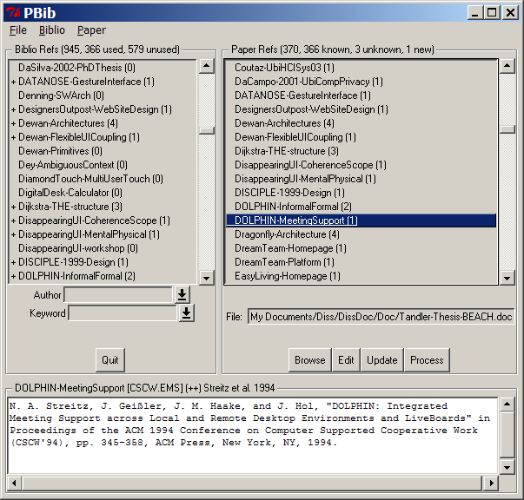
Number of citations in current paper
References
in current paper
References
in database
Quickly search
authors and keywords
Previous searches
Current paper
Details of currently
selected reference
CiteKey, category, and recommendation of currently selected reference

