Slide 1
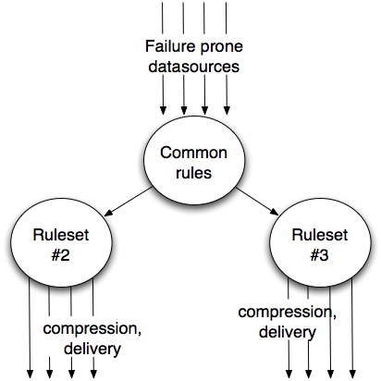
The problem

Slide 2
The solution
... some clean way that I can set up a hierarchy of my business rules

Slide 3
In my case, this stuff should Just Work
Log::Log4perl (woot!)
Working directory, archive directory, filename defaults
Scheduling
Fork maximum of X children at a time (queue the rest)
Child timeouts
Child result aggregation
Encryption
Delivery
Notification
Retries
Let me focus on the exceptions only.

Slide 4
Cabal of Awesome
POE
Stable. Too stable!!
Event handling
Child forking (POE::Wheel::Run)
Signal handling
Moose
Inheritance / Roles to any level of business rule complexity
DRY
Clean 'n pretty

Slide 5
POE::Wheel::Run + Moose =
MooseX::Workers
package Manager;
use Moose;
with qw(MooseX::Workers);
sub run {
$_[0]->spawn( sub { print "Hello World\n" } );
POE::Kernel->run();
}
sub worker_stdout { warn $_[1]; }
Manager->new->run();

Slide 6
Callbacks
sub run { }
sub worker_manager_start { warn 'started worker manager' }
sub worker_manager_stop { warn 'stopped worker manager' }
sub max_workers_reached { warn 'max worker count reached' }
sub worker_started { }
sub worker_stdout { }
sub worker_stderr { }
sub worker_error { }
sub worker_done { }
sub worker_timeout { }
sub sig_child { }

Slide 7
enqueue()
sub run {
for my $num (1..3) {
$_[0]->enqueue(
sub { print "HELLO $num\n" }
);
}
POE::Kernel->run();
}
my $Manager = Manager->new();
$Manager->max_workers(2);
$Manager->run();

Slide 8
MooseX::Workers::Job
sub run {
foreach (qw( foo bar baz )) {
my $job = MooseX::Workers::Job->new(
name => $_,
command => sub { print "Hello World\n" },
timeout => 30,
);
$_[0]->spawn( $job );
}
POE::Kernel->run();
}

Slide 9
MooseX::Workers::Job
sub worker_stdout {
my ( $self, $output, $job ) = @_;
printf(
"%s(%s,%s) said '%s'\n",
$job->name, $job->ID, $job->PID, $output
);
}
Manager->new()->run();
# bar(2,32423) said 'Hello World'
# foo(1,32422) said 'Hello World'
# baz(3,32424) said 'Hello World'

Slide 10
TO DO
Suggested yesterday:
Add automatic retries, max_retries() setting
Push more of my $work namespace code down into MooseX::Workers?
http://github.com/perigrin/moosex-workers
or /jhannah/
...requests? jay@jays.net
jhannah on irc.perl.org #moose #perl-help etc.

