Slide 1
Event-Driven Programming with Node.js and the Force.com Streaming API
Developer Track
Pat Patterson, salesforce.com, @metadaddy

Slide 2
Safe Harbor
Safe harbor statement under the Private Securities Litigation Reform Act of 1995:
This presentation may contain forward-looking statements that involve risks, uncertainties, and assumptions. If any such uncertainties materialize or if any of the assumptions proves incorrect, the results of salesforce.com, inc. could differ materially from the results expressed or implied by the forward-looking statements we make. All statements other than statements of historical fact could be deemed forward-looking, including any projections of product or service availability, subscriber growth, earnings, revenues, or other financial items and any statements regarding strategies or plans of management for future operations, statements of belief, any statements concerning new, planned, or upgraded services or technology developments and customer contracts or use of our services.
The risks and uncertainties referred to above include – but are not limited to – risks associated with developing and delivering new functionality for our service, new products and services, our new business model, our past operating losses, possible fluctuations in our operating results and rate of growth, interruptions or delays in our Web hosting, breach of our security measures, the outcome of intellectual property and other litigation, risks associated with possible mergers and acquisitions, the immature market in which we operate, our relatively limited operating history, our ability to expand, retain, and motivate our employees and manage our growth, new releases of our service and successful customer deployment, our limited history reselling non-salesforce.com products, and utilization and selling to larger enterprise customers. Further information on potential factors that could affect the financial results of salesforce.com, inc. is included in our annual report on Form 10-Q for the most recent fiscal quarter ended July 31, 2011. This documents and others containing important disclosures are available on the SEC Filings section of the Investor Information section of our Web site.
Any unreleased services or features referenced in this or other presentations, press releases or public statements are not currently available and may not be delivered on time or at all. Customers who purchase our services should make the purchase decisions based upon features that are currently available. Salesforce.com, inc. assumes no obligation and does not intend to update these forward-looking statements.
Notes:
Any purchase decisions customer make should be made based on currently available technology. Please visit our website sto review our Safe Harbor statement in detail.

Slide 3
Pat Patterson
Principal Developer Evangelist
salesforce.com
@metadaddy

Slide 4
Event-Driven What Now?
By the end of this session, you will be familiar with these concepts:
Force.com Streaming API
Event-driven, non-blocking code
Node.js
Heroku
You’ll also have some ideas on how to apply them in your applications
Code is on GitHub
https://github.com/metadaddy-sfdc/DF11NodeStreaming
There’s a lot to get through, so let’s get started!
Notes:
Only cover non-blocking concept and Node.js briefly, since there was an introductory session on these earlier.

Slide 5
Example App – Chat Server
Basic functionality
Allow users to post messages
Display messages
Lots of ideas on how to extend it!
Notes:
We’ll create a very simple app to begin with, and extend it as we move through the session

Slide 6
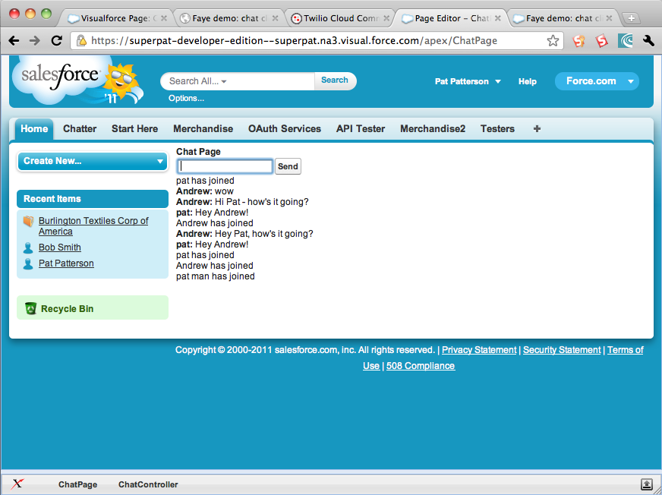
Demo
Chat Server based on Force.com
Message__c custom object
Fields for sender, text and timestamp
Visualforce page
Allow a new message to be sent
Show last 10 messages
Notes:
Look at custom object, show Chat1 VF page, briefly talk through code – should be nothing new for most people. We would really like the message list to update when another user sends a message! In the past we would probably poll for changes every few seconds, but…

Slide 7

The Force.com Streaming API
Currently still in limited developer preview
Administrator creates a topic (PushTopic standard object) based on a SOQL query
Applications subscribe to the topic
Apps receive near real-time updates as query results change
Bayeux protocol – libraries available from cometd.org
Command-line or browser apps
Data synchronization or alert use cases
Notes:
How many of the audience have used the Streaming API? Need to check whether it will still be in dev preview at DF11.

Slide 8
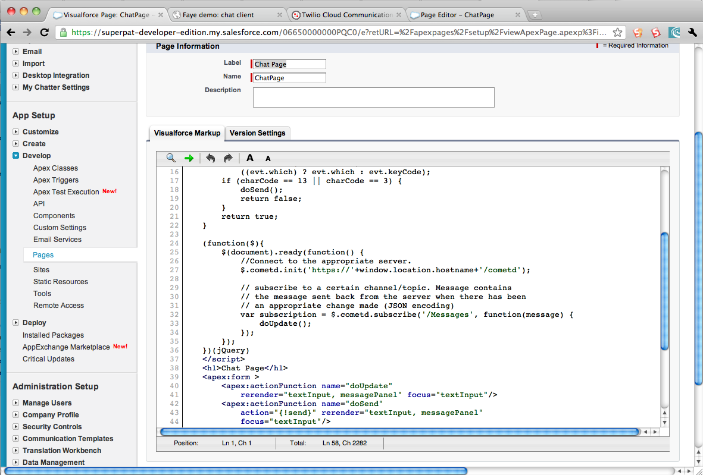
Demo
Add Streaming
Messages PushTopic: SELECT Id FROM Message__c
Visualforce page
Rerender message list on update
Notes:
Create PushTopic in Workbench, show Chat2 VF page, talk through code as we go

Slide 9
Pushing Beyond the Org
Chat Server works well, but is limited to users logged in to the Org
We’d like to be able to allow customers to chat with employees
External app
Subscribe for updates – Streaming API
Insert new messages – REST API
We’ll build an Node.js app as our external interface
Server-side JavaScript
Non-blocking, event-driven architecture
Notes:
B2C use case. Could create an Apex REST method to accept new messages, but no real point, since it would tightly wrap the Message__c creation.

Slide 10
What Do We Mean By Non-Blocking?
Traditional web server approach:
repeat forever accept a connection spin off a thread (or even fork a process!) send a request to a database block until a response arrives render a page thread is recycled
Even with a thread pool, lots of context switching
Most of the time, those threads are sitting around waiting for I/O!

Slide 11
A New Approach
Non-blocking version:
repeat forever accept a connection send a request to a database, with a reference to some code to execute when a response is available when a response arrives from the database render a page
The server NEVER blocks – in fact, everything can run in one thread – better performance
Notes:
Who here has written a Node app? Who has written JavaScript? You’re ¾ of the way there ☺

Slide 12

Node.js
Server-side JavaScript framework for non-blocking I/O
var http = require("http");
http.createServer(function(request, response) {
response.writeHead(200, {"Content-Type": "text/plain"});
response.write("Hello World");
response.end();
}).listen(8888);
Notes:
Walk through five-line web server example for folks who weren’t in the introductory node session.

Slide 13
Node.js
Server-side JavaScript framework for non-blocking I/O
var http = require("http");
http.createServer(function(request, response) {
response.writeHead(200, {"Content-Type": "text/plain"});
response.write("Hello World");
response.end();
}).listen(8888);
Notes:
Node.js has a module architecture – here we pull in the http module – it has everything we need to build a simple web server.

Slide 14
Node.js
Server-side JavaScript framework for non-blocking I/O
var http = require("http");
http.createServer(function(request, response) {
response.writeHead(200, {"Content-Type": "text/plain"});
response.write("Hello World");
response.end();
}).listen(8888);
Notes:
Creating a web server instance is one library call.

Slide 15
Node.js
Server-side JavaScript framework for non-blocking I/O
var http = require("http");
http.createServer(function(request, response) {
response.writeHead(200, {"Content-Type": "text/plain"});
response.write("Hello World");
response.end();
}).listen(8888);
Notes:
We pass an anonymous function to createServer() – this will be called every time a request arrives.

Slide 16
Node.js
Server-side JavaScript framework for non-blocking I/O
var http = require("http");
http.createServer(function(request, response) {
response.writeHead(200, {"Content-Type": "text/plain"});
response.write("Hello World");
response.end();
}).listen(8888);
Notes:
This is all we’ll do – say Hello World

Slide 17
Node.js
Server-side JavaScript framework for non-blocking I/O
var http = require("http");
http.createServer(function(request, response) {
response.writeHead(200, {"Content-Type": "text/plain"});
response.write("Hello World");
response.end();
}).listen(8888);
Notes:
Finally, we’ll tell the server to listen on port 8888.

Slide 18
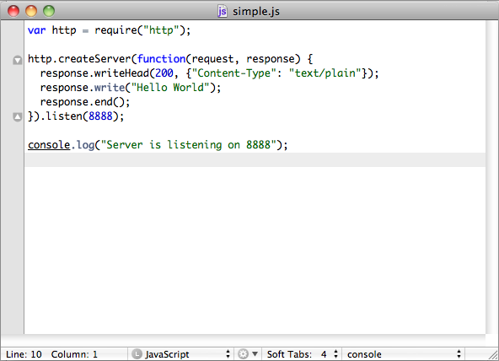
Demo
Hello World in Node.js
Notes:
Let’s see our simple example in action – simple.js – add some console output so we can tell that something is happening!

Slide 19
Back to Our Chat Server
Let’s build a simple Node.js server that will act as a gateway to our Chat system

Slide 20
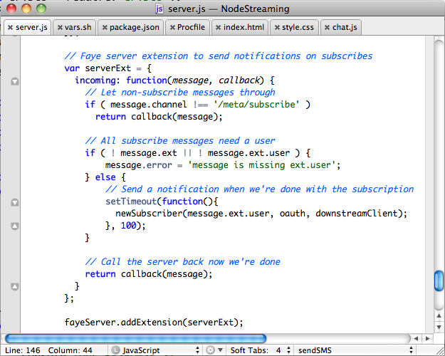
Demo
Node.js app to allow external users to send messages and see replies
Use Faye library to subscribe to Messages topic and act as chat server for browser clients
Use OAuth to authenticate as ‘API user’
Use Express web framework
Serve HTML, JS, CSS to browser clients
Notes:
Just running on localhost for now. That was a great little app, but still very limited – I’m just talking to myself!

Slide 21

Heroku
Platform-as-a-Service
Ruby, Node.js, Clojure, …
Oriented towards ‘front office’ web apps
Heroku acquired by salesforce.com Jan 2011
Focus is on application development
Higher level of abstraction than Amazon Web Services
Never need to start a server, configure a web tier
Just push source code and app starts running!
Notes:
Let’s put it out on the web. If this session were a couple of years ago, I might start an EC2 instance and run it there, but there’s a better choice… Heroku.

Slide 22
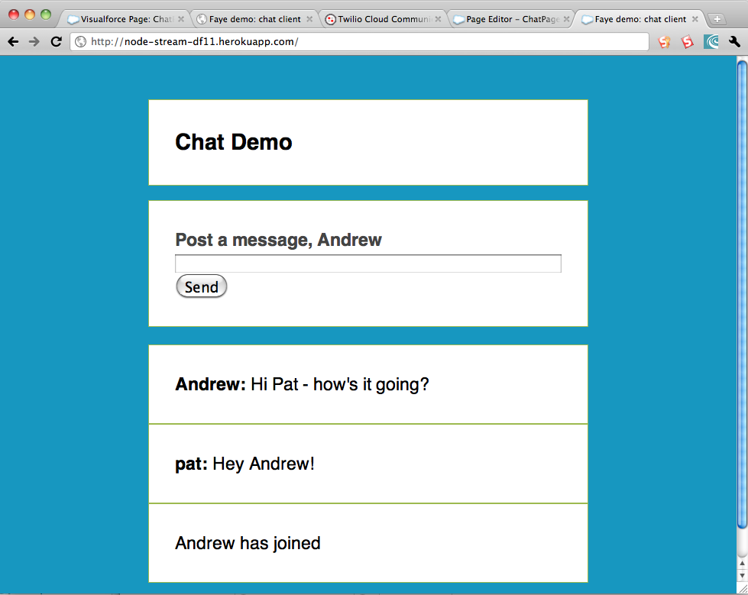
Demo
Create Heroku application
node-stream-df11
Push code to Heroku
git push heroku master
http://node-stream-df11.herokuapp.com/
Notes:
This will take all of one minute! ☺ Encourage audience to go to the URL and try it out.

Slide 23

What about Mobile?
Smart phone users can use the web page, but feature phone users are out in the cold
Add SMS functionality with Twilio
Notes:
This app took so little time to write, I thought I’d go for extra credit with mobile integration

Slide 24
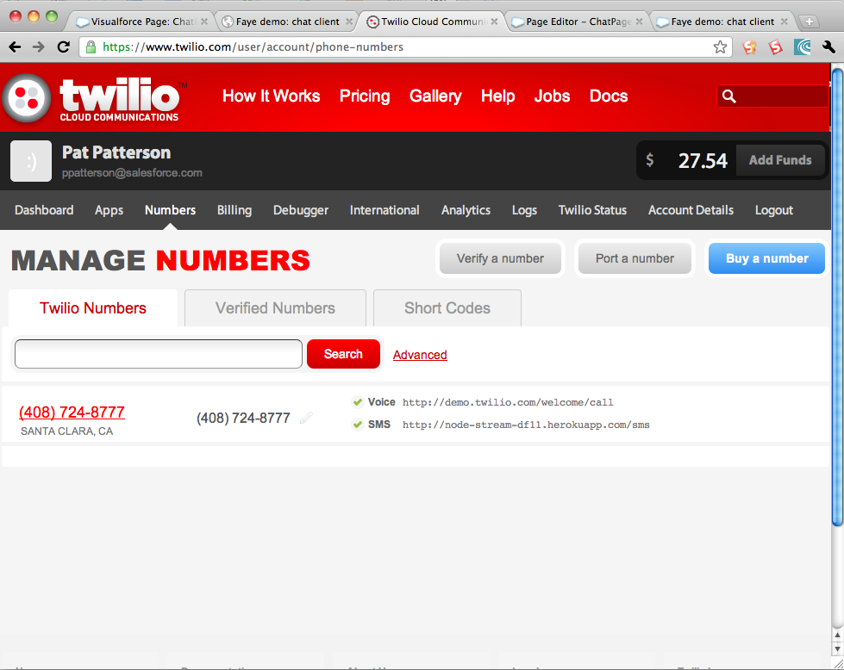
Demo
Add SMS integration
Receive SMS at http://node-stream-df11.herokuapp.com/sms
Send SMS to https://api.twilio.com/2010-04-01/Accounts/{twilio_sid}/SMS/Messages.json
Easy UI!
START {username} to subscribe
STOP to unsubscribe
+1 (408) 724-8777
Notes:
Paste SMS handling code into app. Subscribe and post a message on my phone. Encourage audience to chat

Slide 25
In Summary
Force.com Streaming API offers (near) real-time updates
http://developer.force.com/streaming-api
Node.js allows rapid development of event-driven server apps
http://nodejs.org/
Heroku makes deployment to the web pain free
http://www.heroku.com/
Twilio provide super easy SMS/voice integration
http://www.twilio.com/

Slide 26

Pat Patterson
@metadaddy
ppatterson@salesforce.com
Principal Developer Evangelist
https://github.com/metadaddy-sfdc/DF11NodeStreaming

Slide 27
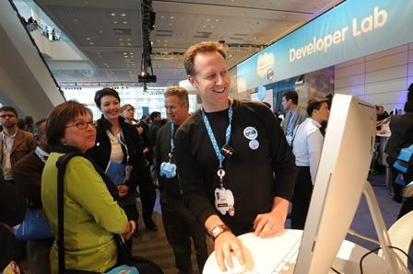




But wait, the DevZone has more!
Hackathon
Check out the Finale, Thurs, 2:30pm
Open Source Lab
Discover new & interesting open projects
Lightning Forum
Drop in for a quick blast of knowledge
Tech Demos
See and learn the latest from the experts
Code Consultations
Sign up for 1:1 sessions at the Welcome Desk
@forcedotcom

Slide 28

How Could Dreamforce Be Even Better? Tell Us!
Every session survey you submit is a chance to win an iPad 2!
Watch your inbox at the end of each day for an email from our survey partner, Alliance Tech.
Click on the personalized link to be directed to the survey page for the sessions you attended.

Slide 29
Event-Driven Programming with Node.js and the Force.com Streaming API
Developer Track
Pat Patterson, salesforce.com, @metadaddy

