Slide 1
Open Source Identity for the
Web 2.0 Era
  Pat Patterson
  pat.patterson@sun.com

Slide 2
Agenda
OSIS
  A confederation of open source projects
OpenSSO
  Sun's open source identity project
Project Lightbulb
  Bringing open identity standards to the wider world
Demo
  With source code!
Resources
  All the URLs

Slide 3





OSIS
Open Source Identity System – 'Identity 2.0'
Umbrella Organization
  Bandit (Novell)
  Heraldry (Apache)
  Higgins (Eclipse)
  OpenSSO (Sun)
  OpenXRI (Epok)
  Shibboleth (Internet2)
  Whobar (Sxip)
Goals:
  Internet-scale identity interoperability across projects, protocols, companies and platforms
  Enable a pluralistic technology and business ecosystem for identity product and service components

Slide 4

OpenSSO
Based on Sun Java System Access Manager 7.0
Basis for Sun Java System Access Manager 8.0
Enterprise
  Access Control
  Single Sign-On
Federation
  SAML 1.x
  Liberty ID-FF
  SAML 2.0
Web Services
  WS-I BSP
  Liberty ID-WSF

Slide 5
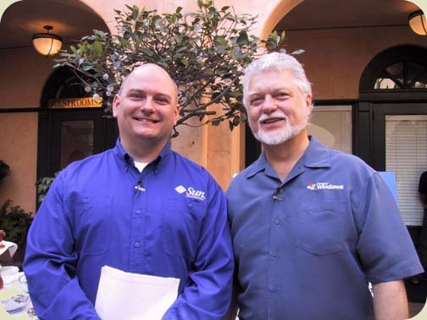
What's New
Java EE Web Application
  Single WAR file deployment
CDDL License
ID-WSF 2.0
WS-* support
  WS-Federation – integration
  with Active Directory
  Federation Services (ADFS)
  WS-Trust – integration with
  Windows Communication
  Foundation (WCF/Indigo)
External participation
  Already have code contributed from participants outside Sun

Slide 6
Requirements from Web 2.0 world
Mashups involve multiple sites
  Need mechanisms to transport identity across sites
SAML 2.0
  Open Standard
  + Security, Privacy, Industrial Strength
  - Complexity: SOAP, XML Signature
Lightweight language
  PHP
  Perl
  Python
  Ruby
LAMP
Open Source

Slide 7
Typical Scenario
PHP Site currently authenticates all users locally

Slide 8
Requirement for Federation
PHP Site wants to delegate authentication for some set of users to an identity provider

Slide 9
Solution 1 – PHP/Java Bridge
Requires Open Federation / Federation Manager

Slide 10
Solution 2 – 'Pure' PHP Library
No separate federation server required

Slide 11

Project Lightbulb
Extending OpenSSO
  Linux/Apache/MySQL/PHP-Perl-Python (LAMP)
  MySQL/Apache/Ruby/Solaris (MARS)
  .NET
Initial work is in PHP
  'Native' SAML 2.0 SP implementation
    SSO, SLO
    No custom PHP modules required
    Source code available NOW in OpenSSO
    Many thanks to Rob Richards for PHP XML Security code
  'Bridge' to OpenSSO
    'mashing up' PHP/Java
    To be released later in 2006
  Can SAML 2.0 enable Drupal, WordPress
Ruby in pipeline

Slide 12
DEMO

Slide 13
Project Lightbulb
What next?

Slide 14
Project Lightbulb
What next?
  You decide!

Slide 15
Participate!
OpenSSO web site - opensso.dev.java.net
  Join now!
Downloads
  Try it out!
Mailing Lists
  dev, users, announce
IRC Channel - #opensso
  Real-time
  On-line community

Slide 16
Resources
Liberty Alliance Project
  http://projectliberty.org
OSIS
  http://osis.netmesh.org/
OpenSSO
  https://opensso.dev.java.net/
  irc://irc.freenode.net/#opensso
Shameless self-promotion :-)
  http://blogs.sun.com/superpat
  pat.patterson@sun.com

