Slide 1
A Top Tech Trend to Avoid: Just Say NO to Accessibility Overlays
Dr. Kate Deibel
Inclusion & Accessibility Librarian
Syracuse University Libraries
Email: kndeibel@syr.edu
Twitter: @metageeky

Slide 2
Presentation Materials Available
This talk’s materials, including a captioned recording and transcript, is available at:
https://metageeky.github.io/talks/ala-overlays-2021
or
https://bit.ly/3wQFq9e

Slide 3
Who I Am
Inclusion & Accessibility Librarian at Syracuse University Libraries
Oversee assistive technologies and accessibility services
Guide and support efforts to promote diversity, equity, inclusion and accessibility in services, planning, assessment, and advocacy
Active advocate and speaker for disability access in libraries:
ALA Midwinter 2019: “Pushing on the Frontier: Disability Access & the Future of Libraries”
Code4Lib 2021: “Thinking Beyond the Basics of Accessibility”

Slide 4
Accessibility Always a Top Tech Trend
Accessibility (disability access) is a great thing
…and should always be a top tech trend
The pandemic helped push everyone to make things more accessible
…and we have no excuse to regress to poorer accessibility
And in a time of crisis, people look for easy answers:
that is the sham and fraud of accessibility overlays

Slide 5
A Tech Trend to Avoid: Accessibility Overlays
An accessibility overlay is third-party JavaScript code that when added to a website is claimed to:
Fix ALL accessibility issues on the site automatically
Ensure that your website is fully compliant with the Web Accessibility Content Guidelines (WCAG)
Protect you from disability lawsuits
These overlays sound so amazingly wonderful that you literally can picture and hear the infomercial now…

Slide 6
Compelling questions that lie
Want to stop worrying about those pesky disabled users?
Tired of accessibility complaints and lawsuits?
Want those horrid “accessibility experts” to shut up?

Slide 7
What overlay vendors promise
With just a small line of JavaScript and a large annual cash delivery, your accessibility problems can be solved!
Just pay AccessiBe!
Or EqualWeb!
Or AudioEye!
Or any other accessibility overlay!

Slide 8
Look at the institutions who hate their disabled users
Join great institutions like:
Marymount University https://marymount.edu
FCC Consumer Complaint Center https://consumercomplaints.fcc.gov
The United States Social Security Administration https://ssa.gov
Department of Health | State of Louisiana https://ldh.la.gov
Note that some ad blockers / privacy add-ons may prevent these overlays from working.

Slide 9
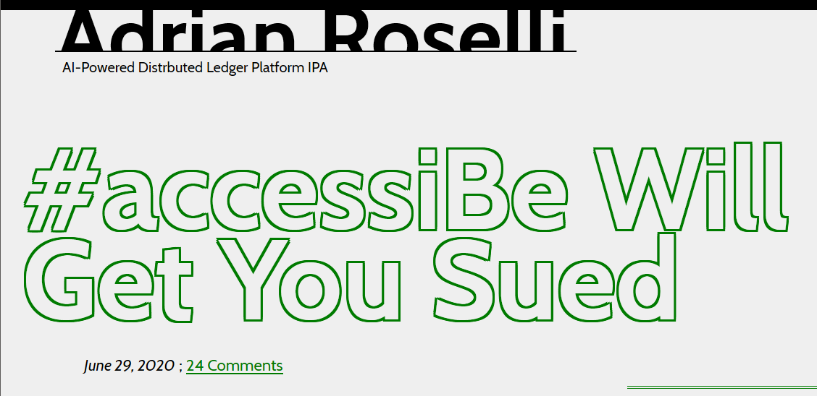
Legal guarantees (of getting sued)
And you’re “guaranteed that you won’t be sued…
https://adrianroselli.com/2020/06/accessibe-will-get-you-sued.html

Slide 10



Identifying Accessibility Overlays
Popular Overlays on the Market:
AccessiBe
AudioEye
EqualWeb
User1st
MaxAccess
The following “buttons” suggest an overlay is present:

Slide 11
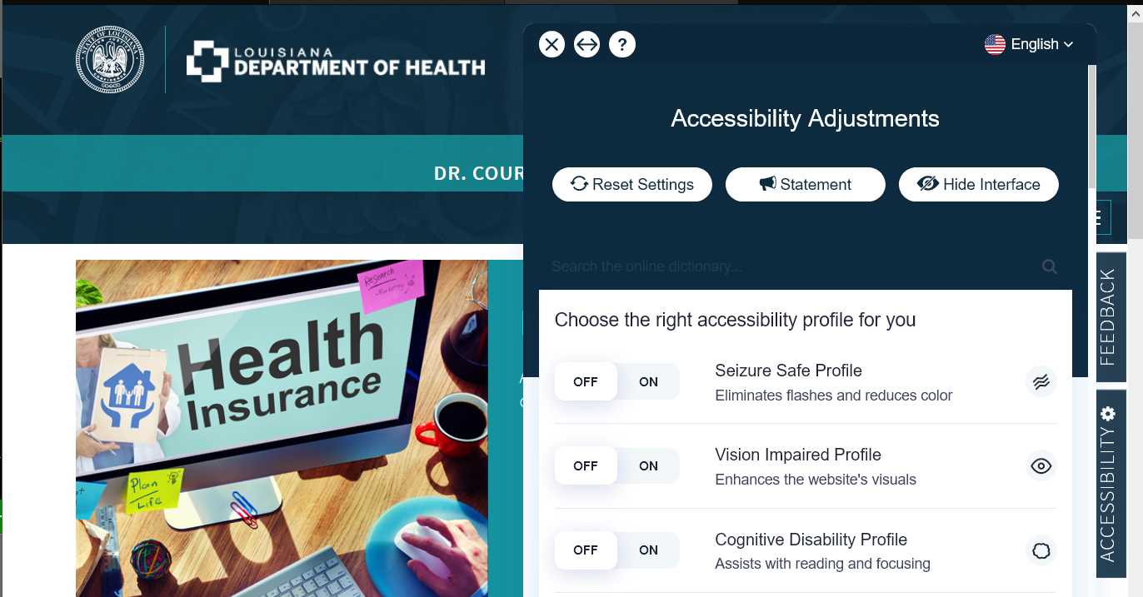
Example: Louisiana Department of Health
https://ldh.la.gov/

Slide 12
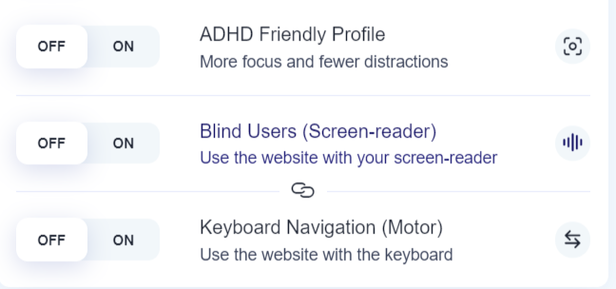
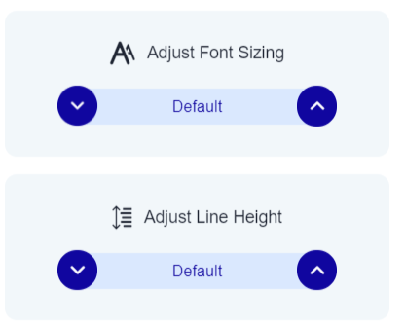
What Overlays Offer
An overlay’s menu will typically let a user set the following:
Turn on one or more profiles based on user disability (ADHD, low vision, etc.) or planned interaction (keyboard, switch)
Adjust individual settings on the page such as font, font size, colors, spacing, line height, etc.
The underlying page structure (HTML) may also be changed.

Slide 13
Why Overlays Don’t Work (1/2)
Automated accessibility testing software can only catch 25% of issues.
So how can an automated overlay fix 100% of accessibility issues?
Web frameworks (i.e., Vue, React) can change the page beyond what the overlay can reach or effect.
Browsers already provide tools for customizing fonts, text, colors, etc.
Overlays do not fix linked to PDFs, Word documents, PowerPoints, etc.
Overlays also do not add captions to videos.

Slide 14
Why Overlays Don’t Work (2/2)
A major accessibility is the lack of accessible descriptions for images.
AI techniques can only do so much in terms of accuracy.
Image descriptions need to be relevant to the context
Overlays push accessibility work onto the someday / never pile.
If the overlay solves it all, why fix our code?
Screen readers and other assistive technologies get blocked by overlays!

Slide 15
Complaints by Disabled Users
...I know with 100% certainty, any site which has deployed an overlay in the past year and a half has been less useable for both my wife and me—both blind.
GeauxEnder
When #AccessiBe is enabled, the page is flooded with headings. Lots of heading level 2's. The title of each phone remains a heading in both versions of the page, but with it enabled, things like cost, display, and all the other components of the tables become headings as well.
CatchTheseWords
People With Disabilities Say This AI Tool is Making the Web Worse for Them
Vice Magazine

Slide 16
Accessibility Experts Say No to Overlays
January 2021 WebAIM Survey of Web Accessibility Practitioners https://webaim.org/projects/practitionersurvey3/#overlay
67% of web accessibility practitioners find web accessibility overlays not very or not at all effective
Only 3% find them very effective
If only considering practitioners who identify as having a disability:
72% find overlays to be not very or not at all effective
Only 2% find overlays to be very effective

Slide 17
The Experts Also Say
AccessiBe will get you sued by Adrian Roselli
5 False Claims 1-Line “AI” Accessibility Script Vendors Make by Eric Eggert
Is there a silver bullet for ADA website accessibility? Sorry, but the answer is no. by Richard Hunt
Overlay Fact Sheet (signed by 441 accessibility advocates as of 6/1) by Karl Groves

Slide 18
The Summarized Facts
Accessibility overlays will not magically fix all your accessibility problems.
You can and will receive complaints or lawsuits even with them.
Invest your money instead in making your sites accessible now.
WCAG is over 20 years old. There is no excuse.
And please…

Slide 19
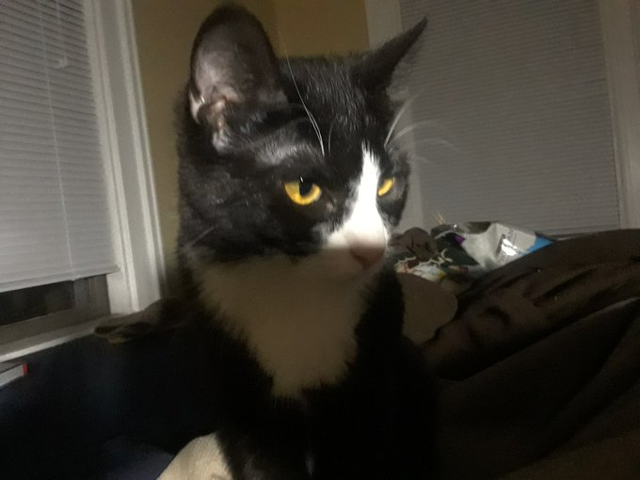
Just Say NO to Accessibility Overlays
Or Fiona will find you…

Slide 20
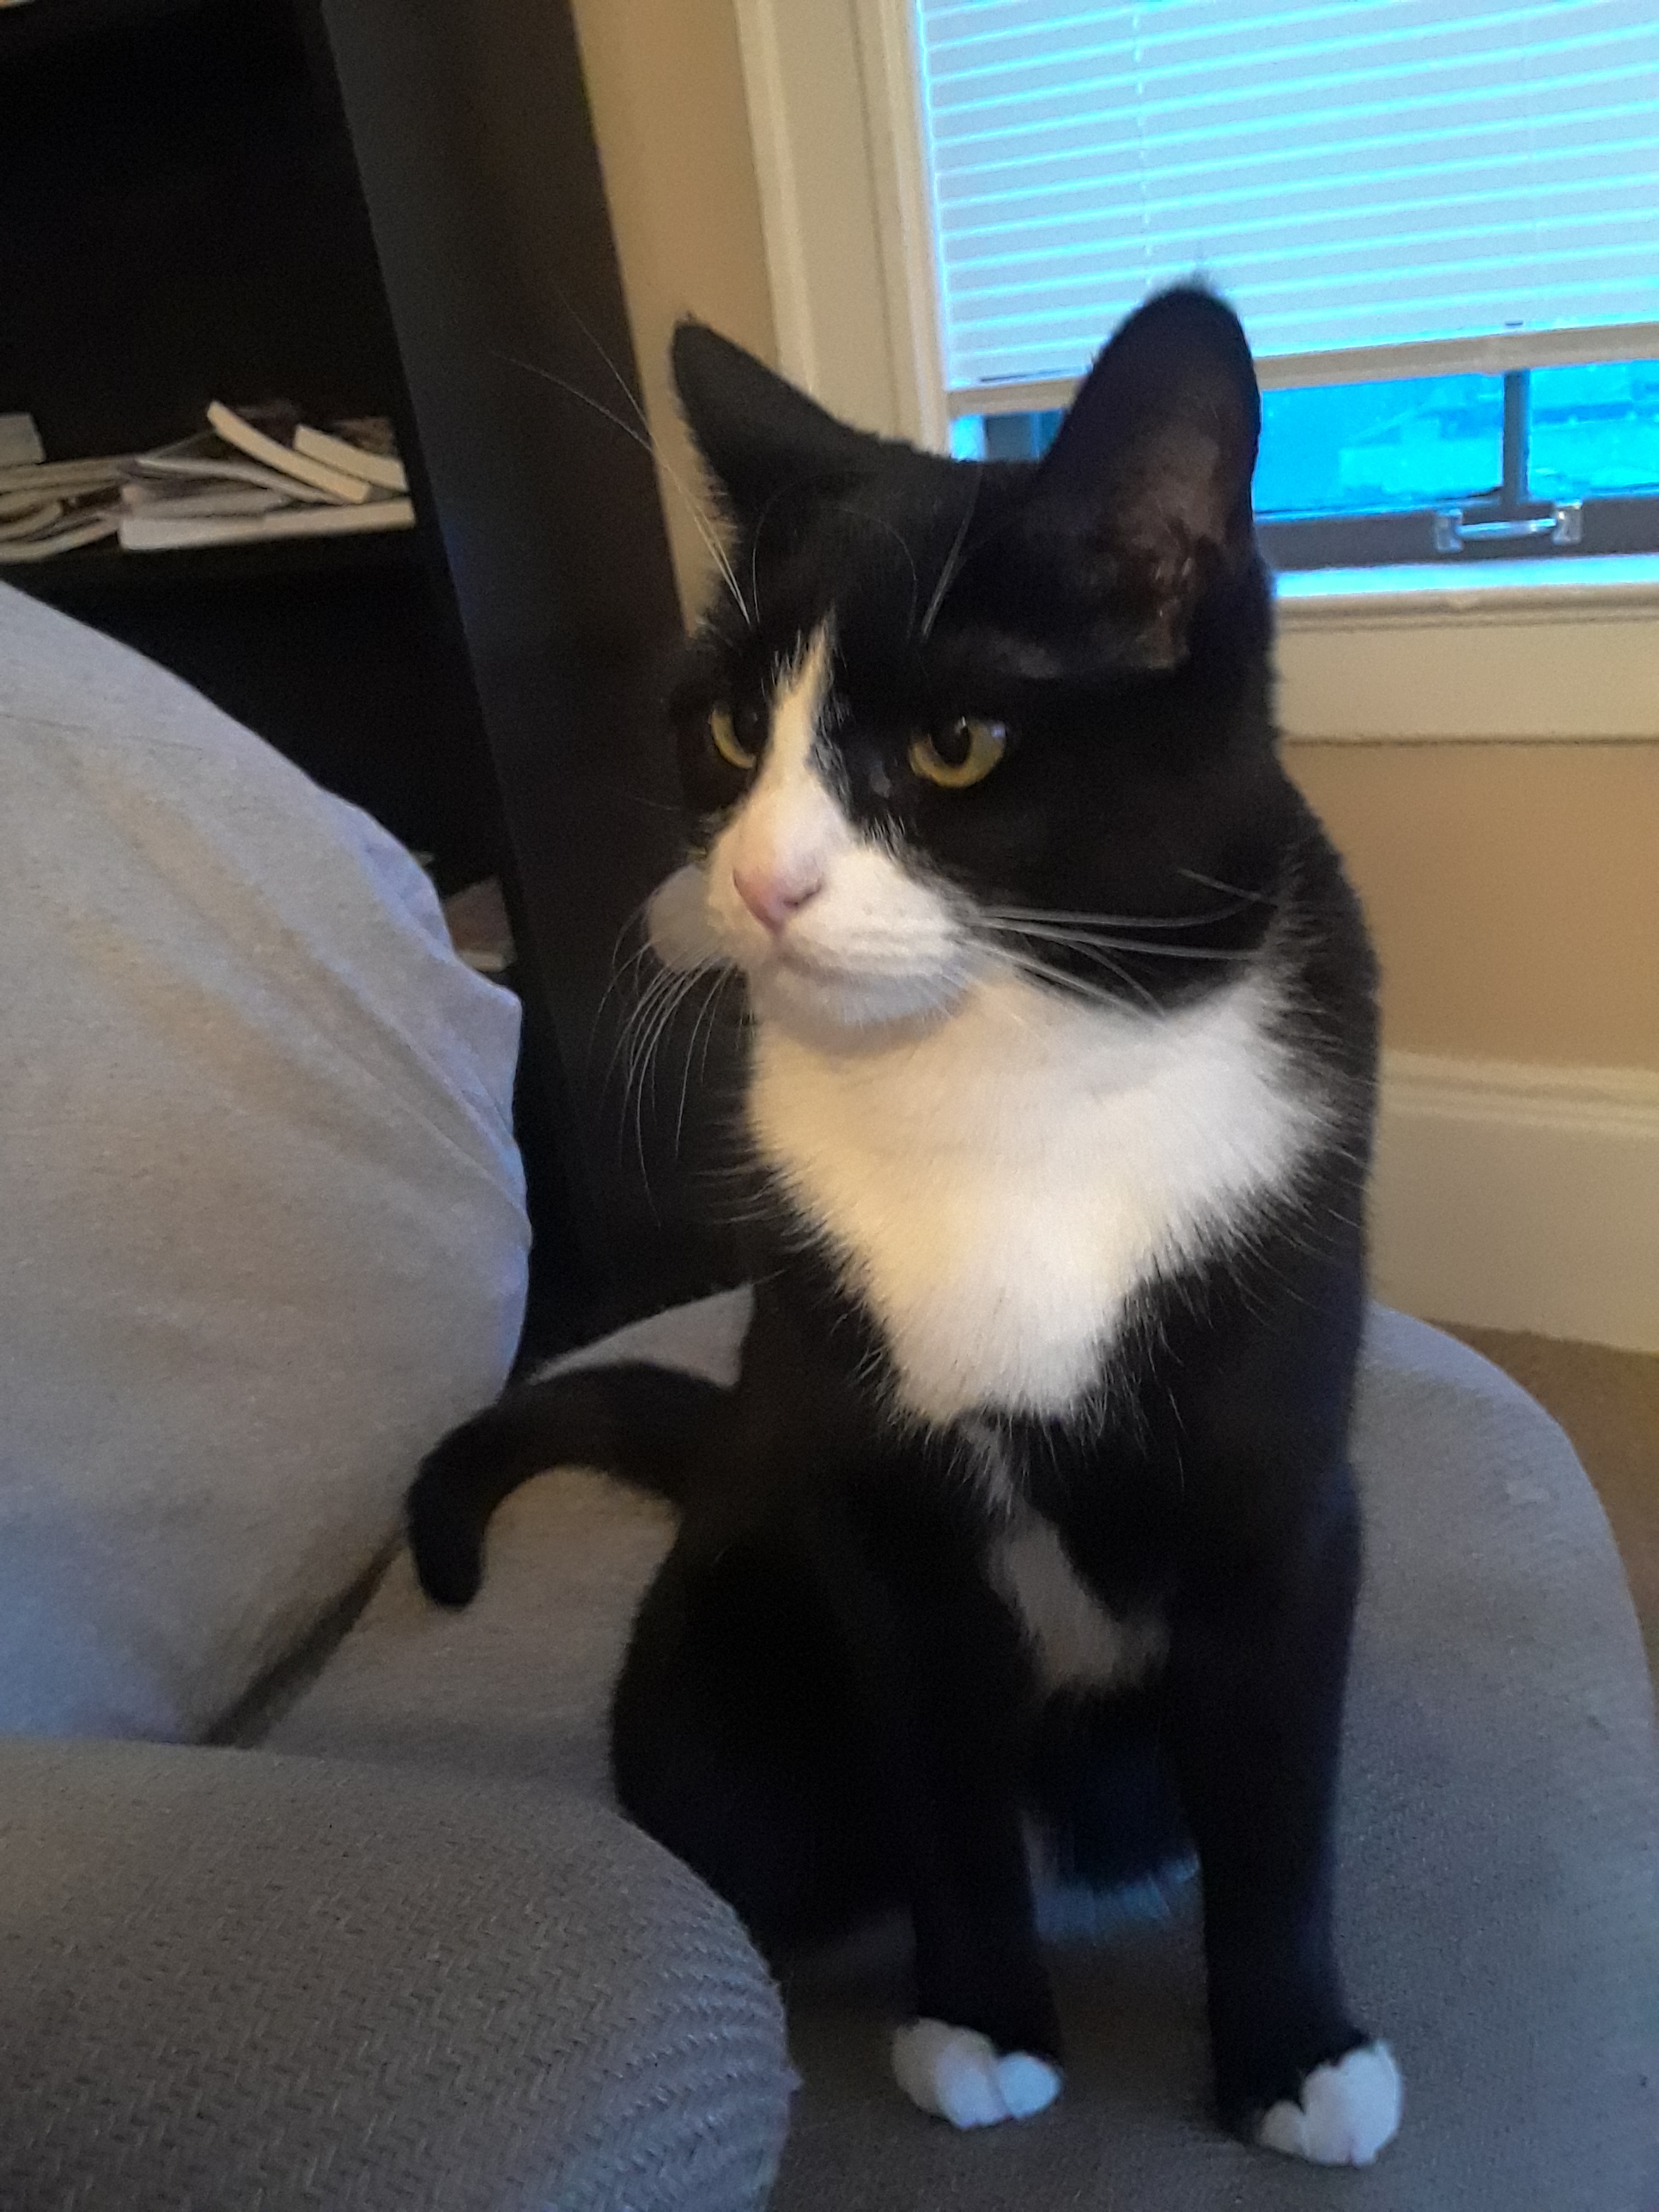
Contact Information
Dr. Katherine “Kate” Deibel
Email: kndeibel@syr.edu
Twitter: https://twitter.com/metageeky
GitHub: https://github.com/metageeky
This slide deck is distributed under a Creative Commons Attribution 4.0 International License.
Commercial icons used under fair use.

