Slide 1
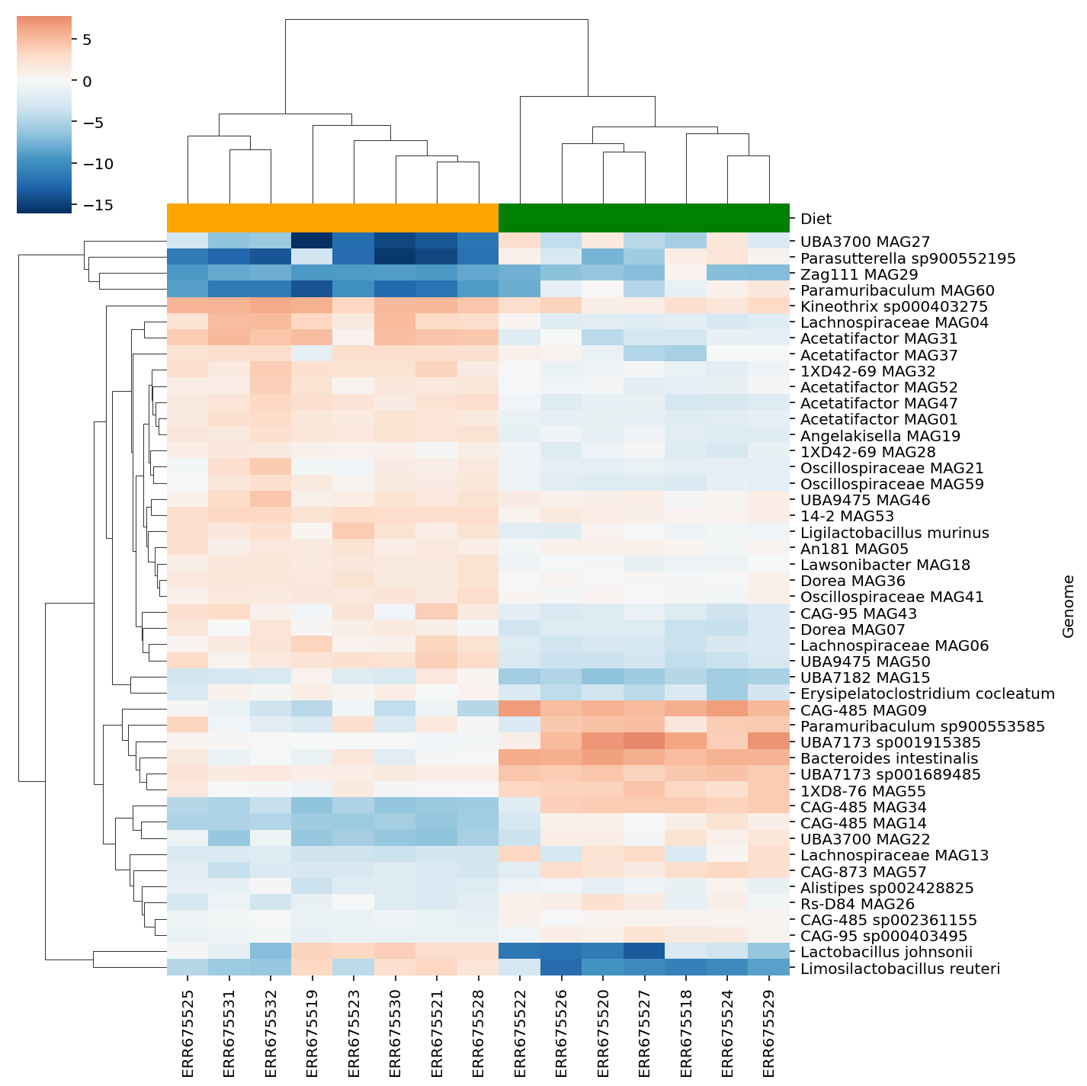
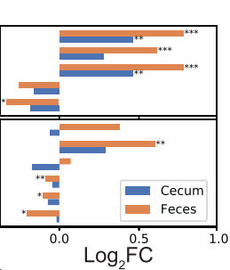
Assembly
Quantification
ATLAS
Binning
Annotation
Clostridiaceae nov.
A. muciniphila

