Slide 1
Proportional multi-state life table model
PMSLT is a simulation model that estimates the effect of changes in the population distribution of risk factor/s in terms of health benefits/disbenefits.

Slide 2
Proportional multi-state life table model
Health simulation modelling tool
Quantify the health impact of changes in exposure to health risk factors
Comparative risk assessment tool: what if?
Comparison of a policy scenario/intervention with baseline scenario
What for?
Chronic disease modelling studies
Assessing Cost Effectiveness in Prevention (Australia)
Burden of Disease Epidemiology, Equity & Cost-Effectiveness Programme (BODE³) (New Zealand)
Applications

Slide 3
Proportional multi-state life table model
Outputs
Health-adjusted life years: like QALYs
Life years
Disease mortality and incidence
Life expectancy
Health adjusted life expectancy
By age-cohort and sex
Per simulation year
Accumulated over the life course

Slide 4
Proportional multi-state life table model
Scientific development

Slide 5
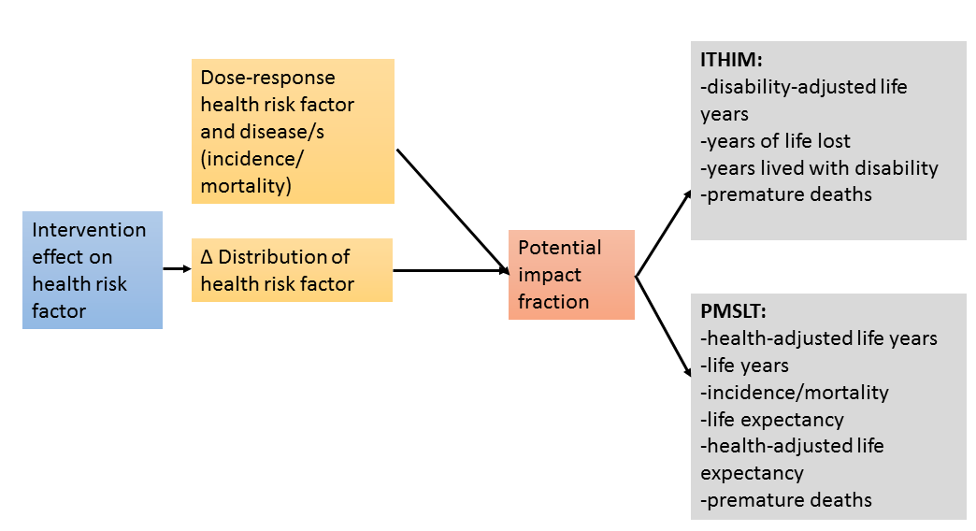
Proportional multi-state life table model
Contribution to ITHIMR

Slide 6
Proportional multi-state life table model
Main differences with ITHIM
Include diseases’ trends (incidence/case fatality)
Time lags exposure to incidence/case fatality
(via the PIF)
Population growth
Time component
Cohorts modelled over time
Year of life/YLLs
Based on observed mortality rates
Impact of disability on increased life expectancy
Burden of disease shift to later years

Slide 7
Proportional multi-state life table model
3
Age and sex
Life table
Life years lived
Life expectancy
Health adjusted life years
Health-adjusted life expectancy
2
Disease specific life table
Mortality
1
Potential impact factor
Prevalence
Dose response
Incidence
Risk factor prevalence
Notes:
Basic model infrastructure.

Slide 8
Proportional multi-state life table model
3
Age and sex
Life table
Life years lived
Life expectancy
Health adjusted life years
Health-adjusted life expectancy
Adds disability adjustment to life years lived prevalent years lived with disability rate (pYLDs)
Health adjusted life years Life years lived*pYLDsrate
Mechanism of change for scenario analysis: mortality rate and pYLDrate

Slide 9
Proportional multi-state life table model
3
Age and sex
Life table
Life years lived
Life expectancy
Health adjusted life years
Health-adjusted life expectancy
PrevYLDrate
2
Disease specific life table
Mortality
1
Potential impact factor
Prevalence
Dose response
Incidence
Risk factor prevalence

Slide 10
Proportional multi-state life table model
R development
Long script (documented in R Markdown)
Functions
Inputs
Notes:
Alternative data inputs to be discussed.

Slide 11
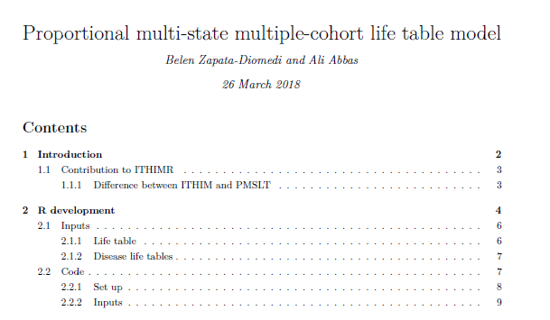
Proportional multi-state life table model
Long script (documented in R Markdown)
Notes:
Alternative data inputs to be discussed.

Slide 12
Proportional multi-state life table model
Functions
Life table (baseline and scenario)
Disease life table (baseline and scenario)
Potential impact fraction
Output: (1) plots (Age and sex) and (2) Aggregate outcomes (total population over the years)
Notes:
Alternative data inputs to be discussed.

Slide 13
Function: life table
Age and sex
All-cause mortality
Population numbers
All-cause morbidity (pYLDs)
Δ Disease specific mortality
Δ Disease specific morbidity (disease pYLDs)
Sex | Age | average mortality rate at age x | probability of dying between age x and x+1 | no. of survivors at age x out of those in year 1 | no. who die between age x and x+1 | no. of person-years lived by cohort to age x+½ | life expectancy | prevYLD rate from all causes | Health adjusted person-years | Health-adjusted life expectancy
 |  | m_{x} | q_{x} | l_{x} | d_{x} | L_{x} | e_{x} | w_{x} | Lw_{x} | ew_{x}
Male | 22 | Rate | q_{x} = 1 - EXP(-m_{x}) | l₀ = n population | d_{x} = q_{x} × l_{x} | L_{x} = (l_{x} + l_{x+1})/2 L₁₀₀₊ = l₁₀₀₊/m₁₀₀₊ | e_{x} = ΣL_{x} / l_{x} | data | Lw_{x} = L_{x}(1-w_{x}) | e_{x} = ΣLw_{x} / l_{x}
 |  |  |  | l_{x} = l_{x-1} - d_{x-1}
Calculations
Calculations
Cohort
Inputs

Slide 14

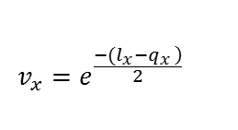
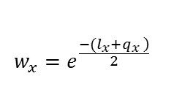

Function: disease life table
Age and sex
sex | age | incidence | remission | case fatality | mortality(other) | Intermediate variables |  |  |  | Healthy | Diseased | Dead | Check, should be 1000 | (No. alive) | Person-years lived at risk (between x and x+1) | prevalence rate | mortality rate
 | x | i_{x} | r_{x} | f_{x} | m_{x} | l_{x} | q_{x} | w_{x} | v_{x} | S_{x} | C_{x} | D_{x} |  |  | PY_{x} | c_{x} | b_{x}
 |  | Data | 0 | Data | 0 |  |  |  |  |  |  |  | =S_{x}+C_{x}+D_{x} | =S_{x}+C_{x} | =0.5(S_{x}+C_{x+}S_{x+1}+C_{x+1)} | c_{x}=0.5 (C_{x}+C_{x+1})/PY_{x} | b_{x}=(D_{x}-D_{x+1})/PY_{x}
Calculations
Intermediate variables
Numbers in each state (S, C and D)
$$l_{x}=i_{x}+r_{x}+f_{x}$$
$$S_{x}=\frac{(2∗\left(v_{x}−w_{x}\right)∗\left[S_{x−1}∗\left(f_{x}+r_{x}\right)+C_{x−1}∗r_{x}\right]+S_{x−1}∗\left[v_{x}∗\left(q_{x}−l_{x}\right)+w_{x}∗\left(q_{x}+l_{x}\right)\right])}{2∗q_{x}}$$
$$q_{x}=\sqrt{i_{x}^{2}}+2∗i_{x}∗f_{x}+r_{x}^{2}+2f_{x}∗r_{x}+ f_{x}^{2}$$
$$C_{x}=−\frac{\left(v_{x}−w_{x}\right)∗\left\{2\left[\left(f_{x}+r_{x}\right)∗\left(S_{x−1}+C_{x−1}\right)−l_{x}∗S_{x−1}\right]−C_{x−1}∗l_{x}\right\}−C_{x−1}∗q_{x}\left(v_{x}+w_{x}\right)}{2∗q_{x}}$$
$$w_{x}=e^{\frac{\left.−(l_{x}+q_{x }\right)}{2}}$$
$$v_{x}=e^{\frac{\left.−(l_{x}−q_{x }\right)}{2}}$$
$$D_{x}=\frac{\left(v_{x}−w_{x}\right)∗\left\{2∗f_{x}∗C_{x−1}−l_{x}∗\left(S_{x−1}+C_{x−1}\right)\right\}−q_{x}∗\left(S_{x−1}+C_{x−1}\right)∗\left(v_{x}+w_{x}\right)+2∗q_{x}∗\left(S_{x−1}+C_{x−1}+D_{x−1}\right)}{2q_{x}}$$
Calculations
Inputs
Barendregt et al 2003
Notes:
I am only writing equations out of the table when these are too long to fit in.

Slide 15
Function: disease life table
Age and sex
PIF calculations will be the same as those used in the general ITHIM model
The PIF is used to calculate a parallel population for which incidence of disease changes, therefore, prevalence (pYLDs) and case fatality (mortality).
 | new incidence | remission | case fatality | Mortality (other)
1-PIF | i'_{x} | r'_{x} | f'_{x} | m'_{x}
0.9443225 | 0.053070 | 0 | 0.4875 | 0
0.9423417 | 0.055334 | 0 | 0.5008 | 0
Δincid | Δprev | Δmort | ΔpYLD
 |  |  | Δprev*DWdisease
-0.003129074 | -0.00118042 | -0.00063541 | -0.00016169
-0.003385678 | -0.00315244 | -0.00162243 | -0.00043182
Calculations

Slide 16
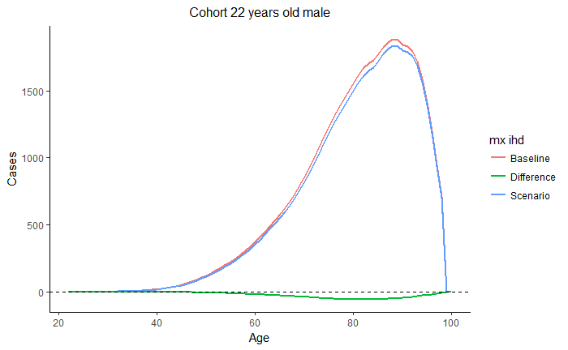
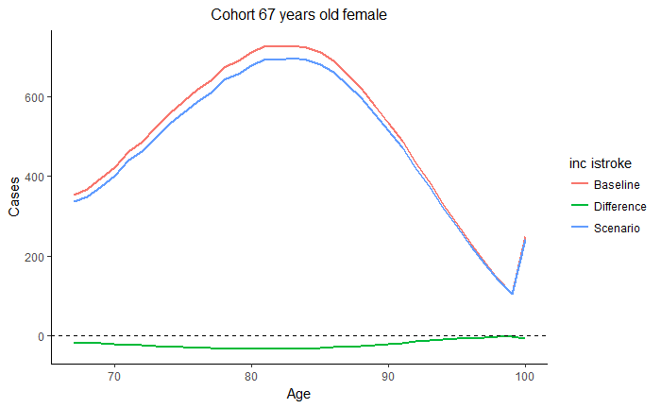
Function: output (plots)

Slide 17
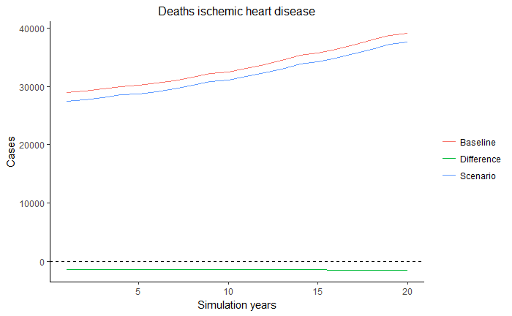
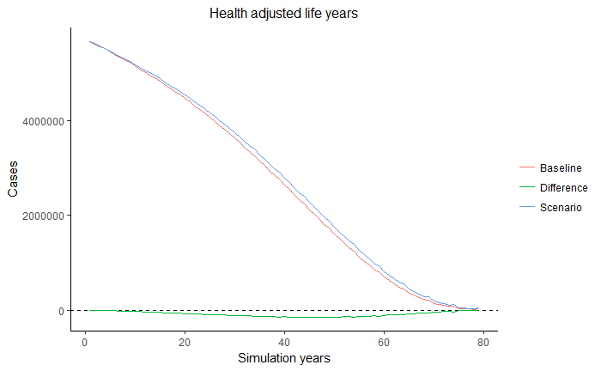
Function + script: output (aggregate outcomes)

Slide 18
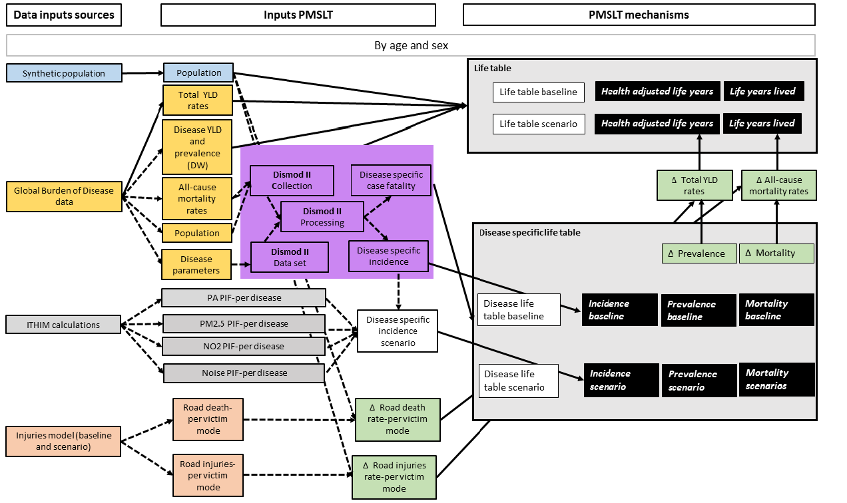
PMSLT: Summary

Slide 19
PMSLT: Summary inputs

Slide 20
Proportional multi-state life table model
Model assumptions:
The incidence of a disease should be independent from all causes of death, except its own disease specific mortality
Disease incidences are independent
All causes of death are independent
Markov type model: markovian assumption, current state occupancy is not related to occupancy in an earlier state.

Slide 21
Proportional multi-state life table model
Challenges
Data inputs for disease life table: requires processing with Dismod II (or think of alternatives)
Data intensity?
More realistic more data needs (e.g. trends)
Discussion
GBD data at the national level for most case studies. Use rates adjustments based on mortality rates.
Dismod II, what can we do about it?
Notes:
Time dimension:
-period in years assumed between the moment of cessation of exposure and the moment the lowest relative risk for ex-exposed, the remnant RR is reached (called LAG in PREVENT). The introduction of this dimension necessitates an adjustment of the equation used for the calculation of PIF as well as an additional dimension of the input data on prevalence and RRs. This means that the ultimate PIF is not reached immediately after the intervention but only after LAG years.
-The time dimension also means, that past changes in risk factor prevalence, whatever their cause, may continue to affect disease incidence in the future. This change in disease specific incidence should be ascribed to the intervention. To incorporate the proportional effect of such past (and possibly also of future) “autonomous trends” in risk factor prevalence, PREVENT calculates Trend Impact Fractions (TIFs,) in a manner similar to the PIF’s.
The LAG seems to function as a proportional change in the PIF over the years.
How are demographic changes modelled?
“The effect of the absolute numbers, the health benefits, will of course also depend three other factors: on the proportional changes in diseases specific incidence over the same period caused by autonomous trend (the TIF’s), the relative contribution of the diseases, influenced by that specific risk factor, on total mortality and the demographic changes in the population over those LAG years.”
“The assumption is that the proportional changes in incidence from the first part of the model, the PIF’s and TIF’s, are translated into the same proportional changes in disease specific mortality after a certain latency period, LAT”.
In the PMSLT we should also multiply incidence in the model scenario to the trend to reflect the trend scaenrios (TIF in PREVENT).

