Slide 1


Analysis and Prediction on
Crime in Chicago City
Haoran Li, Oliver
Ziyue Peng

Slide 2
Agenda
1. Identify problem (purpose of our study)
2. Data sources (where & how)
3. Prepare data (integrate, transform, clean, filter, aggregate)
4. Data Visualization
5. Build model & Evaluate model (applying evaluators)
6. Communicate results (final achievement)

Slide 3
1
Crime issue
Dangerous zones
Low arrest rate
Our purpose
Identify problem

Slide 4


2
2
Data Source
Data source was obtained from Kaggle.com
The original data was extracted from Chicago Police Department's CLEAR (Citizen Law Enforcement Analysis and Reporting) system
The dataset contains crime information from 2001 to 2017, and is consisted of nearly 8 million rows

Slide 5
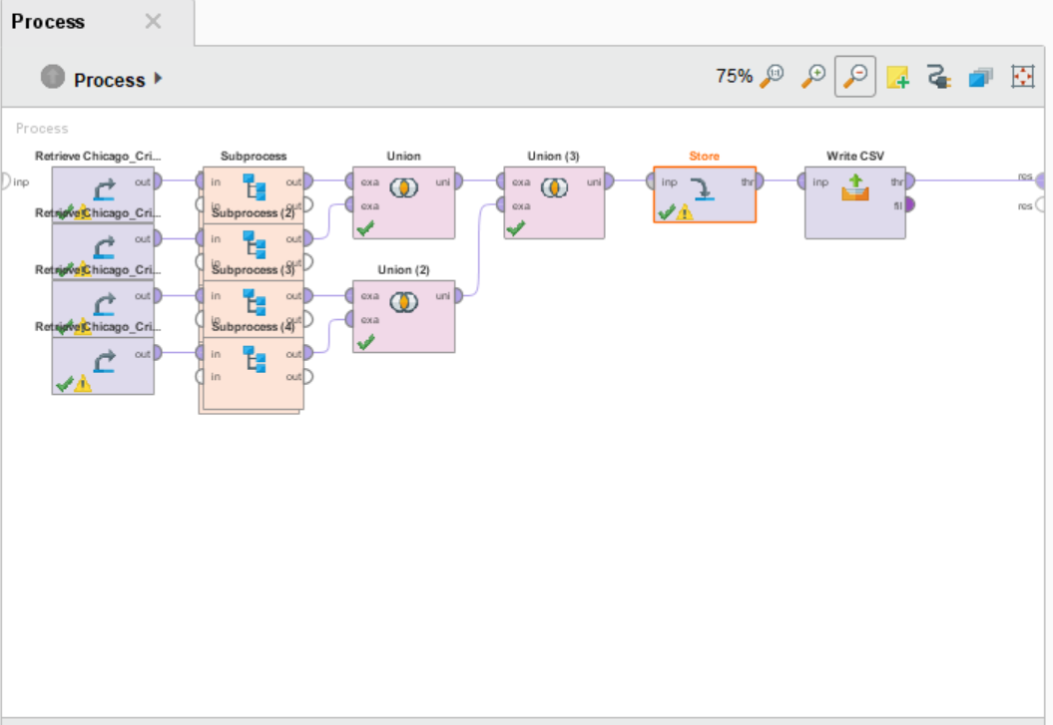
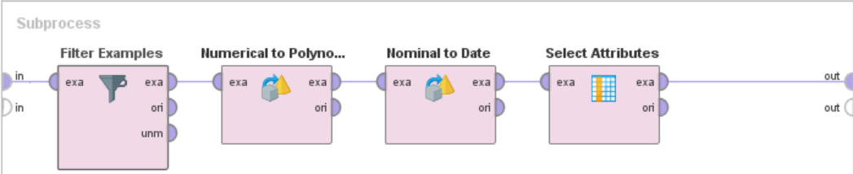
3
Data Preparation
We have completed data cleaning on our own for machine learning part by using RapidMiner, a visualized data cleaning and data mining software.

Slide 6
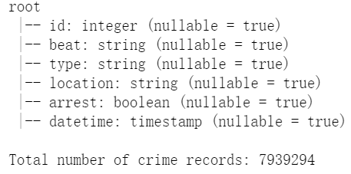
3
Data Preparation
We have also used built-in methods in spark to do some other kinds of data type transformation, since RapidMiner is not supporting all types of transformation

Slide 7
PART
4
Data Visualization

Slide 8
5
Build Models
In general, we have chosen 3 machine learning models to apply in our project: Naïve Bayes, Logistic Regression, Linear Support Vector Machine.
Naïve Bayes
NB is one of the simplest model in ML. It converges faster than other models, providing fast speed as well as relatively good performance
Logistic Regression
LR has a nice probabilistic interpretation. And when you don’t have too many features, it has very high accuracy.
Linear Support Vector Machine
If we define features as vectors, then our data can be located in a high dimensional space. SVM is a hyperplane that divide the hyperplane to help doing classification.

Slide 9
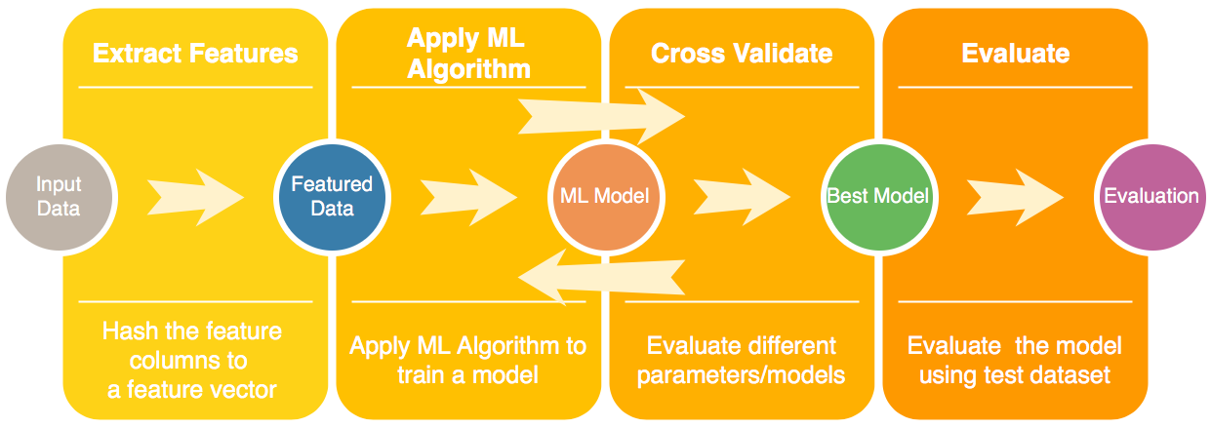
5
Working Pipeline

Slide 10

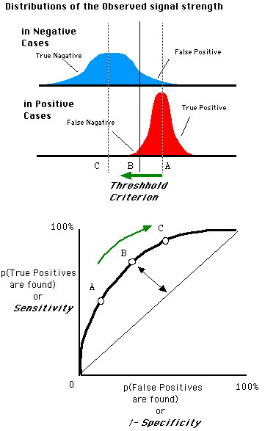
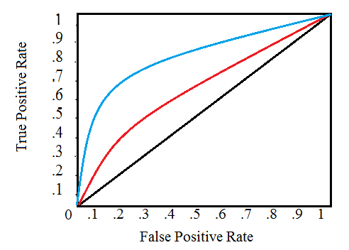
5
Evaluate Models
Binary classification evaluator
AUC (Area Under ROC Curve)

Slide 11

Information in data
Methodology of machine learning
Results
Prediction of arresting results
Real world effects

Slide 12
Q&A

Slide 13
2018
THANK
YOU!
Our greatest appreciation to the general support of
Prof. Yi Shang and members of TA group!

