Slide 1
MulESOFT Order ManageMENT API
OVERVIEW OF SOLUTION
Ragavendra Chandramouli
May 2025

Slide 2
Objective : To create a mulesoft application managing orders via REST aPI
Technologies/components used :
Mulesoft Anypoint Studio 7.21
Mulesoft Runtime 4.9
Mulesoft CloudHub 2.0
MySQL DB 5.5
Notes:
App objectives and features :
Buid an app for order management.
App to be used to accept orders
App to be used to display orders from backend
Expose app’s features as REST API – ie., submit order and retrieve orders

Slide 3
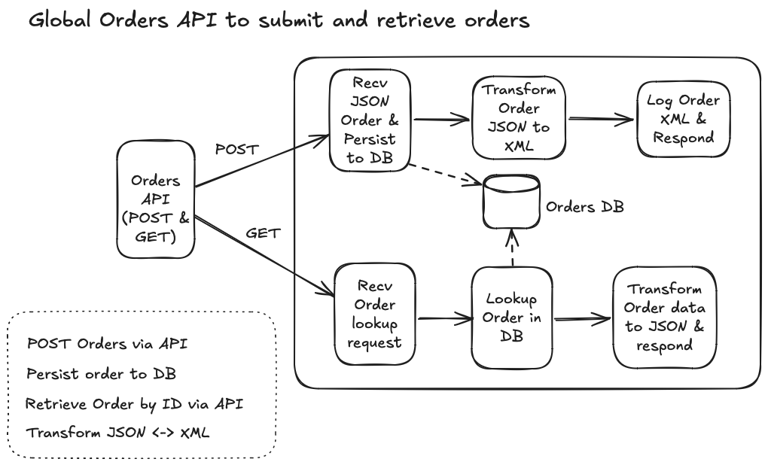
Logical Solution design
Notes:
Diagram illustrating the general processing steps of the order management app

Slide 4
POST API – Create order
Description: Endpoint for creating new orders.
Method: POST
Endpoint: /orders
Request Payload: JSON object containing order details.
Process:
Receive order data from client.
USE Transformer to convert JSON order payload to XML.(possibly for downstream consumption later on)
Use DB connector to insert order data into MySQL table.
Response: Confirmation of order creation in JSON format.
Notes:
Orders Post API -- details

Slide 5
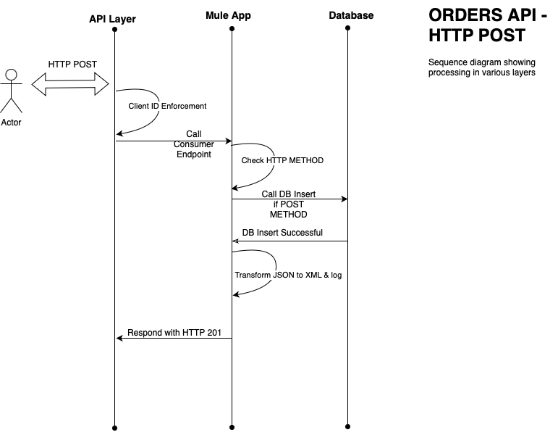
ORDERS API – HTTP POST Flow
Notes:
Sequence diagram for Orders submission - showing low level info on sequence of steps from request to response

Slide 6
GET API - Retrieve Order
Description: Endpoint for retrieving order details by ID.
Method: GET
Endpoint: /orders
Request Payload: Order ID from JSON object
Process:
Receive order ID from client.
Use DB connector to look up order in table.
USE CHOICE Router to check if ORDER exists.
USE Transformer to convert DB lookup output to JSON response.
Response: JSON object containing order details (or AN appropriate message).
Notes:
Order GET API details

Slide 7
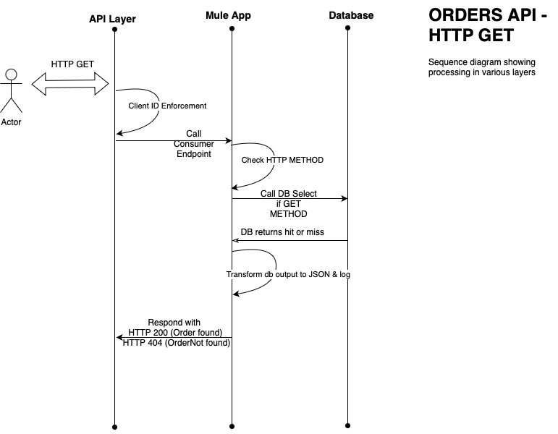
ORDers API – HTTP GET Flow
Notes:
Sequence diagram showing – step by step processing of GET request

Slide 8
Summary of Logic
Method | Path | Payload | HTTP Response code | Behaviour
POST | /orders | Order Details JSON object | 201 Created | Accepts new Order
GET | /orders | Order ID JSON object | 200 OK (if Order found) 404 Not Found (if Order not found) | Fetch and return Order details
PUT | NA | NA | 405 Unsupported Method | Return 405 Unsupported Method
DELETE | NA | NA | 405 Unsupported Method | Return 405 Unsupported Method
Notes:
General table showing API Methods, Path and behaviour
Project name : demo-gblordmgmt

Slide 9
Security and other considerations
API POLICY for security :
Client ID enforcement at HTTP BASIC Auth level.
HTTP Method(s) based routing :
Method is evaluated to determine if request is for order submission (POST) or order look up (GET). All other methods are unsupported.
Parameterize by Environment
Environment info like db connectivity info are parameterized using Global PROPERTY and configuration
Error handling :
Dedicated http response codes for success and Unsupported operations.
use of TRY to throw and handle errors from DB operations.
Testing :
Postman collections used to hit api endpoint.
Future enhancements :
Modularize with sub-flows.
Validate API payload REQUESTS.
Implement ORDER listing mode with set fetch limits (/orders?mode=list).
Integrate ORDERs with downstream apps via queues or write files to on-prem/cloud Storage.
Notes:
Points –
API compliance policy client ID and Client secret using (security aspect)
Methods based routing
Testing and enhacements.

Slide 10
RUNNING The APP– New Order
Let’s try to create an Order using the Orders API.
Import the demo-api POSTMAN collections into POSTMAN.
Check Request named : “POST-orders-201-CREATED”. This request will create a new Order.
Change order id in request’s Order JSON payload to say “2025” (ie, “orderId”: “2025”)
Hit ‘Send’ and check response, successful response should return JSON as below with HTTP 201 code :
{
"message": "Order has been Accepted",
"orderId": ”2025",
"region": "SGP"
}
Notes:
POSTMAN collections file : demo-api.postman_collection.json
Demo order posting with POSTMAN collection and CloudHub app logs

Slide 11
RUNNING The APP–Order Lookup
Let’s check if previously created Order can be retrieved.
Check Request named : “GET-orders-200-OK”. This will return Order details if present.
Change order id in request’s JSON payload to say “2025” (ie, “orderId”: “2025”)
Hit ‘Send’ and check response, successful response should return JSON as below with HTTP 200 code :
{
"message": "Order details retrieved",
"OrderInfo": {
"orderId": 2025,
"region": "SGP",
"orderDate": "2025-05-10"
}
Notes:
Demo order lookup with POSTMAN collection and CloudHub app logs

Slide 12
RUNNING The APP–Order Lookup - Contd
If Order is not found, a response as below with HTTP 404 code should be seen :
{
"message": "No data found for input Order #3333"
}
Any other HTTP Method verbs should return a HTTP 405 code with message : “ Unsupported Operation”
Notes:
Demo “order not found” and ”Unsupported Operations” scenarios

Slide 13
Q & A

