Slide 1
Growth, Distribution, and Sustainable Development Goals MANOJ PANDA INSTITUTE OF ECONOMIC GROWTH, DELHI
BITS Goa ECONOMIC CONCLAVE March 12-13, 2016

Slide 2
Introduction
How do judge whether people in a country are better off or not? Where do we place India in answering this question?
Welfare of a nation’s population is generally determined by:
National income per capita (GDP/Population)
Income Distribution (Share of various sections in total income)
Non-income dimensions of well-being such as health, education, environment etc to judge quality of life.
UN’s Human development index, MDGs, SDGs attempt to capture non-income dimensions of human welfare
In order to understand how are Indian people doing, this lecture covers these three dimensions.

Slide 3
Why income?
Income determines purchasing power; command over goods and services by the population
Consumption and savings are determined by level of income
Savings determine assets or wealth
GDP per capita is a rough and ready indicator of income of the population in a nation
When we characterise countries or regions as developed or not, we do so by the yardstick of income
During the Moghul era, India was counted among the richest nations in the world (Maddison)
It was among the poorest nations when the British left 70 years ago
Various policies were formulated after independence for income growth over the years
Distribution: national income growth should be widespread and not concentrated among some sections
Equality of opportunity and social justice are integral part of our constitution.
All sections must have income earning opportunity

Slide 4
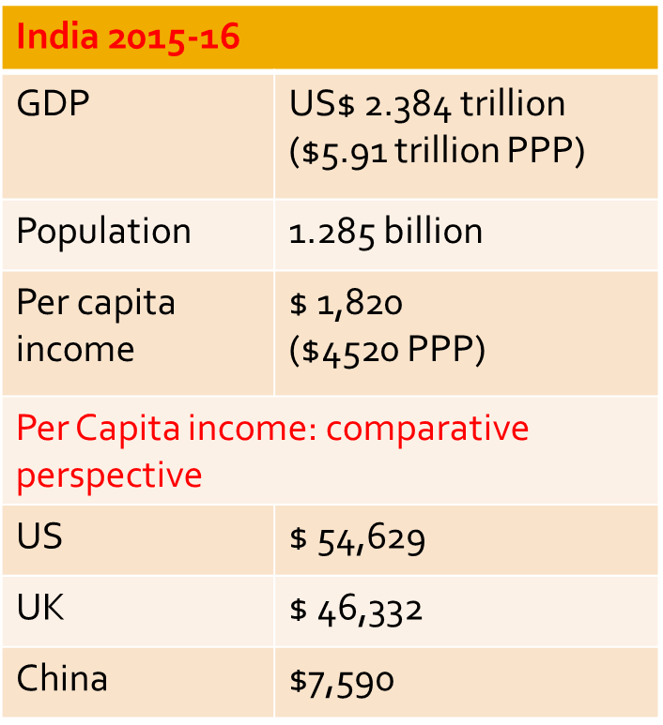
Indian Economy
Per capita income less than $300 in early 1950s
Stagnant ‘Hindu’ growth rate of 3.5% during first 3 decades of planning. A break occurred around 1980 with GDP growth rate of 5.5%.
GDP accelerated since the reforms in 1991
Cross country evidence shows: effects of reforms often context specific
India: 6.0% during 1990s; 8.6% (2002-07)
India graduated to become a ‘low middle income’ country a few years ago,
Yet, long way to reach global average

Slide 5
Trends in Annual GDP Growth Rate, India 1951-2015
GDP growth has increased on a long term basis
But, unlike that of China, growth process of the Indian economy has been highly uneven on a medium term basis

Slide 6
Sectoral composition of GDP Service driven growth process

Slide 7
Future Growth Prospects
Most analysts of Indian economy agree that economy has potential to grow at 7-8% on a medium to long term basis.
It needs to do so to meet aspirations of its citizens and to occupy a rightful place on the global high table
Favourable factors:
Savings-investment rate high,
Demographic dividend
Macroeconomic stability broadly
Productivity growth and efficiency
Can the prosperity be shared without considerable rise in inequality?

Slide 8
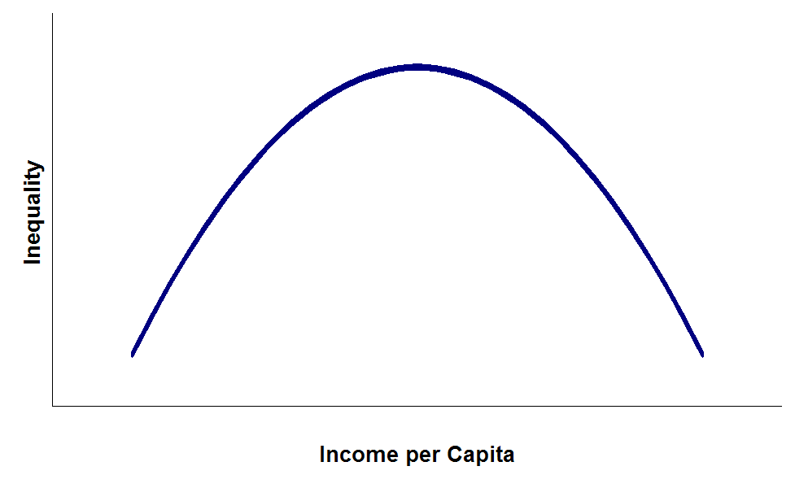
Kuznet’s Curve
Empirical relation using cross countries data
Had major impact on growth strategy during 1960s and 1970s
Economic growth process involves shifts of labour from agriculture to non-agriculture and adoption of new technologies. It initially benefits a small proportion of the population, inter sectoral productivity differences widen.
As the growth process continues, the benefits of growth are shared more evenly:
Human capital expands,
Less people depend on agriculture,
Productivity rises in across sectors
Govt revenue rises enabling welfare programmes
Higher per capita GDP for most of population tends to reduce inequality.

Slide 9
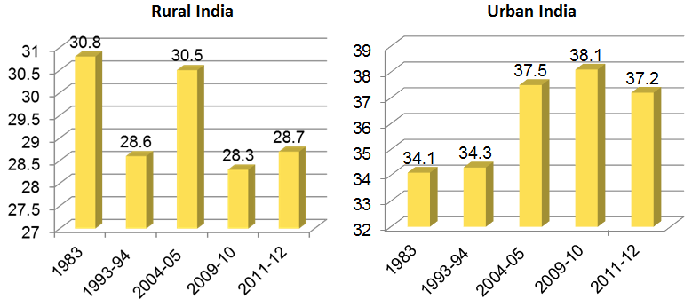
Inequality: Gini-coefficient in per capita consumption
Rise in urban inequality after 1993-94
Some indication of a Kuznet’s curve type hypothesis? Too early to conclude
Recent debate by Piketty and others: top 1% getting 8-10% of income

Slide 10
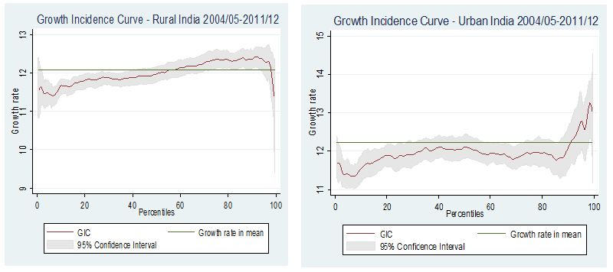
Growth Incidence Curve
Less than average growth for bottom half in rural areas and bottom 90% in urban areas

Slide 11
Growth and Poverty
Per capita consumption growth is associated with falling poverty
Countries with high sustained growth have reduced their absolute poverty levels
East Asia and the Pacific: rapid economic growth benefited all groups
The evidence is one of association, neither causation nor sufficient condition
Causality might run in the opposite direction depending on the context
Impact may vary by sector
In India, fluctuations in poverty incidence till early 1970s primarily due to slow per capita income growth.
Incidence of poverty started to fall after mid-1970s when there was marked acceleration in per capita GDP growth rate to above 3 per cent per annum.

Slide 12
Indian Poverty Line
Tendulkar Committee (2009): Consumption basket corresponding to all-India Urban PL based on Lakdawala Committee report used as uniform PL for rural and urban areas. It is adjusted for price differentials across states and sectors
All-India PL 2011-12: Rs 816 Rural and Rs 1000 urban
Absolute no. of poor: 270 million in 2011-12
Rangarajan Committee (2014)
All-India Rs 972 Rural; Rs. 1407 Urban 2011-12
Large revision for urban areas
Absolute no. 363 million in 2011-12
Rural HCR |  | Urban HCR
2009-10 | 2011-12 | 2009-10 | 2011-12
Tendulkar Committee
33.8 | 25.7 | 20.7 | 13.7
Rangarajan Committee
39.6 | 30.9 | 35.1 | 26.4

Slide 13
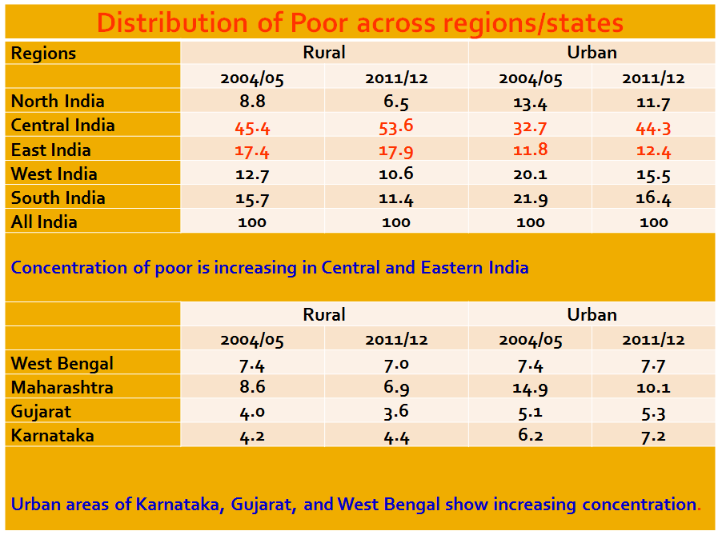

Slide 14
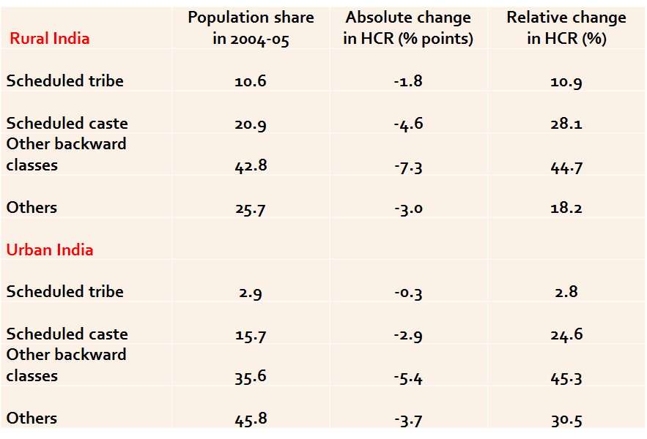
Poverty Reduction by Social Group, 2004-05 to 2011-12

Slide 15
Poverty, Growth and Current Policy Focus
Poverty depends on mean income and distribution. Higher growth need not lead to faster poverty reduction depending on distribution factor.
If inequality remains constant, growth in mean income reduces poverty
If mean income remains constant, inequality rise increases poverty
Poverty reduction fast when average income rises and inequality falls.
Current policy focus more on employment generation and insurance coverage
Make in India, innovate India, Start-up projects, development of entrepreneurship
JAM – Janadhana, Aadhar and Mobile for insurance and transfers

Slide 16
Why not fast enough reduction in poverty?
Neglect of Agriculture
Increase in Regional Disparity
Isolation of ST-SC from the mainstream of economic life
Growth process not accompanied by enough job creation, neglect of labour intensive manufacturing sector
Rural-Urban Disparity
Did all sections benefit at least to some extent on income scale?
Yes at the all-India level
What about non-income indicators of level of living?

Slide 17
Sustainable Development Goals (SDGs)
SDGS Inter-governmental agreement adopted at the Summit called by the UN in Sept 2015 in New York.
It states what kind of future the global community wants under the title Transforming our world: the 2030 Agenda for Sustainable Development
Incorporates the MDGs, environmental and climate change goals but goes beyond. Talks of:
Ending poverty and hunger,
Improving health and education,
Making cities more sustainable and liveable,
Combating climate change,
Protecting oceans and forests.
Contained 17 goals with 169 targets covering a broad range of sustainable development issues.
Reflects global aspirations, though critics think by incorporating so many targets, it is losing focus; too ambitious on so many fronts. Countries may choose their own subset of targets.

Slide 18
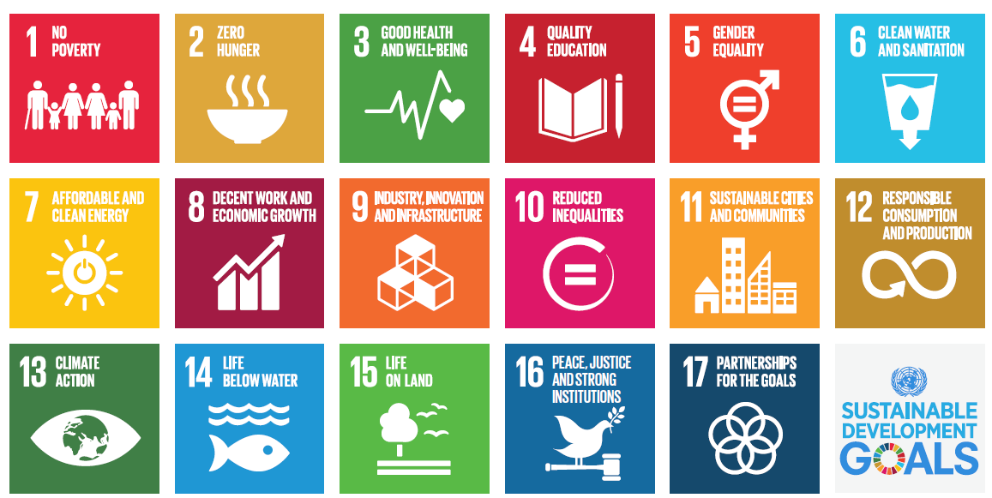

Slide 19
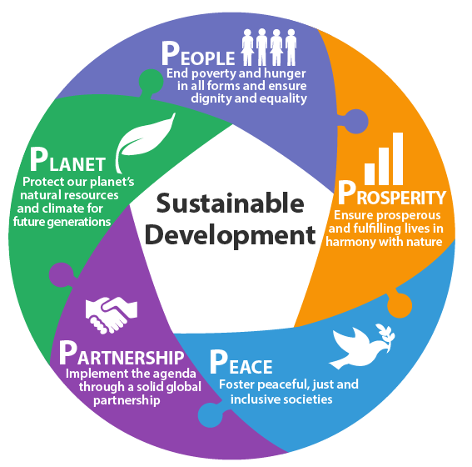
SDGs – 5 areas of critical importance
The Goals will stimulate action over the next 15 years in 5 areas of critical importance: People, Planet, Prosperity, Peace, and Partnership

Slide 20
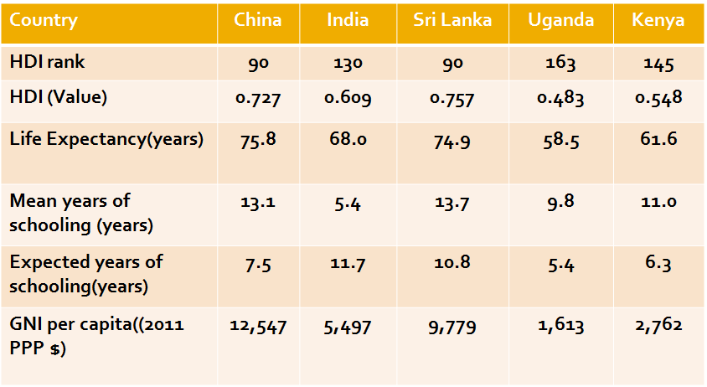
Human Development Index, 2015 (HDR 2015)

Slide 21
HDI and Child Mortality
Country | HDI rank (2014) | IMR (2013) | U5MR (2013)
China | 90 | 10.6 | 12.7
India | 130 | 41.4 | 52.7
Sri Lanka | 73 | 8.2 | 9.6
Uganda | 163 | 43.8 | 66.1
Kenya | 145 | 47.5 | 70.7

Slide 22
(Early) Neonatal and Infant Mortality
Early neonatal mortality – dying before completing first week of birth;
Neonatal mortality – dying before completing first month of birth;
Infant mortality – dying before completing first birthday

Slide 23
Maternal mortality ratio (MMR)

Slide 24
Relationship of income growth to sustainability
Improvements in quality of life and human development or sustainable development not always related to income.
Some countries at low level of income have achieved high levels of development in social sectors comparable to developed countries
Elasticities of health and environmental indicators are generally found to be low 0.1 or 0.2 at best
Therefore income growth alone cannot meet the SDGs
Governments need to allocate higher public expenditure
Media need to focus on information, communication and education (ICE) so that social behavior changes

Slide 25
Environmental Issues
Degradation of environmental resources: anthropogenic factors (production and consumption) and natural factors (fire, storm, flood)
Natural resource base partly regenerative (within bounds) and partly non-renewable
As long as human activities lies below the regenerative capacity of nature, there is no decline in natural resources
No longer so in recent decades due to large demand for natural resources from increasing population and industrial production
Natural resources in danger of exhaustion, excessive use
Use of natural resources not properly accounted for in the usual GDP calculation
Attempts to value damage to natural resources: several approaches, each has limitations
Yet, such accounting could sensitize us, alter our perception of the development path, help in better accounting system in future

Slide 26
Environmentally adjusted GDP
Some countries have attempted to develop a measure of GDP considering environmental damage
Not easy to value resources in money matric
Some success in sectors like forestry
Efforts have not always been satisfactory in measuring air or water quality degradation
Often GDP growth drops by a third or a fourth
Some countries like China have abandoned the efforts.
Whether we are able to measure properly or not, environment related costs will have to be met and might pre-empt government revenue from other uses.
Balancing various claims for govt resources going to be more complex.

Slide 27
Conclusions
Indian growth story has been uneven, though increasing on a long term basis
It is service driven and share of manufacturing and industry has not changed much
Inequality in consumption distribution has increased in recent decades in urban areas; Urban top 10% having higher than average urban MPCE growth
Higher growth in recent decades has reduced poverty
But, poverty is increasingly getting concentrated in Central and Eastern India
Welfare of all sections judged by consumption increased since 2004-05 at the all-India level and in most, but not all, states.

Slide 28
Conclusions
Yet, disquiet feeling persists given higher aspirations
Health, education and environment in urgent need of higher budgetary allocation and more efficient use of resources
Public awareness on nutrition, institutional delivery, sanitation and cleanliness could play critical role
Labour intensive manufacturing must be focused for wide spread growth effects
As China’s wage cost rises, it will not have competitive advantage in exports of labour intensive consumer items.
Can India capture this advantage?

Slide 29
Thank You!

