Slide 1
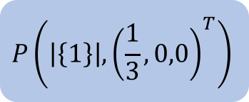
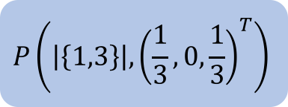
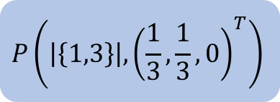
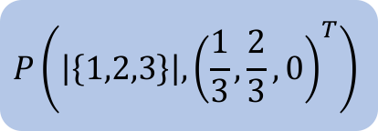

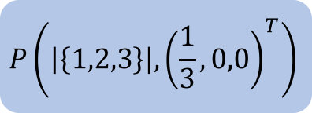


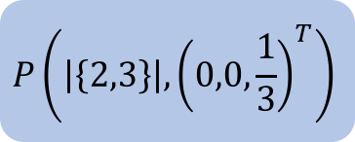
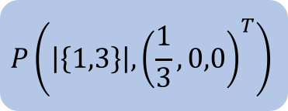
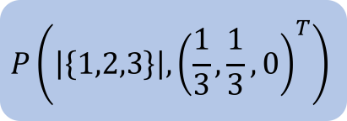
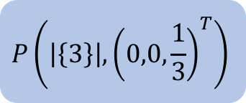
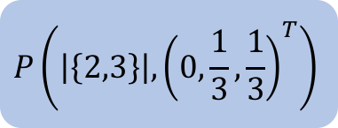
$$P\left(\left|\left\{2\right\}\right|,{\left(0,0,0\right)}^{T}\right)$$
$$P\left(\left|\left\{3\right\}\right|,{\left(0,0,\frac{1}{3}\right)}^{T}\right)$$
$$P\left(\left|\left\{2,3\right\}\right|,{\left(0,0,0\right)}^{T}\right)$$
3
$$P\left(\left|\left\{2,3\right\}\right|,{\left(0,0,\frac{1}{3}\right)}^{T}\right)$$
2
$$P\left(\left|\left\{2,3\right\}\right|,{\left(0,\frac{1}{3},\frac{1}{3}\right)}^{T}\right)$$
$$P\left(\left|\left\{1,2,3\right\}\right|,{\left(0,0,0\right)}^{T}\right)$$
1
$$P\left(\left|\left\{1\right\}\right|,{\left(\frac{1}{3},0,0\right)}^{T}\right)$$
$$P\left(\left|\left\{1,3\right\}\right|,{\left(\frac{1}{3},0,0\right)}^{T}\right)$$
3
$$P\left(\left|\left\{1,3\right\}\right|,{\left(\frac{1}{3},0,\frac{1}{3}\right)}^{T}\right)$$
$$P\left(\left|\left\{1,2,3\right\}\right|,{\left(\frac{1}{3},0,0\right)}^{T}\right)$$
2
$$P\left(\left|\left\{1,3\right\}\right|,{\left(\frac{1}{3},\frac{1}{3},0\right)}^{T}\right)$$
$$P\left(\left|\left\{1,2,3\right\}\right|,{\left(\frac{1}{3},\frac{1}{3},0\right)}^{T}\right)$$
2
$$P\left(\left|\left\{1,2,3\right\}\right|,{\left(\frac{1}{3},\frac{2}{3},0\right)}^{T}\right)$$

