Slide 1

G2M CASE STUDY (XYZ)
11-March-2021 Burak Demir
Data and Analytics Turkey

Slide 2
Background – Go-To-Market (Cab Industry) Case Study
XYZ is a private equity firm in US. Due to remarkable growth in the Cab Industry in last few years and multiple key players in the market, it is planning for an investment in Cab industry.
Objective : Provide actionable insights to help XYZ firm in identifying the right company for making investment.
The analysis has been divided into four parts:
Data Understanding
Forecasting profit and number of rides for each cab type
Finding the most profitable Cab company
Recommendations for investment

Slide 3
Profit Analysis
Adjustments:
Gain and Gain per KM feature were created to make a short road.
Gain = Price_Charged - Cost_of_Trip
Gain per KM = (Price_Charged - Cost_of_Trip)/KM Travelled
Outliers are present in Gain feature but due to unavailability of trip duration details, we are not treating this as outlier.
Created lots of csv datas (yearly, seasonal etc.) to make a short road.
Cab_Data.csv
Customer_ID.csv
Transaction_ID.csv
masterdf.csv
City.csv

Slide 4
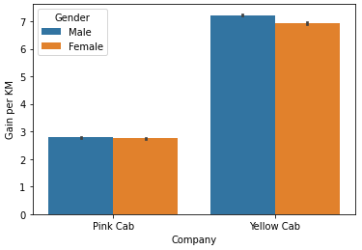
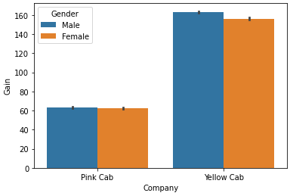
Profit Analysis
Company | Total Gain | Gain per KM | Total Ride
Pink Cab | 5,307,328 | 2.77 | 84,711
Yellow Cab | 44,020,373 | 7.11 | 274,681
Gain < 0 | Pink Cab | Yellow Cab
Gain loss | -226,672 | -259,098
Gain loss per KM | -0.912 | -0.839
Gain loss per ride | % 13.14 | % 4.98

Slide 5
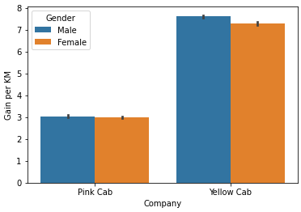
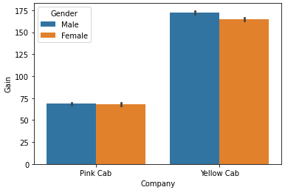
Yearly Profit Analysis 2016
Company | Total Gain | Gain per KM | Total Ride
Pink Cab | 1,713,511 | 3.03 | 25,080
Yellow Cab | 13,926,995 | 7.49 | 82,239
Gain < 0 | Pink Cab | Yellow Cab
Gain loss | -71,200 | -78,038
Gain loss per KM | -1.006 | -0.891
Gain loss per ride | % 12.92 | % 4.73

Slide 6
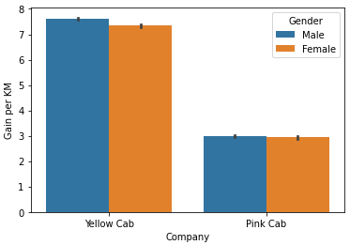
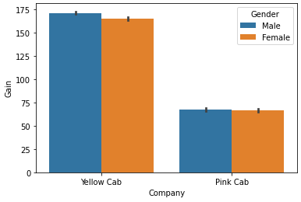
Yearly Profit Analysis 2017
Company | Total Gain | Gain per KM | Total Ride
Pink Cab | 2,033,654 | 2.96 | 30,321
Yellow Cab | 16,575,978 | 7.49 | 98,189
Gain < 0 | Pink Cab | Yellow Cab
Gain loss | -95,193 | -106,178
Gain loss per KM | -0.961 | -0.915
Gain loss per ride | % 14.39 | % 5.19

Slide 7
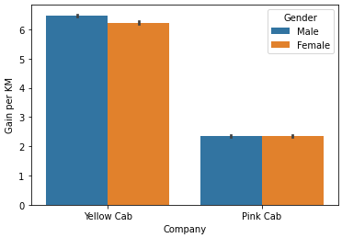
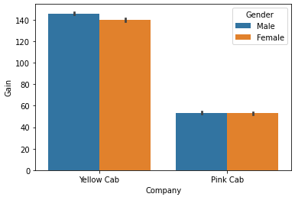
Yearly Profit Analysis 2018
Company | Total Gain | Gain per KM | Total Ride
Pink Cab | 1,560,162 | 2.35 | 29,310
Yellow Cab | 13,517,400 | 6.36 | 94,253
Gain < 0 | Pink Cab | Yellow Cab
Gain loss | -60,278 | -74,883
Gain loss per KM | -0.764 | -0.713
Gain loss per ride | % 12.03 | % 5.00
Yellow Cab regularly more profits than Pink Cab. In addition, the number and amounts of loss is less than Pink Cab.

Slide 8
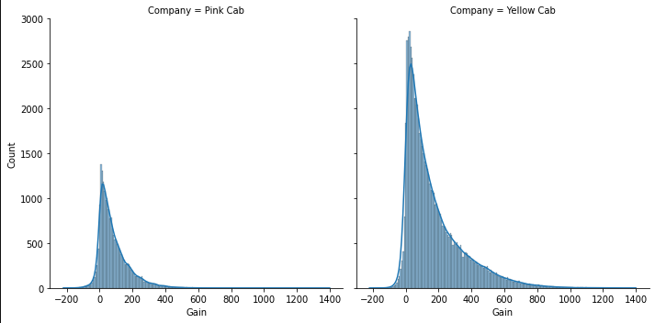
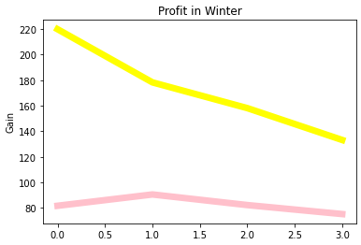
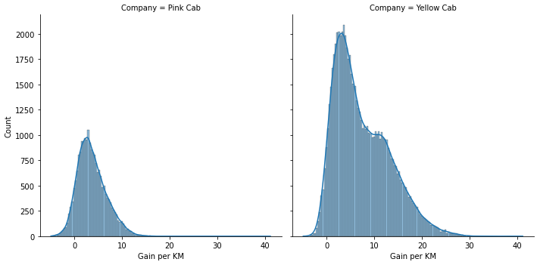
Winter Profit Analysis
Yellow loses % 39.44
Pink loses % 7.95
The fall of Yellow Cab’s profits in winter period is very dramatic.

Slide 9
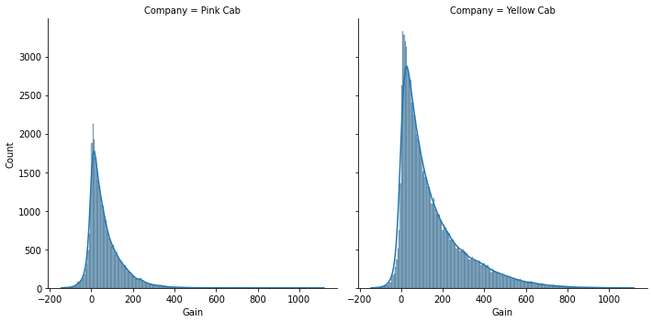
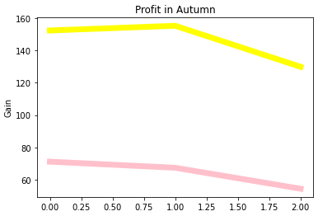
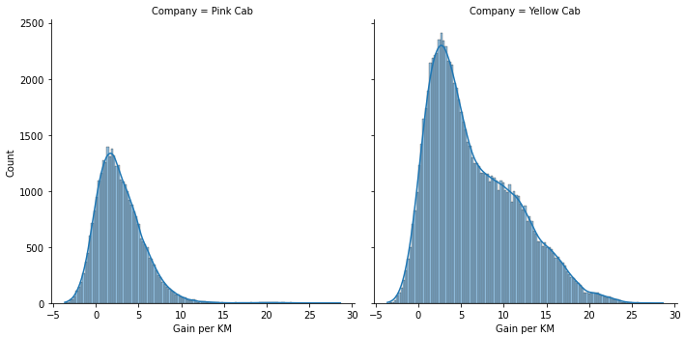
Autumn Profit Analysis
Yellow loses % 14.76
Pink loses % 23.58

Slide 10
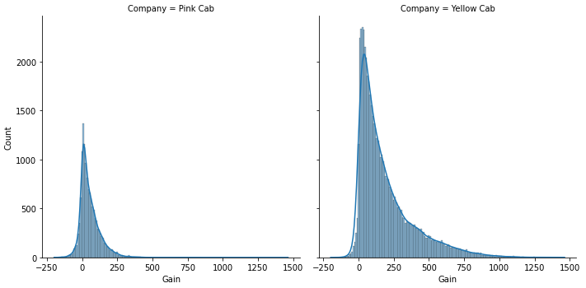
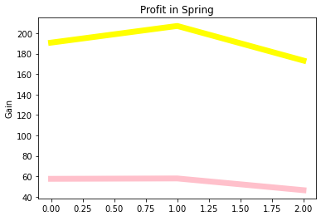
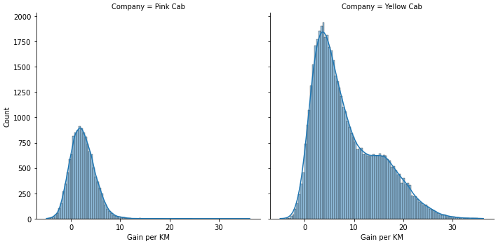
Spring Profit Analysis
Yellow loses % 9.21
Pink loses % 19.38

Slide 11
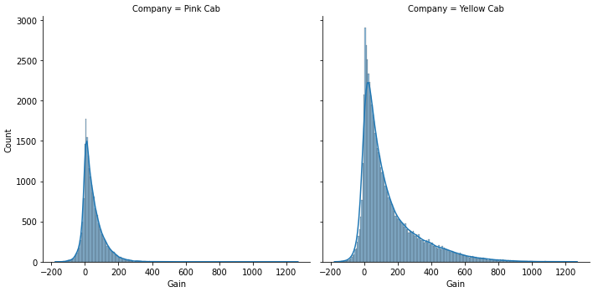
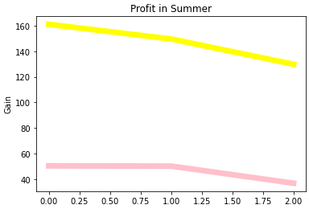
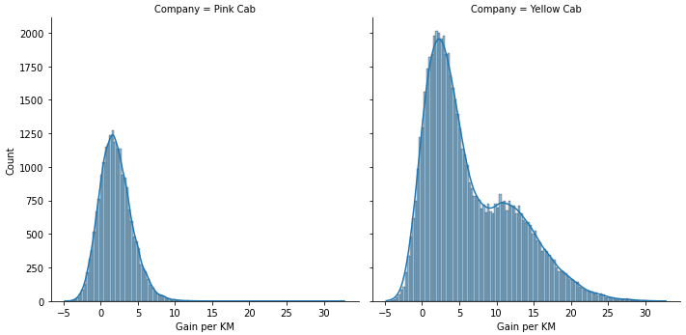
Summer Profit Analysis
Yellow loses % 19.42
Pink loses % 26.98
Despite the fall in winter, Yellow Cab seems to be a better option than Pink Cab.

Slide 12
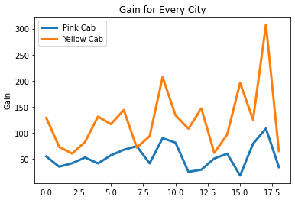
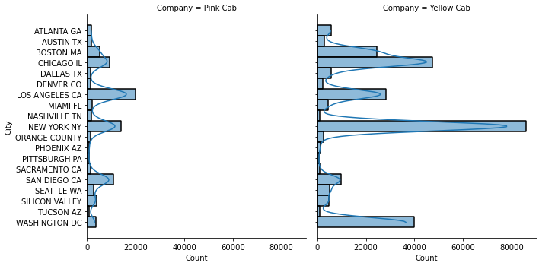
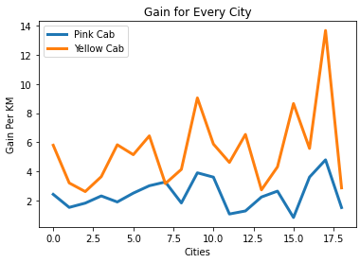
Profit for Every City
Yellow Cab has made more profit than Pink Cab in every city except Tucson AZ.

Slide 13
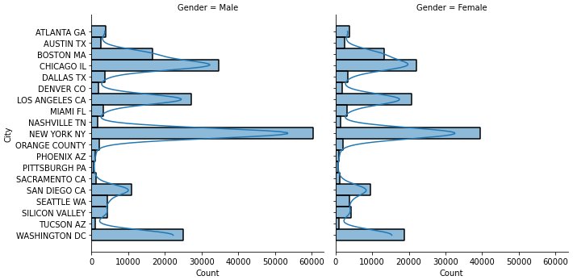
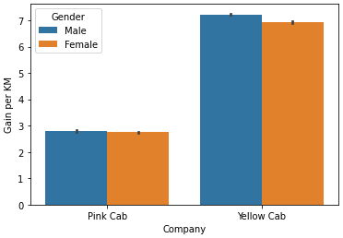
Gender Analysis
Gender | Pink Cab | Yellow Cab | Total
Male | 47,231 | 158,681 | 205,912
Female | 37,480 | 116,000 | 153,480
There is no differences between the genders both Pink and Yellow Cab . The number of male is slightly higher in both.

Slide 14
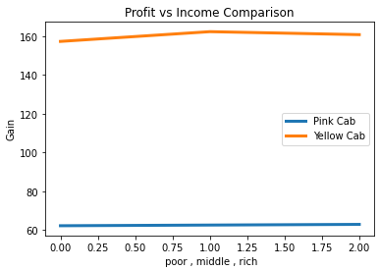
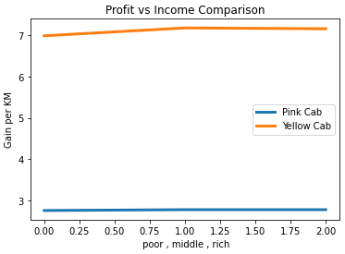
Profit – Income Comparison
Income
< 10000 -- Poor
10k-20k -- Middle
> 20000 -- Rich
Regardless of the salary, a balanced and even distribution is observed. The difference is only arises when company names come into play.

Slide 15
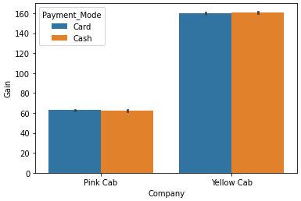
Payment Mode Comparison
Payment Mode | Pink Cab | Yellow Cab
Card | 50,719 | 164,785
Cash | 33,992 | 109,896
There is no differences between payment options in terms of profit. The number of card payments is higher in both.

Slide 16
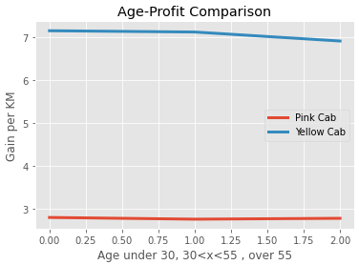
Age – Profit Comparison
Age
< 30
30 < x < 55
> 55
Yellow Cab have brought more profit for all age groups.

Slide 17
Recommendations
We have evaluated both the cab companies on following points:
Customer Reach : Yellow cab has reached 3+ times more customer than the Pink Cab.
Average Gain per KM: Yellow Cab’s average gain per KM is almost three times the average gain per KM of the Pink Cab.
Yearly wise Profit: Yellow Cab regularly more profits than Pink Cab. In addition, the amounts of loss is less than Pink Cab.
Seasonal wise Profit: Yellow Cab earned more profit in all seasons. In all seasons other than winter, Pink Cab has experienced more declines.
Gain Loss : If we look at the total in 2 compaines, they have made equal losses. However, it is seen that the Pink Cab has suffered
a lot in the loss per ride.
Profit in Every City: Yellow Cab has made more profit than Pink Cab (total or per KM) in every city except Tucson AZ.
Age wise Reach : Yellow cab has customer in all age group and it’s been observed that it’s even popular in 55+ age group as equally as its in <30 age group.
Income - Gain : Regardless of the salary, a balanced and even distribution is observed. The difference is only arises when company names come into play. Yellow Cab provides 3 times more profit per KM in every income group (poor,middle,rich).
Considering these points, we should prefer Yellow Cab for investment.

Slide 18

Thank You

