Slide 1
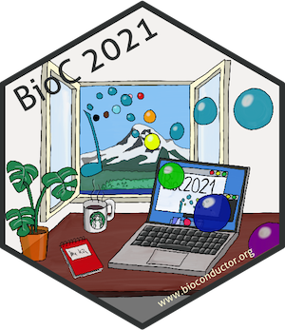

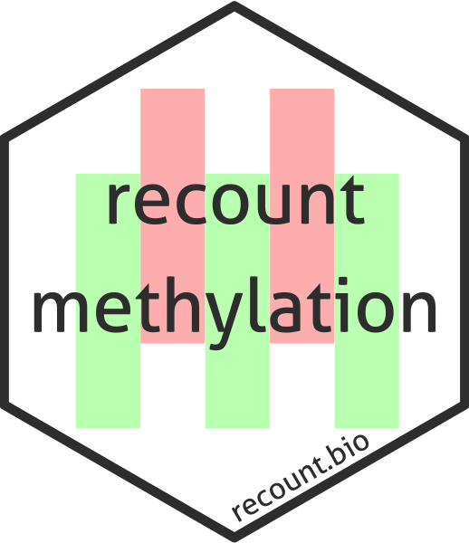

Accessing, querying, and analyzing public DNAm array data compilations with recountmethylation
Bioc2021 remote workshop, August 4th, 2021
Sean Maden, Ph.D. Candidate
Advisor Prof. Abhinav Nellore
Computational Biology program
Biomedical Engineering Department
Oregon Health & Science University

Slide 2
Resources for this workshop
Workshop GitHub repo: https://github.com/metamaden/recountmethylation_bioc2021
Wiki containing key background and resource links
The recountmethylation cheatsheet
Slides and code from this talk

Slide 3
DNA methylation (DNAm) overview
DNAm – methyl group (CH₃) covalently bound to cytosine
Found at cytosine-guanine dinucleotide loci (a.k.a. CpG loci)
DNAm enriched at CpG islands
Mediates gene expression
DNAm is a biomarker in normal cells/tissues and disease
Best studied epigenetic mark, often with microarrays

Slide 4
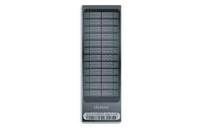
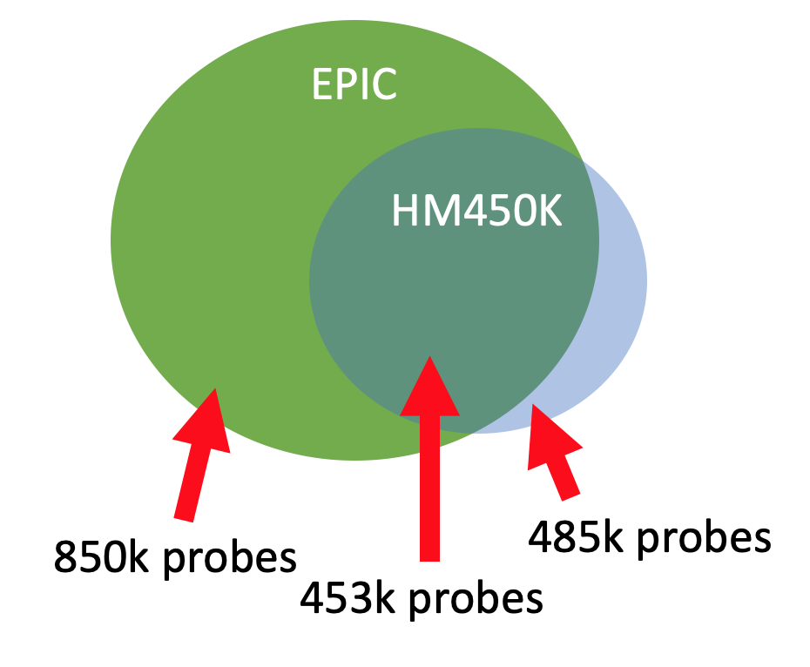
DNAm arrays – Illumina BeadArray platforms
BeadArrays quantify DNAm at CpG-targeted probes
Two most common platforms, HM450K (older) and EPIC (newer), present a coverage-to-throughput tradeoff
Raw intensity or “IDAT” files required for uniform normalization
Public repos provide access to DNAm arrays
Gene Expression Omnibus (GEO)
Array Express
Illumina BeadArray example

Slide 5
Code break #1!
Handling HM450K and EPIC DNAm array data using the minfi library

Slide 6

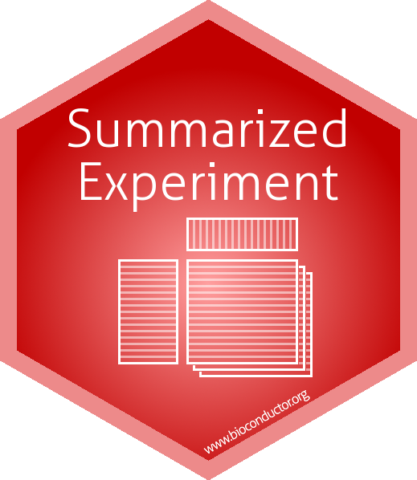
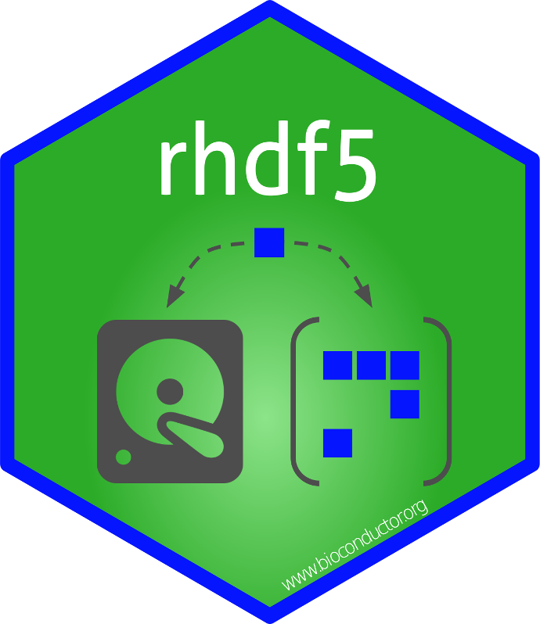
What are DNAm array compilations?
Resources, typically data freezes, pairing metadata with DNAm measures
DNAm measures can be raw or uniformly normalized
Sample metadata typically harmonized
Predicted metadata precomputed from canonical DNAm models
Ages from Horvath 2013 clock, wateRmelon library
Sex predictions from minfi library
Blood cell fractions from Houseman et al 2012 data, minfi library

Slide 7
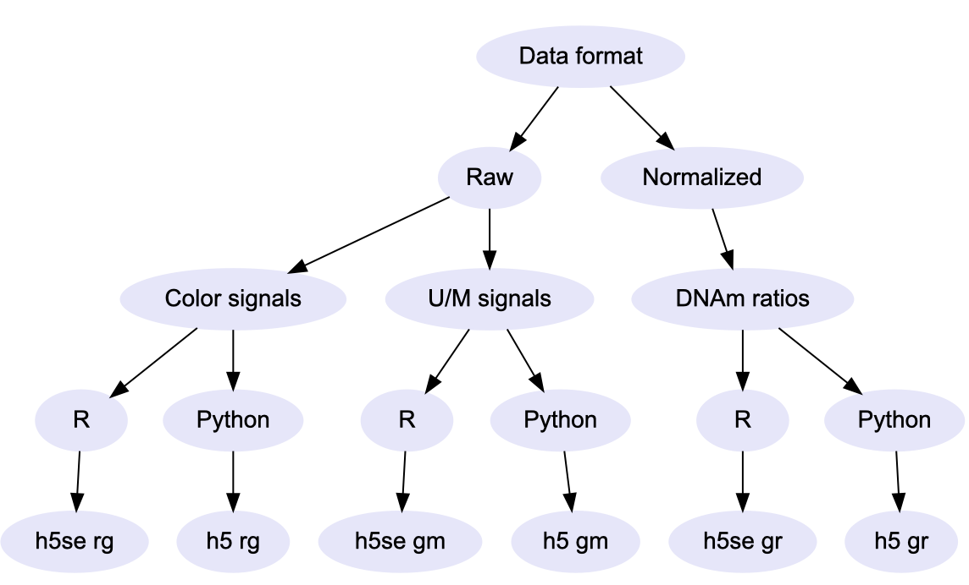
How do I pick the right database file?
First, choose a platform (HM450K or EPIC)
Next, determine the format of interest
Finally, choose a data format (h5se or h5) based on your programming environment
Decision tree from recountmethylation cheatsheet

Slide 8
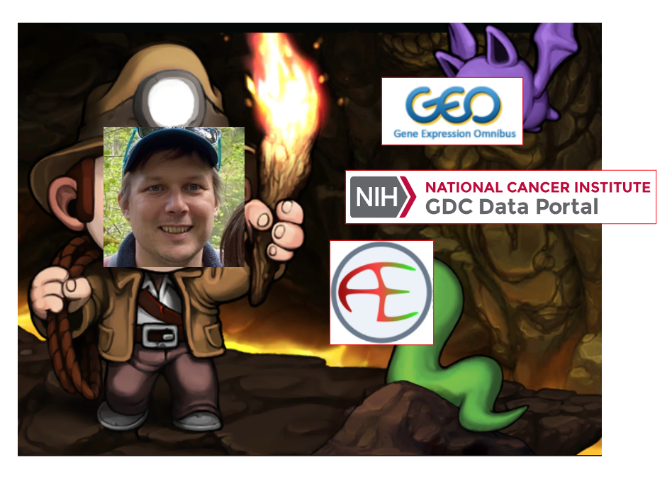
More data spelunking, less mining
What’s out there?
Published data needs to be discoverable
Samples need to be properly characterized
Just because it’s data, doesn’t mean it’s useful/useable
Not all published data is applicable in all experiments
Some analyses leverage “all the data”, but many don’t
Image source

Slide 9
Code break #2!
Working with the h5se compilation datasets in an R session

Slide 10




Harmonized metadata
Harmonized = standard format across studies
Learned and predicted terms for sample properties (tissue, disease state) and demographics (sex, age)
Sparse harmonized metadata doesn’t mean metadata absence
Validate with GEO, manuscript docs, etc.

Slide 11
Querying the learned metadata
Learned terms use standard characters, format
Terms lowercase, separated by underscores
Separate terms divided by semicolons
Use regular expressions to query learned terms
Use functions such as “grepl()” and “gsub()”
Note “colo” -> matches “colon”, “colorectal”, “colonoscopy”, etc.
“(^|;)colon($|;)” -> matches “colon”, “colon;colorectal”, excludes “colorectal”, “colonoscopy”

Slide 12
Code break #3!
Identifying and analyzing samples of interest using harmonized metadata

