Slide 1
MCC 프로젝트 결과보고
김원세 박사
(aquinasws@snu.ac.kr)

Slide 2
Contents
Introduction to 3 kinds of sides on user nodes
Receive Sides
Conditional Quantile Analysis on survival time.

Slide 3
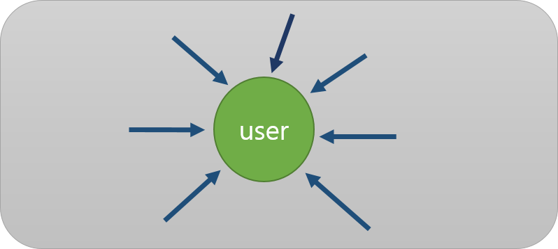
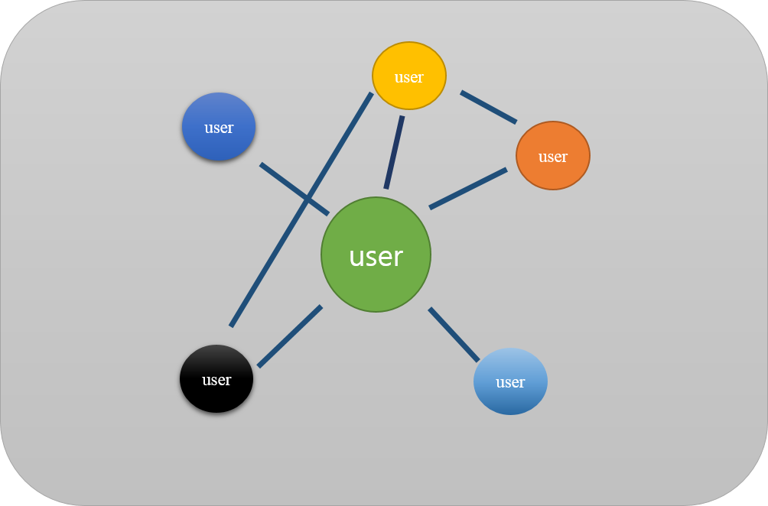
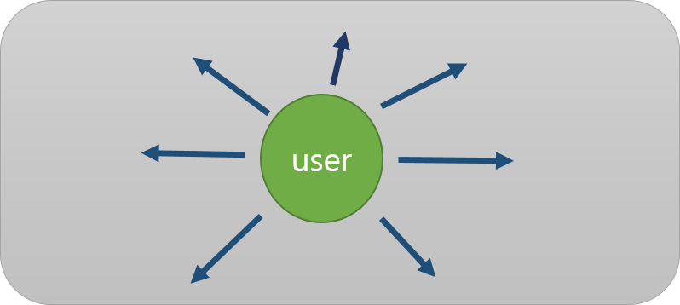
1. Introduction of 3 kinds of sides on user nodes
1. Receive Side Analysis
3. Network Analysis
2. Tansmits Side Analysis

Slide 4
1. Introduction of 3 kinds of sides on user nodes: select Time Horizon (daily, weekly)
Daily => 0:00:00 ~ 23:59:59 (Shortest time horizon )
Weekly => Sunday ~ Saturday
Monthly: => There is no enough data yet.

Slide 5
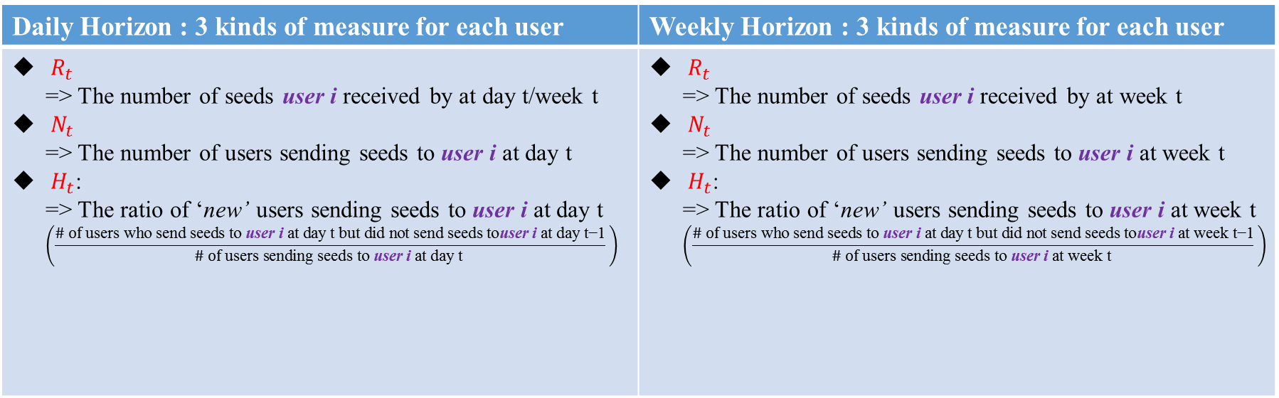
2. Receive Side Measures
Daily Horizon : 3 kinds of measure for each user | Weekly Horizon : 3 kinds of measure for each user
$R_{t}$ => The number of seeds user i received by at day t/week t $N_{t}$ => The number of users sending seeds to user i at day t $H_{t}$: => The ratio of ‘new’ users sending seeds to user i at day t $\left(\frac{\# \text{of} \text{users} \text{who} \text{send} \text{seeds} \text{to} \text{user} \text{i} \text{at} \text{day} \text{t} \text{but} \text{did} \text{not} \text{send} \text{seeds} \text{to}\text{user} \text{i} \text{at} \text{day} \text{t}\text{−1}}{\# \text{of} \text{users} \text{sending} \text{seeds} \text{to} \text{user} \text{i} \text{at} \text{day} \text{t} } \right)$ | $R_{t}$ => The number of seeds user i received by at week t $N_{t}$ => The number of users sending seeds to user i at week t $H_{t}$: => The ratio of ‘new’ users sending seeds to user i at week t $\left(\frac{\# \text{of} \text{users} \text{who} \text{send} \text{seeds} \text{to} \text{user} \text{i} \text{at} \text{day} \text{t} \text{but} \text{did} \text{not} \text{send} \text{seeds} \text{to}\text{user} \text{i} \text{at} \text{week} \text{t}\text{−1}}{\# \text{of} \text{users} \text{sending} \text{seeds} \text{to} \text{user} \text{i} \text{at} \text{week} \text{t} } \right)$
user i

Slide 6
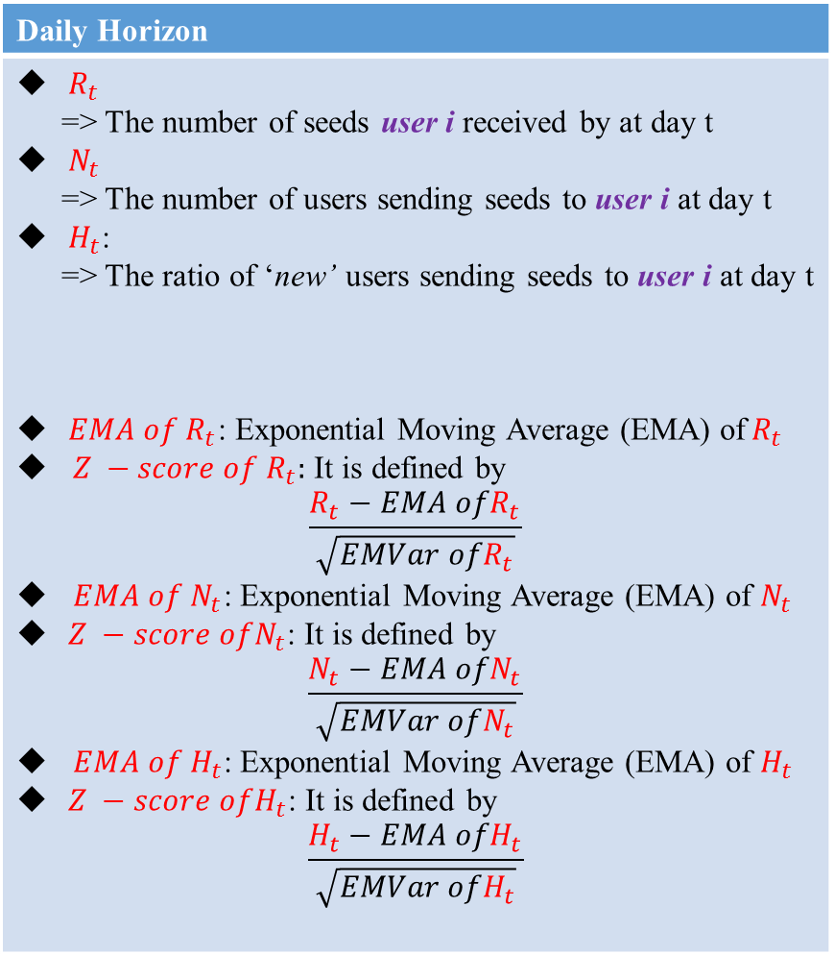
2. Receive Side Measures
Daily Horizon
$R_{t}$ => The number of seeds user i received by at day t $N_{t}$ => The number of users sending seeds to user i at day t $H_{t}$: => The ratio of ‘new’ users sending seeds to user i at day t $EMA of R_{t}$: Exponential Moving Average (EMA) of$R_{t}$ $Z −score of R_{t}:$ It is defined by $\frac{R_{t}−EMA ofR_{t}}{\sqrt{EMVar ofR_{t}}}$ $EMA of N_{t}$: Exponential Moving Average (EMA) of $N_{t}$ $Z −score ofN_{t}$: It is defined by $\frac{N_{t}−EMA ofN_{t}}{\sqrt{EMVar ofN_{t}}}$ $EMA of H_{t}$: Exponential Moving Average (EMA) of $H_{t}$ $Z −score ofH_{t}$: It is defined by $\frac{H_{t}−EMA ofH_{t}}{\sqrt{EMVar ofH_{t}}}$
user i

Slide 7

2. Receive Side Measures
Let, a time series data $x_{1},x_{2},⋯,x_{t},⋯$, The initial values are $EMA_{1}≔x_{1}, EMVar_{1}≔0$, and we then compute the subsequent values using following recursive fomular,
$$\begin{matrix}δ_{i} & = & x_{i}−EMA_{i−1} \\ EMA_{i} & = & EMV_{i−1}+α⋅δ_{i} \\ EMVar_{i} & = & \left(1−α\right)⋅(EMVar_{i−1}+α⋅δ_{i}^{2})\end{matrix}$$
Then, $Z_{t}$, is defined by
$$Z_{t}≔(x_{t}−EMA_{t−1})/\sqrt{EMVar_{t−1}}$$

Slide 8
3. Conditional Quantile Analysis on survival time. (w.r.t number of seeds)
ex) 99% Quantile on survival time 10 days:
=> 가입 후 10 일이 지난 user 들 중 상위 99% 의 유저가 받은 seed 의 개수
Conditional Quantile (w.r.t number of seeds) Analysis 를 통하여 가입 후 시간이 지남에 따라 User가 받는 씨앗의 분포가 어떠한 형태를 향해 가는 지 파악 할 수 있다.

Slide 9
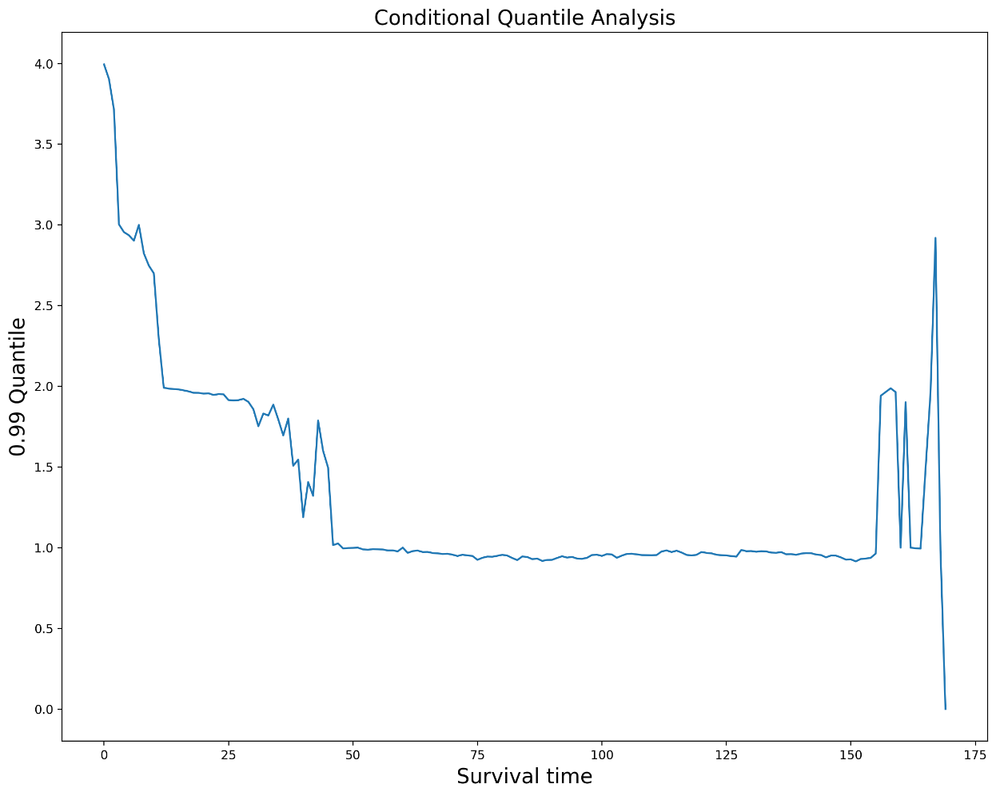
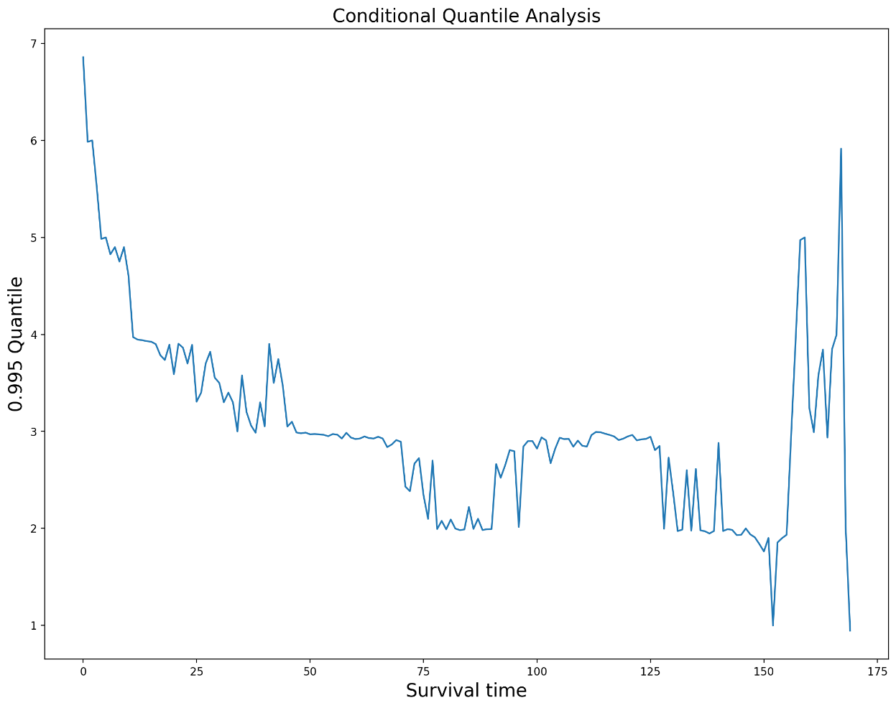
Daily Horizon

Slide 10
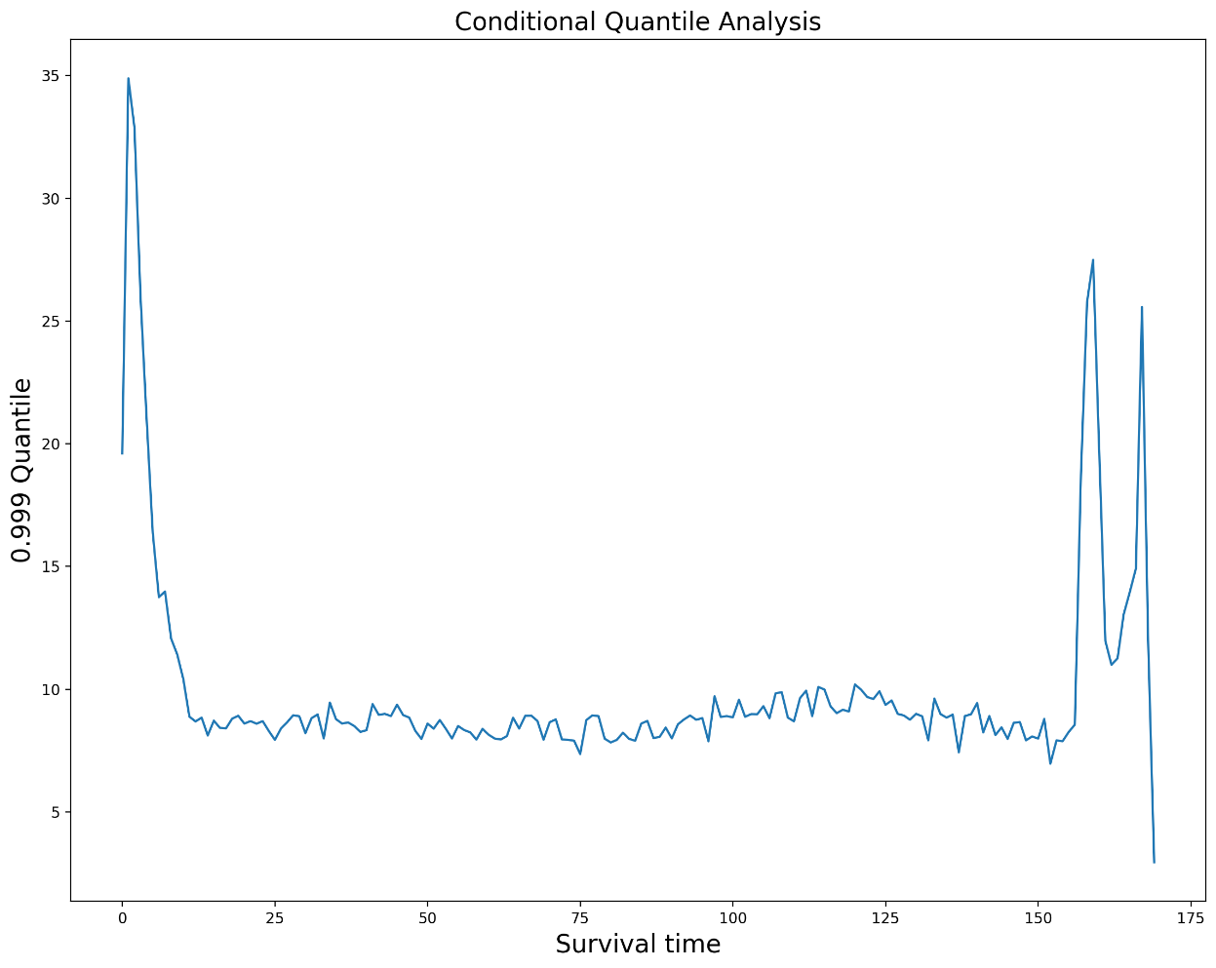
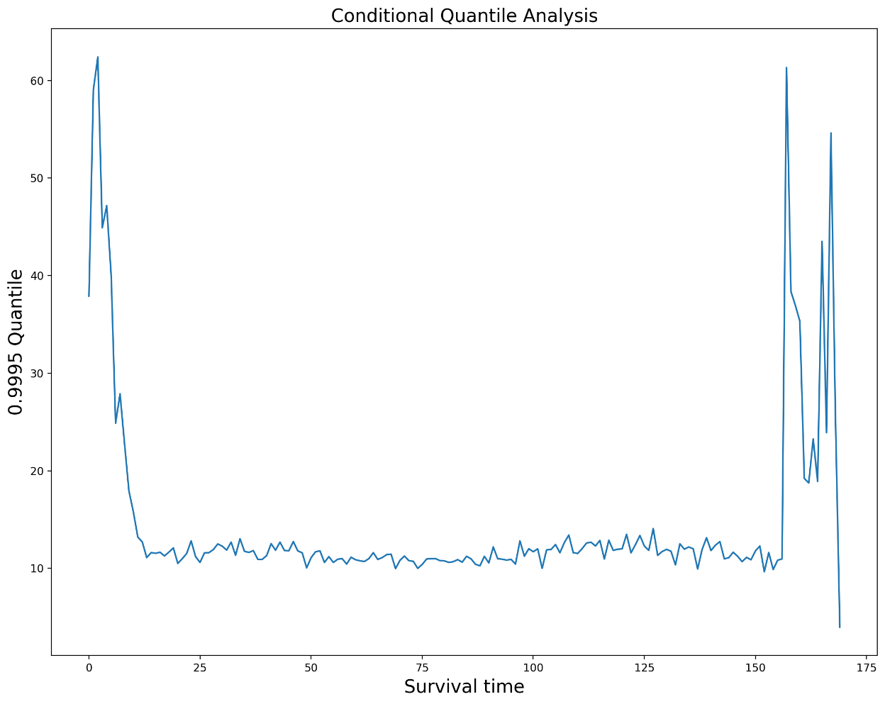
Daily Horizon

Slide 11
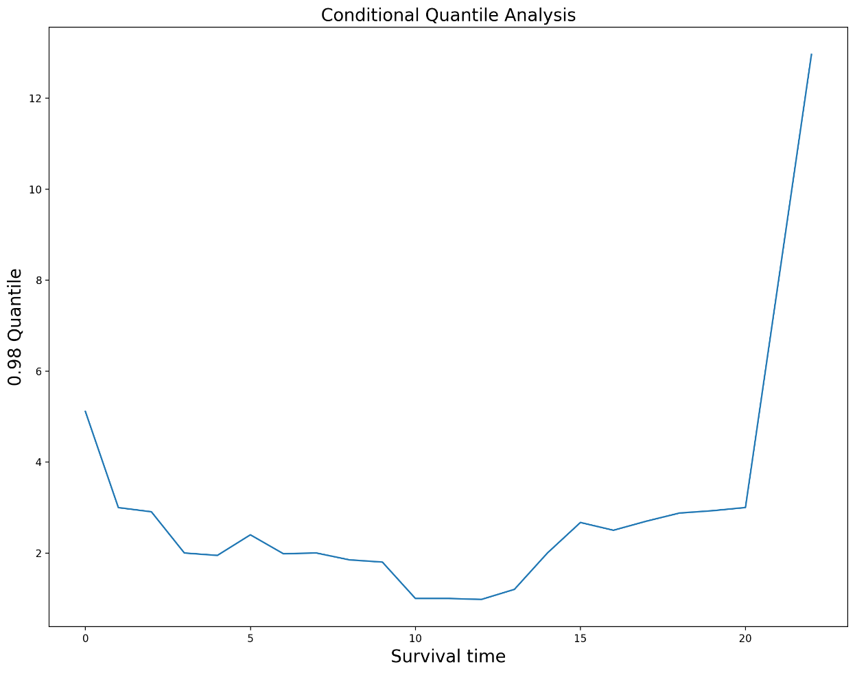
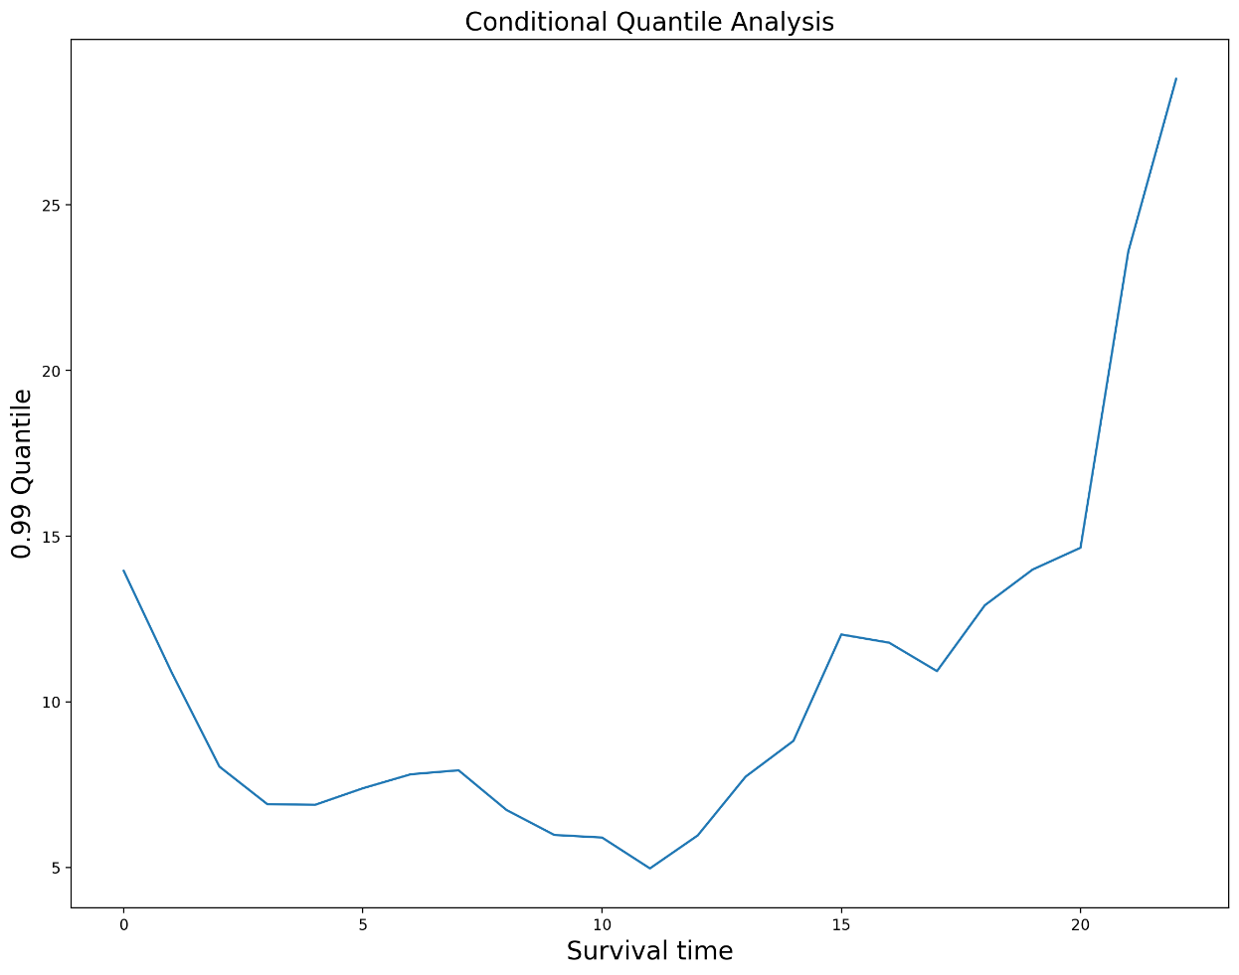
Daily Horizon

Slide 12
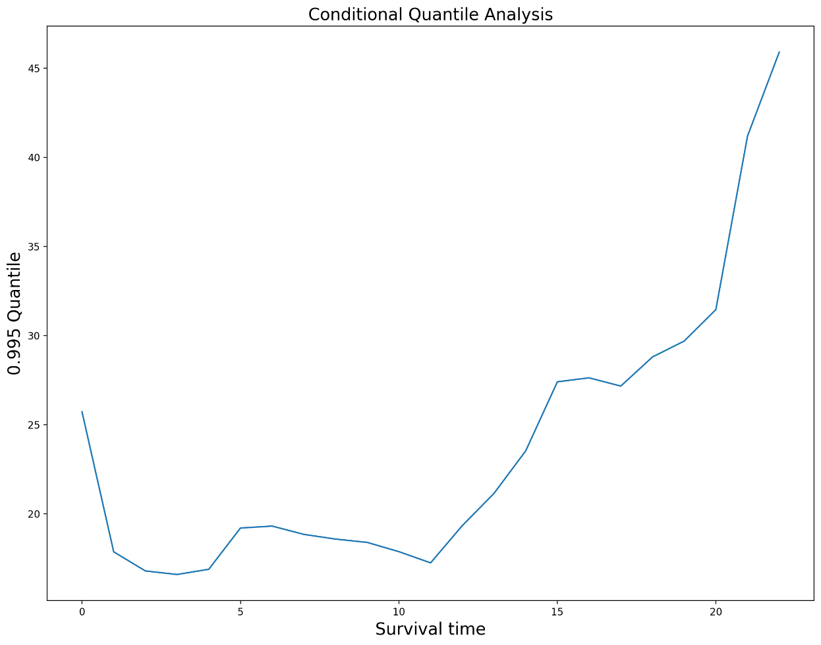
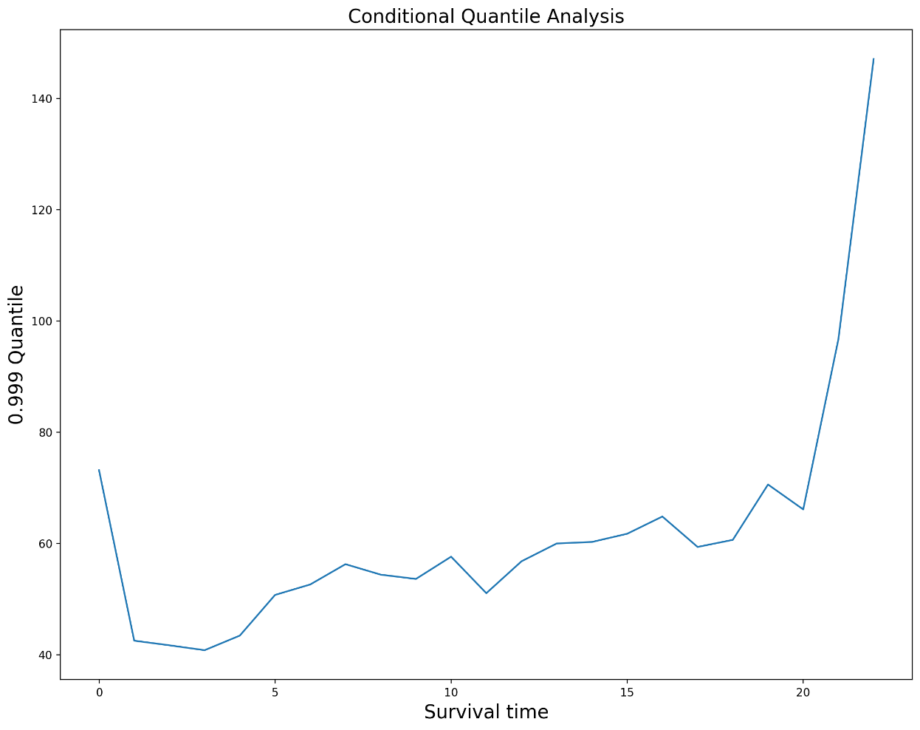
Daily Horizon

Slide 13
Thank you

