Slide 1
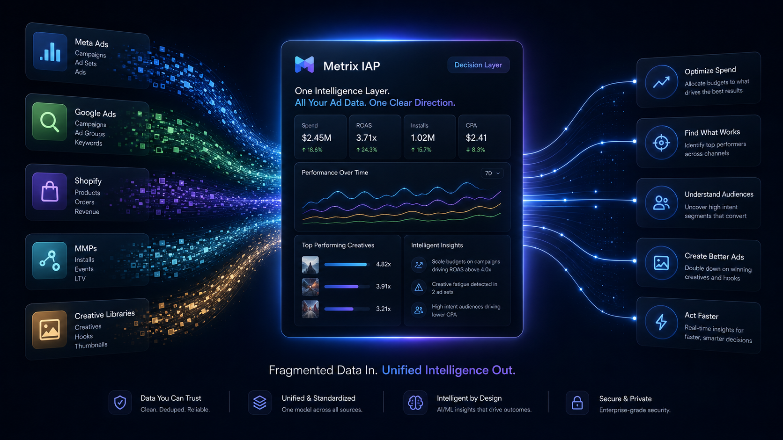
METRIX IAP
YouTube Brief + Screenshot References
Source deck for NotebookLM. Built to create a high-conviction video for media buyers, strategists, and agency operators.
MEDIA BUYERS
STRATEGISTS
AGENCY OPERATORS
Position Metrix as the missing layer between ad data, creative strategy, and execution.
METRIX IAP // NOTEBOOKLM SOURCE DECK
01

Slide 2
CORE STORY
Not more data. Better decisions.
Metrix translates fragmented performance data into insight, action, strategy, and briefs.
PROBLEM
The numbers explain what happened.
Media buyers still have to manually translate campaign metrics into creative cause, budget action, and next tests.
GAP
Creative signal is buried.
Winning hooks, offers, formats, audience intent, and funnel stage rarely live in one operator-readable view.
METRIX
Decision first, data second.
The user sees the Priority Read first, then the evidence underneath. Data validates the read instead of forcing interpretation.
OUTCOME
Faster learning loops.
Scale, hold, kill, rebuild, and brief the next creative sprint with less manual interpretation.
Video thesis
The teams that win on paid social are not guessing faster. They are learning faster. Metrix makes the learning loop operational.
METRIX IAP // NOTEBOOKLM SOURCE DECK
02

Slide 3
RECOMMENDED VIDEO STRUCTURE
8-10 minute YouTube narrative
Keep it sharp: each beat should make the viewer smarter or more convicted.
0:00
Hook
Most accounts do not have a data problem. They have a translation problem.
0:30
Problem
Winners are visible, but causal creative variables are not.
1:30
Reveal
Metrix sits above ad platforms and turns signals into decisions.
3:00
Demo
Command Center → Creative Signal → Sprint Matrix → Brief Generator.
5:30
Buyer value
Scale what works. Kill waste. Spot risk. Validate faster.
7:00
Strategist value
Convert data into roadmap, brief, and production direction.
8:30
Close
Learning velocity is the advantage. Metrix operationalizes it.
Strongest opening line
“You can see which ad won. But can you explain why it won well enough to brief the next five creatives?”
METRIX IAP // NOTEBOOKLM SOURCE DECK
03

Slide 4
VISUAL REFERENCE 01
Fragmented data in. Unified intelligence out.
Use this as the macro product mental model.
NotebookLM visual read
1. Show ad platforms, ecommerce data, MMPs, and creative libraries flowing into Metrix.
2. Make the output feel practical: spend optimization, creative direction, audience clarity, action speed.
3. Voiceover should frame Metrix as a layer above the tools, not a replacement for them.
Use this frame to guide the video edit: slow zoom, cursor highlight, one decisive voiceover point per screen.
REFERENCE MOCKUP: replace with live Metrix UI screenshot before final public upload.
METRIX IAP // NOTEBOOKLM SOURCE DECK
04

Slide 5
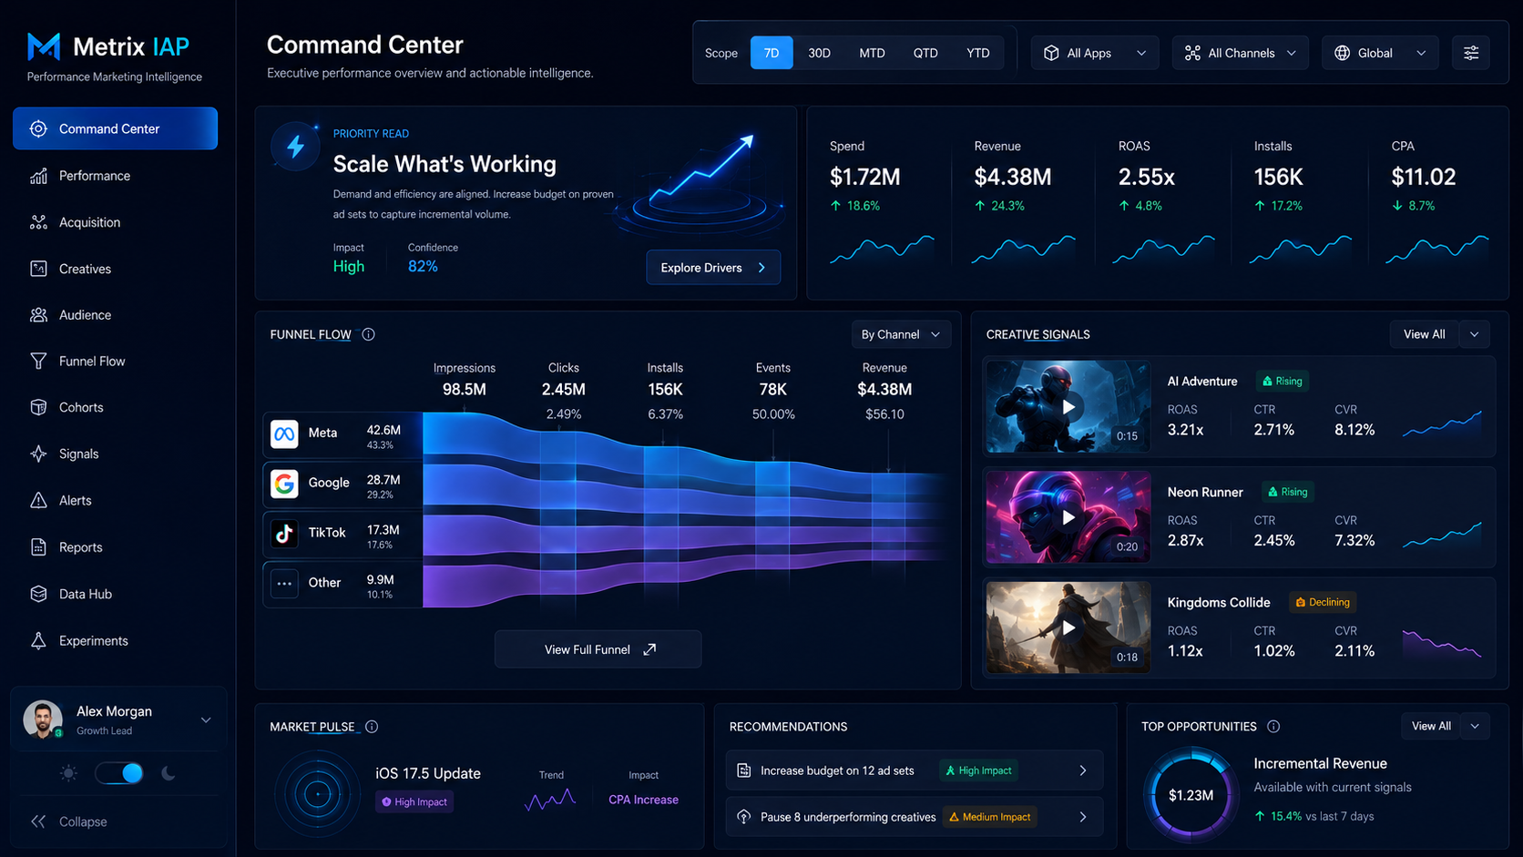
VISUAL REFERENCE 02
Command Center: decision-first read.
This is the fastest “aha” screen for the viewer.
NotebookLM visual read
1. Start with Priority Read before showing KPIs.
2. Use the KPI strip as evidence, not the main story.
3. Narrate what the buyer should do next, not just what the dashboard shows.
Use this frame to guide the video edit: slow zoom, cursor highlight, one decisive voiceover point per screen.
REFERENCE MOCKUP: replace with live Metrix UI screenshot before final public upload.
METRIX IAP // NOTEBOOKLM SOURCE DECK
05

Slide 6
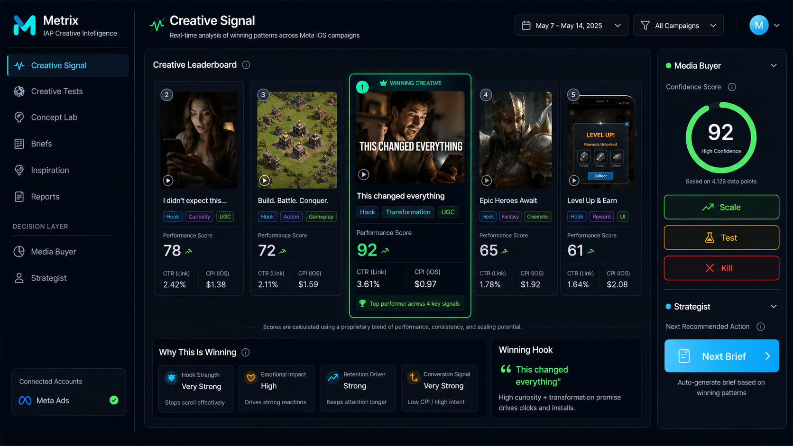
VISUAL REFERENCE 03
Creative Signal: why the winner is winning.
Make the creative intelligence value obvious.
NotebookLM visual read
1. Show the winning creative and its score.
2. Call out hook, transformation, UGC, format, emotional impact, and conversion signal.
3. Use the right panel to show the two audiences: media buyer action and strategist next brief.
Use this frame to guide the video edit: slow zoom, cursor highlight, one decisive voiceover point per screen.
REFERENCE MOCKUP: replace with live Metrix UI screenshot before final public upload.
METRIX IAP // NOTEBOOKLM SOURCE DECK
06

Slide 7
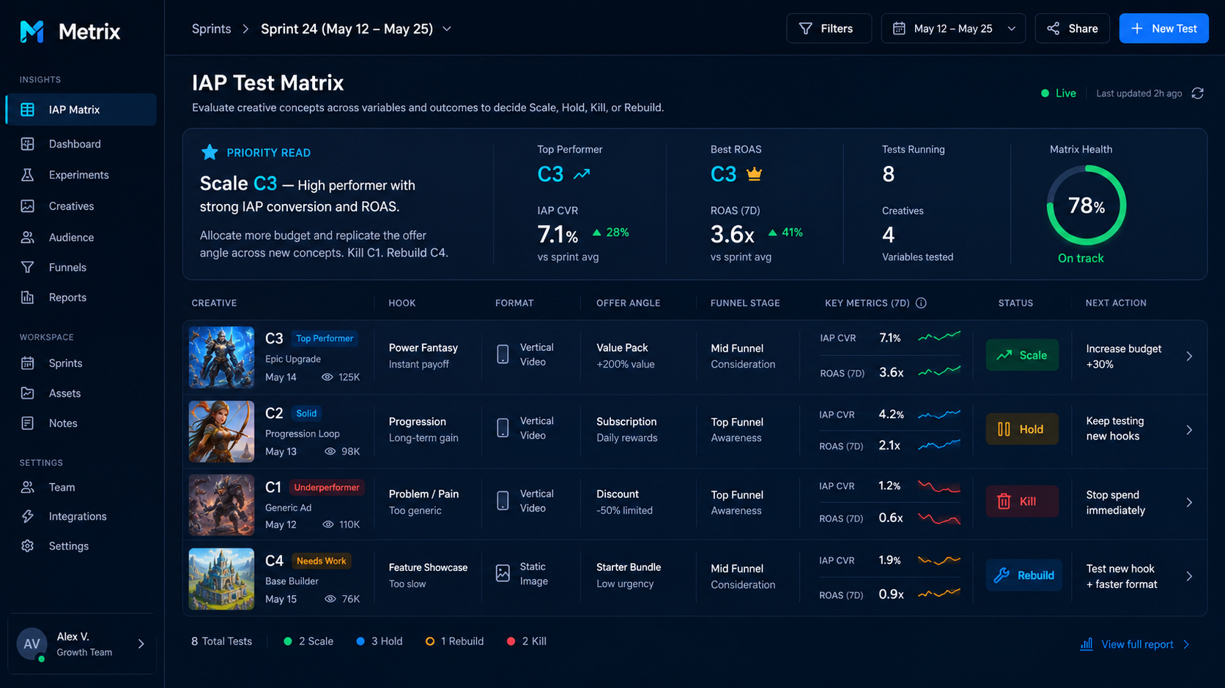
VISUAL REFERENCE 04
IAP Sprint Matrix: scale, hold, kill, rebuild.
This is the execution layer for testing cadence.
NotebookLM visual read
1. Frame the matrix as a sprint operating system.
2. Explain that every concept has a status and next action.
3. Use this moment to connect creative testing to budget allocation.
Use this frame to guide the video edit: slow zoom, cursor highlight, one decisive voiceover point per screen.
REFERENCE MOCKUP: replace with live Metrix UI screenshot before final public upload.
METRIX IAP // NOTEBOOKLM SOURCE DECK
07

Slide 8
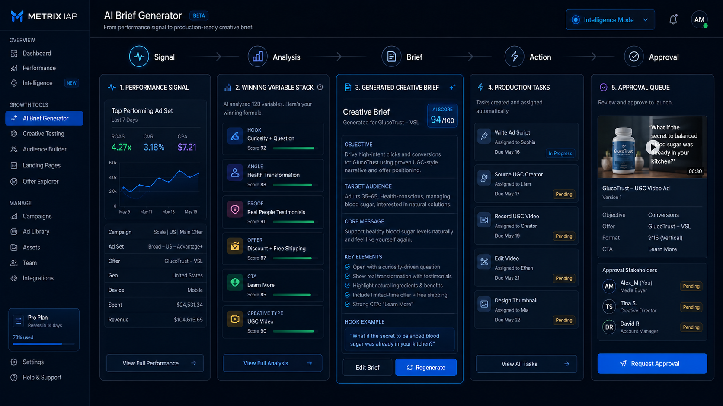
VISUAL REFERENCE 05
AI Brief Generator: signal becomes production.
This closes the loop from insight to asset creation.
NotebookLM visual read
1. Show the path: signal → analysis → brief → action → approval.
2. Emphasize production-ready direction based on real account signal.
3. Avoid over-selling AI. The real value is reducing translation friction.
Use this frame to guide the video edit: slow zoom, cursor highlight, one decisive voiceover point per screen.
REFERENCE MOCKUP: replace with live Metrix UI screenshot before final public upload.
METRIX IAP // NOTEBOOKLM SOURCE DECK
08

Slide 9
SHOT-BY-SHOT DIRECTION
How NotebookLM should build the video
Use screenshot beats as visual anchors and narration as the strategic layer.
01
Cold open
02
Pain proof
03
Product reveal
04
Decision layer
Dark product montage + line: “your creative data has been lying to you.”
Zoom on scattered metrics. Explain what data cannot answer alone.
Show Metrix as the intelligence layer above fragmented sources.
Command Center. Show “what matters” before dense dashboards.
05
Creative causality
06
Testing cadence
07
Brief output
08
Close
Creative Signal. Explain variable stack and next creative implication.
Sprint Matrix. Translate concepts into scale/hold/kill/rebuild actions.
AI Brief Generator. Move from signal to production-ready tasks.
Learning loop thesis + CTA for early access/walkthrough.
Editing note: make every screenshot feel alive with crop zooms, callout highlights, mouse movement, and clean pauses. Do not over-animate.
METRIX IAP // NOTEBOOKLM SOURCE DECK
09

Slide 10
NOTEBOOKLM INPUT PROMPT
Paste this instruction with the deck + brief
Use it to force a strategic, high-conviction output rather than a generic SaaS explainer.
Use the attached Metrix IAP brief and screenshot deck to create an 8-10 minute YouTube video script and visual outline for experienced media buyers, strategists, and agency operators. The video should create conviction by explaining the pain of fragmented ad data, the gap between performance metrics and creative decision-making, and how Metrix turns raw data into insight, action, strategy, and creative briefs. Keep the tone direct, operator-grade, and premium. Avoid exaggerated claims. Treat screenshot metrics as example data unless marked verified. Output: script, shot list, chapters, title options, description, thumbnail concepts, and CTA options.
Source pack
Guardrails
1. Brief DOCX/PDF
2. Screenshot reference deck
3. Any real product screenshots
4. Verified case data or metrics
5. Brand/logo assets
Do not call Metrix a reporting dashboard. Do not imply automatic gains without verified proof. Do not make it beginner-level Meta Ads education. The strongest frame is creative intelligence as a decision operating system.
METRIX IAP // NOTEBOOKLM SOURCE DECK
10

