Slide 1
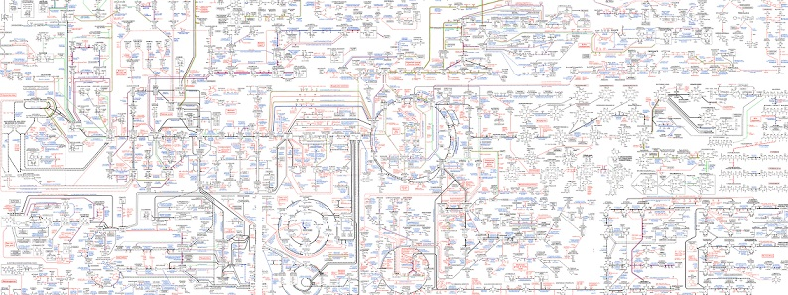

MetaMolEs

Slide 2
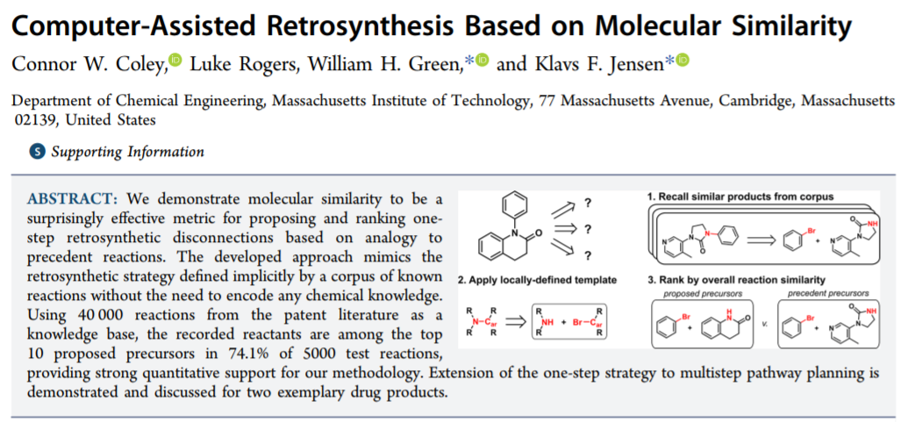
CAD tools exist to retrosynthesize complex chemicals
Notes:
Pre-defined libraries of catalysts, reactants and products

Slide 3
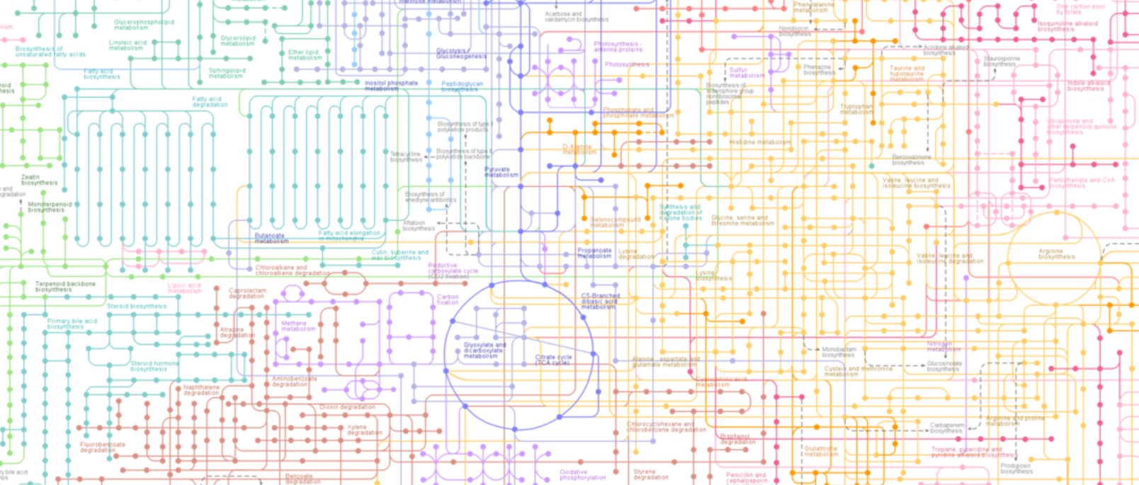
Chemical reactions in metabolism are nearly entirely catalyzed by enzymes

Slide 4
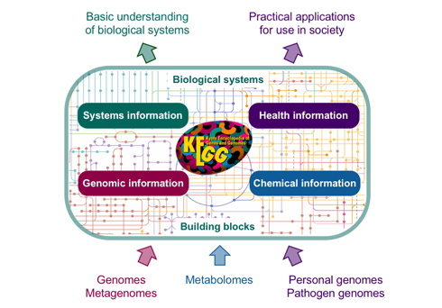
Databases of enzyme-catalyzed reactions exist

Slide 5
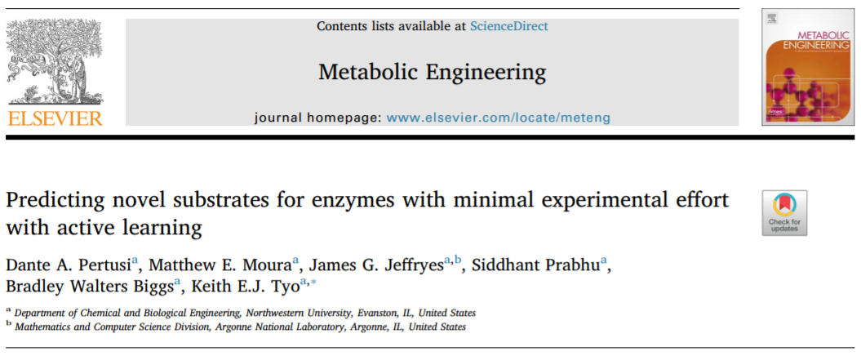
Enzymes are often able to catalyze “promiscuous” chemical transformations

Slide 6
“A month in the laboratory can often save an hour in the library.”
- Frank Henry Westheimer

