Slide 1
인공지능 반도체
PROJECT2
Pattern Classification DNN hardware design
Team 3
2017103780 권용환
2017103935 최지훈
2019103877 이규린

Slide 2
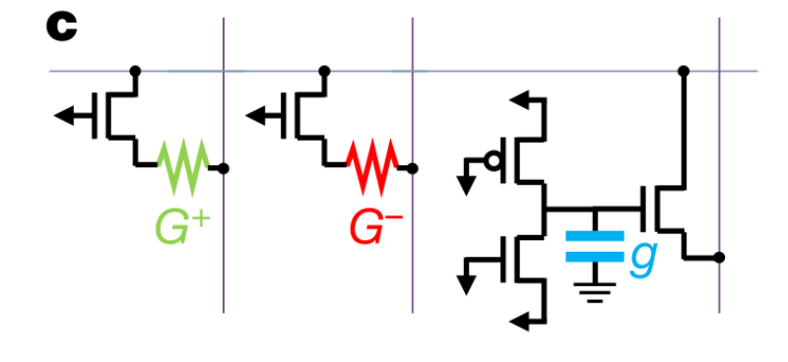
RRAM_cell
Icp include G+, G-, g

Slide 3
RRAM_cell
al
bl
bl_u
sl
al_u
wl
cell
i_delta1
wl
sl
i_delta2
Icp_out =
V(sl)×Icp
o_delta
Icp
bl_d
Dback
al_d
V(al_u)+
Icp_out
Icp = Icp – lr × (i_delta1+i_delta2) × V(sl)

Slide 4
RRAM_sigconv
//wl
if (Dwl) V(wl) <+ vdd;
else V(wl) <+ 0;
//sl
if (Dsl) V(sl) <+ vdd;
else V(sl) <+ 0;
//bl
if (Dset)
if (Dbl) V(bl) <+ 2*vdd;
else V(bl) <+ 0;
else
if (Dbl) V(bl) <+ vdd;
else V(bl) <+ 0;
wl[3:0]
sl[3:0]
al[3:0]
bl[3:0]
Dwl[3:0]
sigconv
Dsl[3:0]
Dbl[3:0]
Dset
sum[3:0]
//al (sigmoid)
V(sum) <+
1
;
1 + exp( -1 * V(al) )

Slide 5
Feedforward
sl[5]
sum5
sum3
sum1
sl[4]
sum4
sum2
al_u
al_u
al_u
al_u
al_u
wl[5]
L1_11
o_delta[3]
wl[4]
L1_12
o_delta[1]
wl[3]
L2_11
o_delta[5]
wl[2]
L2_12
o_delta[4]
wl[1]
L3_11
error
sl[5]
o_delta[2]
sl[5]
o_delta[0]
sum5
i_delta
sum5
i_delta
sum3
i_delta
o_delta[3]
o_delta[1]
o_delta[5]
al_d[5]
bl_d[5]
al_d[4]
bl_d[4]
al_d[3]
bl_d[3]
al_d[2]
bl_d[2]
al_d1]
bl_d[1]
wl[5]
L1_21
o_delta[3]
wl[4]
L1_22
o_delta[1]
wl[3]
L2_21
o_delta[5]
wl[2]
L2_22
o_delta[4]
wl[1]
L3_21
error
sl[4]
o_delta[2]
sl[4]
o_delta[0]
sum4
i_delta
sum4
i_delta
sum2
i_delta
o_delta[1]
o_delta[0]
o_delta[4]
al[5]
bl[5]
al[4]
bl[4]
al[3]
bl[3]
al[2]
bl[2]
al[1]
bl[1]
L1_sig
L2_sig
L3_sig
sum5
sum4
sum3
sum2
sum1

Slide 6
Feedforward
sl[5]
al_d[5]
al[5]
sum5
sum3
L1_21
Icp_out
sum1
sl[4]
sum4
sum2
al_u
al_u
al_u
al_u
al_u
wl[5]
L1_11
o_delta[3]
wl[4]
L1_12
o_delta[1]
wl[3]
L2_11
o_delta[5]
wl[2]
L2_12
o_delta[4]
wl[1]
L3_11
error
sl[5]
o_delta[2]
sl[5]
o_delta[0]
sum5
i_delta
sum5
i_delta
sum3
i_delta
o_delta[3]
o_delta[1]
o_delta[5]
al_d[5]
bl_d[5]
al_d[4]
bl_d[4]
al_d[3]
bl_d[3]
al_d[2]
bl_d[2]
al_d1]
bl_d[1]
wl[5]
L1_21
o_delta[3]
wl[4]
L1_22
o_delta[1]
wl[3]
L2_21
o_delta[5]
wl[2]
L2_22
o_delta[4]
wl[1]
L3_21
error
sl[4]
o_delta[2]
sl[4]
o_delta[0]
sum4
i_delta
sum4
i_delta
sum2
i_delta
o_delta[1]
o_delta[0]
o_delta[4]
al[5]
bl[5]
al[4]
bl[4]
al[3]
bl[3]
al[2]
bl[2]
al[1]
bl[1]
L1_sig
L2_sig
L3_sig
sum5
sum4
sum3
sum2
sum1

Slide 7

Backpropagation
wnew = wold + △weight
△weight = lr × $δ$ × input
error = sum - label
sl[5]
sum5
sum3
sum1
Label
sl[4]
sum4
sum2
al_u
al_u
al_u
al_u
al_u
wl[5]
L1_11
o_delta[3]
wl[4]
L1_12
o_delta[1]
wl[3]
L2_11
o_delta[5]
wl[2]
L2_12
o_delta[4]
wl[1]
L3_11
error
sl[5]
o_delta[2]
sl[5]
o_delta[0]
sum5
i_delta
sum5
i_delta
sum3
i_delta
o_delta[3]
o_delta[1]
o_delta[5]
al_d[5]
bl_d[5]
al_d[4]
bl_d[4]
al_d[3]
bl_d[3]
al_d[2]
bl_d[2]
al_d1]
bl_d[1]
wl[5]
L1_21
o_delta[3]
wl[4]
L1_22
o_delta[1]
wl[3]
L2_21
o_delta[5]
wl[2]
L2_22
o_delta[4]
wl[1]
L3_21
error
sl[4]
o_delta[2]
sl[4]
o_delta[0]
sum4
i_delta
sum4
i_delta
sum2
i_delta
o_delta[1]
o_delta[0]
o_delta[4]
al[5]
bl[5]
al[4]
bl[4]
al[3]
bl[3]
al[2]
bl[2]
al[1]
bl[1]
L1_sig
L2_sig
L3_sig
sum5
sum4
sum3
sum2
sum1

Slide 8
Backpropagation
wnew = wold + △weight
△weight = lr × $δ$ × input
error = sum - label
sl[5]
sum5
sum3
sum1
Label
sl[4]
sum4
sum2
△weight = lr × (error+i_delta) × sum3
o_delta[5] = (error+i_delta)
al_u
al_u
al_u
al_u
al_u
wl[5]
L1_11
o_delta[3]
wl[4]
L1_12
o_delta[1]
wl[3]
L2_11
o_delta[5]
wl[2]
L2_12
o_delta[4]
wl[1]
L3_11
error
sl[5]
o_delta[2]
sl[5]
o_delta[0]
sum5
i_delta
sum5
i_delta
sum3
i_delta
o_delta[3]
o_delta[1]
o_delta[5]
al_d[5]
bl_d[5]
al_d[4]
bl_d[4]
al_d[3]
bl_d[3]
al_d[2]
bl_d[2]
al_d1]
bl_d[1]
wl[5]
L1_21
o_delta[3]
wl[4]
L1_22
o_delta[1]
wl[3]
L2_21
o_delta[5]
wl[2]
L2_22
o_delta[4]
wl[1]
L3_21
error
sl[4]
o_delta[2]
sl[4]
o_delta[0]
sum4
i_delta
sum4
i_delta
sum2
i_delta
o_delta[1]
o_delta[0]
o_delta[4]
al[5]
bl[5]
al[4]
bl[4]
al[3]
bl[3]
al[2]
bl[2]
al[1]
bl[1]
L1_sig
L2_sig
L3_sig
sum5
sum4
sum3
sum2
sum1

Slide 9
Backpropagation
wnew = wold + △weight
△weight = lr × $δ$ × input
error = sum - label
△weight = lr × (o_delta[5] +i_delta) × sum3
o_delta[3] = (o_delta[5] +i_delta)
sum1
Label
al_u
al_u
al_u
al_u
al_u
wl[5]
L1_11
o_delta[3]
wl[4]
L1_12
o_delta[1]
wl[3]
L2_11
o_delta[5]
wl[2]
L2_12
o_delta[4]
wl[1]
L3_11
error
sl[5]
o_delta[2]
sl[5]
o_delta[0]
sum5
i_delta
sum5
i_delta
sum3
i_delta
o_delta[3]
o_delta[1]
o_delta[5]
al_d[5]
bl_d[5]
al_d[4]
bl_d[4]
al_d[3]
bl_d[3]
al_d[2]
bl_d[2]
al_d1]
bl_d[1]
wl[5]
L1_21
o_delta[3]
wl[4]
L1_22
o_delta[1]
wl[3]
L2_21
o_delta[5]
wl[2]
L2_22
o_delta[4]
wl[1]
L3_21
error
sl[4]
o_delta[2]
sl[4]
o_delta[0]
sum4
i_delta
sum4
i_delta
sum2
i_delta
o_delta[1]
o_delta[0]
o_delta[4]
al[5]
bl[5]
al[4]
bl[4]
al[3]
bl[3]
al[2]
bl[2]
al[1]
bl[1]
L1_sig
L2_sig
L3_sig
sum5
sum4
sum3
sum2
sum1

Slide 10
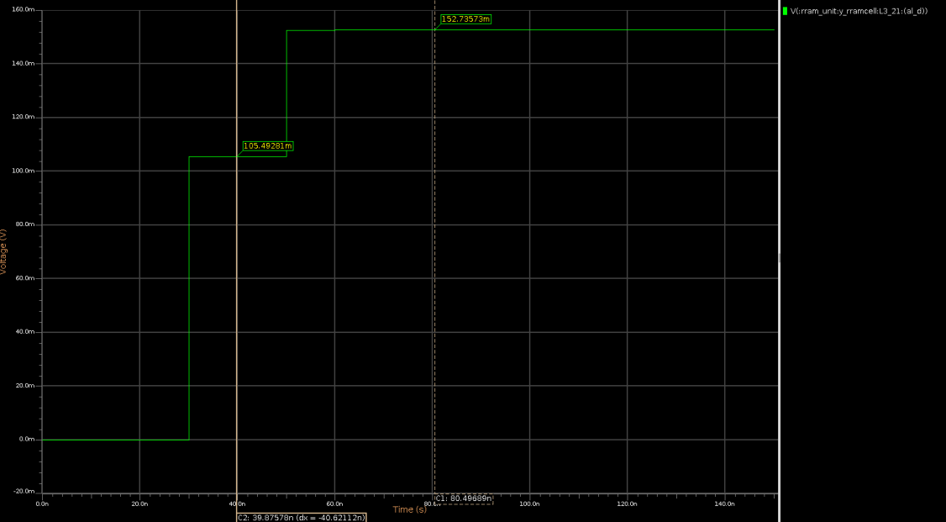
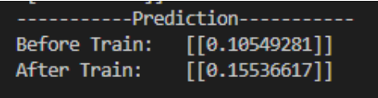
Python result & veriloga result

Slide 11
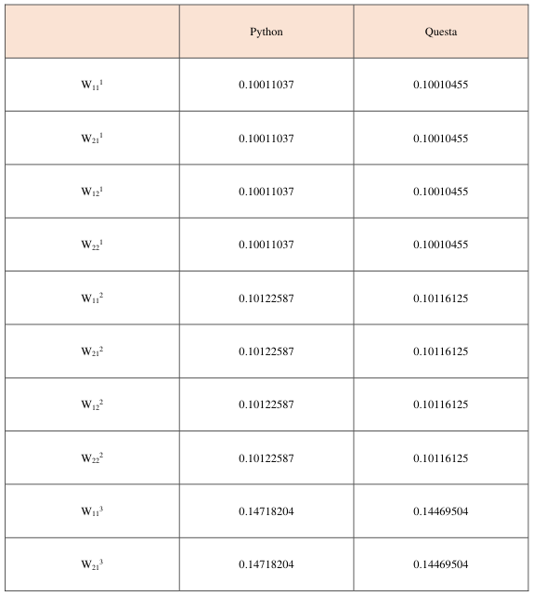
Python result & veriloga result

Slide 12
Application
“Direction detector”
Label |  | Label
000 |  | 100
001 |  | 101
010 |  | 110
011 |  | 111
0
0
0
1
0
0
1
0
0
1
1
0
0
0
0
0
1
0
0
0
0
0
1
0
0
1
0
1
1
1
0
0
1
1
1
0
0
1
1
1
0
0
1
1
0
1
1
1
1
1
1
0
1
0
0
1
1
1
1
0
0
1
1
1

Slide 13
Application
0
0
0
0
0
0
1
0
1
1
0

Slide 14
Application
L1_11
L1_12
L1_13
L1_14
L2_11
L2_12
L2_13
L2_14
L3_11
L3_12
L3_13
L1_21
L1_22
L1_23
L1_24
L2_21
L2_22
L2_23
L2_24
L3_21
L3_22
L3_23
L1_31
L1_32
L1_33
L1_34
L2_31
L2_32
L2_33
L2_34
L3_31
L3_32
L3_33
L1_41
L1_42
L1_43
L1_44
L2_41
L2_42
L2_43
L2_44
L3_41
L3_42
L3_43
L1_sig
L2_sig
L3_sig

Slide 15
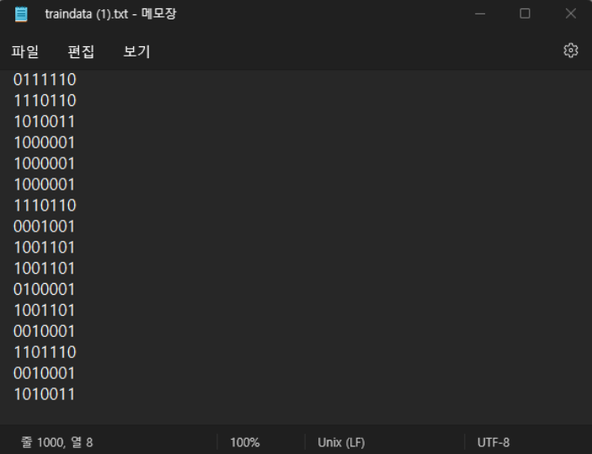
Application / Python result & veriloga result
Random Data Set

Slide 16
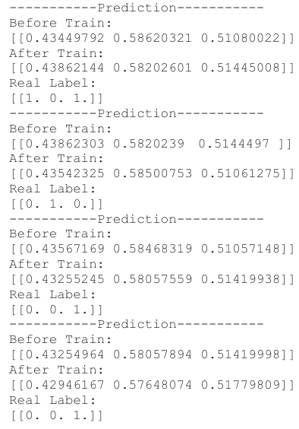
Application / Python result & veriloga result

Slide 17
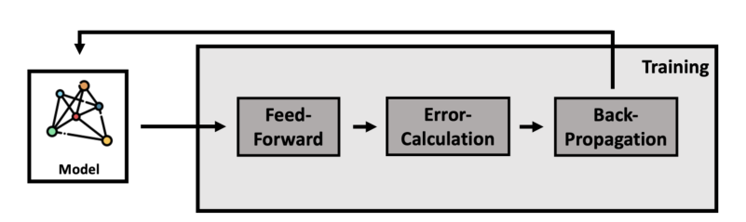
Application / Python result & veriloga result

Slide 18
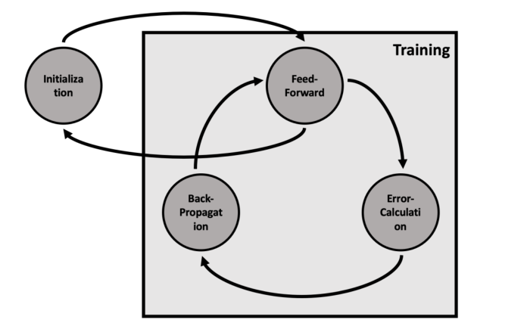
Application / Python result & veriloga result

Slide 19
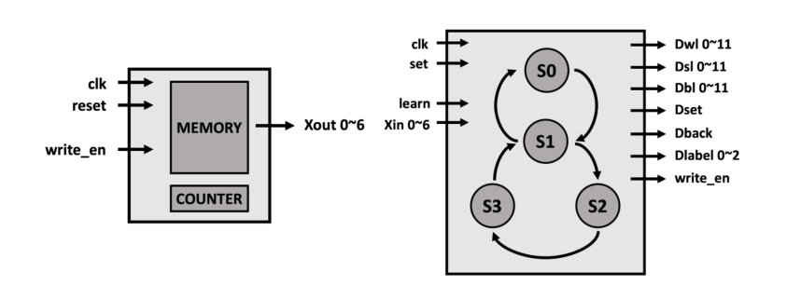
Application / Python result & veriloga result

Slide 20
Application / Python result & veriloga result

Slide 21
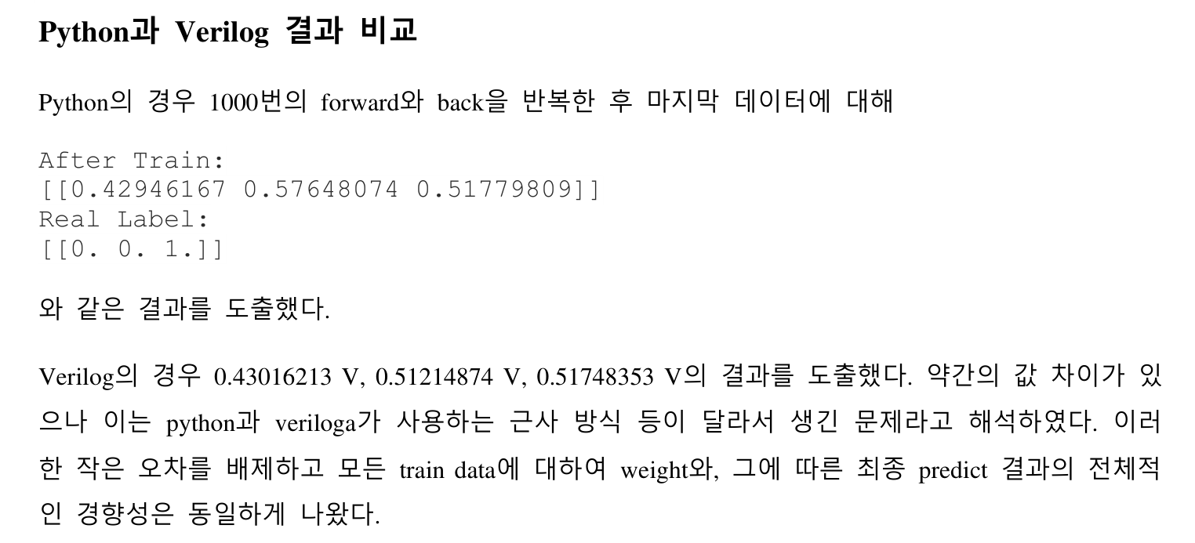
Application / Python result & veriloga result

Slide 22
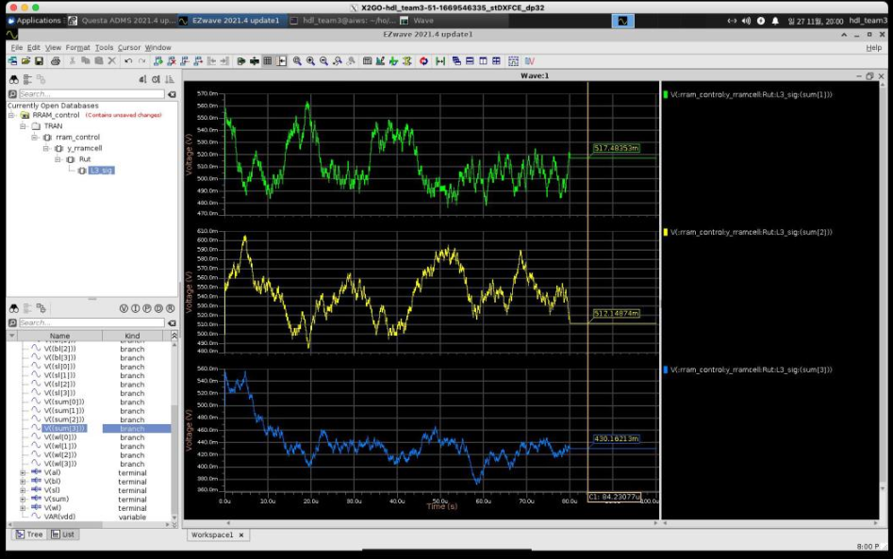
Application / Python result & veriloga result

Slide 23
Thank You

