Slide 1
PROJECT3:
Event-driven Asynchronous Communication using Mesh Architecture
Team2
Do Quang Huy 강덕현 권용환

Slide 2
Index
1. Purposed Architecture
2. Result
3. Conclusion

Slide 3
Purposed Architecture
-Core
-Channel
-Allocator
-Random pulse generator

Slide 4

CORE - architecture
empty
Local channel
Local channel
North channel
North channel
East channel
Allocator
East channel
South channel
South channel
West channel
request
West channel

Slide 5


CORE – grant & fill
fill
Local channel
Local channel
grant
North channel
North channel
East channel
Allocator
East channel
South channel
South channel
West channel
West channel

Slide 6
CORE – inside, outside channel
Local channel
In core
Local channel
North channel
North channel
East channel
Allocator
East channel
South channel
South channel
West channel
West channel
Adjacent core

Slide 7
Channel
empty
request
XNOR
XOR
fill
grant
D
Q1
Q2
D
data stream
data stream
D
Q
Combinational
Logic
D
Q

Slide 8
Channel logic
fill -> grant -> fill -> grant -> …
Q1 | Q2 | Empty | Request
0 | 0 | 1 | 0
1 | 0 | 0 | 1
1 | 1 | 1 | 0
0 | 1 | 0 | 1
Empty and request repeat (1,0) & (0,1)

Slide 9
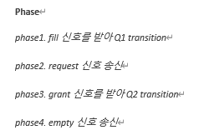
Channel logic

Slide 10
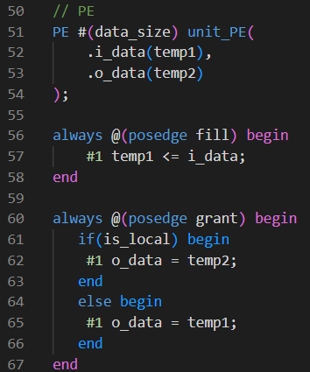
Channel logic
Local channel :
Processing Element embedded

Slide 11
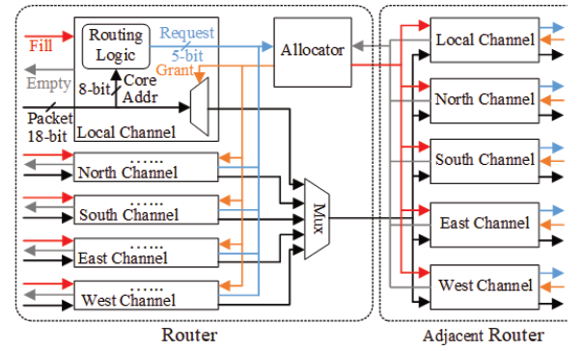
Allocator
How to cope with multiple input and multiple output?

Slide 12
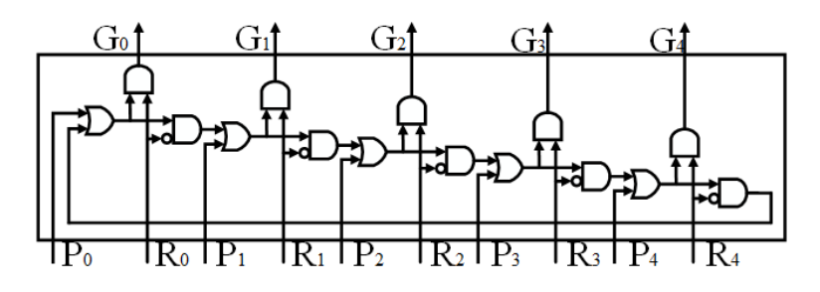
Allocator
G: grant
R: request
P: priority counter

Slide 13
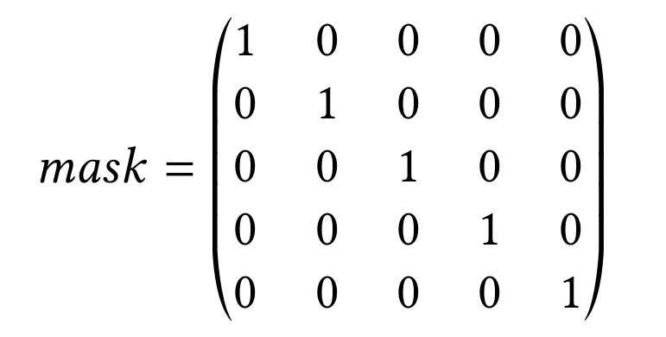

Allocator
LUT
$$grant=mask\left[cnt\right] \& request$$
cnt : 0~4 ring counter

Slide 14
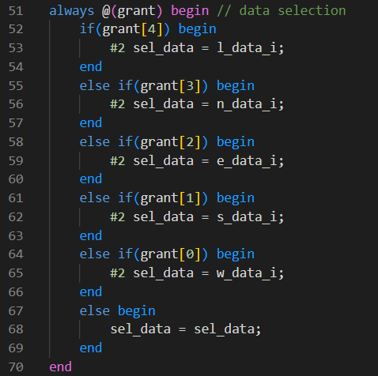
Allocator
Delay #2
Channel’s propagation delay
Priority rotate
select channel’s output according to grant

Slide 15

Allocator
Multicasting to Adjacent empty channel
Allocator Processing Sequence
grant in response to request
Data selection(Multiplexing)
Fill in response to empty

Slide 16
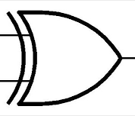
Random pulse generator
D
Q
D
Q
D
Q
D
Q
D
Q
D
Q
D
Q
D
Q
clk
8bit output
Use LFSR for Random pulse generator
-8bit data
-1bit fill

Slide 17
2. Simulation

Slide 18
Simulation
Random Pulse Generator
fill
data
fill : 1bit random signal
Core1
Core2
data : 8bits random signal
Core3
Core4

Slide 19
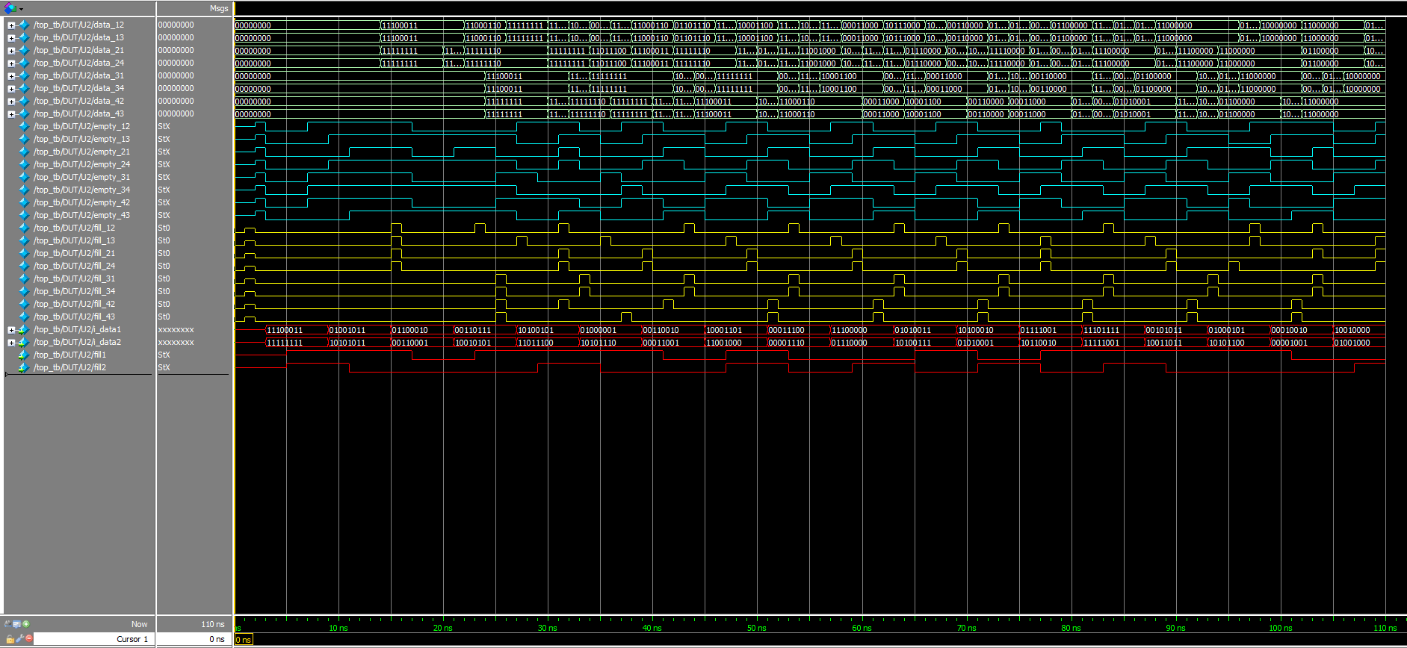
Simulation

Slide 20
Simulation
Irregular fill signal distribution
Irregular empty signal distribution
Irregular data transmission distribution

Slide 21
3. Conclusion

Slide 22
Advantage
Event-driven Asynchronous and Multicasting
could be used for parallel, redundant and concurrent processing.
And it is good for communication system required multiple access
with limited resources.
Also, It has good scalability.
Another option
Router can choose click-base element also for select only one fill signal
In repose to empty signal

Slide 23
Thank you

