Slide 1
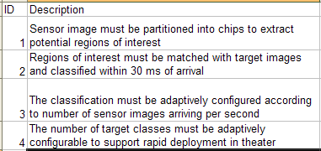
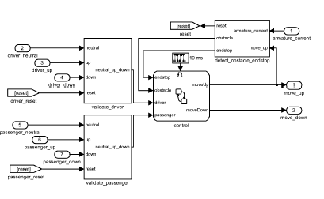
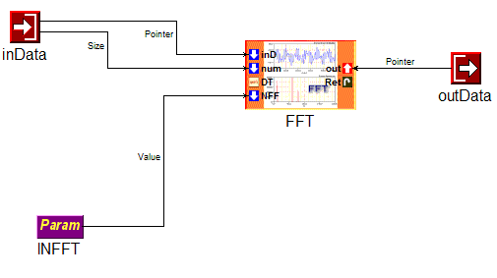
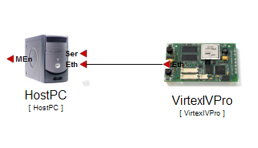
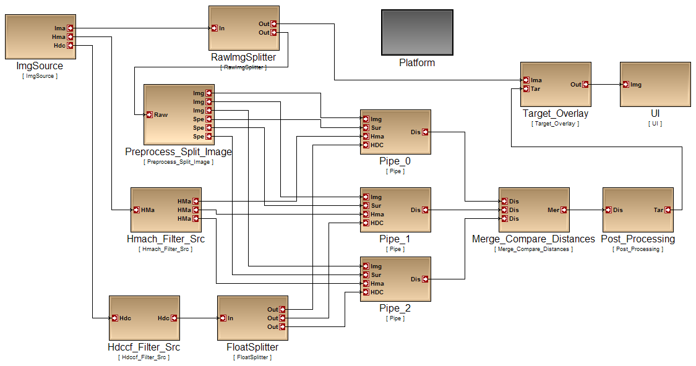
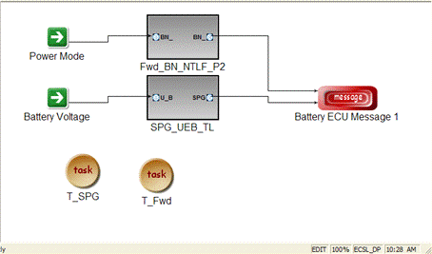
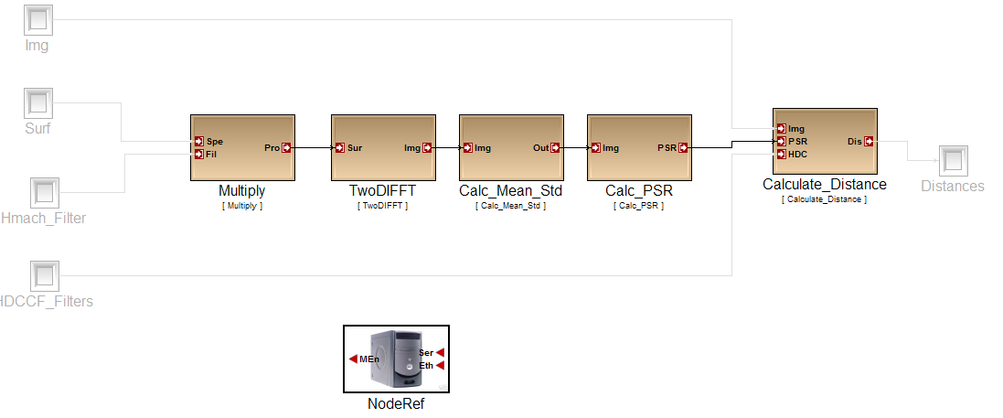
Requirement Specification
RA
Control Design
FD
HwA
Functional
Mod/Sim
Software Architecture
HW Arch. Design
HW Pwr/
Perf Est
SwA
Component Design
System Arch. Design
Arch Mod/Sim
SY
CD
Code Gen.
Verif.
Latency/RT
Analysis
Alloc./Sched.
Analysis
DPL
SW Deployment

