Slide 1
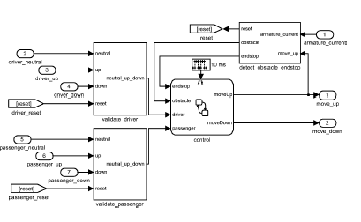
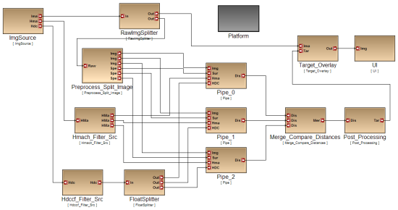
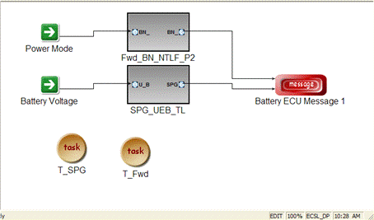
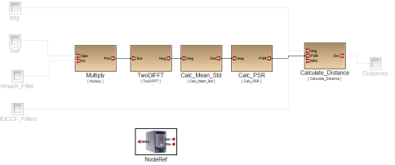
Matlab/Simulink/Stateflow
Functional Design
ECSL Modeling Tool (GME)
Componentization
Software Architecture
CSP-based Scheduler
Resource allocation
(Scheduling)
Allocation and Deployment
Time-Triggered Formal Model
Time-Triggered Platforms
DEVS++
Simulation
Execution
Platform

Slide 2
