Slide 1



Automated Synthesis of Time-Triggered Architecture-based TrueTime Models for Platform Effects Simulation and Analysis
Graham Hemingway, Joseph Porter, Nicholas Kottenstette, Harmon Nine, Chris vanBuskirk, Gabor Karsai and Janos Sztipanovits
Institute for Software Integrated Systems
Vanderbilt University
Rapid System Prototyping ’10 - Fairfax, VA, June 8-11
Notes:
As session says - we are doing all of this using a model-based approach

Slide 2
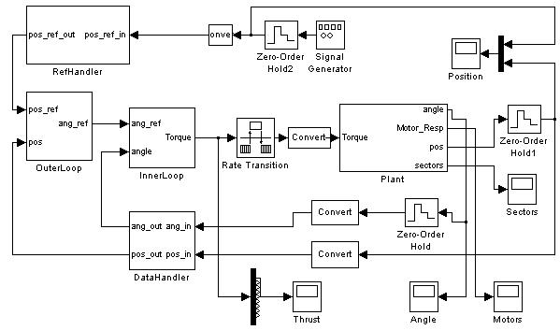

Software + Hardware = Any Problems?
Deployment of a software model onto an actual hardware platform can introduce unexpected issues =
Platform Effects
Time-related differences
Numerical differences
Platform flaws
Environmental effects
Error conditions
And more...
+
Rapid System Prototyping ’10 - Fairfax, VA, June 8-11
Notes:
Cyber-physical system domain
Starting is Simulink for controller design
Real-time sf introduced to hardware

Slide 3
Current Approaches
What are the common current approaches for simulating and analyzing platform effects for embedded systems?
Hacking Simulink model
Co-simulation
Actual deployment and testing on prototype hardware
Custom-built simulation environment
SystemC / AADL
Rapid System Prototyping ’10 - Fairfax, VA, June 8-11
Notes:
Insert some delays in SL model
Co-simulation is very low level
Desire to allow Simulink-based controls engineers

Slide 4
Time Triggered Architecture
TTA is a robust model of execution for high-confidence embedded systems.
Static execution schedule for both tasks and communications
Good fault detection and recovery characteristics
Strong time synchronization between nodes - on message transmission
Requires accurate on-line scheduler execution
Bus
Node A Schedule
(@ 5ms) - Receive msg
(@ 10ms) - Task A
(@ 15ms) - Send msg
Node A
Rapid System Prototyping ’10 - Fairfax, VA, June 8-11
Notes:
Mention nature of high-confidence systems: examples
H. Kopetz in Austria, TTTech, TTP/A and TTP/C, TTP/E
Extend Kopetz’s model to include tasks execution not just comms.

Slide 5
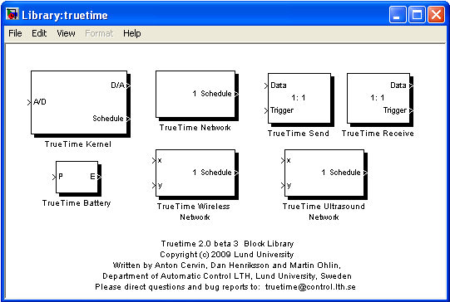
TrueTime toolkit for Simulink
Set of Simulink blocks for simulating task scheduling and execution and network communication.
Task-level execution
Diverse & detailed network models
C++/M-code/SL-block integration
Highly flexible on-line scheduler + API
Standard Simulink visualization of schedule execution
Rapid System Prototyping ’10 - Fairfax, VA, June 8-11
Notes:
Network types: Simple bus, Bus ethernet, Switched ethernet, Flexray, etc., wireless networks also
Built in schedulers: Rate monotonic & Earliest Deadline First, Priority-based

Slide 6

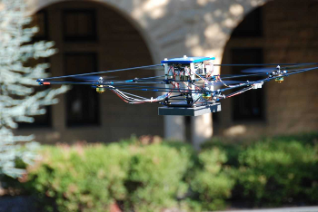
Example - Quad-Integrator Controller
Simplified controller from an actuator-limited quad-rotor helicopter - of course, built in Matlab/Simulink.
InnerLoop
OuterLoop
Plant
DataHandling
Rapid System Prototyping ’10 - Fairfax, VA, June 8-11
Notes:
Claire Tomlin @ Berkeley (Starmac)
Passivity-based developed by Nicholas Kottenstette (50Hz)
Capture of controller requirements (performance etc.) - step response and ...
Transform this controller model into TrueTime by adding hardware platform++

Slide 7
ESMoL Modeling Process
Several steps are required to synthesize a TTA-based TrueTime model using the ESMoL toolchain.
Import controller design from Simulink
Define components and message types
Generate component functional code
Create deployment hardware configuration
Deploy components and messages
Calculate time-triggered schedule
Synthesize the TrueTime model
Rapid System Prototyping ’10 - Fairfax, VA, June 8-11
Notes:
Side note: support for hardware-in-the-loop simulation, TT runtime layer(FRODO)
All steps take place inside of the GME modeling tool
7th step is the contribution

Slide 8
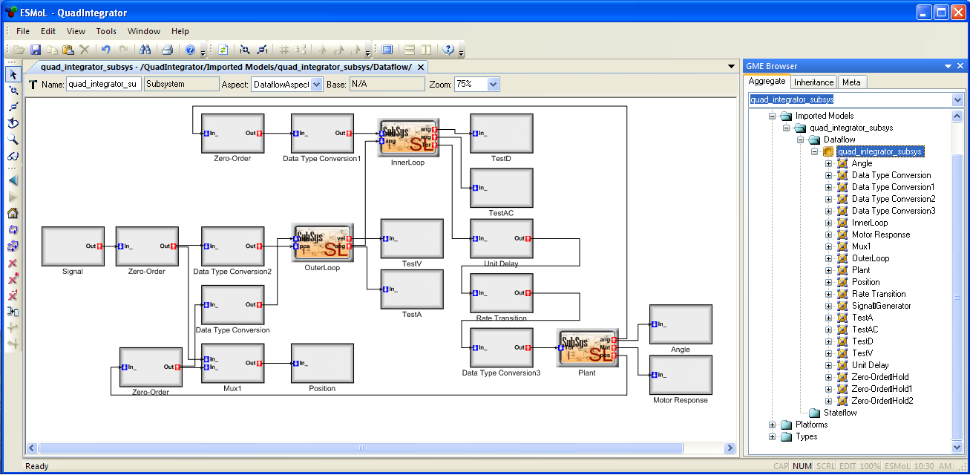
Step 1 - Import Controller from Simulink
Automated import tool reads Simulink model and creates equivalent model in ESMoL language. Multiple models of computation are supported:
Sub-Languages
Dataflow
Stateflow
Petri-nets
Rapid System Prototyping ’10 - Fairfax, VA, June 8-11
Notes:
Initial focus on Matlab/Simulink, now expanding sub-language support to non-TTA based approaches
See GME on right

Slide 9
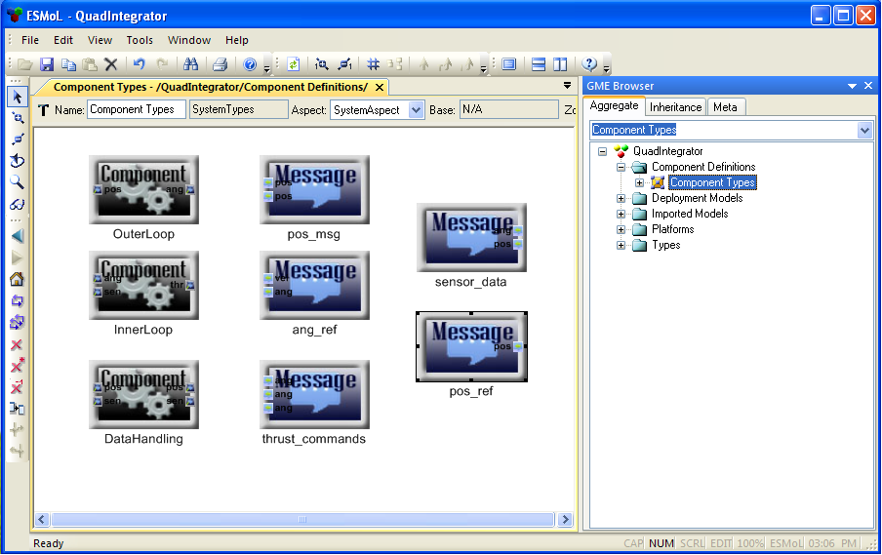
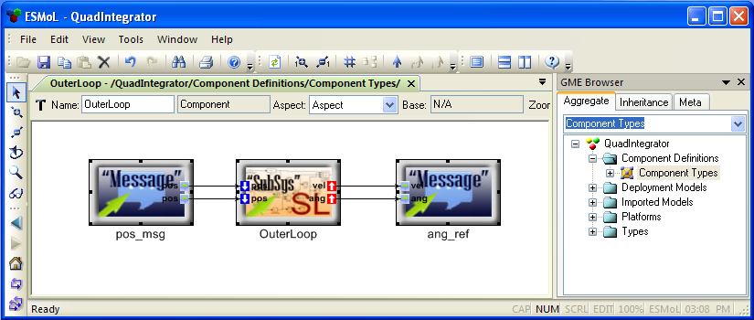
Step 2 - Define Comp. & Message Types
Component types are created from references to imported models. Message types define inputs and outputs to component types.
Referenced SL Block
Input Msg
Output Msg
Rapid System Prototyping ’10 - Fairfax, VA, June 8-11
Notes:
Logical execution-time semantics - Henzinger

Slide 10
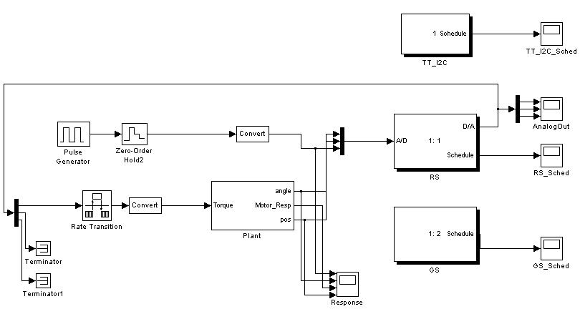
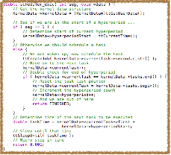
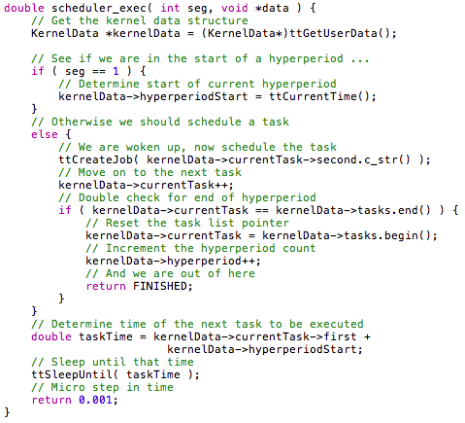
Step 3 - Generate Functional Code
C-code is automatically synthesized from component definitions and is linked into final execution environment.
Exactly the same code is used in all environments
Only two entry functions per component:
  Initialization function
  Execution function
TrueTime
C-code
ESMoL Component
Deployment
Rapid System Prototyping ’10 - Fairfax, VA, June 8-11
Notes:
One C-file per component type.
One header for all message types.

Slide 11
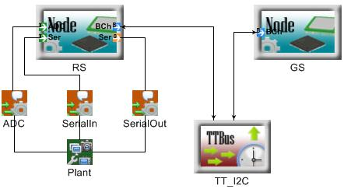
Step 4 - Define Hardware Configuration
A complete hardware platform definition is added into the ESMoL model.
Nodes
Each block contains internal configuration information
In example:
  Robostix Node (RS)
  Gumstix Node (GS)
  TT I²C Bus
  Quad-integrator plant reference
Plant
Comms Bus
Rapid System Prototyping ’10 - Fairfax, VA, June 8-11
Notes:
Mention ports on nodes and ADC + serial connections
Channels are defined for I2C connections
Can use xPC for H-I-L simulation

Slide 12
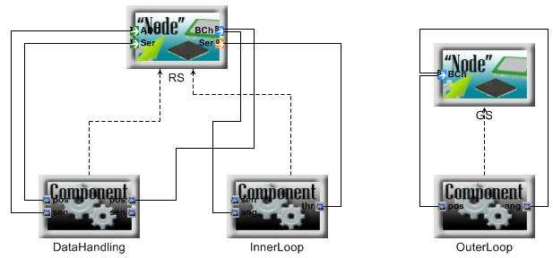
Step 5 - Deploy Components & Messages
Instances of software components are “deployed” onto hardware nodes. Component in/out messages are mapped to node communication ports.
Rapid System Prototyping ’10 - Fairfax, VA, June 8-11
Notes:
Stress instances of components. May have multiple instances of same component type.
Port mapping must translate to valid communications network.

Slide 13

Step 6 - Calculate Execution Schedule
An off-line constraint-based solver creates the static schedule for task execution and all communication
Each component & bus contains scheduling information
Specify WCET & frequency for each task and message
Determines length of global hyperperiod
Determines when to start execution in hyperperiod
ESMoL Model
Execution
Schedule
Problem
Details
Constraint-based Scheduler
Rapid System Prototyping ’10 - Fairfax, VA, June 8-11
Notes:
Developed by Joe Porter - presented at last years ESWeek in Grenoble
Either returns a valid schedule or not-possible
Data fusion

Slide 14
Step 7 - Synthesize TrueTime Model
The synthesis of a complete TrueTime model has two distinct aspects: the Simulink model and the code implementing time-triggered behavior.
Simulink Model
Synthesis of new Simulink model
Time-triggered online scheduler
Task execution loop
TTA Code
Rapid System Prototyping ’10 - Fairfax, VA, June 8-11

Slide 15
Mapping ESMoL to TrueTime
There is a mapping from ESMoL model software & hardware elements to TrueTime blocks and code:
ESMoL Node
TT Kernel
ESMoL Bus
TT Network
ESMoL Plant
Simulink Block
ESMoL Component
C-Code
Rapid System Prototyping ’10 - Fairfax, VA, June 8-11

Slide 16
TrueTime - New Model Synthesis
Based on the defined hardware configuration, a new Simulink model using TrueTime blocks and original plant block is created.
DataHandling
InnerLoop
OuterLoop
Rapid System Prototyping ’10 - Fairfax, VA, June 8-11
Notes:
Mention that network is off on its own - this is OK. RS/GS communicate via network using TT API - the implementation code - next step

Slide 17
TrueTime - The TTA Glue Layer
A “glue-code” layer must live between the new Simulink model and the functional code. This is where the TTA behavior exists.
TrueTime Simulink Model
Time-Triggered Glue Layer
Comp A
Comp B
Comp C
Rapid System Prototyping ’10 - Fairfax, VA, June 8-11
Notes:
Use Simulink compiler to compile together TrueTime header & libs. (+) glue layer (+) component functional code.

Slide 18
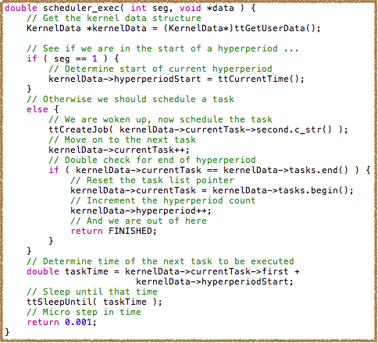
TrueTime - Time Triggered Scheduler
The default TrueTime scheduler is augmented using a custom-built reusable time-triggered scheduler.
Maintains pointer to next task
Consumes some simulation time each invocation
Resets each hyperperiod
Allows for modeling faults
  WCET overrun
  Task collision
  etc...
Uses TrueTime schedule for actual task execution
Rapid System Prototyping ’10 - Fairfax, VA, June 8-11

Slide 19
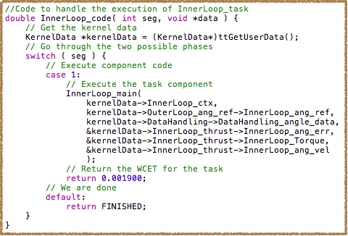
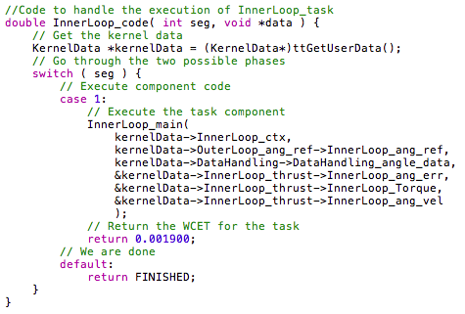
TrueTime - Task Execution Loop
Each task or communication (send/receive) is invoked by the TrueTime scheduler, at the request of the on-line TTA scheduler.
Stores persistent data in KernelData structure, maintained by TrueTime
Calls generated functional code
Consumes task-specific amount of simulation time
Does allow for modeling of faults
Rapid System Prototyping ’10 - Fairfax, VA, June 8-11

Slide 20
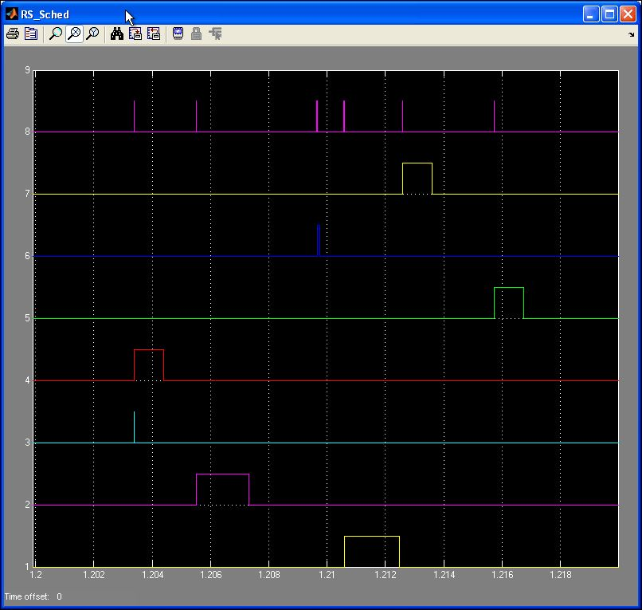
Results - Execution Schedule
Schedule execution is visualized using standard Simulink scopes. One scope is created per task and network.
Custom TT Scheduler
Inner Loop Task
Data Handler Task
Actuator Output
Bus Comms. #1
Sensor Input
Bus Comms. # 2
Outer Loop Task
Rapid System Prototyping ’10 - Fairfax, VA, June 8-11
Notes:
Execution schedule may introduce unit delays due to ordering, communications, etc. This should be evident in the actual execution behavior.

Slide 21
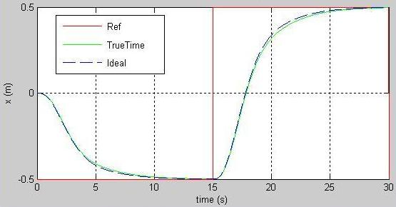
Results
Controller specification required performance in response to step function. TrueTime model allows easy comparison between time-invariant simulation and full platform.
Rapid System Prototyping ’10 - Fairfax, VA, June 8-11
Notes:
Ref = Step function @15sec - ideal is blue dashed, TT is solid green

Slide 22
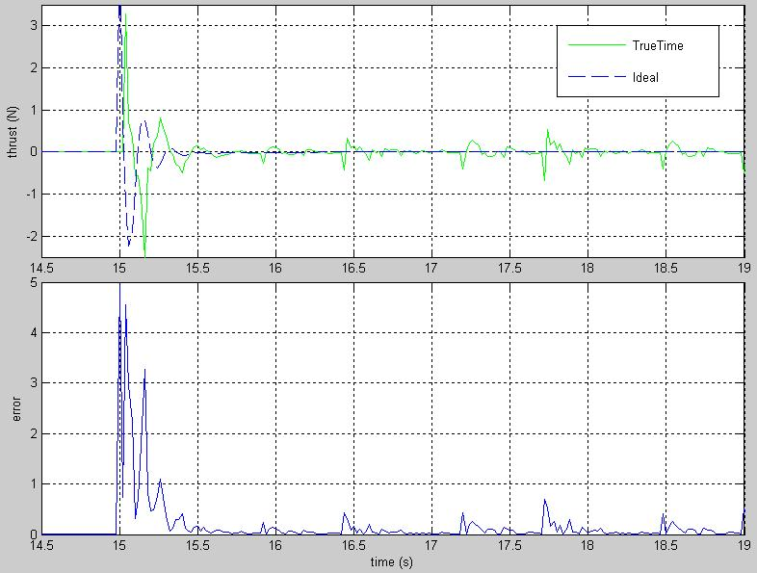
Results - Platform Effects
TrueTime simulation reveals impact of deployment onto TTA-based platform
Rapid System Prototyping ’10 - Fairfax, VA, June 8-11
Notes:
R² error analysis
Execution schedule induces small response delay (0.1s)

Slide 23
Conclusion
From a fully specified software/hardware model a TTA-based TrueTime model is synthesized
Simulation & analysis of platform effects
Allows for diverse fault modeling
Easy enough for controller designers to use
Future Work:
  More detailed failure case support & analysis
  Execution speed-up
  Adding support for event-based execution (BIP)
Toolchain and samples available at:
https://wiki.isis.vanderbilt.edu/hcddes/index.php/Main_Page
Rapid System Prototyping ’10 - Fairfax, VA, June 8-11
Notes:
60x slowdown in Simulink performance due to tiny time-steps sizes
Working with Ed Clarke & Paolo Zuliani @ CMU for statistical analysis of fault conditions
Working with Joseph Sifakis @ VERIMAG for BIP integration and event-based execution

Slide 24
References
F. Balarin, et. al. Metropolis: An integrated electronic system design environment. Computer, 36(4):45–52, April 2003.
A. Basu. Component-based Modeling of Heterogeneous Real Time Systems in BIP. PhD thesis, VERIMAG, 2008.
A. Basu. BIP2 User Manual. VERIMAG, 2009.
A. Basu, M. Bozga, and J. Sifakis. Modeling heterogeneous real-time components in BIP. In SEFM, volume 6, pages 3–12, 2006.
P. Caspi, et. al. From Simulink to SCADE/Lustre to TTA: A layered approach for distributed embedded applications. In Proceedings of the 2003 ACM SIGPLAN Conference on Languages, Compilers, and Tools for Embedded Systems, pages 153–162. ACM New York, NY, USA, 2003.
A. Cervin, M. Ohlin, and D. Henriksson. Simulation of net- worked control systems using TrueTime. In Proc. 3rd Inter- national Workshop on Networked Control Systems: Tolerant to Faults, 2007.
P. V. den Bosch and E. V. de Waal. A case study of multi- disciplinary modeling using Matlab/Simulink and TrueTime. In Proceedings of INCOSE Symposium, 2005.
J. Eker and A. Cervin. A Matlab toolbox for real-time and control systems co-design. In Proceedings of the 6th International Conference on Real-Time Computing Systems and Applications, pages 320–327, 1999.
E. Farcas, C. Farcas, W. Pree, and J. Templ. Transparent distribution of real-time components based on logical execution time. In Proceedings of the 2005 ACM SIGPLAN/SIGBED Conference on Languages, Compilers, and Tools for Em- bedded Systems, pages 31–39. ACM New York, NY, USA, 2005.
T. Grotker. System design with SystemC. Kluwer Academic Publishers Norwell, MA, USA, 2002.
D. Henriksson, A. Cervin, and K. Arzen. TrueTime: Real-time control system simulation with Matlab/Simulink. In Proceedings of the Nordic MATLAB Conference, Copenhagen, Denmark, 2003.
T. Henzinger, B. Horowitz, and C. Kirsch. Giotto: A time-triggered language for embedded programming. Lecture Notes in Computer Science, 2211: 166-184, 2001.
Rapid System Prototyping ’10 - Fairfax, VA, June 8-11

Slide 25
References (Continued)
W. Herzner, et. al. Model-based development of distributed embedded real-time systems with the DECOS tool-chain. In Proceedings of the 2007 SAE AeroTech Congress & Exhibition. Citeseer, 2007.
J. Hudak and P. Feiler. Developing AADL models for control systems: A practitioner’s guide. Tech. Rpt. CMU/SEI-2007-TR-014, Software Engineering Institute (SEI), 2007.
H. Kopetz. Real-time systems: Design principles for distributed embedded applications. Springer, 1997.
H. Kopetz and G. Bauer. The time-triggered architecture. Proceedings of the IEEE Special Issue on Modeling and Design of Embedded Software, 91(1):112–126, October 2003.
H. Kopetz and G. Gru ̈nsteidl. TTP - A time-triggered protocol for fault-tolerant real-time systems. Computer, 27(1):14–23, 1993.
N. Kottenstette and J. Porter. Digital passive attitude and altitude control schemes for quadrotor aircraft. Technical report, Vanderbilt University, 2008.
Mathworks.TheMathWorks,Inc.Simulink/Stateflowtools. http://www.mathworks.com.
J. Porter, G. Karsai, and J. Sztipanovits. Towards a time-triggered schedule calculation tool to support model-based embedded software design. In EMSOFT ’09: Proceedings of the 7th ACM International Conference on Embedded Soft- ware, pages 167–176, New York, NY, USA, 2009. ACM.
J. Porter, G. Karsai, P. Volgyesi, H. Nine, P. Humke, G. Hemingway, R. Thibodeaux, and J. Sztipanovits. To- wards model-based integration of tools and techniques for embedded control system design, verification, and imple- mentation. In Workshops and Symposia at MoDELS 2008, volume 5421 of LNCS, pages 20–34, 2008.
J. Porter, P. Volgyesi, N. Kottenstette, H. Nine, G. Karsai, and J. Sztipanovits. An experimental model-based rapid prototyping environment for high-confidence embedded software. In Proceedings of the 2009 IEEE/IFIP International Symposium on Rapid System Prototyping, volume 0, pages 3–10. IEEE Computer Society, 2009.
K. Schild and J. Wu ̈rtz. Scheduling of time-triggered real- time systems. Constraints, 5(4):335–357, Oct. 2000.
C. Schulte, M. Lagerkvist, and G. Tack. Gecode: Generic Constraint Development Environment. http://www.gecode.org/.
R. Thibodeaux. The specification and implementation of a model of computation. MS thesis, Vanderbilt Univ., 2008.
Rapid System Prototyping ’10 - Fairfax, VA, June 8-11

