Slide 1
Inertial Control of Quad-Rotor Helicopter: A Passivity Based Approach
Nicholas Kottenstette
ISIS-Vanderbilt University
October 14, 2008

Slide 2
Outline
To make (distributed) control system design and synthesis intuitive and robust via passivity formalisms
LTI Passive Systems
Design of Networked Control Systems Using Passivity
Literature Review (attitude/inertial control)‏
Main Idea (Cascade of Passive Systems)‏
Quad-rotor Dynamics
Overall Control Scheme
Passive Digital Controller Synthesis
Simulating the System
Future Directions

Slide 3
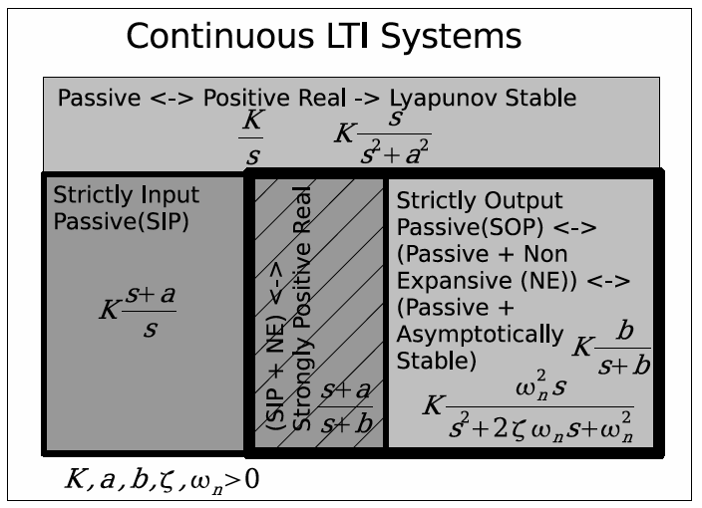
LTI Passive Systems

Slide 4
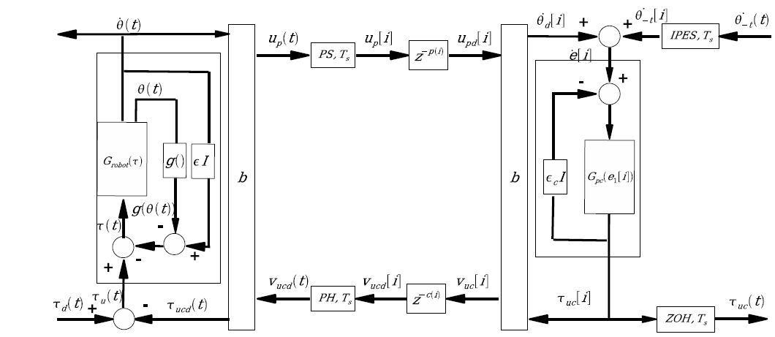
Design of Networked Control Systems Using Passivity
Wireless Network
Robotic System
(attitude control on robostix)‏
Digital Controller
(inertial control on gumstix)‏

Slide 5
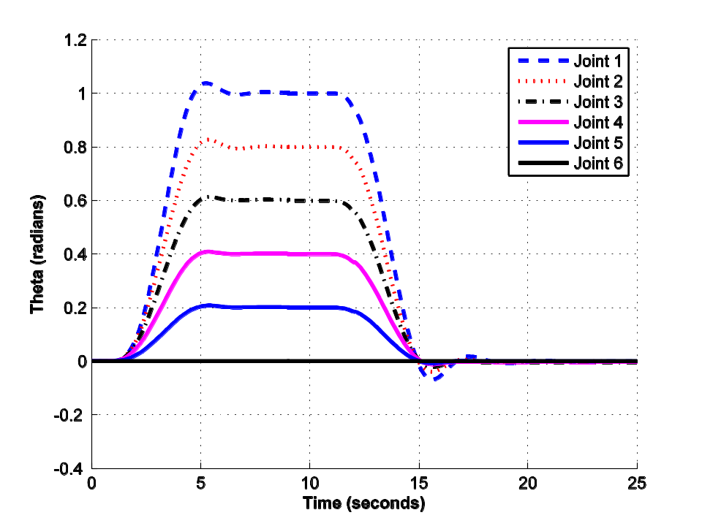
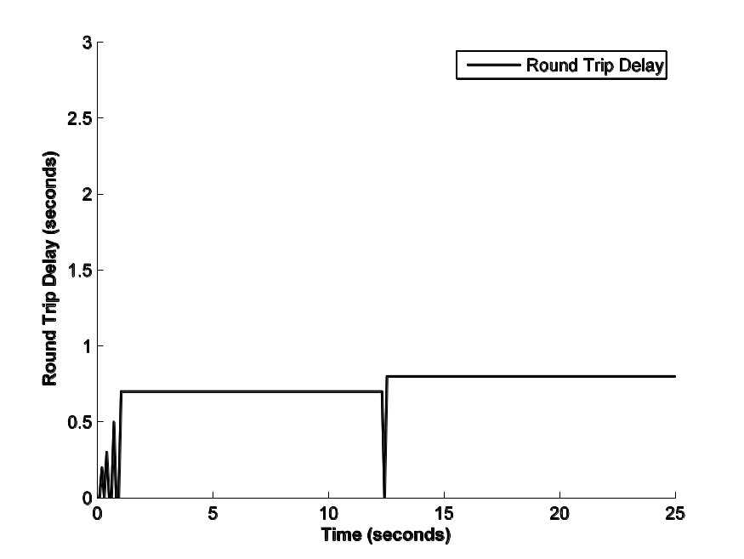
Systems can be designed confident that (varying) time delays will not destabilize system.

Slide 6
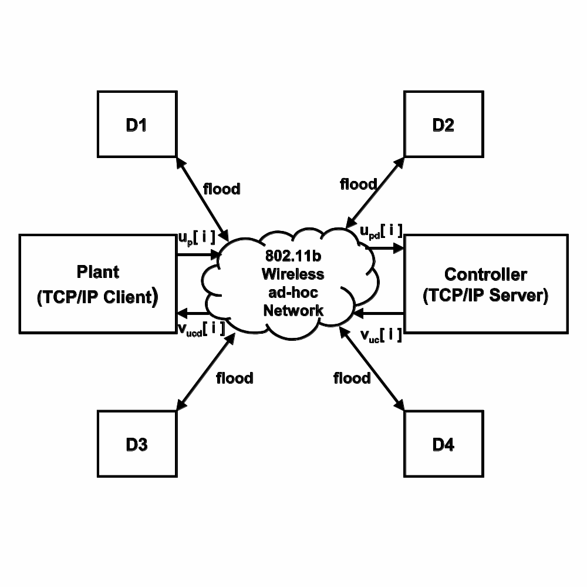
Even when the network is subject to a ping attack flood.

Slide 7
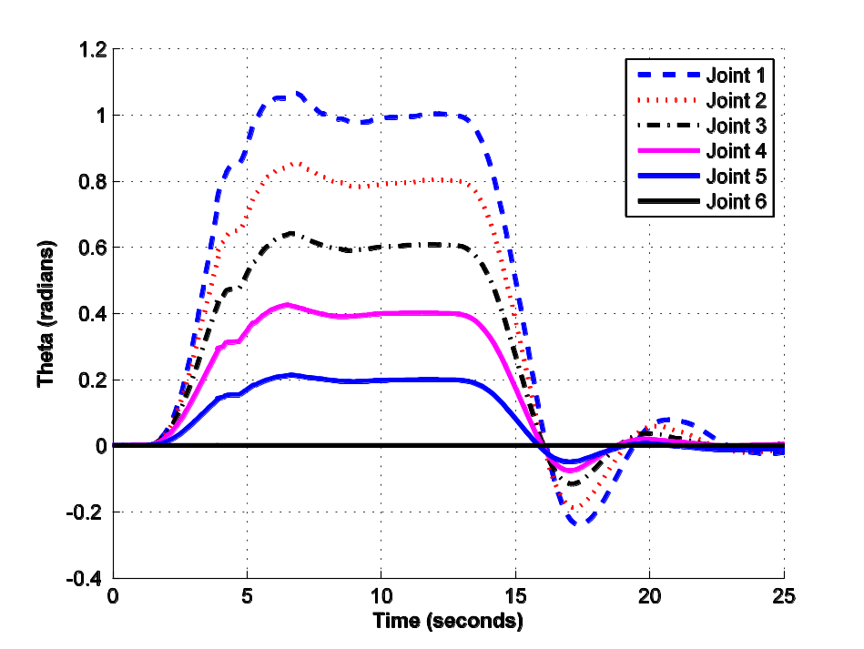
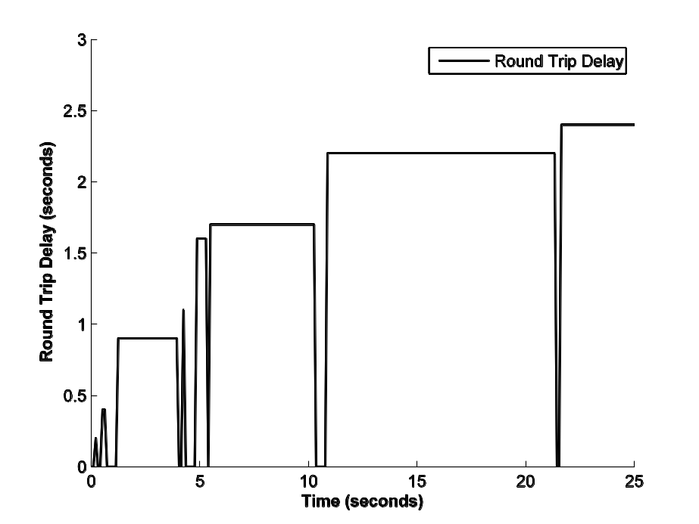
Even when the network is subject to a ping attack flood.

Slide 8
Literature Review
Passivity Control Related:
Tayebi, and McGilvray, Attitude Stabilization of a VTOL Quadrotor Aircraft, IEEE Trans. On Control Systems Technology, May 2006.
Costic, Dawson, Queiroz, Kapila, Quaternion-Based Adaptive Attitude Tracking Controller Without Velocity Measurements, Journal of Guidance, Control, And Dynamics Dec. 2001.
Tsiotras, Further Passivity Results for the Attitude Control Problem, IEEE Trans. On Automatic Control November, 1998.
Lizarralde and Wen, Attitude Control Without Angular Velocity Measurement: A Passivity Approach, IEEE Trans. On Aut. Control March, 1996.
Modeling Related:
Hoffmann, Huang, Waslander, Tomlin, Quadrotor Helicopter Flight Dynamics and Control: Theory and Experiment AIAA 2007.
Hamel, Mahoney, Lozano, and Ostrowski, Dynamic Modelling and Configuration Stabilization For An X4-Flyer, IFAC 2002.
Castillo, Dzul, Lozano, Real-Time Stabilization and Tracking of a Four-Rotor Mini rotorcraft, IEEE Trans. On Control Systems Tech., July 2004.
Pounds, Mahony, Corke, Modeling and Control of a Quad-Rotor Robot, Australian Conference on Robotics & Automation 2006.

Slide 9
Cascade of Passive Systems
control input:
sensor output:
Internal sensor out:
$y_{1}\left(t\right)=u_{2}\left(t\right)$
$u_{1}\left(t\right)$
$y_{2}\left(t\right)$
$G_{1}:u_{1}\left(t\right)→y_{1}\left(t\right)$
$G_{2}:u_{2}\left(t\right)→y_{2}\left(t\right)$
$G_{c}:u_{1}\left(t\right)→y_{2}\left(t\right)$
$G_{1}\left(t\right), G_{2}\left(t\right)$
are typically passive systems, however
$G_{c}\left(t\right)$
the cascaded system is (typically) not
We typically have access to the control input and sensor output (possibly) the internal sensor output as well.
Is there a typical way to construct a system to control the sensor output?

Slide 10
Control of Cascaded Passive Systems
YES
$y_{2d}\left(t\right)$
+
$e_{2}\left(t\right)$
+
$e_{1}\left(t\right)$
$y_{1}\left(t\right)$
$K_{2}$
$K_{1}$
$G_{1}:u_{1}\left(t\right)→y_{1}\left(t\right)$
-
-
$u_{2}\left(t\right)$
$y_{2}\left(t\right)$
$G_{2}:u_{2}\left(t\right)→y_{2}\left(t\right)$
$K_{i}∈ℝ^{m×m}, K_{i}=diag\left(k_{i_{1}},k_{i_{2}},…,k_{i_{m}}\right), k_{i_{j}}>0$
$G_{cl}\left(t\right):y_{2d}\left(t\right)→y_{1}\left(t\right)$
Closed loop system is strictly output passive, and L^{m}₂ stable.
If both systems have state space realizations, and are zero-state detectable, asymptotic stability can typically be shown.

Slide 11
Position Control of a Mass
$\frac{s}{τs+1}$
$V_{d}\left(s\right)$
+
$X_{d}\left(s\right)$
+
$E_{x}\left(s\right)$
+
$E_{v}\left(s\right)$
$V\left(s\right)$
$K_{2}$
$K_{1}$
$\frac{1}{ms}$
-
-
$X\left(s\right)$
$\frac{1}{s}$
$X_{d}\left(s\right)$
+
$E_{x}\left(s\right)$
$\frac{\left(τ+\frac{1}{K_{2}}\right)s+1}{τs+1}$
$\frac{\frac{K_{1}}{m}}{s\left(s+\frac{K_{1}}{m}\right)}$
$X\left(s\right)$
$K_{2}$
-
$\frac{X\left(s\right)}{X_{d}\left(s\right)}=\frac{\left(τ+\frac{1}{K_{2}}\right)s+1}{τs+1}\frac{ω_{n}^{2}}{s^{2}+2ζω_{n}s+ω_{n}^{2}}, ω_{n}=\sqrt{\frac{K_{1}K_{2}}{m}}, ζ=\frac{1}{2}\sqrt{\frac{K_{1}}{K_{2}m}}$
$K_{1}=\frac{ζω_{n}}{2}, K_{2}=\frac{ω_{n}}{2ζ}$

Slide 12
Rigid Body Kinematics, Dynamics
$\begin{aligned}I_{b}\overset{˙}{ω_{b}}+ω_{b}xI_{b}ω_{b}=τ_{b} \\ m\overset{˙}{v_{I}}=f_{I} \\ f_{I}=R^{T}\left(η\right)f_{b}, v_{I}=R^{T}\left(η\right)v_{b} \\ \overset{˙}{η}=J\left(η\right)ω_{b}\end{aligned}$
$\left(\left(ω_{b},τ_{b}\right),\left(v_{b},f_{b}\right)\right),\left(v_{I},f_{I}\right)∈ℝ^{3}$
(flow, effort) variables in body and inertial frame
$η^{T}={\left[ϕ,θ,ψ\right]}^{T}$
Euler angles (roll, pitch, yaw)‏
$m∈ℝ, I_{b}∈ℝ^{3×3}$
mass and rigid-body inertia matrix in body coordinates
$ax=\left(\begin{matrix}0 & −a_{3} & a_{2} \\ a_{3} & 0 & −a_{1} \\ −a_{2} & a_{1} & 0\end{matrix}\right)$
$R^{T}R=I, R∈SO\left(3\right)$

Slide 13
Attitude Dynamics
$\begin{aligned}I_{b}\overset{˙}{ω_{b}}+ω_{b}xI_{b}ω_{b}=I_{b}+C\left(ω_{b}\right)ω_{b}=τ_{b} \\ \overset{˙}{η}=J\left(η\right)ω_{b} \\ I_{b}>0, \overset{˙}{I_{b}}=0, C\left(ω_{b}\right)=−C^{T}\left(ω_{b}\right)→\overset{˙}{I_{b}}−2C\left(ω_{b}\right)=−{\left(\overset{˙}{I_{b}}−2C\left(ω_{b}\right)\right)}^{T}\end{aligned}$
$G_{a}:τ_{b}→ω_{b}$
is a passive (lossless) system
$S\left(ω_{b}\right)=\frac{1}{2}ω_{b}^{T}I_{b}ω_{b}, \overset{˙}{S}\left(ω_{b}\right)=ω_{b}^{T}τ_{b}$
+
$e_{1}\left(t\right)$
$ω_{b}\left(t\right)$
$K_{1}$
$G_{a}:τ_{b}\left(t\right)→ω_{b}\left(t\right)$
-
We desire to control the frame orientation in order to control the inertial force. We chose to use Euler angles, however:
$G_{o}:ω_{b}→η,$
is only passive for limited range and Euler rates (Future: modified Rodriquez parameters possess a passive mapping).

Slide 14
Attitude Dynamics and Control
$η_{d}\left(t\right)$
+
$e_{2}\left(t\right)$
+
$τ_{b}\left(t\right)$
$ω_{b}\left(t\right)$
$K_{2}$
$K_{1}$
$G_{a}:τ_{b}\left(t\right)→ω_{b}\left(t\right)$
-
-
$η\left(t\right)$
$G_{o}:ω_{b}\left(t\right)→η\left(t\right)$
$\begin{aligned}\overset{˙}{η}=J\left(η\right)ω_{b}, J\left(η\right)=\left[\begin{matrix}1 & sin\left(ϕ\right)tan\left(θ\right) & cos\left(ϕ\right)tan\left(θ\right) \\ 0 & cos\left(ϕ\right) & −sin\left(ϕ\right) \\ 0 & \frac{sin\left(ϕ\right)}{cos\left(θ\right)} & \frac{cos\left(ϕ\right)}{cos\left(θ\right)}\end{matrix}\right], \\ J>0 if ϕ,θ∈\left[−π\frac{29}{90},π\frac{29}{90}\right], ψ∈\left[−π,π\right]\end{aligned}$

Slide 15
Inertial Control
${mge}_{z}=\left[\begin{matrix}0 \\ 0 \\ mg\end{matrix}\right]$
-
$f_{c}\left(t\right)$
+
+
$f_{I}\left(t\right)$
$x_{Id}\left(t\right)$
$\overset{˙}{x_{I}}\left(t\right)$
$K_{2}$
$K_{1}$
$G_{fci}$
$G_{I}:f_{I}\left(t\right)→\overset{˙}{x_{I}}\left(t\right)$
-
$\frac{1}{s}$
$η_{d}\left(t\right)=\left[\begin{matrix}ϕ\left(t\right) \\ θ\left(t\right) \\ ψ\left(t\right)\end{matrix}\right]=\left[\begin{matrix}\frac{−f_{cy}\left(t\right)}{f_{cz}\left(t\right)} \\ \frac{f_{cx}\left(t\right)}{f_{cz}\left(t\right)} \\ 0\end{matrix}\right]$
$f_{I}\left(t\right)$
$G_{fci}$
$f_{c}\left(t\right)$
$f_{c}\left(t\right)=\left[\begin{matrix}f_{cx}\left(t\right) \\ f_{cy}\left(t\right) \\ f_{cz}\left(t\right)\end{matrix}\right]$
$η_{d}\left(t\right)$
$η\left(t\right)$
$1$
$f_{c}→η_{d}$
$f_{I}\left(t\right)$
$T=f_{cz}\left(t\right)$
$f_{I}\left(t\right)={mge}_{z}−{TR}^{T}\left(η\right)e_{z}$

Slide 16
Inertial Control, Thrust Commands
$η_{d}\left(t\right)$
$η\left(t\right)$
$f_{I}\left(t\right)=\left[\begin{matrix}0 \\ 0 \\ mg\end{matrix}\right]−T\left[\begin{matrix}cos\left(ϕ\right)sin\left(θ\right)cos\left(ψ\right)+sin\left(θ\right)sin\left(ψ\right) \\ cos\left(ϕ\right)sin\left(θ\right)sin\left(ψ\right)−sin\left(ϕ\right)cos\left(ψ\right) \\ cos\left(θ\right)cos\left(ϕ\right)\end{matrix}\right]$
$1$
$f_{I}\left(t\right)$
$T$
$f_{I}\left(t\right)={mge}_{z}−{TR}^{T}\left(η\right)e_{z}$
$\left[\begin{matrix}τ_{bx} \\ τ_{by} \\ τ_{bz} \\ T\end{matrix}\right]=\left[\begin{matrix}0 & −dx & 0 & dx \\ dx & 0 & −dx & 0 \\ −K_{t} & K_{t} & −K_{t} & K_{t} \\ 1 & 1 & 1 & 1\end{matrix}\right]\left[\begin{matrix}T_{m1} \\ T_{m2} \\ T_{m3} \\ T_{m4}\end{matrix}\right]$
$\left[\begin{matrix}T_{m1} \\ T_{m2} \\ T_{m3} \\ T_{m4}\end{matrix}\right]={\left[\begin{matrix}0 & −dx & 0 & dx \\ dx & 0 & −dx & 0 \\ −K_{t} & K_{t} & −K_{t} & K_{t} \\ 1 & 1 & 1 & 1\end{matrix}\right]}^{−1}\left[\begin{matrix}τ_{bx} \\ τ_{by} \\ τ_{bz} \\ T\end{matrix}\right]$

Slide 17
Motor Lead Compensator
$T_{mi}\left(s\right)$
$T_{mai}\left(s\right)$
$\frac{1}{τs+1}$
Motor lag, introduces non-passive map for both inertial and attitude control. So add phase margin up to nyquist rate.
$T_{mi}\left(s\right)$
$\frac{τs+1}{\frac{T_{s}}{π}s+1}$
$T_{mli}\left(s\right)$
$T_{mai}\left(s\right)$
$\frac{1}{τs+1}$
$G_{lead}\left(s\right)$
The following formula allows one to synthesize a discrete passive filter from its continuous counterpart.
$H\left(z\right)=k_{s}\frac{{\left(z−1\right)}^{2}}{z}Z\{\frac{H\left(s\right)}{s^{2}}\}, k_{s}=\frac{1}{T_{s}}\left(typ.\right)$

Slide 18
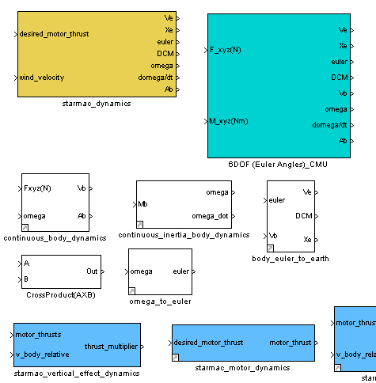
Aero-Sim Library (aero_sim_lib)‏

Slide 19
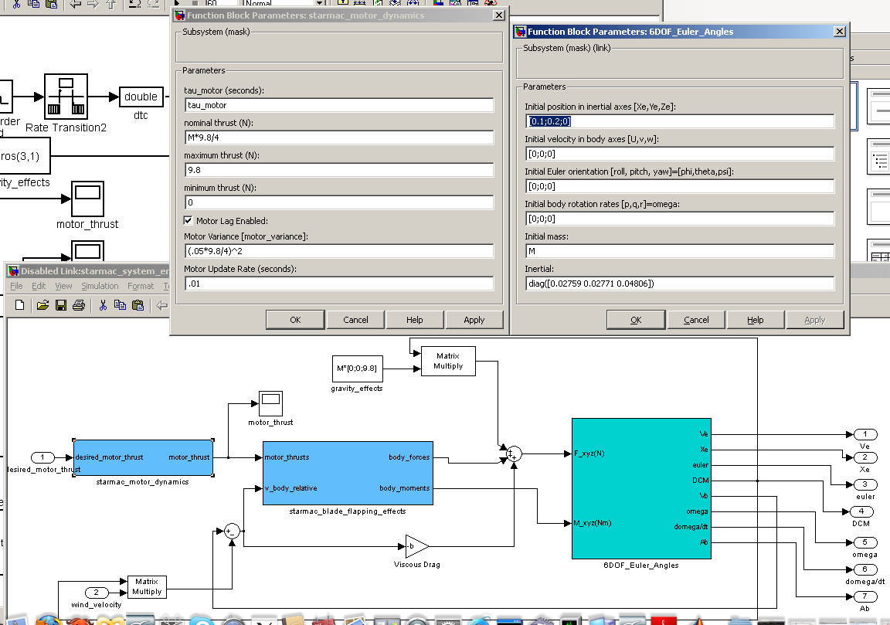
STARMAC Dynamics

Slide 20
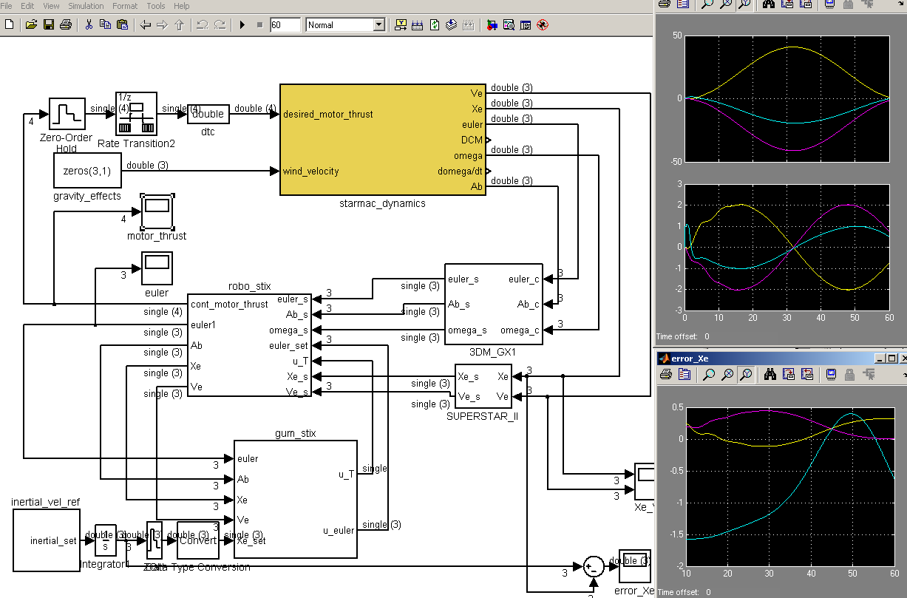
STARMAC System

Slide 21
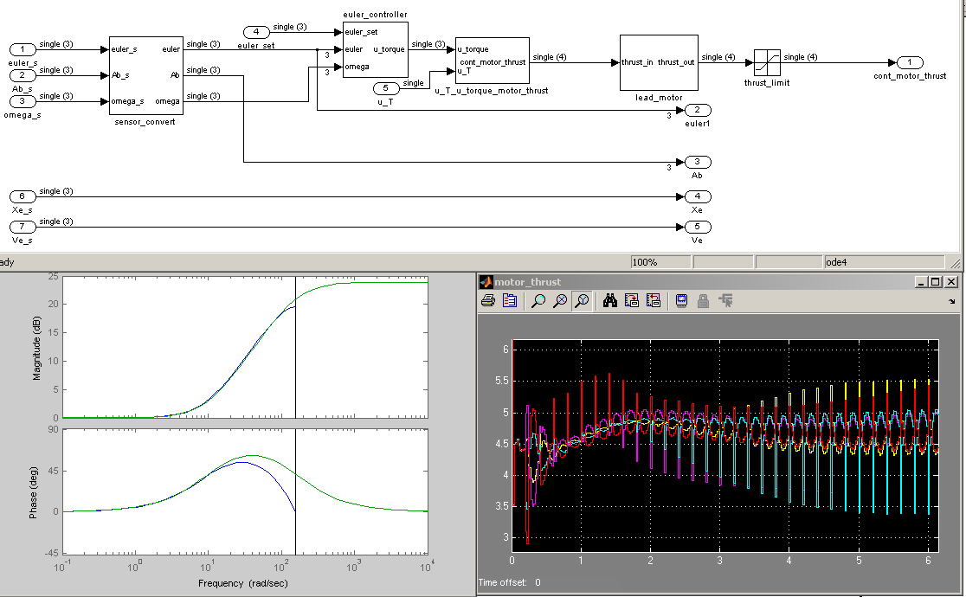
Robostix System

Slide 22
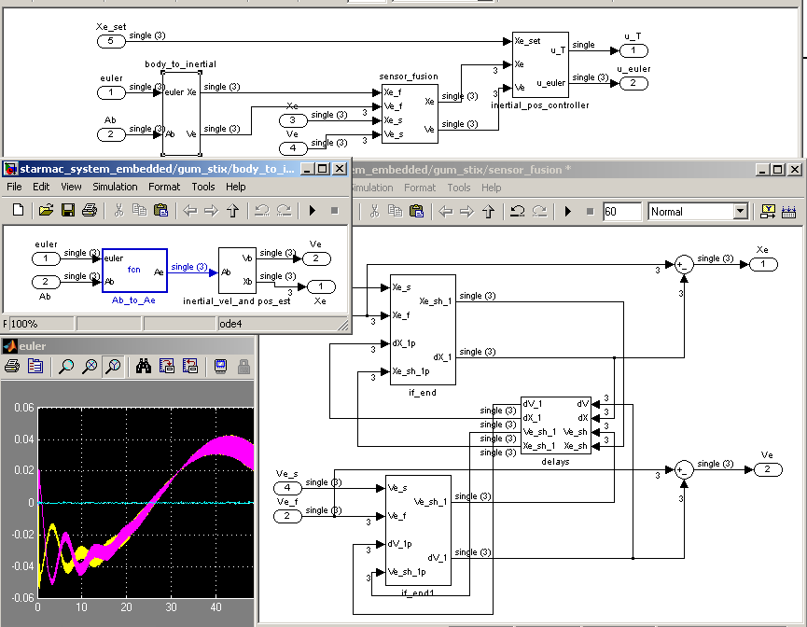
Gumstix System

Slide 23
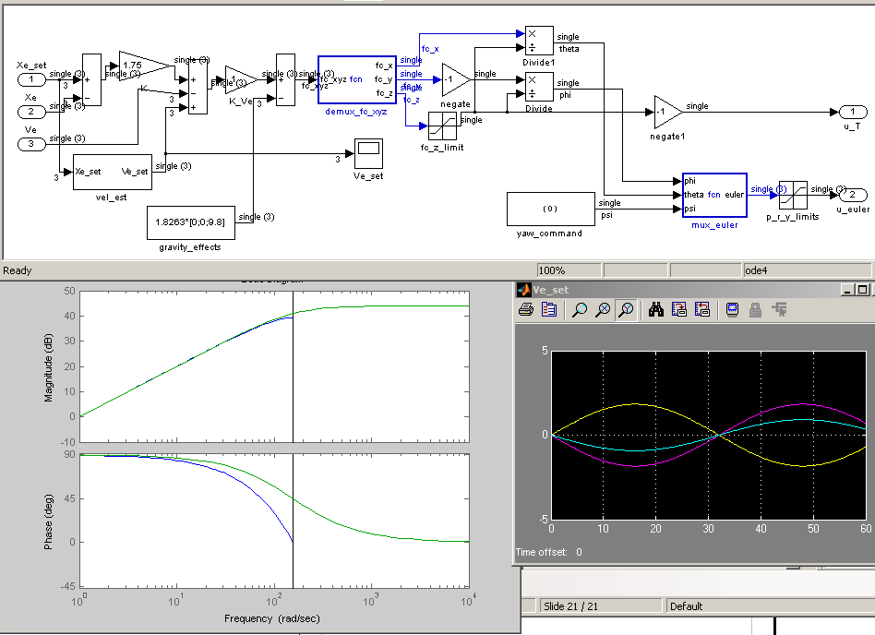
Inertial Controller

Slide 24
Future Directions
Short Term:
Implement control system on STARMAC.
Understand .1 second time constant related to motor thrust.
Use modified Rodrigues parameters for attitude control.
Integrate wave variables between Gumstix and Robostix platforms in order to further reduce sampling rates.
Long Term:
Develop tools to aid in developing overall passive control architecture.
Tools to aid in identifying non-passive mappings and provide means to recover passivity.
All the while providing a high-confidence and robust system.

