Slide 1
Multi-Physics, Multi-Fidelity System Design Evaluation Simple Satellite Model
OpenMETA Design Study
Across
Geometry, Dynamics, Structural
Metamorph Software
Vanderbilt University
Ted Bapty (ted.bapty@metamorphsoftware.com / bapty@isis.vanderbillt.edu)

Slide 2
What/Why/How
What?
Tools for Design and Evaluation of Complex Systems
Using Single Model to drive Multiple Analysis Tools
E.g. CAD, FEA-Nastran,Abaqus, Dynamics-Modelica,Simulink, CFD-OpenFOAM, SPICE, SystemC, …
Determine Best Design Choices, Architecture, Software. Predict System Performance/Cost Before You Build/Buy It.
Why?
Subsystems & Components Interact in Many Complex Ways, Across Multiple Domains
E.g. Component Choice Placement → Inertia, Thermal Interactions. Inertia→Control Actuators & Algorithms. Actuators → Power Consumption & Thermal Source, …
Maintaining Multiple System Models to Accomplish This Is Expensive, Error-Prone (Model Sync) and Time/Cost Prohibitive.
How?
OpenMETA Design Tools Capture System Structure & Components
OpenMETA Analysis Tools Auto-Compose Models for Other Common Tools (PTC Creo, NASTRAN, Dymola, Simulink
Integrated MDAO Tools Execute Multi-Physics Analysis Campaigns, Leveraging Workstations and Cloud Computing
Core Tools are Open Source – Metamorph Business Model is to Help Integrate Into Organizational Design Processes and Add Analysis Tool Support

Slide 3
Who Can Use It, & How
Concept Evaluation
Evaluate a Wide Range of Concept Designs to Help Determine:
Requirement Feasibility And Cost Impact
Concept Development and Rapid Evaluation for Proposed Solutions
Evaluate Proposed Solutions
Across Multiple Scenarios
Validate Feasibility and Costing
Preliminary Design
Evolve Model Detail and Fidelity
Evaluate All Proposed Architectures to Choose Best Cost/Perf
Determine Potential Side Effects And Requirements Satisfaction
Detailed Design
Multiple Fidelity Analysis – Choose the Correct Tool for Accuracy and Compute Cost
Digital Thread – Single Model Auto Maps to All Analysis Tools
Models are Executable In Many Ways
Metamodel-Based Approach Allows Extension

Slide 4
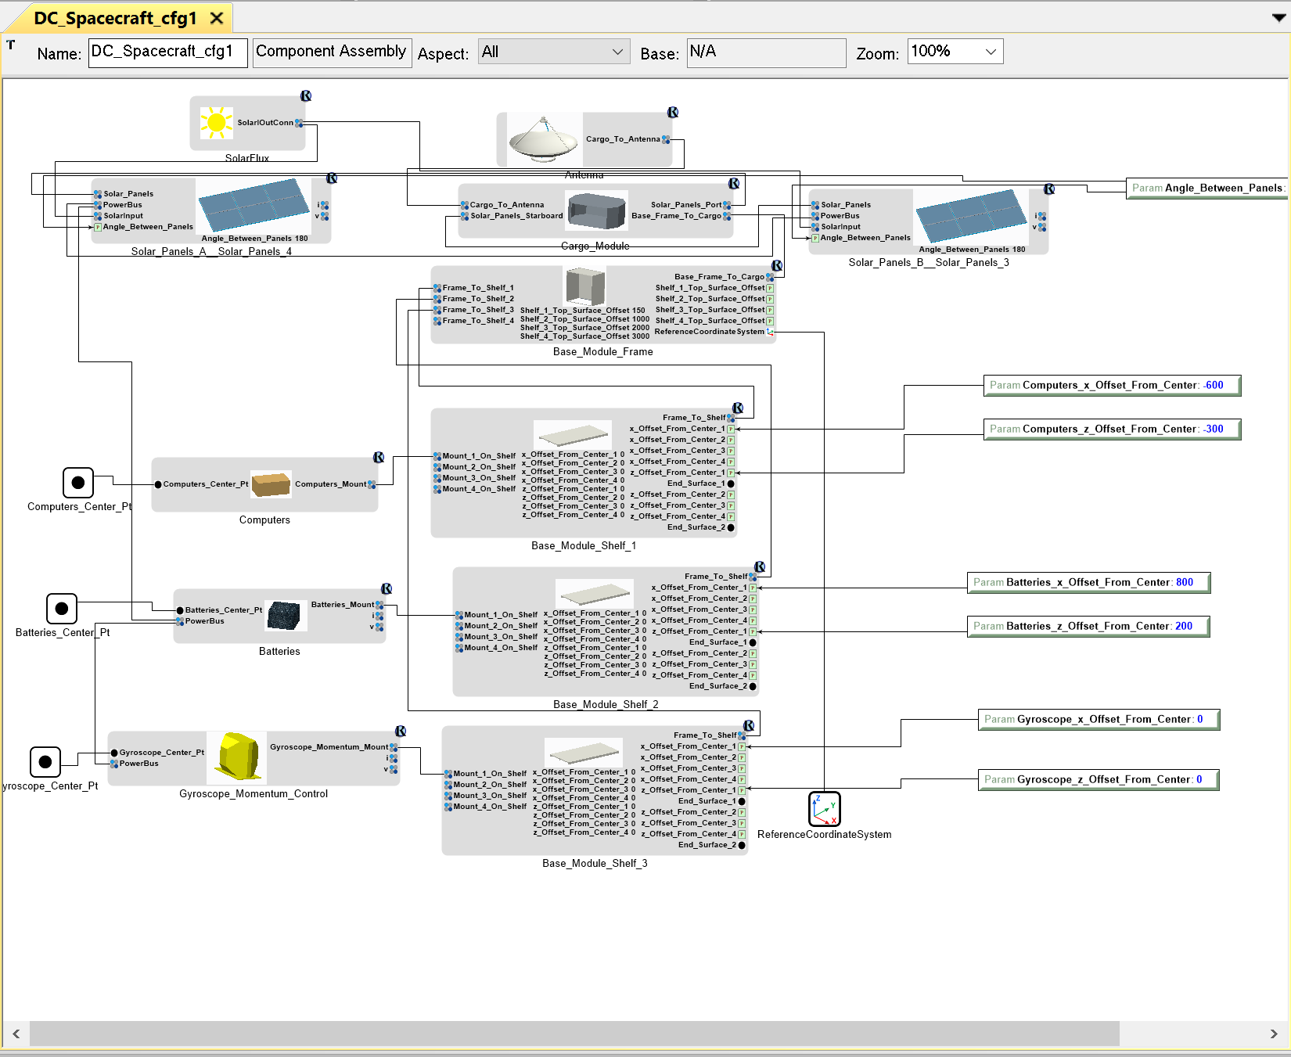
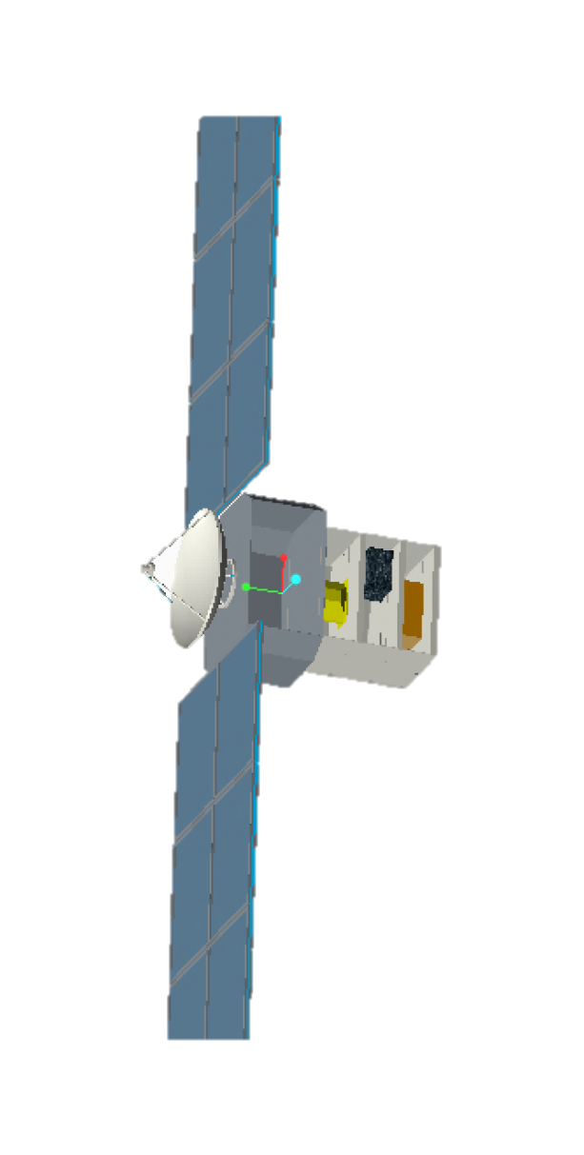
Single Model: (System Block Diagram)
Block Diagram
==
Solid Model

Slide 5
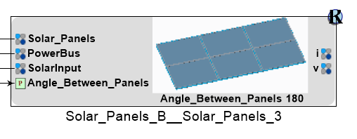
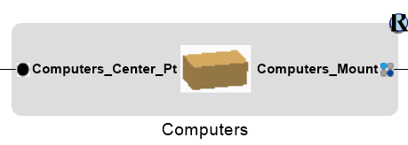
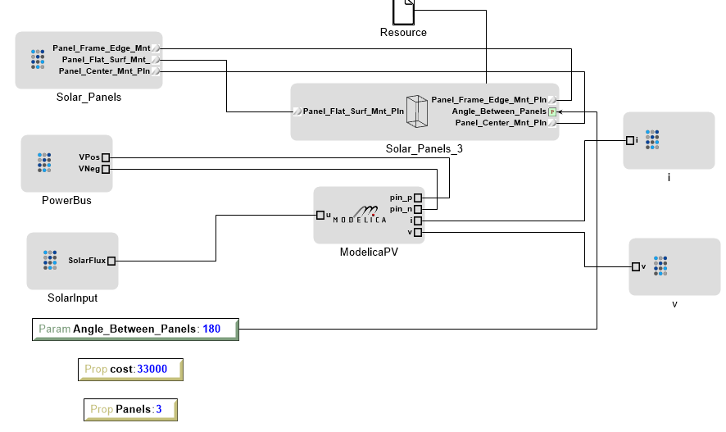
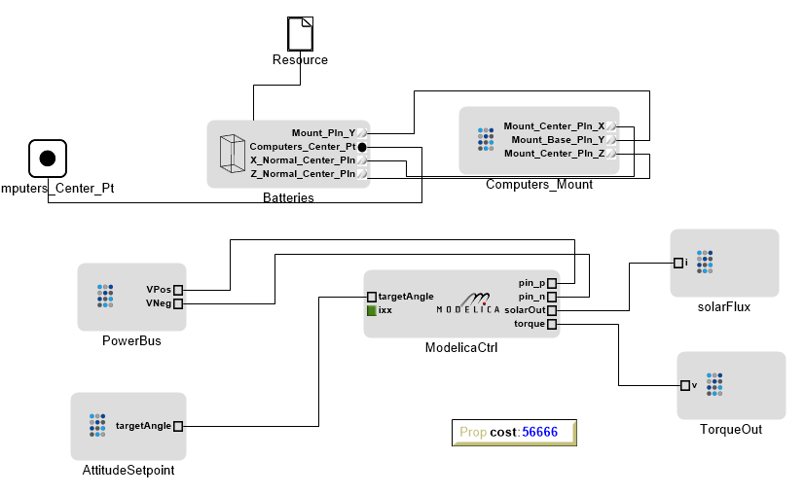
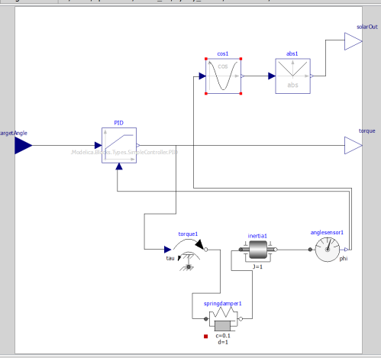
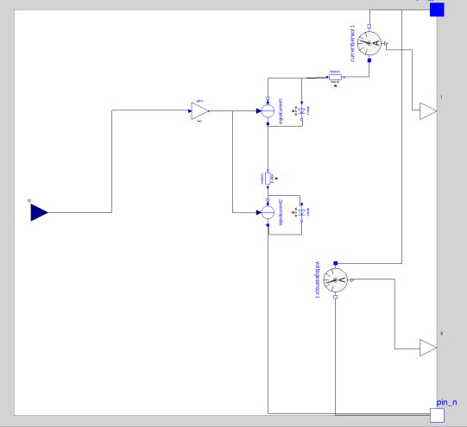
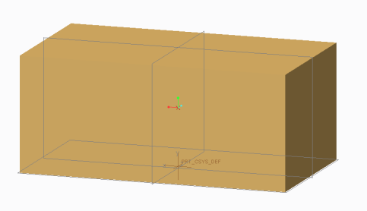
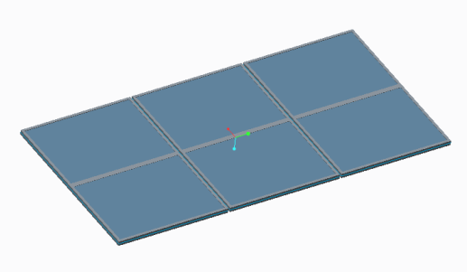
Components: Aggregation of Domain Models
Examples….
OpenMETA
Component
Inside the
Component
Dynamics
Geometry
Dynamics
Geometry
Component
Domain
Models
Solar flux in, power (IV) out Physical, inertial
Attitude set in, PID Contol
Physical, inertial
Mass, Physical BB

Slide 6
Component Dynamics Models
Low Fidelity, Lumped Parameter Models
Couple Rotational Dynamics, Electrical/Torque Relationships, Electrical Energy Management, and Control Against a Simple Scenario

Slide 7
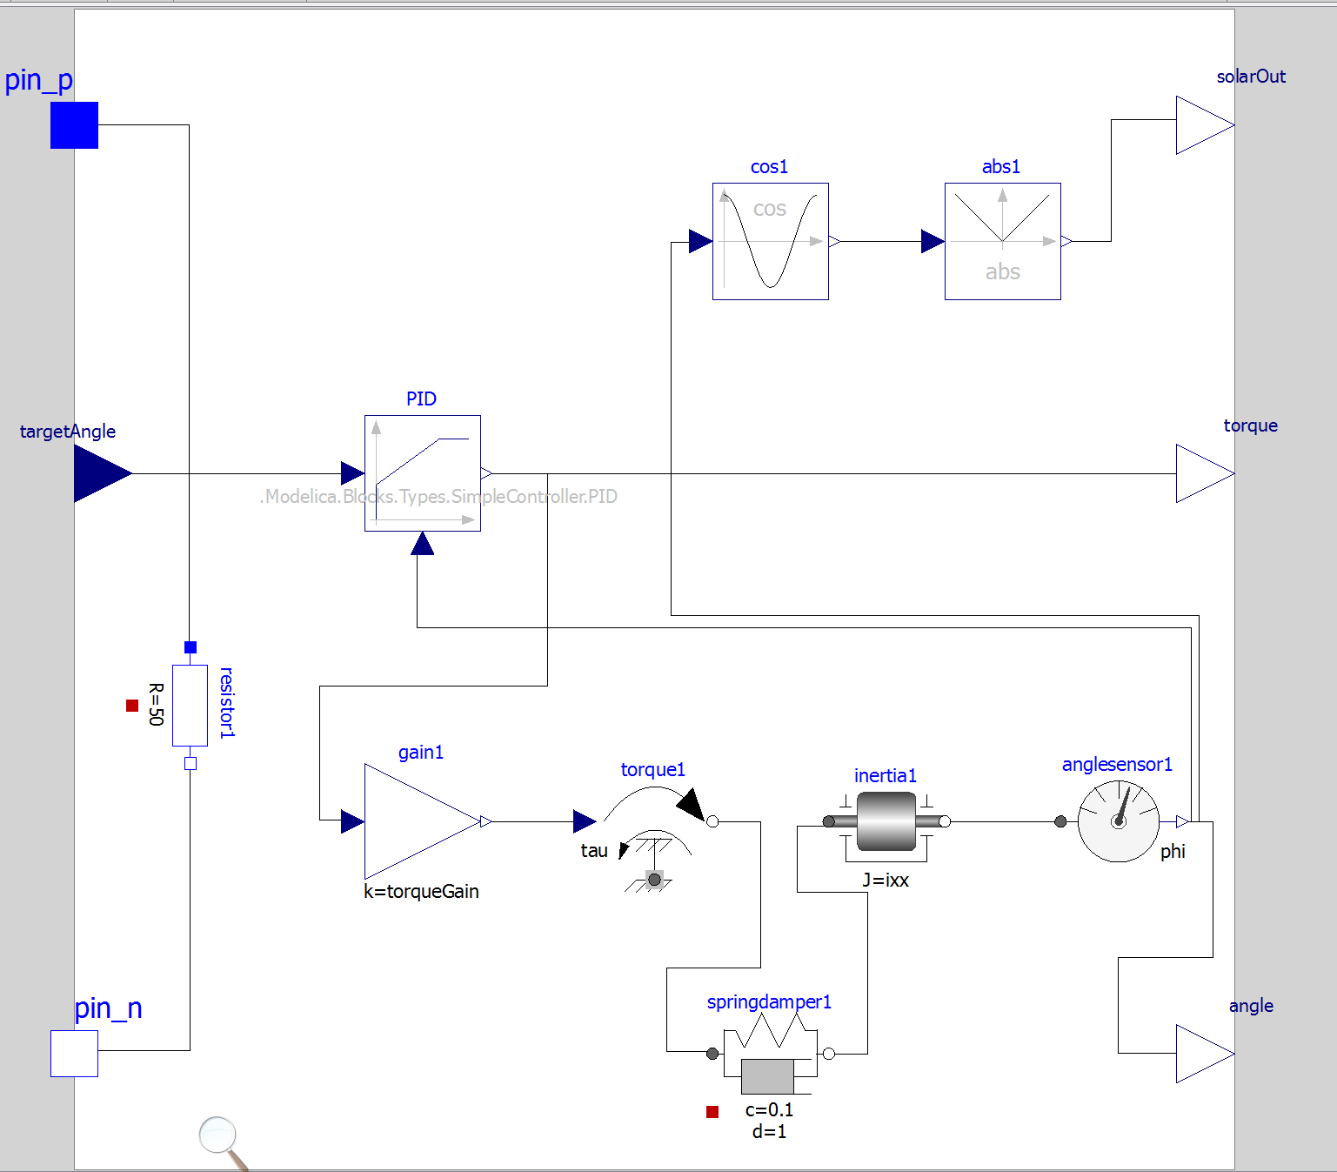
Controller/Inertial/Environment Model
Solar Irradiance
(1D Surrogate)
Controller
(Software)
TBD: Separate into
Different components
Rotational
Dynamics
(1D Surrogate)

Slide 8
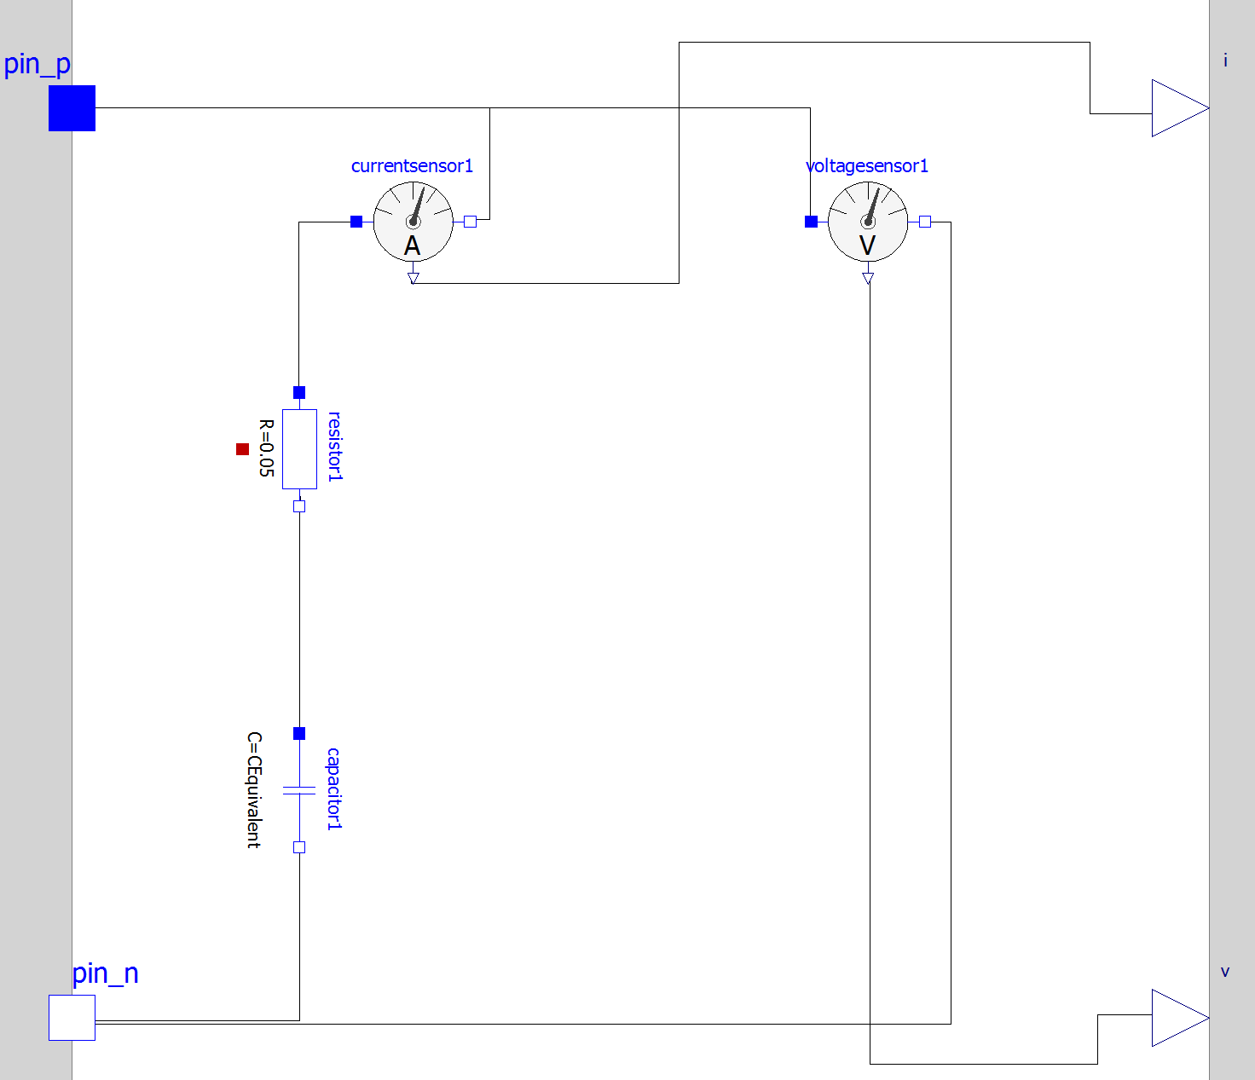
Battery/SuperCap Dynamics

Slide 9
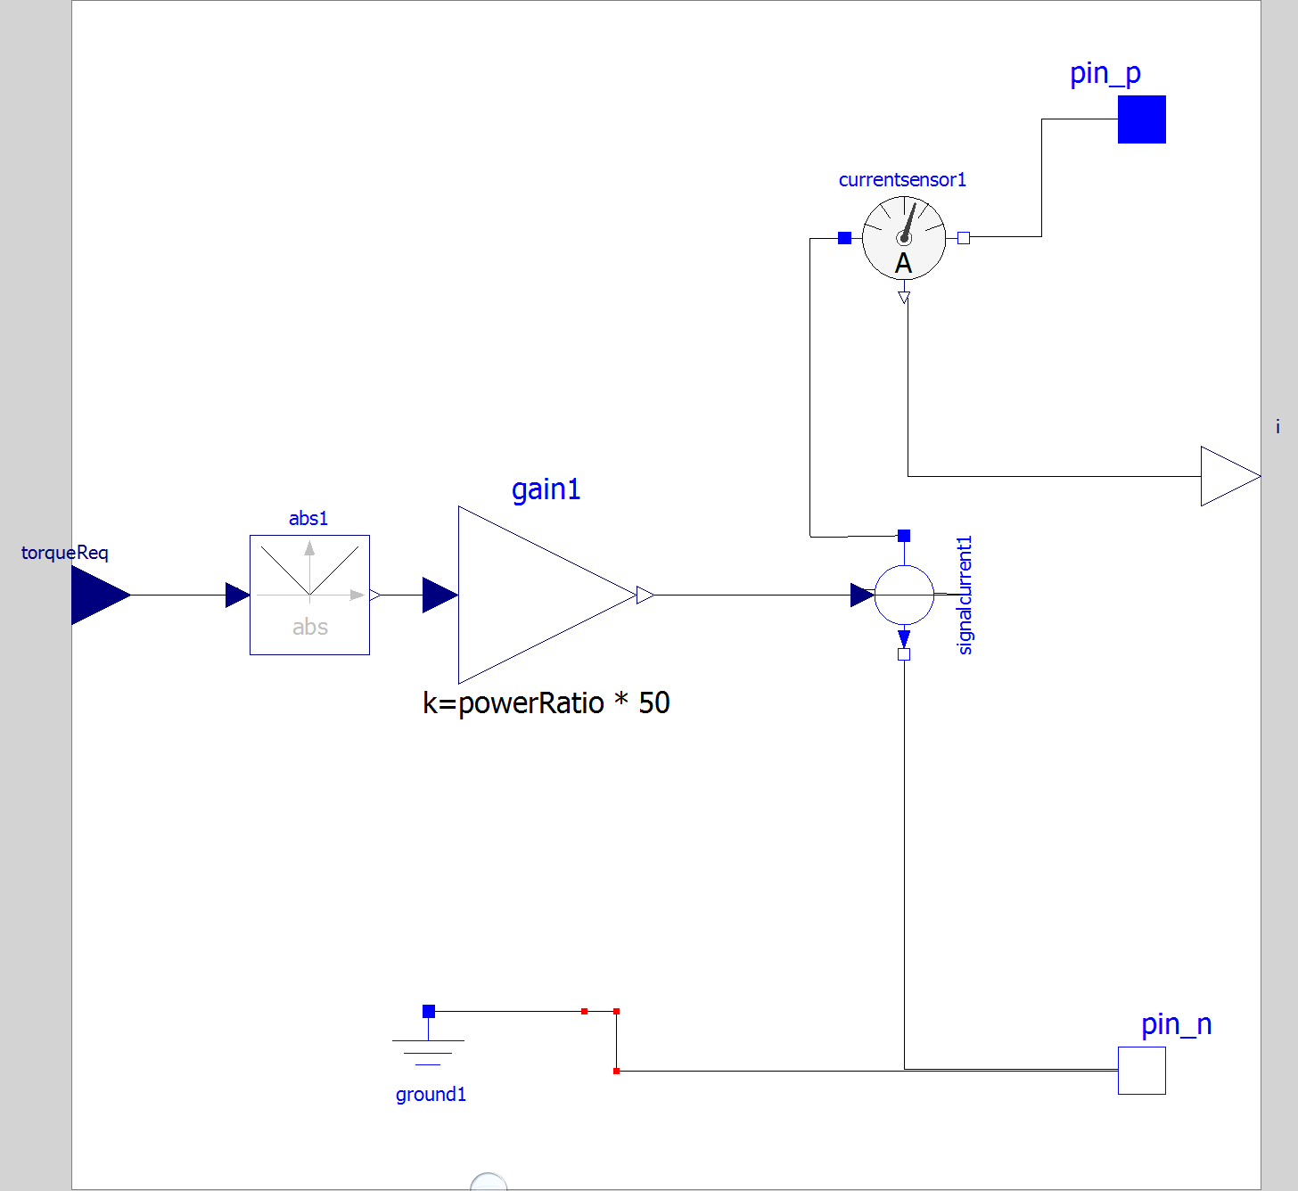
Gyroscope Power Consumption Model

Slide 10
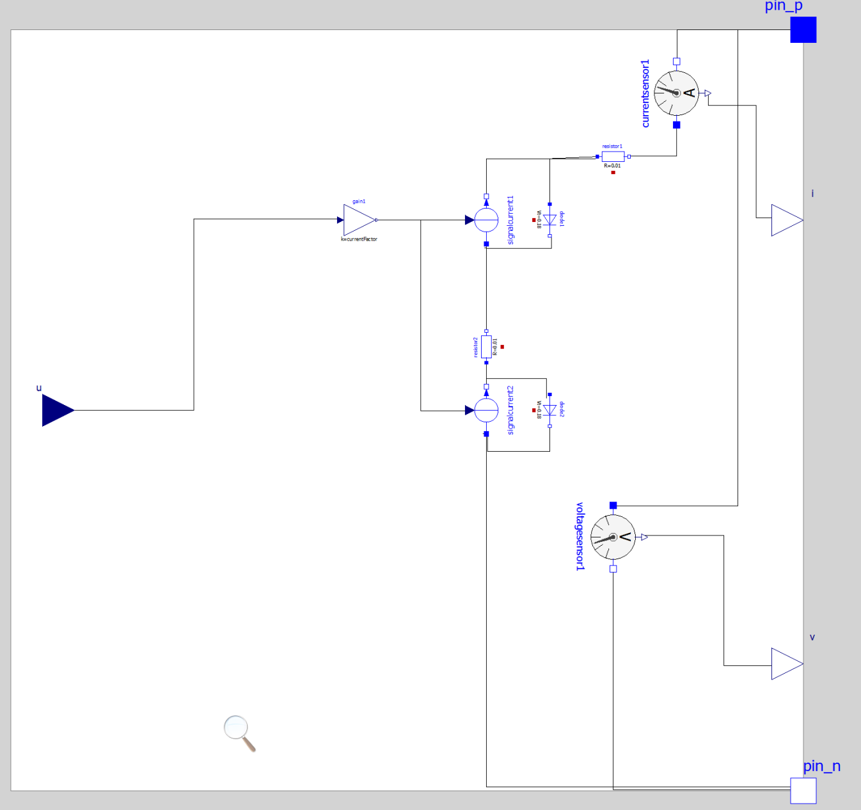
PV Array Electrical Model

Slide 11
Design Analysis For Simple Spacecraft
Design Variables
Solar Cell Size, Gyro/reaction wheel Size, Battery
Geometry (Physical placement of components)
Control Parameters (PID coeff)
Mission Scenario (operations, rotations vs time)
Performance Parameters
Power supply state (min/max V, average batt cap)
Thermal behavior
Time on station (within x of scenario)

Slide 12
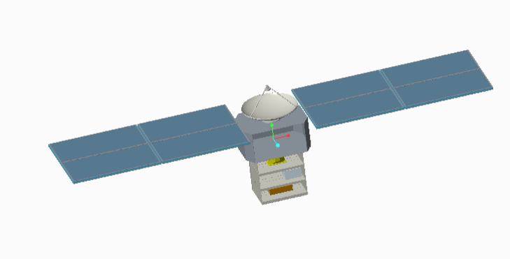
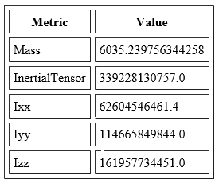
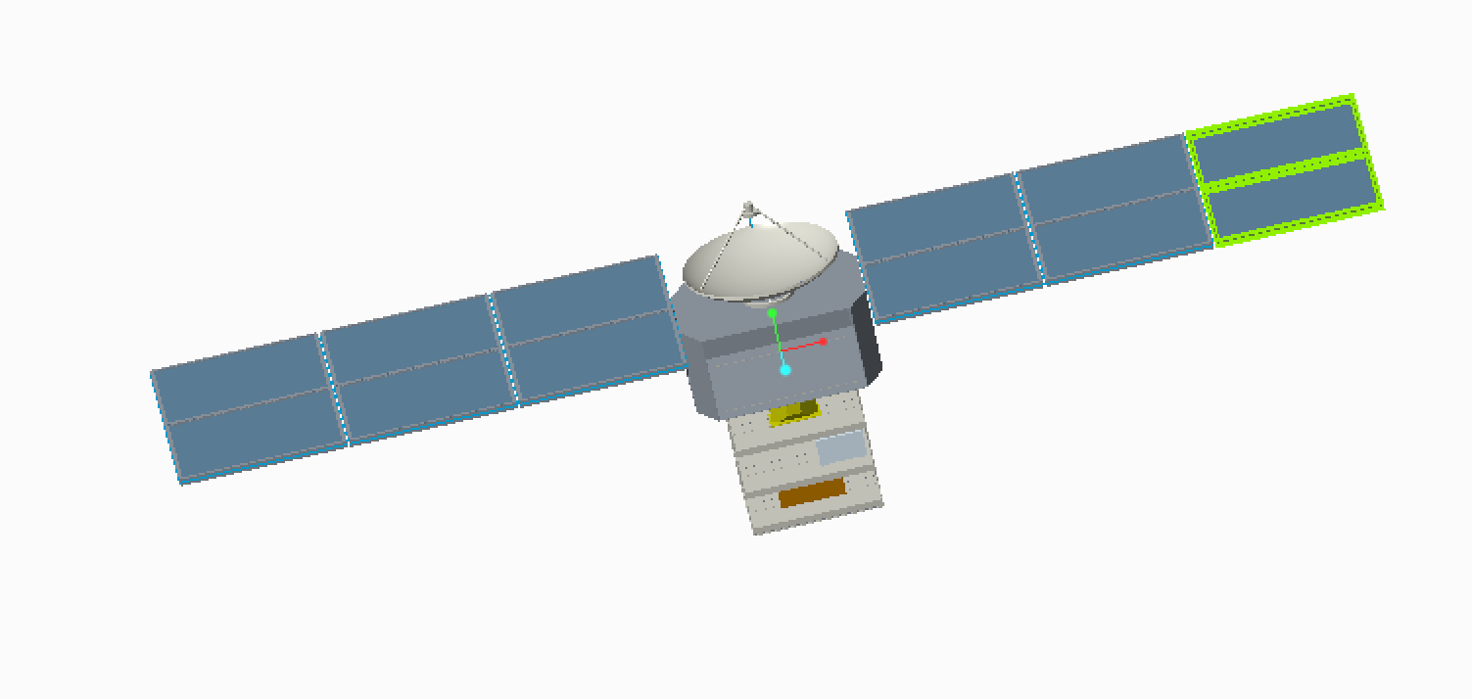
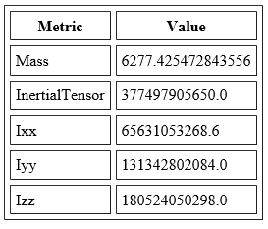
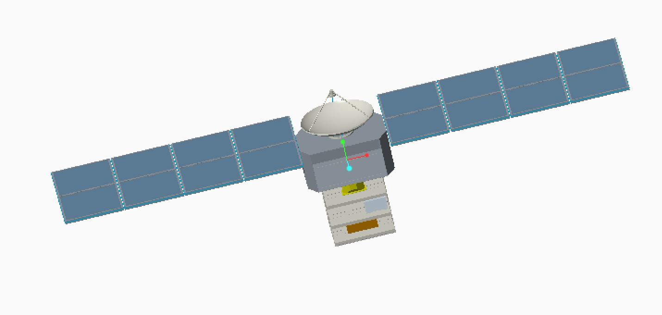
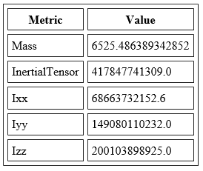
Geometry Analysis
Geometry Design Space
Metrics
2-Panel
3-Panel
4-Panel

Slide 13
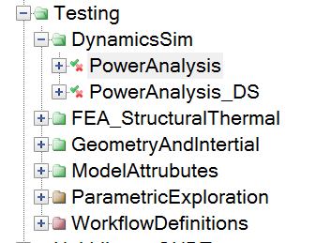
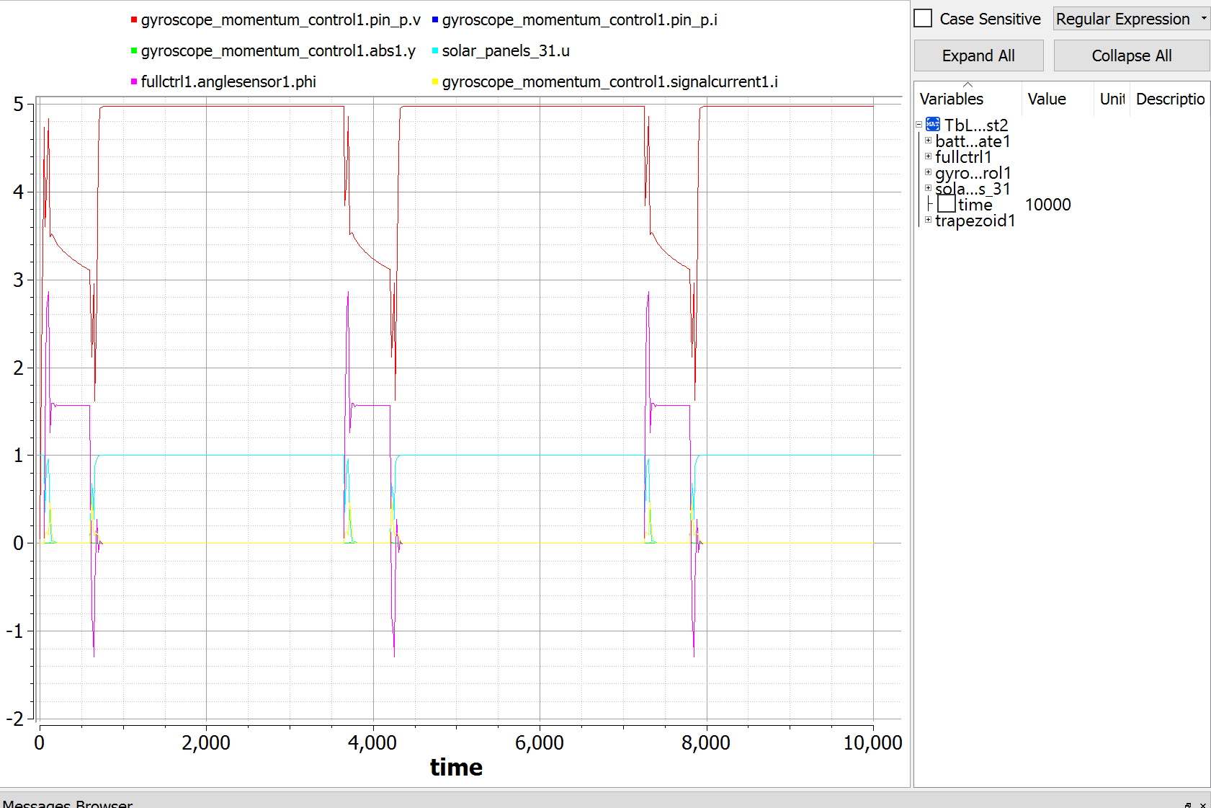
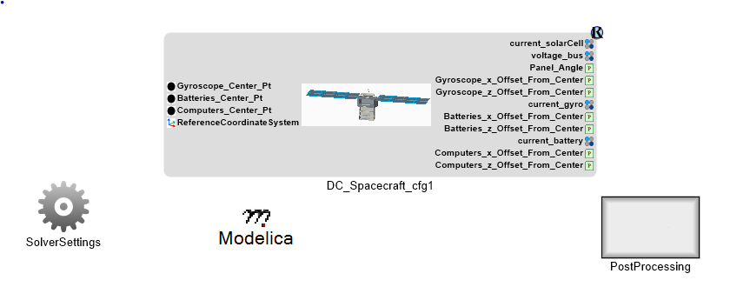
Dynamics Simulation Analysis
Metrics:
Min V = 4.5
Avg Angle Error: xxx
Max Thermal

Slide 14
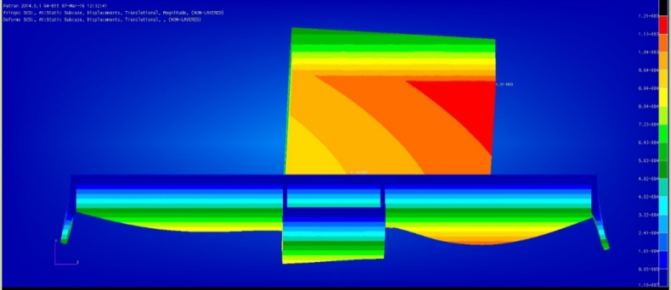
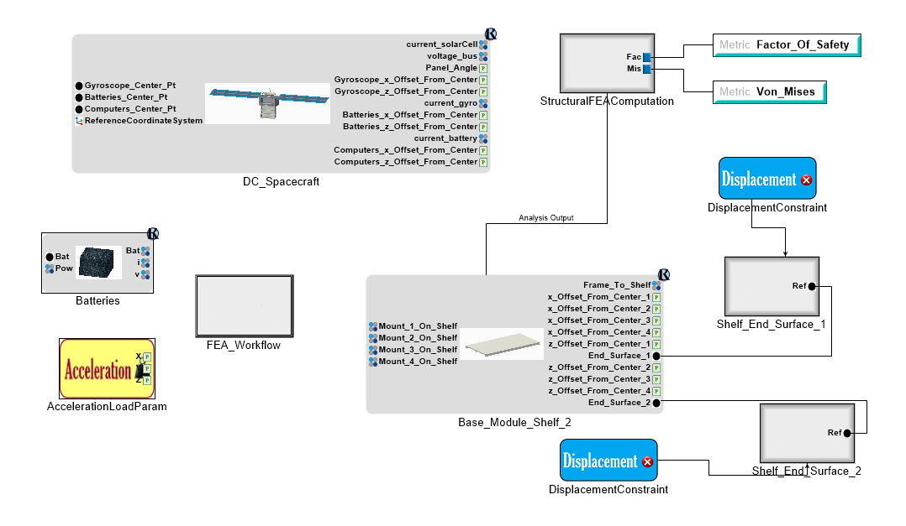
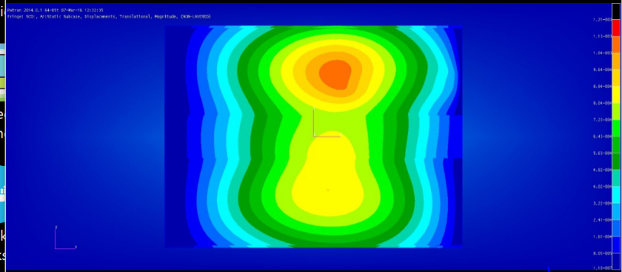
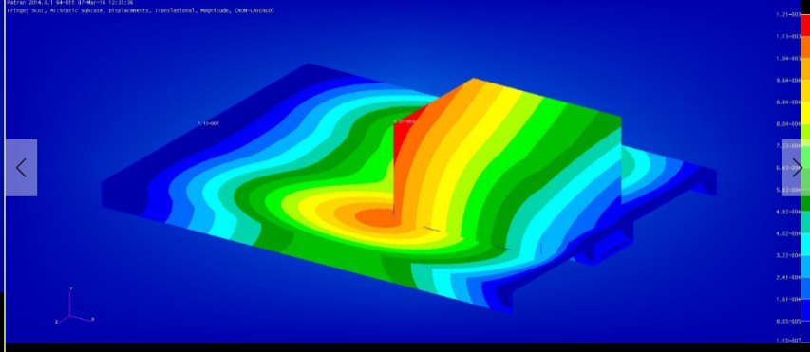
Structural Analysis Using FEA

Slide 15
FEA Process
Compose
Geometry
Initial
Meshing of
Geometry
MM / FeMAP
Mesh Update
FEA Solution
One-Time
Setup
OpenMETA
System Model
Auto-Update Model
Automated Execution
Across Discrete & Parametric Space
Design Study
Study
Driver
Auto-
Compose
Geometry
Mesh
Geometry
Auto-Update Mesh
FEA Solution
Automated FeMAP

Slide 16
Perform A Design Study
Evaluate Discrete Design Choices
Solar Cells: 2-Panel, 3-Panel, 4-Panel
Evaluate Continuous Design Variables
3D Placement of Payload Systems (Battery, Gyro, Electronics)
Gyroscope/Reaction Wheel Sizing, Battery Sizing
Material Thickness For Payload Mounts
Controller Parameters
Design Metrics
Power Bus Stability (Min/Max Voltage on Bus)
Battery Charge Levels
Angle Pointing Error
Mount Component Material Stress Factor-of-Safety

Slide 17
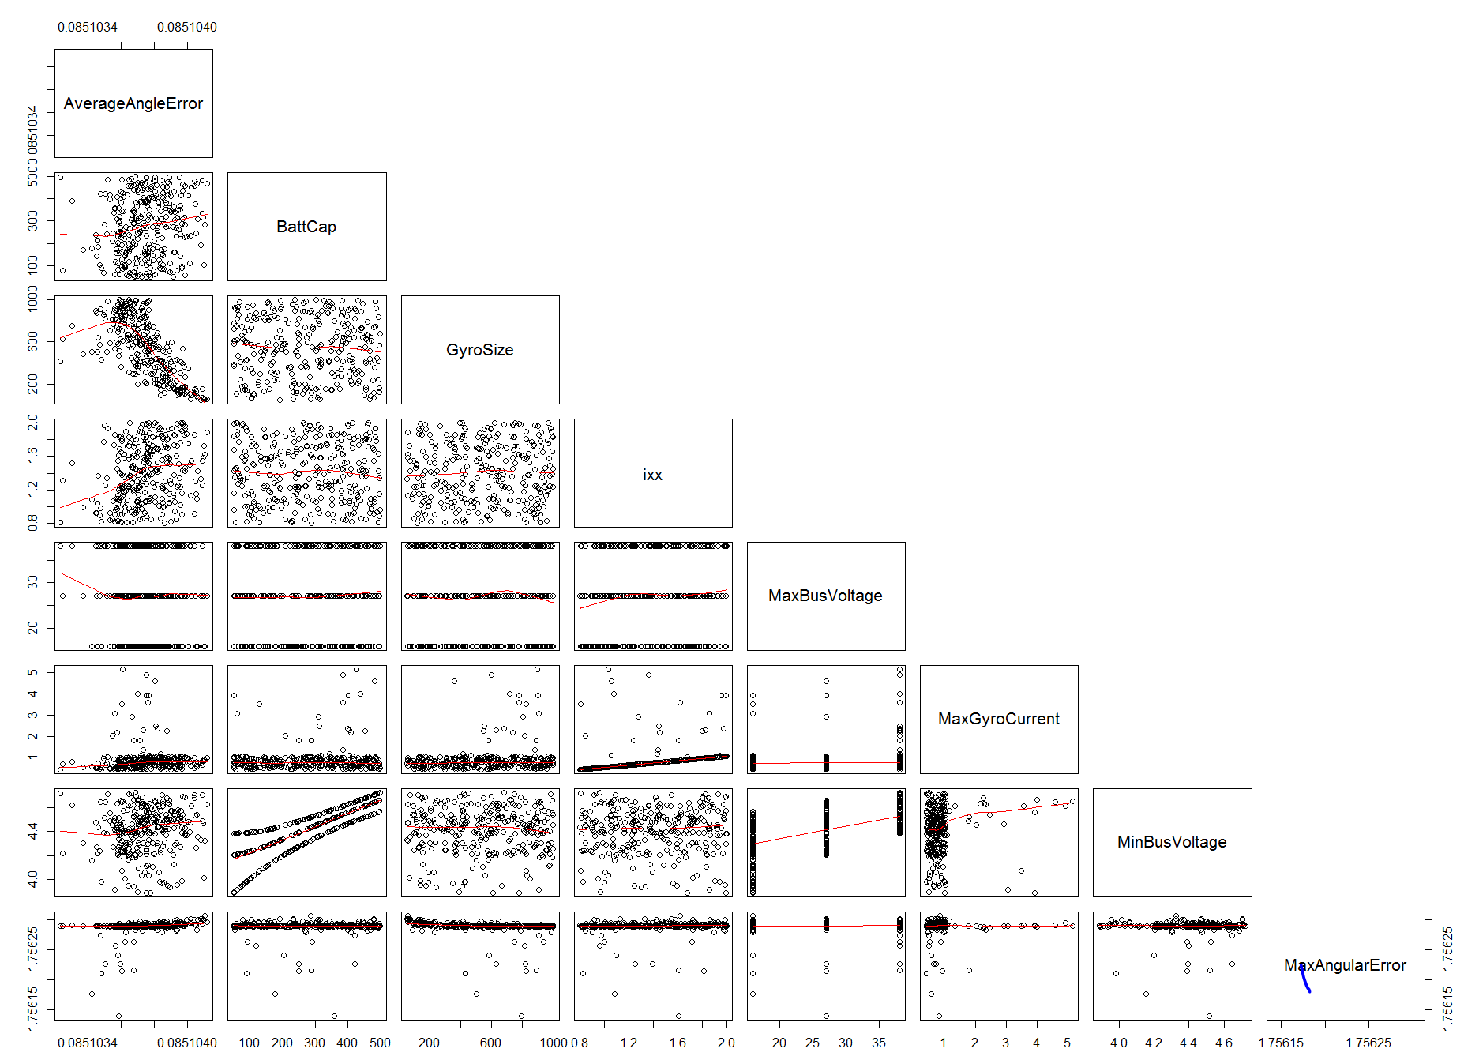
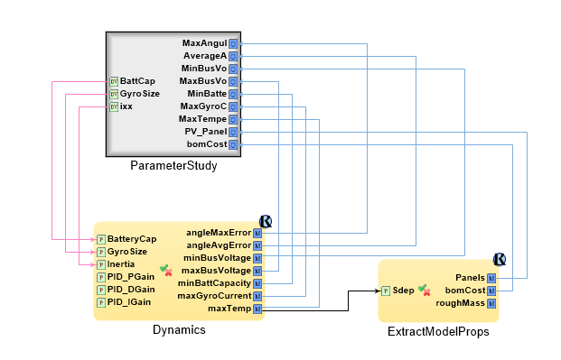
Standalone Dynamics Study
Specify Study
Visualize Results

Slide 18
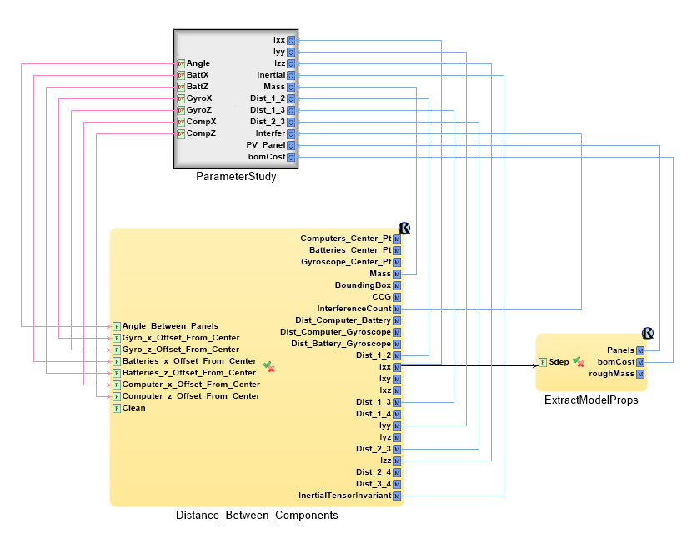
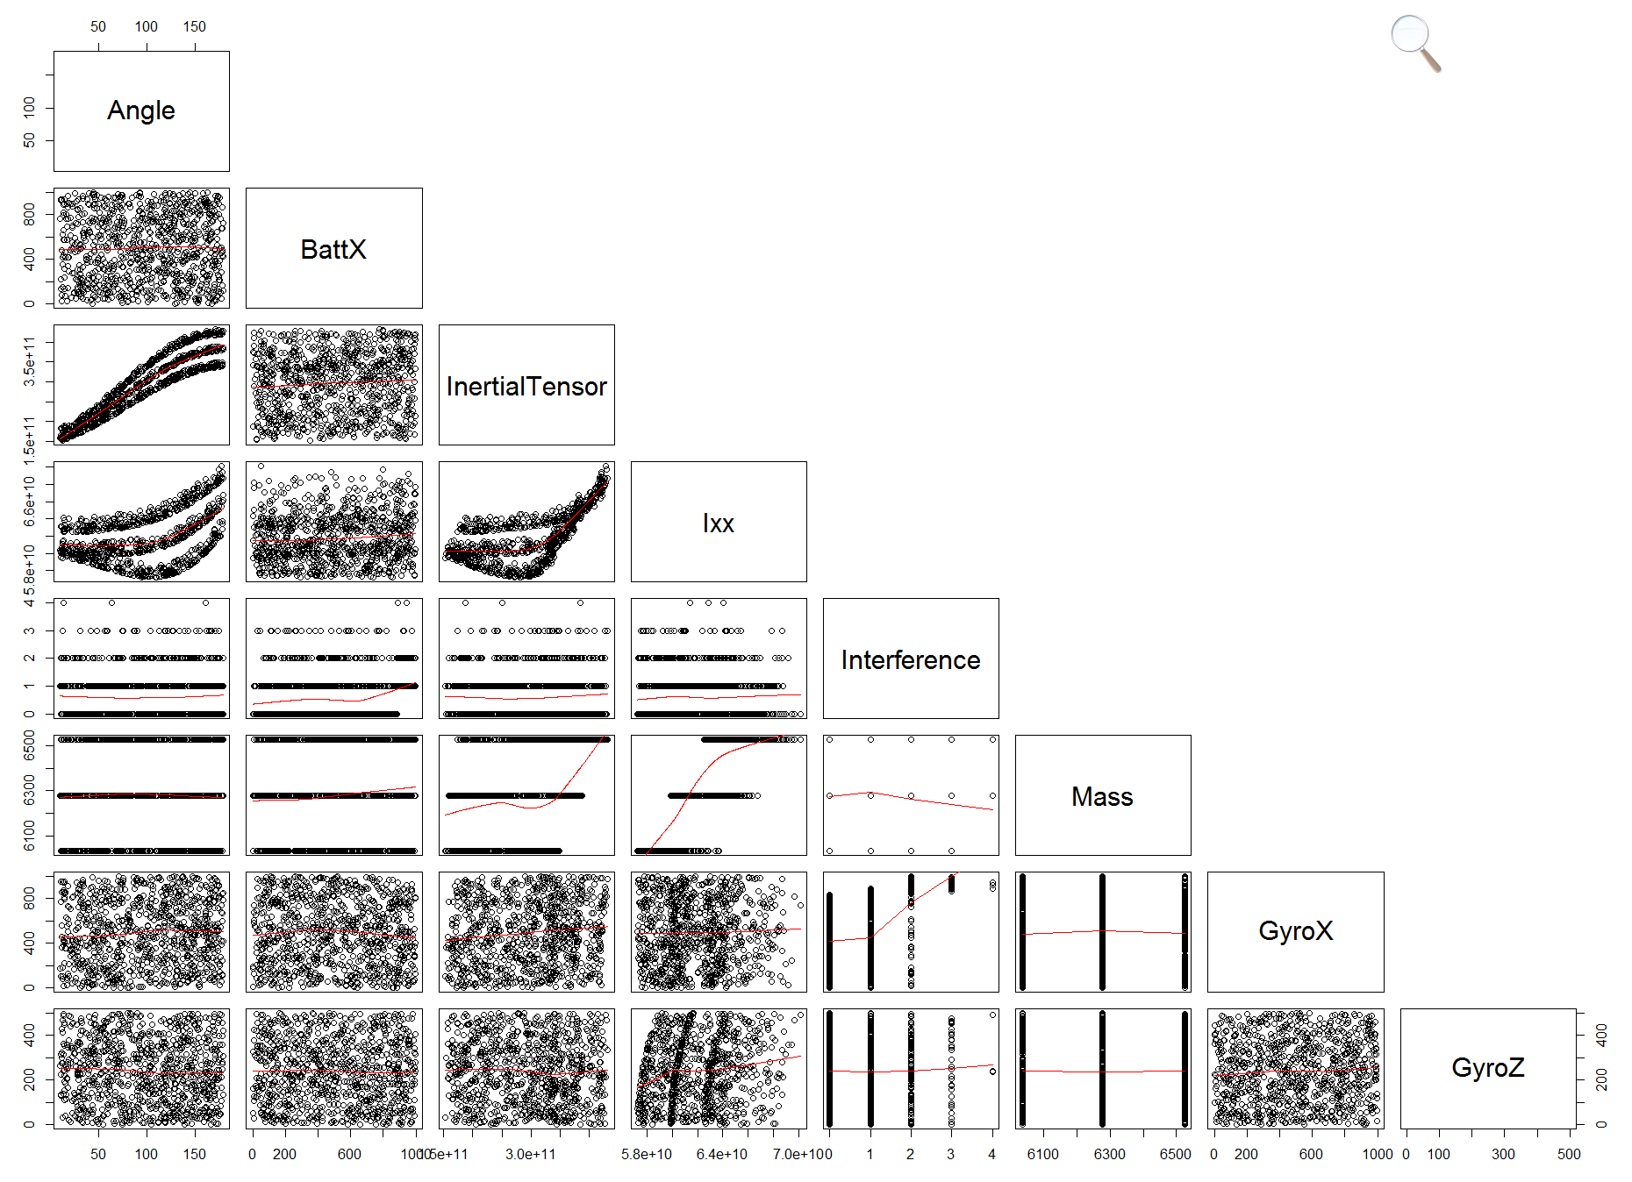
Standalone Geometry Study

Slide 19
Initial Full System Study Workflow
Structural
FEA
CAD Model
Assembly
Stress Factor of Safety
Mesh
Thermal
FEA
Mass, Moments
Dynamic
Sim
Thermal
Conductance /
Masses
Thermal
Sim
Thermal Performance
Over Scenario Time
Power Demand &
Rotation Dynamics
Scenario

Slide 20
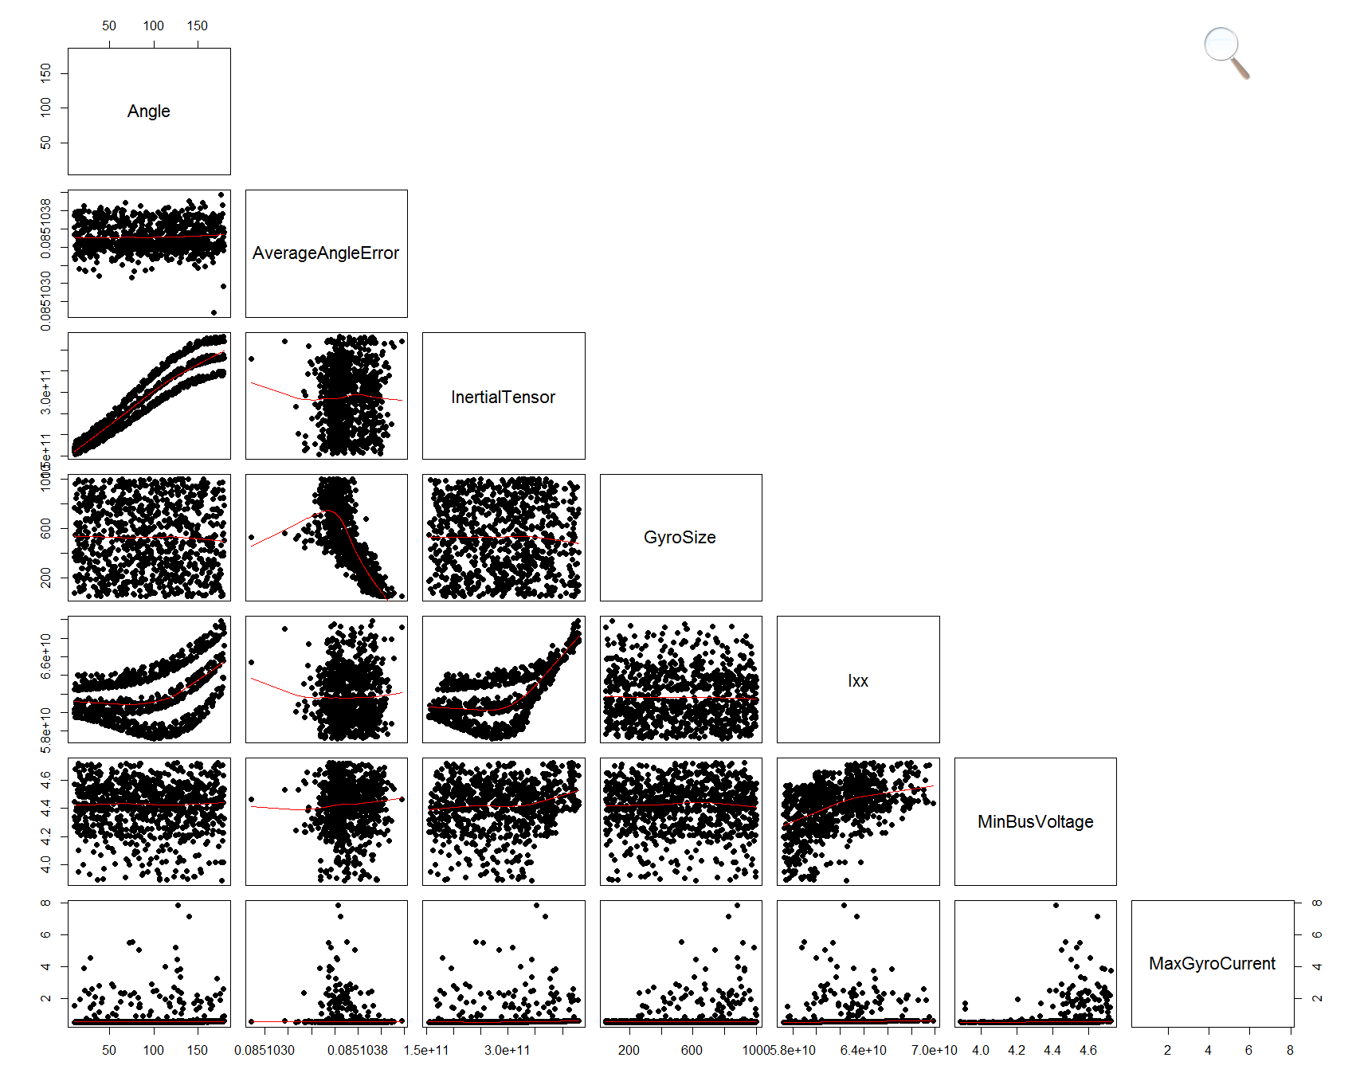
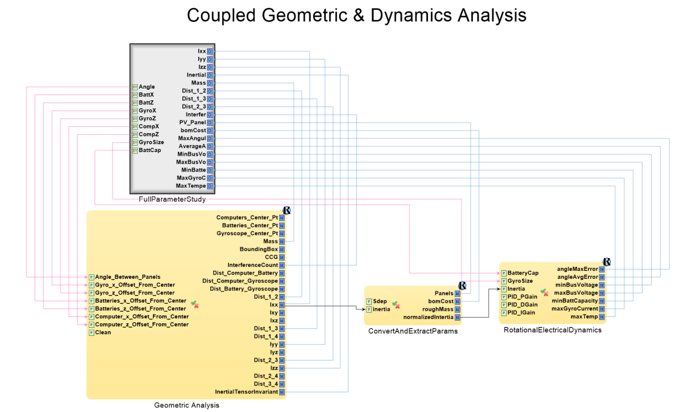
Coupled Analysis
Inertia From Solid Model Drives
Dynamics Model (Rotational Inertia)

Slide 21
Summary
Existing Tool Framework
Has been used for Missile, Vehicle, Electronics Design.
Missile Concept Study 3x Efficiency Gain
Expandable – New Tools Can Be Added
Single Model Drives Multiple Tools
Eliminate Labor/Model Inconsistency
Rapid & Flexible Analysis, Employ Local or Cloud Compute
Spans a Range of Commercial/Open Source Tools
Core Tools are Open Source
But Leverage Commercial Best-In-Class Tools AND Open Source Tools
Also Supports Electronics Design Processes
Plug Together Electronics Functional Blocks
Generates Manufacturable Printed Circuit Boards

Slide 22
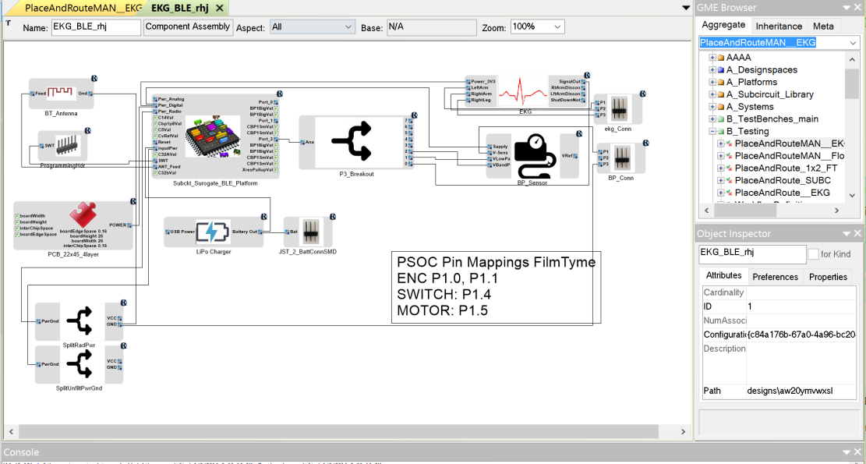
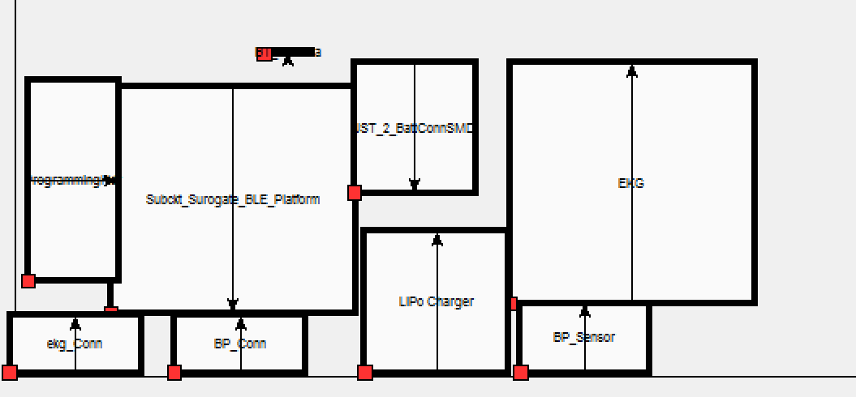
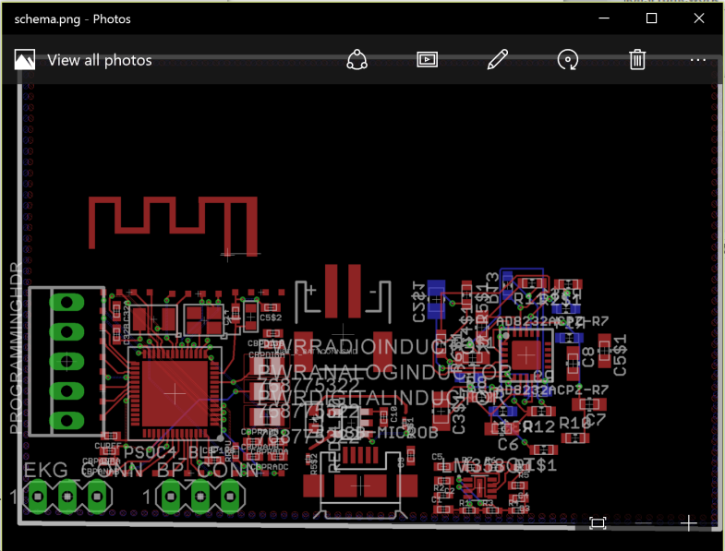
Electronics Design with OpenMETA
2. Place Blocks On Board
1. Define Block Diagram: e.g. Processor, Antenna,
EKG, Blood Pressure
Leverages a Library of Components
And Pre-Routed Subsystems (e.g. Sparkfun
Sensor Library, BLE uC Platforms, …)
Integrates: Spice, EagleCAD, SystemC, OpenEMS
R&D Topic: Integrate with Radiation-Effects
Analysis
3. Tools Create PCB, Uses EagleCAD to Autoroute Intermodule Connections and Produce Manufacturable Data Package

