Slide 1
A Project Management Ontology
Roberto Casadei
April, 2014
Course: Semantic Web
Computer Science and Engineering LM
Alma Mater Studiorum – Università di Bologna

Slide 2
Summary
1) WHAT and WHY: the Domain of Interest
2) The Approach
3) Evaluating Possibilities for Reuse
4) Domain Modelling
5) Development of the Ontology
6) Validation
7) Usage
Notes:
Back to the very origins: it's all about humans and their needs
How is the scenario changed?
The ''Data Deluge''
The past, current, and future Web

Slide 3

WHAT: a project management ontology
An ontology is a
formal,
explicit specification
of a shared
conceptualization
Project management is the application of knowledge, skills, tools, and techniques to project activities to meet the project requirements [5]
My Project Management Ontology (MPMO): a (domain-specific) ontology for project management
  Defining concepts common to the majority of project management efforts
  Defining relationships among those concepts
  Specifying a well-defined semantics for both concepts and properties
using RDF and RDF Schema

Slide 4

WHY: the driving forces
The expected value of such an ontology
  Providing the basis for infrastructures which support an effective management of project data
    E.g., for documentation or monitoring purposes
    E.g., keeping track of events, supporting traceability, etc.
  Using a common format for project management data
  Supporting the implementation of project management software
  Why not simply using standardized data models? [1]
    ''While a standardized data model is good for the exchange of project data between PM-Software, it can also help to build a common understanding of terms and definitions in the field of project management, thus fostering interoperability not only for the exchange of data but also on a business process and organizational level''
    ''A project management ontology is a valuable extension for the representation of project management data since it is semantically more powerful than a data model with explanatory text'

Slide 5
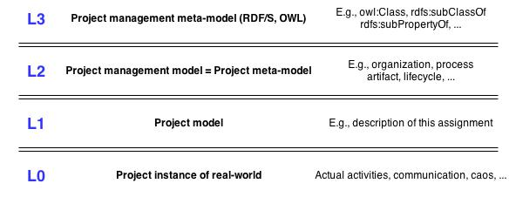
Model layers

Slide 6
The approach: goals and desired properties
Goals
  Producing a model for the project management domain which supports the properties defined below
  Producing an ontology using RDF and RDF Schema which exhibits the properties defined below
  Producing a model for a project management effort using the ontology
Desired properties for the PM ontology
  Generality
  Simplicity
  Flexibility & Extensibility

Slide 7
Towards domain modelling: analysis
Some core concepts come to mind
  Organization
  Project
  Project lifecycle
  Process
  Team
  Stakeholder
  ...
What do these terms (informally) mean?
  The PMBOK (Project Management Body Of Knowledge) as a reference
The matter is complex... have others faced similar issues?

Slide 8
Existing ontologies related to project-management
  Description of a Project (DoaP)
    An XML/RDF vocabulary to describe open source and other software projects
    https://github.com/edumbill/doap/wiki
  Project Documents Ontology (PDO)
    Models the inherent structure and concepts of various documents in a project-specific setting, like meeting minutes, status reports etc.
    http://vocab.deri.ie/pdo#
  SUPER (Semantics Utilised for Process management within and between EnteRprises)
    Focused on BPM
    http://www.ip-super.org/
  Software Process Control Model
    http://spi-fm.uca.es/spdef/models/deployment/spcm/1.0#
  Another Project Management Ontology (APMO)
    https://code.google.com/p/apmo/
  FP research project ontologies
    http://mayor2.dia.fi.upm.es/oeg-upm/index.php/en/ontologies/81-research-proj-ontologies
  PROMONT ontology
    A project management ontology as a reference for virtual project organizations
    Only publications?
  …

Slide 9
Reusing ontologies
Project management is about concepts... → The SKOS ontology
…and about how orgs execute projects... → The ORG ontology
...by driving people and resources... → The FoaF ontology
…in order to deliver some result and ultimately business value
  Other ontologies that will be reused include
    The W3C Time Ontology (OWL-Time), e.g., in order to define time-bounded resource allocations
  The following ontologies are not considered at the general level, but may be in specializations
    DoaP has a narrower scope (software projects, descriptive-level)
    FP Research project ontologies (Documentation, Event, Organization, Person, Project) are very detailed but seem to have a slightly different focus
    SUPER ontologies are part of a complex ecosystem focused on processes
  Moreover, some of them seem to be minor ontologies
    PDO has a narrower scope with respect to deliverables (documents)
    Software Process Control Model has a narrow scope and provides only some general classes
  Also, I'd like to be free in taking decisions about core concept modelling

Slide 10
The FoaF (Friend of a Friend) ontology
  [2], http://xmlns.com/foaf/0.1/‎
  FoaF is a project devoted to linking people and information using the Web
Elements of interest
  foaf:Agent class represents things that do stuff (e.g., person, sw or physical artifact)
    Subclasses: foaf:Person, foaf:Organization, foaf:Group
    May be a choice to represent project participants
      What if I engage a robot in my next SW assignment?

Slide 11
The ORG ontology (1)
  [3], http://www.w3.org/ns/org#
  W3C Recommendation, January 2014
  Core ontology ''for organizational structures, aimed at supporting linked data publishing of organizational information across a number of domains''
    So, it respects our requirement for generality
  ''It is designed to allow domain-specific extensions to add classification of organizations and roles, as well as extensions to support neighbouring information such as organizational activities''
    So, it supports our requirement for flexibility and extensibility

Slide 12
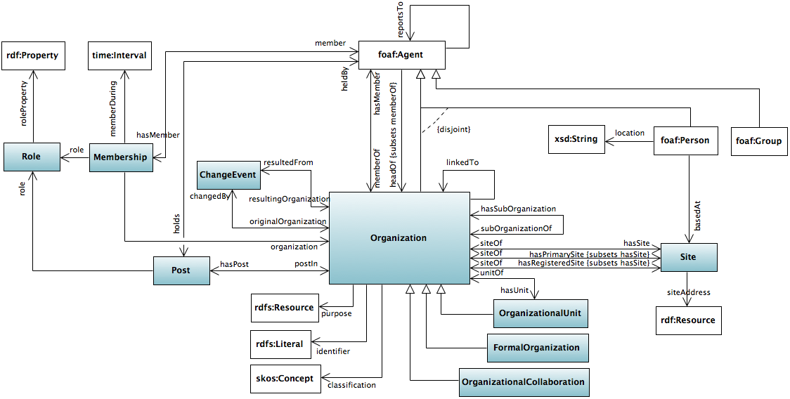
The ORG ontology (2)

Slide 13
The ORG ontology (3)
Elements of interest
  org:Organization: represents a collection of people organized together into a community or other social, commercial or political structure
    May be an org:subOrganizationOf another organization (which in turn org:hasSubOrganization)
    Or may have more org:OrganizationalUnits (which only have meaning within the context of the containing organization)
  Membership
    Direct: an individual (represented as a foaf:Agent) is org:memberOf an organization
      Subproperties of org:memberOf to represent specific roles that the person plays
    Membership n-ary relationship: an org:Membership of an org:member in an org:organization, with possibly an org:role during org:memberDuring
  org:Post represents some position in the organization that may or may not be currently filled.
    Posts enable reporting structures and organization charts to be represented independently of the individuals holding those posts
  org:Sites represent locations at which organizations exist
  When Organizations change substantially […] then the new Organization will typically be denoted by a new URI. In that case we need some vocabulary to describe that change over time and the relationship between the original and resulting resources. ORG provides org:ChangeEvent and associated properties as a foundation for this

Slide 14
The SKOS (Simple Knowledge Organization System) ontology
  [4], http://www.w3.org/2004/02/skos/core#
  SKOS is a common data model for KOSs such as thesauri, classification schemes, subject heading systems and taxonomies
Elements of interest
  A skos:Concept can be viewed as an idea or notion; a unit of thought. However, what constitutes a unit of thought is subjective, and this definition is meant to be suggestive, rather than restrictive
    The notion of a SKOS concept is useful when describing the conceptual or intellectual structure of a knowledge organization system, and when referring to specific ideas or meanings established within a KOS
  A skos:ConceptScheme can be viewed as an aggregation of one or more SKOS concepts
    Is disjoint with skos:Concept
    Semantic relationships (links) between those concepts may also be viewed as part of a concept scheme
    Related properties: skos:inScheme, skos:hasTopConcept, skos:topConceptOf
    There are no conditions preventing a SKOS concept from taking part in zero, one, or more than one concept scheme

Slide 15
Domain modelling (1)
Core concepts
  mpmo:PMModel
    Subclass of skos:ConceptScheme
  mpmo:PMEffort
  mpmo:PMConcept
    Subclass of skos:Concept
  An mpmo:PMModel is a scheme of mpmo:PMConcepts
    skos:hasTopConcept
  An mpmo:PMModel mpmo:governsExecutionOf an mpmo:PMEffort

Slide 16

Domain modelling (2)
Main project management concepts
  They are classes (i.e., instances of rdfs:Class)
  They are instances of mpmo:PMConcept
  mpmo:Process: a set of interrelated actions and activities performed to create a pre-specified product, service, or result. Each process is characterized by its inputs, the tools and techniques that can be applied, and the resulting outputs [5]
    Subclass of mpmo:PMEffort
  mpmo:Project: temporary endeavor undertaken to create a unique product, service, or result [5]
    Subclass of mpmo:Process
  mpmo:ValueResource: anything expected to produce value through interaction with other entities
  mpmo:Deliverable: any unique and verifiable product, result or capability to perform a service that is required to be produced to complete a process, phase, or project [5]
    Subclass of mpmo:ValueResource
  mpmo:Organization: a group of individuals organized to work for some purpose or mission
    Subclass of org:Organization

Slide 17
Domain modelling (3)
  mpmo:Stakeholder: a person which has an interest in the project
    Subclass of foaf:Person
  mpmo:Participant: an agent (which may be a person but not necessarily) which actively does something within a project
    Subclass of foaf:Agent
  mpmo:Role: a role within a project
    Subclass of org:Role
  mpmo:Membership: a membership relationship (agent, role, organization, project/process) within a project
    Subclass of org:Membership
    mpmo:withinProcess allows to specify that such membership relationship applies to given process

Slide 18
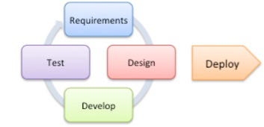

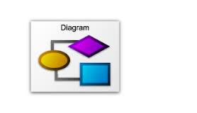


MPMO: ontology development
Iterative process
RDF and RDF Schema
Modelling the domain
Validating the requirements
Validating the schema

Slide 19
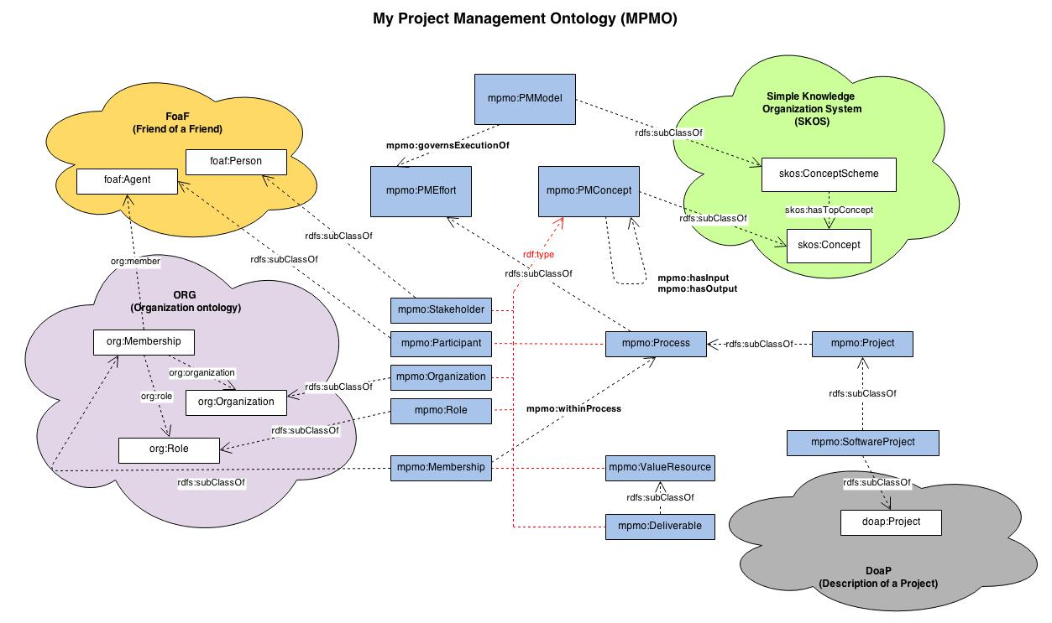
The MPMO ontology

Slide 20
The ontology in use
Describing this assignment
In terms of
  Participants: me and the teacher
  Goals: what need to be delivered
  Approach: the project management model
Also, useful to generate feedback for the ontology modelling phase
  Especially with regards to the desired quality attributes

Slide 21
Conclusion
Lessons learned
  Modelling a domain may be very complex
  Building an ontology is an engineering process
    A mature process is needed
    Trade-offs
  The ontology is a living model

Slide 22
Advice in reuse of ontologies
  http://answers.semanticweb.com/questions/12040/owlequivalentclass-and-owlsameas-considered-troublesome
  http://answers.semanticweb.com/questions/11115/rdfslabel-vs-skospreflabel-vs-dctitle
  http://www.ibm.com/developerworks/xml/library/x-tiprdfai.html
    As for choosing between rdf:ID and rdf:about, you will most likely want to use the former if you are describing a resource that doesn't really have a meaningful location outside the RDF file that describes it

Slide 23
References
  [0]: Google & Wikipedia
  [1]: Sven Abels, Frederik Ahlemann, Axel Hahn, Kevin Hausmann, and Jan Strickmann. 2006. PROMONT – a project management ontology as a reference for virtual project organizations.
  [2]: http://xmlns.com/foaf/spec/
  [3]: http://www.w3.org/TR/2014/REC-vocab-org-20140116/
  [4]: http://www.w3.org/TR/skos-reference/
  [5]: 2004. A Guide to the Project Management Body of Knowledge (PMBOK Guides). Project Management Institute.
  [6]: https://github.com/edumbill/doap/wiki
  [7]: http://www.w3.org/TR/owl-time/

