Slide 1
A Project Management Ontology in OWL
Roberto Casadei
May, 2014
Course: Semantic Web
Computer Science and Engineering LM
Alma Mater Studiorum – Università di Bologna

Slide 2
Summary
1) Introduction
2) Ontology development: a methodology
3) Development of MPMO (My Project Management Ontology)
4) Conclusions
Notes:
Back to the very origins: it's all about humans and their needs
How is the scenario changed?
The ''Data Deluge''
The past, current, and future Web

Slide 3

Introduction
WHAT → modelling the knowledge in a domain of interest using OWL
HOW → trying to follow a methodology for ontology development
With respect to the previous assignment
  More emphasis on the process (rather than on the product)
  Striving to follow a more systematic approach
  Deeper awareness about what an ontology is

Slide 4
Ontology development: the methodology
Iterative process
1) Determine domain, scope and objectives
2) Informal/semi-formal knowledge acquisition
3) Refine requirements and tests
4) Design and implementation
5) Evaluation and quality assurance
6) Maintainance: usage monitoring and evolution

Slide 5
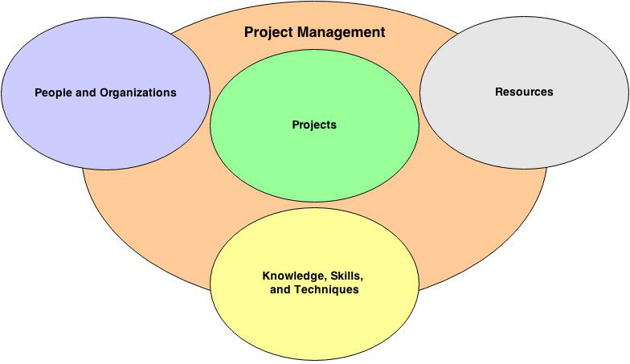
1a) Domain and scope
Domain → project management
  I.e., the application of knowledge, skills and techniques to execute projects effectively and efficiently
Notes:
Sembra che stia già modellando, in realtà fare questo mi serve per delineare meglio lo scope
Notare che questi domini (che si intersecano) contengono concetti a più livelli o punti di vista (struttura/comportamento/interazione)

Slide 6

1b) Domain and scope
Are we sure we need an ontology?
  Actually, this phase might conclude that an ontology is not the right tool for us
High-level objectives
  To provide a description tool and support unambiguous communication
  To provide a model upon which project management software tools can be built
    Typical features: collaborative tools, issue tracking, scheduling, project portfolio management, resource management, document management tools, workflow management, reporting&analysis
Two abstraction levels
  Project management concepts and models
  Project models
Notes:
Rethinking about... why an ontology?
To share common understanding of the structure of info among people and sw agents
To enable reuse of domain knowledge
To make domain assumptions explicit
To separate domain knowledge from the operational knowledge

Slide 7
1c) Domain and scope
Scope
1) Project management models
2) People and organizations
3) Resources
4) Projects
But re-using when possible!

Slide 8
2a) Informal/semi-formal knowledge acquisition
Sources
  The previous assignment
  The ''Project Management'' course ;)
  Wikipedia, the PMBOK (Project Management Body of Knowledge) & literature
Steps
  Collect the terms and informally organize them
  Paraphrase/clarify terms to produce informal concept definitions
  Inspect the terms

Slide 9
2b) Informal/semi-formal knowledge acquisition
Collect the terms and organize them informally
Project management model
Project management concept
Resource
Time
Budget
Tool
Human-resource
Deliverable
Artifact
Documentation
Project management effort
Project
Software project
Process
Activity
Organization
Agent
Person
Participant
Stakeholder
Group
Team
Role
Customer
Membership
Project manager
Team member

Slide 10
2c) Informal/semi-formal knowledge acquisition
Paraphrase the terms to produce informal concept definitions
For example:
  Organization = group of individuals organized to work for some purpose or mission.
  Process = set of interrelated actions and activities performed to create a pre-specified product, service, or result. Each process is characterized by its inputs, the tools and techniques that can be applied, and the resulting outputs.
  Deliverable = any unique and verifiable product, result or capability to perform a service that is required to be produced to complete a process, phase, or project
  … … ...

Slide 11
2d) Informal/semi-formal knowledge acquisition
What do we want to say about these terms? Which properties they have?
For example:
  A resource can be the input or the output of a project/process/activity
  A process can be organized into subprocesses and activities
  An agent or person can play a certain role in a project during a time interval
  … … ...
Do these concepts have some common characteristics? Are there additional things with those characteristics which might be considered?
For example:
  Projects as well as processes and activities have goals, inputs, outputs, and participants
  Organizations as well as projects, processes, and activities can define roles to be played by agents or people
  … … …

Slide 12
3a) Refine requirements and tests: functional requirements
We should define better what we want to do so to be able to move towards design
For example, via use cases
  A project management expert defines a new project management model by extending a basic model with both concepts already defined somewhere and new concepts
  A project manager uses a software tool which allows him to graphically create a project description that is based on the MPMO ontology concepts
  A software tool may be used to check if all the concepts instantiated into a project description are defined within the associated project management model
  … … ...
Notes:
Remember
This is an iterative process
If requirements change, the fitness of OWL should be re-evaluated!!!

Slide 13
3b) Refine requirements and tests: non-functional requirements
What properties should the ontology exhibit?
  Generality & Flexibility: adaptivity to contexts/situations which can be very diverse
  Simplicity: providing a model which is easy to understand and put into action
  Extensibility: providing support for specializations and tailoring
→ These suggest goal-driven tests by the perspective of ontology usage
Is OWL the right language to build the ontology? Which OWL flavor?
→ We compare what we want to express in our ontology to OWL expressivity and decidability boundaries
  For example: a design decision is that of having things being both an instance and a class
    E.g.: Organization is both an instance of PMConcept and a subclass of org:Organization
  This would put the ontology into OWL Full (which is undecidable) – but OWL 2 solves this problem using the so-called punning where a URI can be used in multiple roles
Notes:
Remember
This is an iterative process
If requirements change, the fitness of OWL should be re-evaluated!!!

Slide 14
4a) Design & implementation
Inputs for this phase
  Goals, requirements
  Informal knowledge previously collected
Design / modelling / implementation
  Delve into concepts, relationships, properties
  Organize the concepts
  Formalize the definitions
Conventions
  Class names are singular
Notes:
Modelling of the domain
Design of an ontology
Implementation of an OWL ontology

Slide 15
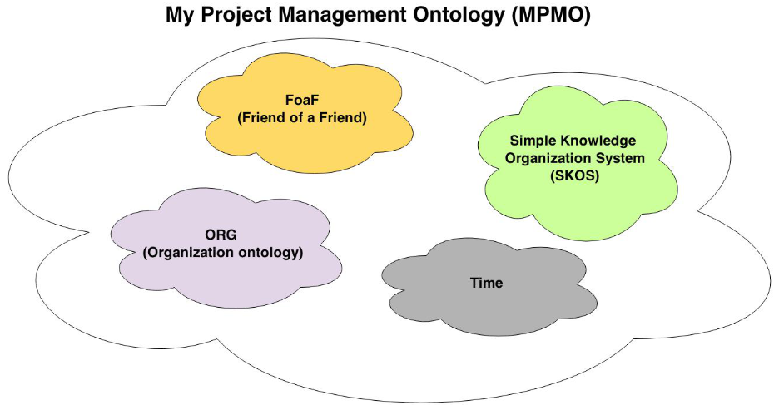
4b) Design & implementation
Ontology editor: Protégé
Imported ontologies
  SKOS
  ORG
  FoaF
  Time
  … … ...
...
...
Notes:
Extend the concepts
Take a group of things and ask what they have in common
And then what other “siblings” there might be
Organize the concepts
Add abstractions where needed, identify relations, identify definable things (i.e., things where you can say clearly what they mean)
Self-standing things can exist on their own (roughly nouns)
Modifiers modify other things (roughly adjectives and adverbs)
Arrange concepts/properties into hierarchy
Reorganize everything but “definable” things into pure trees – these will be the “primitives”
Define properties
Identify domain and range constraints
Definable things
Paraphrase and formalise the definitions in terms of the primitives/relations/other definables

Slide 16
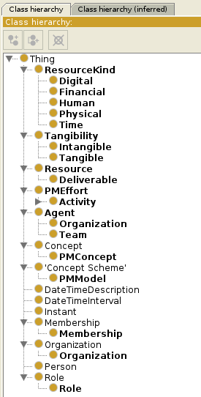
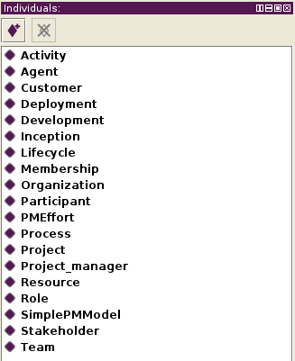
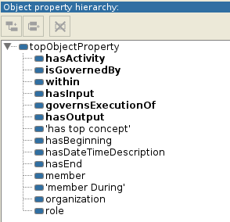
4c) Design & implementation
Notes:
Value partitions → copertura totale esclusiva

Slide 17
4d) Design & implementation
Some notes about design/modelling decisions
  At one abstraction level we have PMModel, PMConcept, PMEffort, and at another abstraction level we have the project management concepts (instances of PMConcept!)
    A PMModel governsExecutionOf PMEffort (inverse functional property)
  Project is a subclass of Process, Process is a subclass of Activity
    A Process must produce in output one or more Deliverables
      This cannot be expressed in RDFS. How is this expressed in OWL?
      Unqualified cardinality restrictions in OWL 1: owl:minCardinality + owl:someValuesFrom
      Qualified cardinality restrictions in OWL 2 : owl:minQualifiedCardinality + owl:onClass
    A Project is a temporary endeavour → it must have a duration
      time:hasBeginning min 1 time:Instant
      time:hasEnd min 1 time:Instant
  Resource has a subclass Deliverable, whereas the kind of resource is expressed using a value partition ResourceKind which is totally covered by disjointed subclasses: Digital, Financial, Human, Physical, Time
Notes:
The case with ''project'' and ''process' is an example of a definition which has been formalised

Slide 18
5a) Evaluation and quality assurance
Based on goals and requirements!!!
Checklist for non-functional ontology properties
  Generality & Flexibility
  Simplicity
  Extensibility
Evaluation through ''acceptance testing''
  No applications are built upon this ontology
  But we can perform some query upon data
Notes:
Remember
This is an iterative process
If requirements change, the fitness of OWL should be re-evaluated!!!

Slide 19
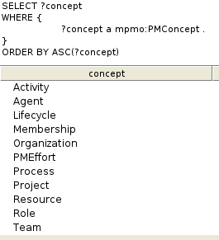
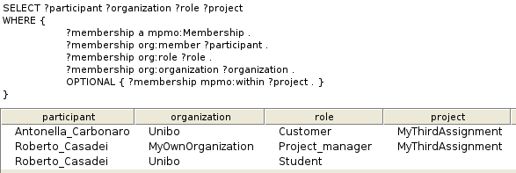
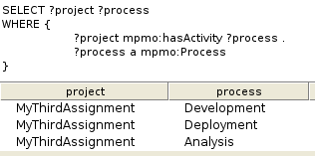
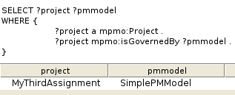
5b) Evaluation and quality assurance
Notes:
Remember
This is an iterative process
If requirements change, the fitness of OWL should be re-evaluated!!!

Slide 20
6a) Maintainance: usage monitoring and evolution
Is there version compatibility with the RDFS model released in the previous assignment?
  Do all constructs have the same meaning? NO.
  E.g., Stakeholder was a subclass of Person while now it is an instance of Role (and Role is disjoint with Agent, which is a superclass of Person)
Notes:
Remember
This is an iterative process
If requirements change, the fitness of OWL should be re-evaluated!!!

Slide 21
Conclusion
Two main considerations
1) As for other engineering efforts, ontology development benefits from the adoption of a methodology
  In particular, be iterative and get feedback by use!
2) OWL allows for the definition of stronger ontologies with respect to those built upon RDF Schema
  The increased expressivity of the ontology language allowed us specify additional constraints and formalize the definitions

