Slide 1
Semantic Web: An Introduction
Roberto Casadei
March, 2014
Course: Semantic Web
Computer Science and Engineering LM
Alma Mater Studiorum – Università di Bologna

Slide 2
Summary
1) WHY: Context and Reasons
2) WHAT: Vision and Goals
3) HOW: Features and Technologies
4) Issues and Challenges
5) WHO/WHERE/WHEN: Semantic Web in the Real World
Notes:
Back to the very origins: it's all about humans and their needs
How is the scenario changed?
The ''Data Deluge''
The past, current, and future Web

Slide 3


The very origin: people
  Human beings as producers and consumers of information
  Through the history, many information-related issues had to be dealt with
  Computers allow for efficient and effective information management...
  … but new possibilities generate new needs

Slide 4
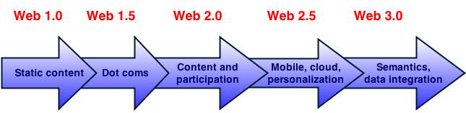
The evolution of Web

Slide 5
Today: a world of data
The scenario has changed
  Big Data
  Data democratization and Open Data
  Emerging data-driven culture
  Increasing data-information gap
The ultimate need is the same
  People wants to acquire and communicate information effectively and efficiently
For this purpose, software-support is essential
  Due to the complexity of the current and future data-driven activities

Slide 6
Why the Semantic Web?
Main features of ''Plain Old'' Web
  Some degree of structure allows processing of documents
  Hyperlinks allow syntactic connection of distributed documents
Limitations
''Too much information [data] with too little structure and made for human consumption''
  Lack of semantics → hindering machine-processing of Web content
  Heterogeneity → hindering information integration
  Keyword-based search is not very effective → hindering information discovery
  Reliability of information → hindering trust

Slide 7
We would like to move...
...from a Syntactic Web to a Semantic Web...
...from a Web of Documents to a Web of Data...
Notes:
Web of Documents
→ mostly unstructured information
The vision of the Semantic Web is to extend principles of the Web from documents to data

Slide 8
… as well as ...
...from Plain Old Data to Smart Data...
...from Data Islands to Linked Data...

Slide 9

Semantic Web: vision and goals
Vision
  Extending the principles of the Web from documents to data
Goals
  Improving information production and generation
  Improving information searching and retrieval
  Improving information analysis, discovery, reasoning
Doing this while reusing, as much as possible, existing data in its existing form

Slide 10
Semantic Web: how
Through a paradigm shift supported by enabling technology
Adding capabilities to the Web
  Semantics → machine-processable data
  Knowledge representation
  Data linking
  Data integration
  Standards and common models

Slide 11
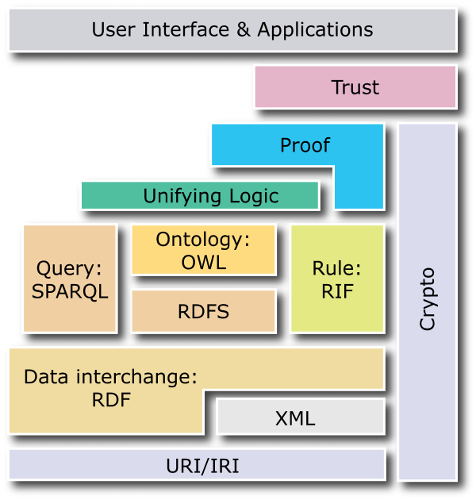
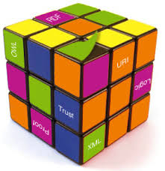
Semantic Web: technology stack

Slide 12

Semantic web: issues
  Privacy
  Legacy data
  Ontology development / evolution / integration
  Standardization
  Proof
  Trust
  Scalability
  Multilingualism
  Stability of technologies/languages

Slide 13

Semantic Web: case studies
  http://www.w3.org/2001/sw/sweo/public/UseCases/
    ''Case studies include descriptions of systems that have been deployed within an organization, and are now being used within a production environment''
  Many case studies about web search improvement
  Use of Semantic Web Technologies on the BBC Web Sites
    Goal: better interlinking among BBC microsites and feeds & search improvement
    http://www.bbc.co.uk/nature/wildlife
  Using the Semantic Web to Enhance the Teaching of Dance
    Goal: allowing dancers to take advantage of video collections to support learning and auto-assessment
  Composing a Safer Drug Regimen for each Patient with Semantic Web Technologies
    Goal: allowing composition of a safe drug regimen via multiple criteria

Slide 14
Semantic Web: current state
  Around 50 significant case studies from W3C
  Many other stories are available from vendor's websites
    e.g., http://www.ontotext.com/clients
  Many well-established standards: URI, XML, RDF, RDFS, SPARQL, OWL, RIF
  Over 300 tools: https://www.w3.org/2001/sw/wiki/Tools
  Many dataset projects: DBpedia, FOAF, Linked History, Dublin Core, ...

