Slide 1
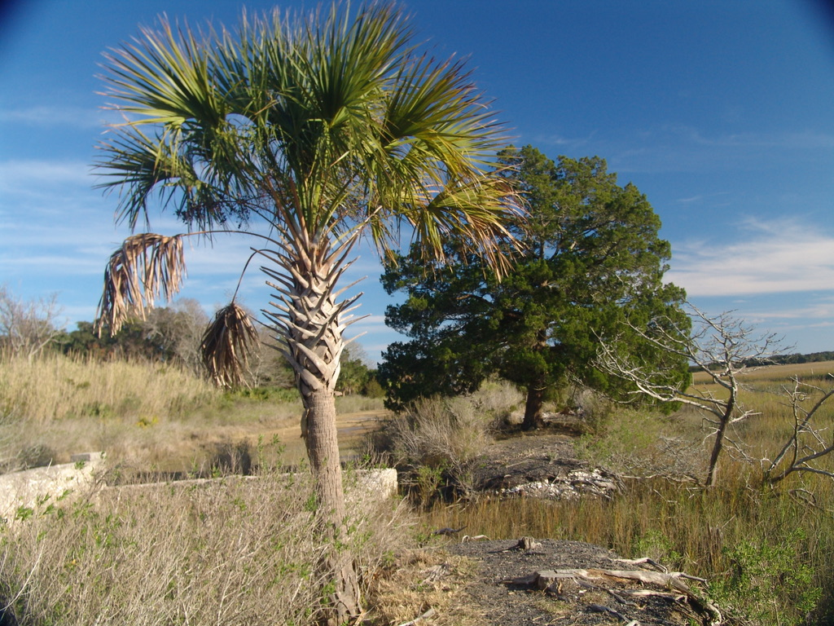
Deep Looking: Unpacking
Amelia Island with AI
Paul Fishwick

Slide 2
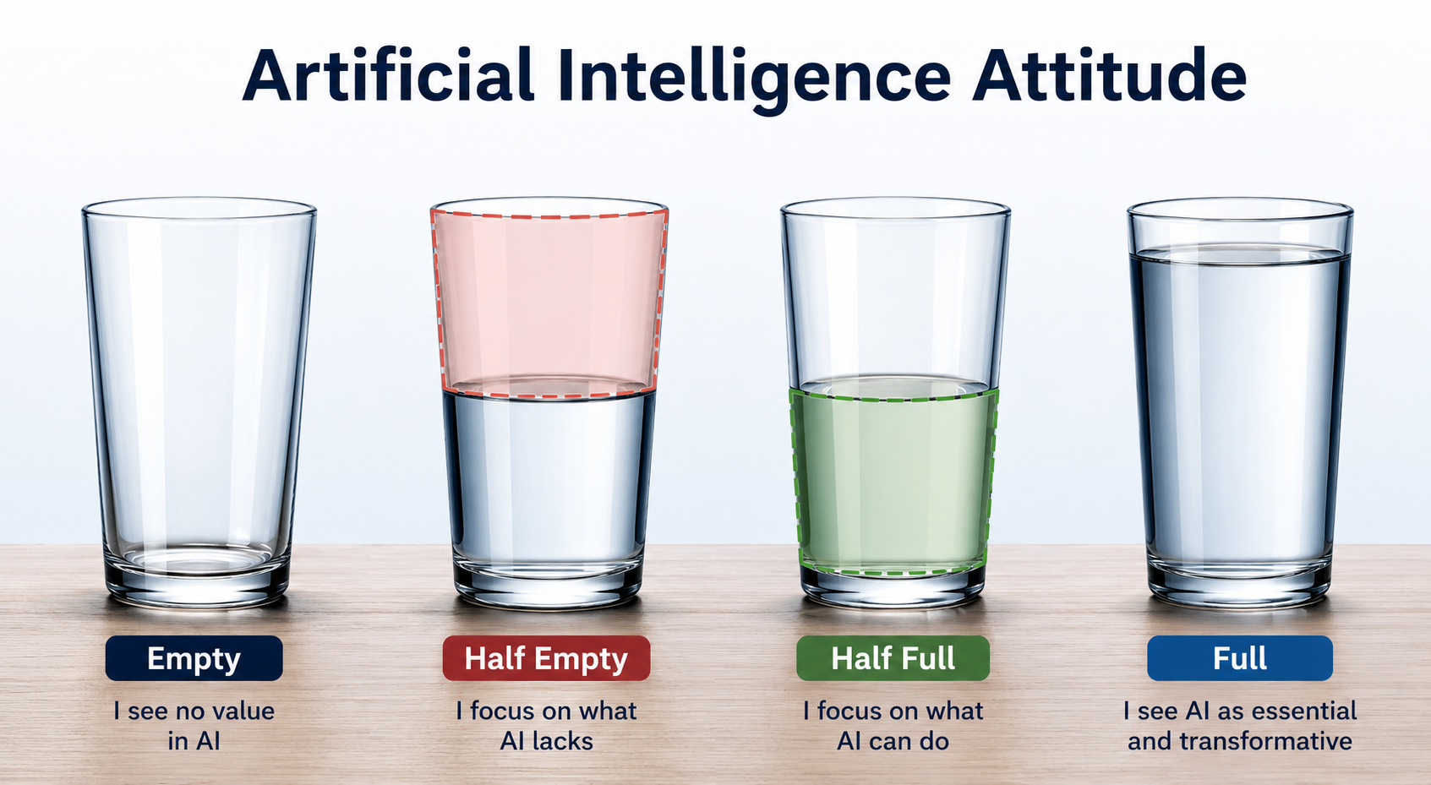

Slide 3
My background
Programmer and Systems Analyst, Newport News Shipbuilding, NASA Langley Research Ctr. (1978-1983)
Faculty, University of Florida, Computer & Info. Science (1986-2012)
Faculty, University of Texas at Dallas, Arts, Humanities, and Technology & Computer Science (2012-2022)
Retired and CEO Metaphorz, LLC, Florida Hurricane and Flood Model Auditing

Slide 4
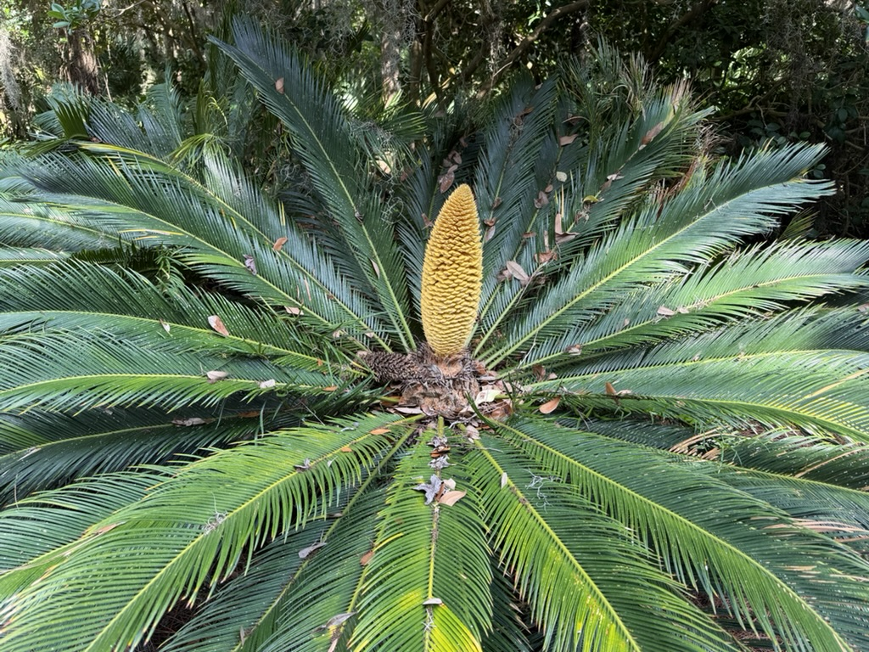

Slide 5
Deep Looking
Attention: Look carefully and be curious. Have a growth mind set
Seek out experts and social groups
Pick one item per day. Ask “how is history related to this?”
Use role playing: ask an expert, or ask a character
  What would Pip from Great Expectations think of Egans Creek?
  Ask Frank Lloyd Wright about the Williams House

Slide 6
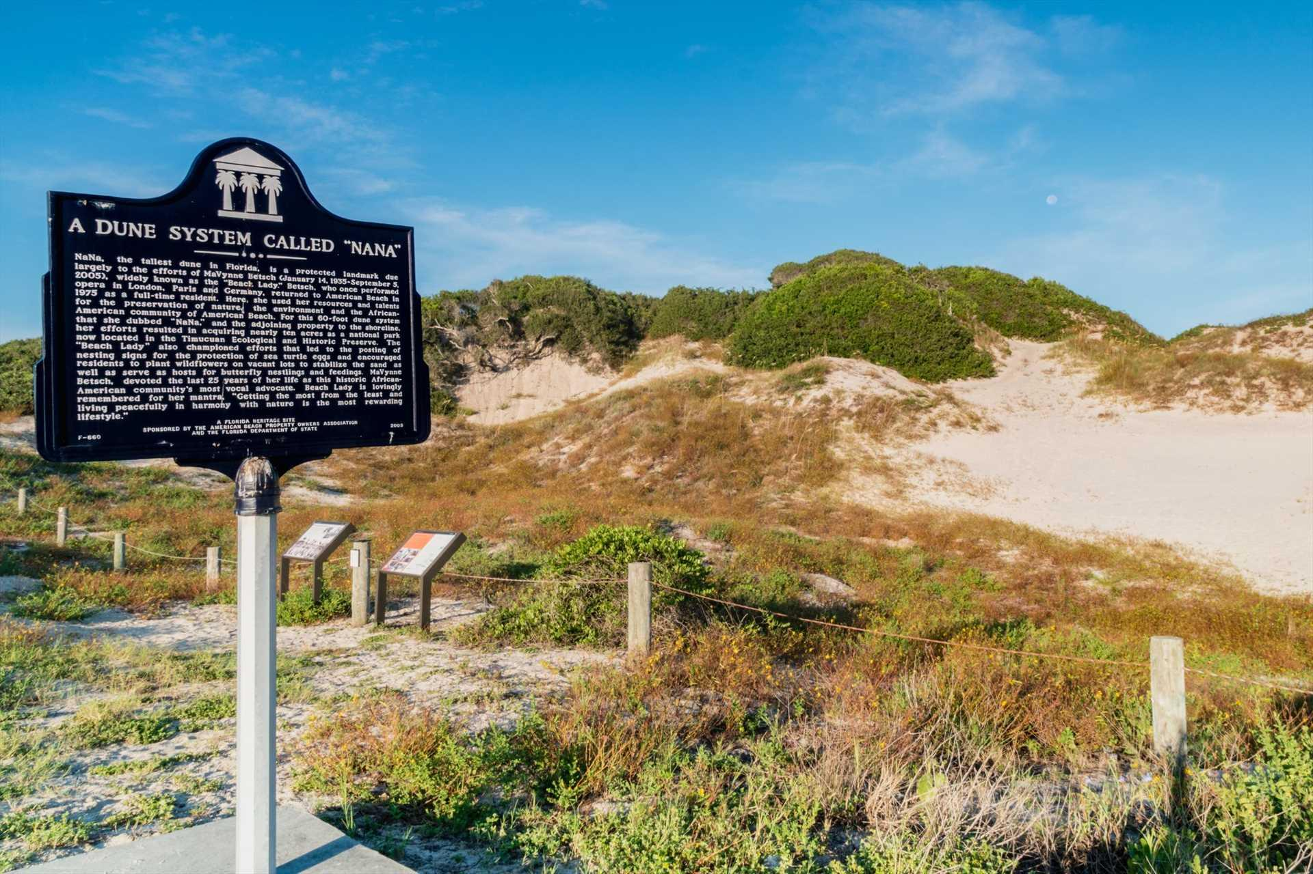
Nana Dune

Slide 7
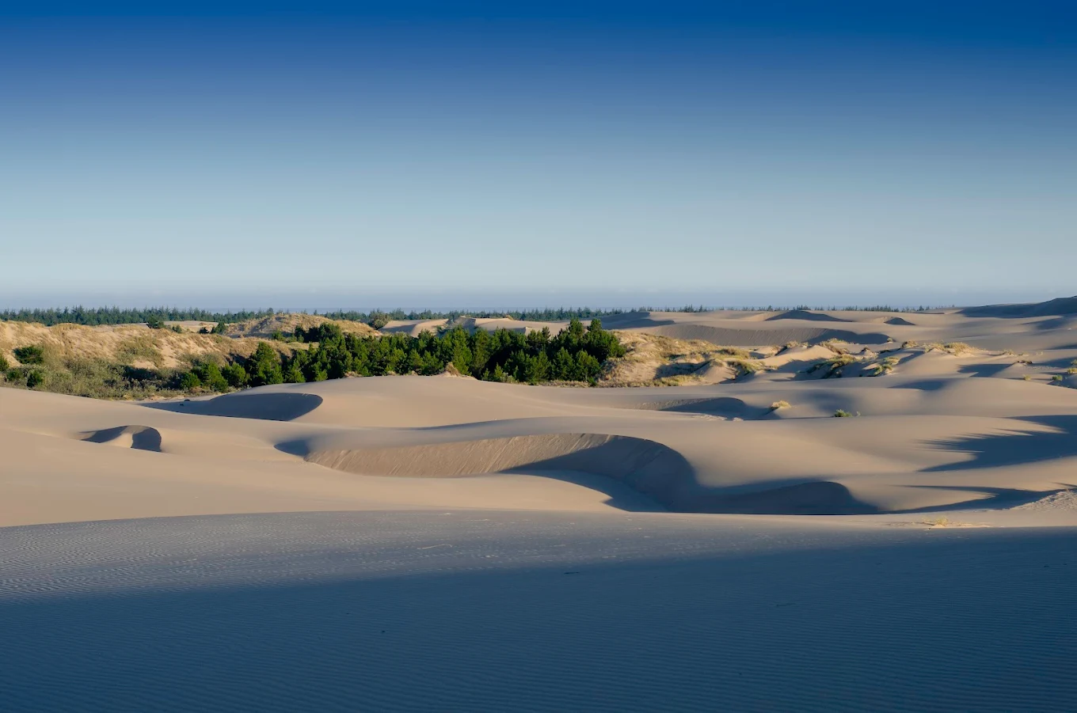
Oregon Dunes, Daniel W. Bates, Photographer
Inspiration for Dune, Frank Herbert
dune as system people try to control
dune as ecological power
dune as warning about engineering nature
dune as politics hidden inside landscape

Slide 8
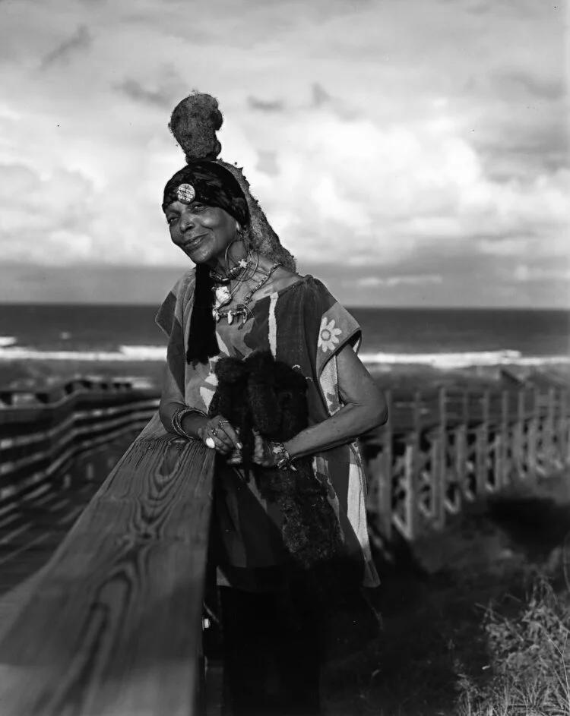
MaVynee Betsch
She told us “NaNa was more than just an ecologically important sand-dune, NaNa was culturally significant as well.”
MaVynee vowed, “I will never allow another
nine holes of golf course to replace NaNa.”
Lauri DeGaris, Fernandina Observer,
Sept. 4, 2024

Slide 9
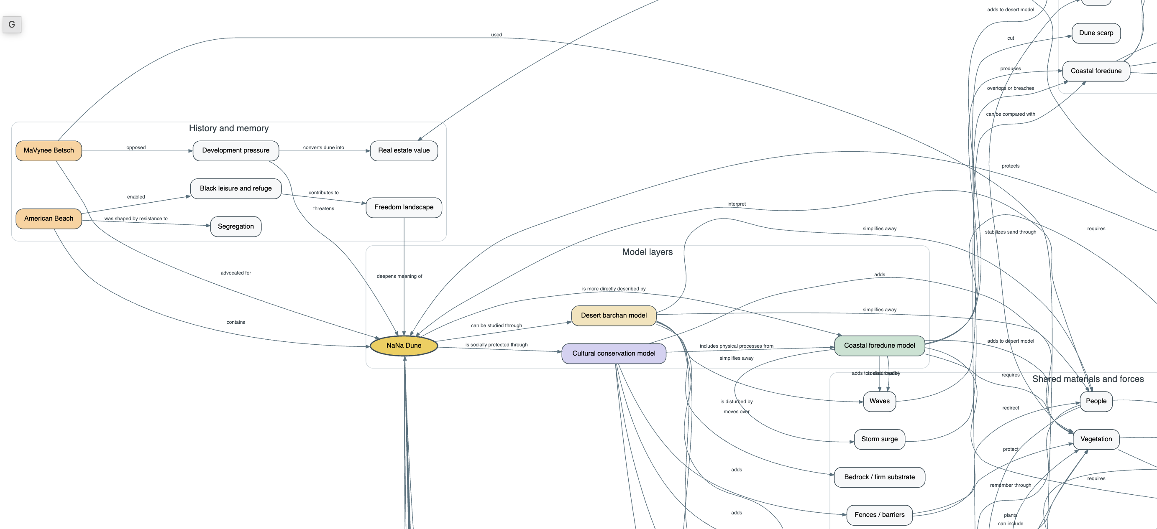
Knowledge Model

Slide 10
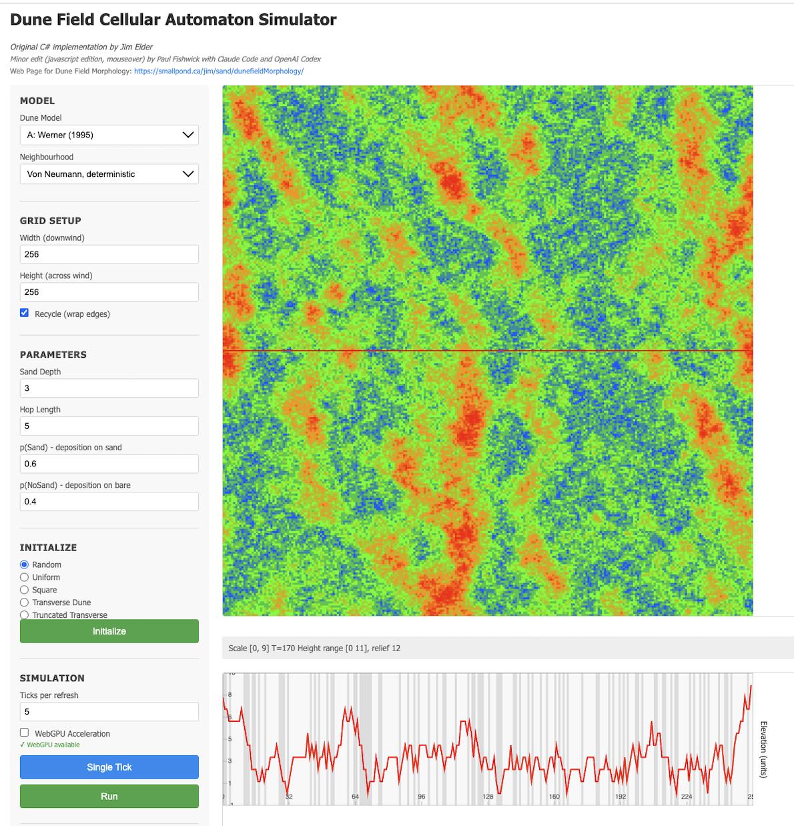

Slide 11
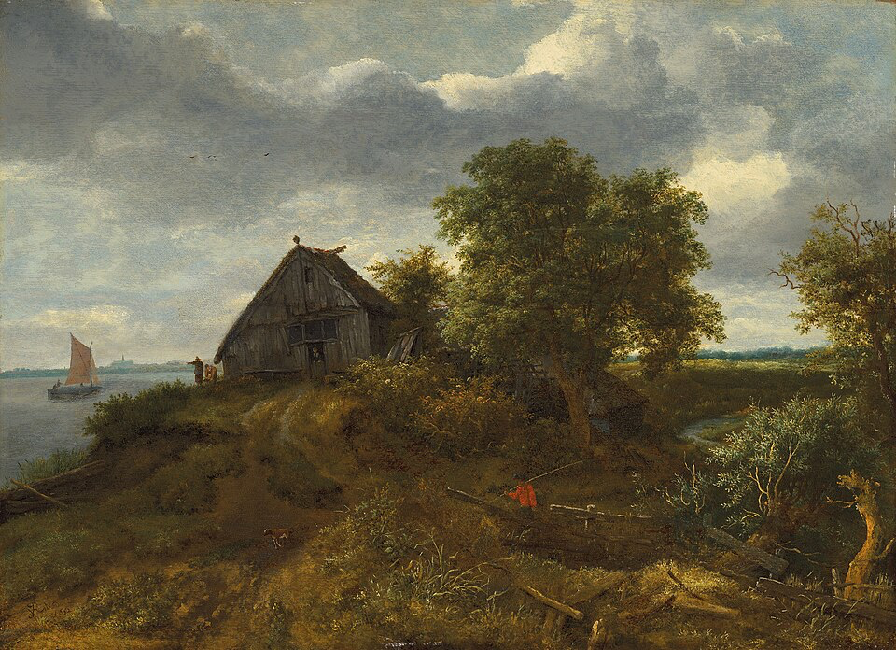
Jacob van Ruisdael: A Dune Landscape with a Distant View of Haarlem, 1652

Slide 12
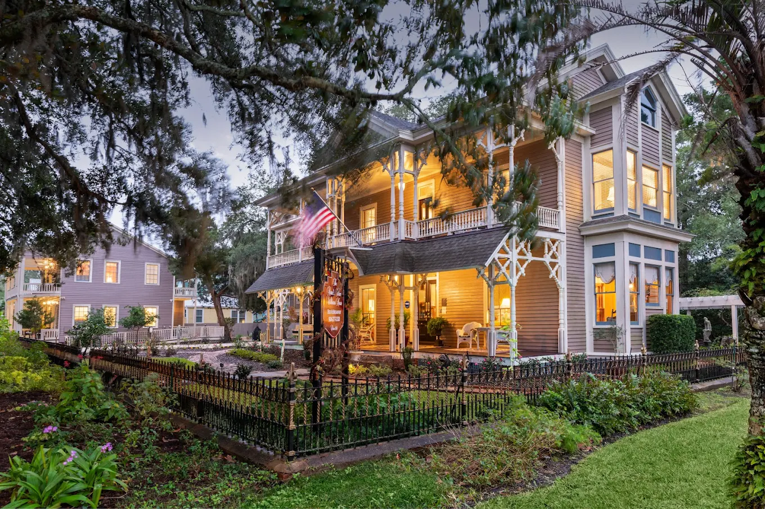
Williams House, 1856
williamshouse.com

Slide 13
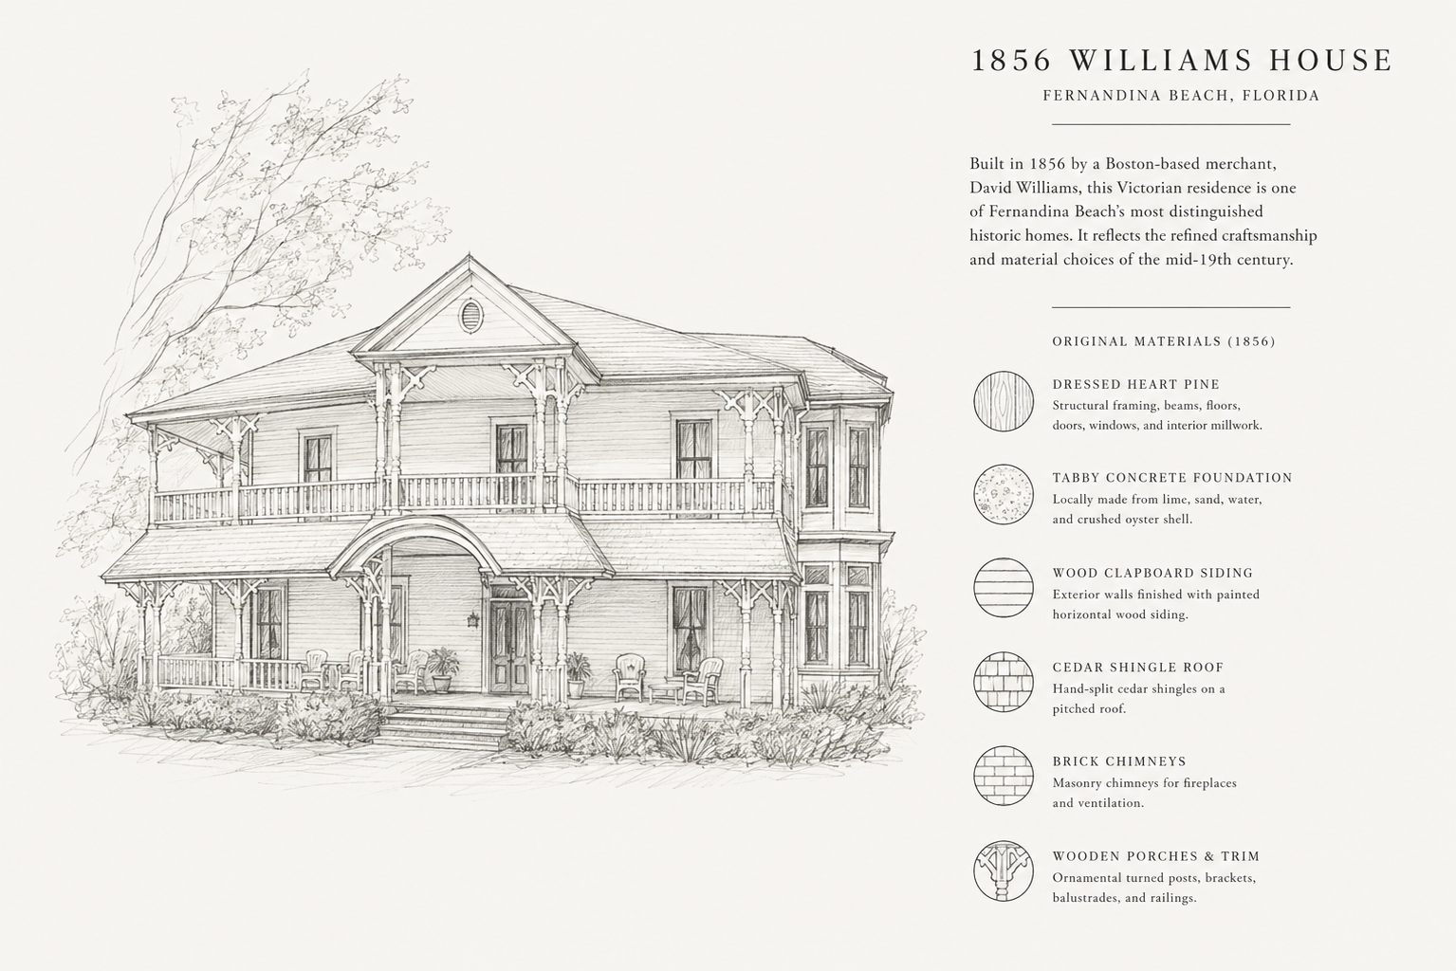
Bostonian: unknown name
Marcellus Williams

Slide 14
YOU CAN LEARN HISTORY
BY SOLVING AI PUZZLES

Slide 15
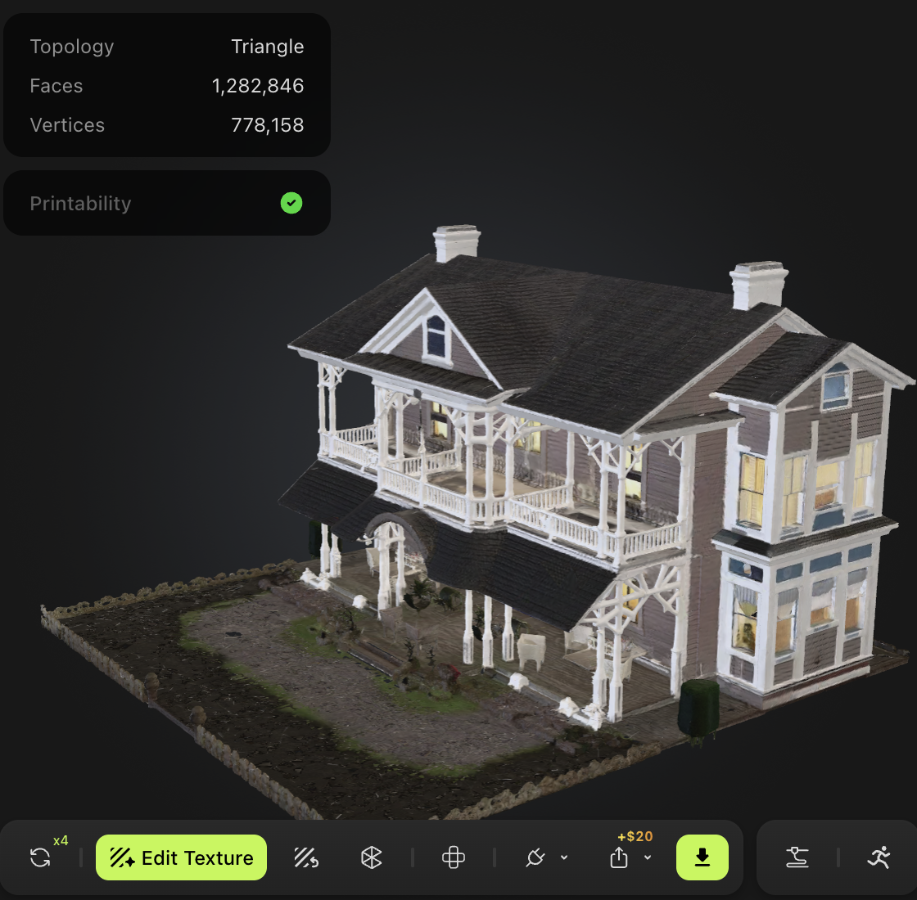
3D Mesh

Slide 16
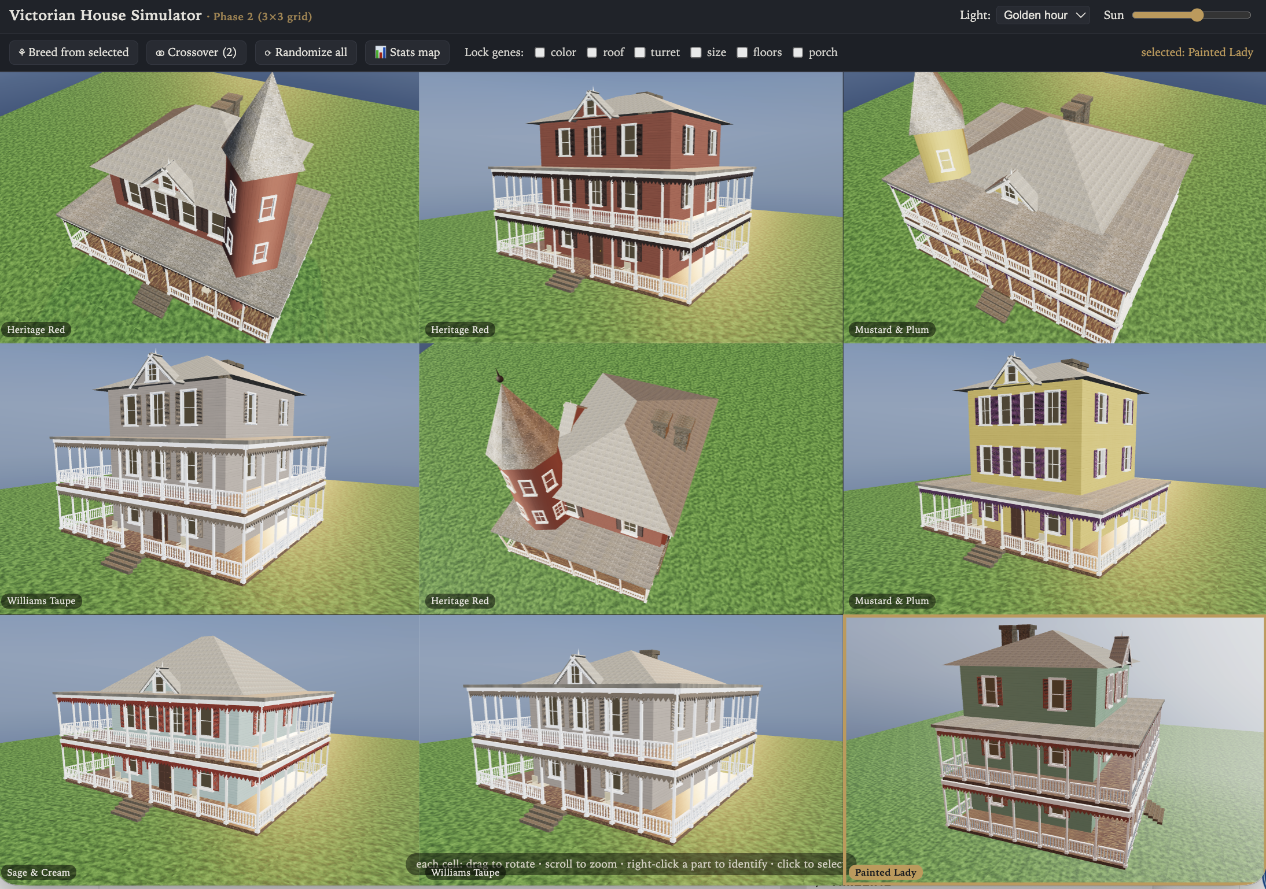

Slide 17
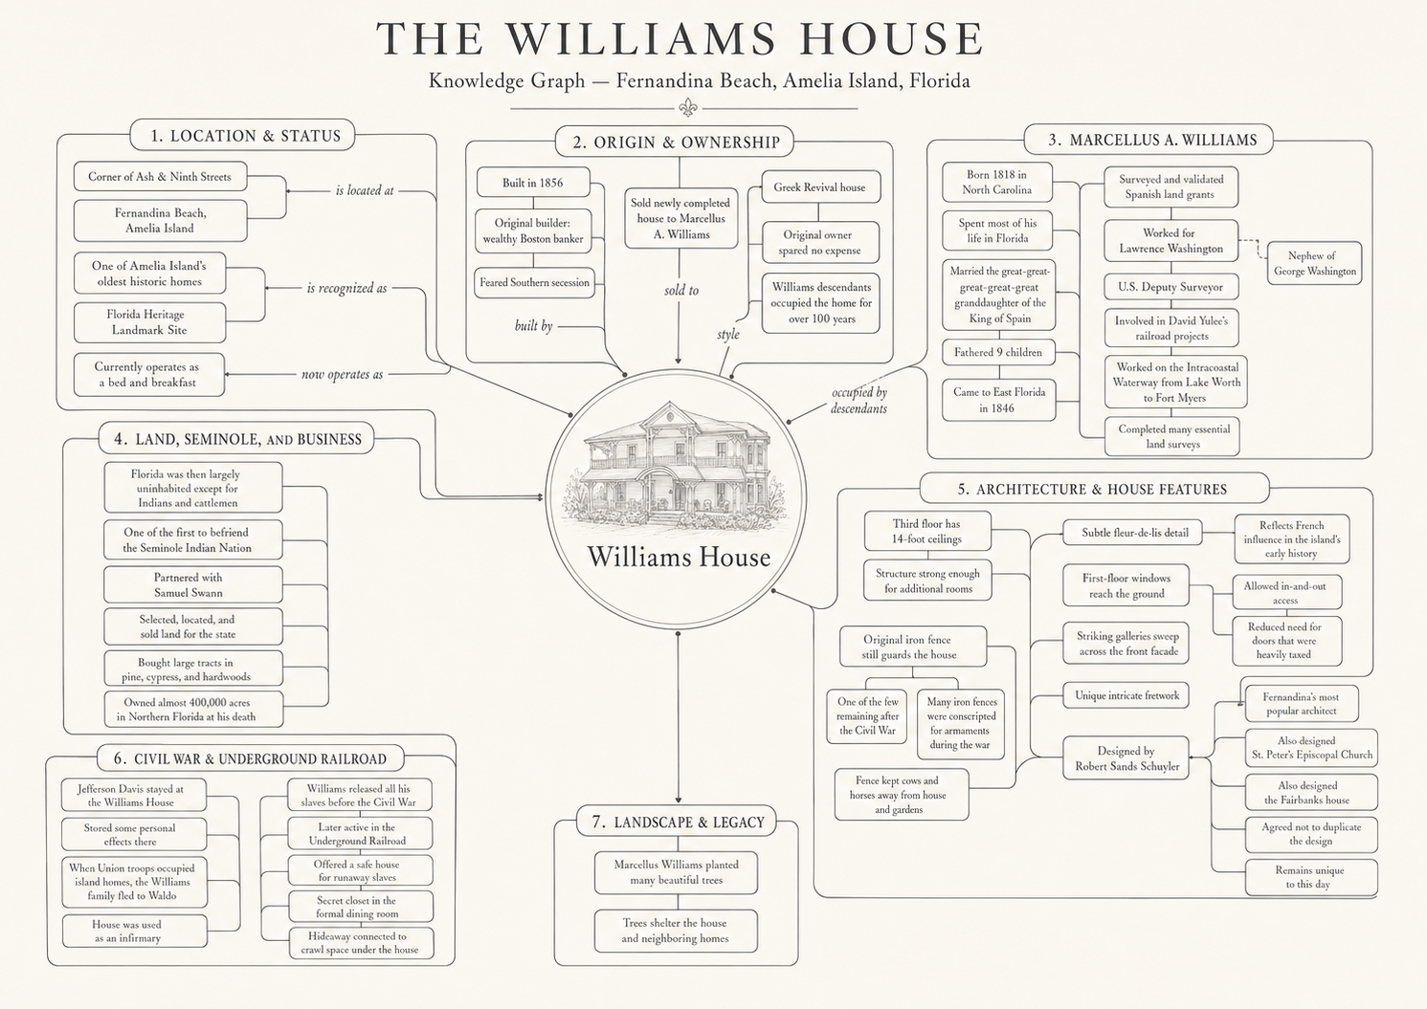
Dickie Anderson, Fernandina Observer, Feb. 19, 2025

Slide 18
Poetry
In the manner of Emily Dickinson
A House remembers more than We
The Foot upon the Stair
A Surveyor’s flight a Soldier’s boot —
Both lodged — in Cedar — there —
The War came knocking — soft as Rain
And asked to be let in
The Walls said nothing being Walls
But kept it like a sin
Beneath the Dining-Room a Door
Or so the Stories say
A House can hold a Secret close
When Witnesses decay

Slide 19

Magic Trick

Slide 20
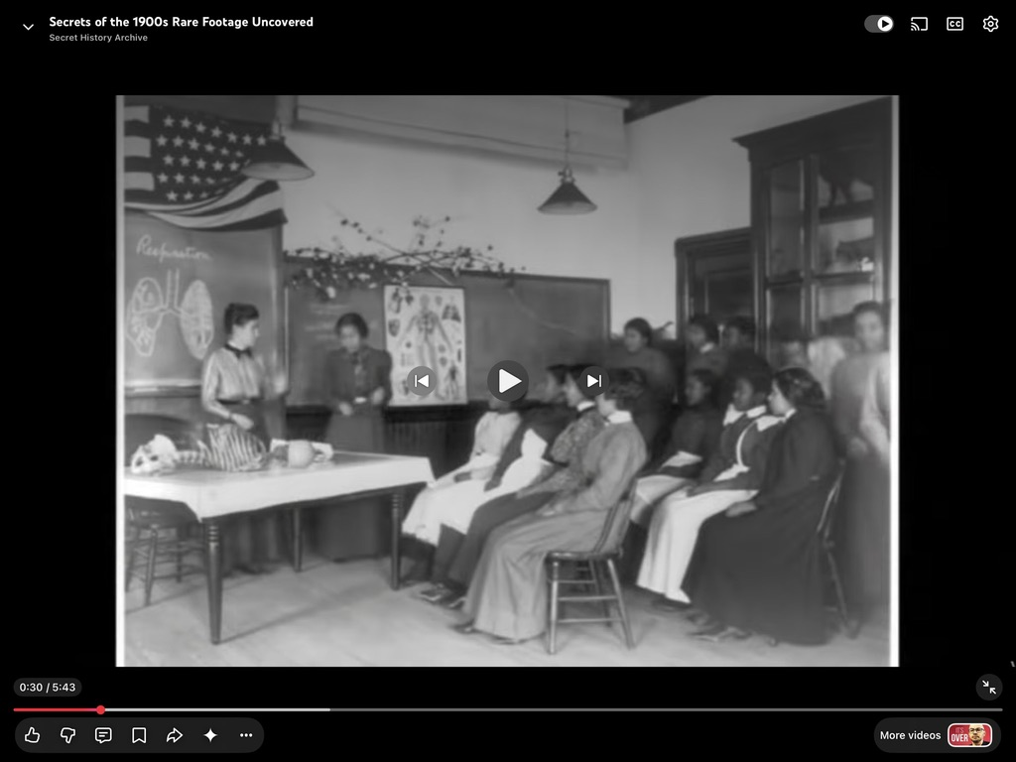

Slide 21
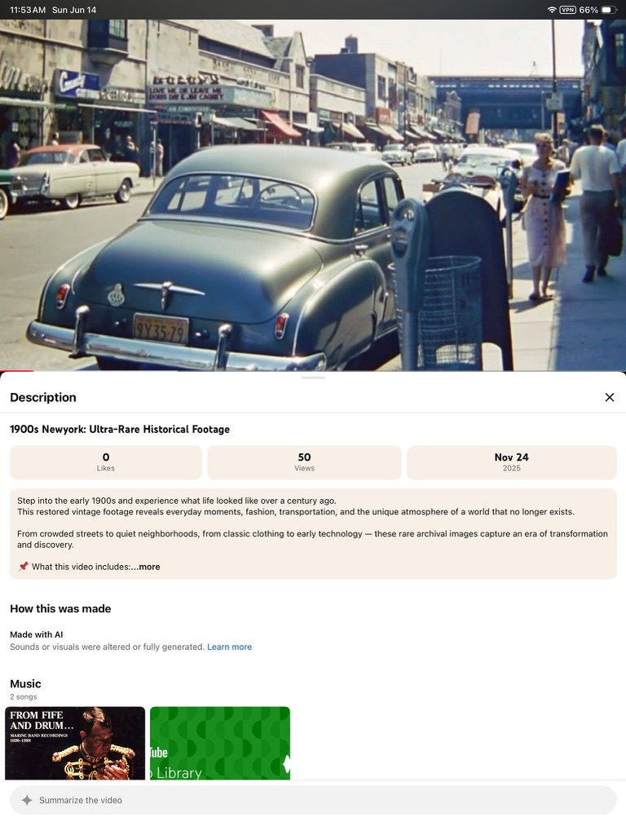

Slide 22
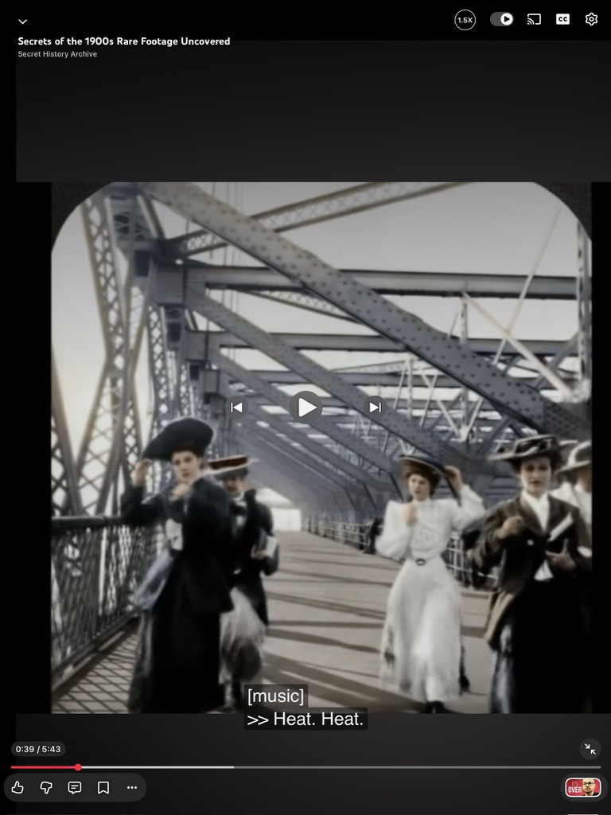
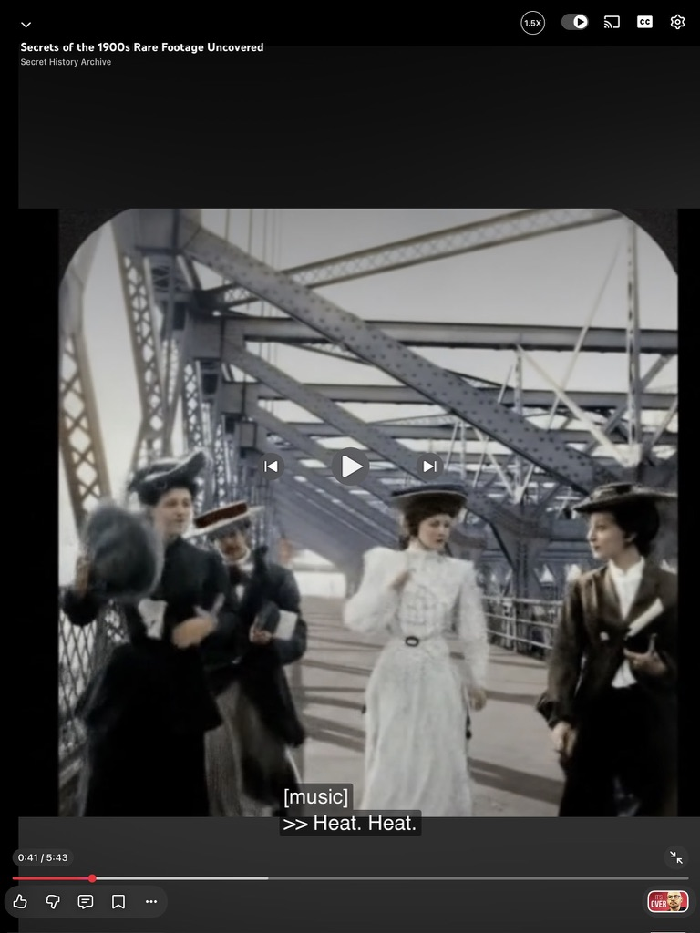

Slide 23
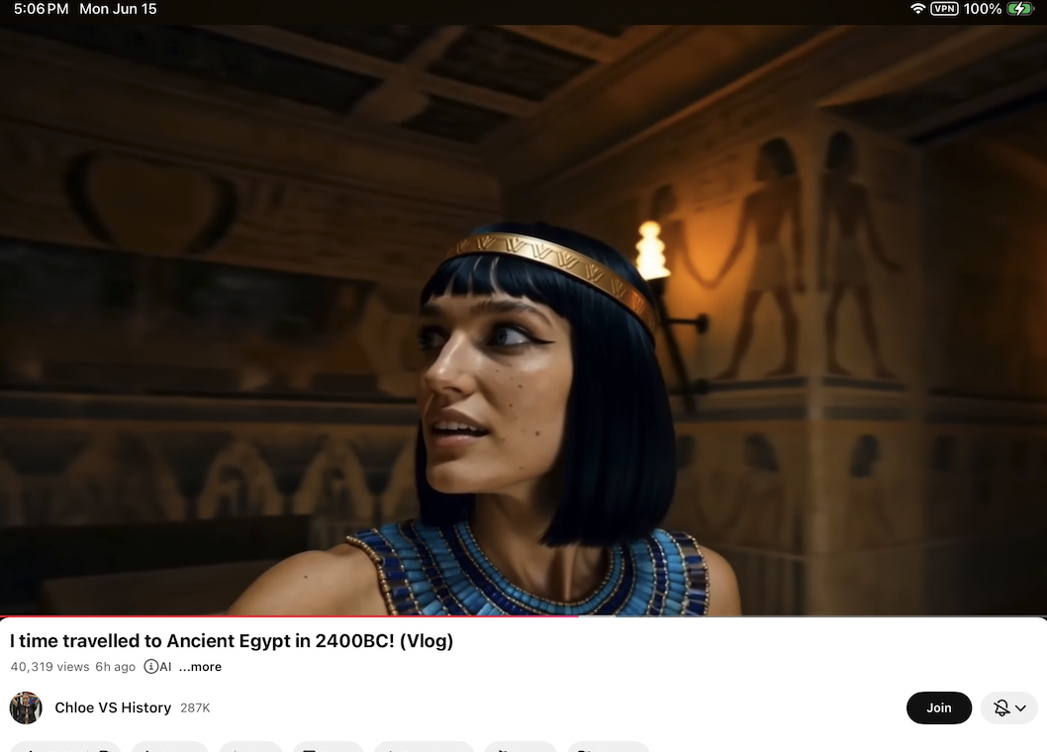

Slide 24
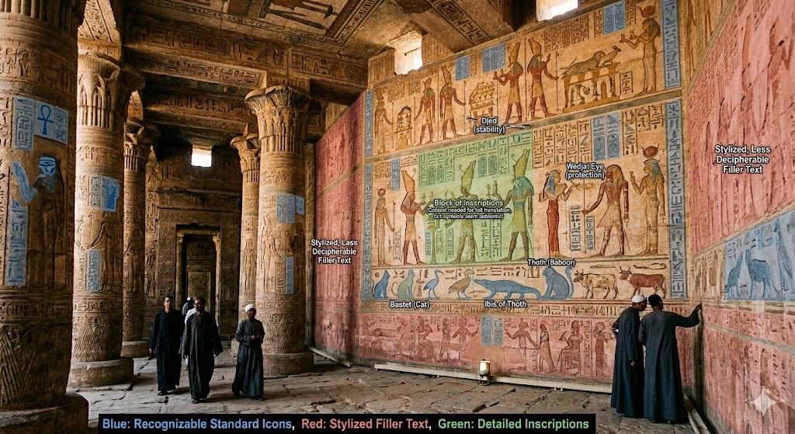

Slide 25
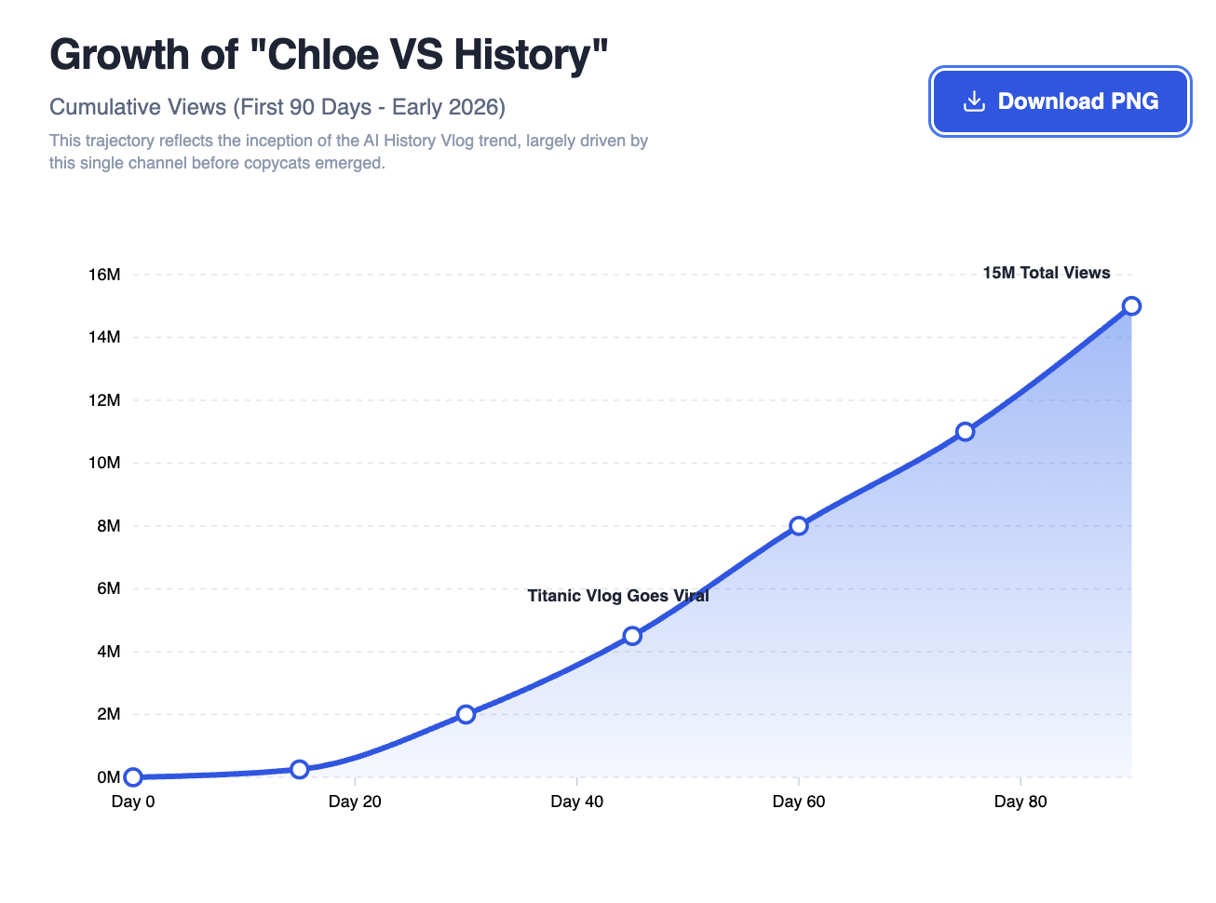

Slide 26
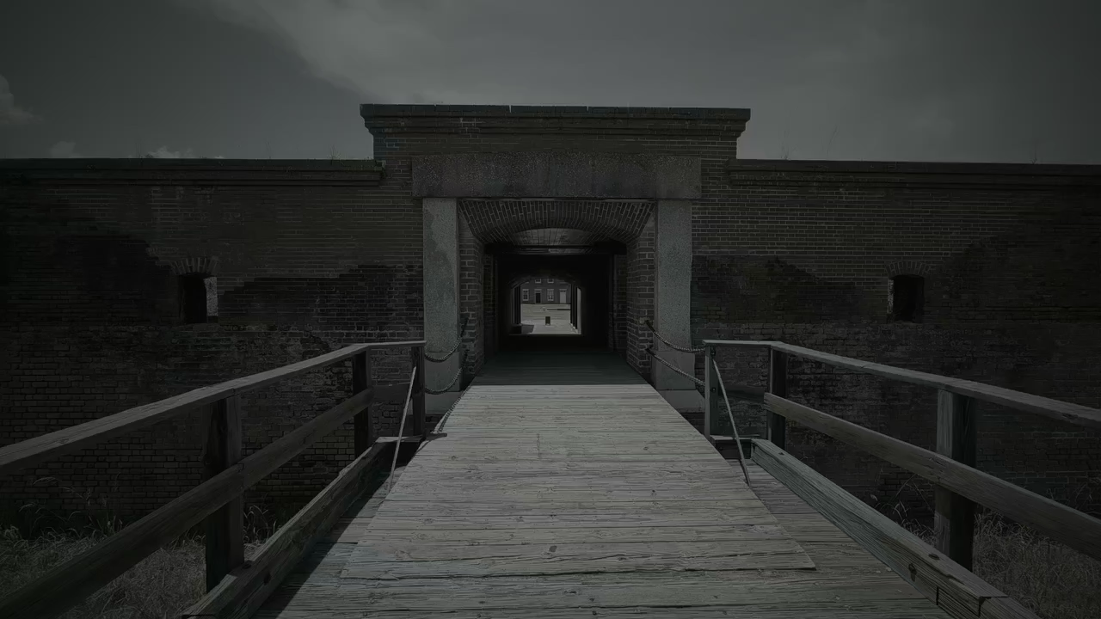

Slide 27
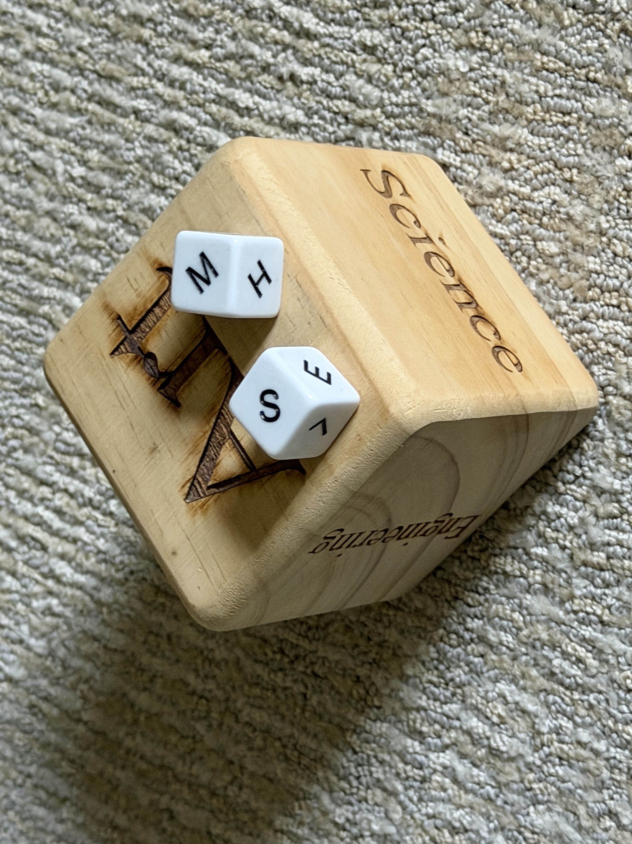

Slide 28
Takeaway
One item per day. Look closely (5 mins). Adopt the growth mindset. Ask many questions. A group setting is perfect.
Ask “how does history relate to this?”
Try role play or subjects (art, science)
Be wary and critical of AI results. Treat as a puzzle leading surfacing new historical knowledge

